Slide 1






Dependent and Independent Variables
Lesson for Middle School

Slide 2







Lesson Outline
Independent vs. Dependent Variables
Representing Variables Using Tables and Graphs

Slide 3






Aside from hot air,
what always goes up and does not come down?

Slide 4




Learning Outcomes
Identify the independent and dependent variables in a given situation
Show relationship between variables using graphs and tables
Variable:
Changing, Not fixed

Slide 5





Checkpoint Task
To prepare a glass of lemon juice, you need 1 tsp. of sugar.
In the scenario below, identify the independent and dependent variables.
Independent Variable | Dependent Variable
Type here | Type here

Slide 6




Independent and Dependent Variables
Aside from hot air, what always goes up and does not come down?
Answer: Age
Every year, all people age. More years, higher age!
We can say that that the age depends on the year of birth!

Slide 7


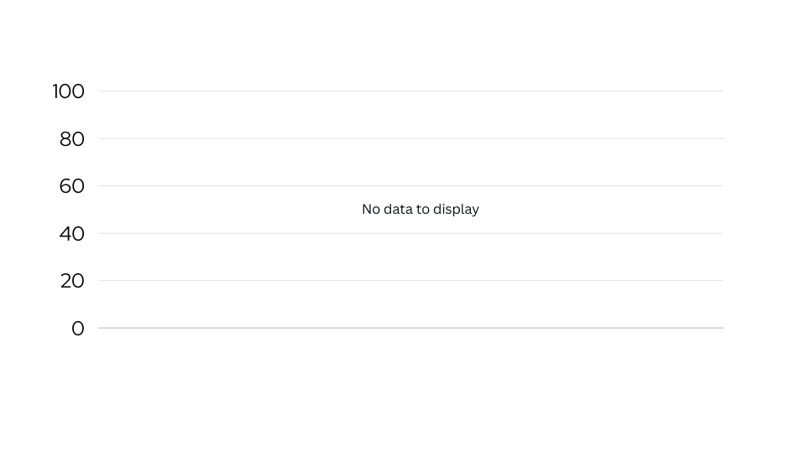


Independent and Dependent Variables
Age is an example of a dependent variable as it can be affected by the year!
Year of birth is an independent variable. Why? Because age depends on it.

Slide 8

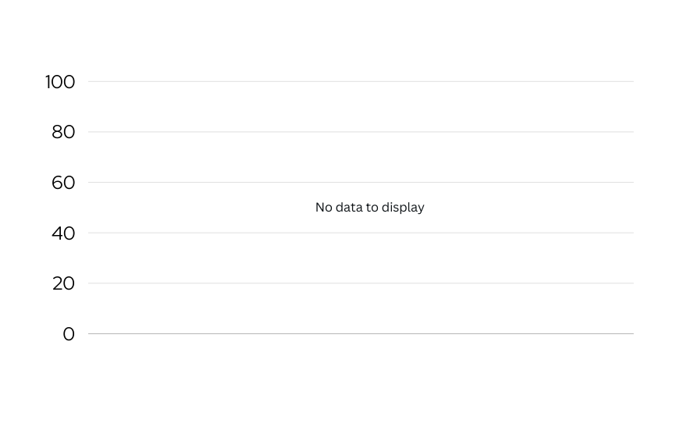


Using Graphs to Represent Variables
Inspect how the variables are graphed.
Dependent variable in the y- axis.
Independent variable in the x- axis.
Age (years)
Thus, y is usually used to represent them.
This is why independent variables are usually represented by x.
Year of Birth

Slide 9

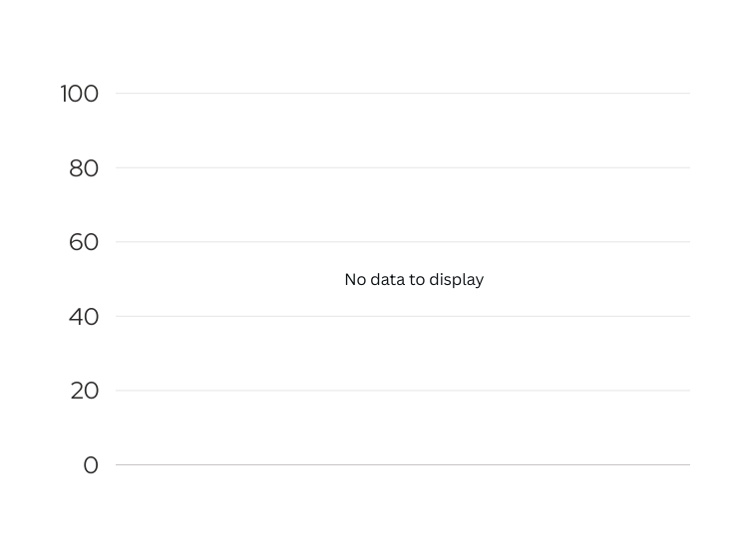

Identify the Variables Using the Graph
The graph below shows the amount one has to pay when buying notebooks.
Independent Variable | Dependent Variable
Type here | Type here
Price in US dollars (US$)
Feel free to edit the table by drawing or directly typing your answer.
Number of Notebooks

Slide 10

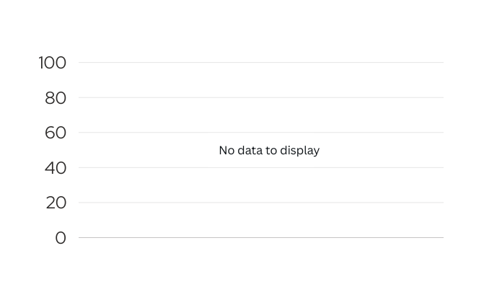

Using Tables to Represent Variables
Aside from graphs, tables may also be used to show the relationship of variables.
When using tables, the relationship of the variables can be identified by looking at the columns.
Number of Notebooks | Price (US$)
1 | 2
2 | 4
3 | 6
4 | 8
5 | 10
6 | 12
7 | 14
Price in US dollars (US$)
Number of Notebooks
The graph and the table give the same information!

Slide 11



Using Tables to Represent Variables
Using the table, we can say:
You can use this rule to know the price based on the number of notebooks!
Number of Notebooks | Price (US$)
1 | 2
2 | 4
3 | 6
4 | 8
5 | 10
6 | 12
7 | 14
The total price depends on the number of notebooks.
The number corresponding to the total price of the notebook (y) is twice the number of notebooks (x).
In terms of x and y, this pattern can be simplified using the rule:
y = 2x

Slide 12




How will the rule change if you are given the total price (y) and is looking for the number of notebooks (x)?
y = 2x

Slide 13



Reference
Mathspace. “6.05 Relationships between quantitites | Grade 6 Math | Common Core 6 - 2023 Edition.” Accessed 13 July 2023, https://mathspace.co/textbooks/syllabuses/Syllabus-1155/topics/Topic-21891/subtopics/Subtopic-279768

Slide 14











Resource Page
Use these design resources in your Canva Presentation.
You can find these fonts online too. Happy designing!
This presentation template uses the following free fonts:
  Titles: Oswald
  Headers: Red Hat Display
  Body Copy: Red Hat Display

Slide 15




Credits
This presentation template is free for everyone to use thanks to the following:
SlidesCarnival for the presentation template
Pexels for the photos
Happy designing!

