Slide 1

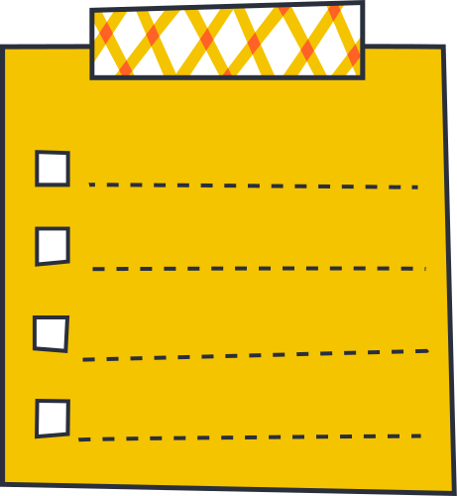


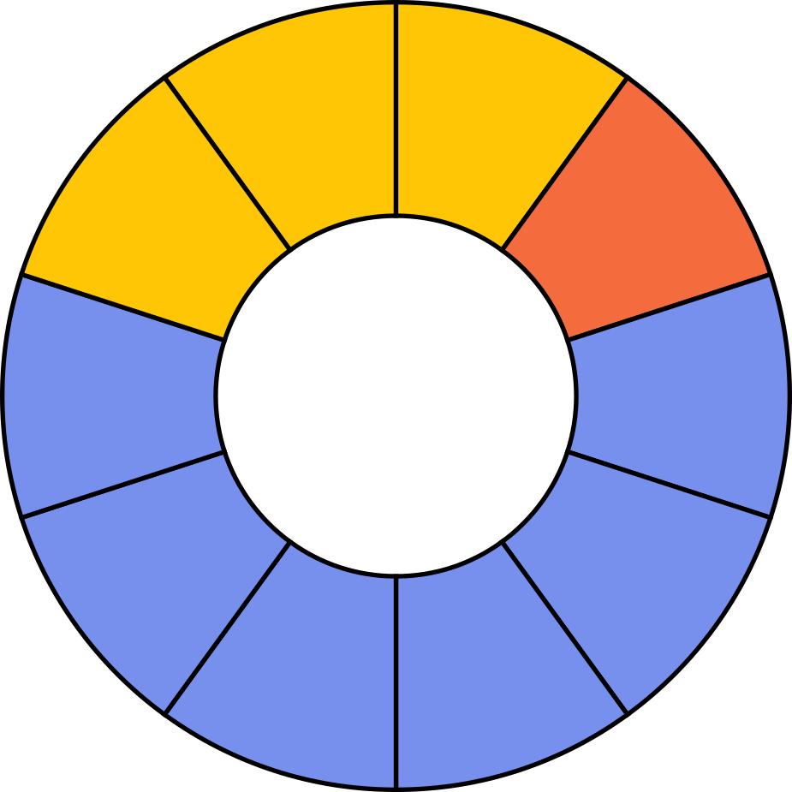
Quotients of Fractions
Dividing fractions
by fractions

Slide 2


How to Use This Presentation
Google Slides
PowerPoint
Canva
Click on the "Google Slides" button below this presentation preview. Make sure to sign in to your Google account. Click on "Make a copy." Start editing your presentation.
Alternative: Click on the "Share" button on the top right corner in Canva and click on "More" at the bottom of the menu. Enter "Google Drive" in the search bar and click on the GDrive icon to add this design as a Google slide in your GDrive.
  Click on the "PowerPoint" button below this presentation preview. Start editing your presentation.
  Alternative: From Canva template file, Click on the "Share" button on the top right corner in Canva and click on "More" at the bottom of the menu. Enter "PowerPoint" in the search bar and click on the PowerPoint icon to download.
  Click on the "Canva" button under this presentation preview. Start editing your presentation. You need to sign in to your Canva account.

Slide 3







Learning
Outcomes
2.
Use multiplication to divide two fractions
1.
Find the reciprocal of a fraction
3.
Solve division
word problems

Slide 4


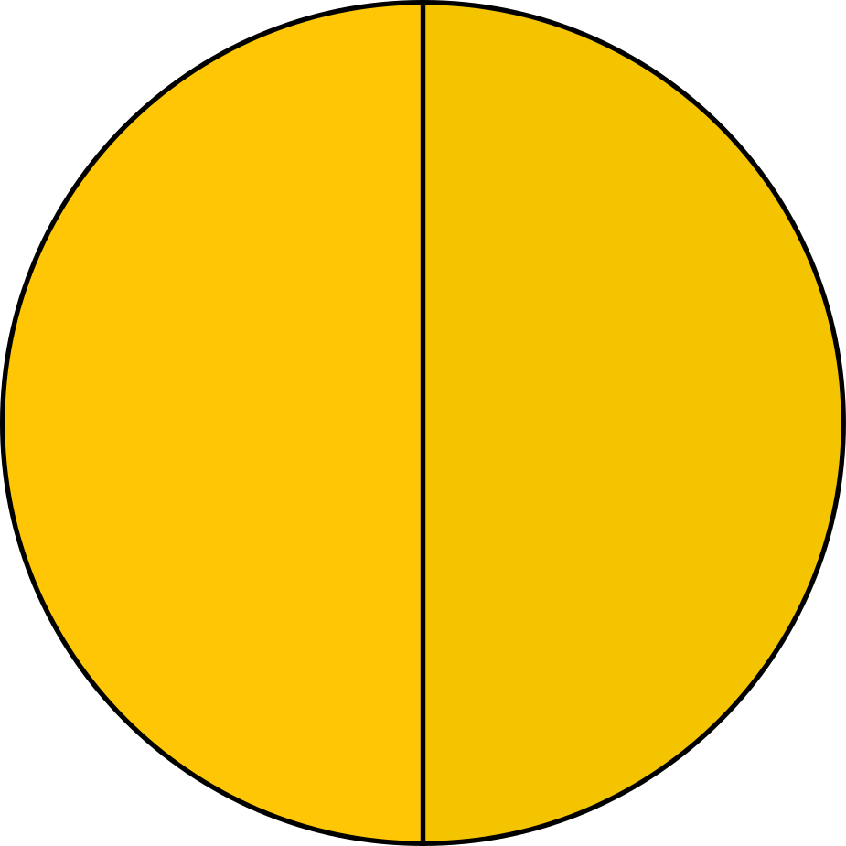
How many
make up half of a cake?
1/8 slices

Slide 5

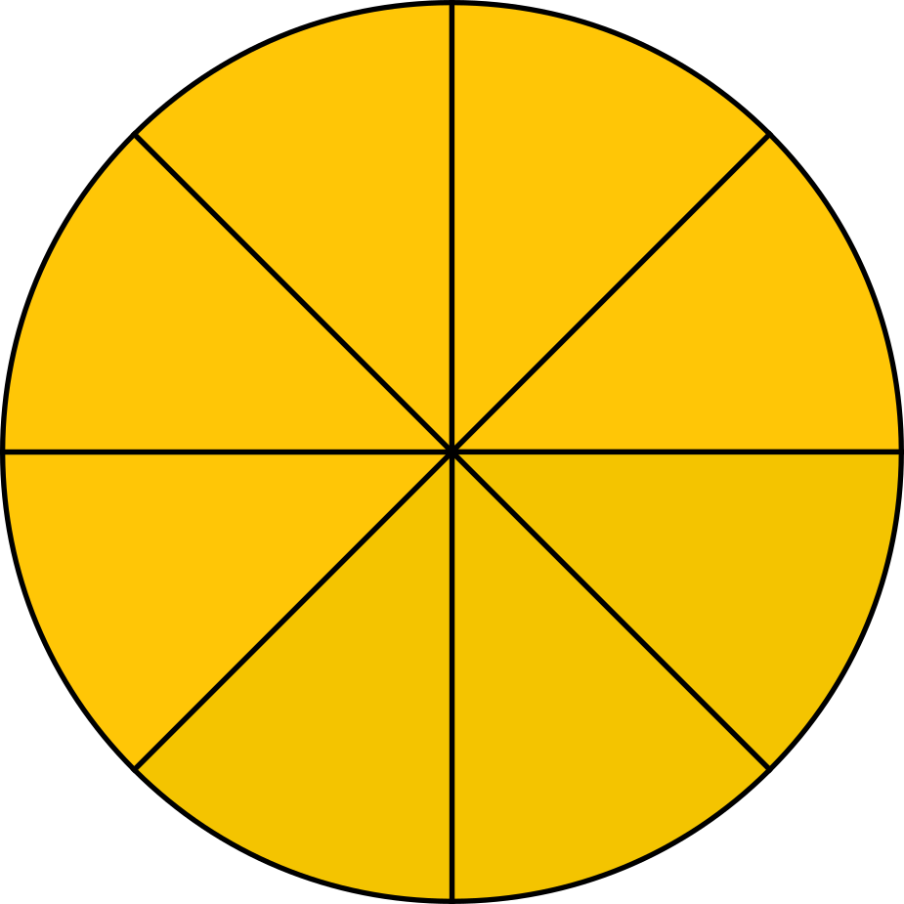

Answer Key
How many
make up half of a cake?
1/8 slices
There are of
1/8 in half of a cake.
4 slices

Slide 6


Getting The Reciprocal
  We swap the numerator and the denominator of a fraction.
7
1
1
7
2
9
9
2
7
or
Recall: Whole numbers can be represented as a fraction with a denominator of 1.

Slide 7

  To find the quotient of two fractions, multiply the first
  fraction by the reciprocal of the second. Then, multiply the
  numerators and denominators.
multiply
3
4
2
3
3
4
3
2
9
8
1
8
÷
×
=
or
1
find the reciprocal

Slide 8

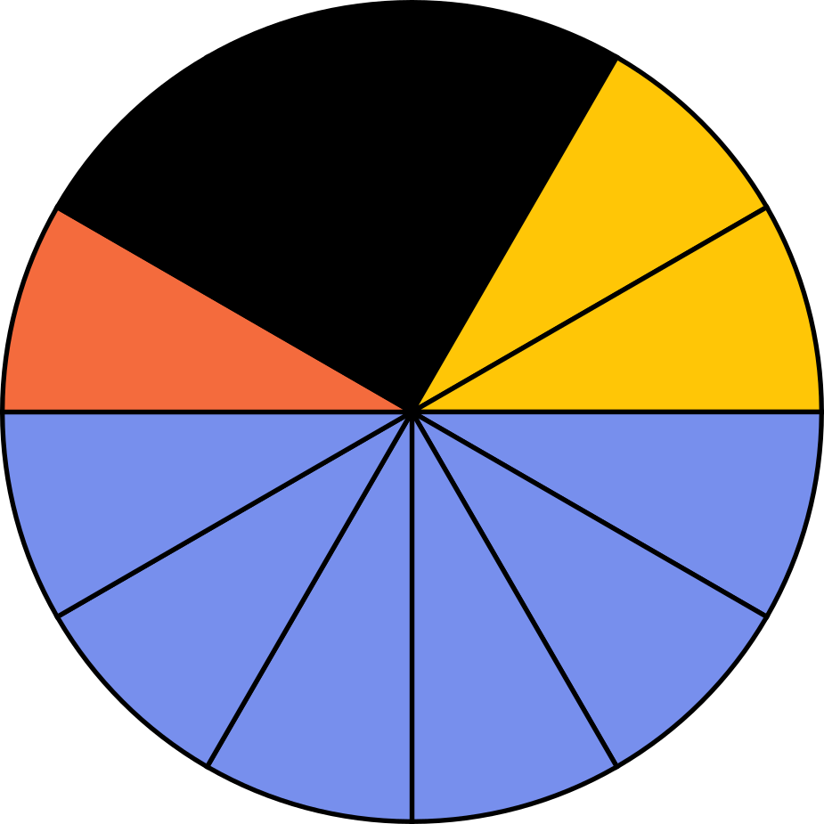


Add a
section
header

Slide 9


Try to
solve this one!
  Write your answer here.
OPTIONAL:
  Add a text quote, photo,
  video, or visual model to support your idea.
2
5
1
3
÷
= ?

Slide 10



ANSWER KEY
2
5
3
1
6
5
1
5
Try to
solve this one!
×
=
or
1
2
5
3
1
6
5
1
5
×
or
1
=
2
5
1
3
÷
= ?

Slide 11



Division Story Problems
  Mila has 8/9 liters of juice
  in a pitcher. She pours it
  equally into smaller glasses
  with a capacity of 2/9 liter
  each. How many glasses
  can she fill?
  Division story problems usually
  have the following keywords:
equally shared
in each
per
divided by

Slide 12
ANSWER KEY
Division Story Problems
8
9
2
9
  Mila has 8/9 liters of juice
  in a pitcher. She pours it
  equally into smaller glasses
  with a capacity of 2/9 liter
  each. How many glasses
  can she fill?
÷
8
9
9
2
72
18
×
=
=
4
  Mila can fill 4 glasses with juice.

Slide 13


Concept check
  Find the reciprocal
  Multiply the fractions
The reciprocal of a whole number is a fraction of 1 over the whole number.
  The reciprocal of a fraction can be found by swapping the numerator and denominator.
  To divide one fraction by another, multiply the first fraction by the reciprocal of the second.

Slide 14
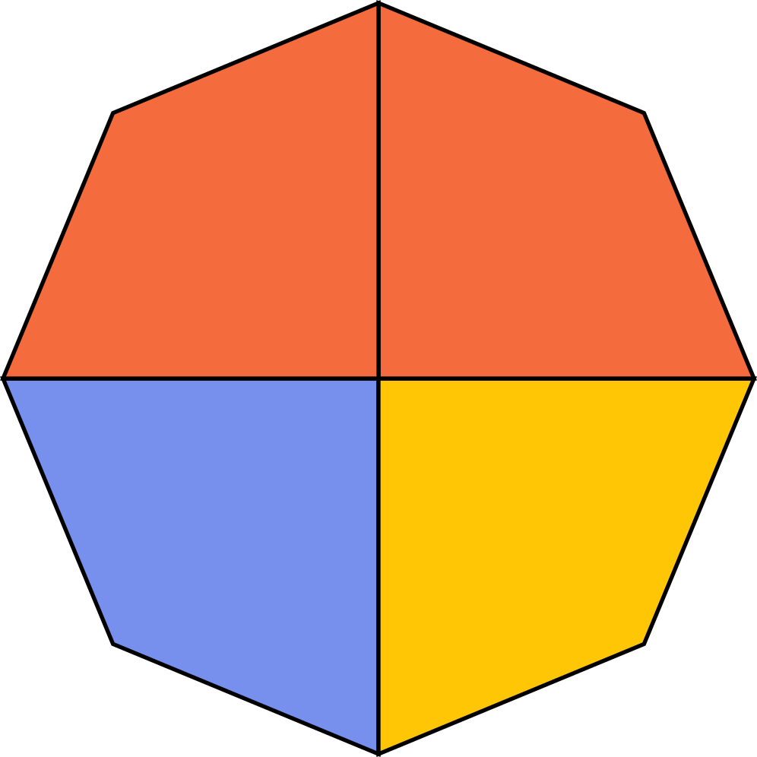
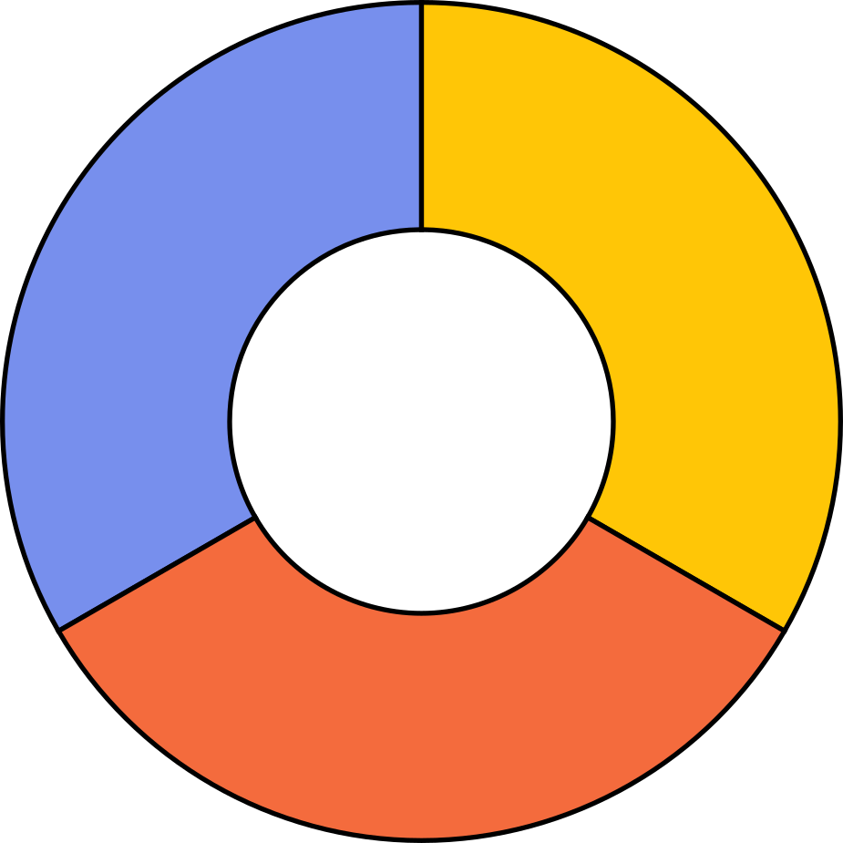

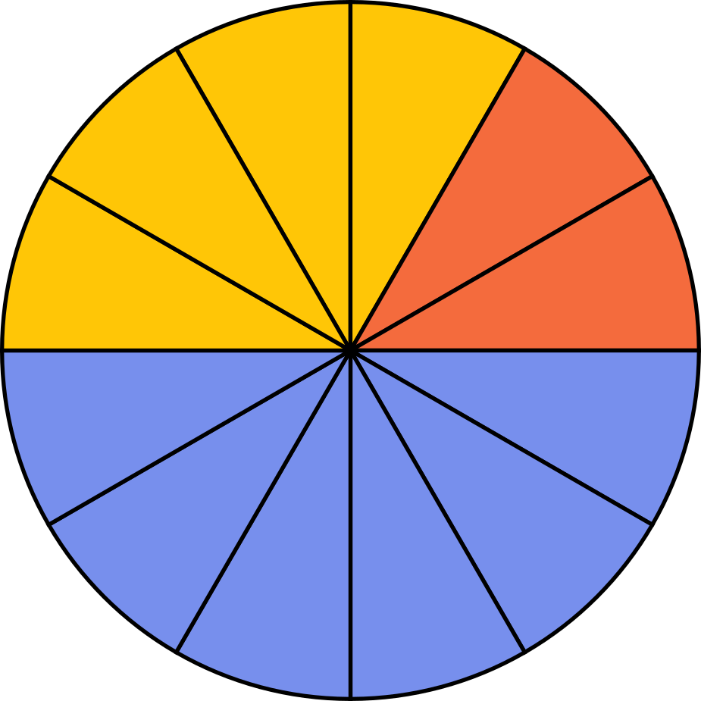
Show a friend
  How will finding the
  reciprocal of a fraction help
  in dividing fractions?
  Explain your answers in our next session.

Slide 15
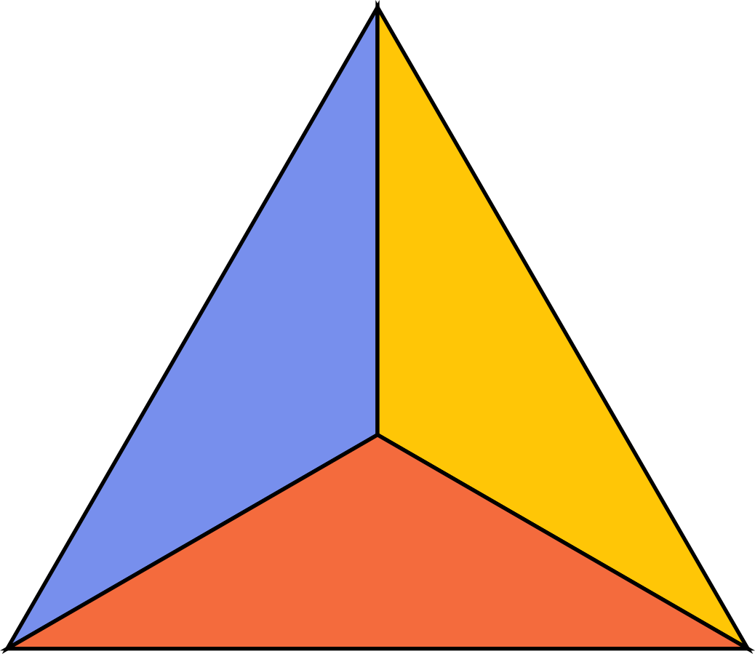

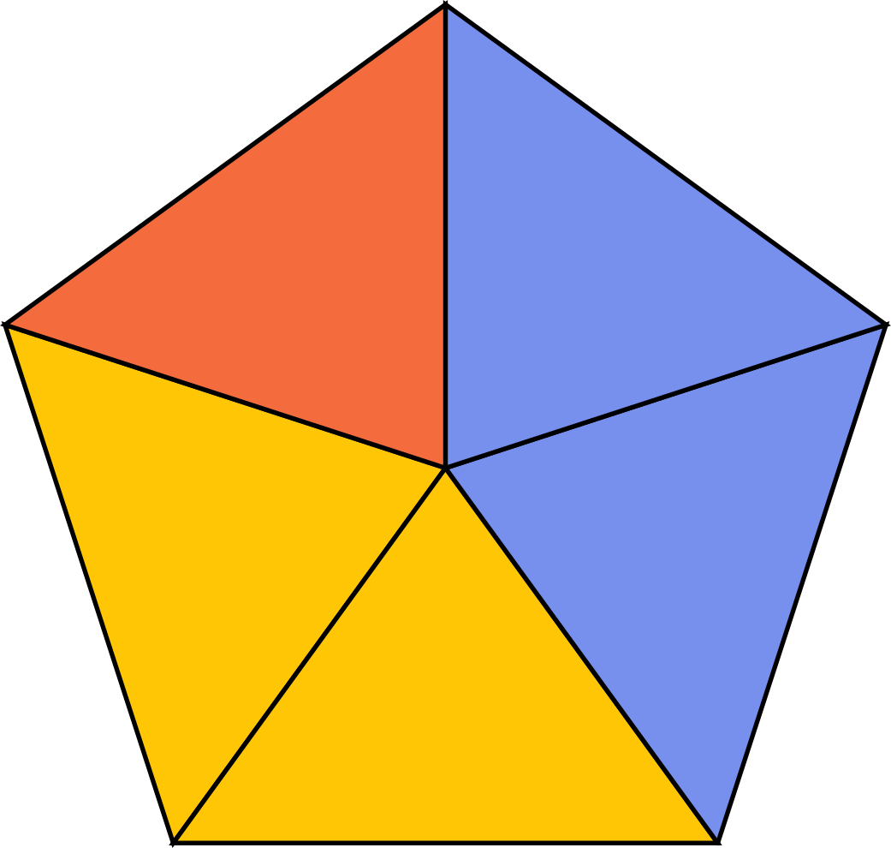
References
  Mathspace. “2.03 Divide fractions | Grade 6 Math | Common Core 6 - 2023 Edition.” Accessed 24 July 2023, https://mathspace.co/textbooks/syllabuses/Syllabus-1155/topics/Topic-21887/subtopics/Subtopic-279725/?searchString=&activeTab=theory
  Mathspace. “2.05 Problem solving with fractions | Grade 6 Math | Common Core 6 - 2023 Edition.” Accessed 24 July 2023, https://mathspace.co/textbooks/syllabuses/Syllabus-1155/topics/Topic-21887/subtopics/Subtopic-279727/?searchString=&activeTab=theory

Slide 16







































Resource
Page
  Use these design resources in your
  Canva Presentation.
  This presentation template uses the following free fonts:
  Titles: Bree Serif
  Headers: Architects Daughter
  Body Copy: Montserrat
  You can find these fonts online too. Happy designing!
  Don't forget to delete this page
  before presenting.

Slide 17

This presentation template is free for everyone to use thanks to the following:
  SlidesCarnival for the presentation template
  Pexels for the photos
Happy designing!

