Slide 1






Making
Connections In
Informational
Texts
through language organization
and information links

Slide 2

Making sense of sentences
Understanding how a writer organizes language and links information in a paragraph or essay, helps us determine the purpose and key ideas of what we are reading.

Slide 3

Comparison
We examine similarities or differences between people, objects, or ideas in order
to arrive at a judgment or conclusion. Some words used for this method are:
ALSO | EQUALLY | JUST AS | TOO
LIKE | LIKEWISE | JUST LIKE | STILL
BOTH | SIMILAR TO | SO | EVEN THOUGH

Slide 4


Lesson Outline
Comparison
Analogy
Categories
Reading and Writing
Connection

Slide 5
Comparing with a Venn Diagram
Below are details found in the paragraph. Are they part of similarities or differences between the two dogs? The Venn Diagram is one way to clearly show the relationship between these details.
A
B
dogs
black
fur
goes on
walks
likes being around my dad
sleeps by the door every afternoon
eats
slowly
eats
quickly
white as
snow
likes being around my mom

Slide 6
Comparing with a Venn Diagram
A
B
eats
quickly
goes on
walks
white as
snow
black
fur
dogs
eats
slowly
likes being around my dad
sleeps by the door every afternoon
likes being around my mom
These descriptions are near the comparison words we noted earlier.

Slide 7

Comparison Clues
Read the paragraph closely. Note some of the
words used for comparison.
My parents own two dogs, namely Skye and Night. They are the same age, but Skye is bigger. Night has black fur, while Skye is as white as the snow. Both dogs like each other and enjoy playing together all the time. They share the same food, but Night eats quicker, and Skye can be a bit slow. Every morning, my parents take them out for a walk. Night and Skye sleep in the same spot by our door every afternoon. But Skye sleeps beside my mom in the evening, while Night likes hanging around with my dad.

Slide 8
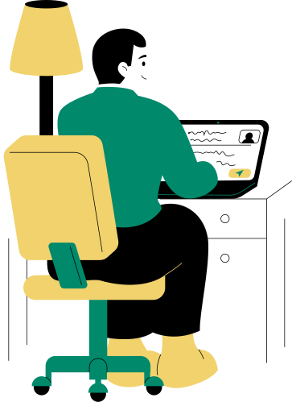
Analogy
An analogy is a special kind of comparison in which a second subject is introduced to explain or justify something about the main topic.
Analogies are different from comparison.
An analogy usually focuses on a main subject, and an analogical subject is used to clarify, emphasize, or persuade.
The analogical subject is usually different from the main topic. It finds unexpected similarities in unlikely things.

Slide 9

Analogy
Just as the sword is a warrior’s weapon, the metaphorical pen is the weapon of a writer. Prominent writers significantly impact people as they can influence one’s thinking and actions. As a warrior would choose the sharpest sword in the most challenging battle, a writer selects specific, impactful words to convey their ideas and opinion. Flowing through their “pens” are expressions that linger on the readers they reach, who are called to act, reflect further, or initiate change. Like victorious warriors, the most successful writers are remembered for all ages.
It is an analogy between a warrior's
sword and a writer's pen.

Slide 10

Anatomy of an Analogy
What is the main topic?
It is about the power and influence of writers.
Apart from the pen and sword, what other analogies were used?
Other analogies are sharp swords and impactful words, and warriors and writers.
How similar is the main topic from the analogical subject?
They're very similar. Both professions and their tools hold power and influence. By comparing writers to warriors, their societal impact is emphasized.

Slide 11
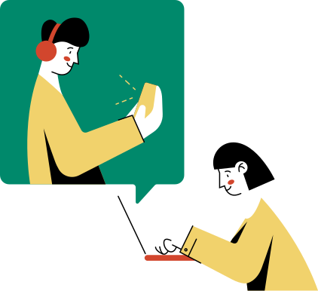

Categories
Organize ideas and offer up examples that fit into each. It is up to you to decide on the criteria for classification, but you must be able to explain your reasoning.

Slide 12






To understand paragraphs developed through categories,
here are some guide questions.
How is each category being described?
What is
being organized?
What are
the main classifications?
What is important to remember
about these categories?
How are these categories similar to/different from one another?
What are the details or
explanations for each category?

Slide 13


Thank
You!

Slide 14


RESOURCE PAGE
  Use these design resources in your Canva Presentation.
Fonts
Design Elements
This presentation template
uses the following free fonts:
TITLES:
CALISTOGA
Titles:
DM SANS
You can find these fonts online too.
Colors
#F9F3E5
#FFB1C3
#00896B
  DON'T FORGET TO DELETE THIS PAGE BEFORE PRESENTING.

Slide 15

CREDITS
  This presentation template is free for everyone to use thanks to the following:
  for the presentation template
Pexels, Pixabay
  for the photos
  Happy designing!

