Slide 1


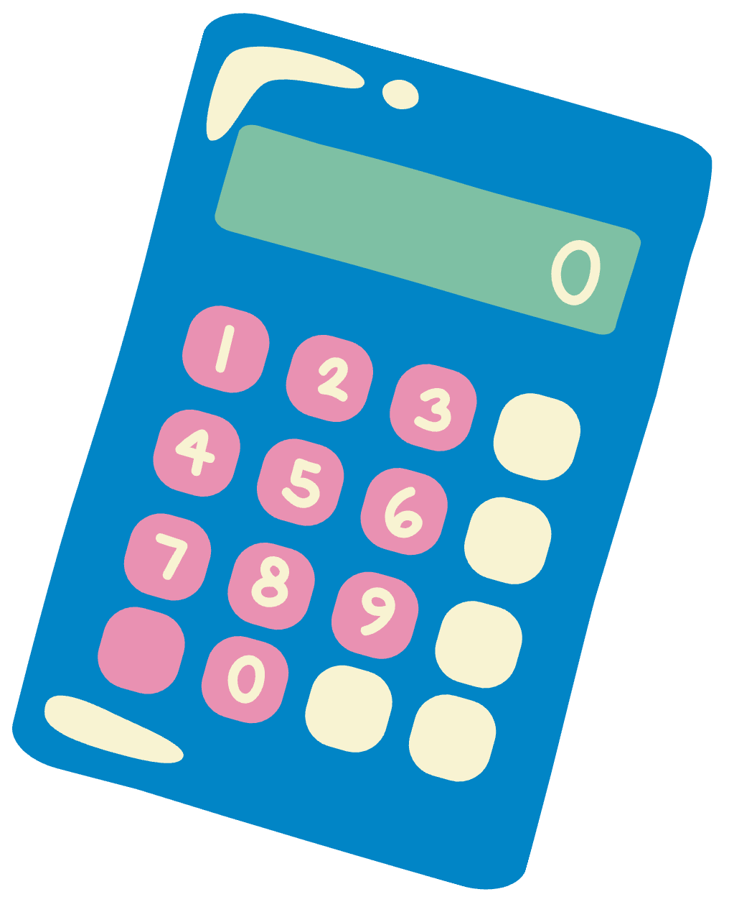

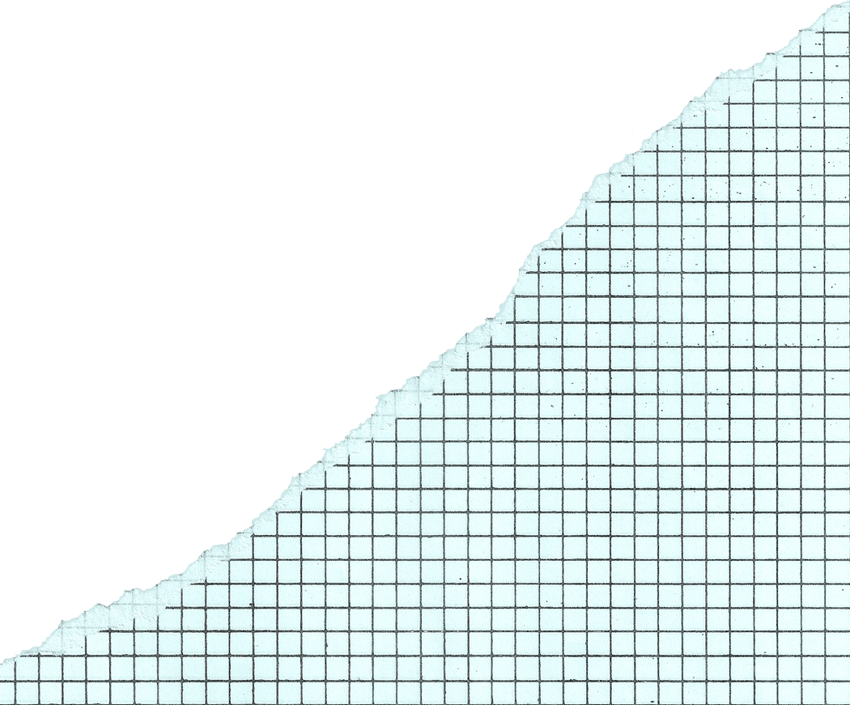


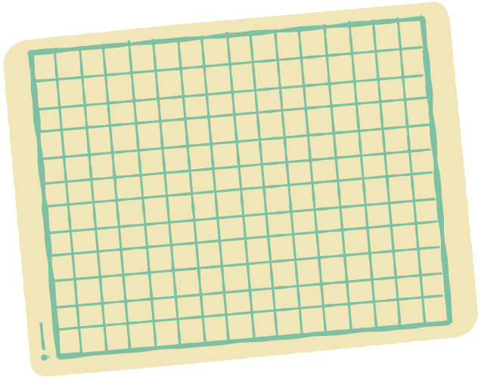
Lesson for Middle School
Multiplication
as Scaling

Slide 2
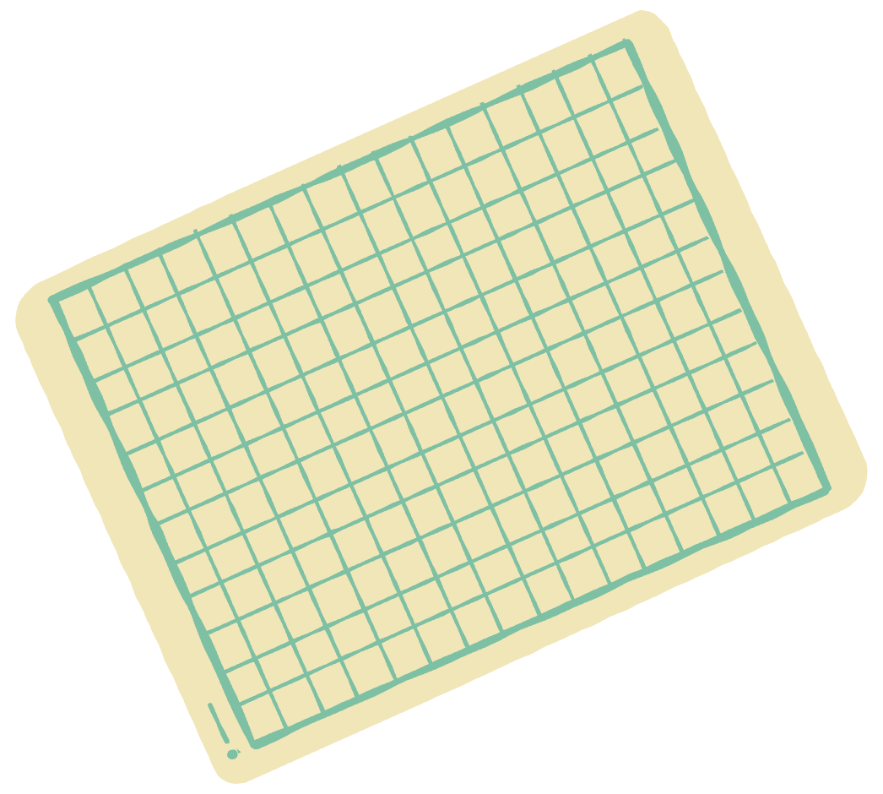

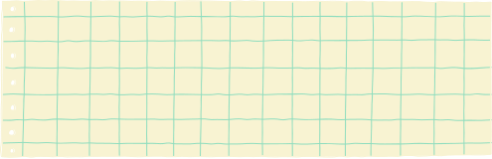



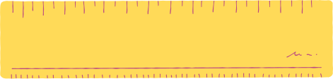
Lesson Outline
Scaling Superpower!
Multiplying Fractions and Whole
Numbers
Multiplication for Scaling

Slide 3


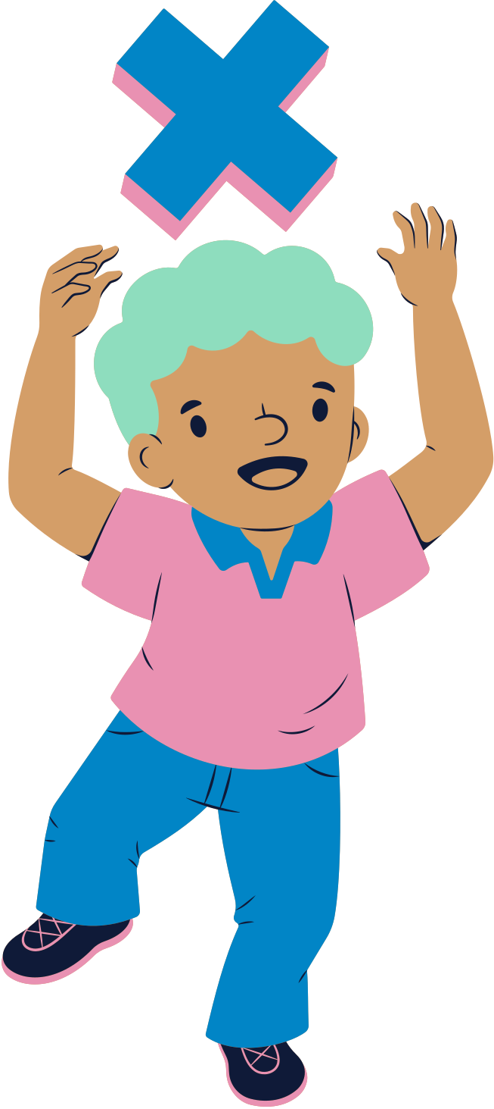

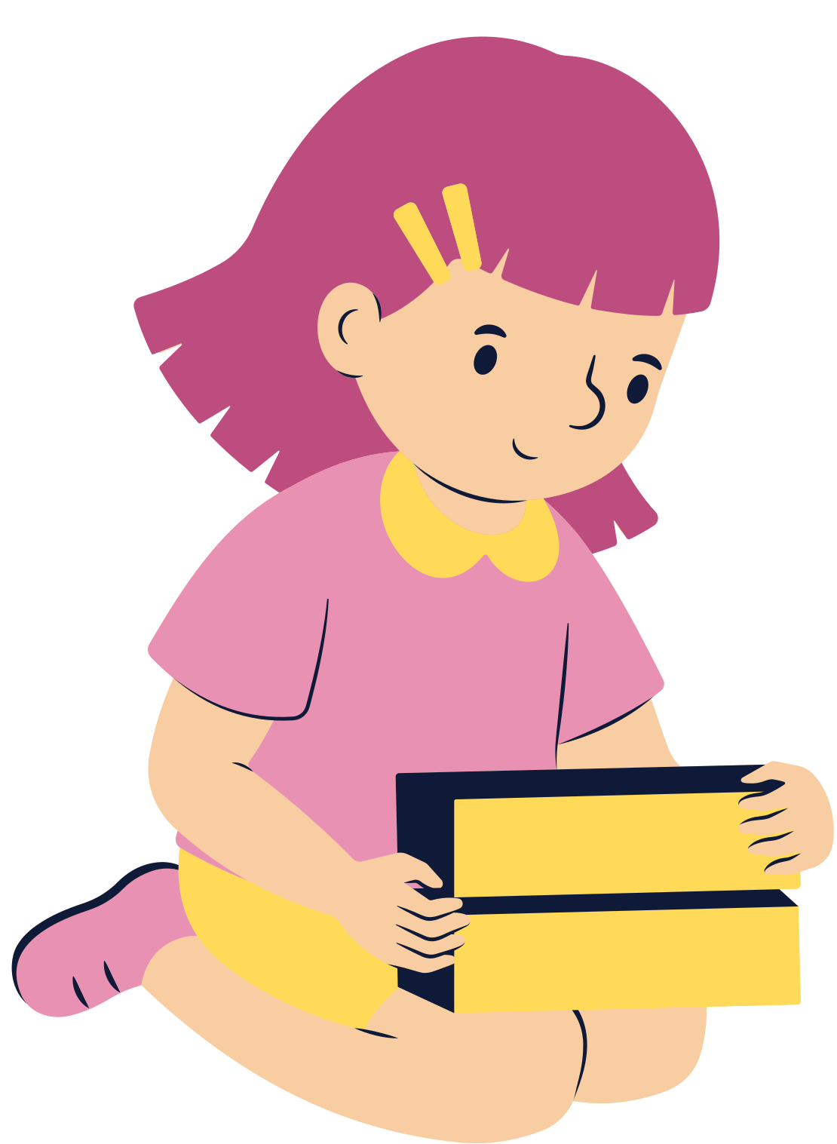
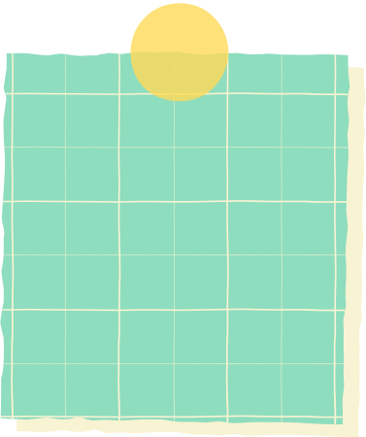
Introduction
Multiplication can make the number bigger or smaller.
Let's explore together how it works!

Slide 4


Multiplying Numbers
When we multiply a number by a whole number, the value of the number gets larger.
When we multiply a number by a fraction,
the value of the number gets smaller.
1
2
2 x 2
2
2 x
2
After multiplying the apples by 2,
the number of apples becomes 4.
After getting one-half of the apple,
the number of apples becomes 1.

Slide 5




Let’s Review
A fraction greater than 1
has a numerator greater
than the denominator.
A fraction less than 1
has a numerator less
than the denominator.
7
4
4
7

Slide 6



Multiplying by a Fraction greater than 1
3
4 x
= 6
4
2
3
Multiplying 4 by means having 3 groups of 4. Then, getting half of it.
2

Slide 7

Multiplying by a Fraction greater than 1
We can see that from 4, it increases to 6.
4
6
When we multiply a number by a fraction greater than 1, the number increases.

Slide 8
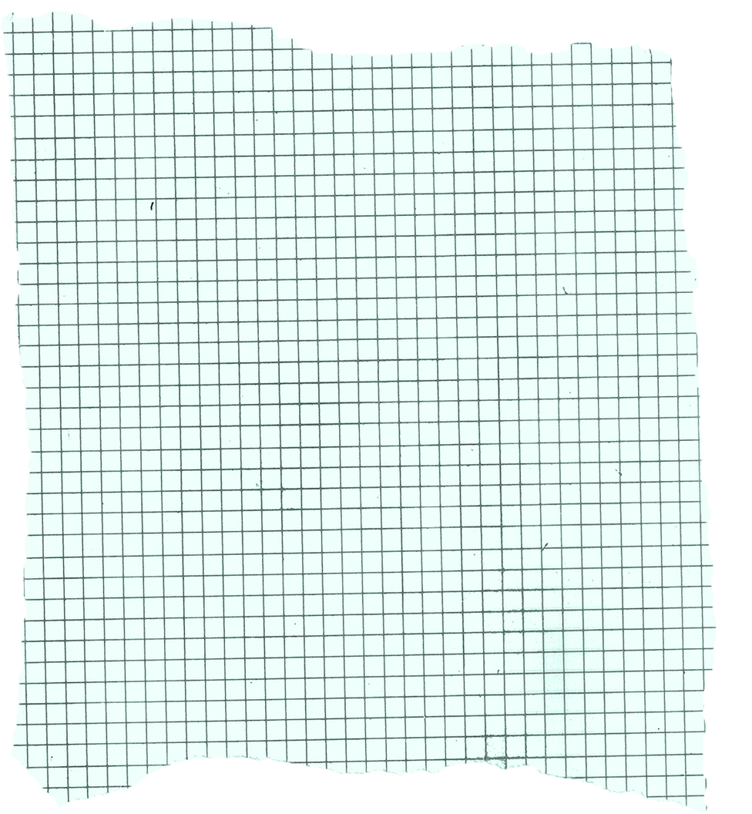

Multiplying by a Fraction less than 1
3
4 x
= 3
4
4
3
Multiplying 4 by means having 3 groups of 4. Then, getting the fourth of it.
4

Slide 9
Multiplying by a Fraction less than 1
We can see that from 4, it decreases to 3.
4
3
When we multiply a number by a number less than 1, the number decreases.

Slide 10



5
3
Which fractions, when multiplied from 10, will result in a higher number?
4
8
Which one will result
in a lower number?
9
2
10
5

Slide 11



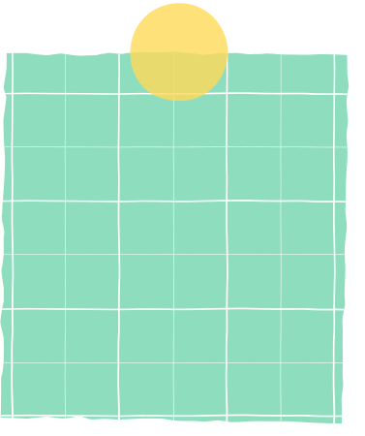
Summary
In multiplying a number by a fraction,
if the fraction is greater than 1, the value
will increase.
if the fraction is less
than 1, the value
will decrease.

Slide 12
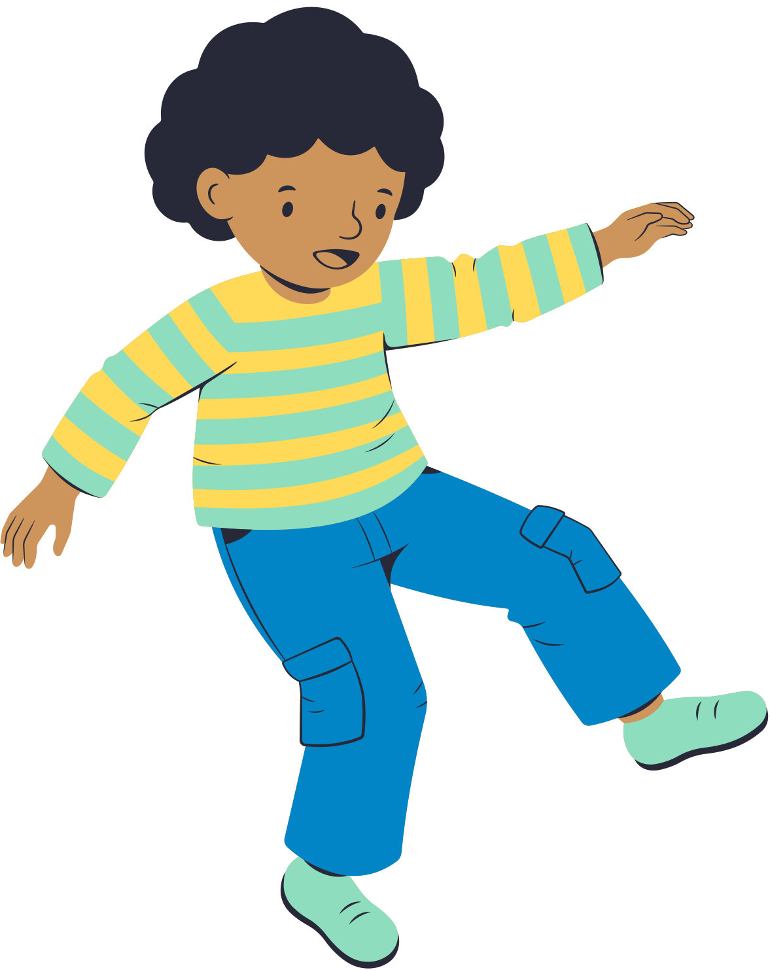
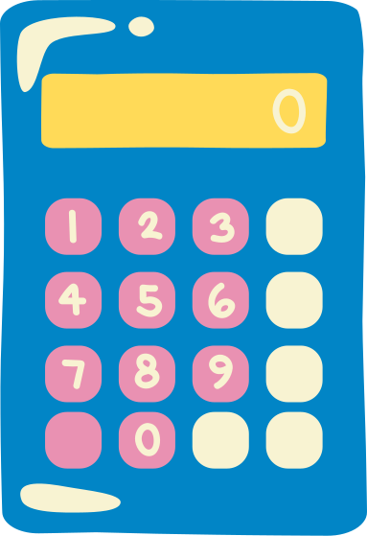

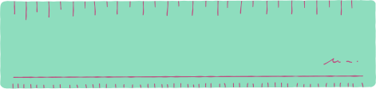

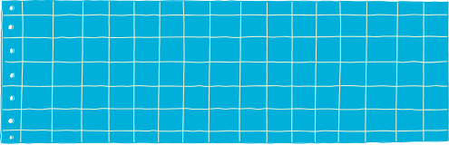
Assignment
Aside from visual models, what are
other ways to show the change
in values when a number is multiplied
by a fraction greater than or less than 1?

Slide 13
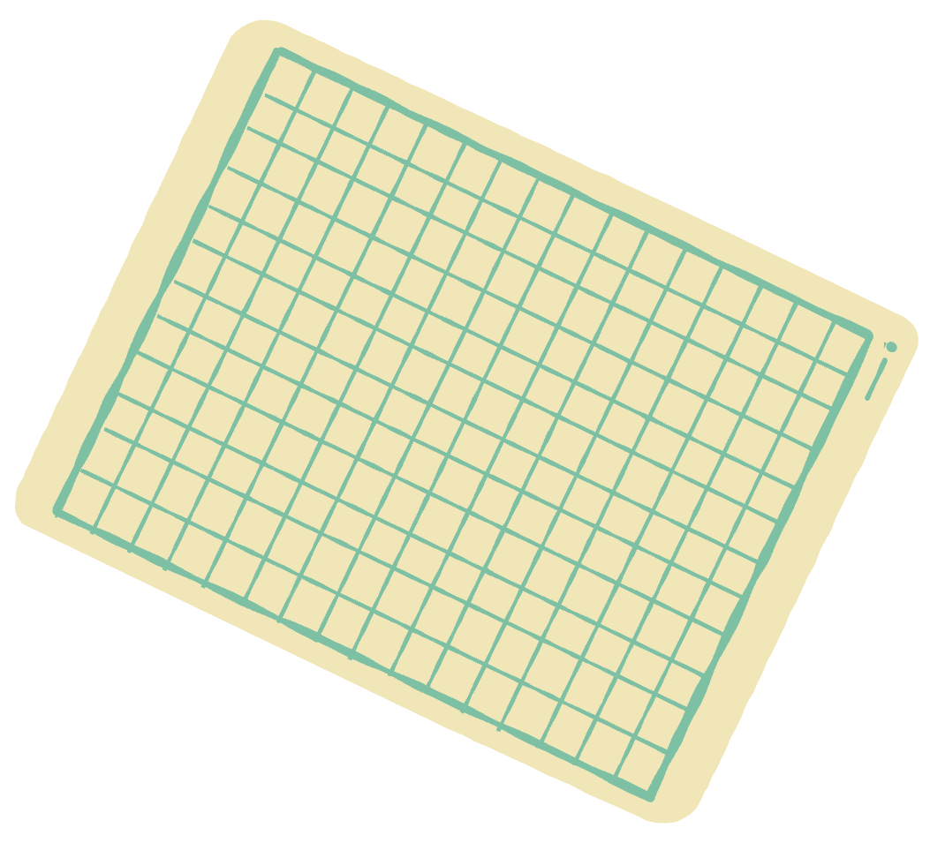
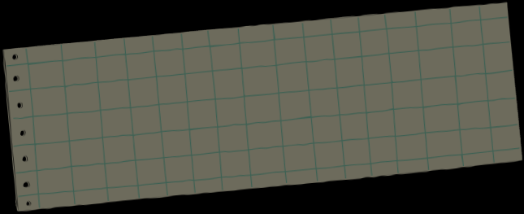
References
Mathspace. “8.02 Multiplication as scaling | Grade 5 Math | Common Core 5 - 2022 Edition.” Accessed 10 June 2023,https://mathspace.co/textbooks/syllabuses/Syllabus-
1091/topics/Topic-21216/subtopics/Subtopic-274739/?searchString=
Mathspace. “8.03 Fractions of a quantity | Grade 5 Math | Common Core 5 - 2022 Edition.” Accessed 10 June 2023, https://mathspace.co/textbooks/syllabuses/Syllabus-
1091/topics/Topic-21216/subtopics/Subtopic-274740/?searchString=
Mathspace. “8.04 Multiples of unit fractions| Grade 5 Math | Common Core 5 - 2022 Edition.” Accessed 10 June 2023, https://mathspace.co/textbooks/syllabuses/Syllabus-
1091/topics/Topic-21216/subtopics/Subtopic-274741/?searchString=
Mathspace. “8.05 Multiply fractions by whole numbers | Grade 5 Math | Common Core 5 - 2022 Edition.” Accessed 10 June 2023, https://mathspace.co/textbooks/syllabuses/Syllabus-
1091/topics/Topic-21216/subtopics/Subtopic-274742/?searchString=

Slide 14
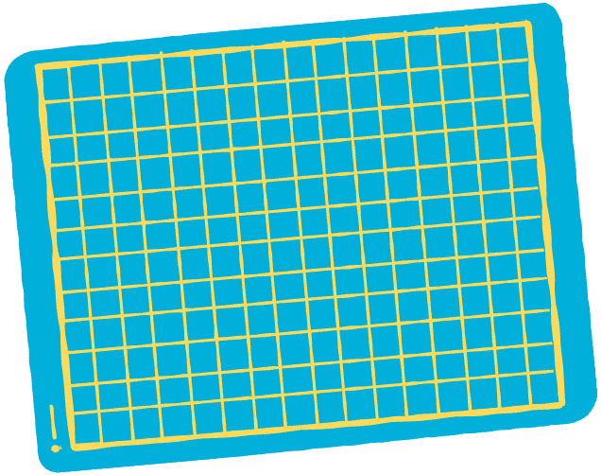



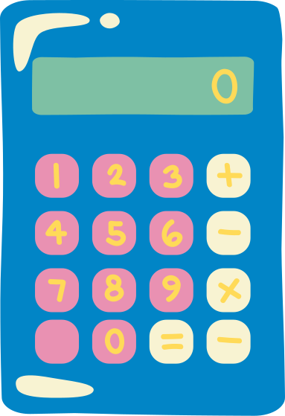

Scaling Superpower!
Poster Making Activity

Slide 15

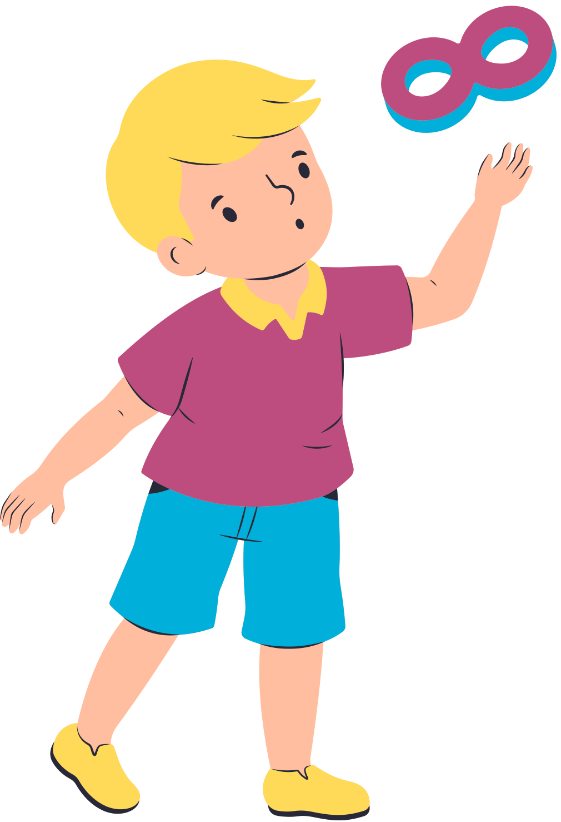
Instructions:
Introduce scaling through multiplication.
Design a poster illustrating how multiplying
a number by a fraction greater than 1 or
less than 1 affects the product's value.

Slide 16

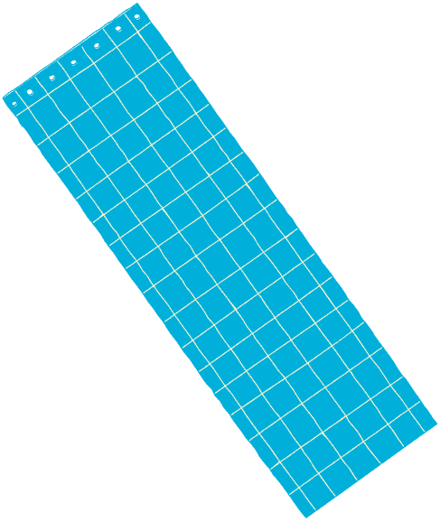

Multiplying Fraction and Whole Numbers
Whiteboard Activity

Slide 17


What happens when we multiply a number by a fraction greater than 1?
  Add diagrams or illustrations.
  Label important parts
Write a short explanation related to the illustration.
Place equations here.
Include a footer for references, legends, and other footnotes.

Slide 18

What happens when we multiply a number by a fraction less than 1?
  Add diagrams or illustrations.
  Label important parts
Write a short explanation related to the illustration.
Place equations here.
Include a footer for references, legends, and other footnotes.

Slide 19



Let's explore the multiplication of fractions and whole numbers.
Find the product of the given values using the number line.
2
4 x
2
3
Step 1
Locate on the number line.
3
0
1
MARK THE
WHOLE NUMBERS
How many equal parts should 1 unit be divided into?

Slide 20
2
Step 2
Locate 4 x on the number line.
3
0
1
USE THE ARROWS TO EMPHASIZE THE NUMBER OF JUMPS
4 x
2
?
=
3
?

Slide 21

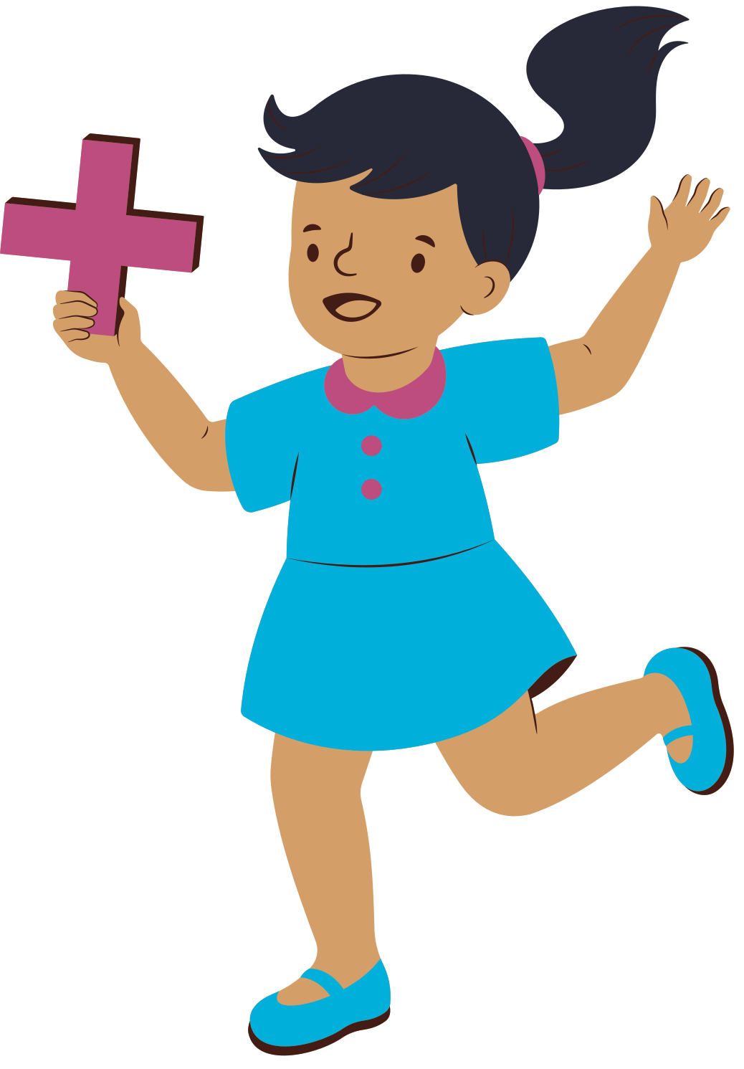
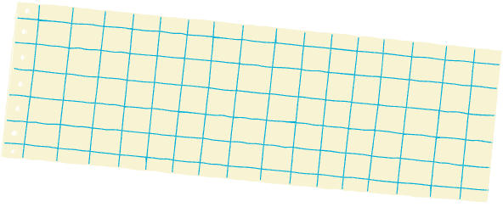
Let’s Recap:
Thank You!
  Add a main point here
Elaborate on what you want to discuss
  Add a main point here
Elaborate on what you want to discuss
  Add a main point here
Elaborate on what you want to discuss

Slide 22
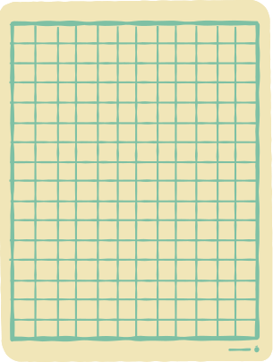
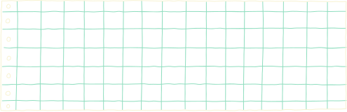


Resource Page
Use these design resources in your Canva presentation.
Fonts
This presentation template
uses the following free fonts:
Titles:
Exo 2
Headers:
Exo 2
Body:
Montserrat
You can find these fonts online too. Happy designing!
Colors

Slide 23




Design Elements

Slide 24
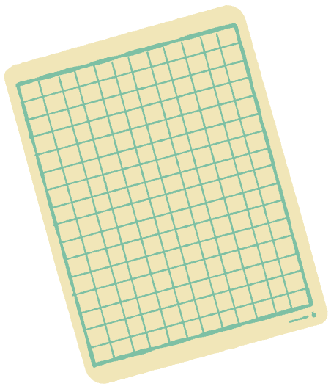

Credits
This presentation template is free for
everyone to use thanks to the following:
Pexels and Pixabay
for the presentation template
For the photos

