Slide 1
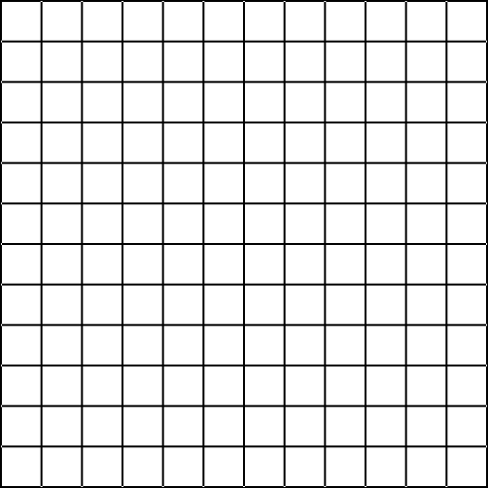

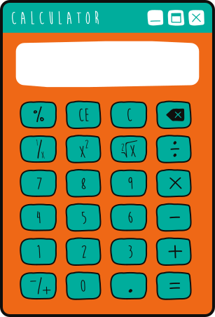


UNIT RATES AND PROPORTIONAL
RELATIONSHIPS
Lesson for High School

Slide 2
LESSON OUTLINE
What is a Rate?
What is a Unit Rate?
Calculating Unit Rates
Real-Life Applications

Slide 3

INTRODUCTION
Did you know that the cheetah holds the record for being the fastest mammal on land? It can reach speeds of around 60 miles per hour.
The concept of unit rate helps us calculate its speed and compare it to other animals.
In this lesson, we'll learn about unit rates and how to calculate them.

Slide 4
WHAT IS A RATE?
Rate is the ratio between two quantities with different units.
Rate tells how quickly one quantity changes in relation to another quantity.
Elliot can type 40 words in 60 seconds.
40 words
Rate =
60s

Slide 5
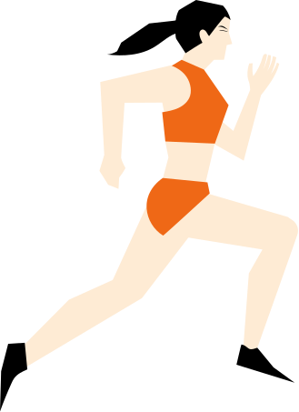
EXAMPLES OF RATE
The athlete ran 200 meters
in 25 seconds.
A pack of apples costs 3 dollars for a weight of 1.5 kg.
200m
$3.00
Rate =
Rate =
25s
1.5kg

Slide 6
A type of rate where the denominator or second quantity in the ratio is always 1 unit.
A unit rate has a compound unit.
WHAT IS
A UNIT
RATE?
Sample Compound Units
for Unit Rates
miles per hour (mi/h)
meters per second (m/s)
liters per day (L/day)

Slide 7
01
CALCULATING UNIT RATES
Sample Problem:
STEP 1
The athlete ran 200 meters
in 25 seconds.
Express the rate as a ratio
in fraction form.
200m
Rate =
25s

Slide 8
02
CALCULATING UNIT RATES
Sample Problem:
STEP 2
The athlete ran 200 meters in 25 seconds.
Rate =
200m
Divide the numerator
and denominator.
25s
Unit Rate = 200m ÷ 25s

Slide 9
03
CALCULATING UNIT RATES
Sample Problem:
STEP 3
The athlete ran 200 meters in 25 seconds.
Write the compound unit.
Combine the two quantities to
get the compound unit.
Rate =
200m
Unit Rate =
200m ÷ 25s
25s
Unit Rate = 8m/s

Slide 10
CALCULATING UNIT RATES
Sample Problem:
The athlete ran 200 meters in 25 seconds.
This means that the athlete runs at a unit rate of 8 meters per second.
Unit Rate = 8 m/s

Slide 11
REAL LIFE APPLICATIONS
LESSON ACTIVITY
Let's calculate the unit rates in each scenario.
Diana walked 450 meters in 30 minutes.
James made 56 pieces of paper flowers in 28 minutes.
Allan used four cups of water per 1.2 tablespoons of syrup.

Slide 12
REAL LIFE APPLICATIONS
ANSWER KEY
Let's calculate the unit rates in each scenario.
Diana walked 450 meters in 30 minutes.
James made 56 pieces of paper flowers in 28 minutes.
Allan used four cups of water per 1.2 tablespoons of syrup.
450 m
56 pcs
4 cups
Rate =
Rate =
Rate =
30 min
28 min
1.2 tbps
Unit Rate = 450 m ÷ 30 min
Unit Rate = 56 pcs. ÷ 28 min
Unit Rate = 4 cups ÷ 1.2 tbsp
Unit Rate = 15 m/min
Unit Rate = 2 pcs/min
Unit Rate = 3.333 cups/tbsp

Slide 13
THANK
YOU!

Slide 14
























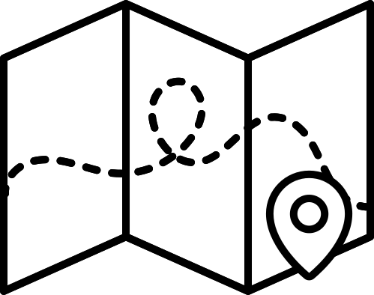














RESOURCE PAGE
  Use these design resources in your Canva Presentation.
Fonts
Design Elements
This presentation template
uses the following free fonts:
TITLES:
ANTON
BODY COPY:
CABIN
You can find these fonts online too.
Colors
#9BD4ED
##EF6816
#728341
  DON'T FORGET TO DELETE THIS PAGE BEFORE PRESENTING.

Slide 15

CREDITS
  This presentation template is free for everyone to use thanks to the following:
  for the presentation template
Pexels, Pixabay
  for the photos
  Happy designing!

