Slide 1







Volumes of Composite Solids
Lesson for High School

Slide 2






Mechanics
Quiz Outline
1
This quiz may be given synchronously or asynchronously. Students may type their answers or write it on a piece of paper.
Part 1
Easy
Part 2
Moderate
2
Find the volume of the figure by counting the cubes or using the formula l × w × h.
Part 3
Challenge

Slide 3



Volume of
Composite Figures
Find the volume of the composite figures.
Write the answer in the
space provided or on a piece of paper.

Slide 4






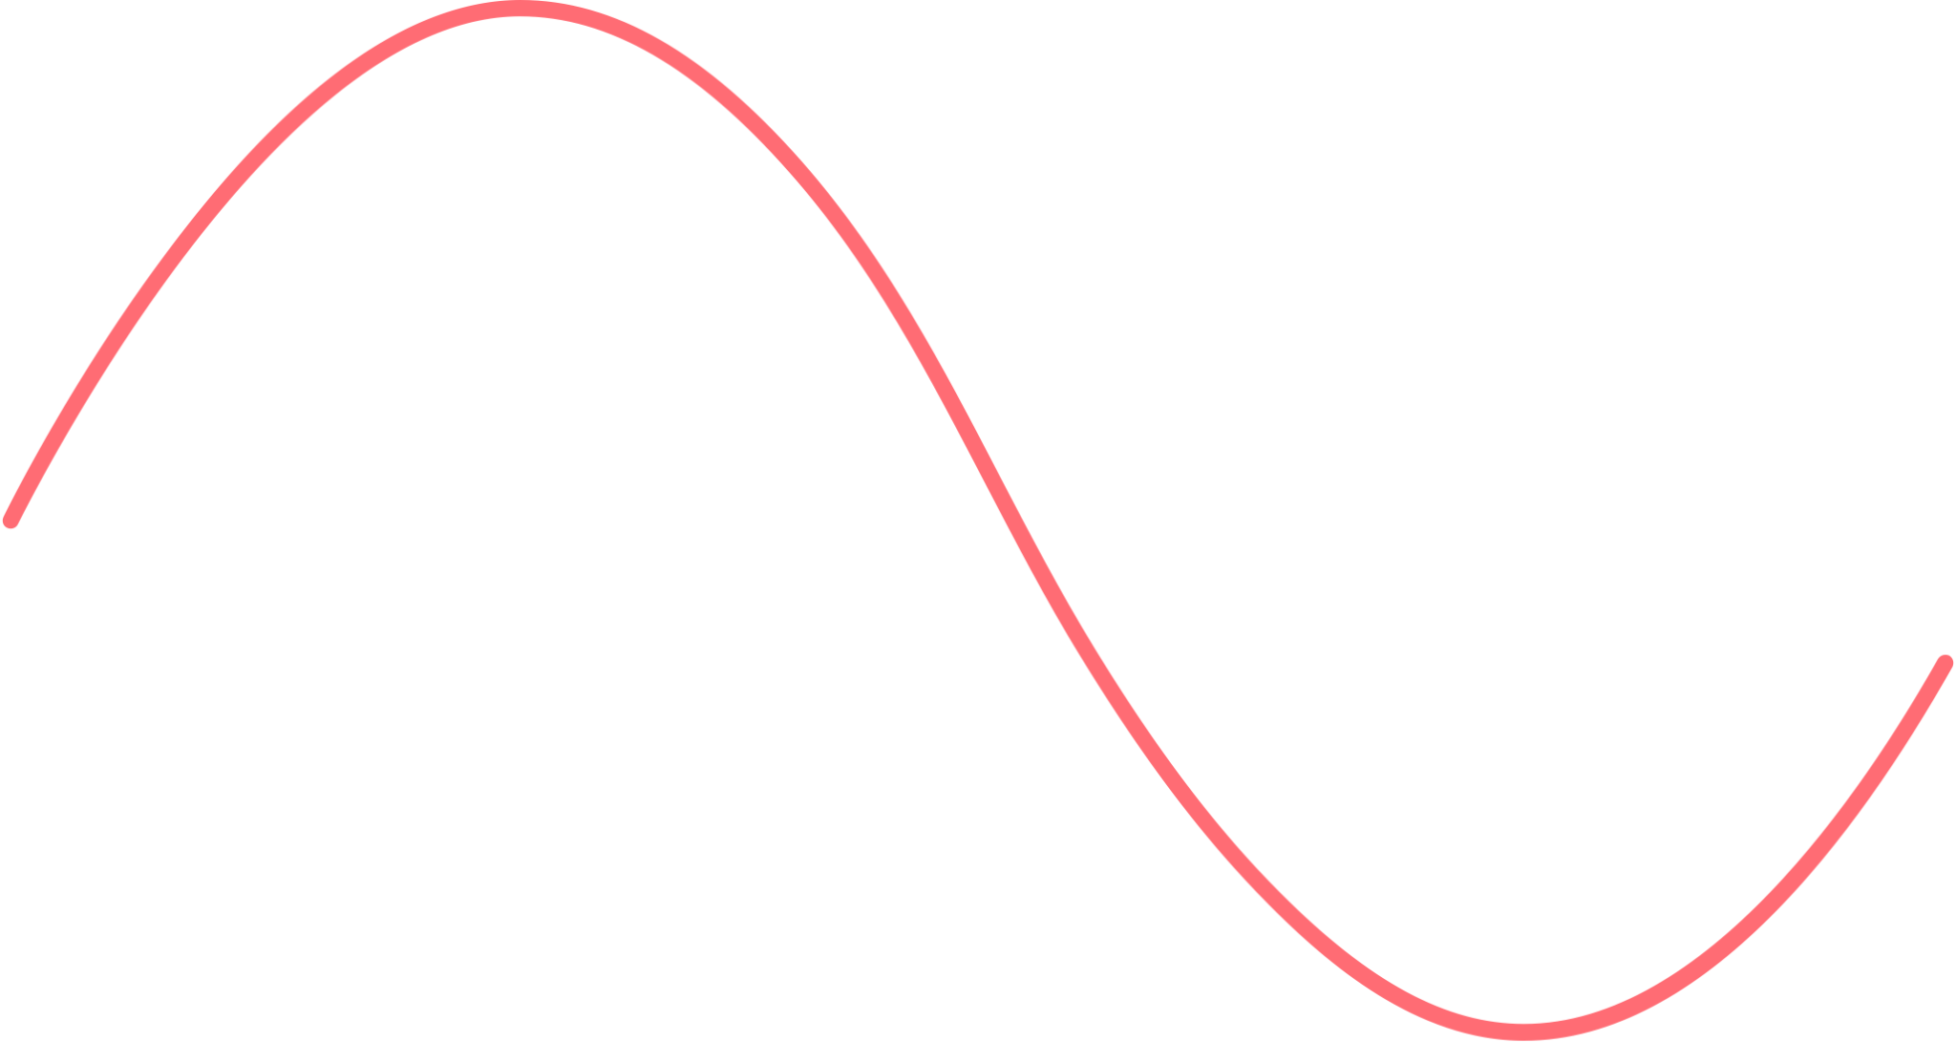

What is the volume
of the table?
Level 1: Easy
Question #1
Type your answer here.

Slide 5


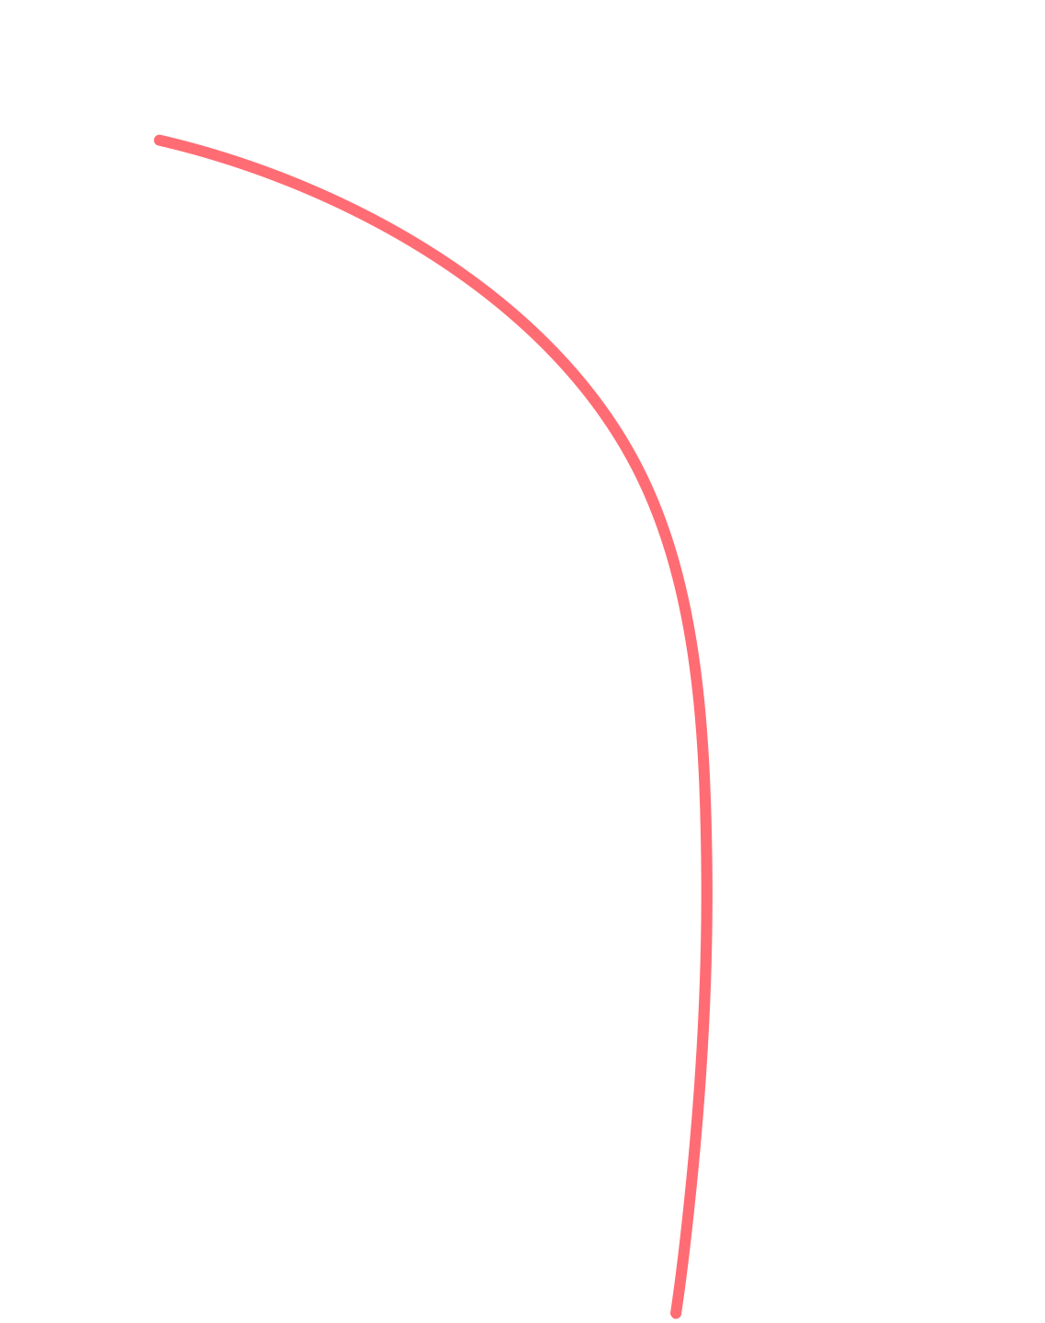


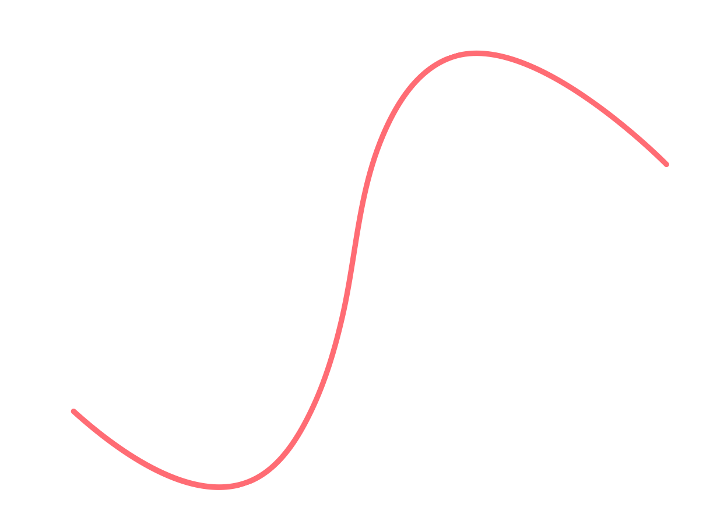

What is the volume
of the bed?
Level 1: Easy
Question #2
Type your answer here.

Slide 6




What is the volume
of the book shelf?
Level 2: Moderate
Question #3
Type your answer here.

Slide 7









ANSWER KEY
100
48
32
64 - 12 = 52
48
24
16
12
18
4 × 2 × 8 = 64
64-12 = 52
52 + 12 = 64
64 Units
5 × 2 × 10 = 100
(opening) 6 × 3 = 18
100 - 18 = 82 units
32 + 48 + 16 =
96 units
48 + 24 = 72 units

Slide 8

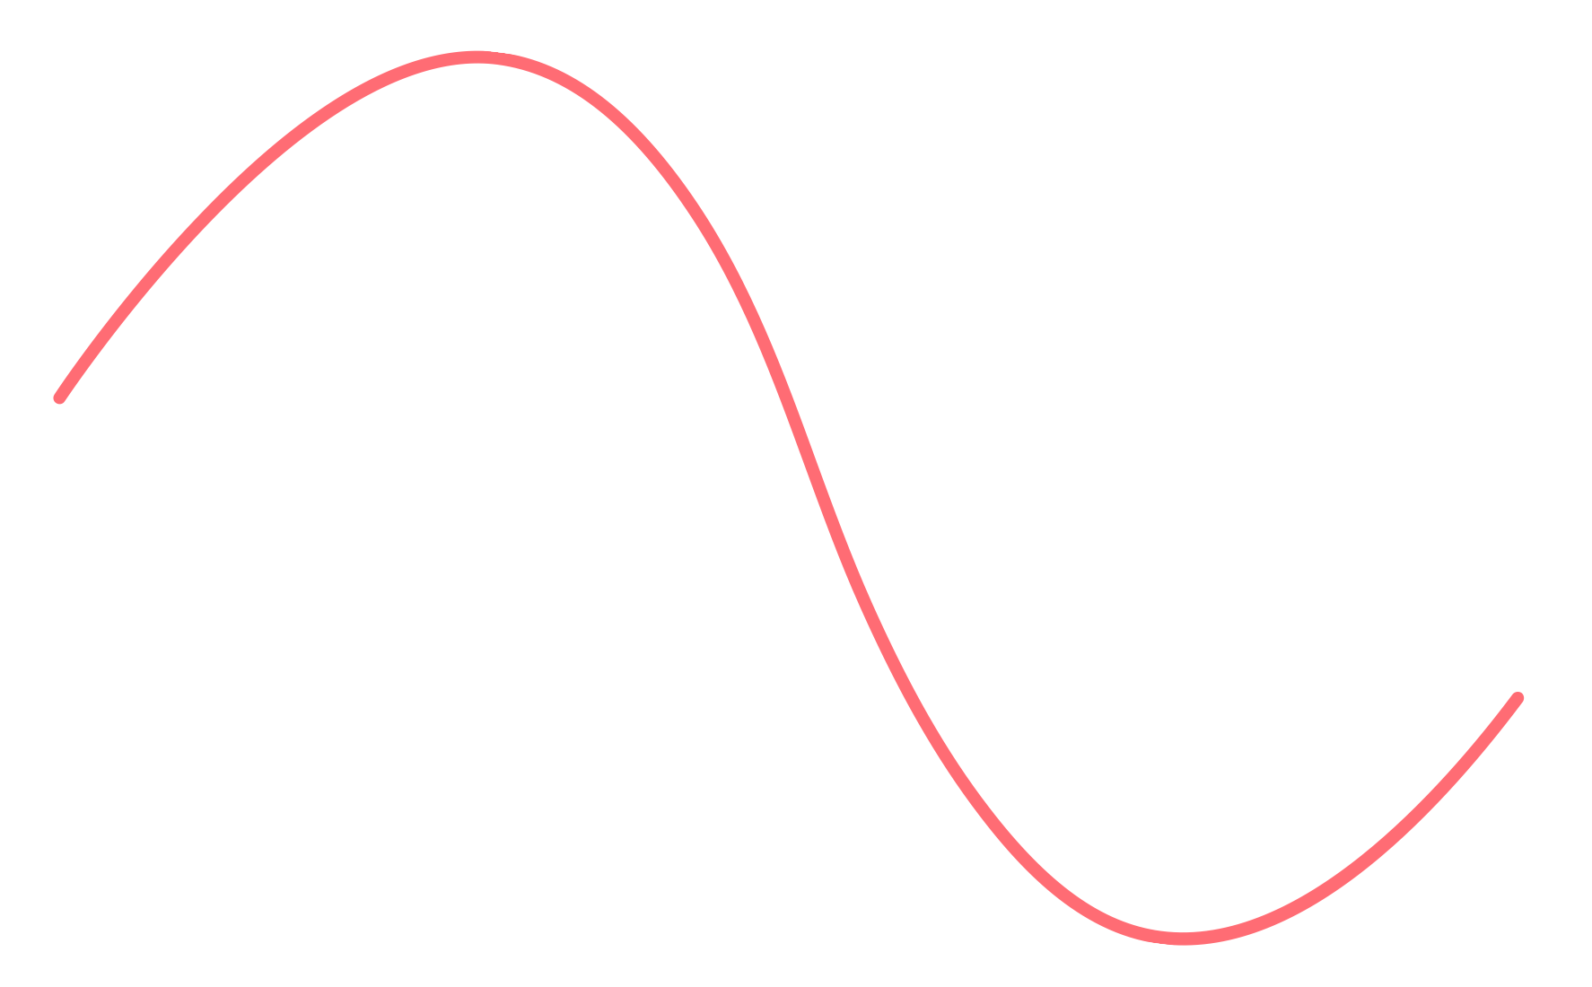

What is the volume
of the couch?
Level 2: Moderate
Question #4
Type your answer here.

Slide 9




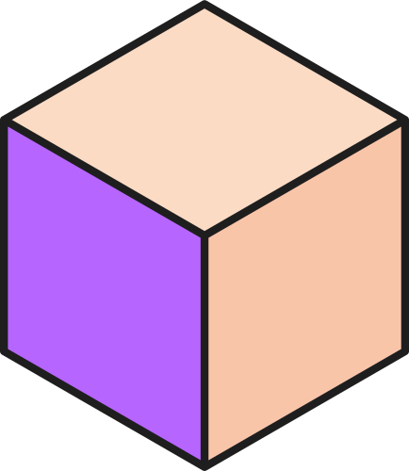




Which 2 figures used the same number of blocks?
Level 3: Challenge
Question #5
Figure A
Figure B
Figure C

Slide 10



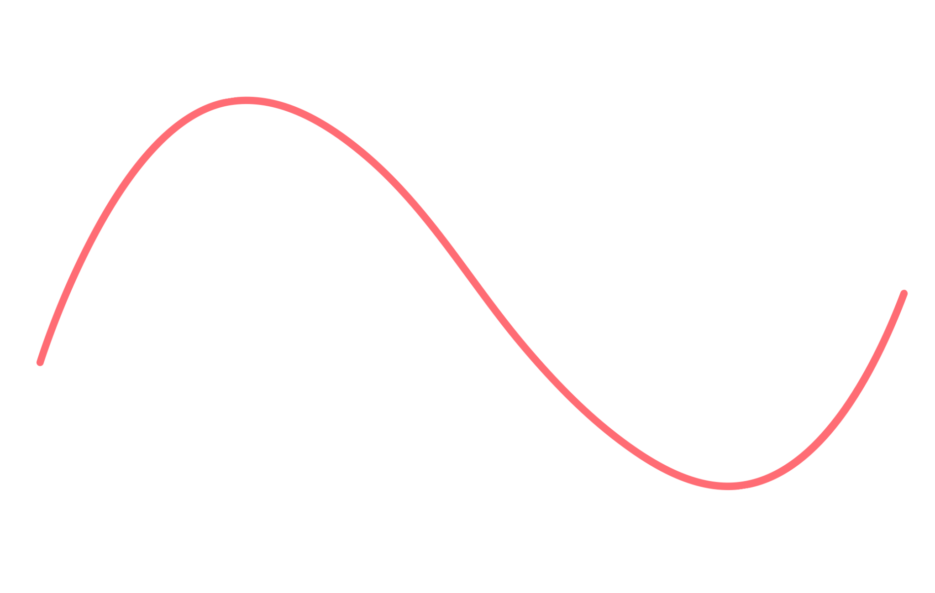

Volume of Composite Figures Quiz
Ready to check your work?

Slide 11



ANSWER KEY
7
2
2
9
6
4
2
8
10
20
22 units
24 units
24 units
Figure A
Figure B
Figure C

Slide 12




Resource Page
Use these design resources in your Canva Presentation.
You can find these fonts online too. Happy designing!
This presentation template uses the following free fonts:
  Titles: Bungee, Caveat
  Headers: Bungee
  Body Copy: Prata, Caveat

Slide 13




Credits
This presentation template is free for everyone to use thanks to the following:
SlidesCarnival for the presentation template
Pexels for the photos
Happy designing!

