Slide 1
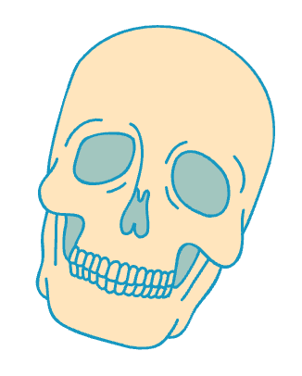
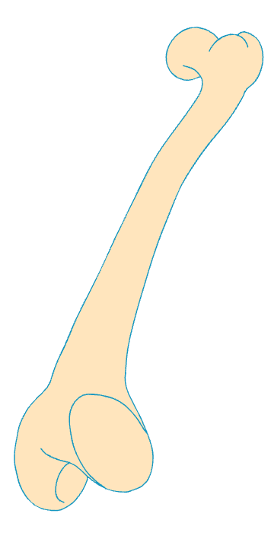
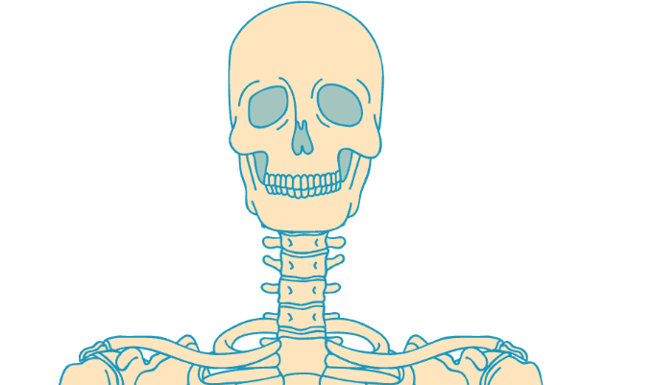
Know Your
206 Bones
Skull (22)
Middle Ear (6)
Thoracic Cage (25)
Cranial Bones (8)
  Frontal
  Parietal (2)
  Temporal (2)
  Occipital
  Sphenoid
  Ethmoid
Facial Bones (14):
  Nasal (2)
  Maxilla (2)
  Zygomatic (2)
  Palatine (2)
  Lacrimal (2)
  Inferior nasal conchae (2)
  Vomer
  Mandible
  Malleus (2)
  Incus (2)
  Stapes (2)
  Sternum (1)
  Ribs (24):
    True ribs (14)
    False ribs (10) - including floating ribs
Vertebral Column (26)
  Cervical vertebrae (7)
  Thoracic vertebrae (12)
  Lumbar vertebrae (5)
  Sacrum (1 – fused from 5)
  Coccyx (1 – fused from 4)
Lower Limbs -
Legs (62)
Hyoid Bone (1)
UPPER Limbs -
ARMS (64)
Per Side (31 bones)
  Pelvis:
    Hip bone (1; composed of ilium, ischium, pubis)
  Thigh:
    Femur (1)
  Kneecap:
    Patella (1)
  Lower Leg:
    Tibia (1)
    Fibula (1)
  Ankle & Foot:
    Tarsals (7)
    Metatarsals (5)
    Phalanges (14)
Per side (32 bones)
  Shoulder Girdle:
    Clavicle (1)
    Scapula (1)
  Arm:
    Humerus (1)
  Forearm
    Radius (1)
    Ulna (1)
  Wrist & Hand:
    Carpals (8)
    Metacarpals (5)
    Phalanges (14)

Slide 2
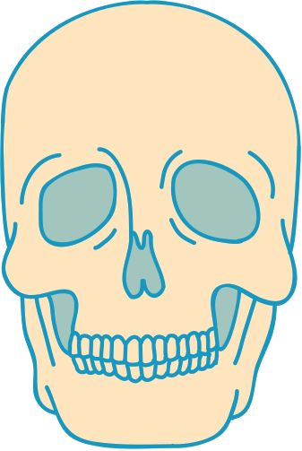
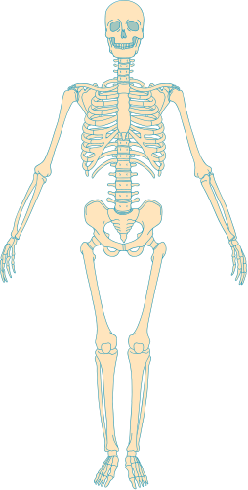
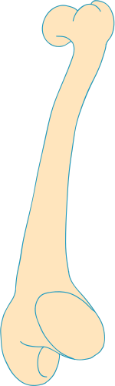
Resource Page
  Use these in your template, then delete or hide this page afterward.
Fonts
Colors
This presentation template
uses the following free fonts:
TITLES:
LUCKIEST GUY
#1798C1
#006D8F
#FFE5BD
BODY TEXT:
Archivo Narrow
You can find these fonts online too.
#FFF7E9
#FFF
Design Elements / Icons

Slide 3

Credits
This template is free for everyone to use,
  thanks to the following:
  for this template
Pexels, Pixabay, Sketchify
  for the photos, graphics, and elements
  Happy designing!

