Slide 1




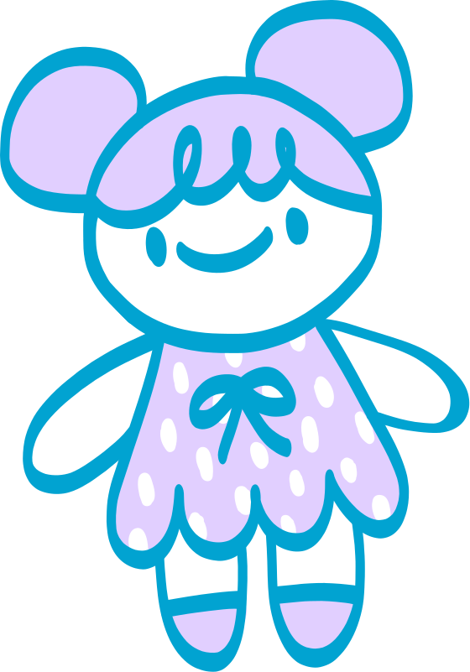

THE NURSE’S KIT OF KINDNESS
Things that help when you’re not feeling your best
BAND-AID
ICE PACK
For little cuts and big courage
To help with bumps and bruises
MEDICINE
SANITIZER
To help you feel better
To keep all the germs away
CUDDLY TOY
KIND WORDS
A soft friend to help you rest
To help you feel safe and calm

Slide 2
RESOURCE PAGE
Use these in your template, then delete or hide this page afterward.
Fonts
Colors
This presentation template
uses the following free fonts:
TITLES:
PASSION ONE
BODY TEXT:
#01A3D1
#E1CFFF
#FAF7FF
Open Sans
You can find these fonts online too.
Design Elements / Icons

Slide 3

CREDITS
This template is free for everyone to use,
thanks to the following:
for this template
Pexels, Pixabay, Sketchify
for the photos, graphics, and elements
Happy designing!

