Slide 1


A Day in the Life
of a Nurse
A day of caring and helping others
WINCREST GROVE LEARNING SCHOOL

Slide 2



The sun comes up and I get ready for work.

Slide 3


Into my colorful scrubs and comfy shoes I go.

Slide 4


At the hospital, my friends wave hello from every room and hallway.

Slide 5

My first stop was Mrs. Garcia, who has the biggest smile today.

Slide 6

“How are you feeling?” I ask, while my stethoscope listens to her heart.

Slide 7

Down the hall, little Colin needs a bandage for his knee.

Slide 8





What color bandage do you think Colin would choose?
Pick your favorite!
Red
Blue
Green
Purple

Slide 9


I give out medicine to patients who need it.

Slide 10

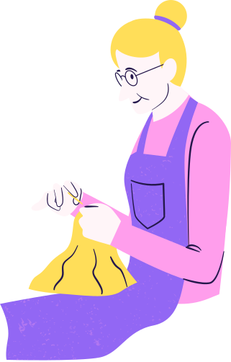
I also talk to families about how their loved ones are doing.

Slide 11

Before I go home, I write notes about each person I helped today.

Slide 12

Tomorrow
I’ll come back to help more people.

Slide 13


Think and Share
What was your favorite part of the nurse’s day?

Slide 14








Resource Page
  Use these in your presentation. Delete or hide this page before presenting.
Fonts
Design Elements / Icons
This presentation template
uses the following free fonts:
TITLES:
Fredoka
BODY TEXT:
Nunito Regular
You can find these fonts online too.
Colors
#FFFFFF
#FFDE59
#FF9EEC
#9267F4
#25184C

Slide 15

Credits
  This presentation template is free for everyone to use, thanks to the following:
Pexels, Pixabay, & Sketchify
  for this presentation template
  for the photos, graphics, and elements
  Happy designing!

