Slide 1



Approach to Bone Tumors
HEALTH NEST FAMILY PRACTICE
A systematic guide to diagnosis and management.
Presenter name: Analisa Laurent
Date: June 2030

Slide 2

Agenda
Understanding bone tumors
Challenges to bone tumors
Approach to bone tumors
  Diagnosis
  Staging
  Management

Slide 3

Bone tumors
Define bone tumors as abnormal growths that affect skeletal tissue. Include key statistics, such as the annual incidence of primary vs. secondary tumors, to show a sense of scale.

Slide 4
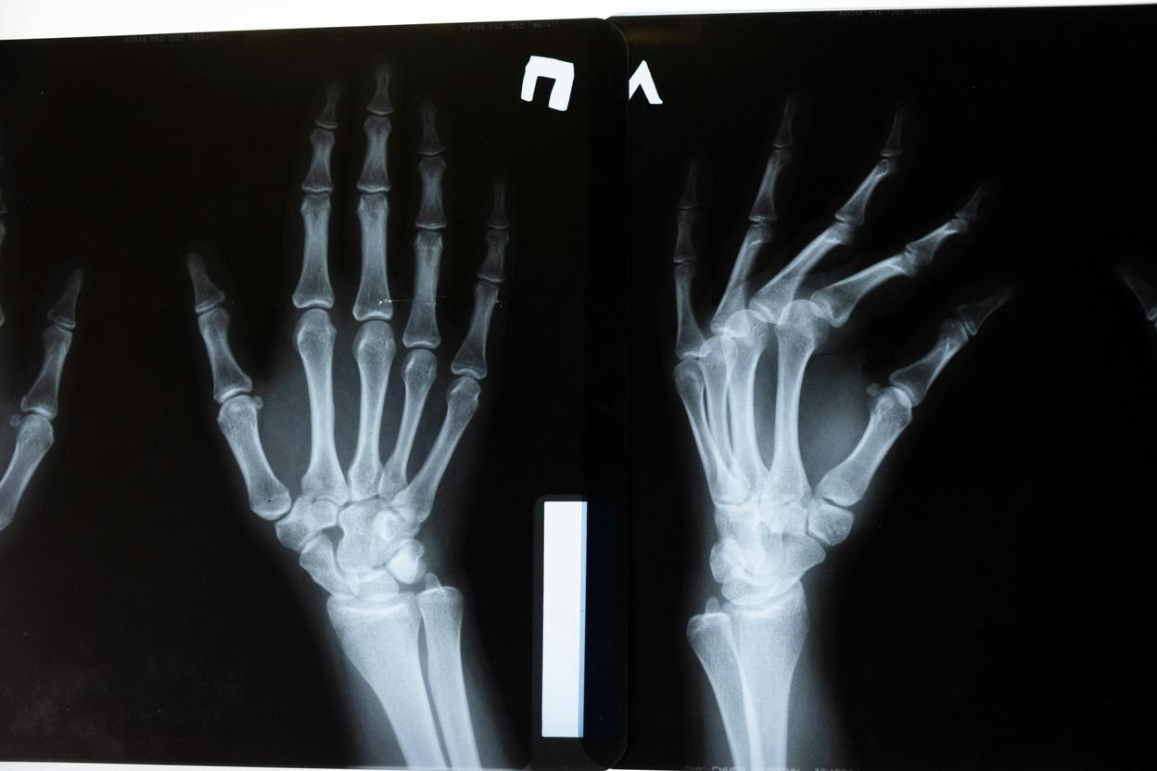
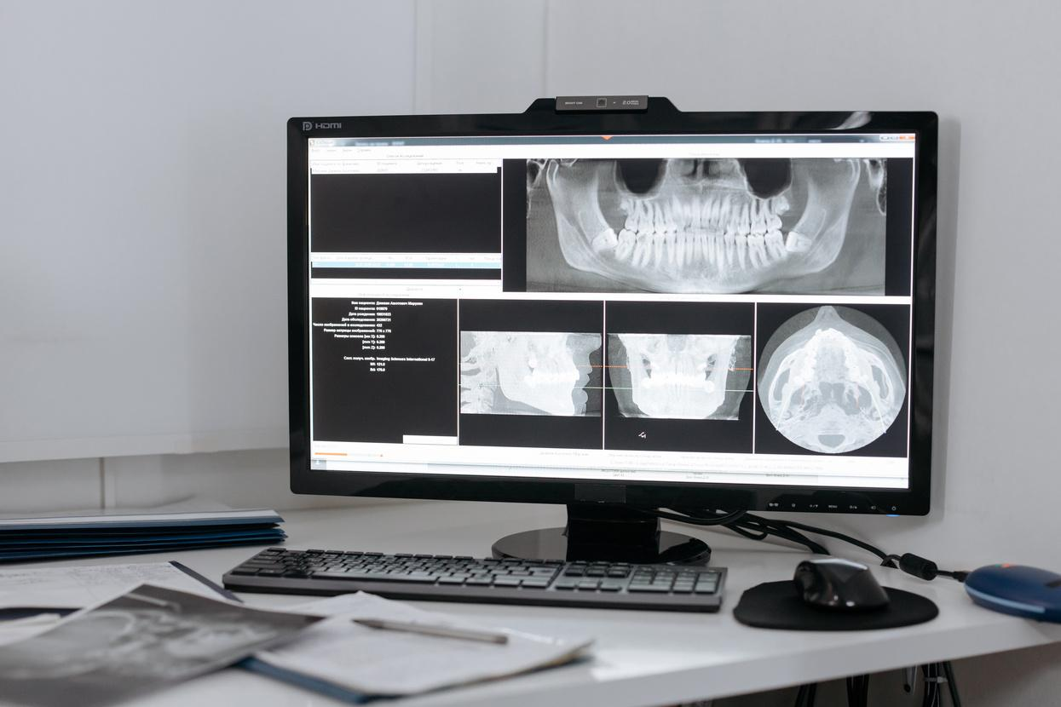
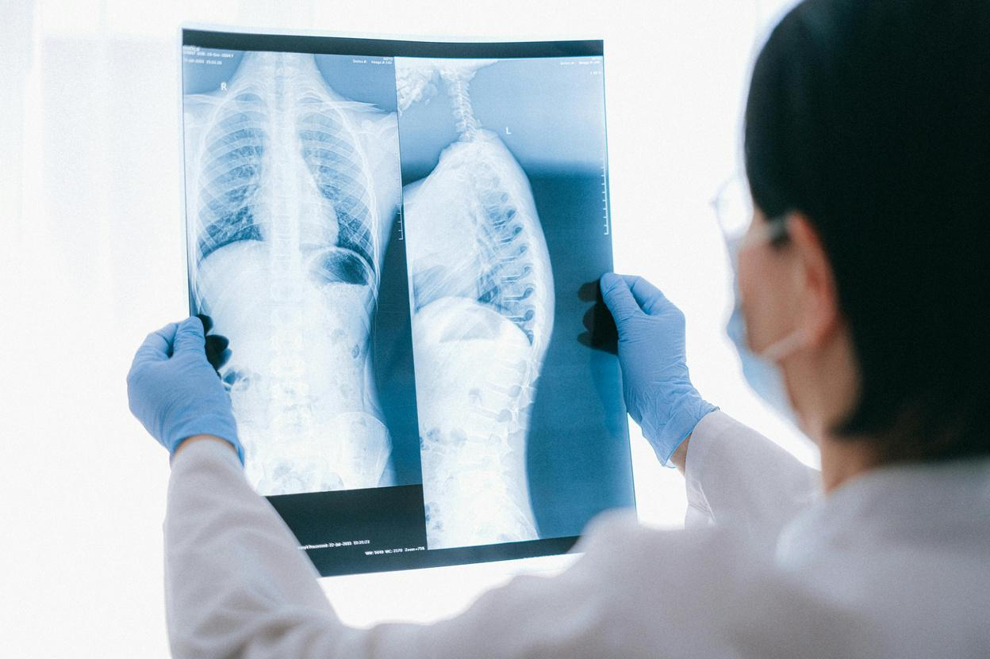
Challenges of bone tumors
List the major challenges associated with diagnosing and treating bone tumors.
Late presentation & diagnosis
Complexity of treatment
Resource availability
Describe why delays are common and how they impact treatment.
Discuss multidisciplinary care and treatment variation.
Highlight the need for specialized diagnostics and surgical support.

Slide 5
Approach to bone tumors
Introduce the key components of evaluating and managing bone tumors.
Diagnosis
Staging
Management
The first and most critical step
Understanding tumor severity
Choosing the right treatment path

Slide 6
Diagnosis
Introduce diagnosis as the first and most critical step in managing bone tumors. Explain the importance of a systematic approach using:
Diagnosis
Imaging studies
Clinical examination
Histopatho-
logical analysis

Slide 7

Staging
Briefly explain what staging means in the context of bone tumors.
List the variables commonly assessed:
  Presence of metastasis
  Tumor size and location
  Another variable here

Slide 8
Staging systems
Introduce the importance of staging systems in assessing bone tumors.
Musculoskeletal Tumor Society (MSTS)/Enneking System
American Joint Committee on Cancer (AJCC) System
Emphasize its value in surgical planning, particularly in distinguishing tumors by grade, anatomical spread, and metastasis status.
Present it as the standard across many cancers, including bone tumors. Emphasize its importance in oncology reporting, prognosis, and treatment planning.

Slide 9
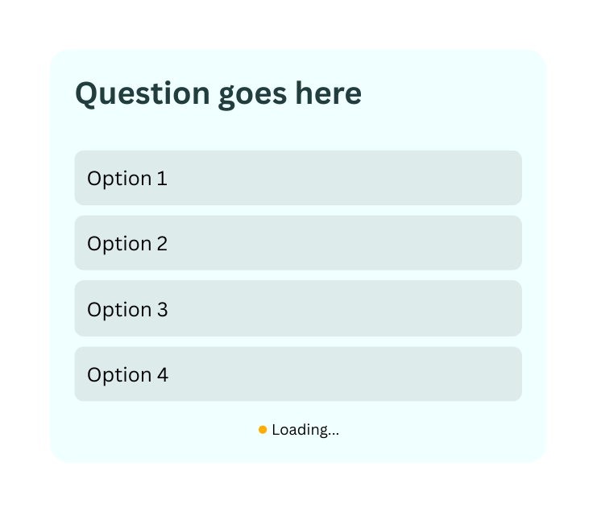
Add a poll or quiz to assess understanding.
Learning check

Slide 10

Management
Provide a high-level summary of how bone tumors are managed.
Emphasize that treatment decisions are based on:
  Diagnosis (benign vs malignant)
  Tumor stage and location
  Histological grade
  Patient-specific factors

Slide 11
Managing benign bone tumors
Some guiding questions:
  How does tumor location affect individual treatment plans?
  What risks or symptoms may lead to intervention?
  Why and when might a benign tumor still require surgery?
Outline the key considerations in treating benign bone tumors.

Slide 12
Managing malignant bone tumors
Some guiding questions:
  What does post-treatment supportive care look like?
  How does treatment balance survival and quality of life?
  Why is early and accurate staging critical?
Discuss the approach to treating aggressive bone tumors.

Slide 13

Review
Bone tumors
Briefly define bone tumors and why early detection matters.
Diagnosis
Outline how bone tumors are identified and confirmed.
Staging
Recap what staging means and why it’s important.
Management
Summarize how bone tumors are typically treated.

Slide 14







































Resource Page
  Use these in your presentation. Delete or hide this page before presenting.
Fonts
Design Elements / Icons
This presentation template
uses the following free fonts:
TITLES:
Bebas Neue
BODY TEXT:
Inter Regular
You can find these fonts online too.
Colors
#FFFFFF
#F0FFFF
#223D3D
#000000

Slide 15

Credits
  This presentation template is free for everyone to use, thanks to the following:
Pexels, Pixabay, & Sketchify
  for this presentation template
  for the photos, graphics, and elements
  Happy designing!

