Slide 1
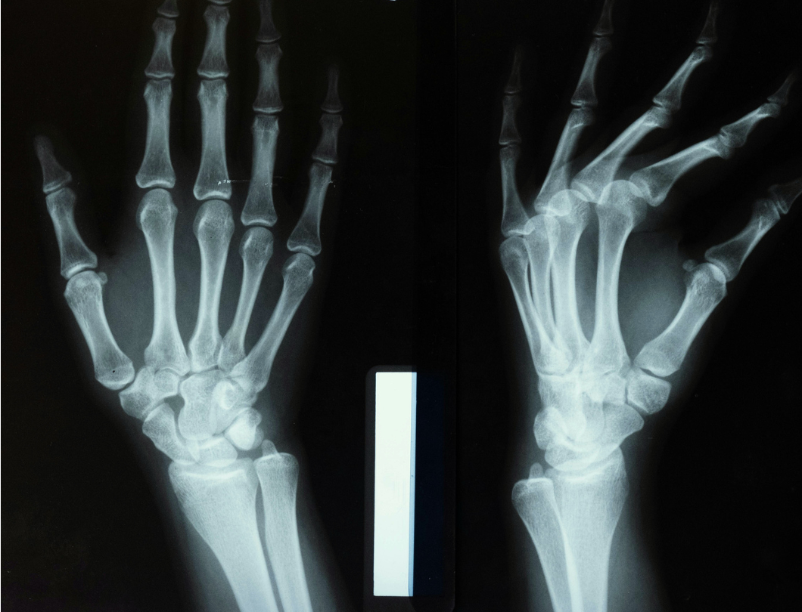
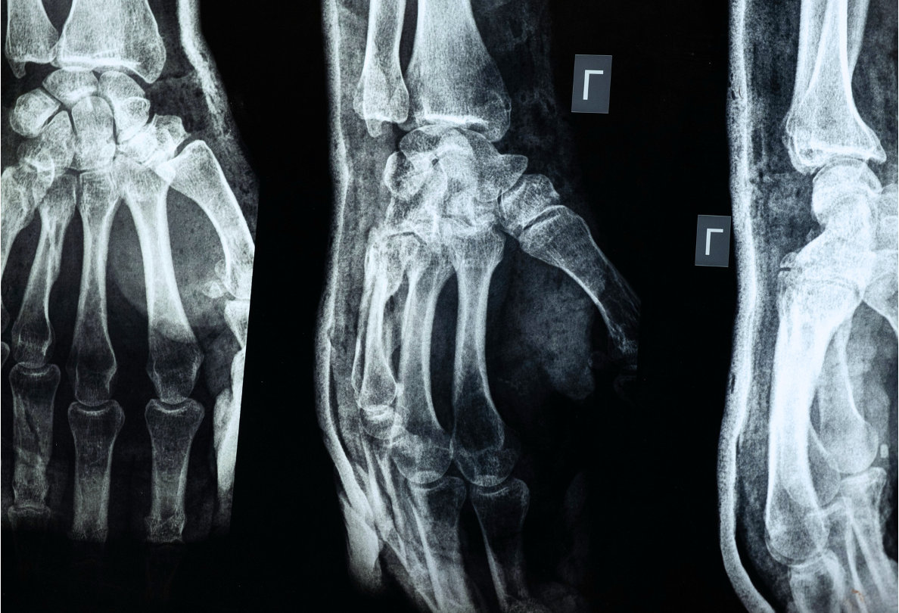
Bones
Background Slides

Slide 2
BONES IN THE BODY
Add supporting details here.
Contents
BONES AT WORK
Add supporting details here.
BONES RANKED BY SIZE
Add supporting details here.

Slide 3
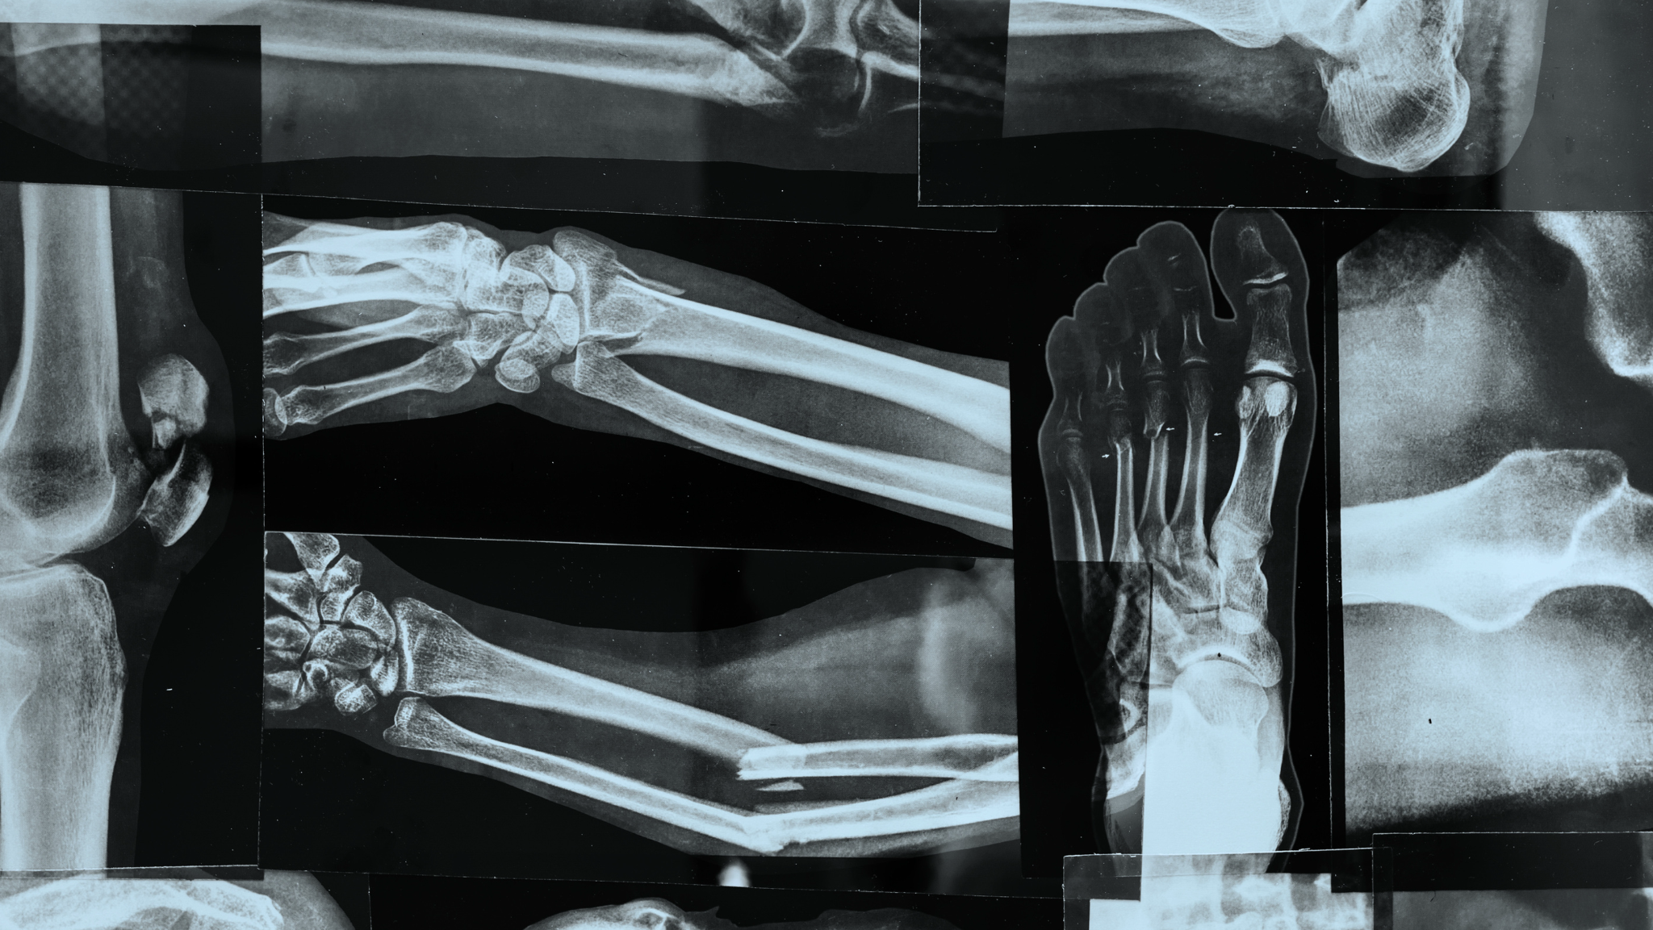
An adult human body has
206
bones

Slide 4
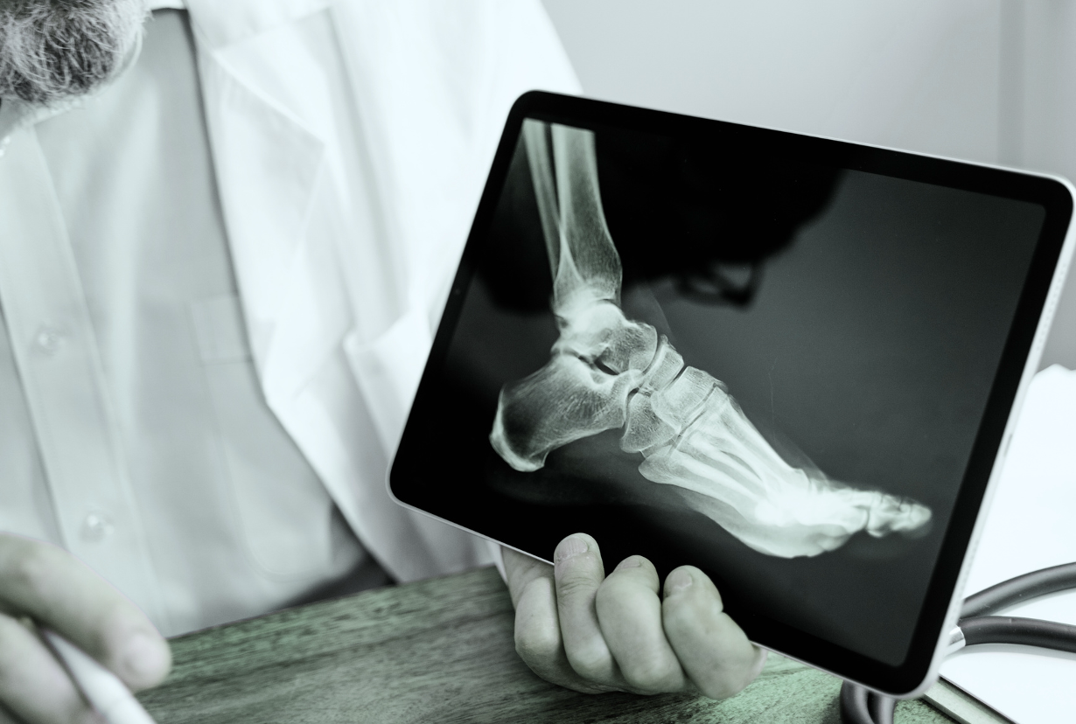
Supports your body | Protects vital organs | Anchors muscles to help you move | Makes blood and stores minerals
Bones at work
Your skeletal system:

Slide 5
Bones ranked by size
A peek at the largest and smallest bones in your body
BIGGEST:
SMALLEST:
Femur - the thigh bone that supports
your weight
Stapes - found in your middle ear and helps you hear sounds

Slide 6
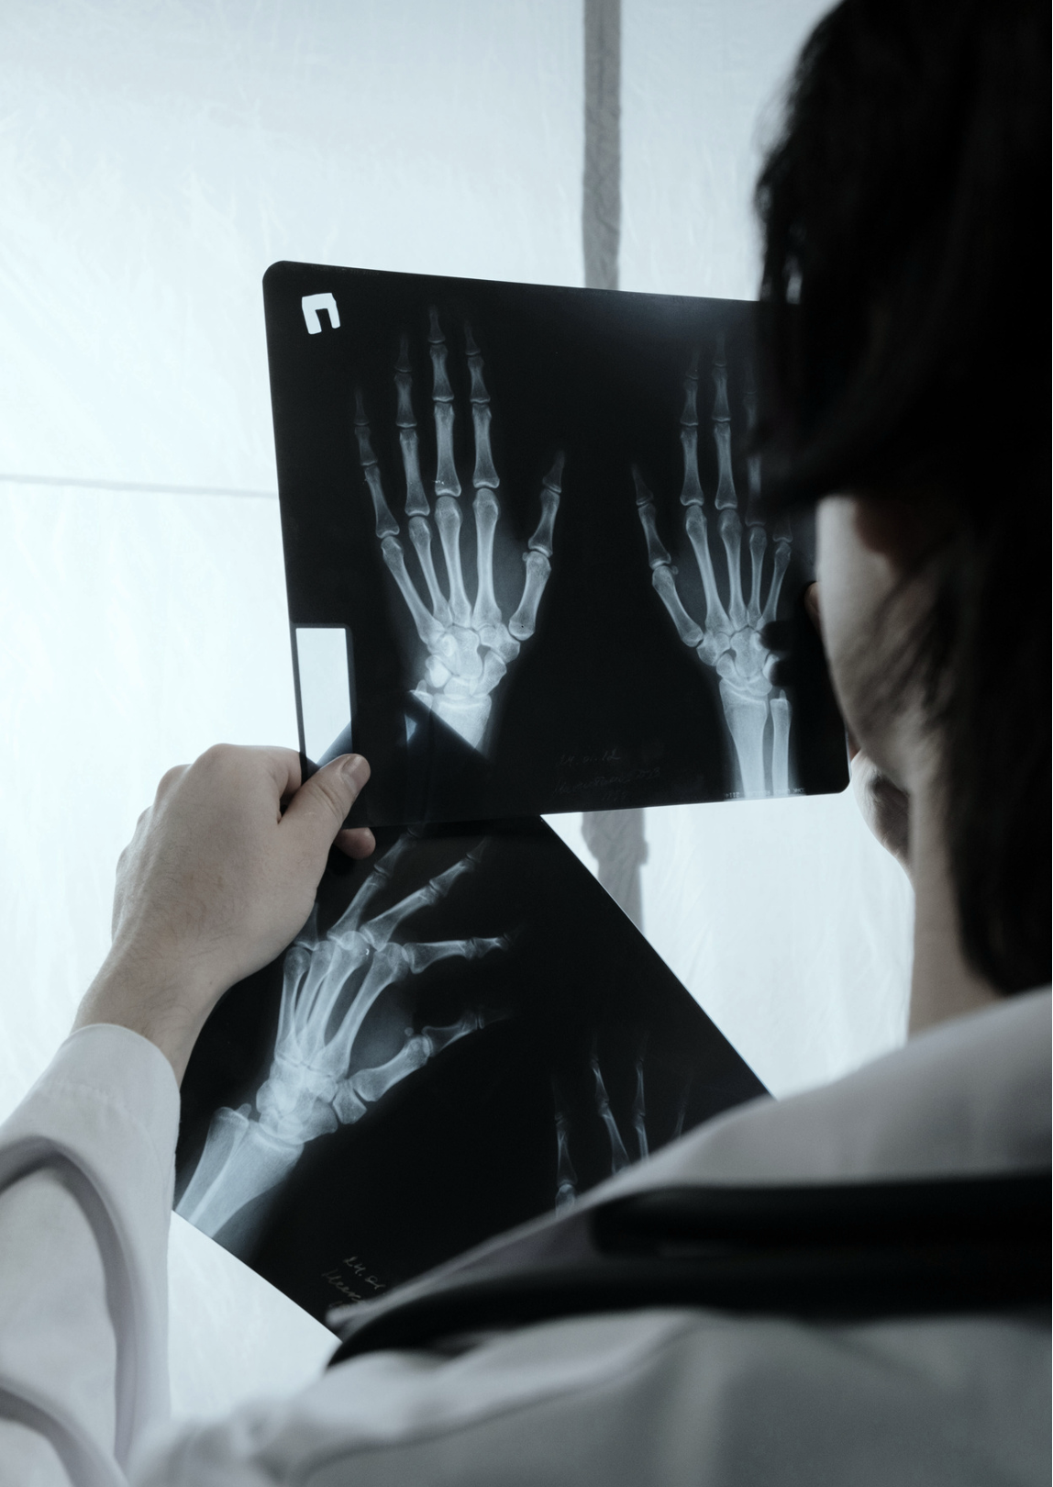
Did you know?
You had around 300 bones as a baby, but many fused as you grew!

Slide 7
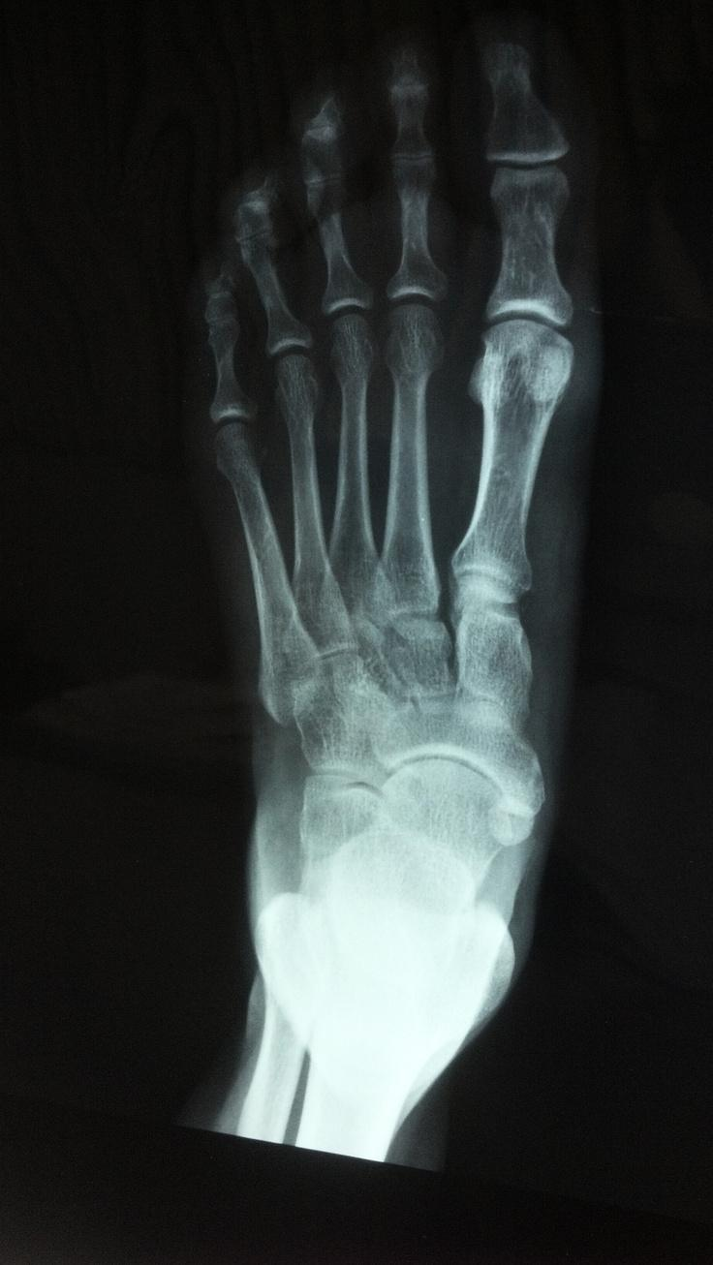
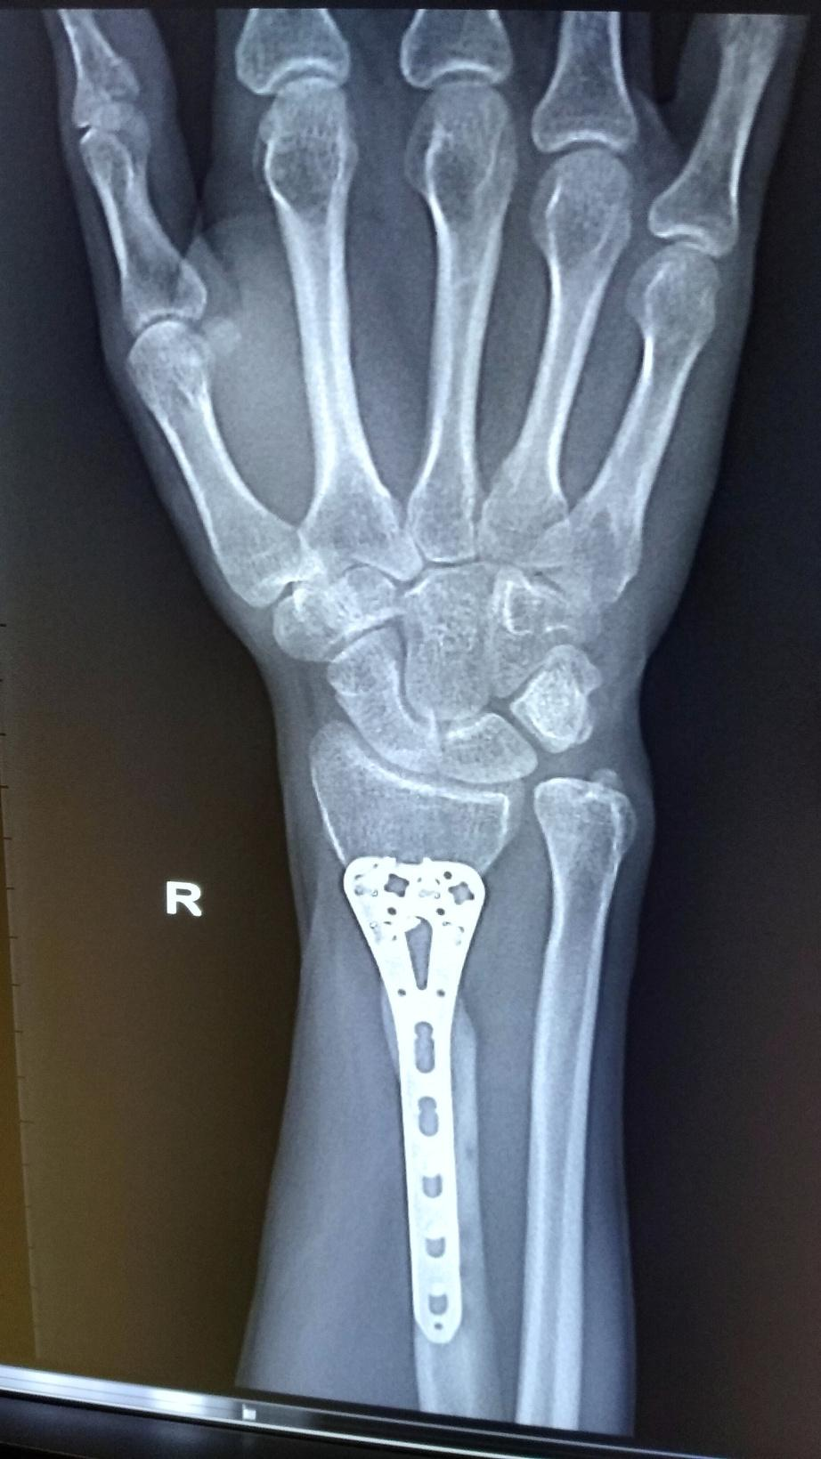
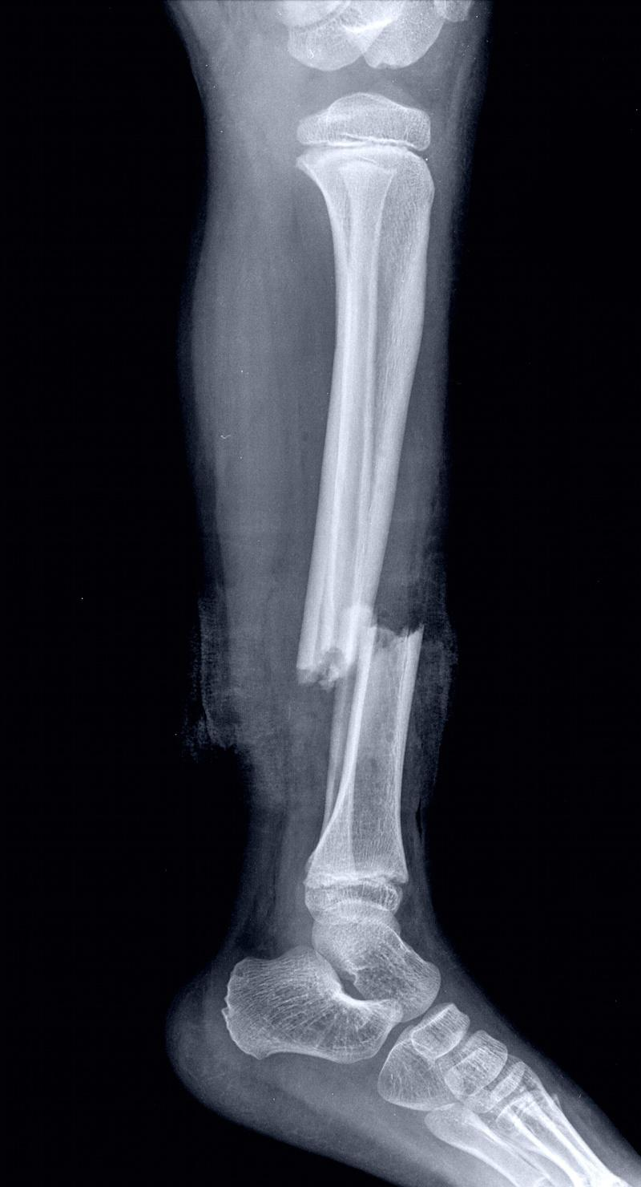
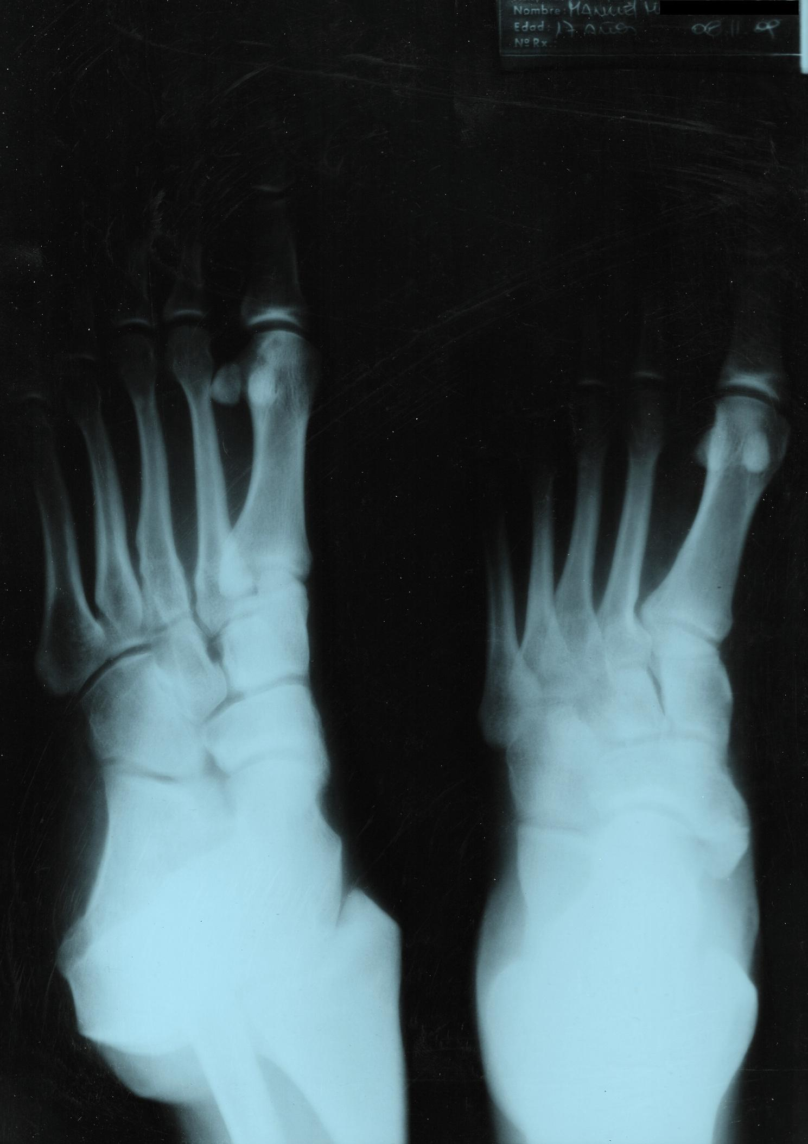
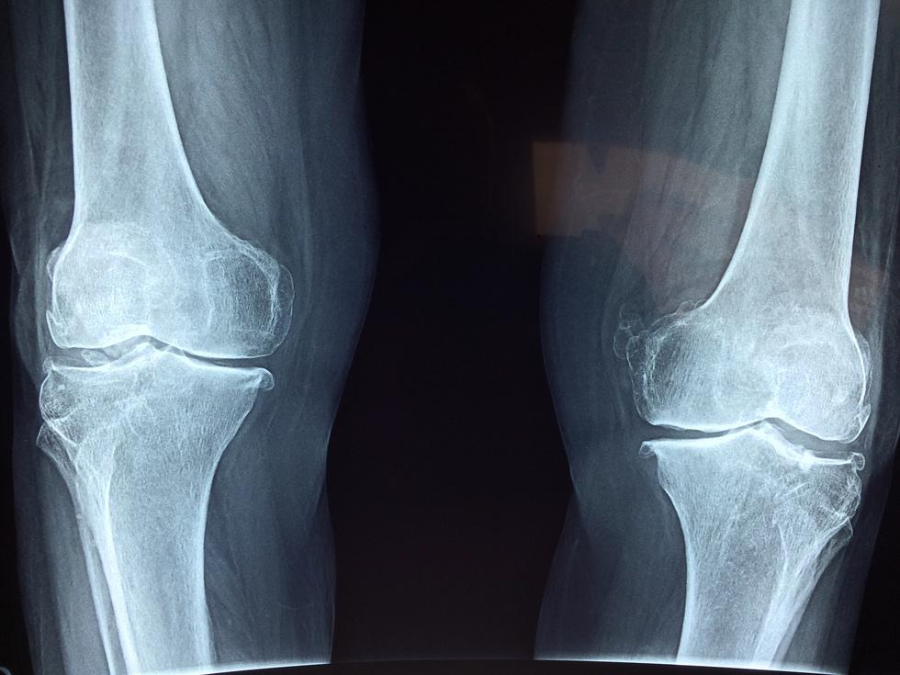
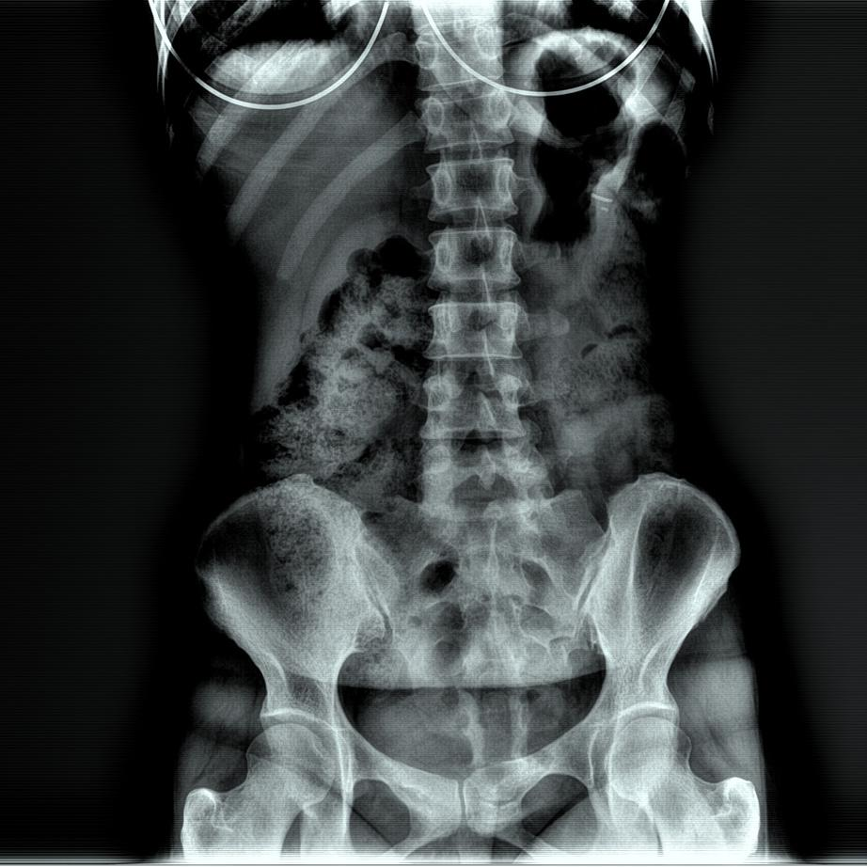
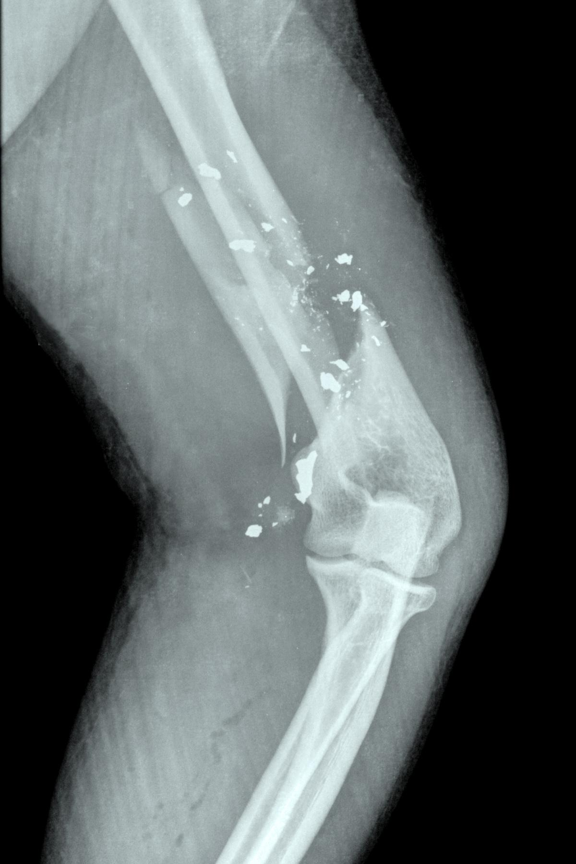
Every bone has a purpose.
Every joint tells a story.
— Unknown

Slide 8
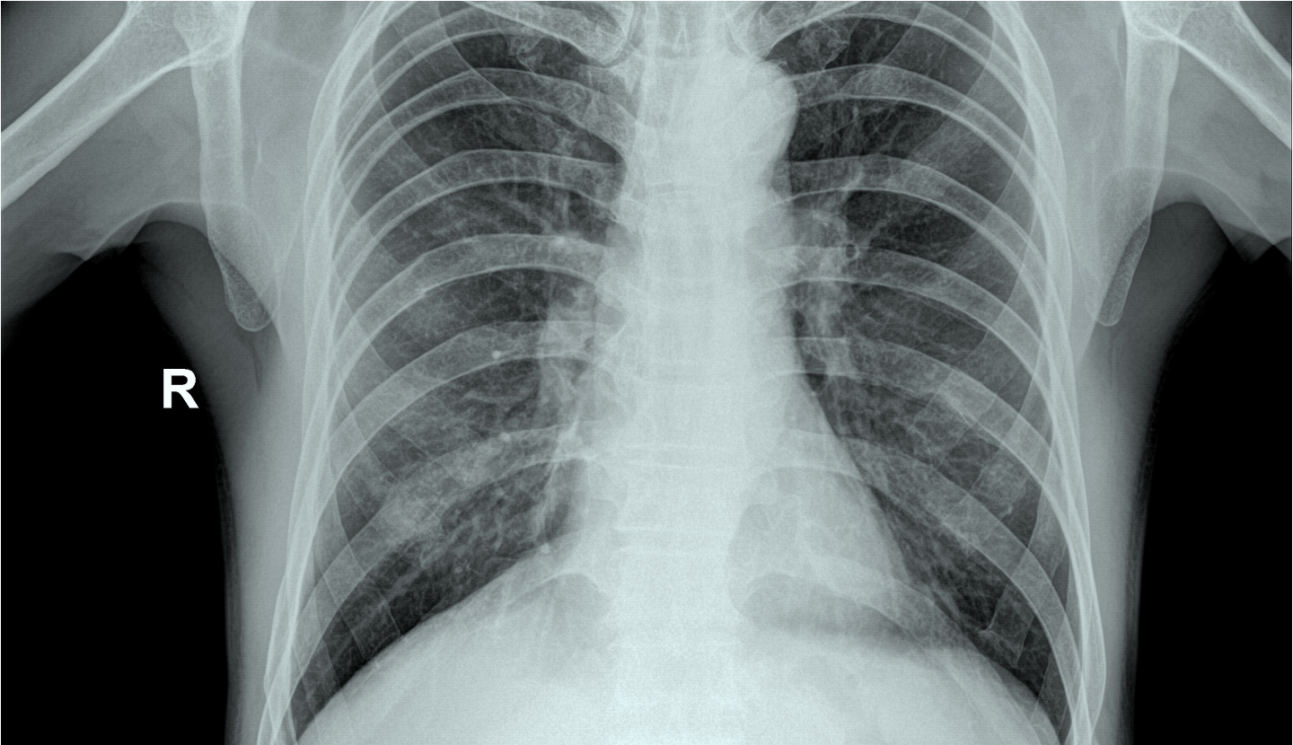
BONES IN THE BODY
Add supporting details here.
A recap
BONES AT WORK
Add supporting details here.
BONES RANKED BY SIZE
Add supporting details here.
FUN FACT ABOUT BONES
Add supporting details here.

Slide 9
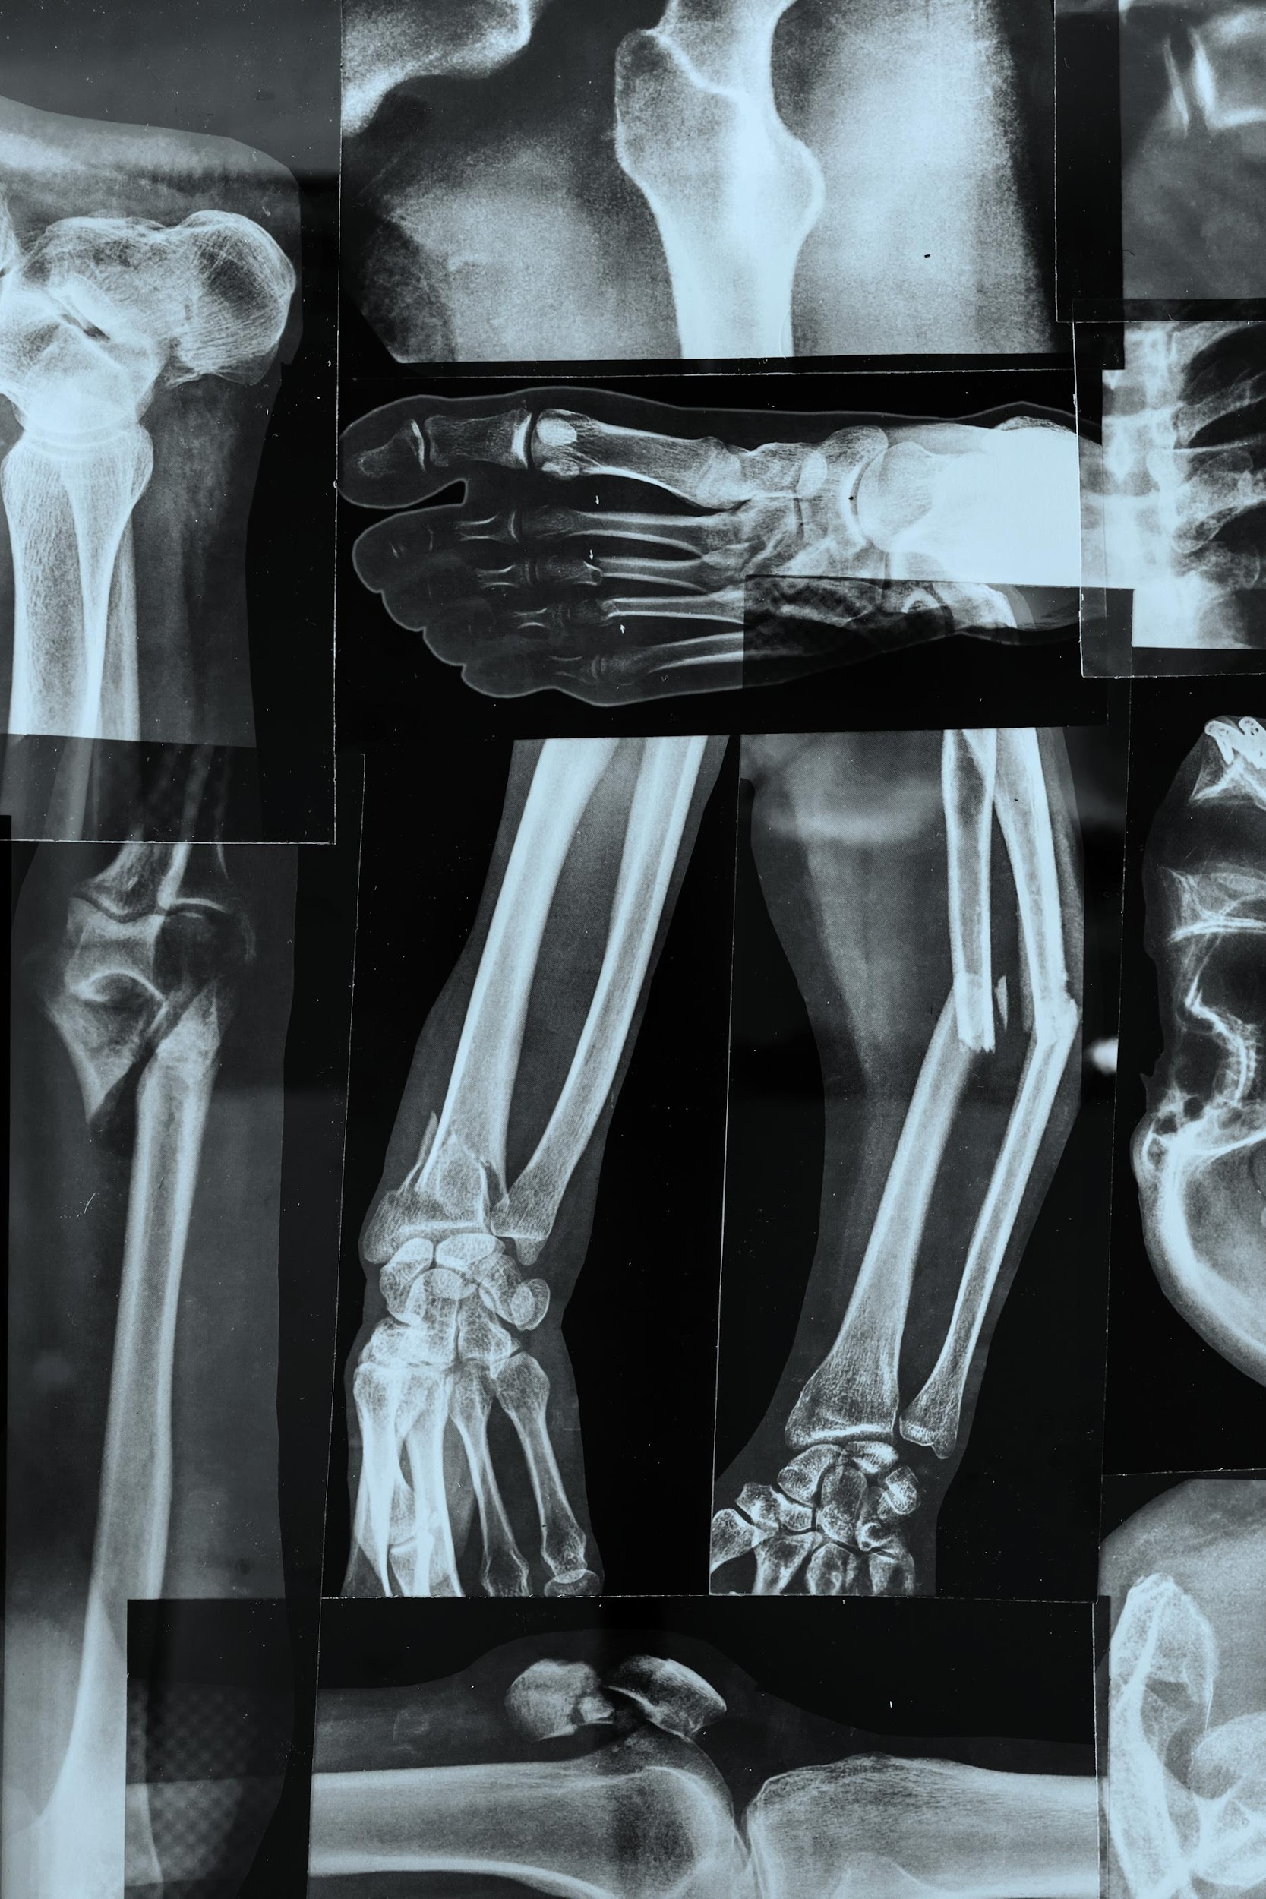
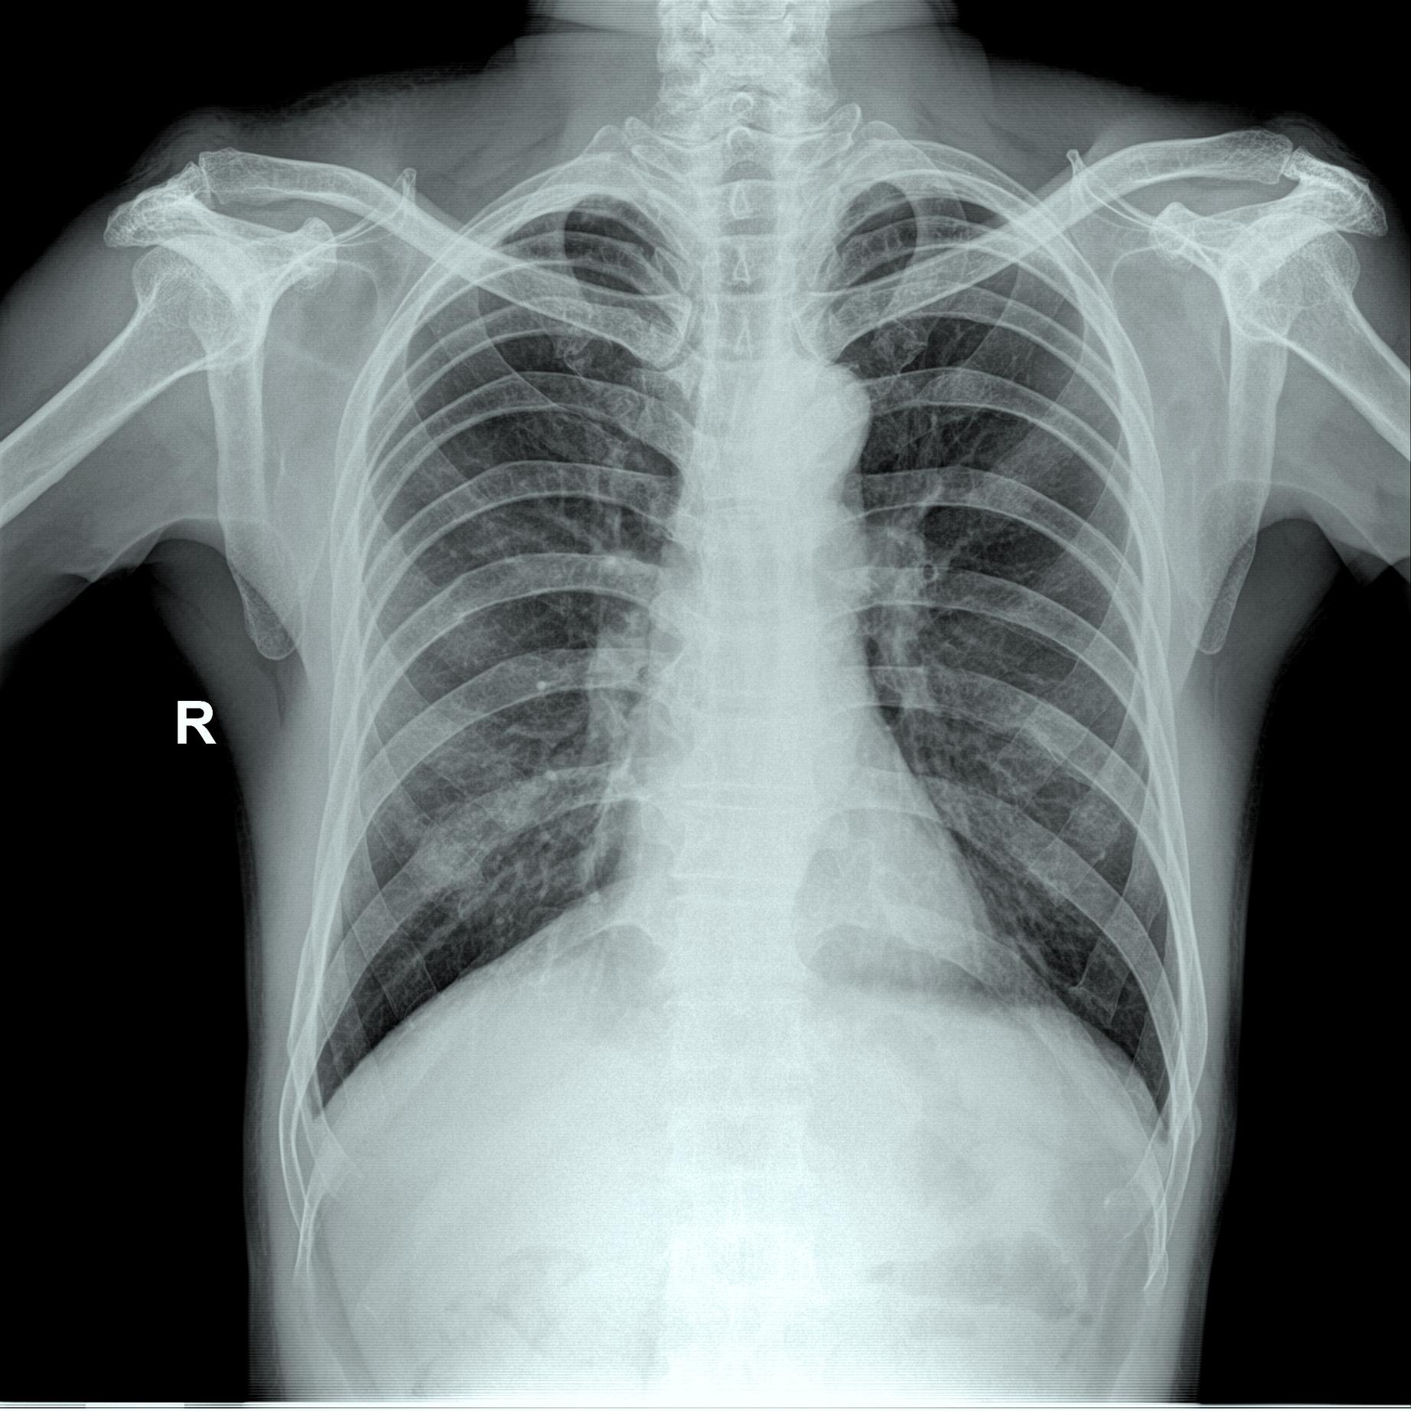
Resource Page
  Use these in your presentation. Delete or hide this page before presenting.
Fonts
Design Elements / Icons
This presentation template
uses the following free fonts:
TITLES:
Atkinson Hyperlegible
BODY TEXT:
Atkinson Hyperlegible
You can find these fonts online too.
Colors
#000000
#FFFFFF

Slide 10

Credits
  This presentation template is free for everyone to use, thanks to the following:
  for this presentation template
Pexels, Pixabay, Sketchify
  for the photos, graphics, and elements
Happy designing!

