Slide 1
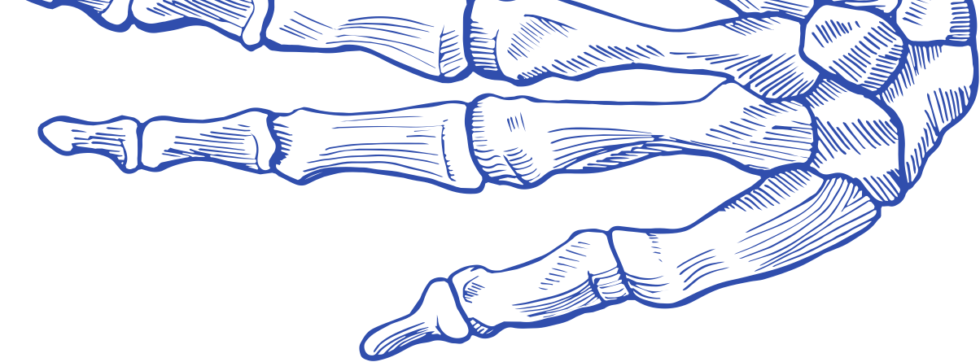
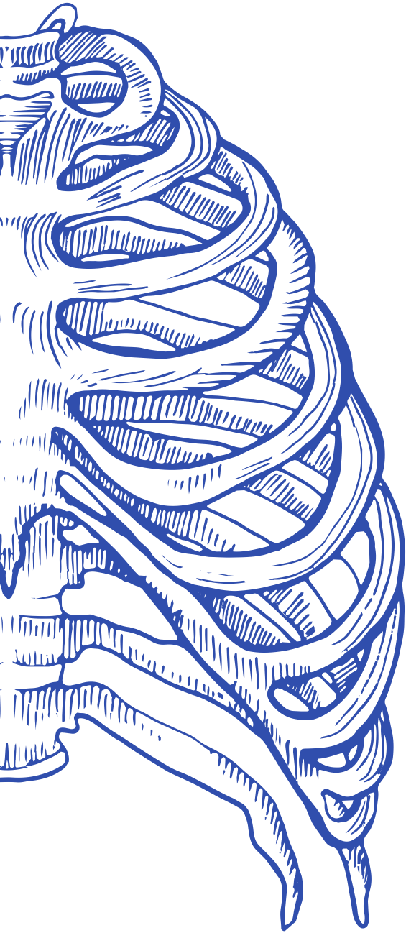

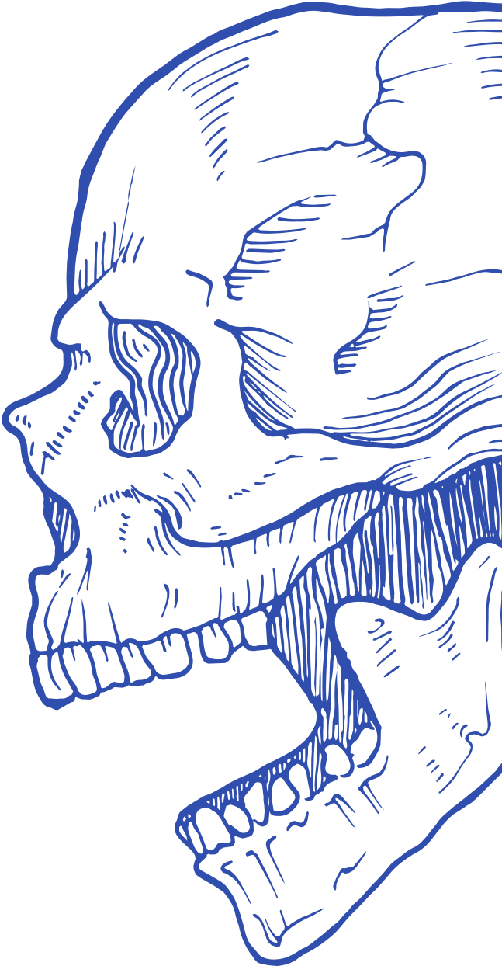
carpals
B
ones
skull
Understanding the human skeletal system and its functions
ribcage
PRESENTER NAME

Slide 2
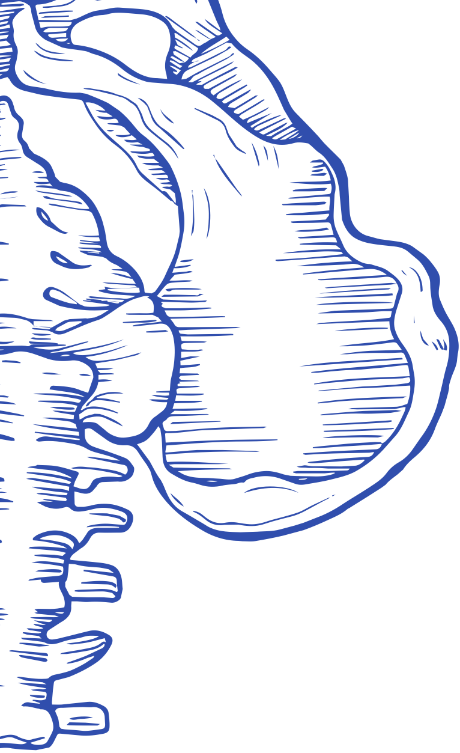

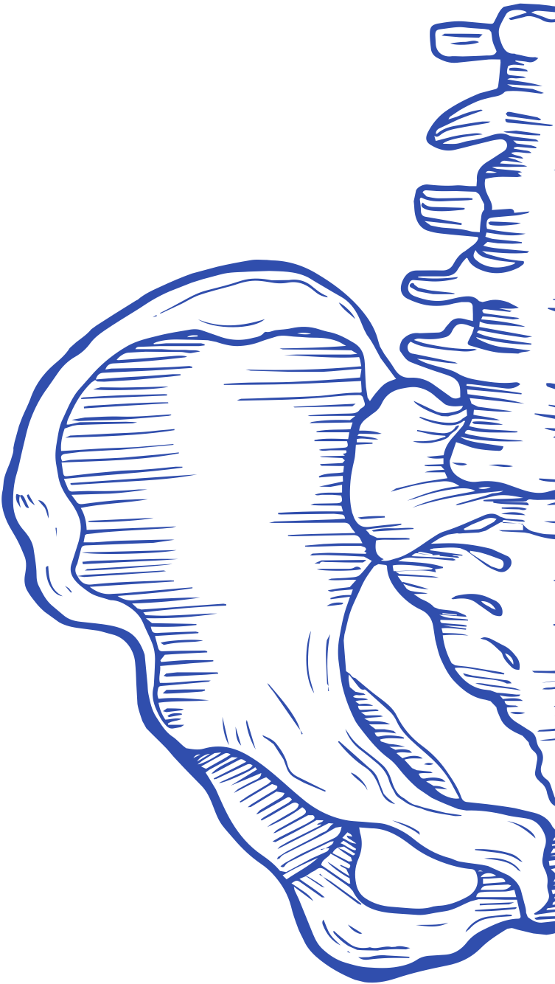
Contents
Why bones matter
The human skeletal system
ilium
Axial vs appendicular skeleton
spine
Types of bones
Cell types in bones
Structure of bone tissue
Ossification

Slide 3
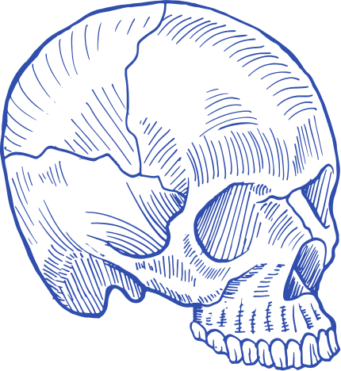
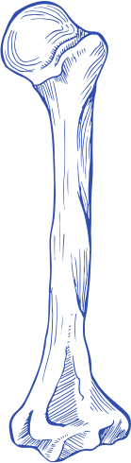
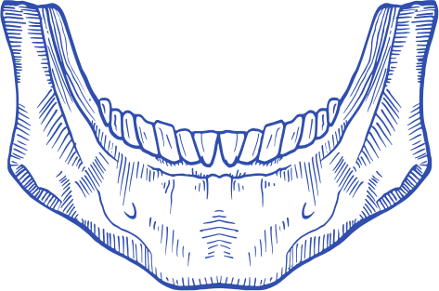
Why bones
matter
Briefly introduce the key functions of the skeletal system that support human survival
Support and protection
Movement
Hematopoiesis
Explain how bones provide structural support and protect internal organs.
Explain how bones work with muscles to enable movement.
Describe the role of bones in red blood cell production.

Slide 4
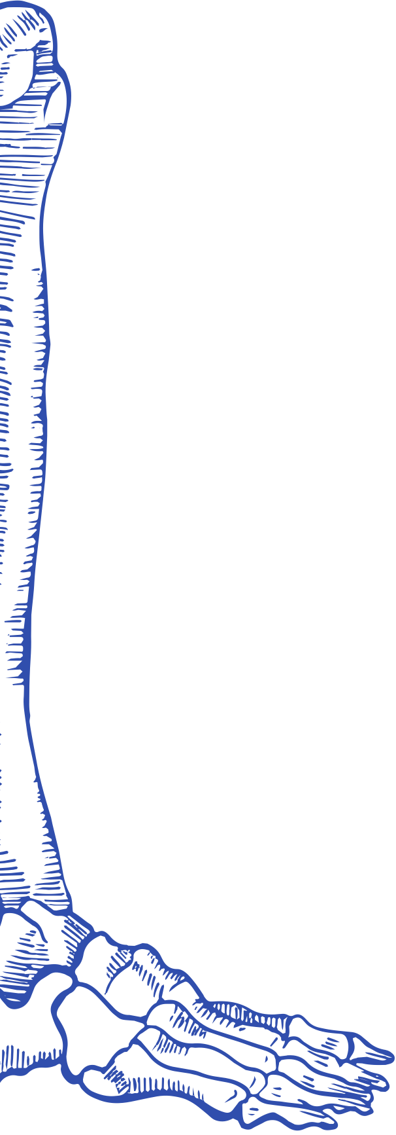
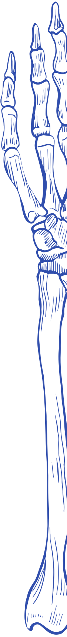
bones
How manybonesdo we have?
A baby is born with
Human adults have
~
3
00
2
06
Explain the difference in bone count between life stages. Mention how bones fuse as we grow.

Slide 5
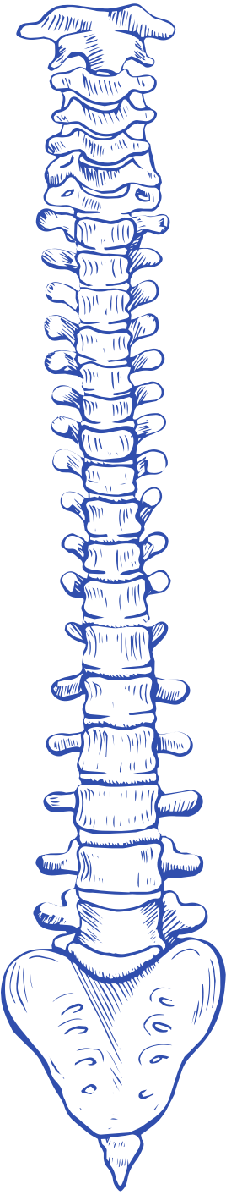
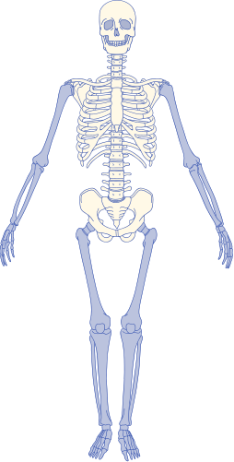
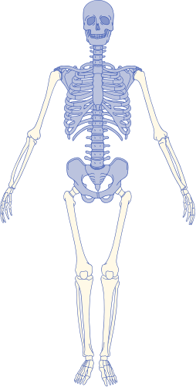
The human skeletal system
Introduce the skeletal system and its two main divisions
Appendicular skeleton
Axial skeleton
Explain its structure and role in protecting vital organs
Explain its structure and role in movement and limb support

Slide 6
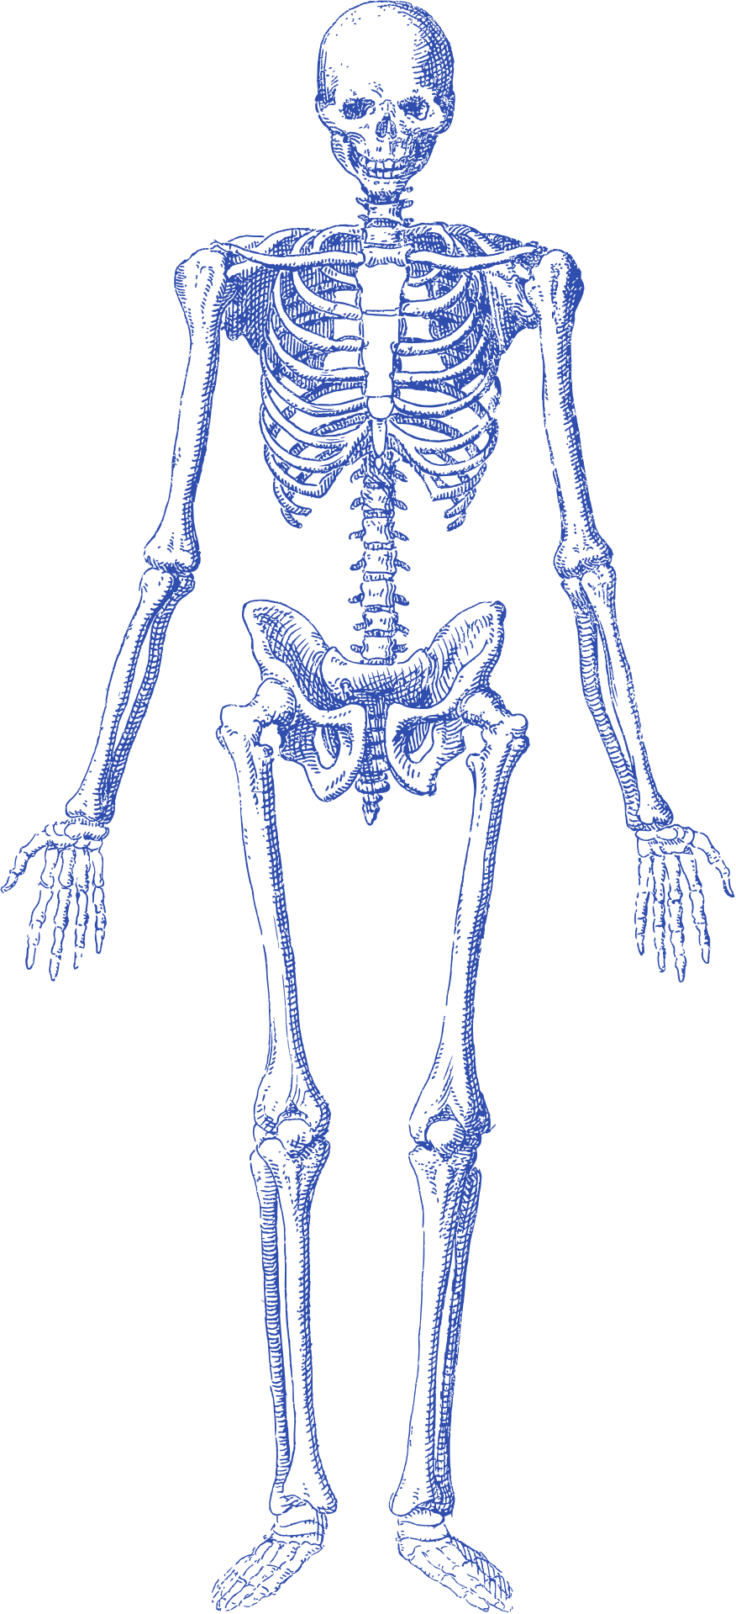

Label
Label
A
xial
Label
Skeleton
Label
Label
List the bones that make up the axial skeleton. Highlight the skull, vertebral column, and rib cage.

Slide 7
Label
A
ppendicular
Label
Skeleton
Label
Label
Label
List the bones that make up the appendicular skeleton. Highlight the limbs, shoulder girdle, and pelvic girdle.
Label
Label
Label

Slide 8

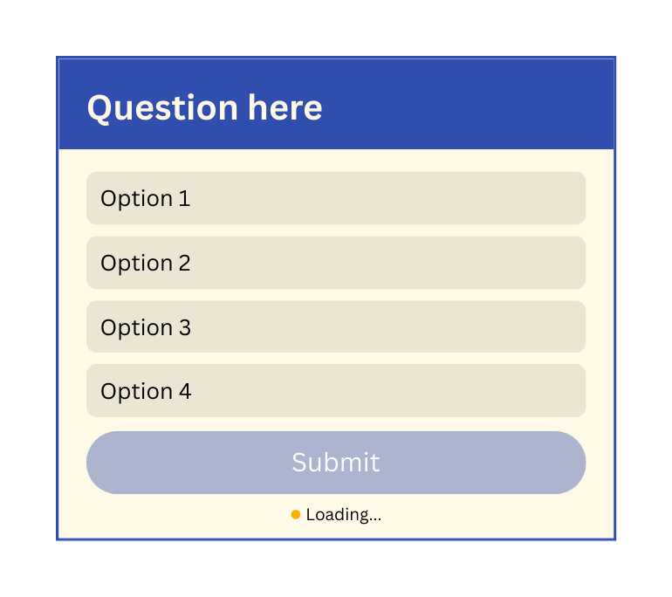

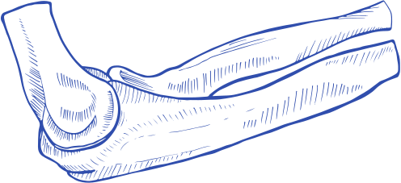
humerus
L
earning
Check
Add a poll or quiz to assess understanding
ulna

Slide 9
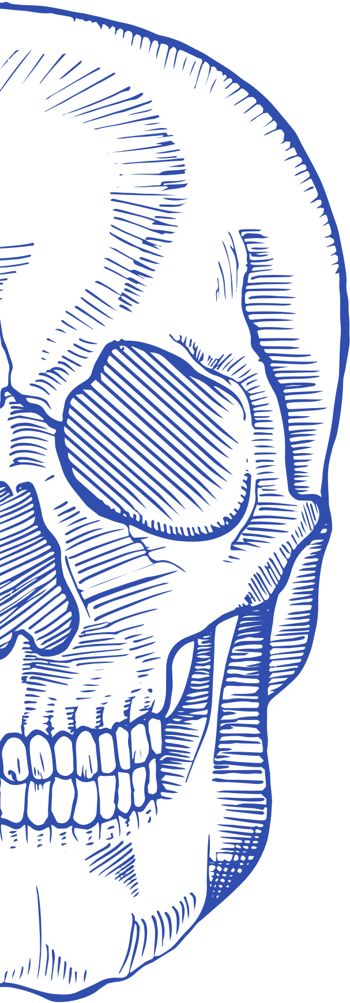
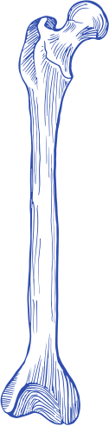
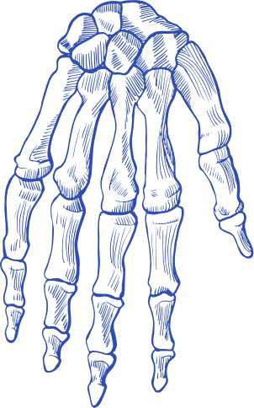
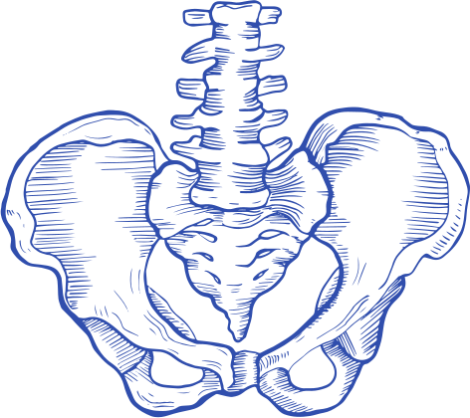

Types
of bones
Long
Short
Describe its primary function and name examples
Describe its primary function and name examples
Flat
Irregular
Describe its primary function and name examples
Describe its primary function and name examples

Slide 10
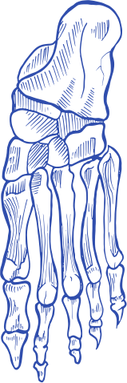
CellTypes
in bones
Use the table to compare
the four main bone cell types
Cell type | Functions | Location
Osteogenic | Describe its role | Where it's found in the body
Osteoblasts | Describe its role | Where it's found in the body
Osteocytes | Describe its role | Where it's found in the body
Osteoclasts | Describe its role | Where it's found in the body

Slide 11

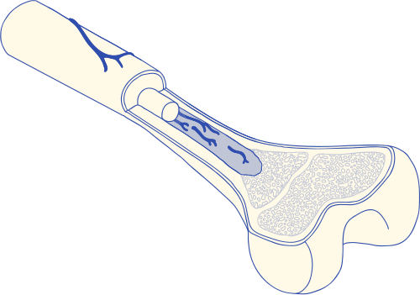

Structure of
bone
tissue
Compact bone
Describe its characteristics and role
Label
Label
Spongy bone
Describe its characteristics and role

Slide 12

calvaria
Ossification
Introduce ossification as the process of bone formation. Explain its role in growth and development.
Intramembranous
Endochondral
Explain how flat bones form directly from connective tissue
Explain how most bones form by replacing a cartilage model over time
mandible

Slide 13
Review
Function of bones
Axial vs appendicular skeleton
Summarize the major roles bones play in the body
Compare their roles and structures.
Types of bones
Ossification
Review the four main types and their functions.
Recap the bone formation process.

Slide 14

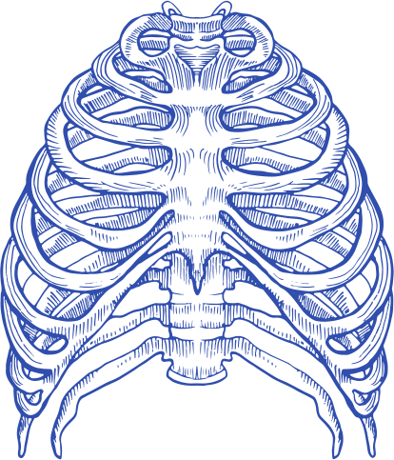
Resource Page
  Use these in your presentation. Delete or hide this page before presenting.
Fonts
Design Elements / Icons
This presentation template
uses the following free fonts:
TITLES:
Fraunces
BODY TEXT:
DM Sans
You can find these fonts online too.
Colors
#304EAD
#FFF9E7

Slide 15

Credits
  This presentation template is free for everyone to use, thanks to the following:
  for this presentation template
Pexels, Pixabay, Sketchify
  for the photos, graphics, and elements
  Happy designing!

