Slide 1
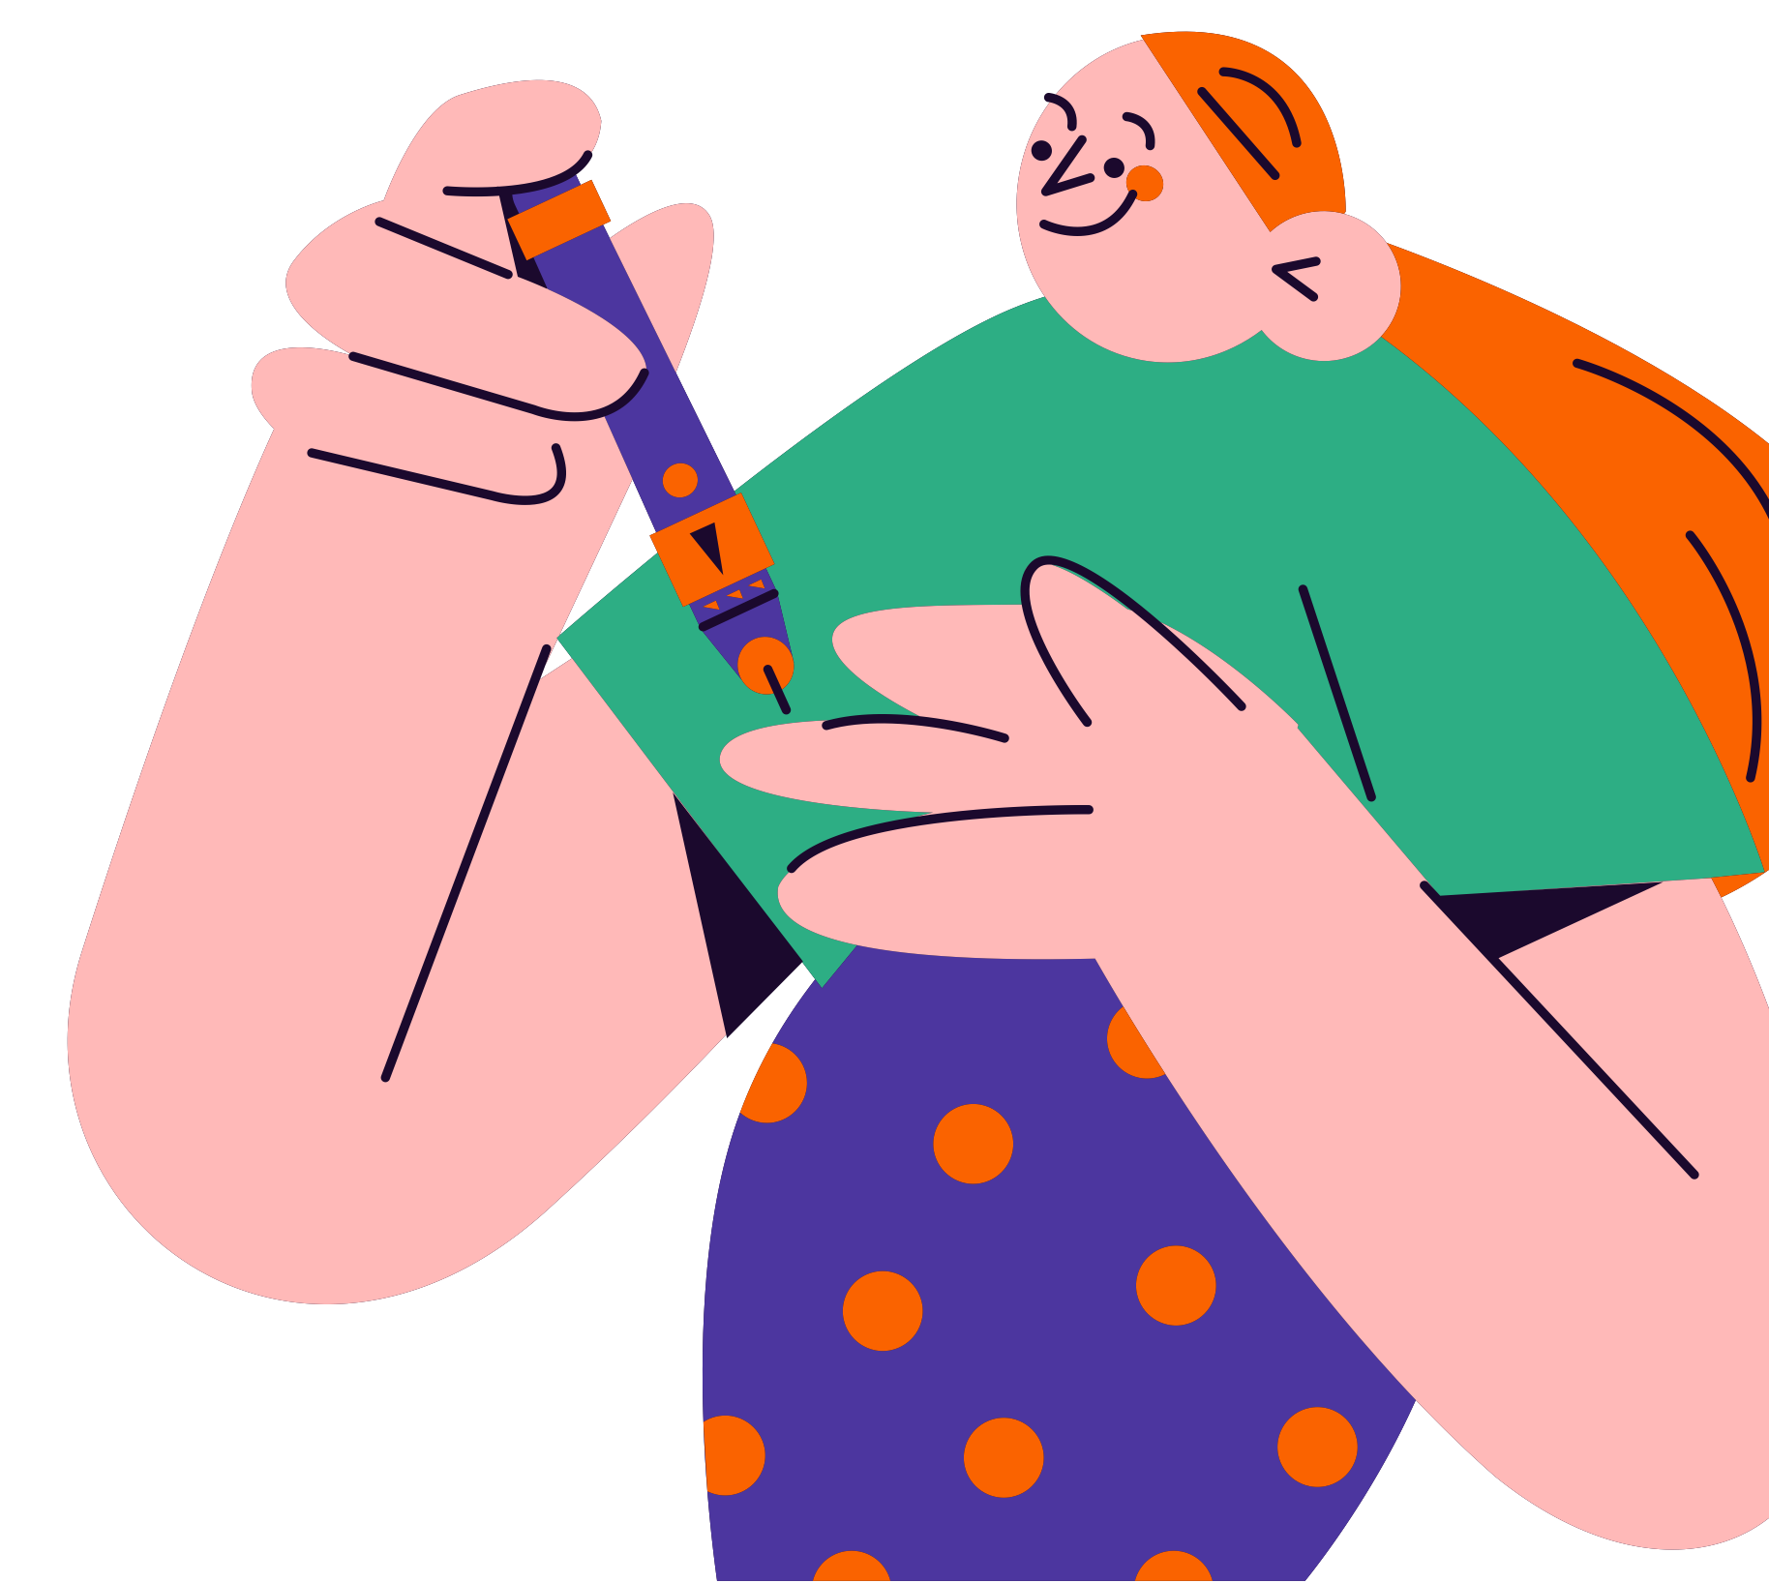
Diabetes Mellitus
The silent epidemic

Slide 2
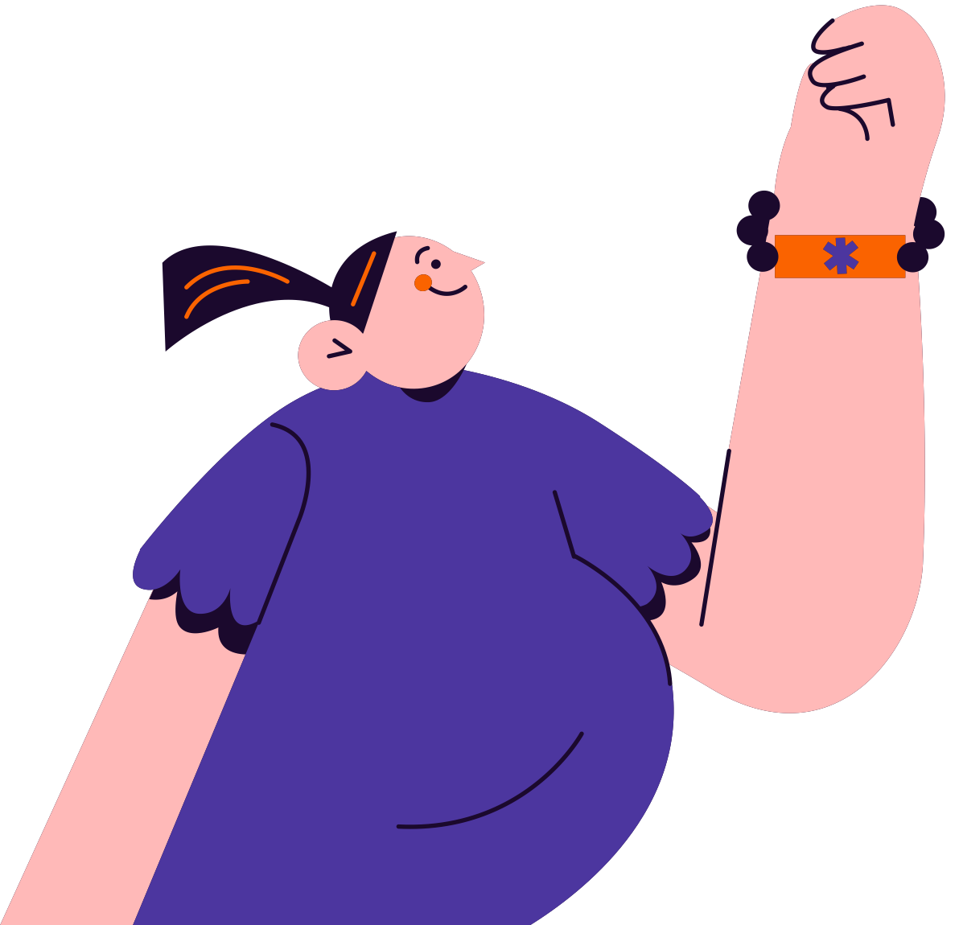
Agenda
What is diabetes?
03
Types of diabetes
05
Signs and symptoms
06
Diagnosis
07
Lifestyle and prevention
08

Slide 3
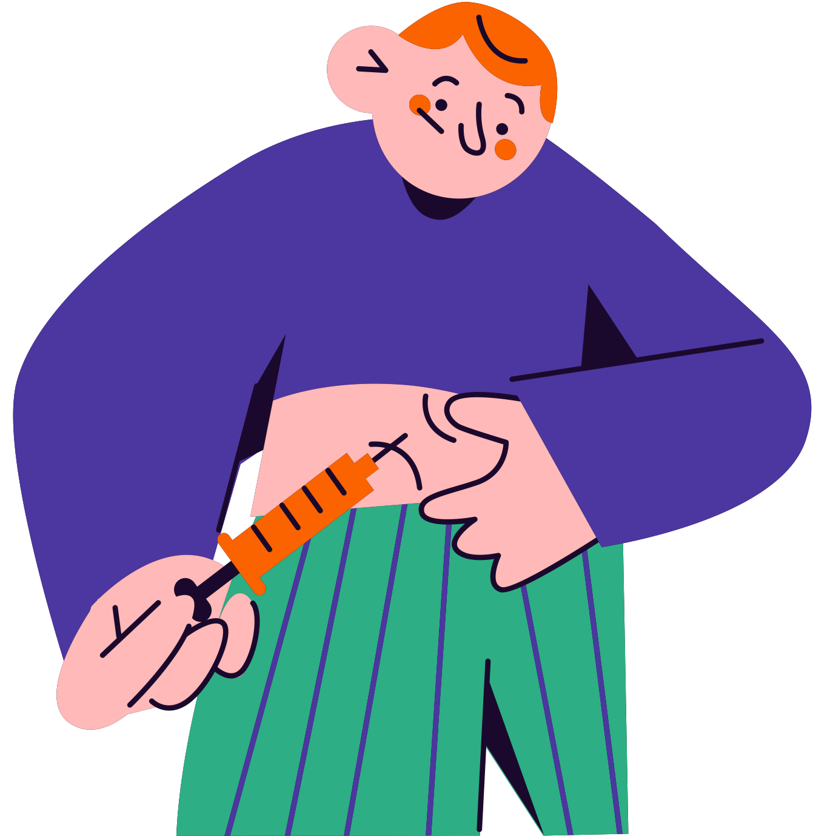
What is diabetes?
Diabetes is a medical condition marked by chronic high blood sugar levels caused by low insulin production.
While diabetes can be a lifelong health issue, it can be managed with proper medication and appropriate lifestyle changes.

Slide 4
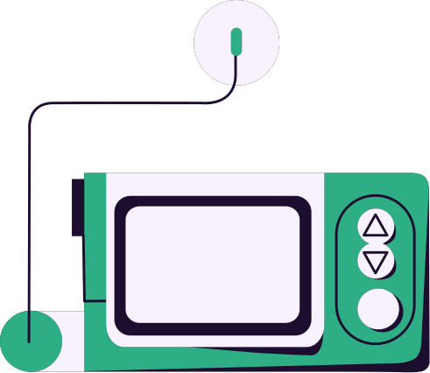
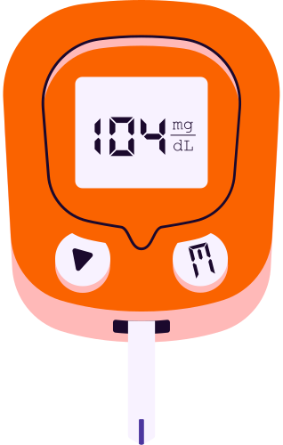


11.6%
87%
38.4 million people
Statistic here
living with diabetes
in the US in 2021
Briefly explain the statistic
of fact being highlighted

Slide 5
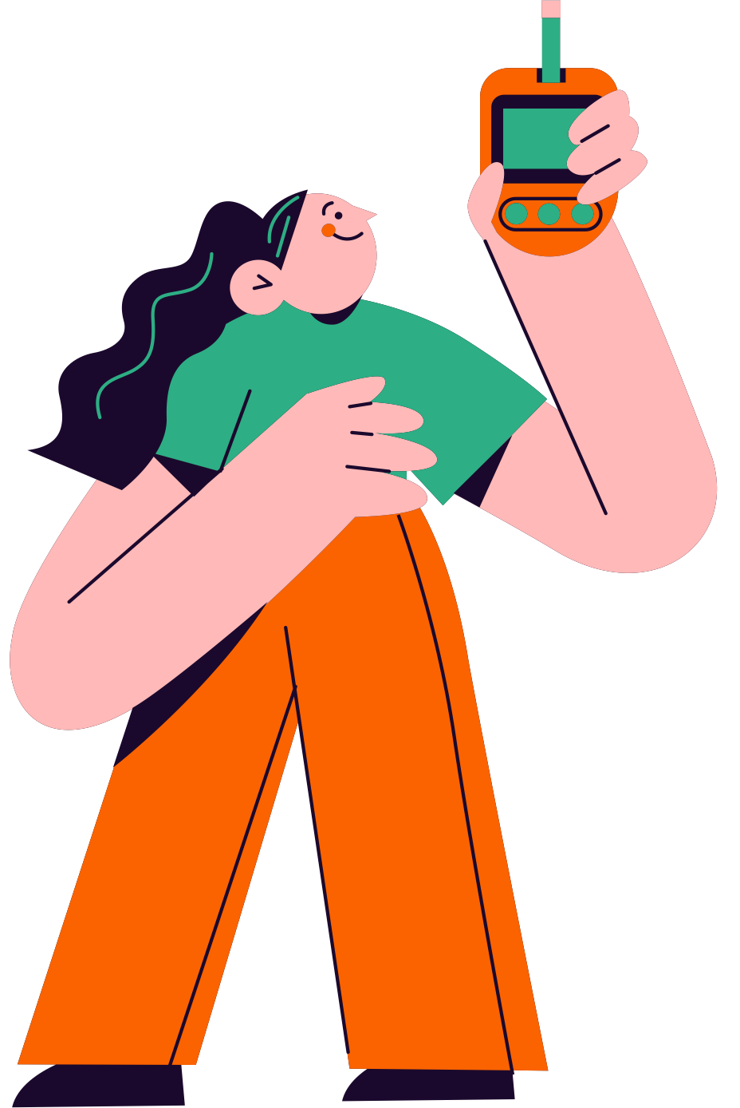
Types of diabetes
Prediabetes
Add type here
Blood glucose levels are elevated, but not yet high enough to be considered Type 2 diabetes.
Provide a brief description here.
Add type here
Add type here
Provide a brief description here.
Provide a brief description here.

Slide 6
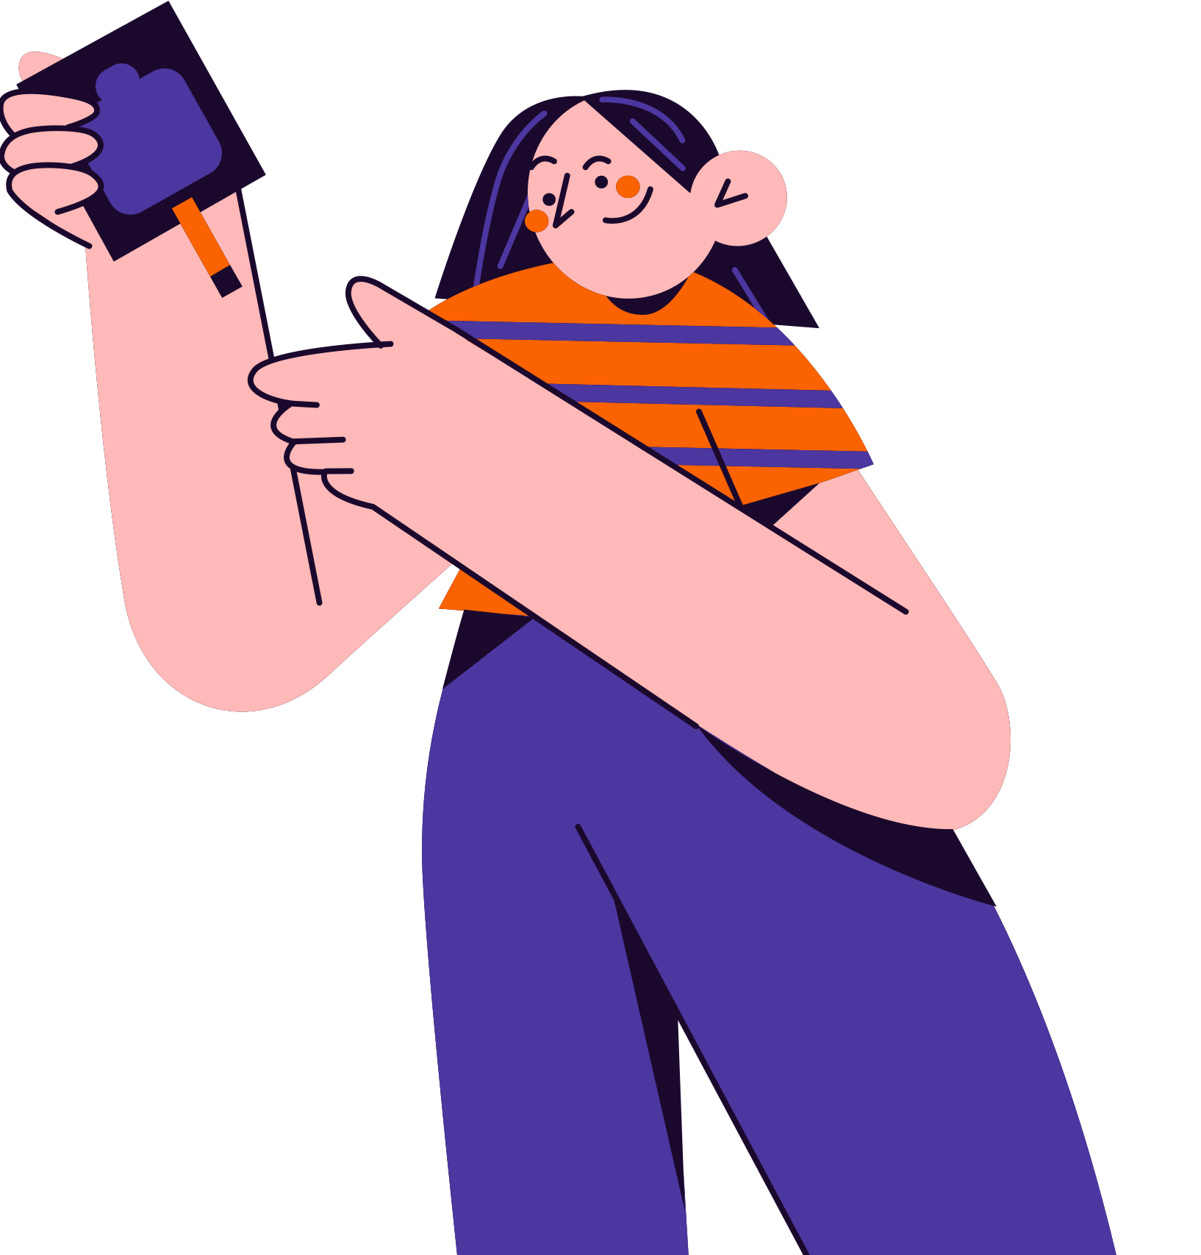
Signs and symptoms
Feeling very thirsty
Symptom here
Symptom here
Individuals with diabetes may experience thirst more often, especially at night.
Add a brief explanation or description of the symptom.
Add a brief explanation or description of the symptom.

Slide 7
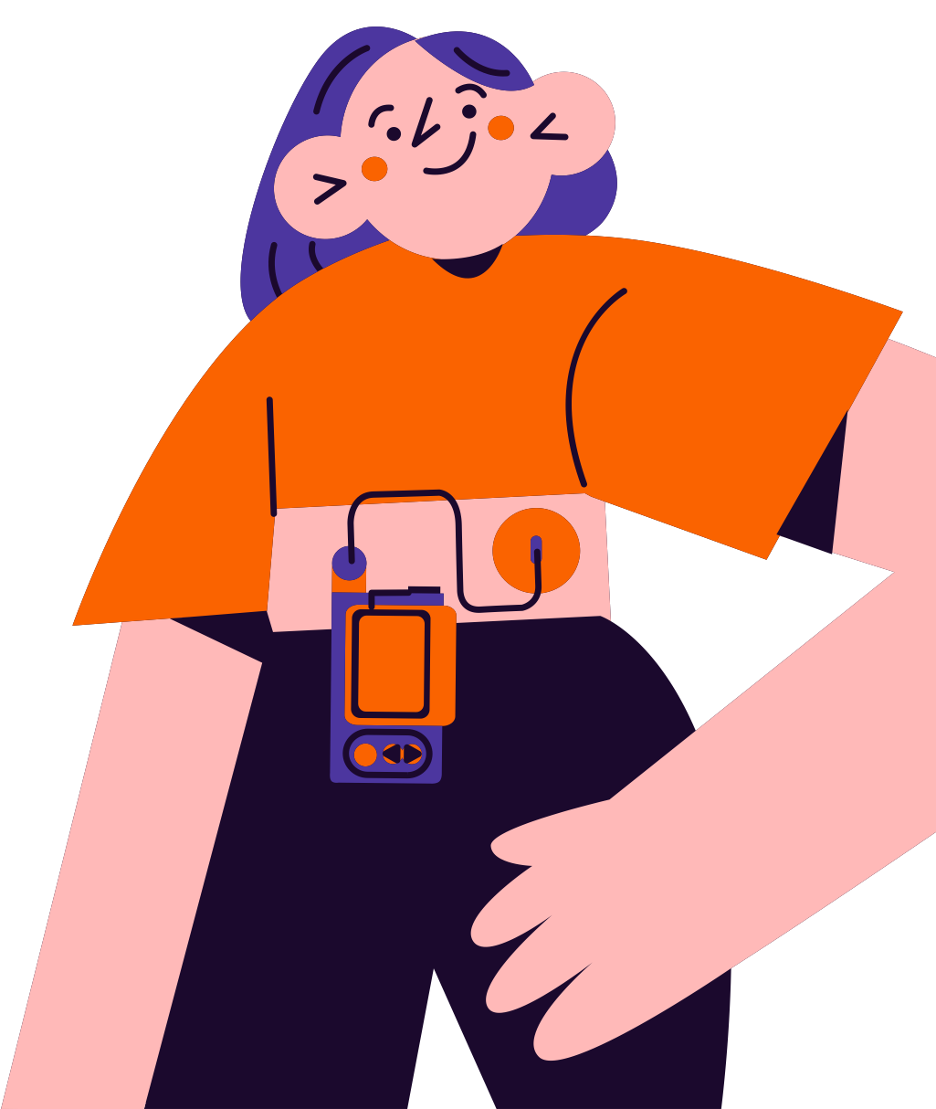
Diagnosis
Proper diagnosis is one of the first steps to dealing with any chronic illness, including diabetes.
Bloodwork
Simple lab tests, like a fasting blood draw, can be used to make or rule out a diagnosis.
Discussion point here
Add a brief description here.
Discussion point here
Add a brief description here.
Discussion point here
Add a brief description here.

Slide 8
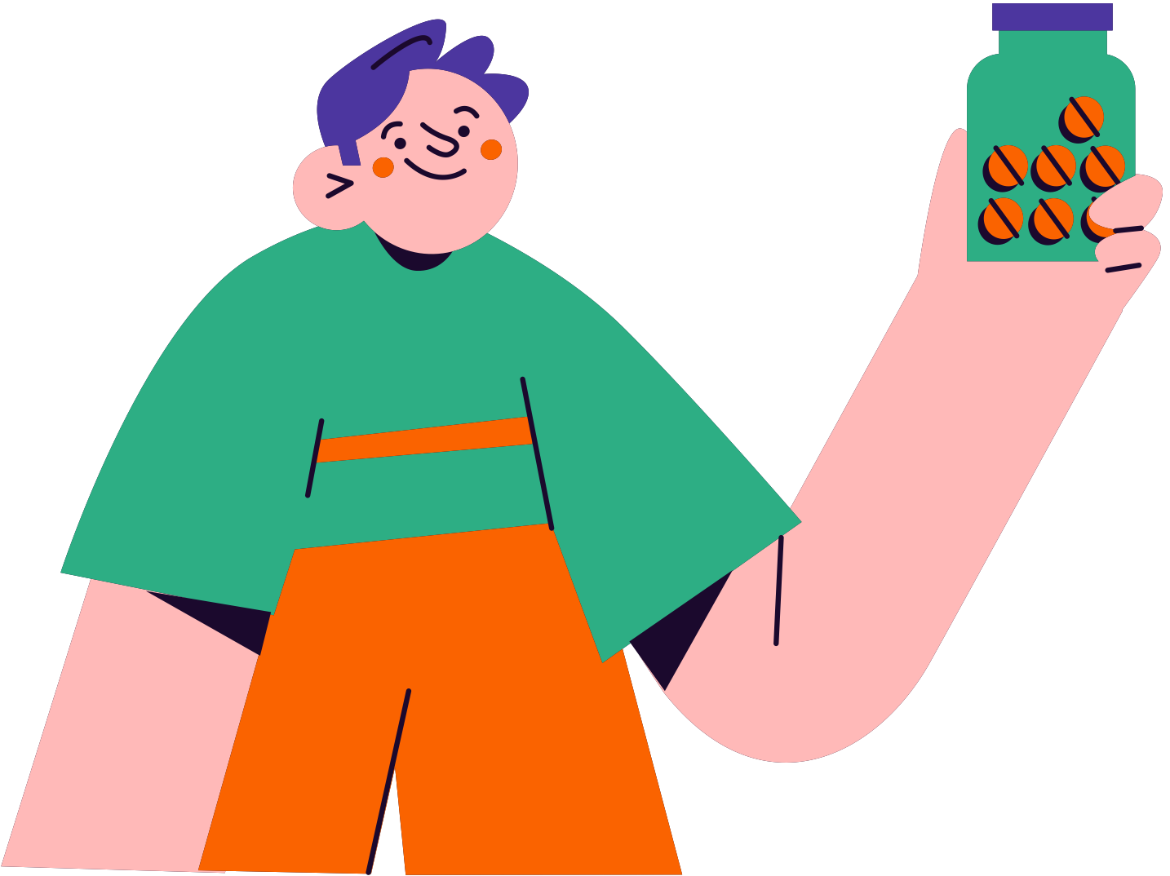
Lifestyle and prevention
Adjust
your diet
Swap simple carbohydrates for complex alternatives and reduce sugar intake.
Lifestyle change here
Add a brief explanation or description here.
Lifestyle change here
Add a brief explanation or description here.

Slide 9
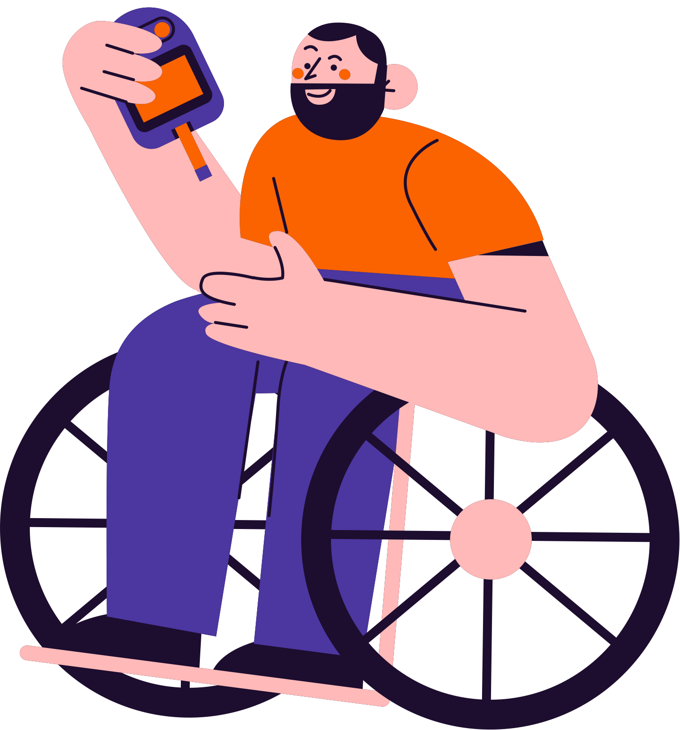
Quick Quiz
Assess the knowledge you’ve gained from the presentation so far.

Slide 10
Question 1:
A
Liver
What organ is responsible for producing the hormone insulin?
B
Lungs
C
Pancreas
D
Kidney

Slide 11
Question 1:
A
Liver
What organ is responsible for producing the hormone insulin?
B
Lungs
C
Pancreas
D
Kidney

Slide 12
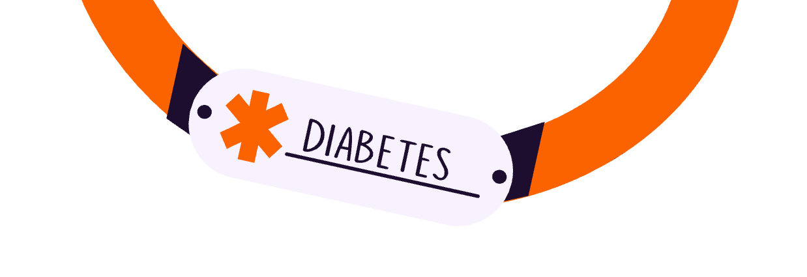
Recap
Diabetes
Key point here
is a medical condition marked by chronic high blood sugar
A paragraph. Elaborate on what you want to discuss.
Key point here
Key point here
A paragraph. Elaborate on what you want to discuss.
A paragraph. Elaborate on what you want to discuss.

Slide 13

Get in touch
Email
Phone
hello@reallygreatsite.com
123-456-7890
Social media
Address
@reallygreatsite
123 Anywhere St., Any City,ST 12345

Slide 14

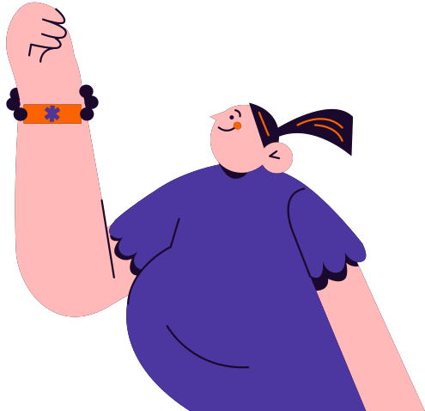
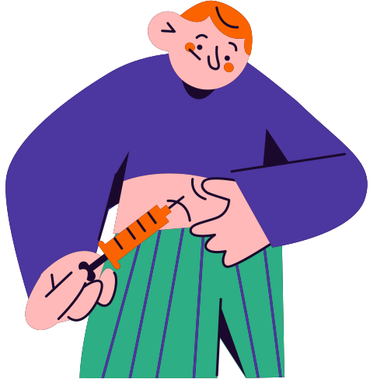

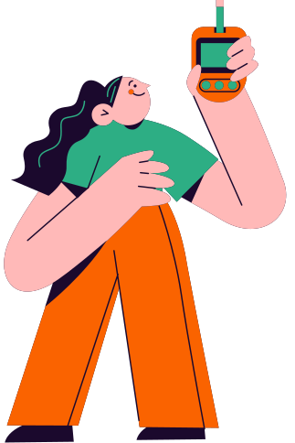
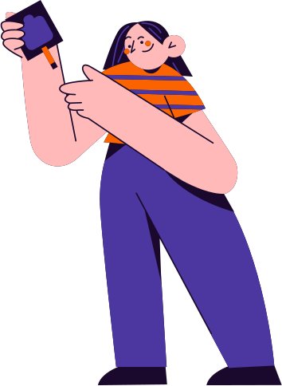

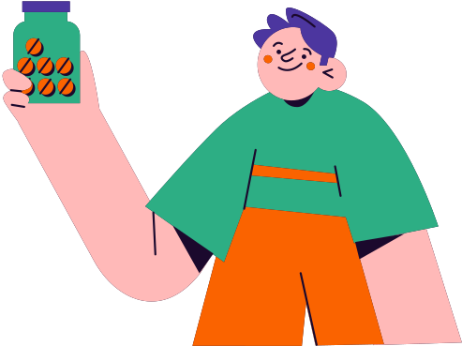
Resource Page
  Use these in your presentation. Delete or hide this page before presenting.
Fonts
Design Elements / Icons
This presentation template
uses the following free fonts:
TITLES:
Marcellus
BODY TEXT:
Roboto
You can find these fonts online too.
Colors
#1D0D2F
#4C369F
#2DAE84
#FA6300
#C5B8F6
#FFB9B8
#F8F2FF

Slide 15

Credits
  This presentation template is free for everyone to use, thanks to the following:
  for this presentation template
Pexels, Pixabay, Sketchify
  for the photos, graphics, and elements
Happy designing!

