Slide 1


Heart Attack vs. Heart Failure
A closer look at how they differ and why it matters

Slide 2
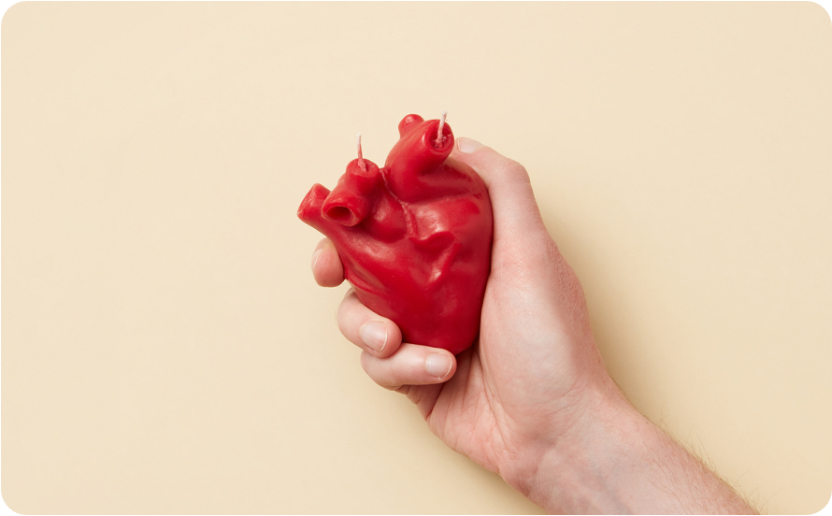
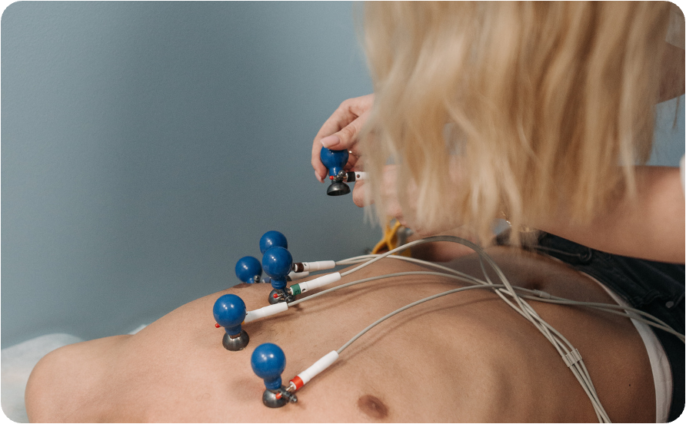

What’s inside
01
02
03
How the normal heart works
What is a heart attack
What is heart failure

Slide 3
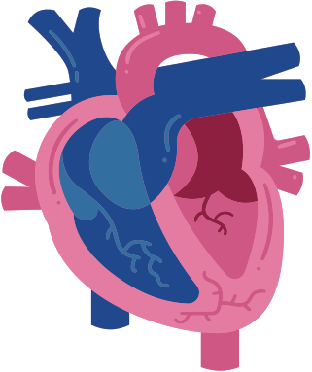
How the normal heart works
Label here
Label here
Walk learners through how the heart pumps blood to and from the body.
Emphasize that a healthy heart has more than enough pumping ability to circulate blood effectively.
Label here
Label here

Slide 4

What is a heart attack?
Explain that a heart attack happens when blood flow to part of the heart is reduced or blocked, usually by plaque buildup in the arteries.
Also include other terms used for this condition, such as myocardial infarction or acute coronary syndrome.

Slide 5
What happens during a heart attack
Show the progression of artery blockage and damage to the heart muscle.
Plaque buildup
Plaque rapture and clot formation
Oxygen supply cut off
Heart muscle damage
Fatty deposits collect in the coronary arteries, narrowing them
Add details here
Add details here
Add details here

Slide 6



Symptoms of heart attack
Chest pain or pressure
Symptom here
Symptom here
Explain why it happens
Explain why it happens
Explain why it happens

Slide 7

Question goes here
Option 1
Learning check
Option 2
Add a multiple-choice question to test understanding.
Option 3
Option 4

Slide 8
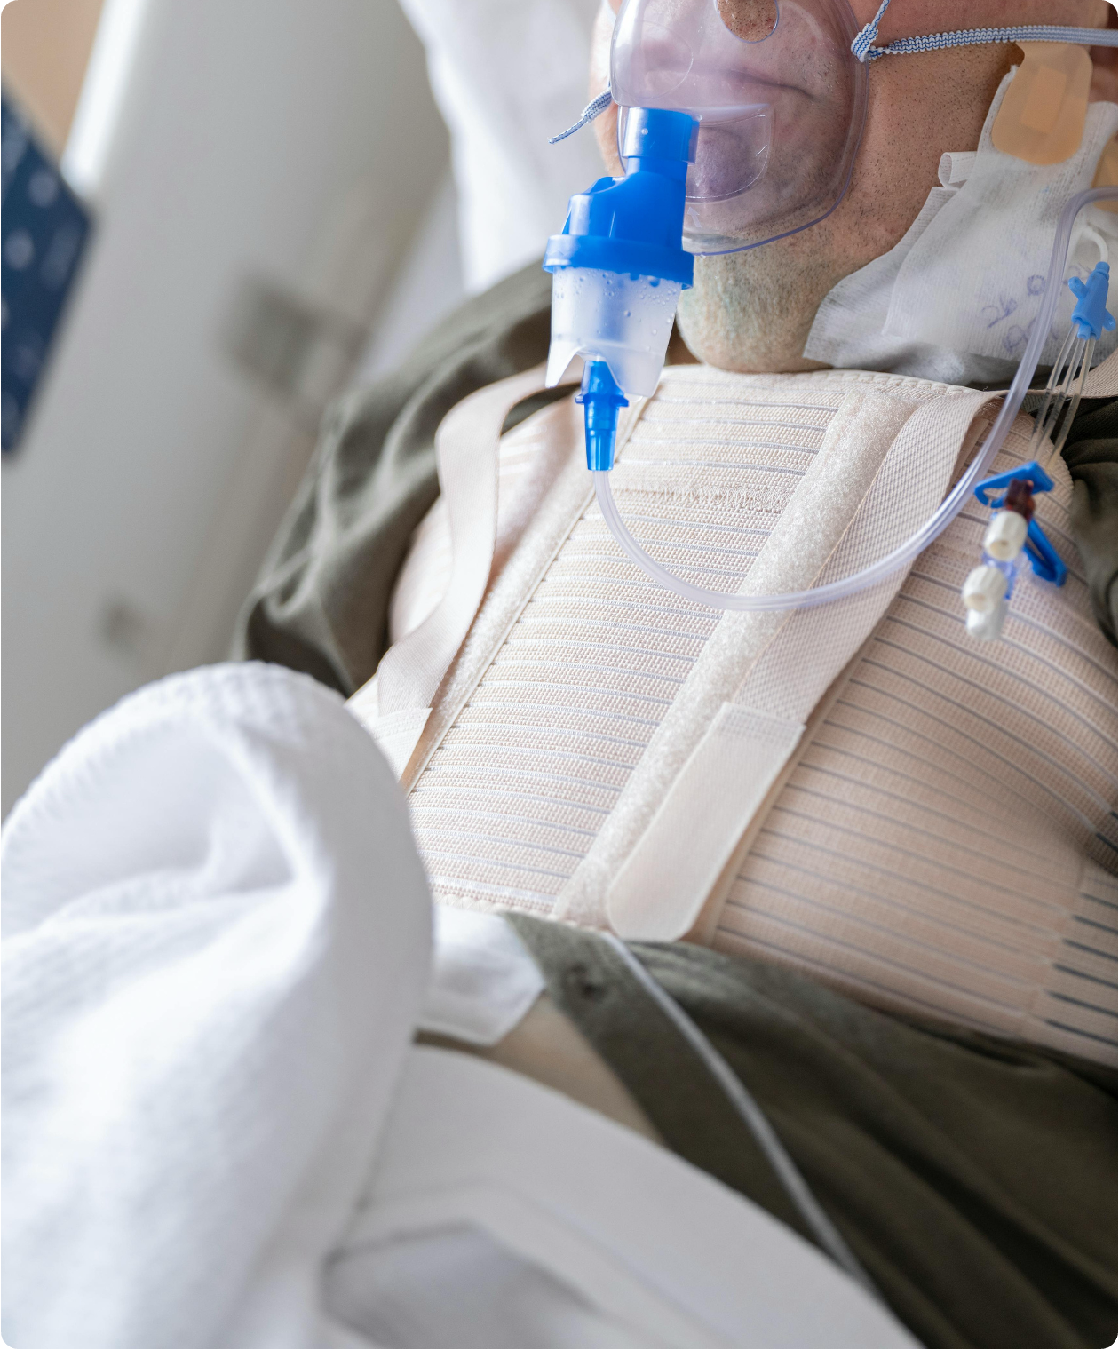
What is heart failure?
Explain that heart failure is a chronic condition where the heart becomes too weak or stiff to pump blood effectively. As a result, the body doesn’t get the oxygen it needs.

Slide 9


How the heart compensates
Describe how the heart tries to make up for reduced function.
Enlarging
Developing more muscle mass
Pumping faster
Helps the heart pump more blood
Add details here
Add details here

Slide 10



Stages of heart failure
Heart failure progresses over time and is classified into four stages. Use this slide to show how symptoms develop.
Stage A
Stage B
Stage C
Stage D
Risk factors are present, but there are no symptoms yet
Clarify what this stage involves
Clarify what this stage involves
Clarify what this stage involves

Slide 11




Symptoms of heart failure
Tiredness and fatigue
Symptom here
Symptom here
When the heart can’t pump enough blood, the body redirects it away from less vital organs and prioritizes the heart and brain.
Explain why it happens
Explain why it happens

Slide 12

Review
 | Heart Attack | Heart Failure
Nature | Sudden event (emergency) | Chronic condition (long-term)
Cause | Add the primary cause here. | Add the primary cause here.
Onset | Describe how quickly symptoms appear. | Describe how quickly symptoms appear.
Symptoms | List symptoms here: Symptom 1 Symptom 2 Symptom 3 | List symptoms here: Symptom 1 Symptom 2 Symptom 3

Slide 13





Resource Page
  Use these in your presentation. Delete or hide this page before presenting.
Fonts
Design Elements / Icons
This presentation template
uses the following free fonts:
TITLES:
Muli Bold
BODY TEXT:
Muli Regular
You can find these fonts online too.
Colors
#8D2041
#FFEAAB
#F0E4E2
#BFB4B2
#FFF

Slide 14

Credits
  This presentation template is free for everyone to use, thanks to the following:
  for this presentation template
Pexels, Pixabay, Sketchify
  for the photos, graphics, and elements
  Happy designing!

