Slide 1
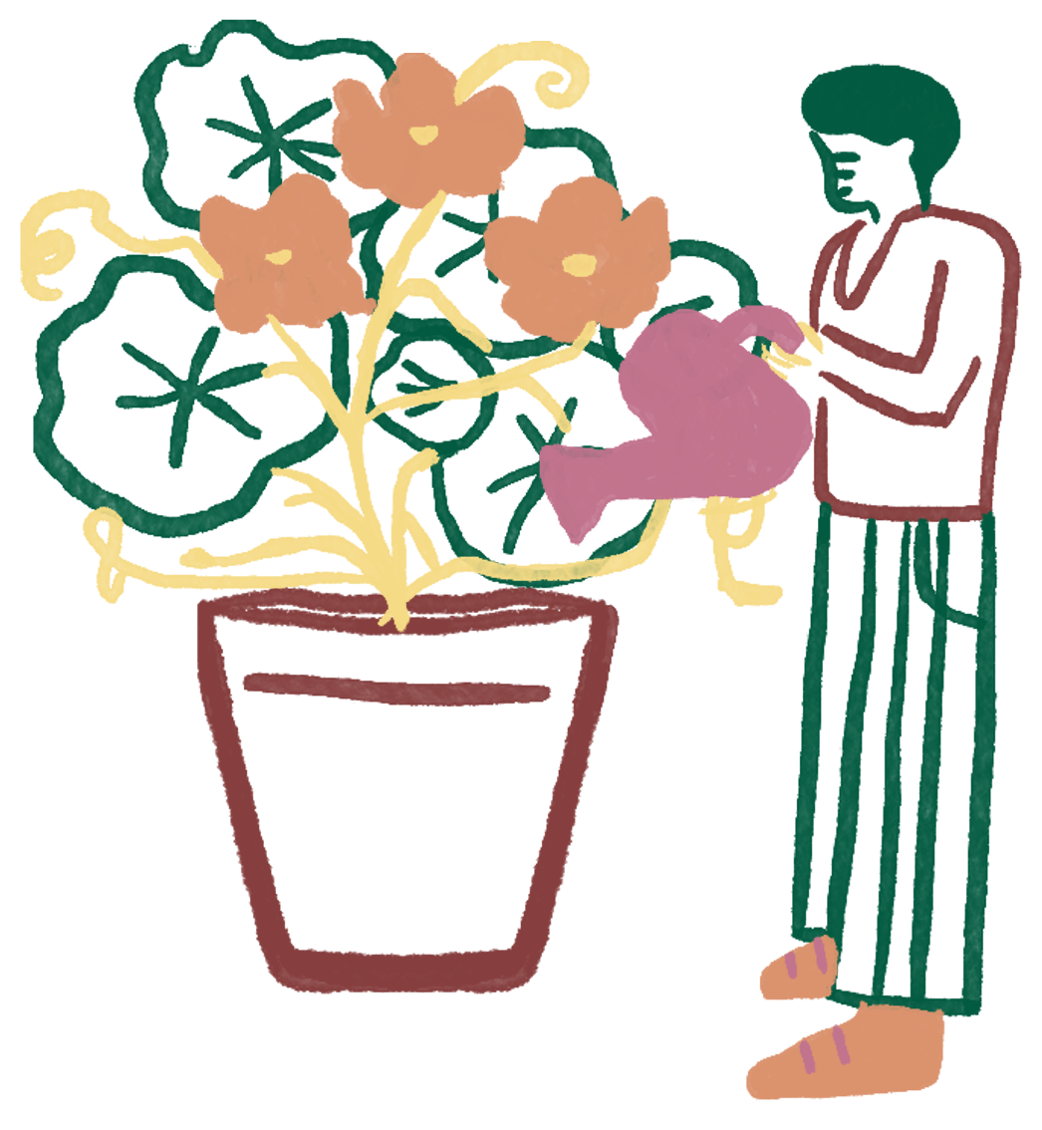
Slides Presentation
Social Psychology
Presenter name here

Slide 2
What we’ll cover
What is social psychology?
Why social psychology matters
Power
of norms
Social identity
Self and others

Slide 3
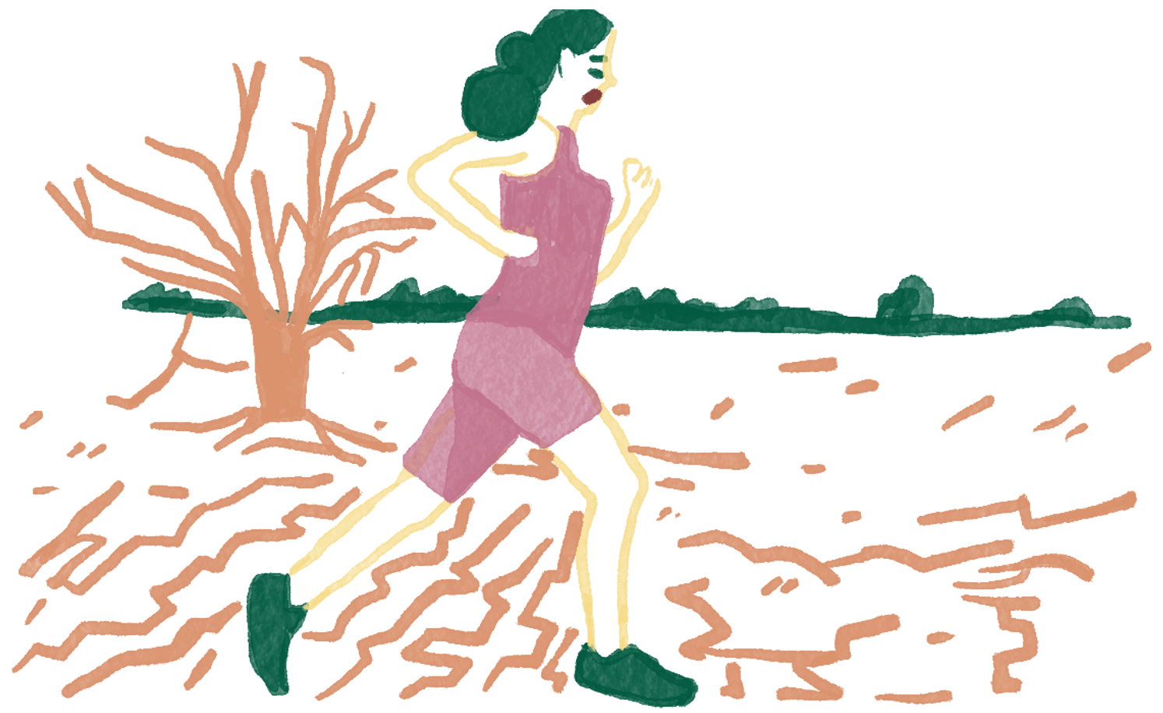
What is social psychology?
Many factors shape our everyday lives: environmental, financial, physical, and countless others. How we behave around other people is also one.

Slide 4
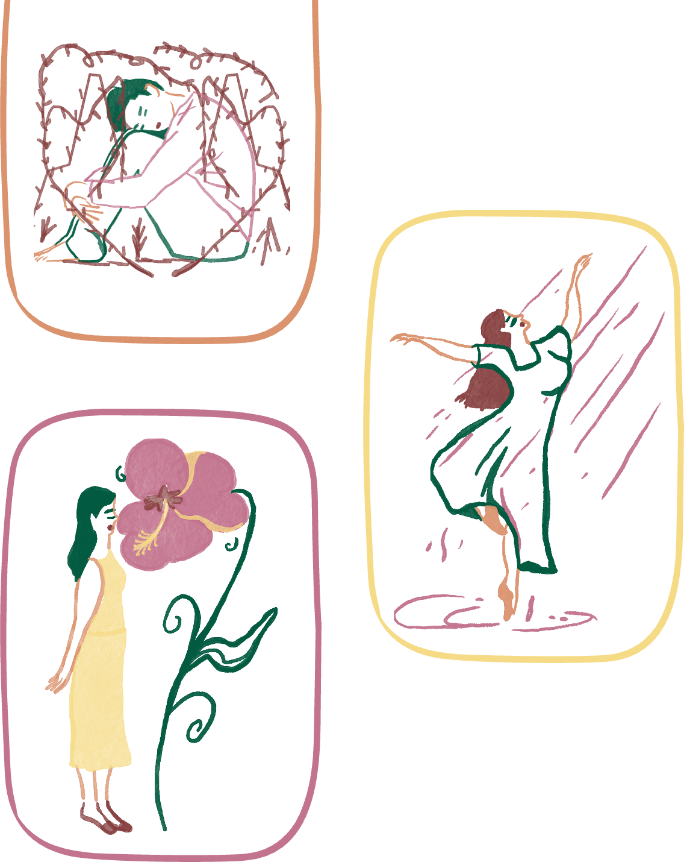
Social factors, such as our relationship with others and group norms, play a large role in how we act and feel. Social psychology is the scientific study of these factors.
Today, we’ll be learning about a handful of key concepts related to social psychology.

Slide 5
Why does it matter?
Improves wellbeing
Key point here
Key point here
Strong social connections are directly linked to good physical and mental health.
Briefly elaborate on the key point here.
Briefly elaborate on the key point here.

Slide 6

Power of norms
Unspoken rules individuals adhere to so they can fit in.
Example: Nobody in the classroom raises their hand to answer, so you also keep your hand down.

Slide 7
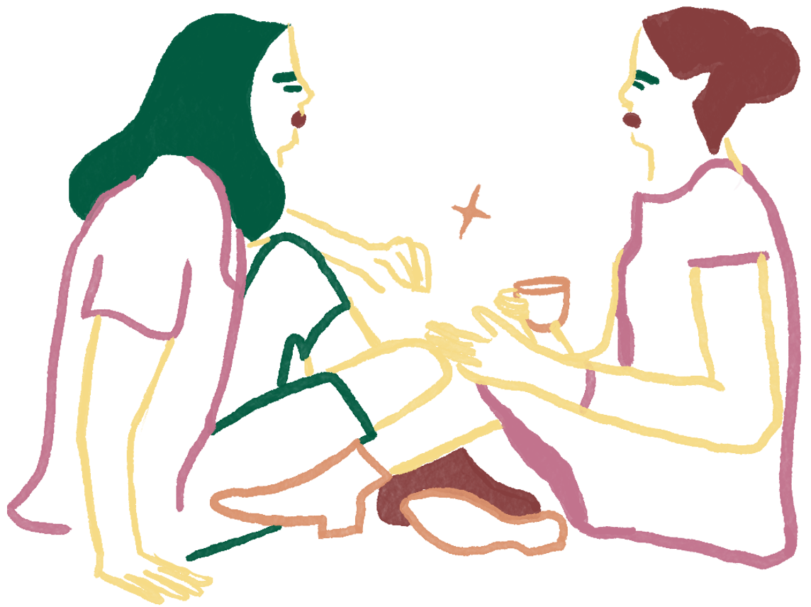
Social identity
Use this section to briefly explain the concept. If possible, provide concrete examples to give the audience a better understanding.

Slide 8



Self & others
Use this section to briefly explain the concept. If possible, provide concrete examples to give the audience a better understanding.

Slide 9
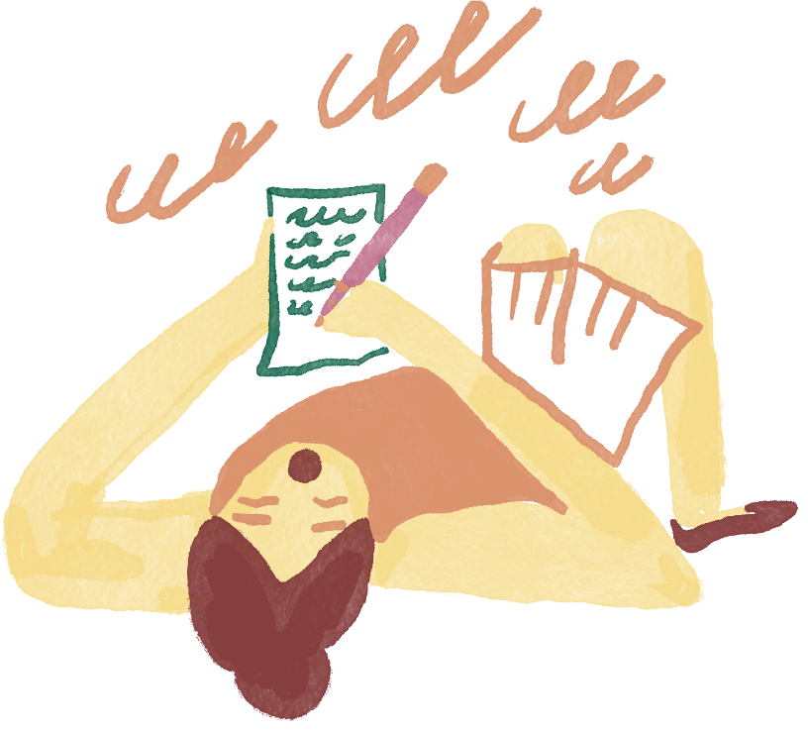
Learning check
How well did you understand the lesson?
Read the scenario provided and choose which among the key concepts discussed it falls under.

Slide 10

A. Power of norms
Scenario:
The school’s basketball team wears matching uniforms during games.
B. Social identity
C. Self & others

Slide 11
A. Answer goes here
B. Answer goes here
Question or scenario goes here
C. Answer goes here
D. Answer goes here

Slide 12
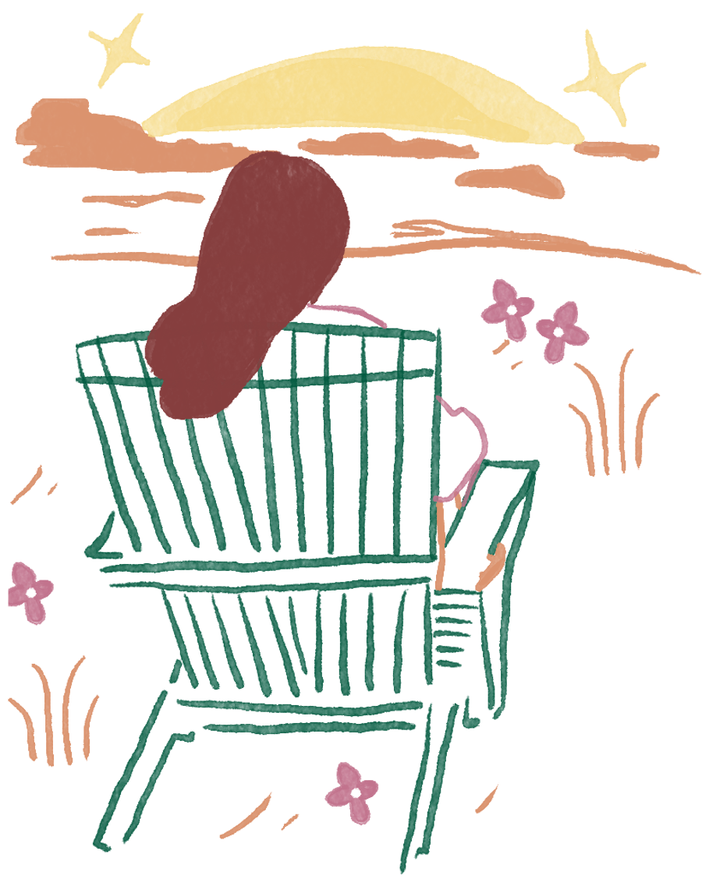
“The deepest principle in human nature is the craving to be appreciated.”
— William James

Slide 13
Recap
Social psychology
Power of norms
The scientific study of how people’s thoughts, feelings, and behaviors are shaped by the presence of others.
Briefly summarize the key discussion point here.
Social identity
Self and others
Briefly summarize the key discussion point here.
Briefly summarize the key discussion point here.

Slide 14





Get in touch
Email
hello@reallygreatsite.com
Social media
@reallygreatsite
Phone
123-456-7890
Address
123 Anywhere St., Any City,ST 12345

Slide 15
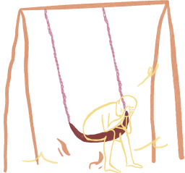

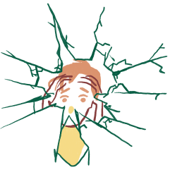

Resource Page
Use these in your presentation. Delete or hide this page before presenting.
Fonts
Design Elements / Icons
This presentation template
uses the following free fonts:
TITLES:
Kalam
BODY TEXT:
Nunito
You can find these fonts online too.
Colors
#025A40
#863E3E
#C2738D
#DB936E
#F6DB86

Slide 16

Credits
This presentation template is free for everyone to use, thanks to the following:
Pexels, Pixabay, Sketchify
for this presentation template
for the photos, graphics, and elements
Happy designing!

