Slide 1
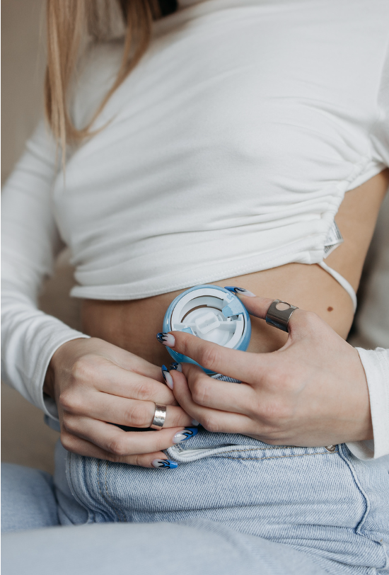


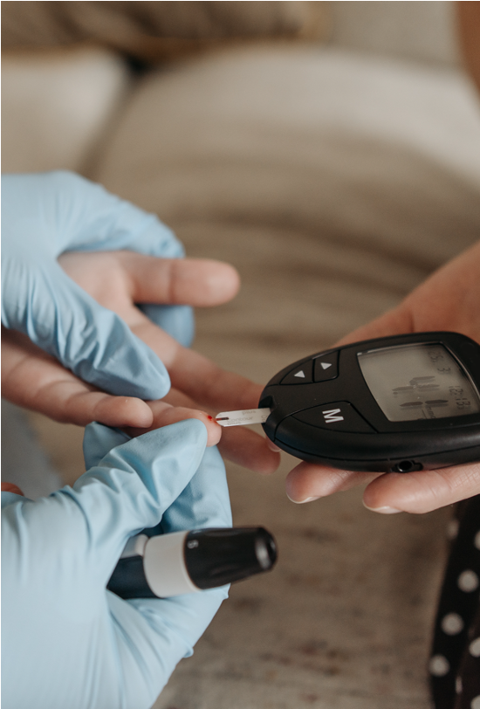

CRIMSWEST
INSTITUTE
Type 1
Diabetes
Empowering knowledge for healthy, happy living

Slide 2




Agenda
What is type 1 diabetes?
Causes and risk factors
Managing type 1 diabetes
Assessment activity
Conclusion and recap

Slide 3
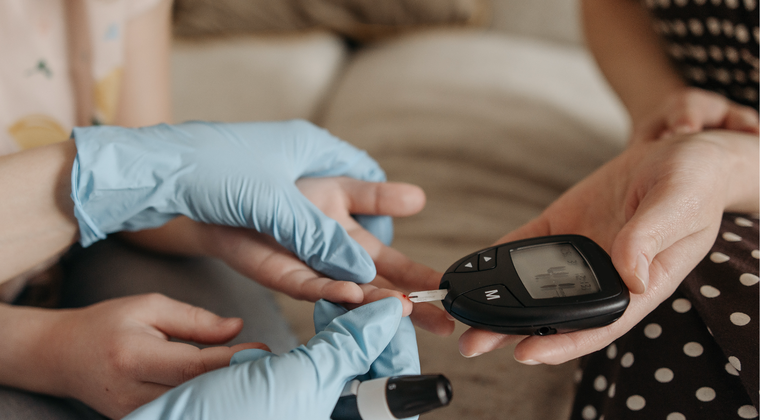
What is type 1 diabetes?

Slide 4




Type 1 diabetes is a chronic condition wherein the body’s pancreas is unable to produce enough insulin.
The condition is often diagnosed at an early age. Symptoms of type 1 diabetes include the following:
  Frequent urination
  Symptom goes here
  Symptom goes here
  Symptom goes here

Slide 5


75
Statistic related to type 1 diabetes here
A paragraph. Explain the significance of the statistic above and stress the importance of covering the topic.
%

Slide 6

Causes & Risk Factors

Slide 7


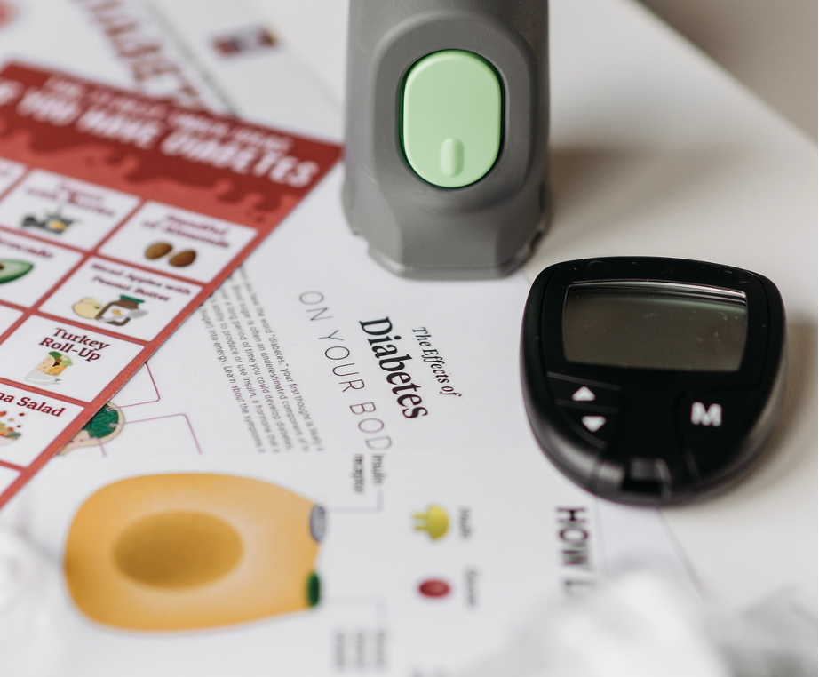
Risk factor here
A paragraph. Elaborate on what you want to discuss.
Age
Risk factor here
Type 1 diabetes is often diagnosed in childhood
A paragraph. Elaborate on what you want to discuss.

Slide 8

Managing type 1 diabetes

Slide 9
Assessment
Read the question provided. Then, select
the correct answer from the options provided.
Which of the following is not a recommended way of managing type 1 diabetes?
Question goes here
A) Maintaining a healthy weight
A) Type an option here
B) Crash dieting
B) Type an option here
C) Regular blood glucose monitoring and insulin management
C) Type an option here
C) None of the above
C) None of the above

Slide 10




Conclusion and recap
While type 1 diabetes can be a struggle, it can be managed with the right tools and knowledge, such as proper insulin management and regular blood glucose monitoring.
Remember: Type 1 diabetes doesn’t need to be faced alone. Let’s use what we’ve learned today to champion understanding and support the community.
Type 1 diabetes
  is often diagnosed at an early age
  discussion point goes here
  discussion point goes here

Slide 11

Get in Touch
EMAIL
hello@reallygreatsite.com
SOCIAL MEDIA
@reallygreatsite
PHONE
+123-456-7890
ADDRESS
123 Anywhere St., Any City, ST 12345

Slide 12




Resource Page
  Use these in your presentation. Delete or hide this page before presenting.
Fonts
Design Elements / Icons
This presentation template
uses the following free fonts:
TITLES:
Radley
BODY TEXT:
Cabin Regular & Bold
You can find these fonts online too.
Colors
#ABC9D3
#B23928
#502B2E
#FFF0DA

Slide 13

Credits
  This presentation template is free for everyone to use, thanks to the following:
  for this presentation template
Pexels, Pixabay, Sketchify
  for the photos, graphics, and elements
  Happy designing!

