Slide 1
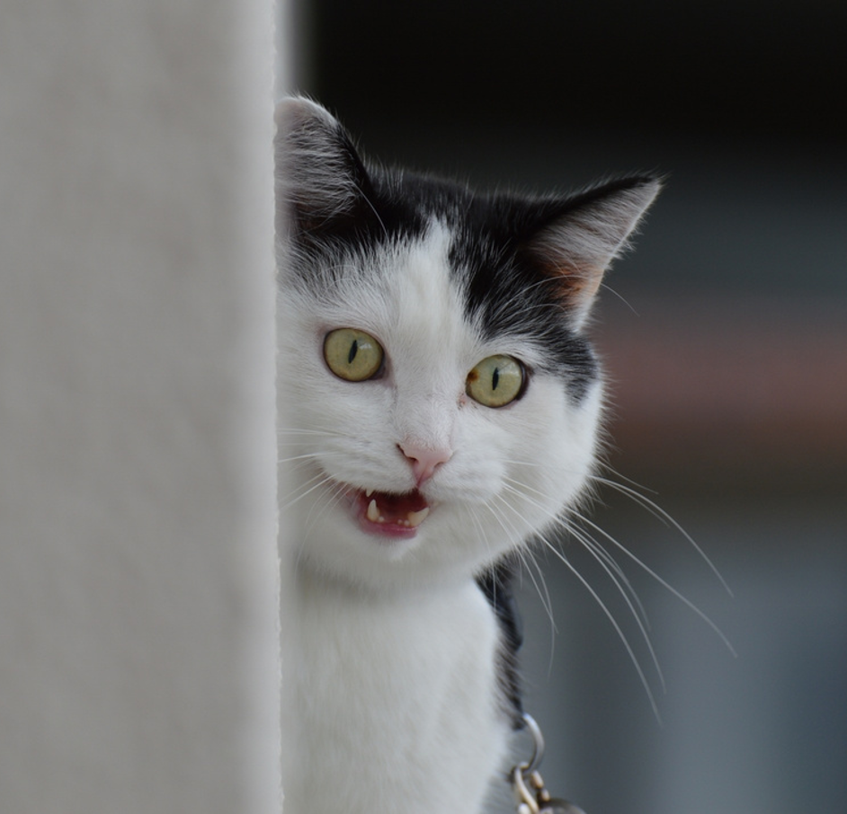
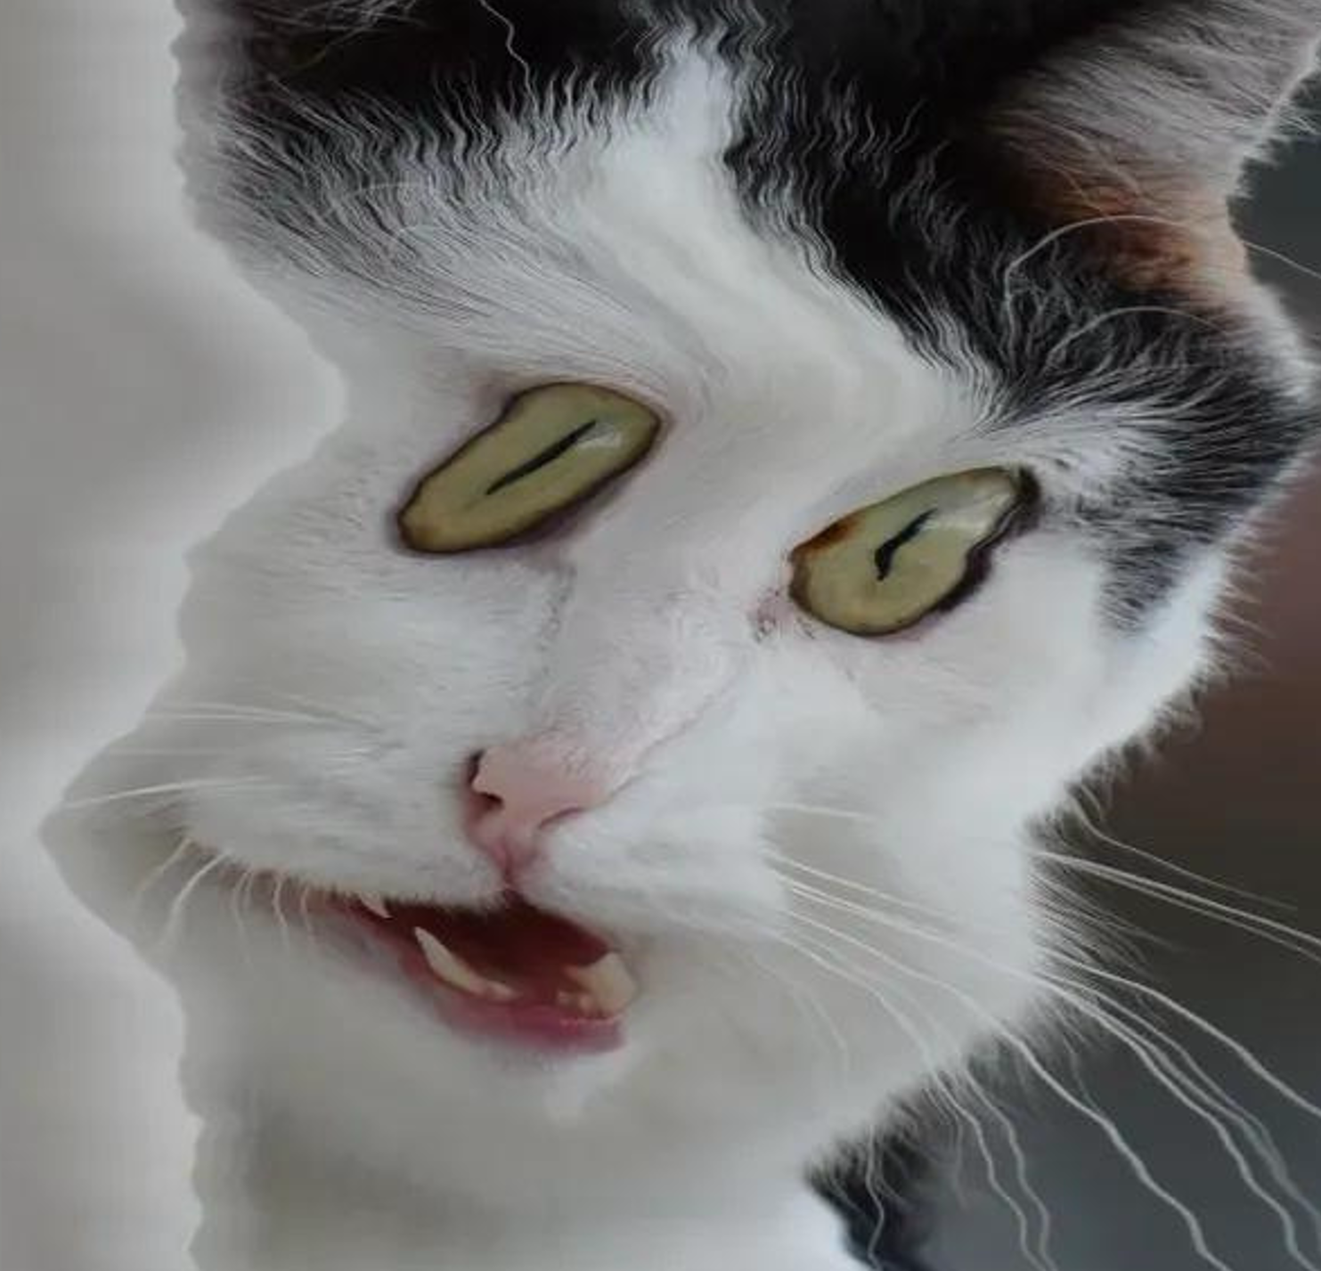
“Time to take Whiskers to the vet.”
the
WHAT?

Slide 2
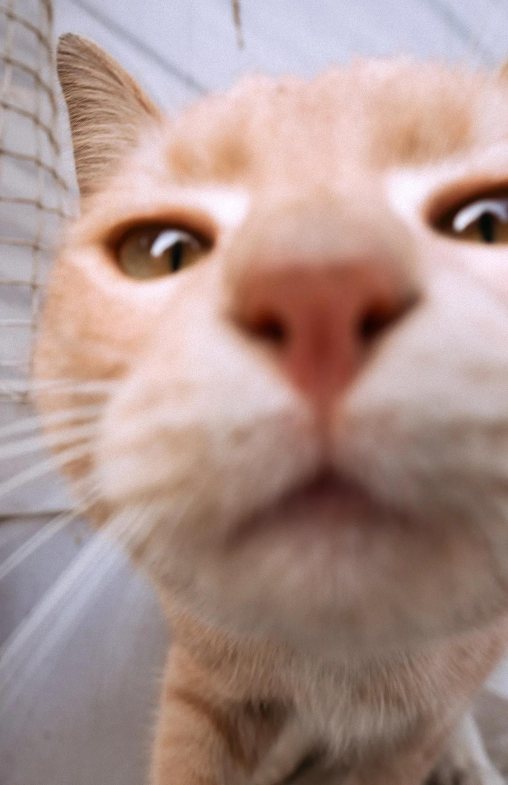



when you accidentally open the front cam but u cute anyway

Slide 3
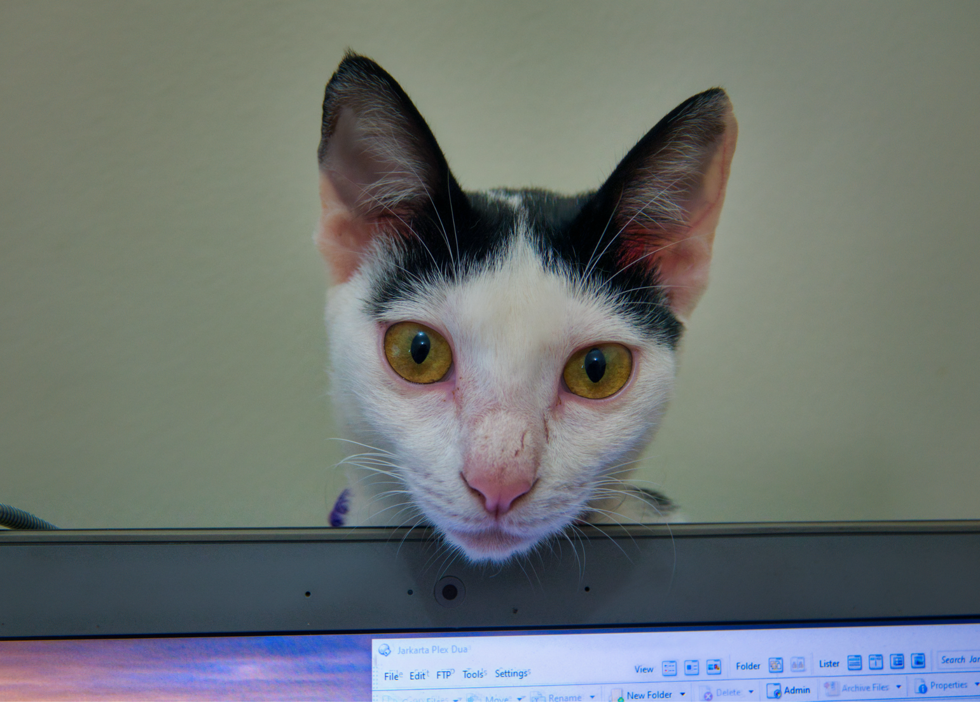

do u have games on ur laptop?

Slide 4
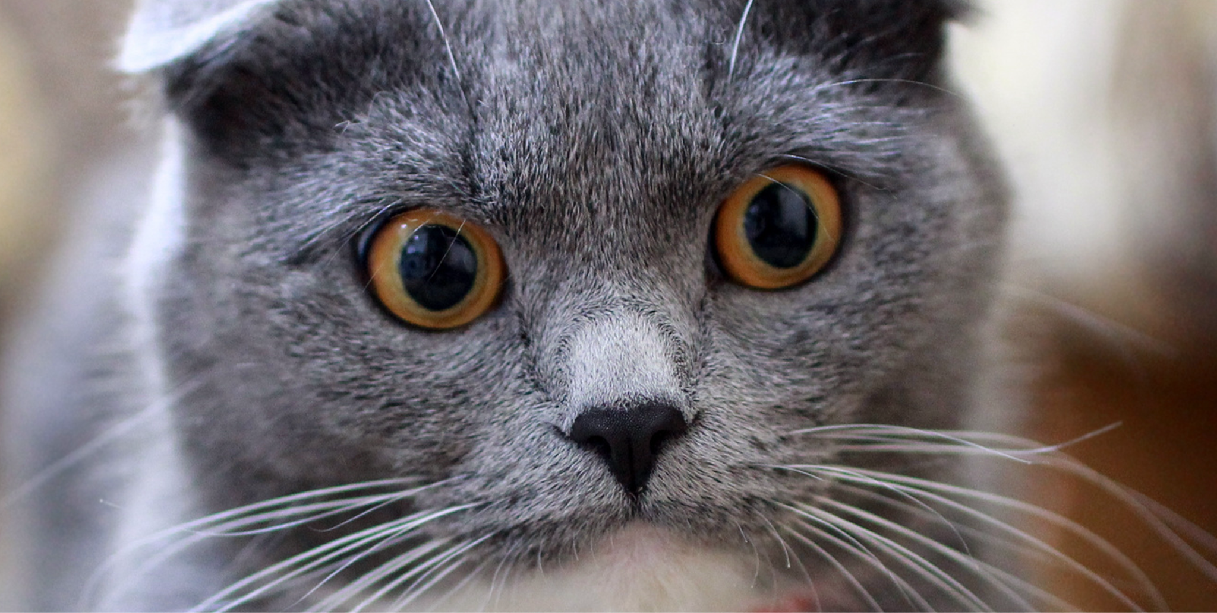
“When a cat closes its eyes, it means they trust you.”
My cat:

Slide 5
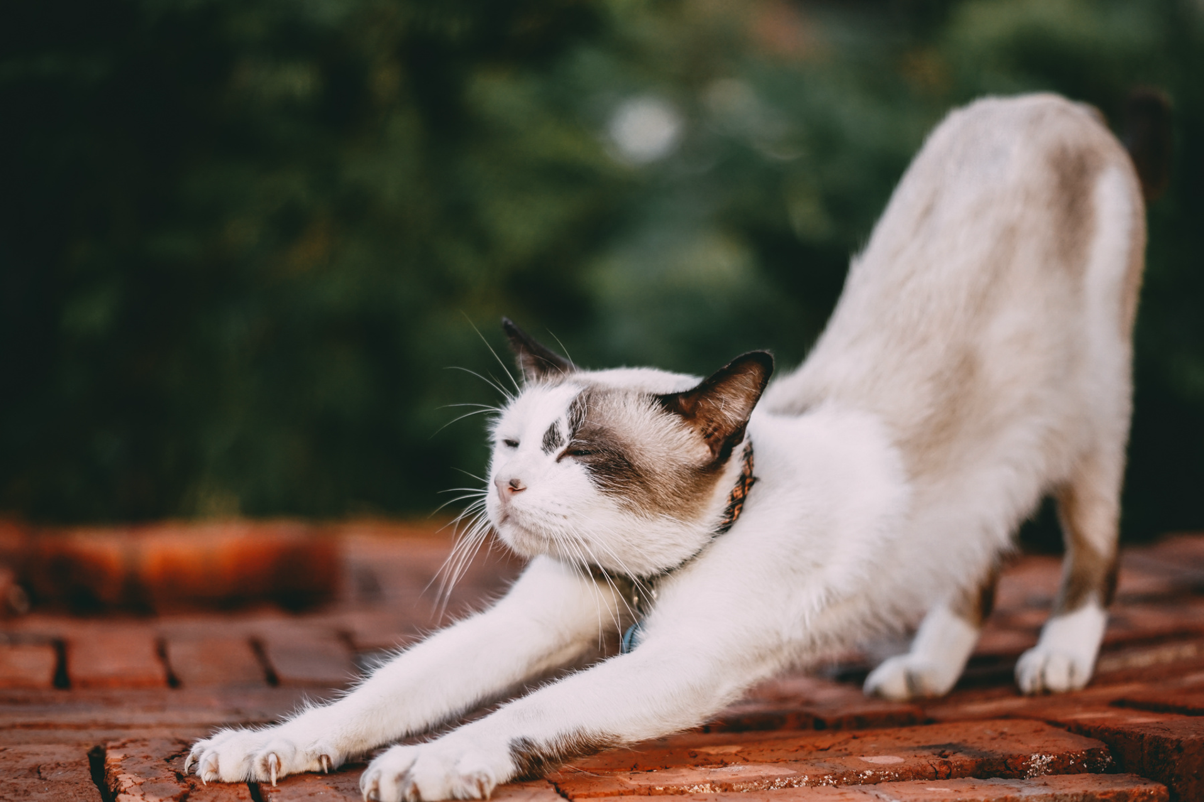
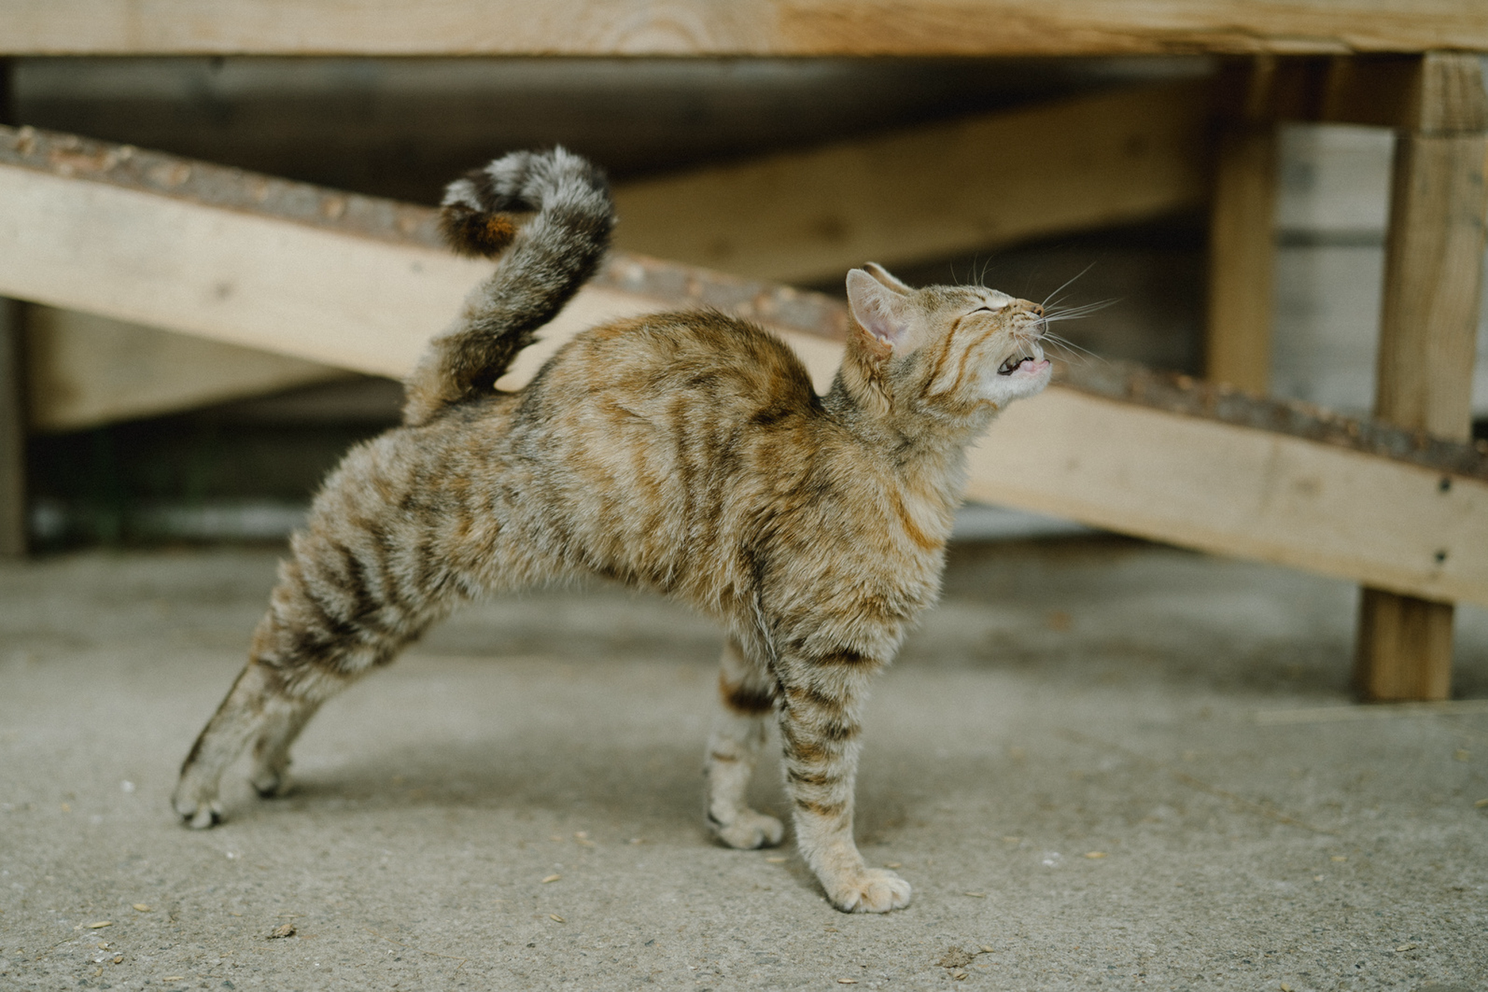
the yoga instructor
me and 25 years of no exercise

Slide 6
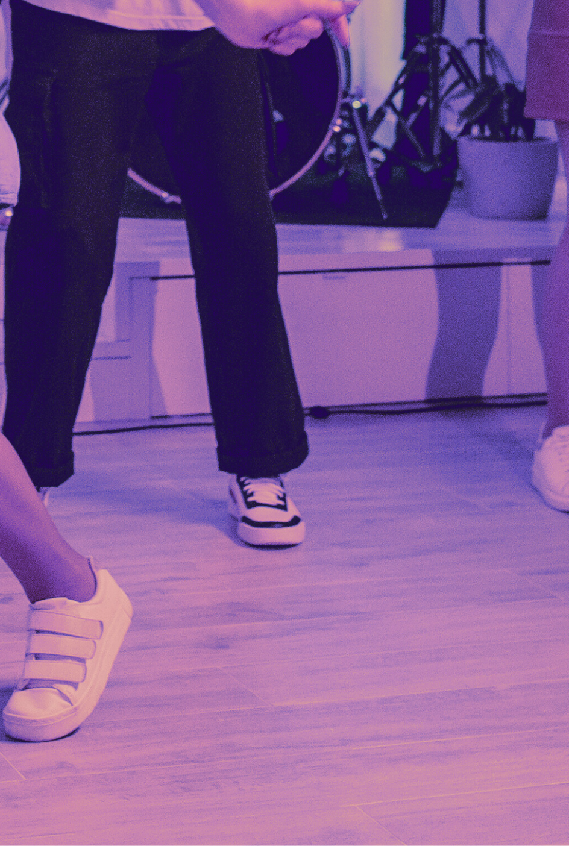
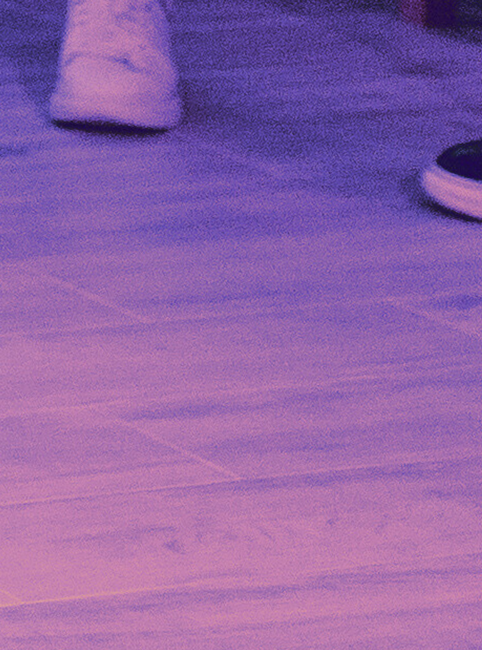
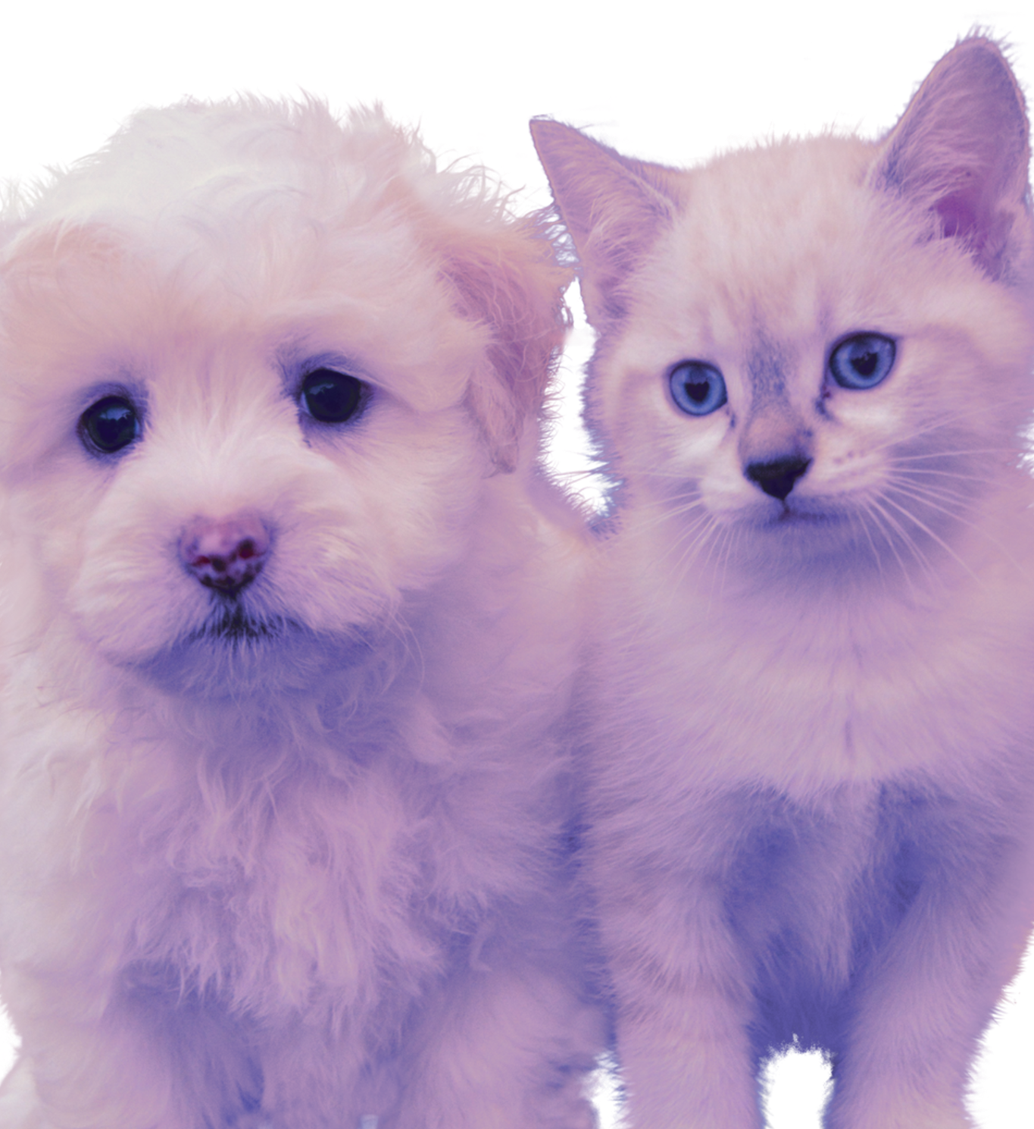
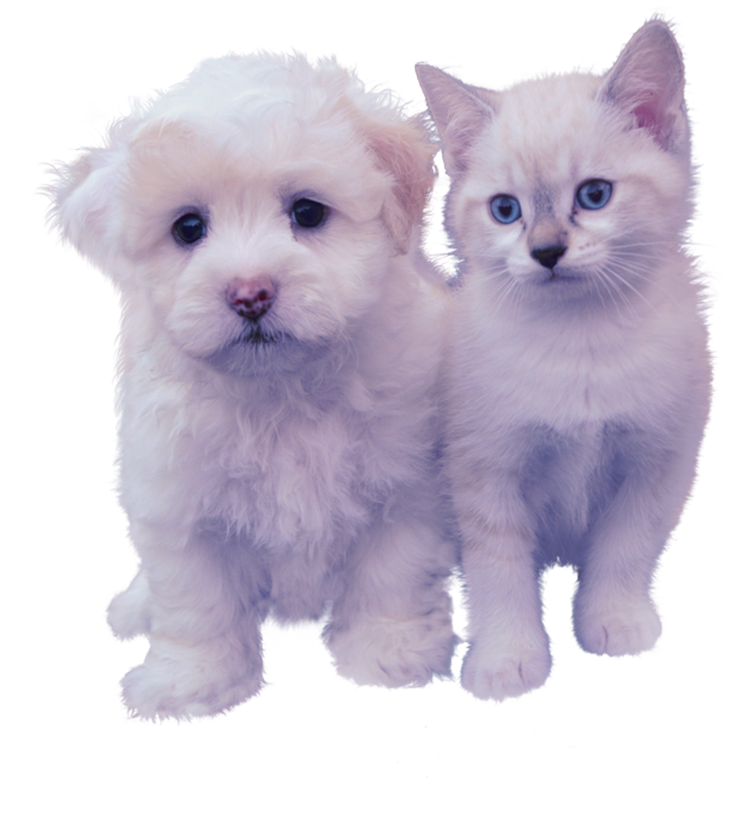
When your social battery runs out

Slide 7
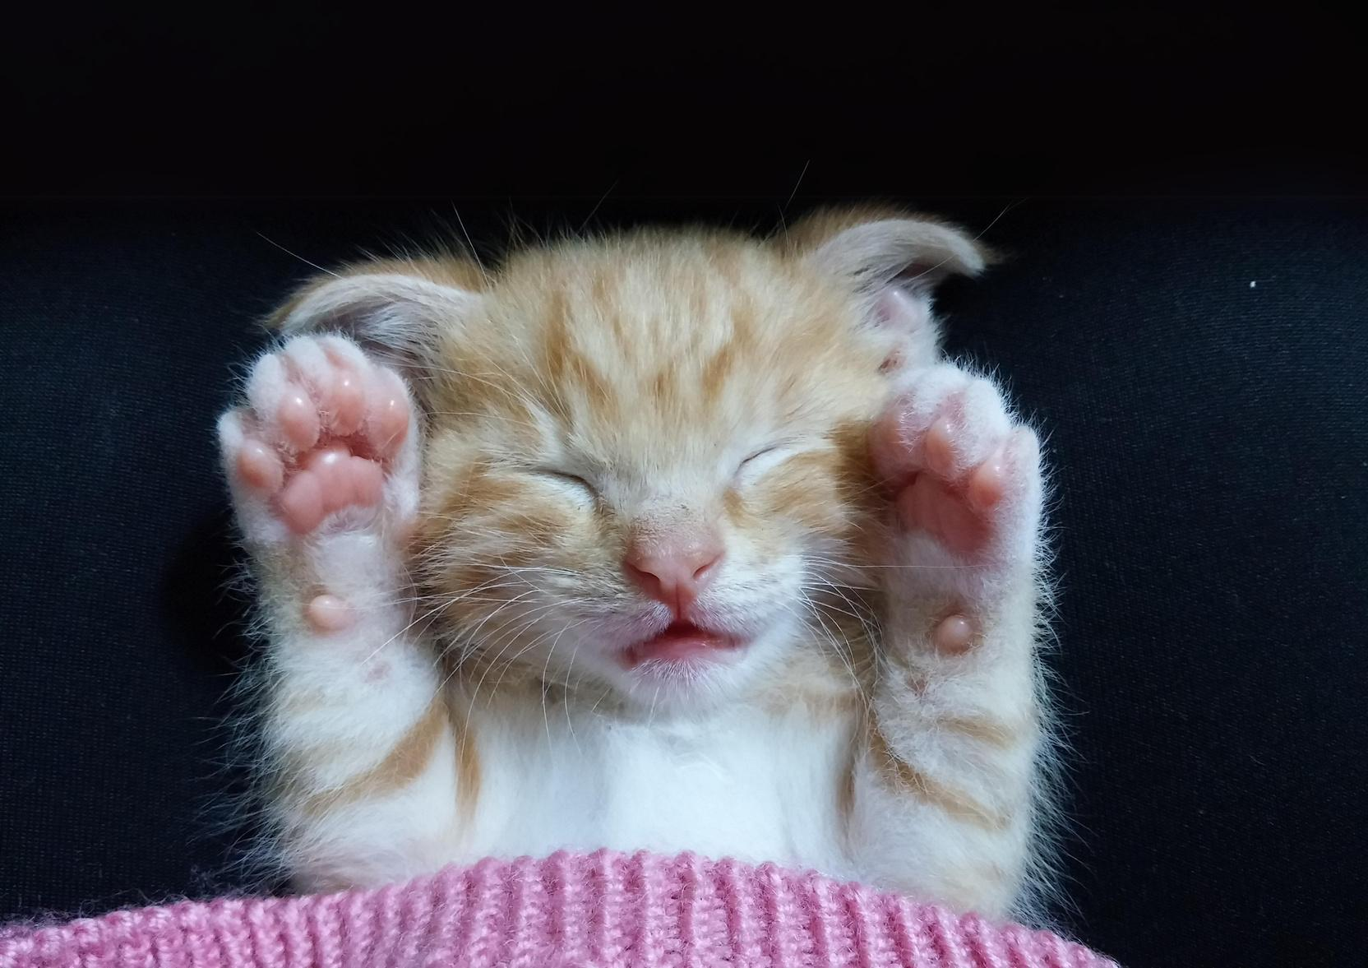
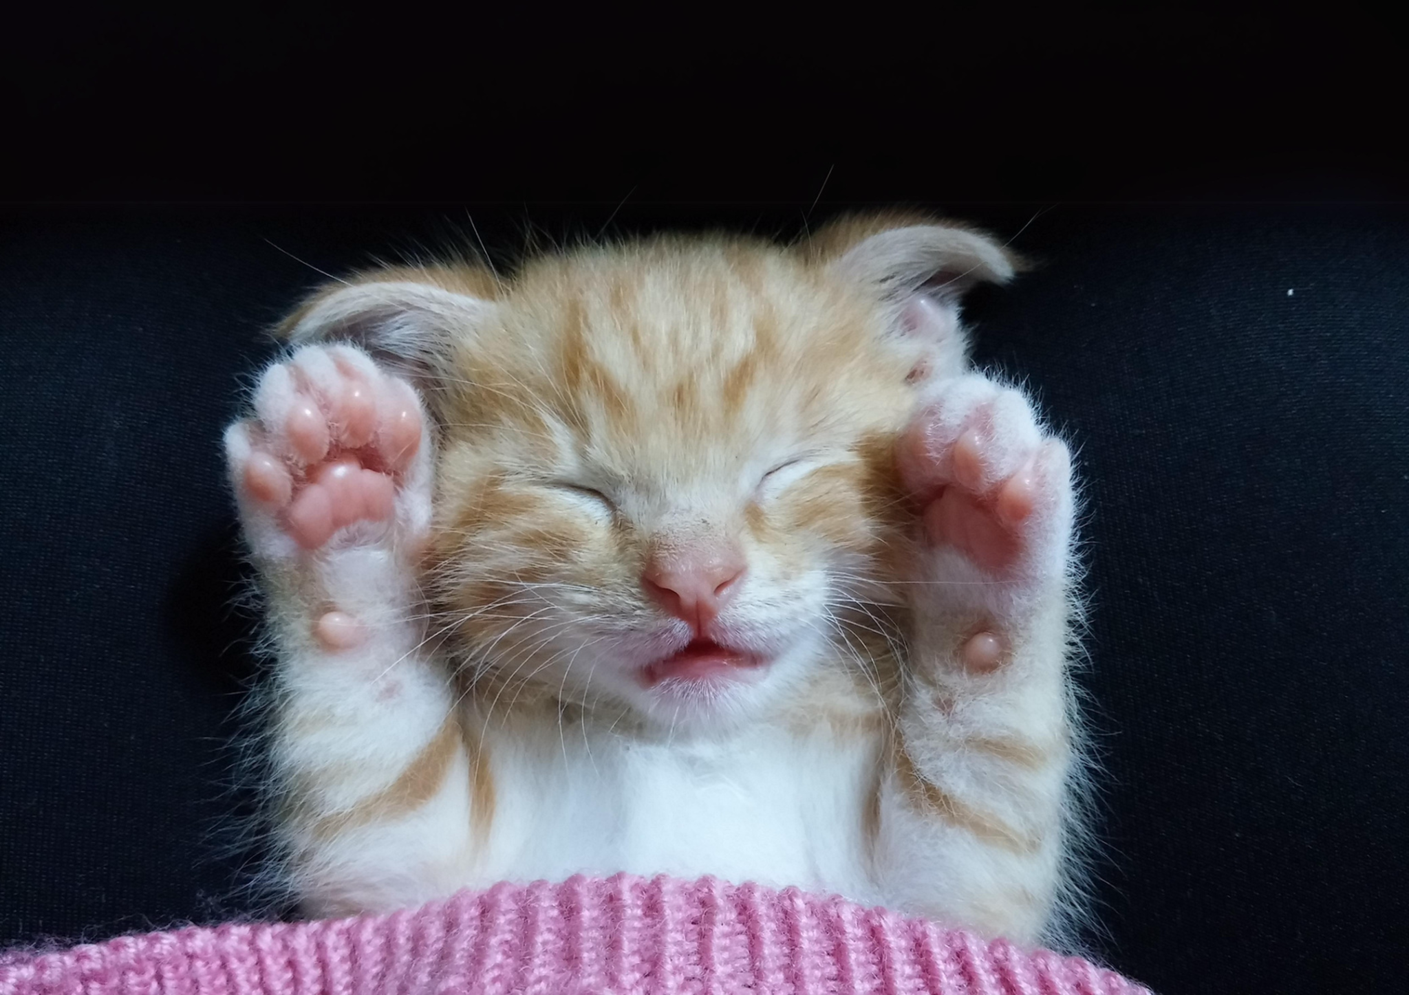
Slept for an extra 5 mins
but at
what cost?

Slide 8
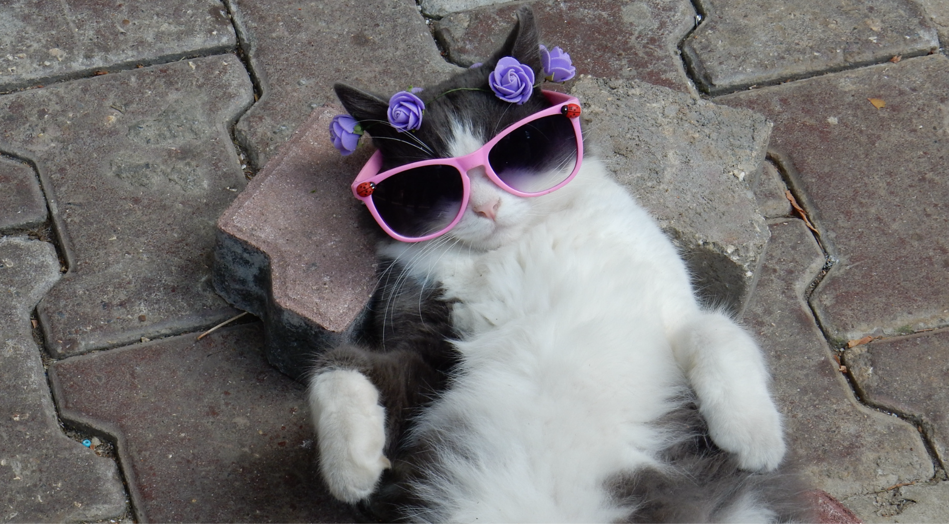
when I’m too broke to go on vacation
this will do

Slide 9
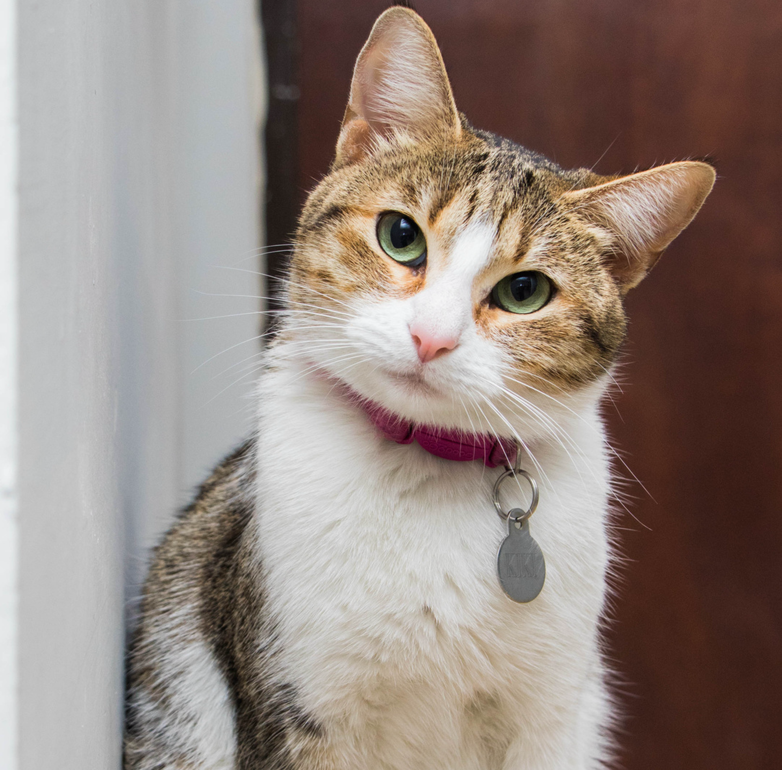
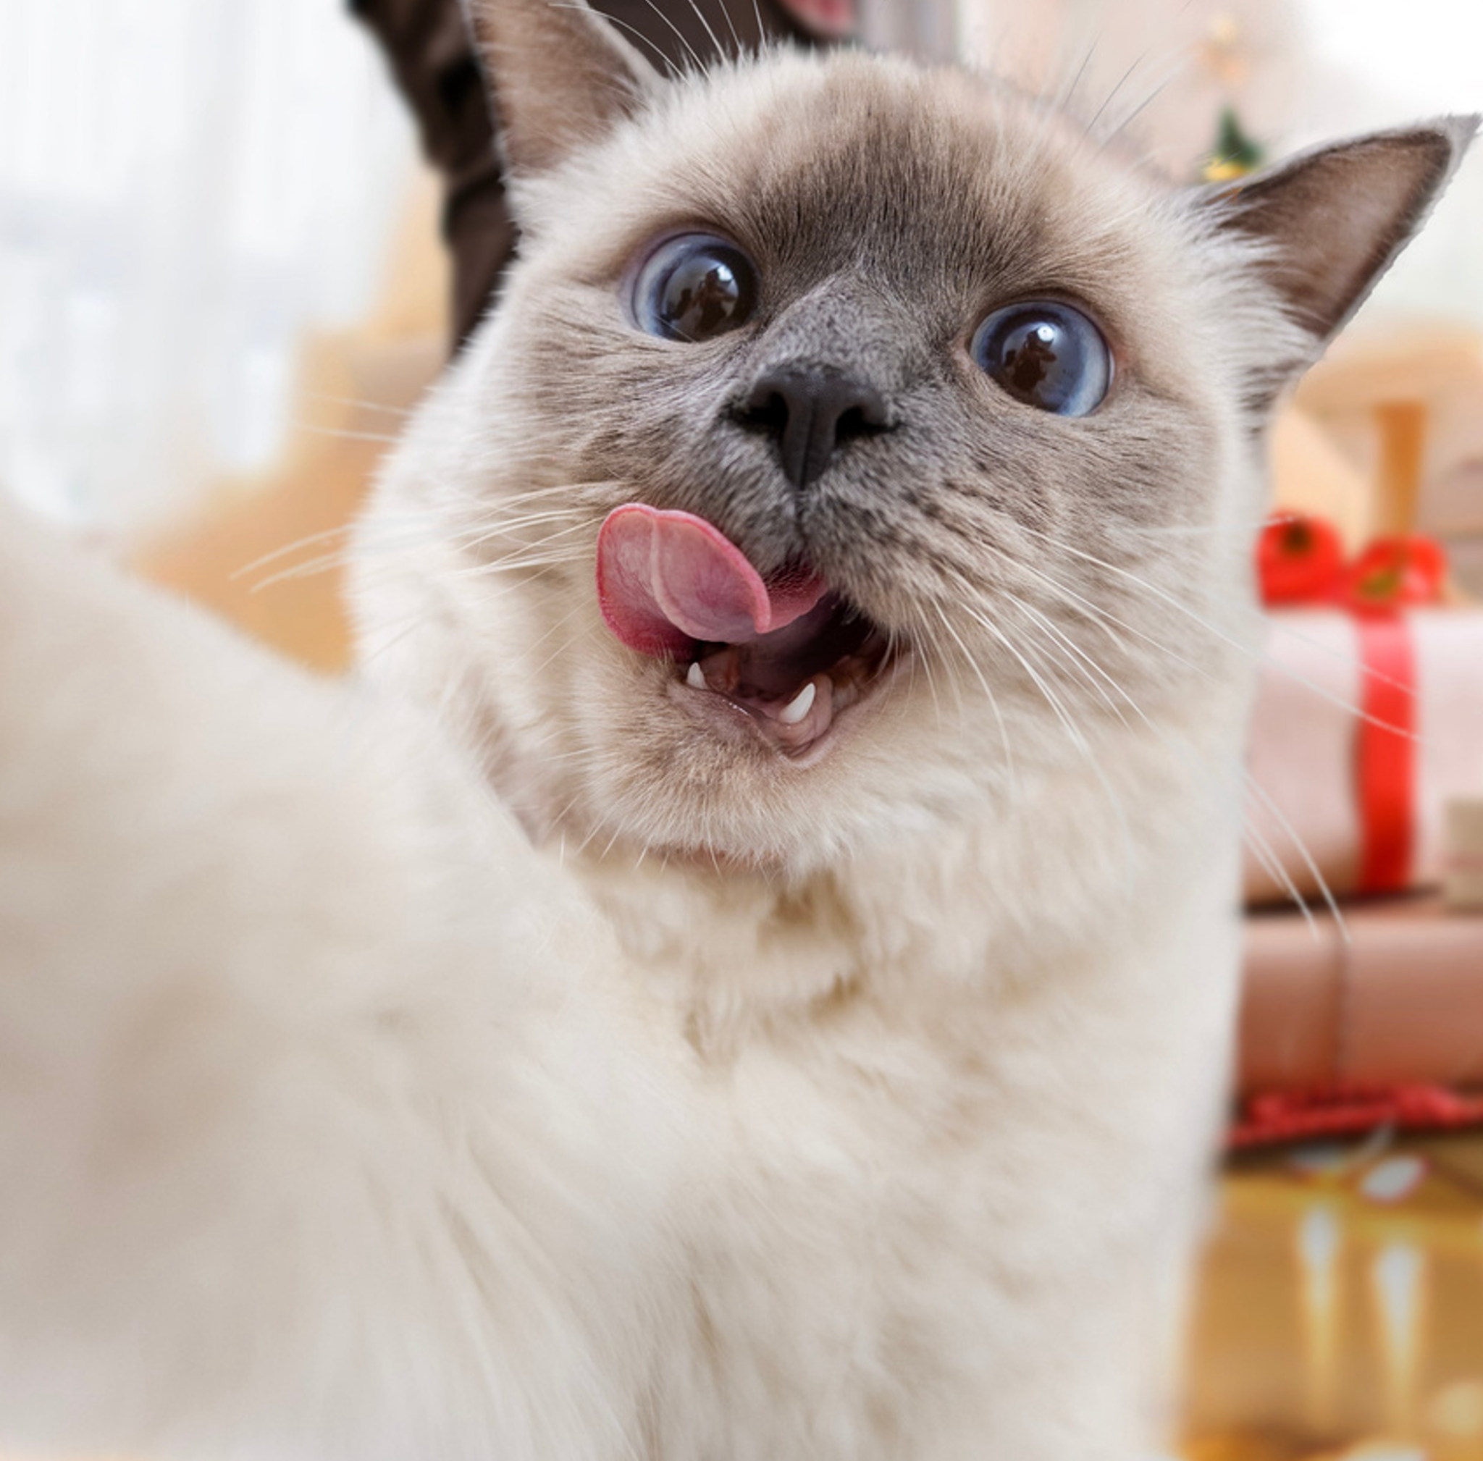
Cats I see on social media
Cats I have at home

Slide 10
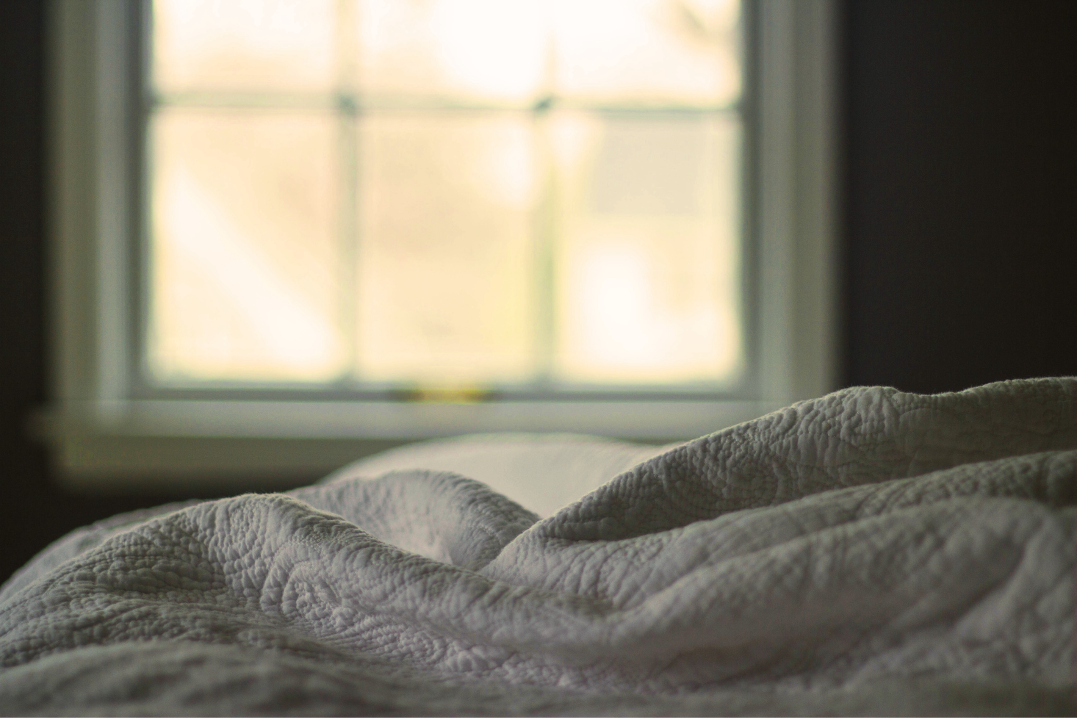

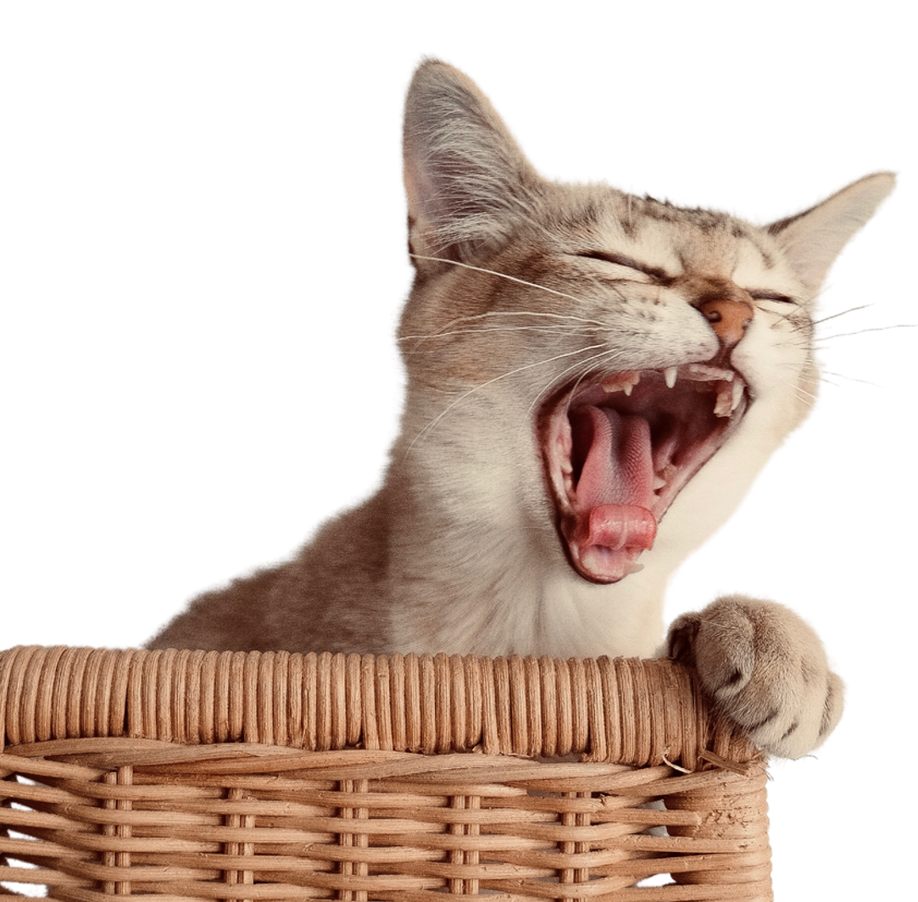

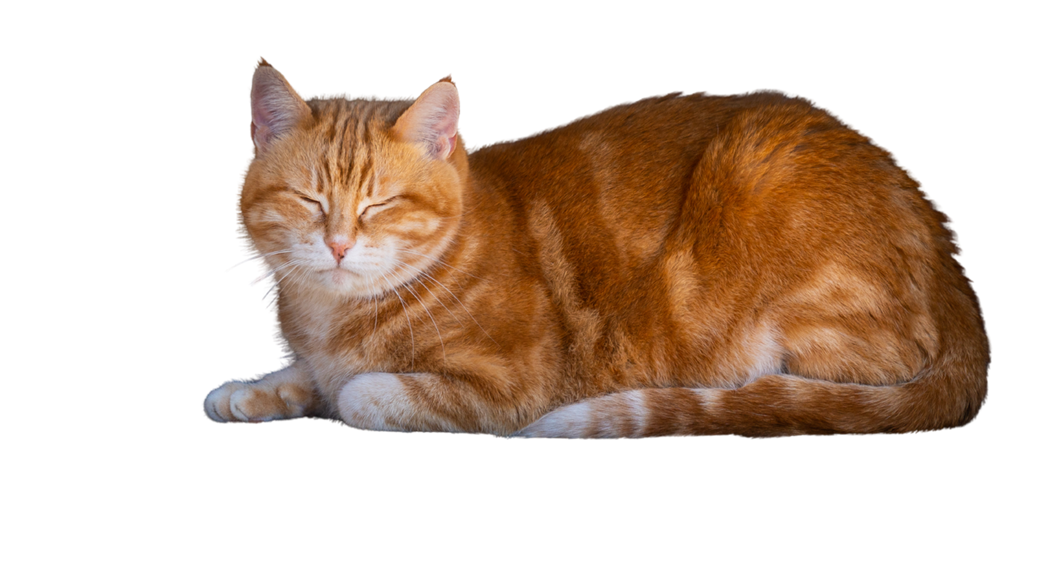
Our relationship in a nutshell:
*Me ranting about my day*
*him not listening*

Slide 11
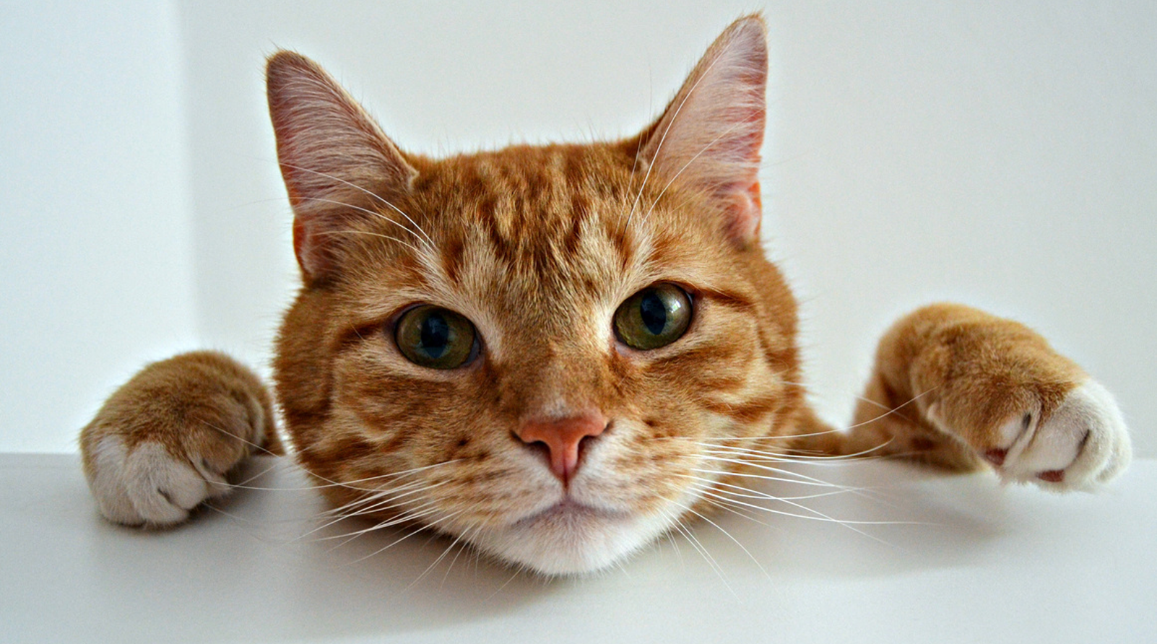
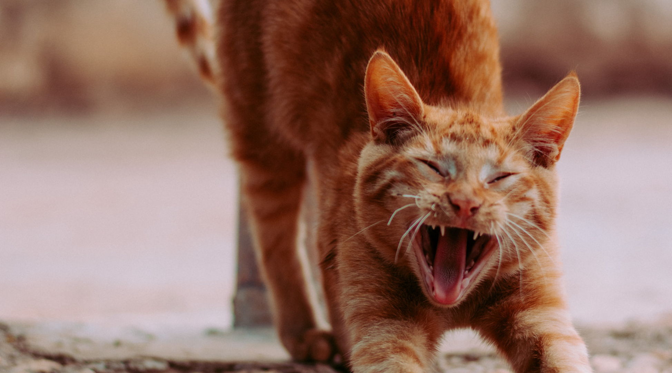
grocery shopping carts:

Slide 12
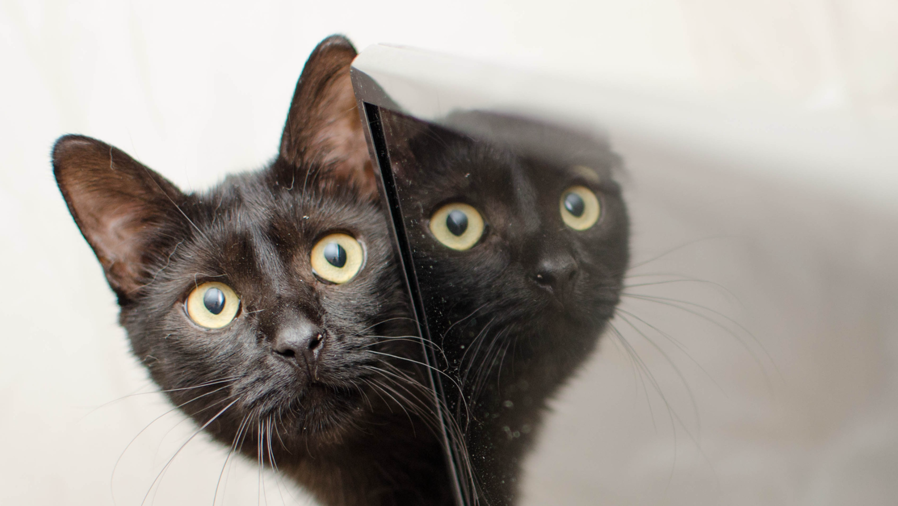
Should I ignore my owner?
do it

Slide 13





Resource Page
  Use these design resources in your Canva Presentation.
Fonts
  Design Elements
  This presentation template
  uses the following free fonts:
  Titles and Body:
INTER
  You can find these fonts online too.
Colors
#E8E8E8
#121010
#3B2929
#FAC832
  Don't forget to delete this page before presenting.

Slide 14

Credits
  This presentation template is free for everyone to use thanks to the following:
  for the presentation template
  PEXELS AND PIXABAY
  for the photos
  HAPPY DESIGNING!

