Slide 1
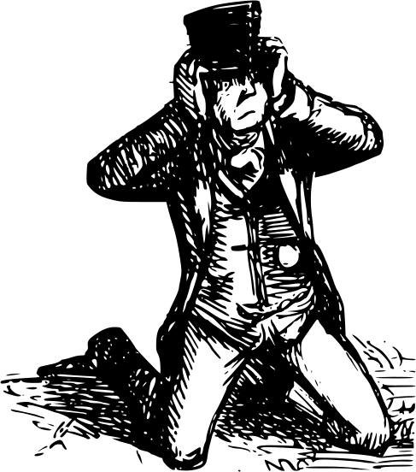
“skibidi”
“mewing”
“YEET!”
“delulu”
“RIZZ”
“sigma”
ME WHENEVER SOMEONE USES GEN-Z SLANG

Slide 2
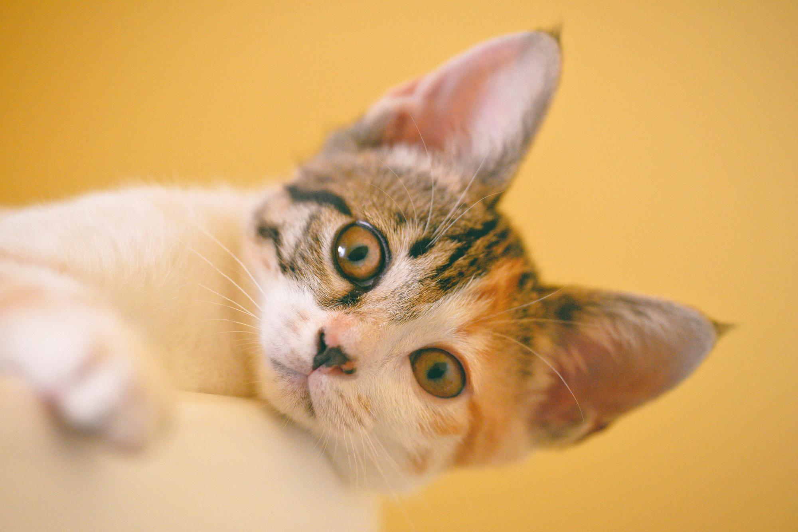
WHAT DO YOU MEME?

Slide 3
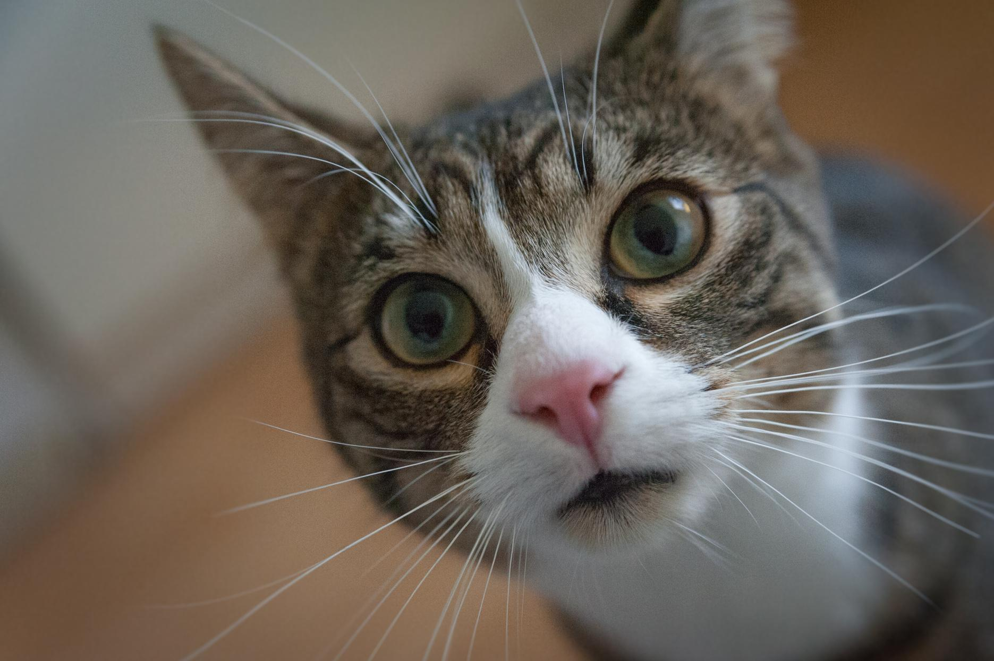
SAY WHAT???

Slide 4
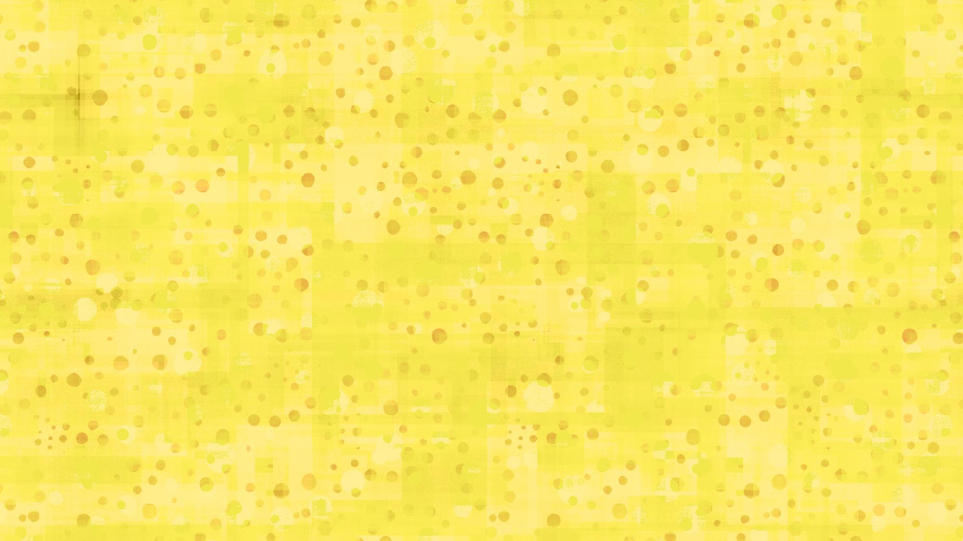

DID SOMEBODY SAY
TREAT???

Slide 5
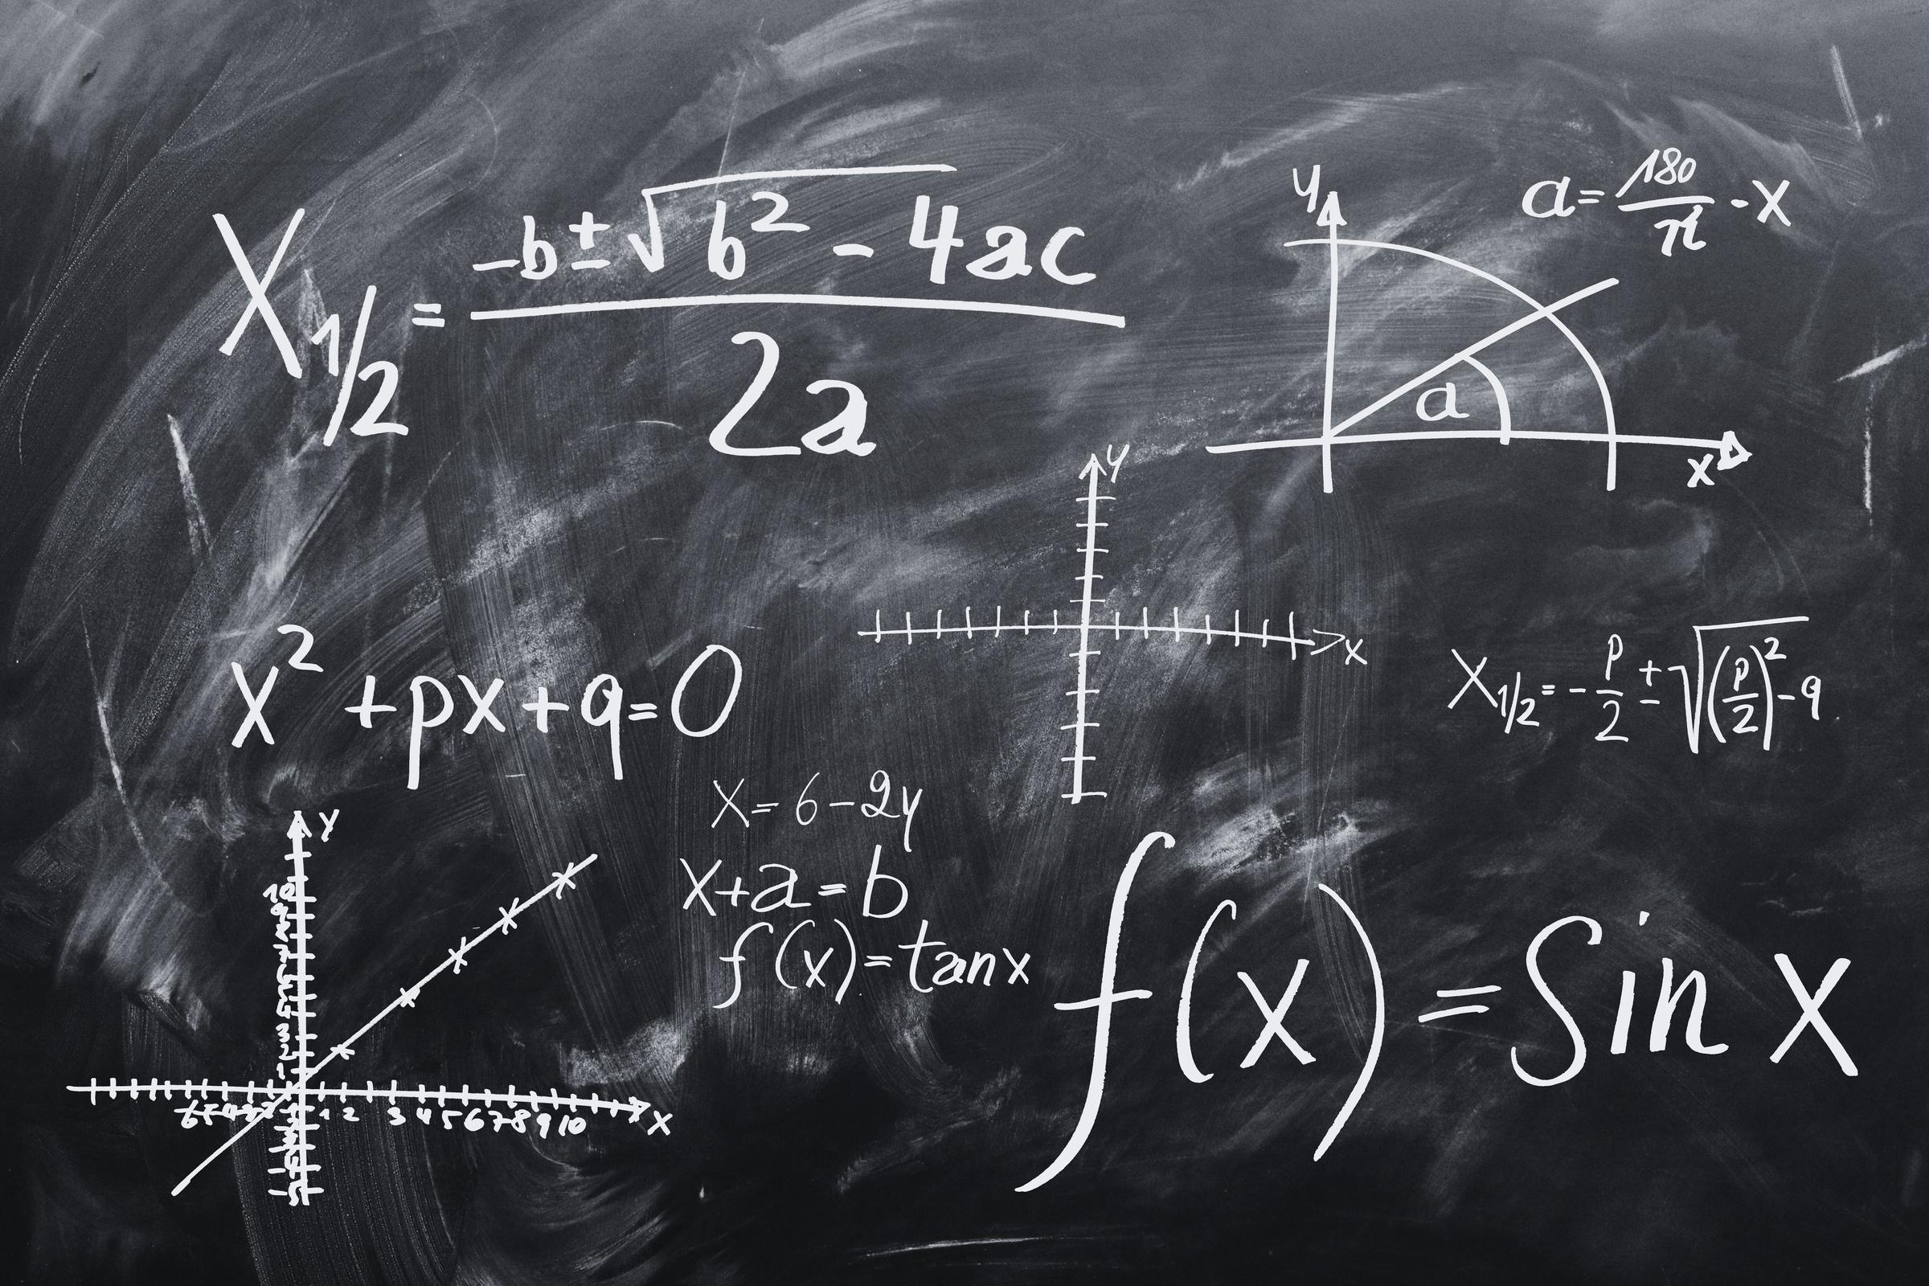
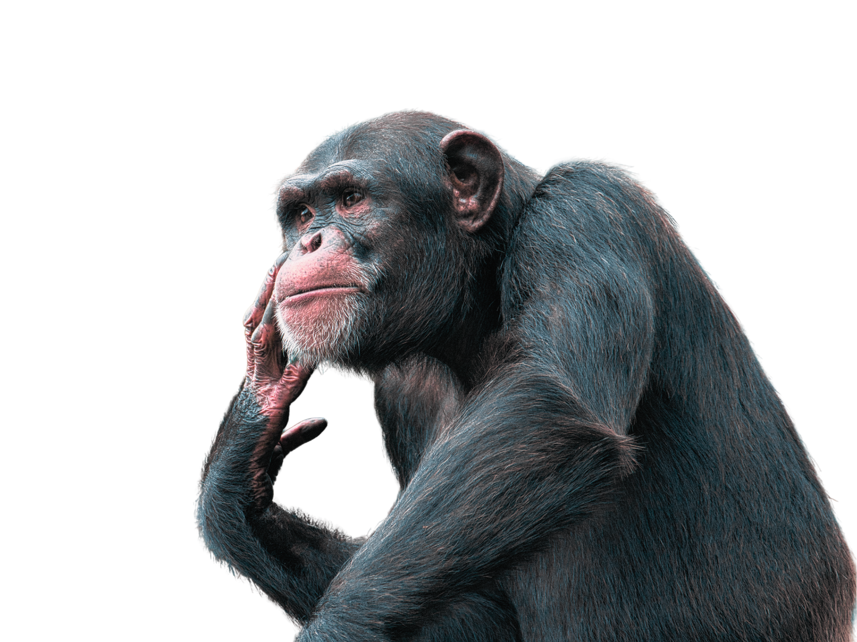
TRYING TO DO MATH WITHOUT CALCULATOR

Slide 6
























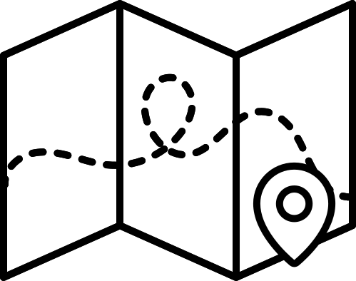














RESOURCE PAGE
  Use these design resources in your Canva Presentation.
Fonts
Design Elements
This presentation template
uses the following free fonts:
TITLES:
ANTON
FRANCOIS ONE
GAEGU
You can find these fonts online too.
Colors
#FFB950
#FFDE59
  DON'T FORGET TO DELETE THIS PAGE BEFORE PRESENTING.

Slide 7

CREDITS
  This presentation template is free for everyone to use thanks to the following:
  for the presentation template
Pexels, Pixabay
  for the photos
  HAPPY DESIGNING!

