Slide 1
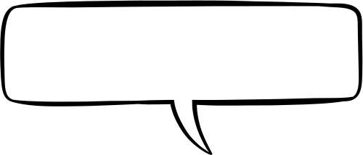
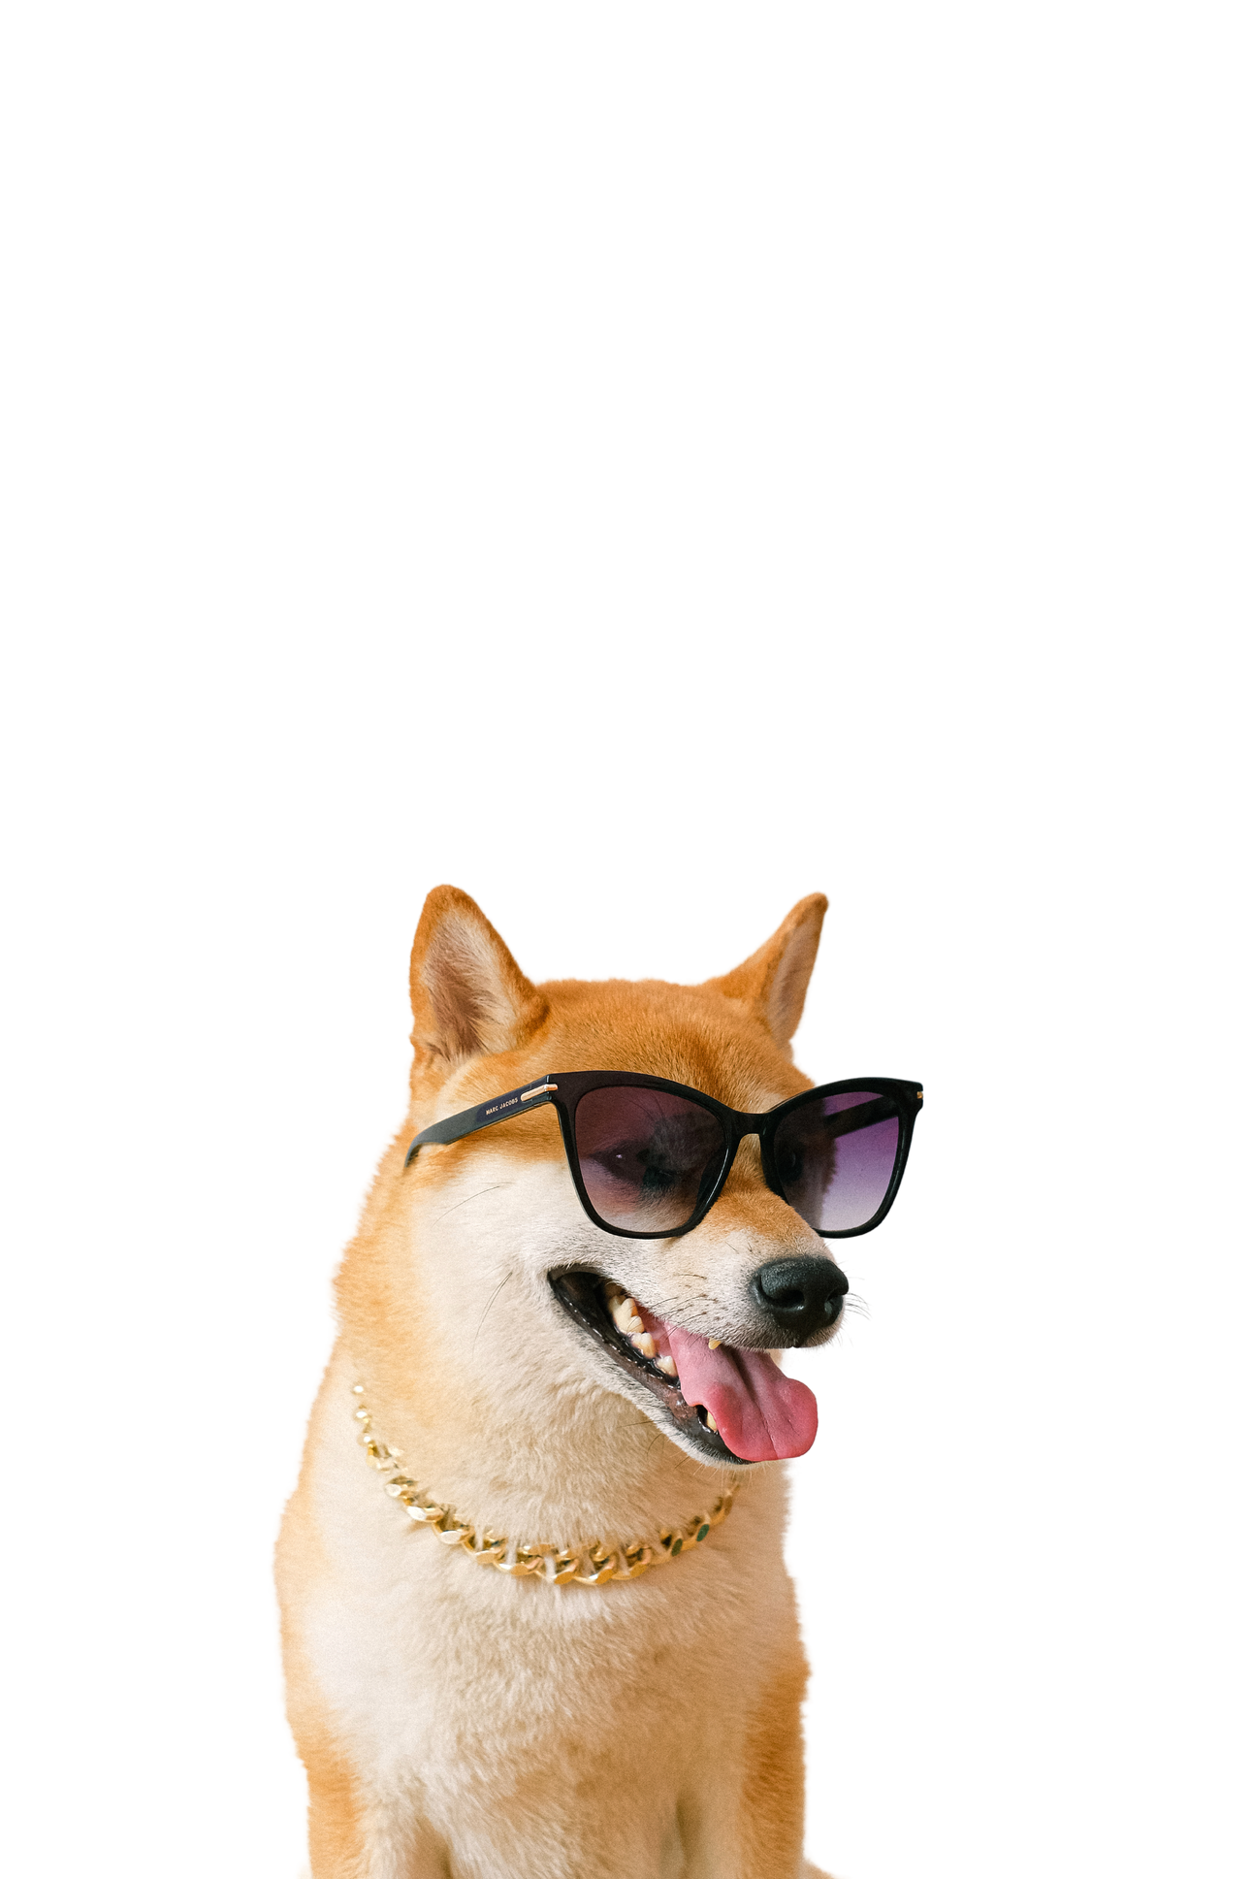
I LOVED YOUR PRESENTATION
ESPECIALLY
THE PART YOU
ENDED IT.

Slide 2

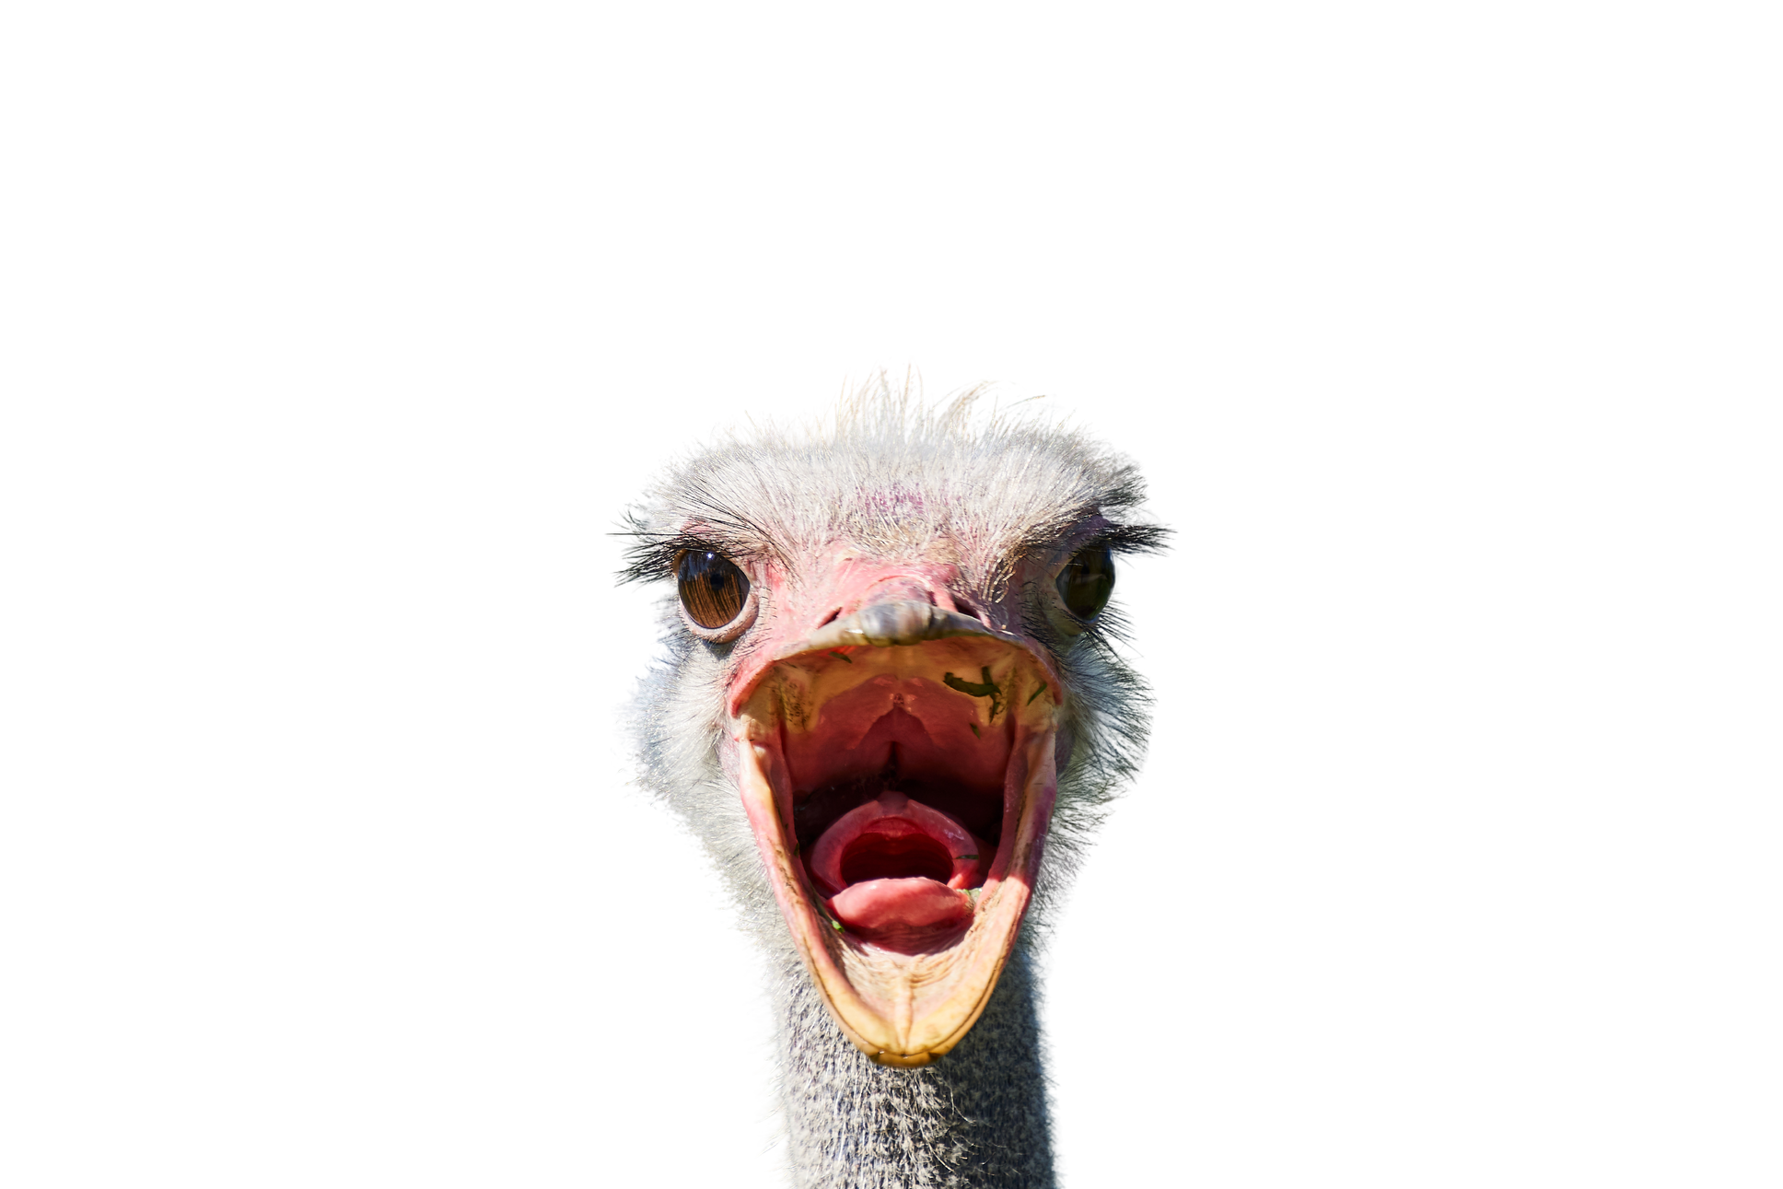
END OF PRESENTATION

Slide 3

DONE WITH MY PRESENTATION
NOW I HAVE TO ANSWER QUESTIONS

Slide 4
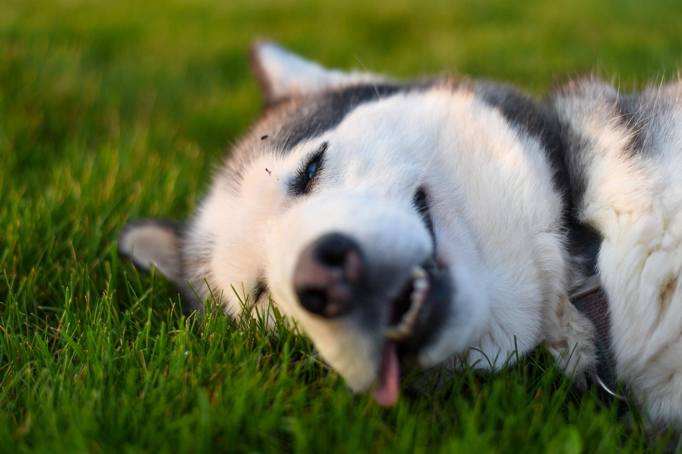
END OF PRESENTATION
NO QUESTIONS, PLEASE

Slide 5

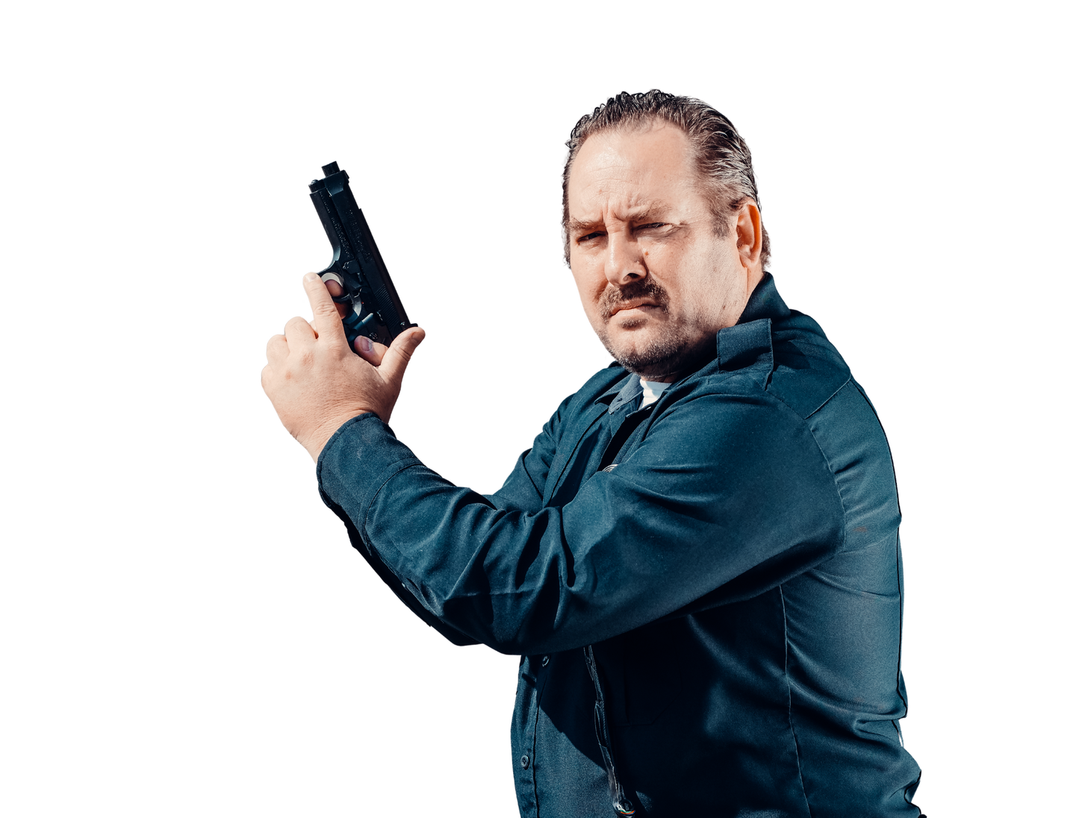
END OF MY PRESENTATION
NOW CLAP!!!

Slide 6
























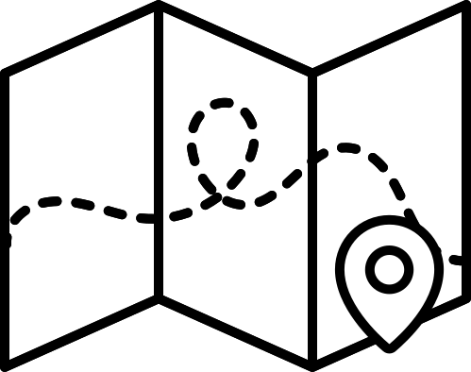














RESOURCE PAGE
  Use these design resources in your Canva Presentation.
Fonts
Design Elements
This presentation template
uses the following free fonts:
TITLES:
ANTON
BODY COPY:
ANTON
You can find these fonts online too.
Colors
#FFB950
#FFF0B1
  DON'T FORGET TO DELETE THIS PAGE BEFORE PRESENTING.

Slide 7

CREDITS
  This presentation template is free for everyone to use thanks to the following:
  for the presentation template
Pexels, Pixabay
  for the photos
  HAPPY DESIGNING!

