Slide 1
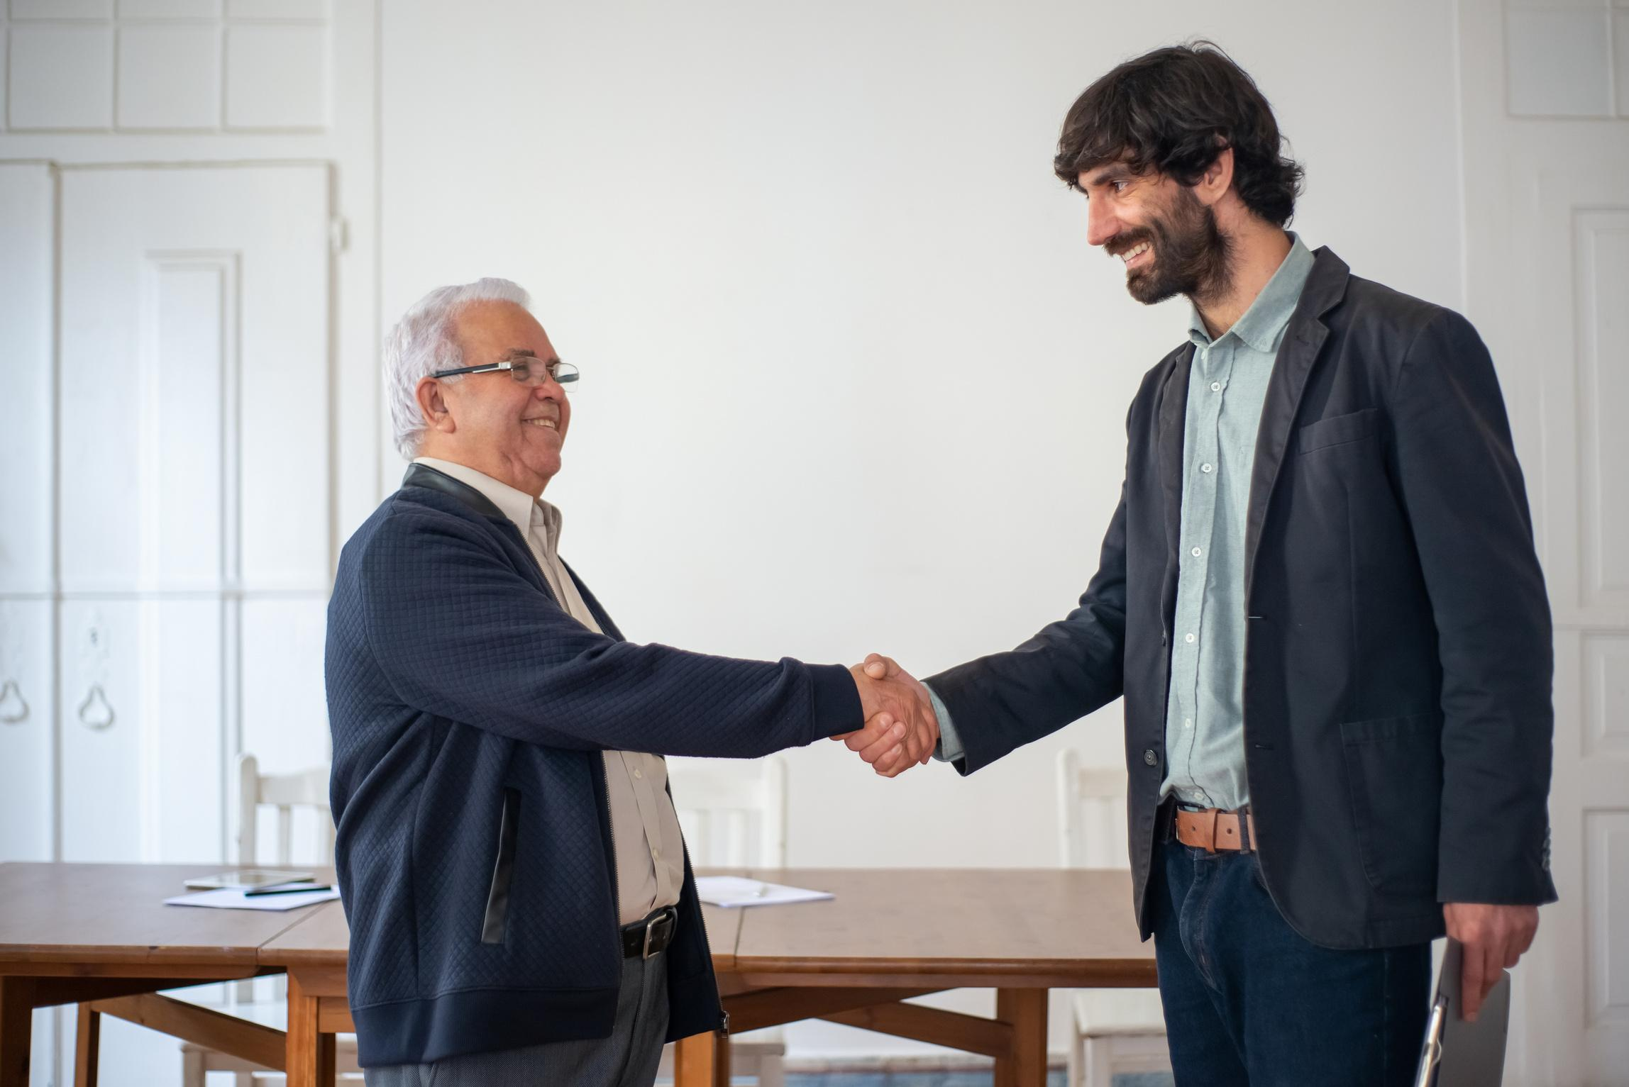
MY FAMILY
THINKING I’M A
COMPUTER
GENIUS
ME WHO JUST
RESTARTEd
THE ROUTER

Slide 2
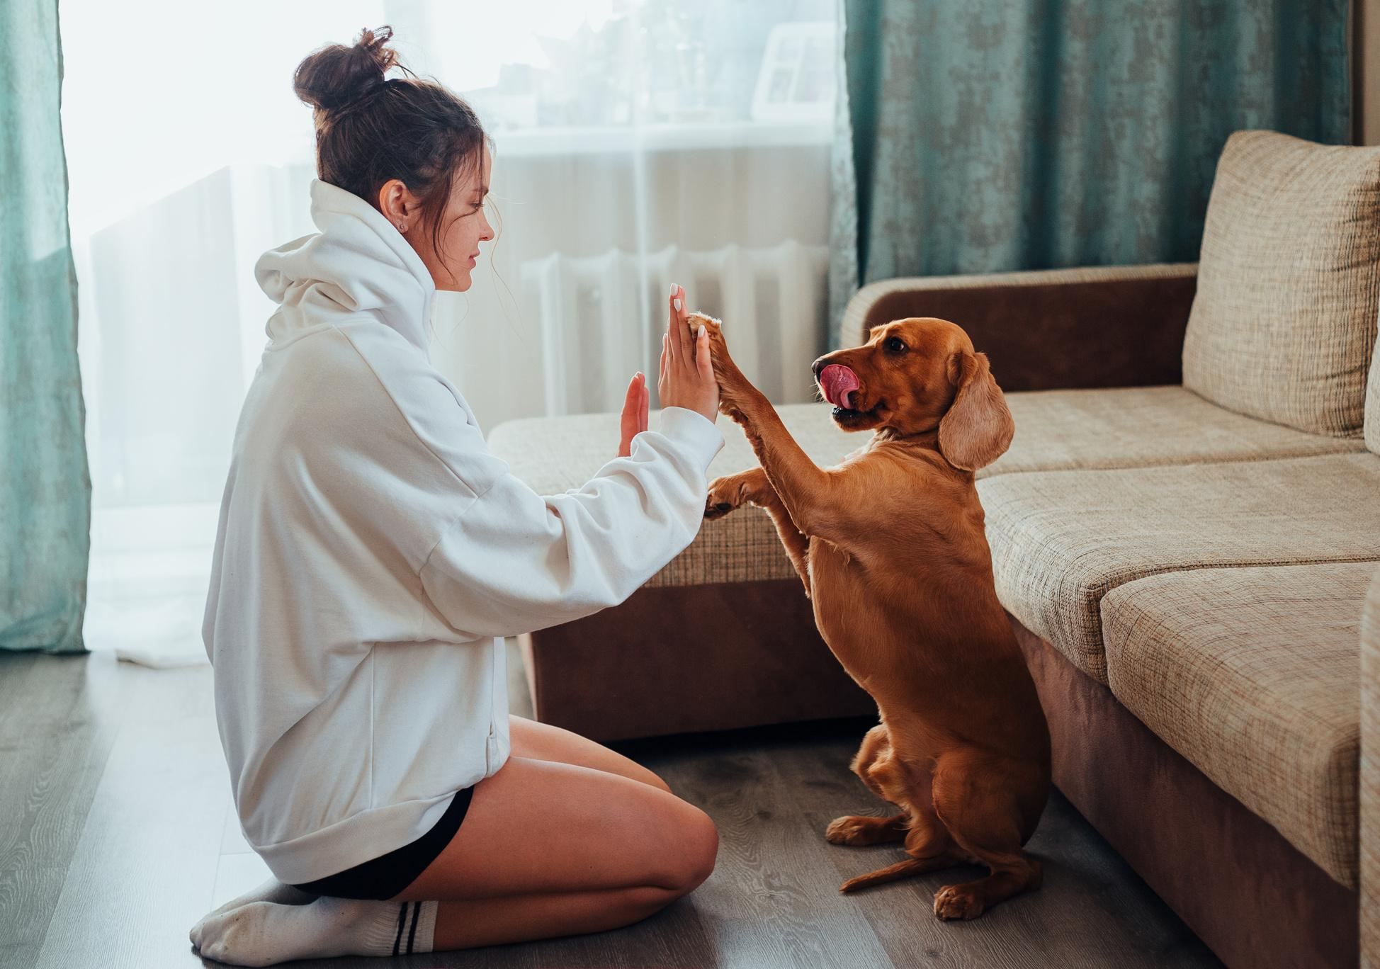
NOT GETTING CHOCOLATES ON VALENTINES DAY
DOGS
SINGLE

Slide 3
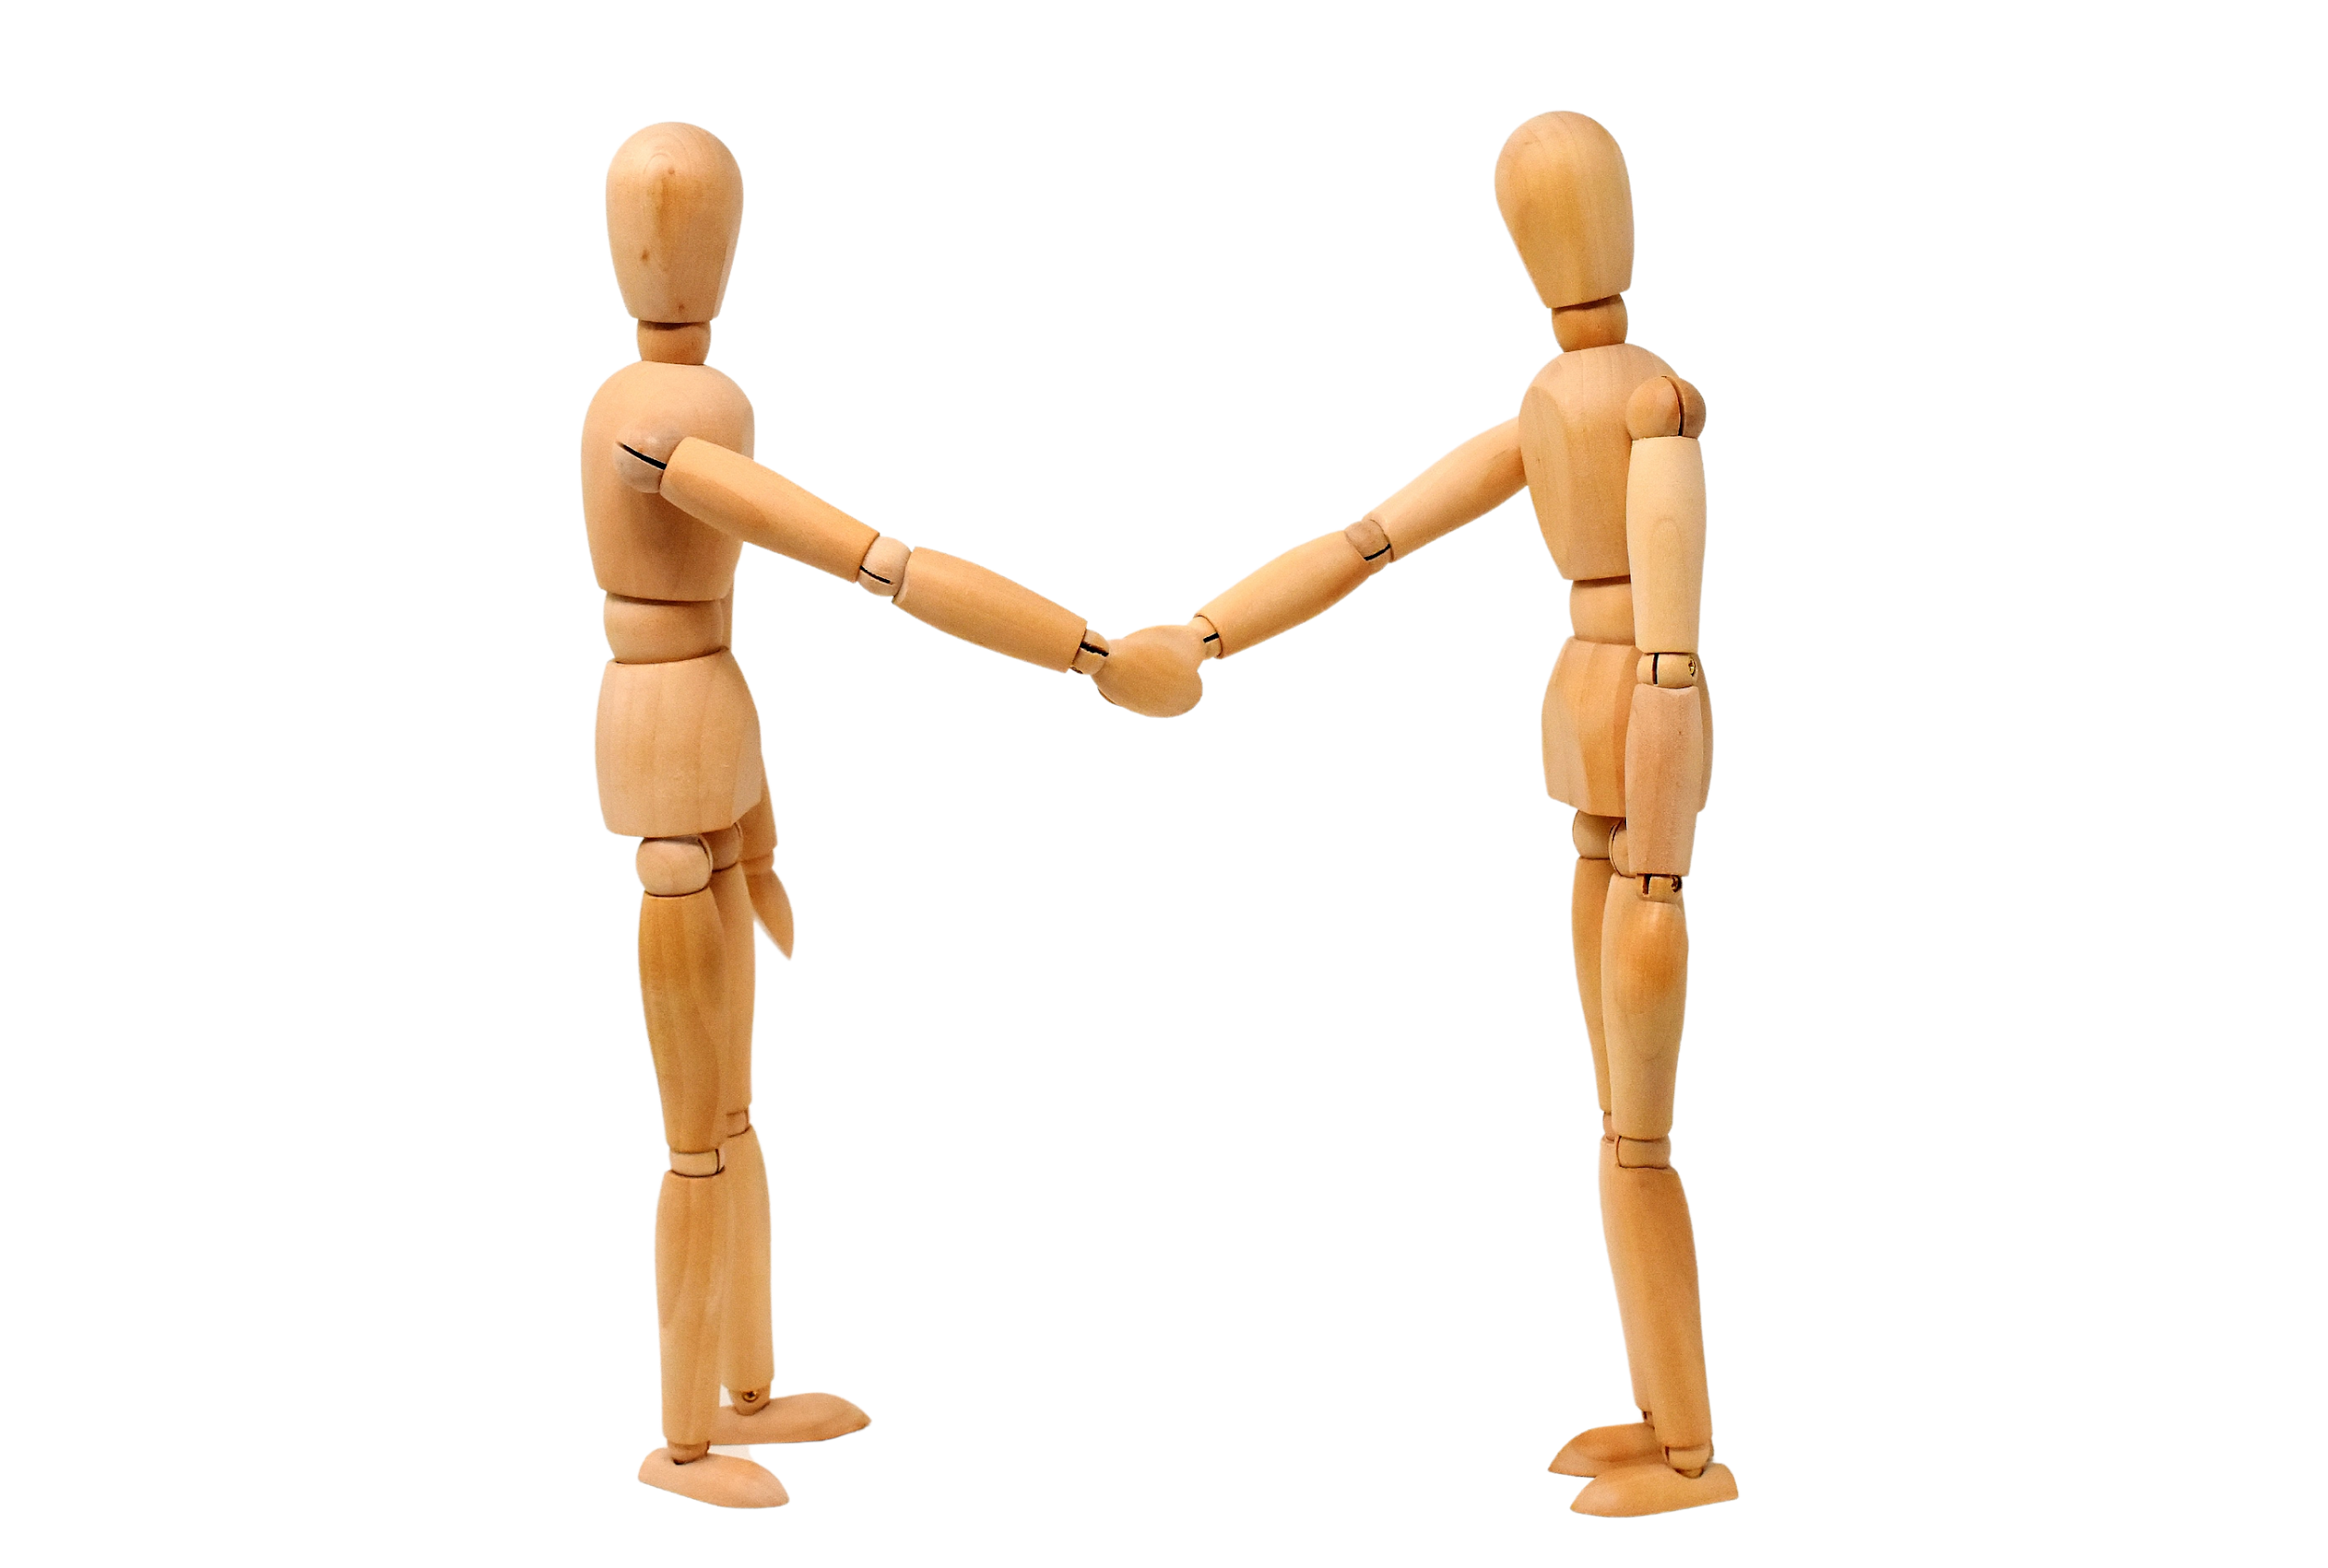
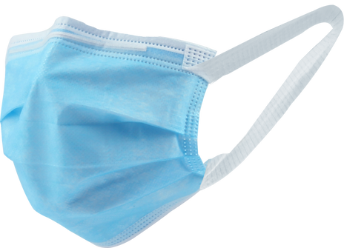
ME WEARING
A MASK TO
HIDE MY FACE
THE SOCIETY
BEING PROUD
OF ME

Slide 4

MY BOSS THANKING ME FOR MY HARDWORK
ME TALKING DOUBLE BREAKS AND BROWSING MEMES

Slide 5
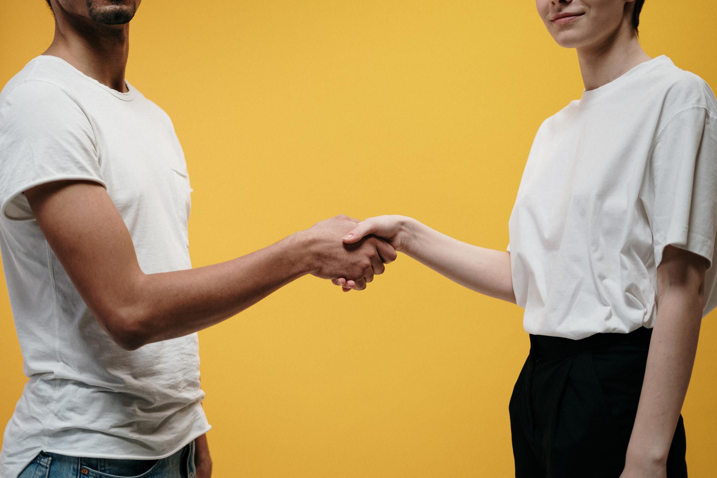
MY FRIENDS SAYING
I’M GOOD AT
KEEPING SECRETS
ME WHO FORGOT THEIR SECRET 5 MINUTES
AFTER THEY TOLD ME

Slide 6
























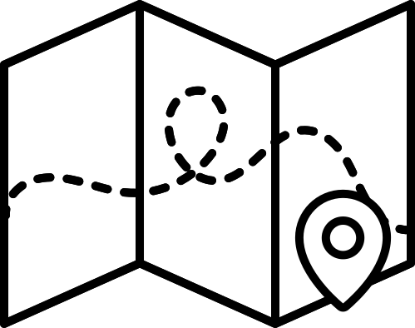














RESOURCE PAGE
  Use these design resources in your Canva Presentation.
Fonts
Design Elements
This presentation template
uses the following free fonts:
TITLES:
BEBAS NEUE
BODY COPY:
BEBAS NEUE
You can find these fonts online too.
  DON'T FORGET TO DELETE THIS PAGE BEFORE PRESENTING.

Slide 7

CREDITS
  This presentation template is free for everyone to use thanks to the following:
  for the presentation template
Pexels, Pixabay
  for the photos
  HAPPY DESIGNING!

