Slide 1

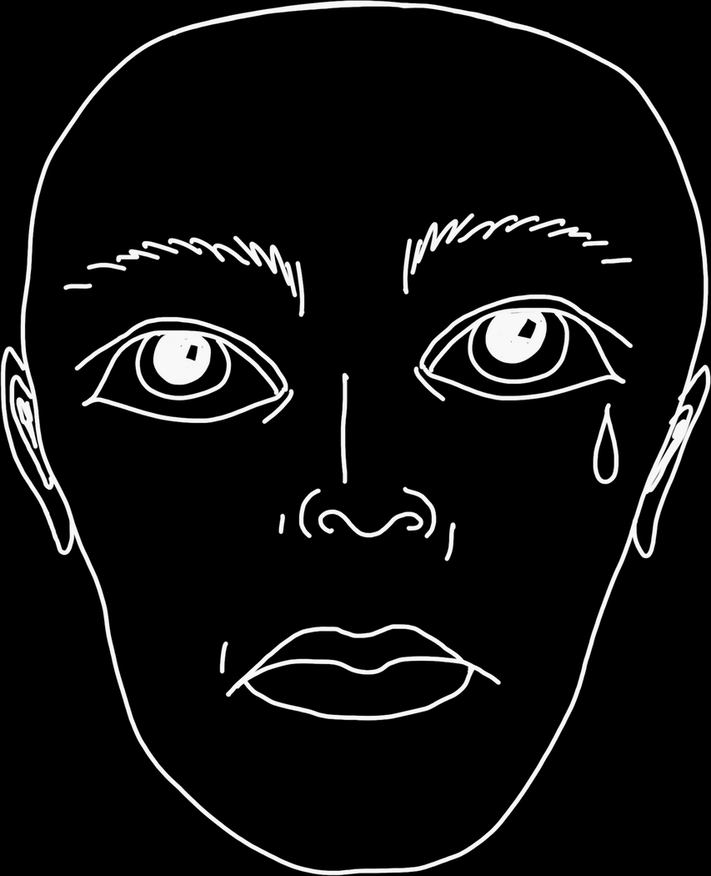


SAD
MEME
SLIDES

Slide 2
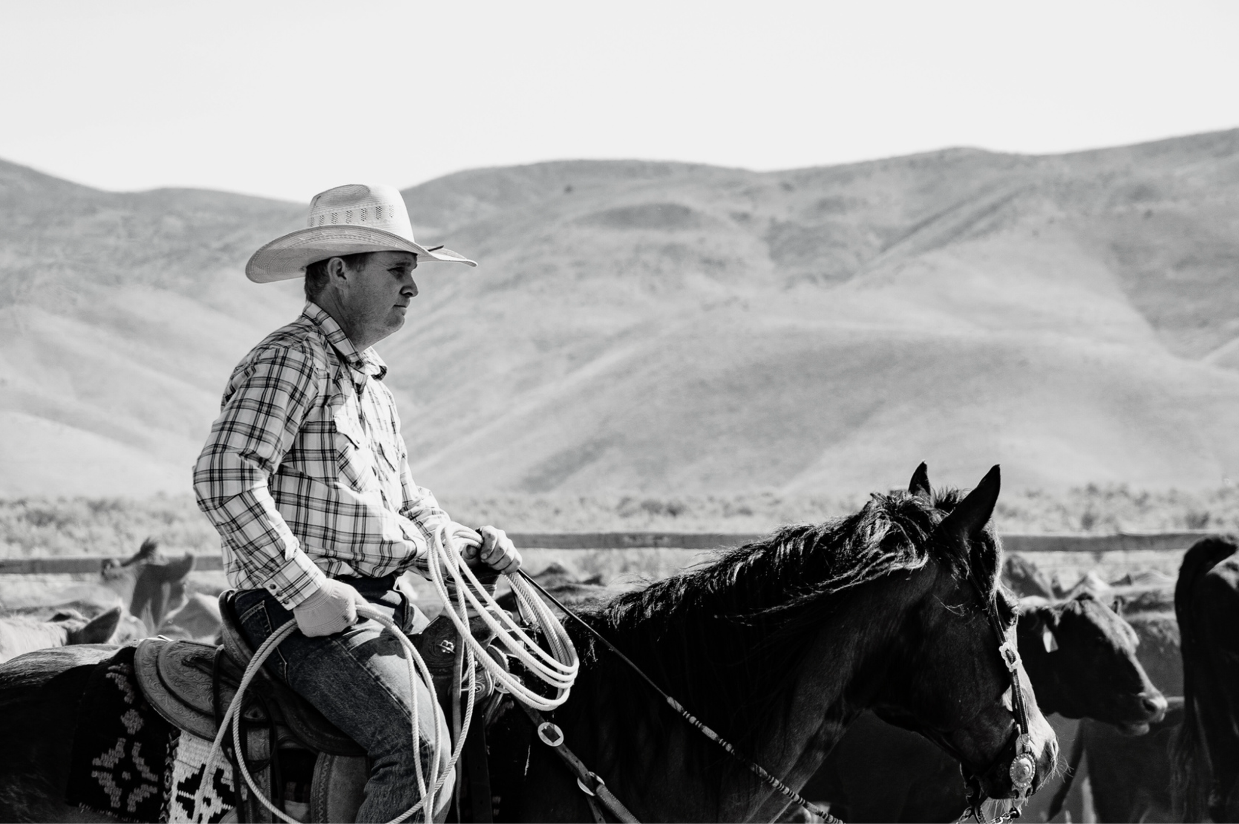

They always say “howdy, partner!”
But never
“how are you, partner?”

Slide 3
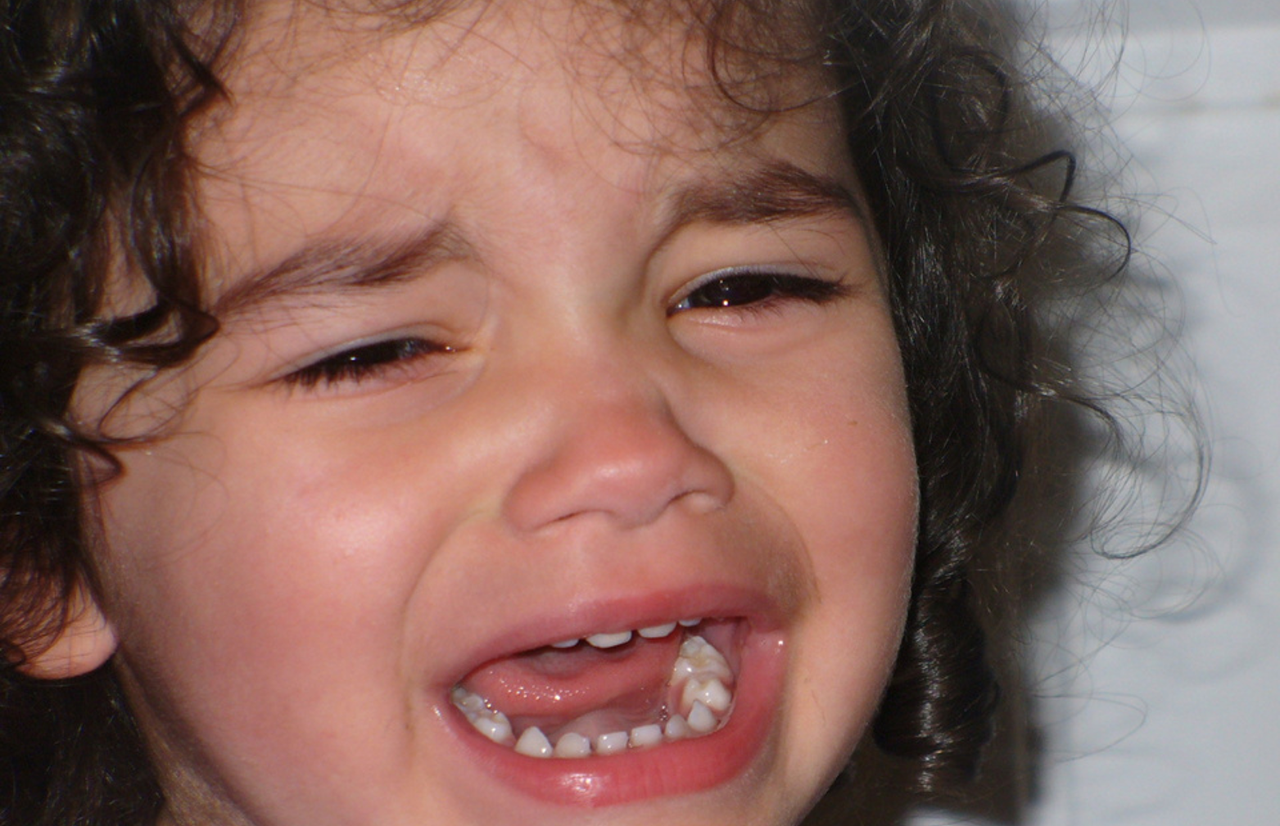
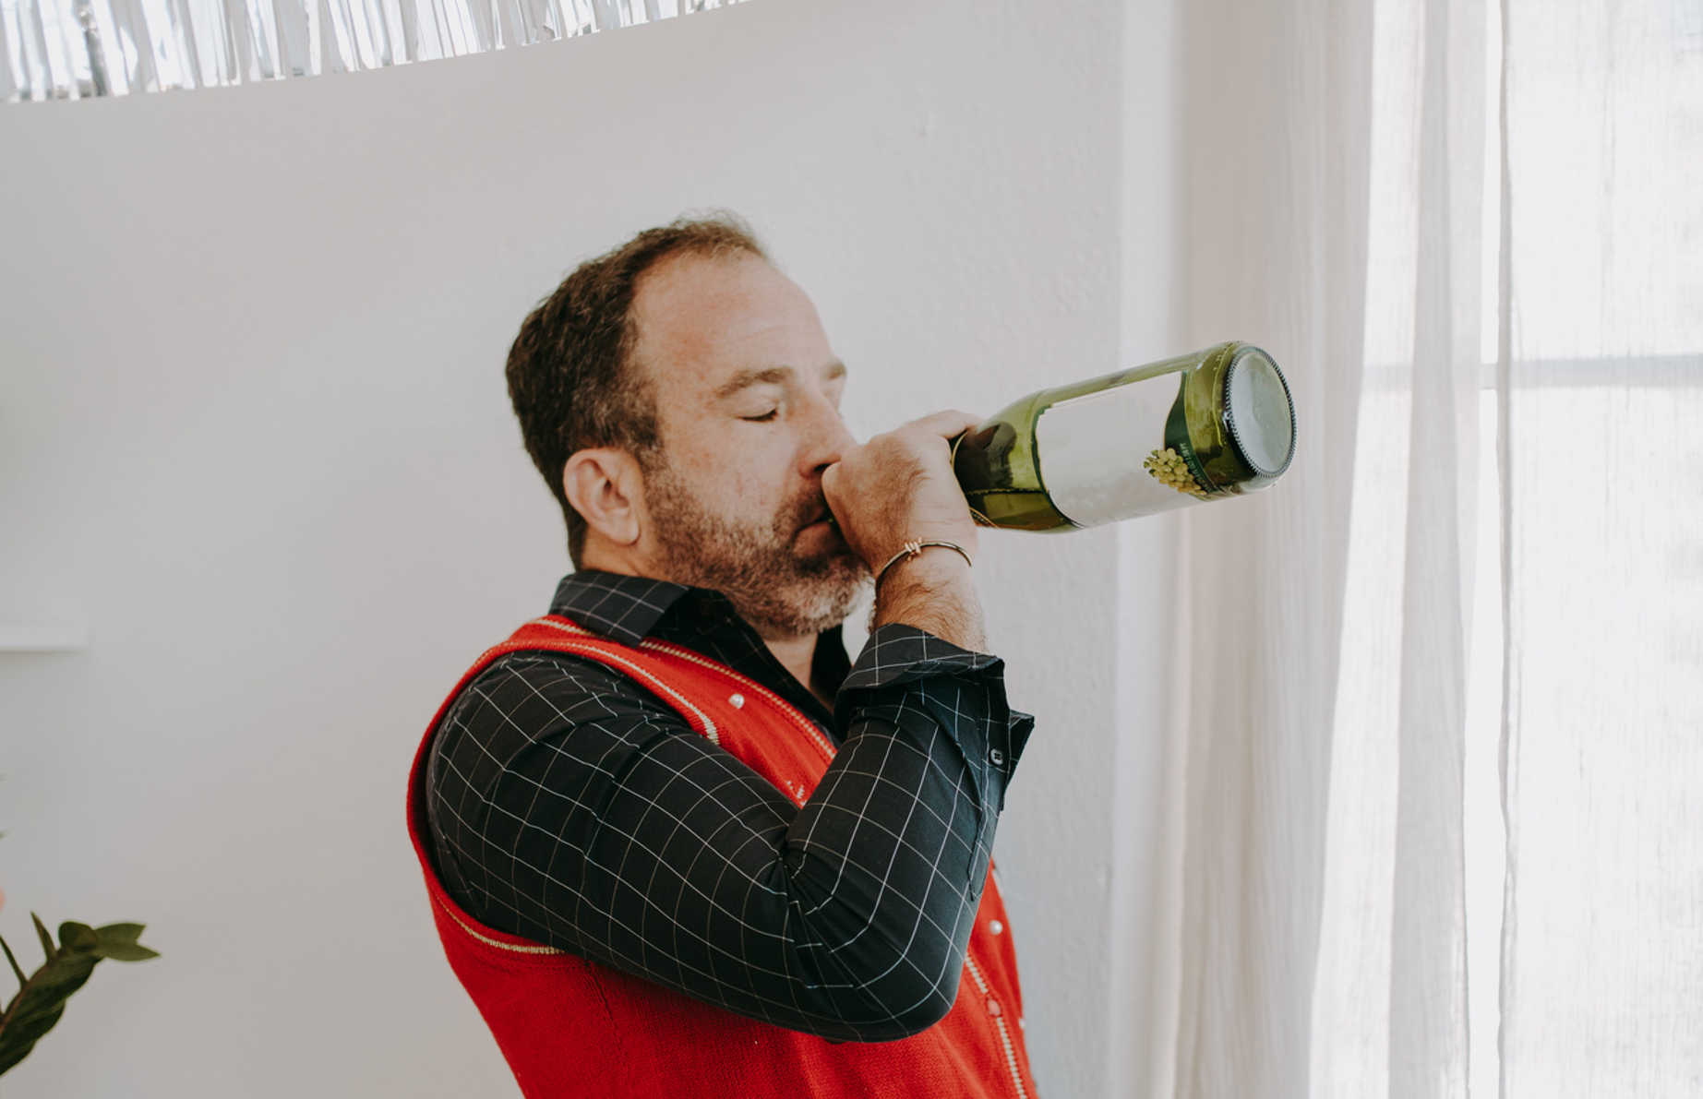
Me: *has a panic attack*
I’m feeling great
Also me 5 mins later:
Nah, what was I thinking

Slide 4
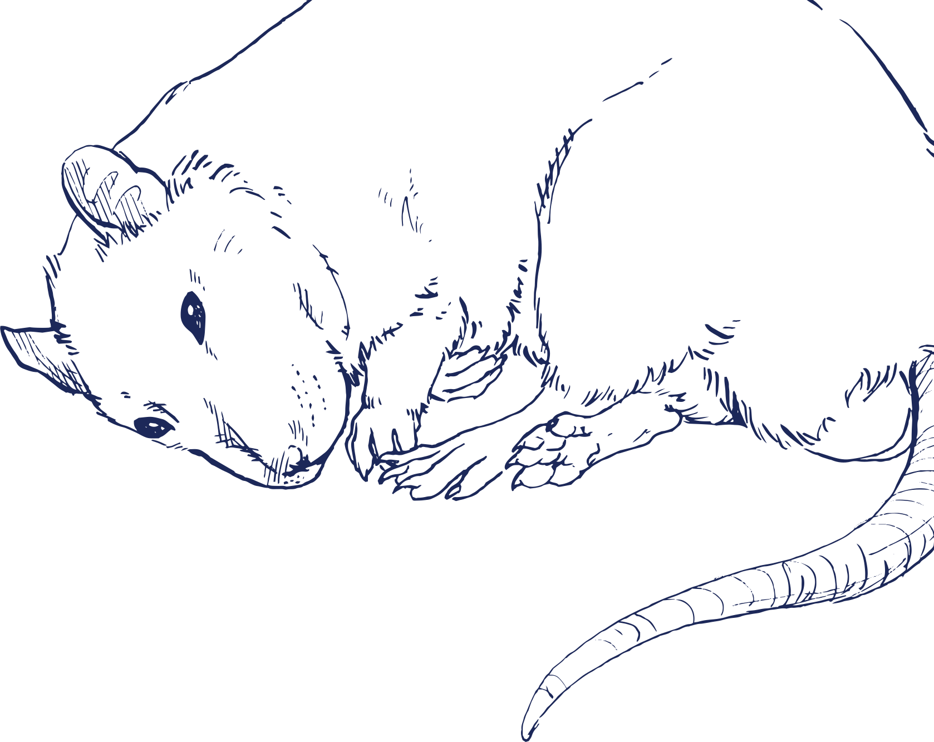
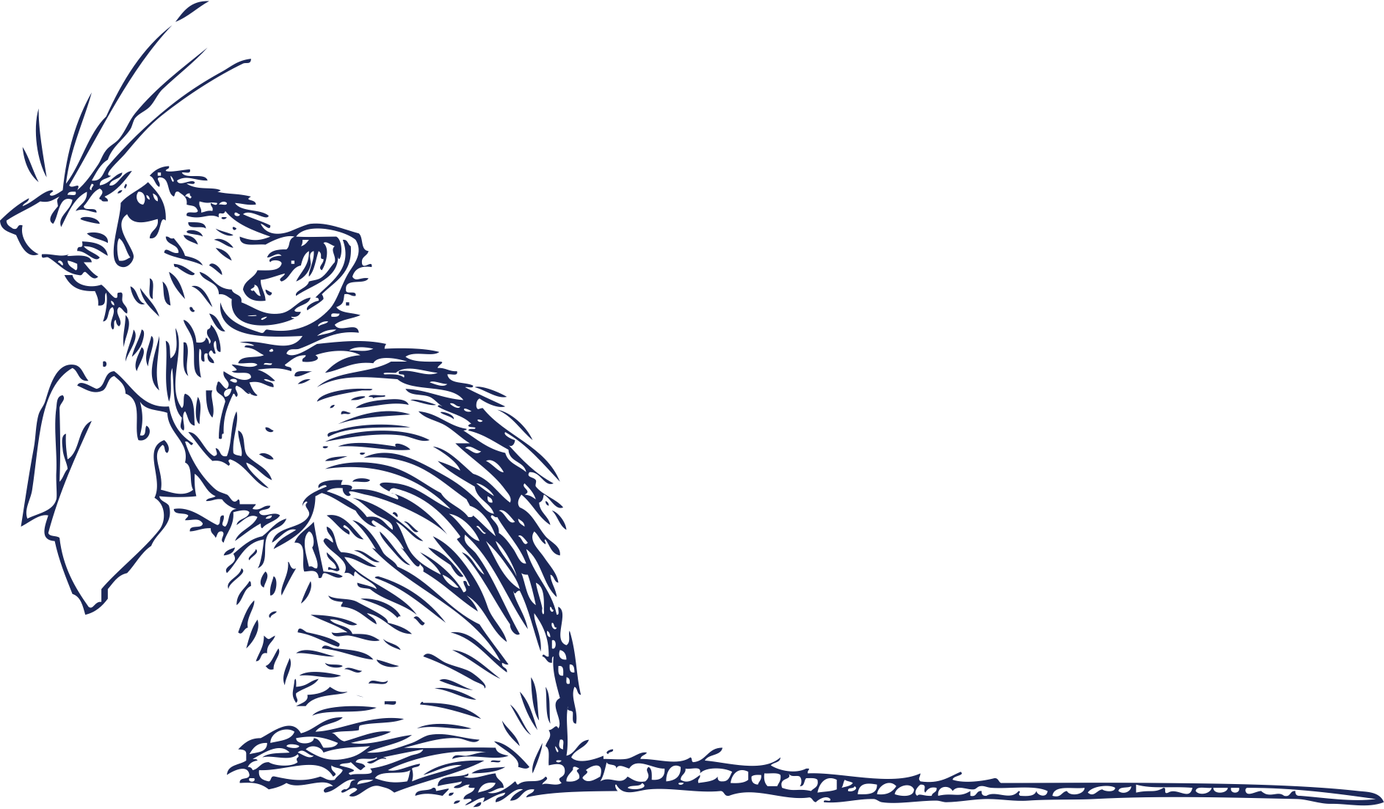
Would you still love me if I were a rat?

Slide 5
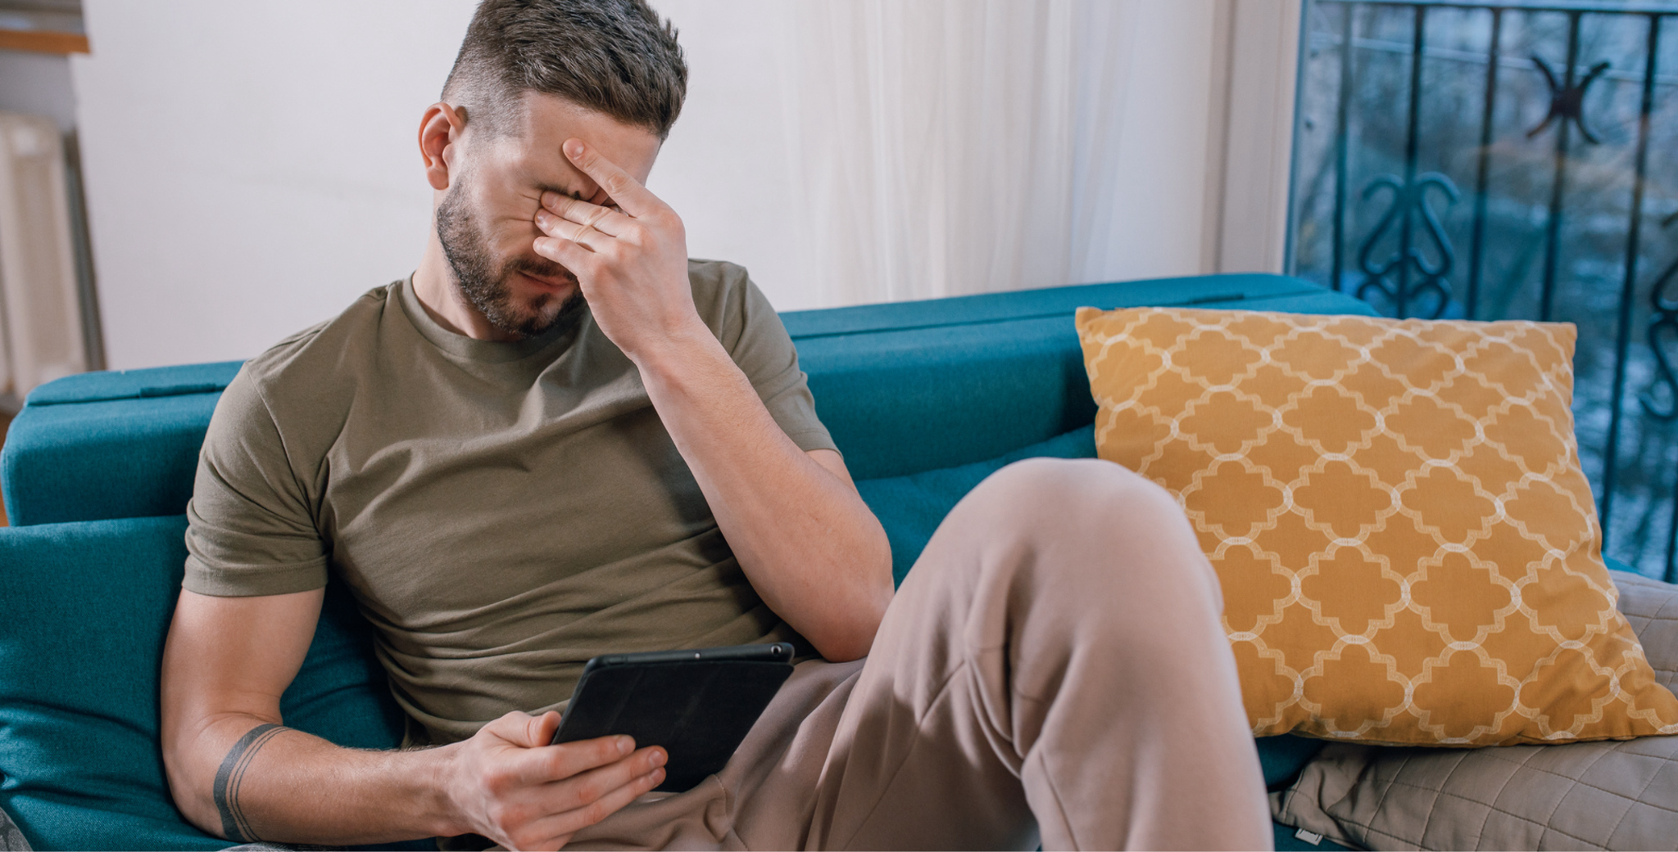
When I’m about to send my friend a funny Tiktok but then I forgot to reply to their rant

Slide 6
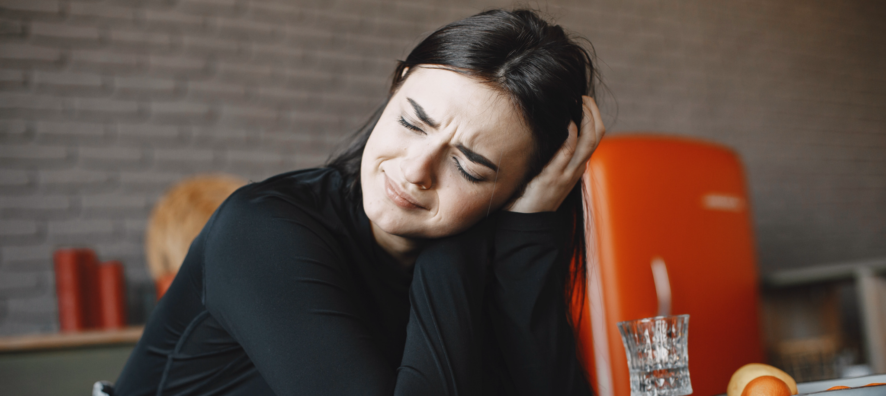
When you clean your room so good
that the only trash left is you

Slide 7


I need to be happy to have friends
I need friends to be happy

Slide 8
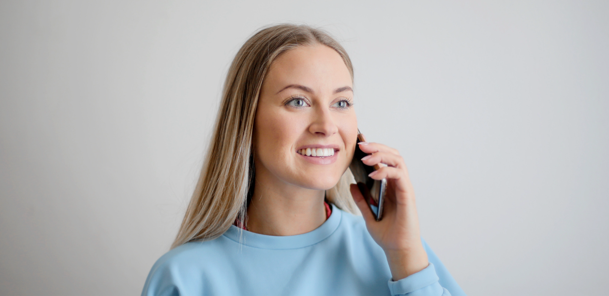
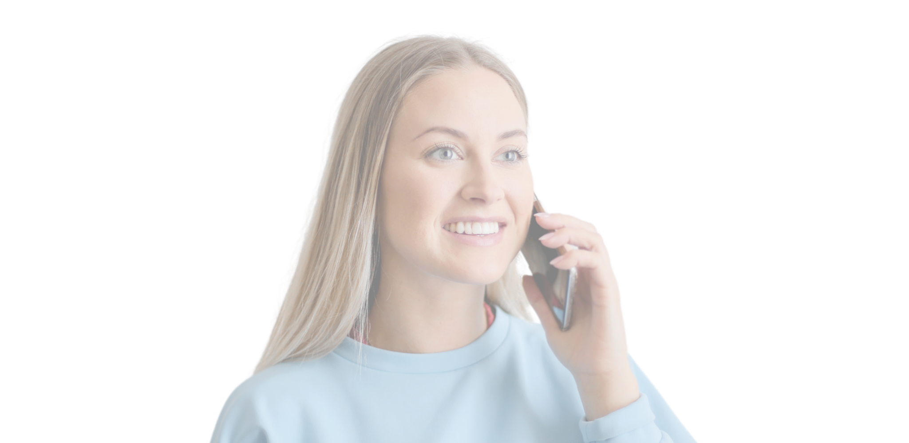

When I tell my mom a funny joke and it turns into a 30 min life lecture

Slide 9
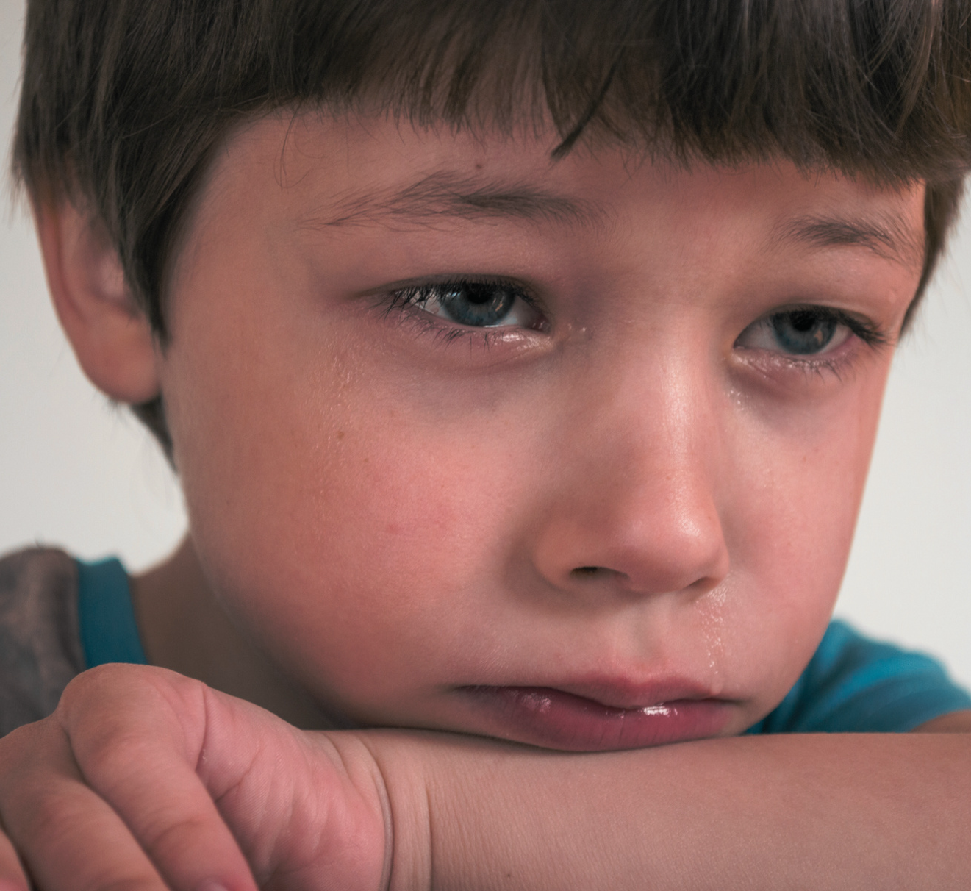
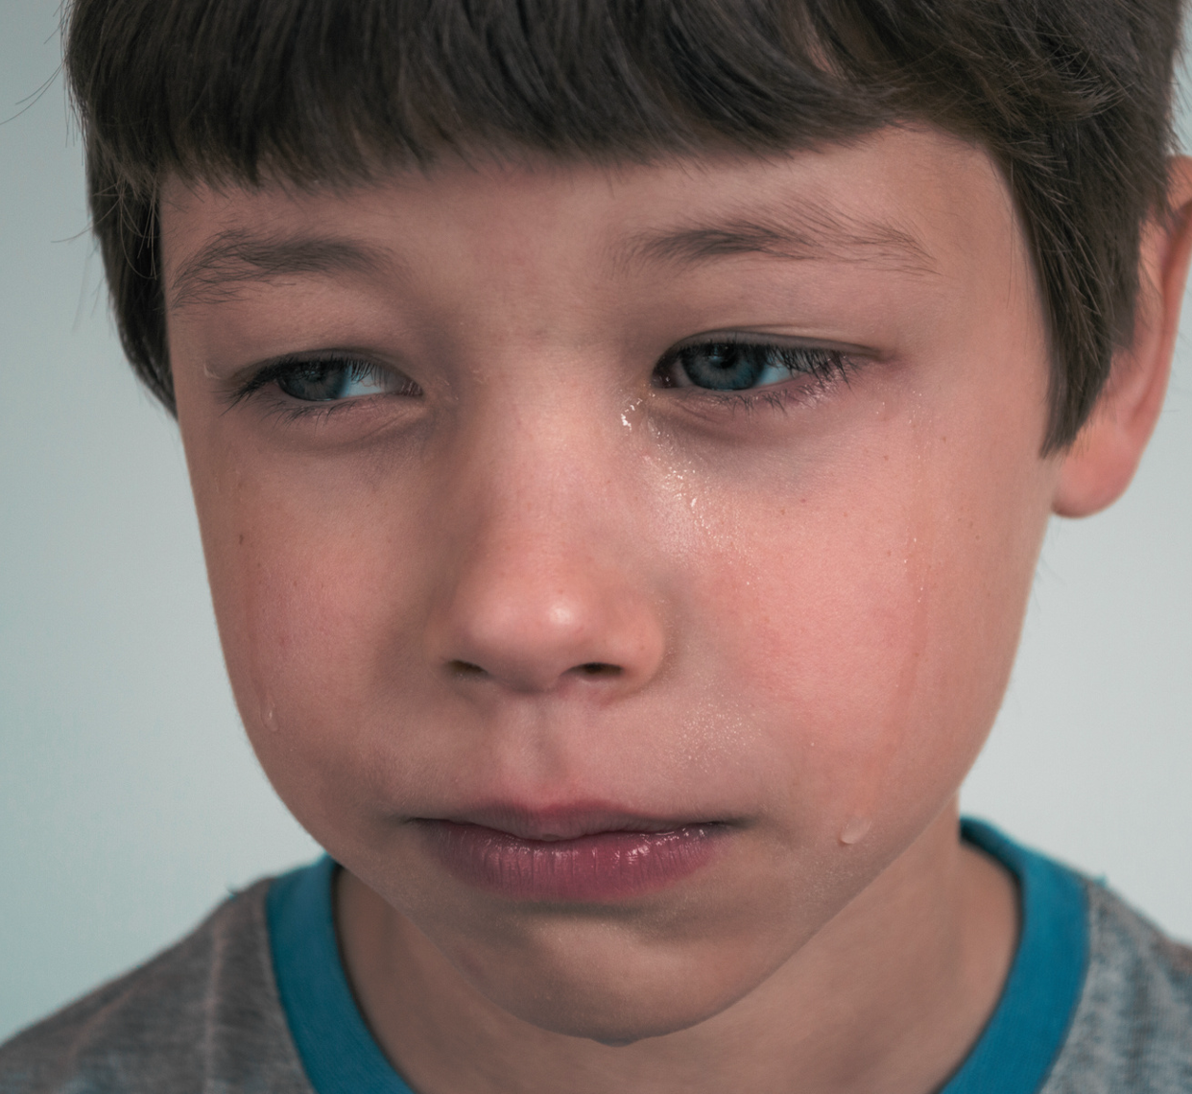
Me staring out of a car window while pretending to be in a sad music video

Slide 10
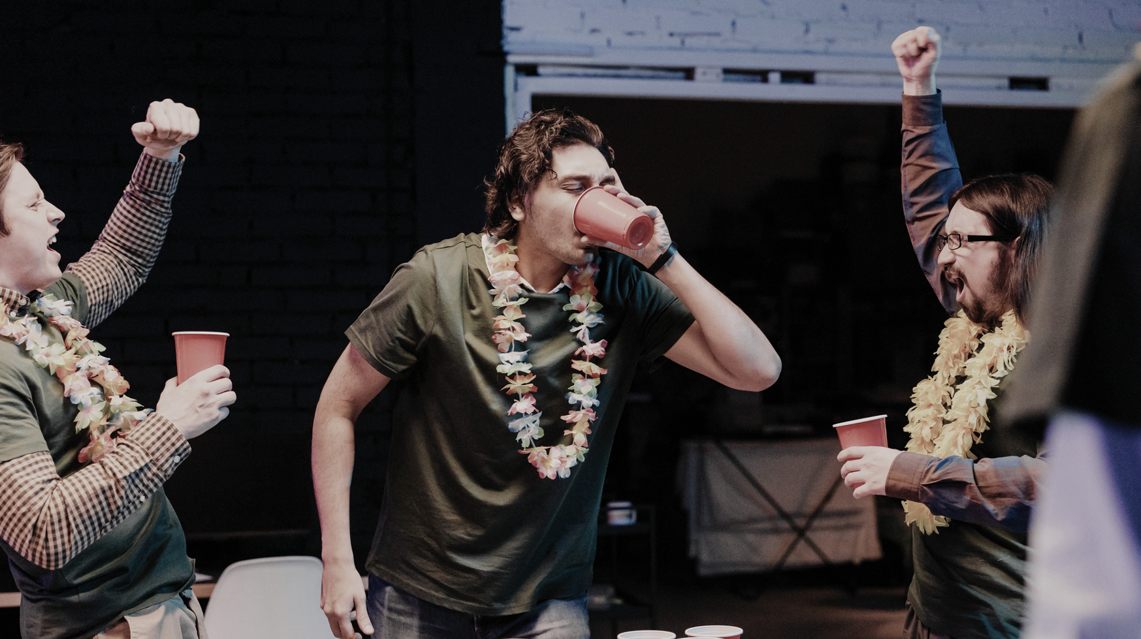
WHEN THE WHOLE GANG GETS TOGETHER
overthinker
loneliness
me
anxiety

Slide 11
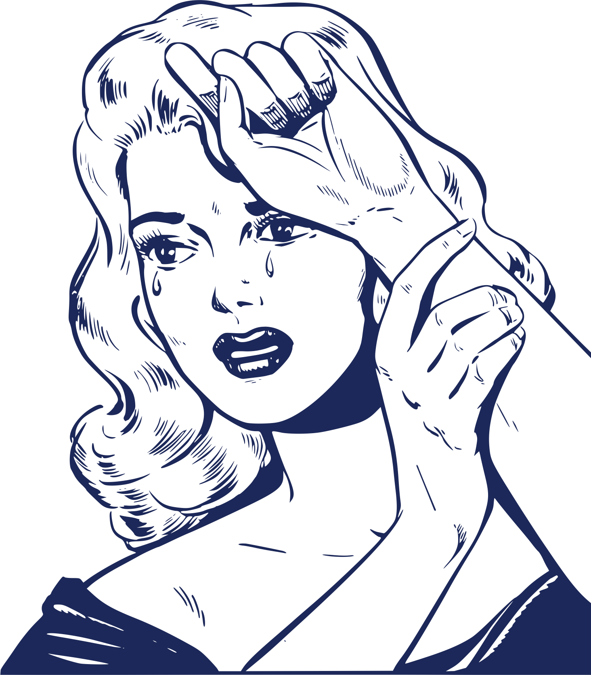
Me after working for 15 mins

Slide 12
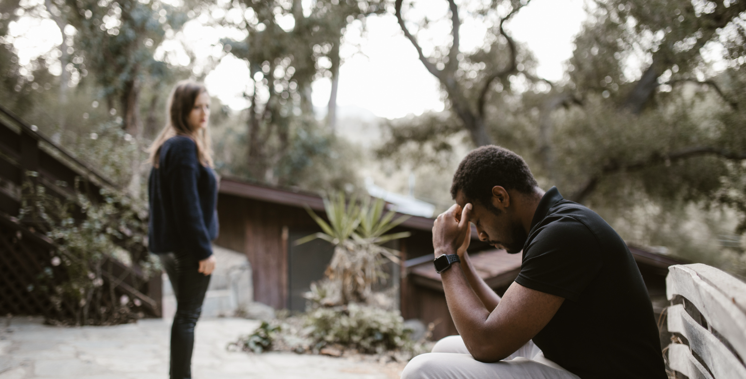

Me when I “meow” and the cat doesn’t “meow” back

Slide 13
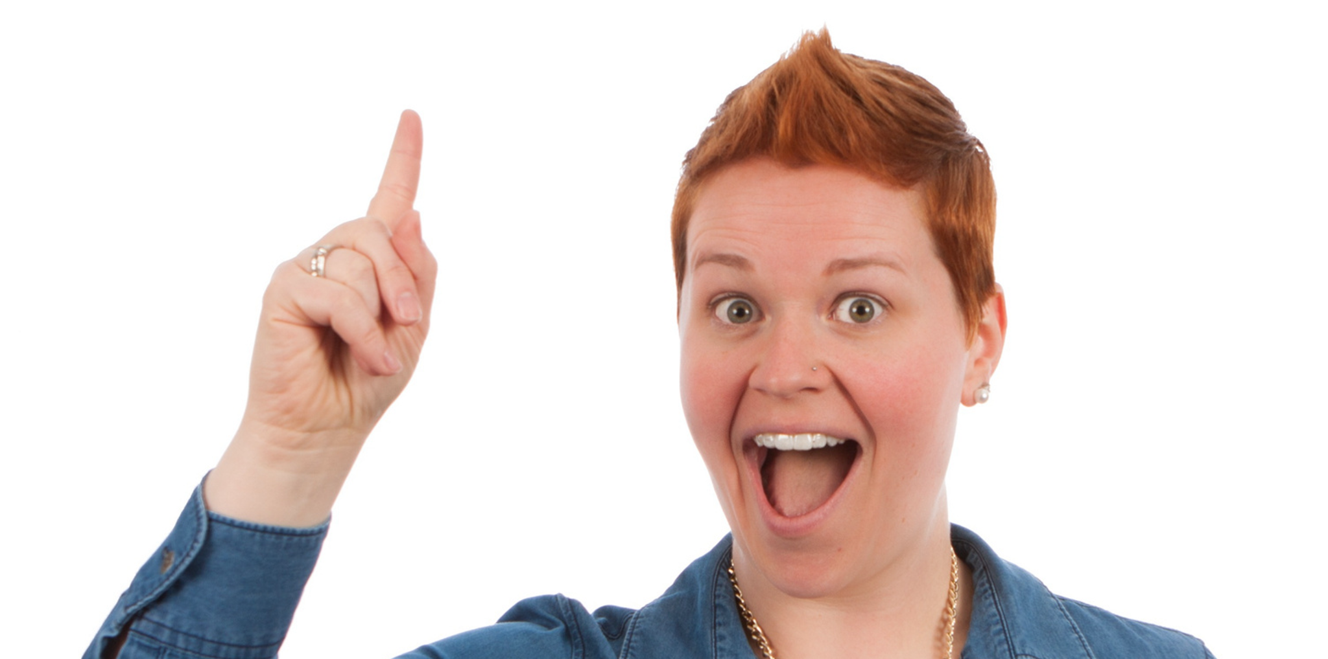
Me: I’m sad
Friend: Hey, don’t be sad, just smile!
why of course, good idea!
silly me

Slide 14
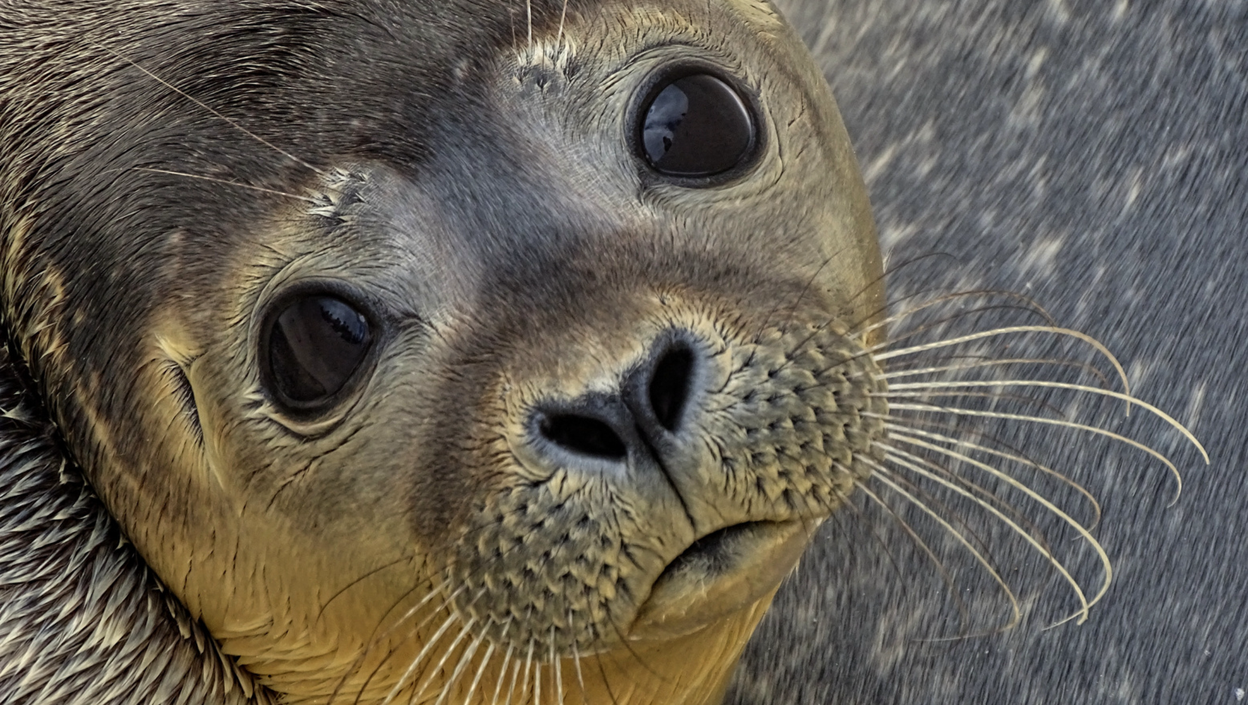
When you offer your last piece of gum and they actually take it
why

Slide 15
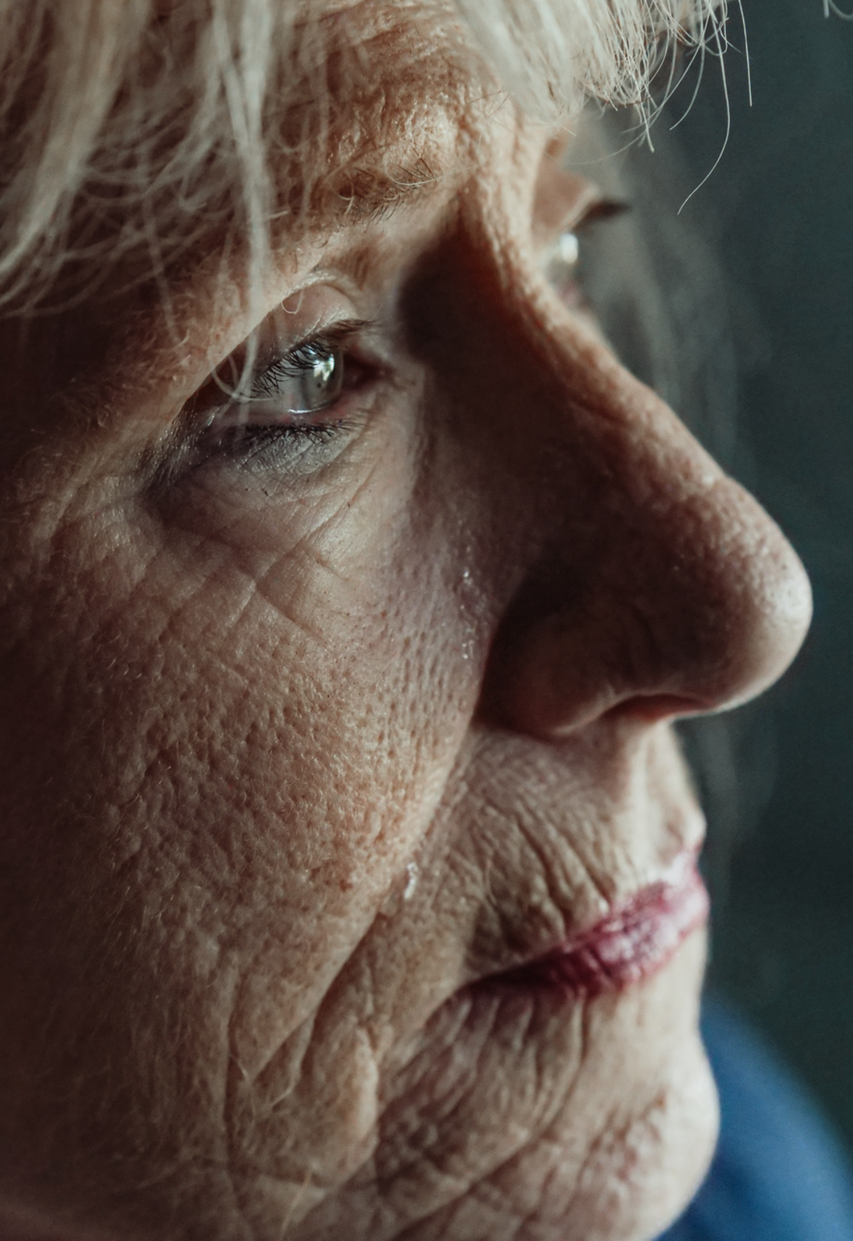
30 year old me:
Watching childhood shows in the desperate hope you will feel the same happiness you did as a child

Slide 16


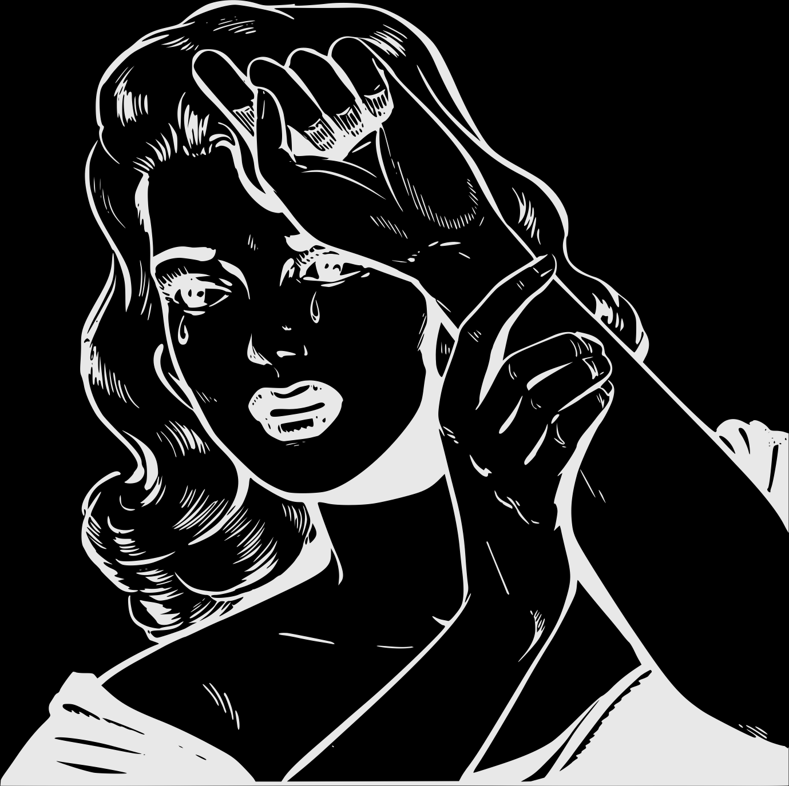

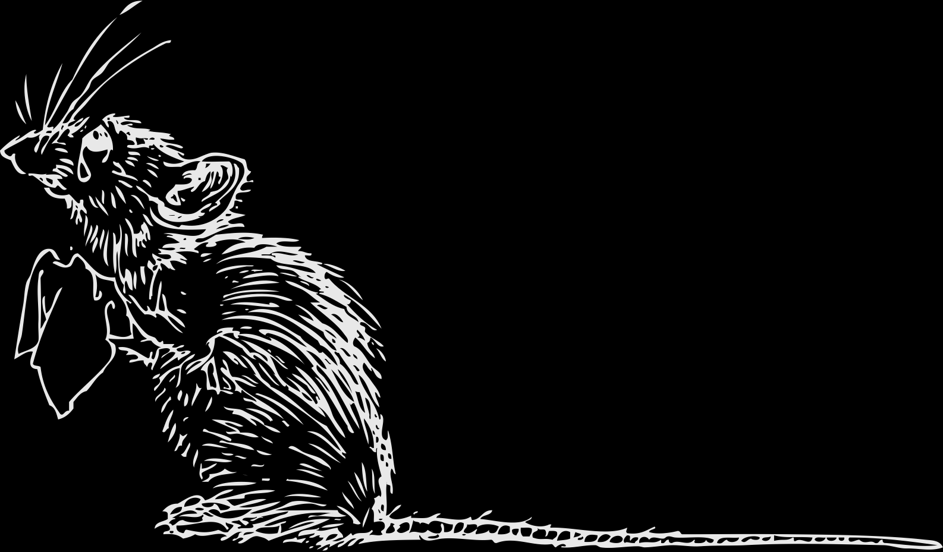
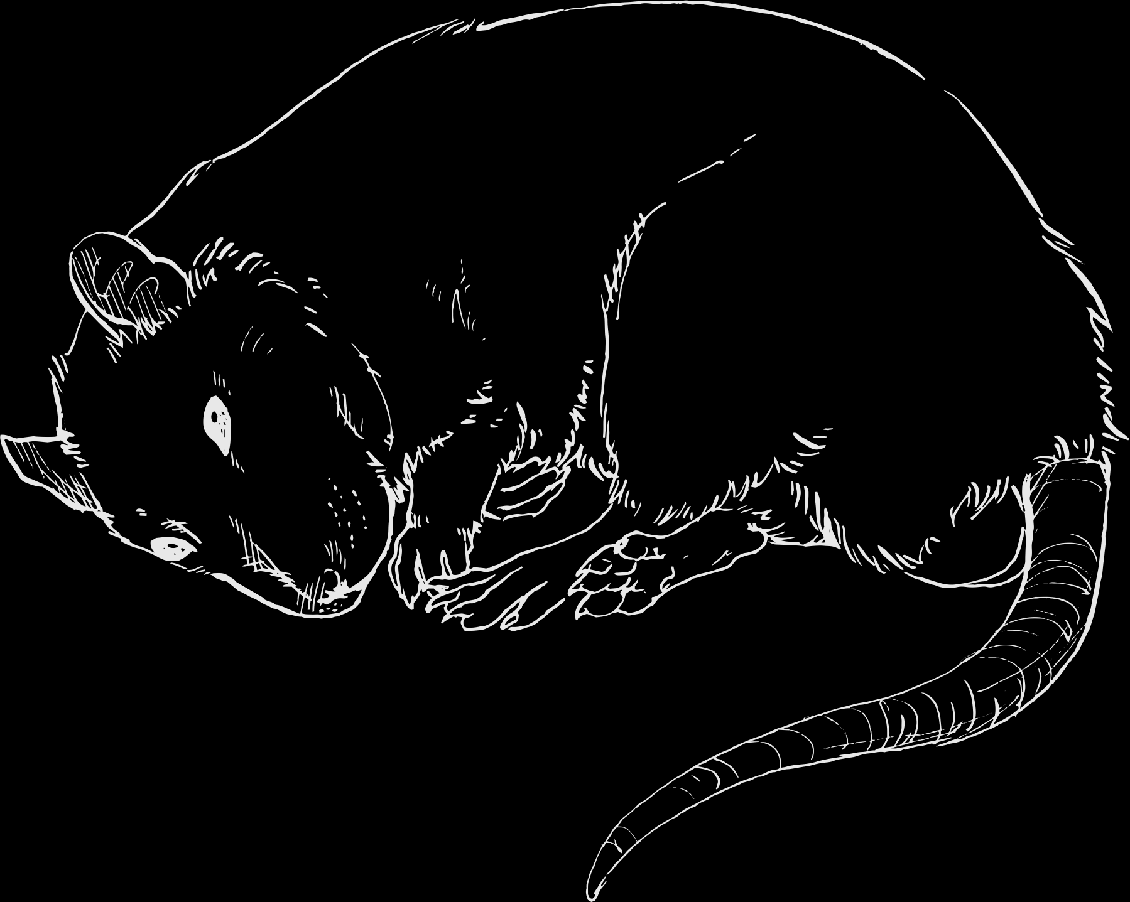
Resource Page
  Use these design resources in your Canva Presentation.
Fonts
  Design Elements
  This presentation template
  uses the following free fonts:
  Titles and Body:
ANTON
INTER
  You can find these fonts online too.
Colors
#E8E8E8
#000000
#3E5064
#1C2859
#C0D0DB
  Don't forget to delete this page before presenting.

Slide 17


Credits
  This presentation template is free for everyone to use thanks to the following:
  for the presentation template
  PEXELS, PIXABAY
  for the photos
  HAPPY DESIGNING!

