Slide 1




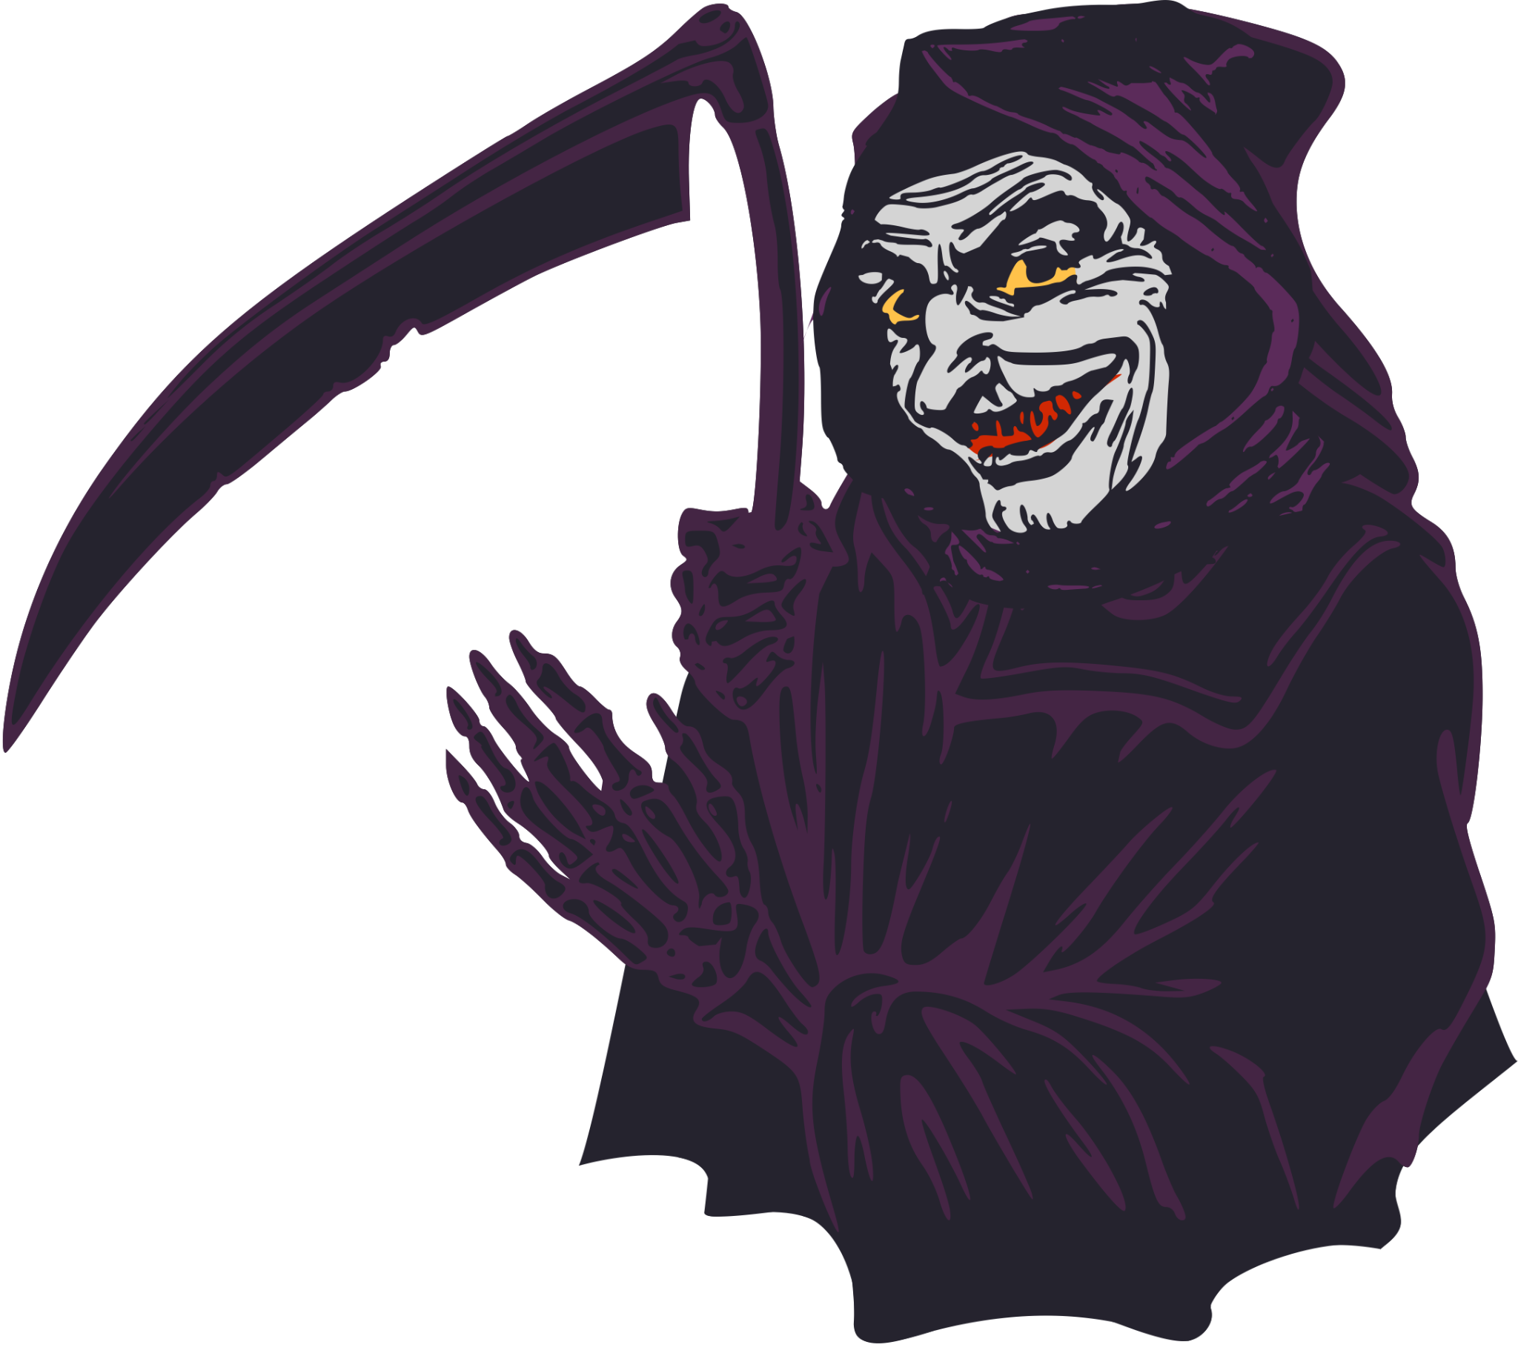





SPIRIT
HALLOWEEN
MEME SLIDES

Slide 2

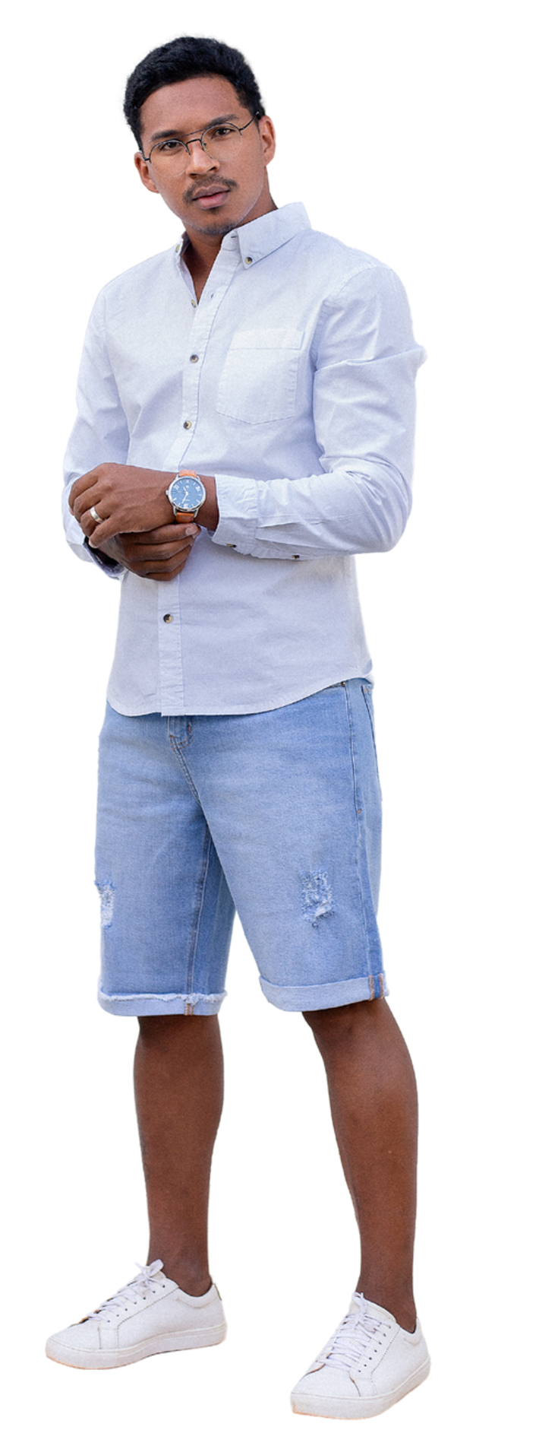
SPIRIT
HALLOWEEN
OLD FRIEND WHO WANTS TO “CATCH UP”
  messages you out of the blue
  asks how you’re doing
  is actually selling insurance
  confusing jargon
  is also a life coach

Slide 3

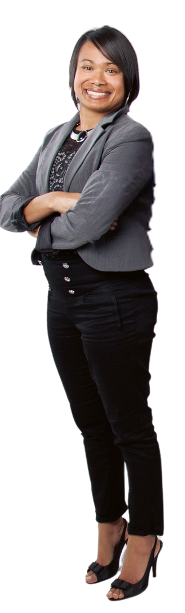

SPIRIT
HALLOWEEN
RECRUITER WHO GHOSTED YOU
  “Management went in another direction”
  “Unfortunately...”
  addicted to talent pooling
  loves random interview questions

Slide 4


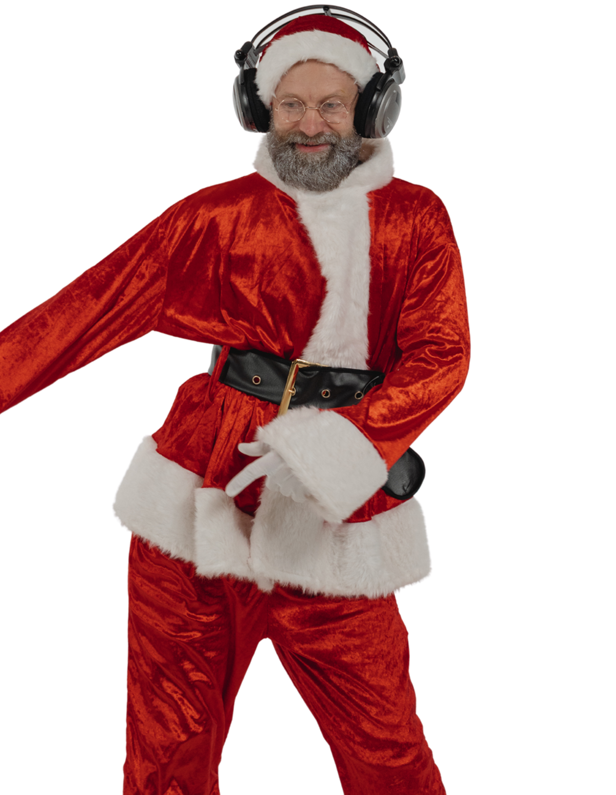

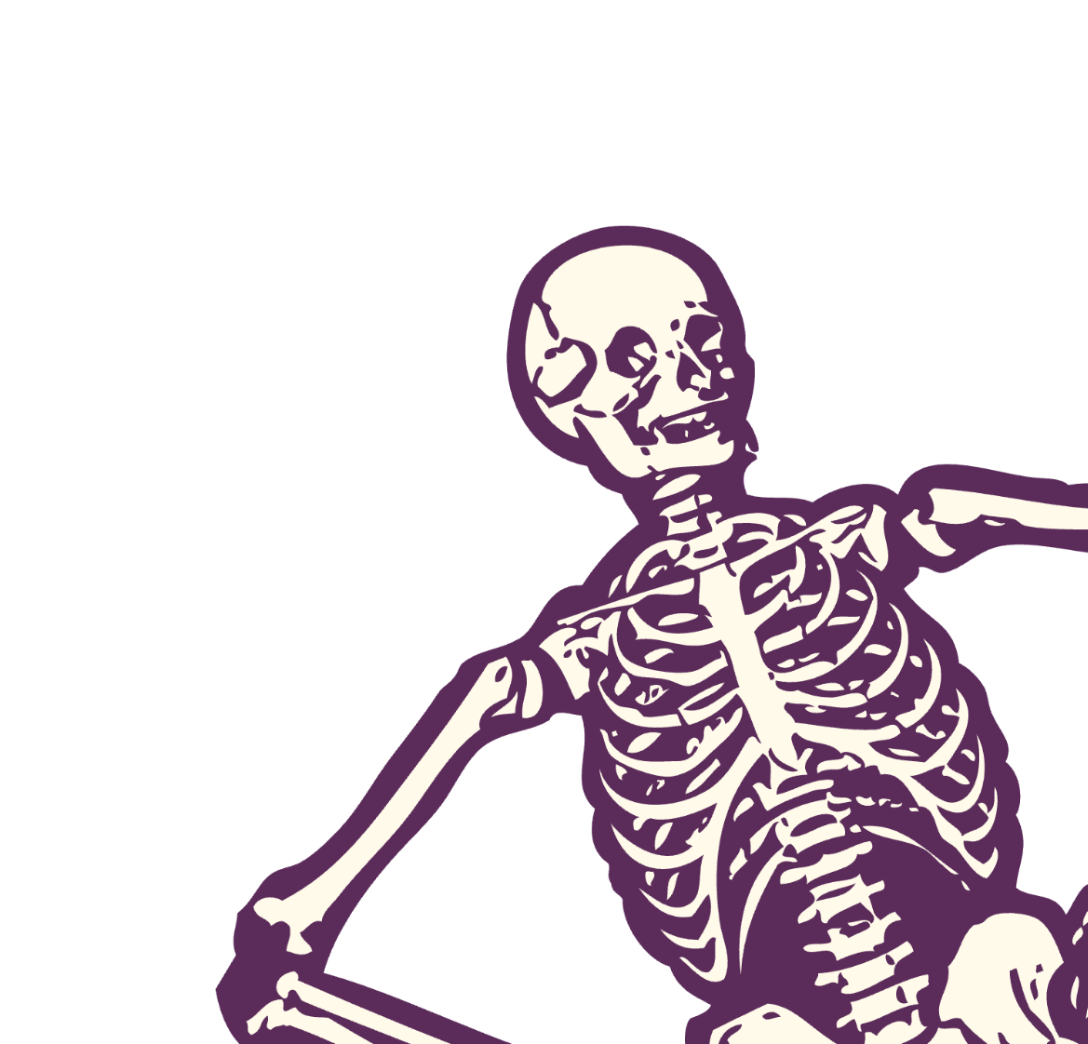
SPIRIT
HALLOWEEN
FUNKY
SANTA CLAUS
  excited for Christmas
  saves money wearing the same costume twice a year
  headset not included

Slide 5
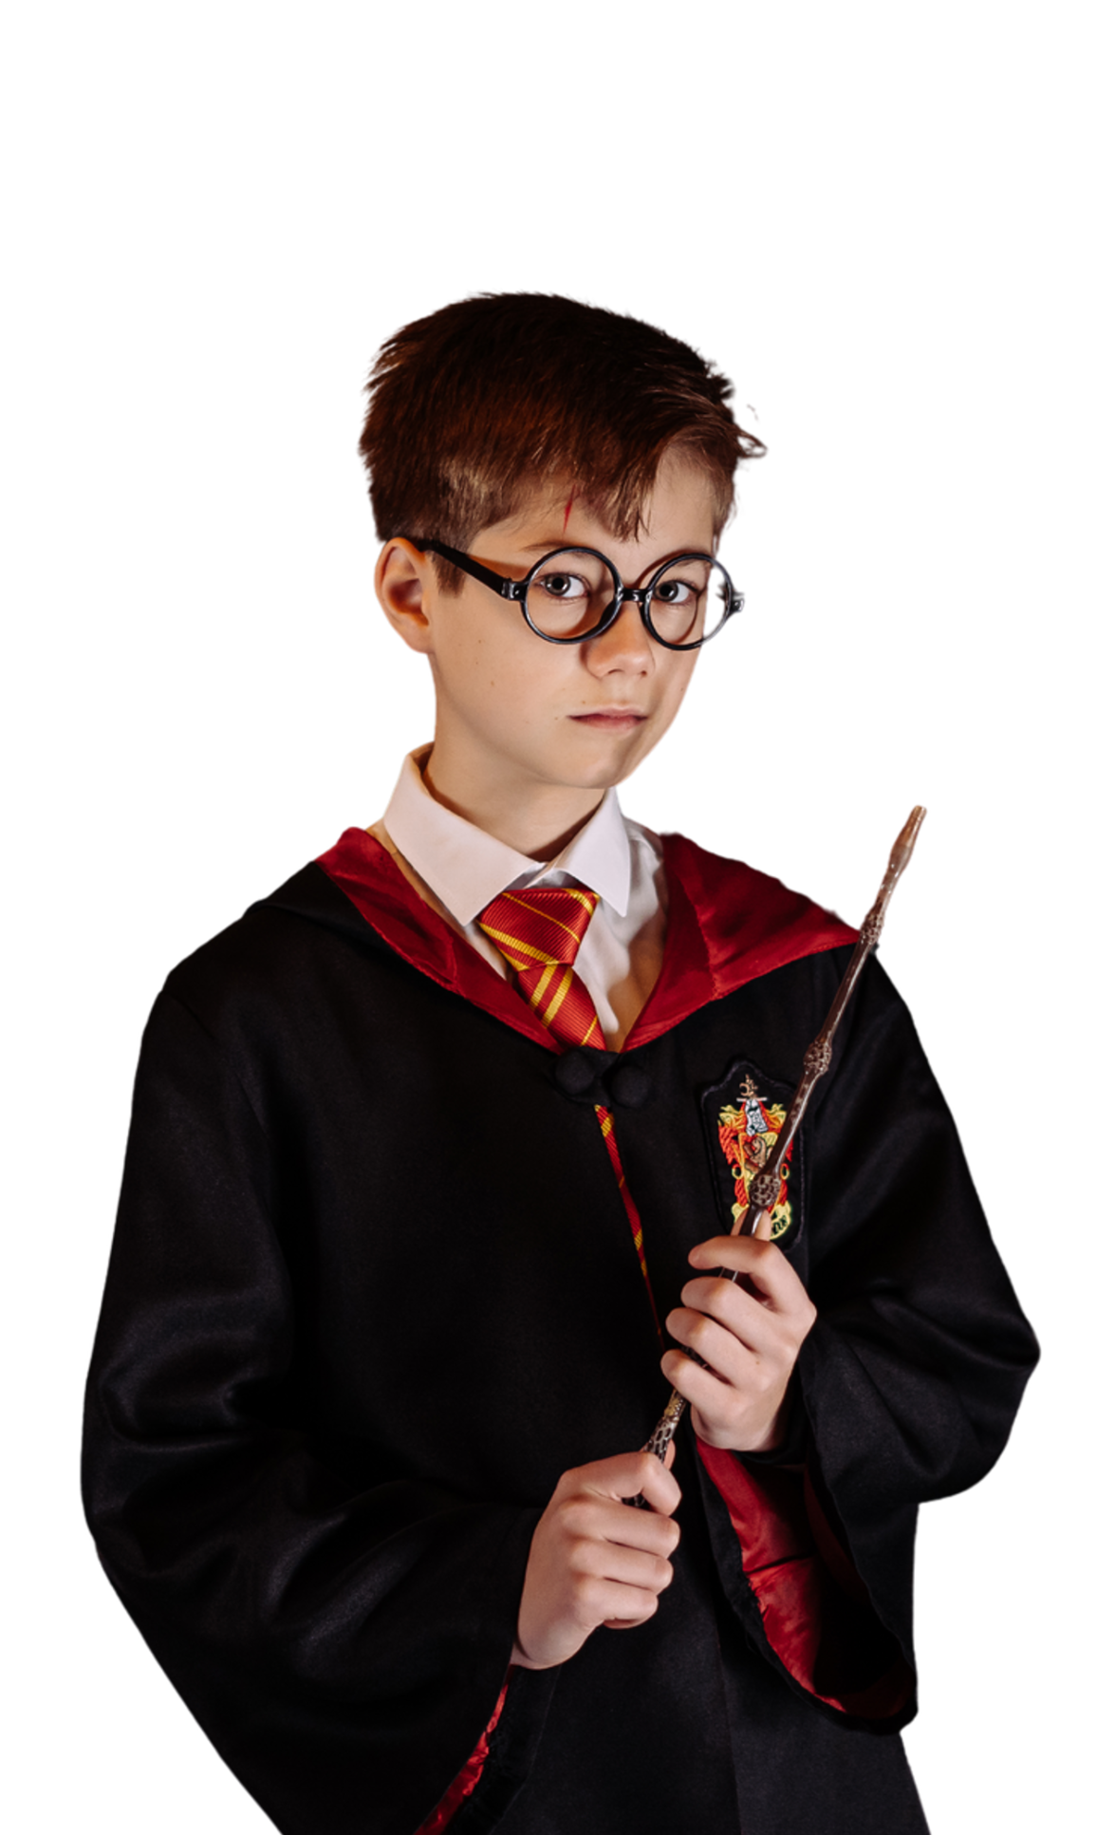

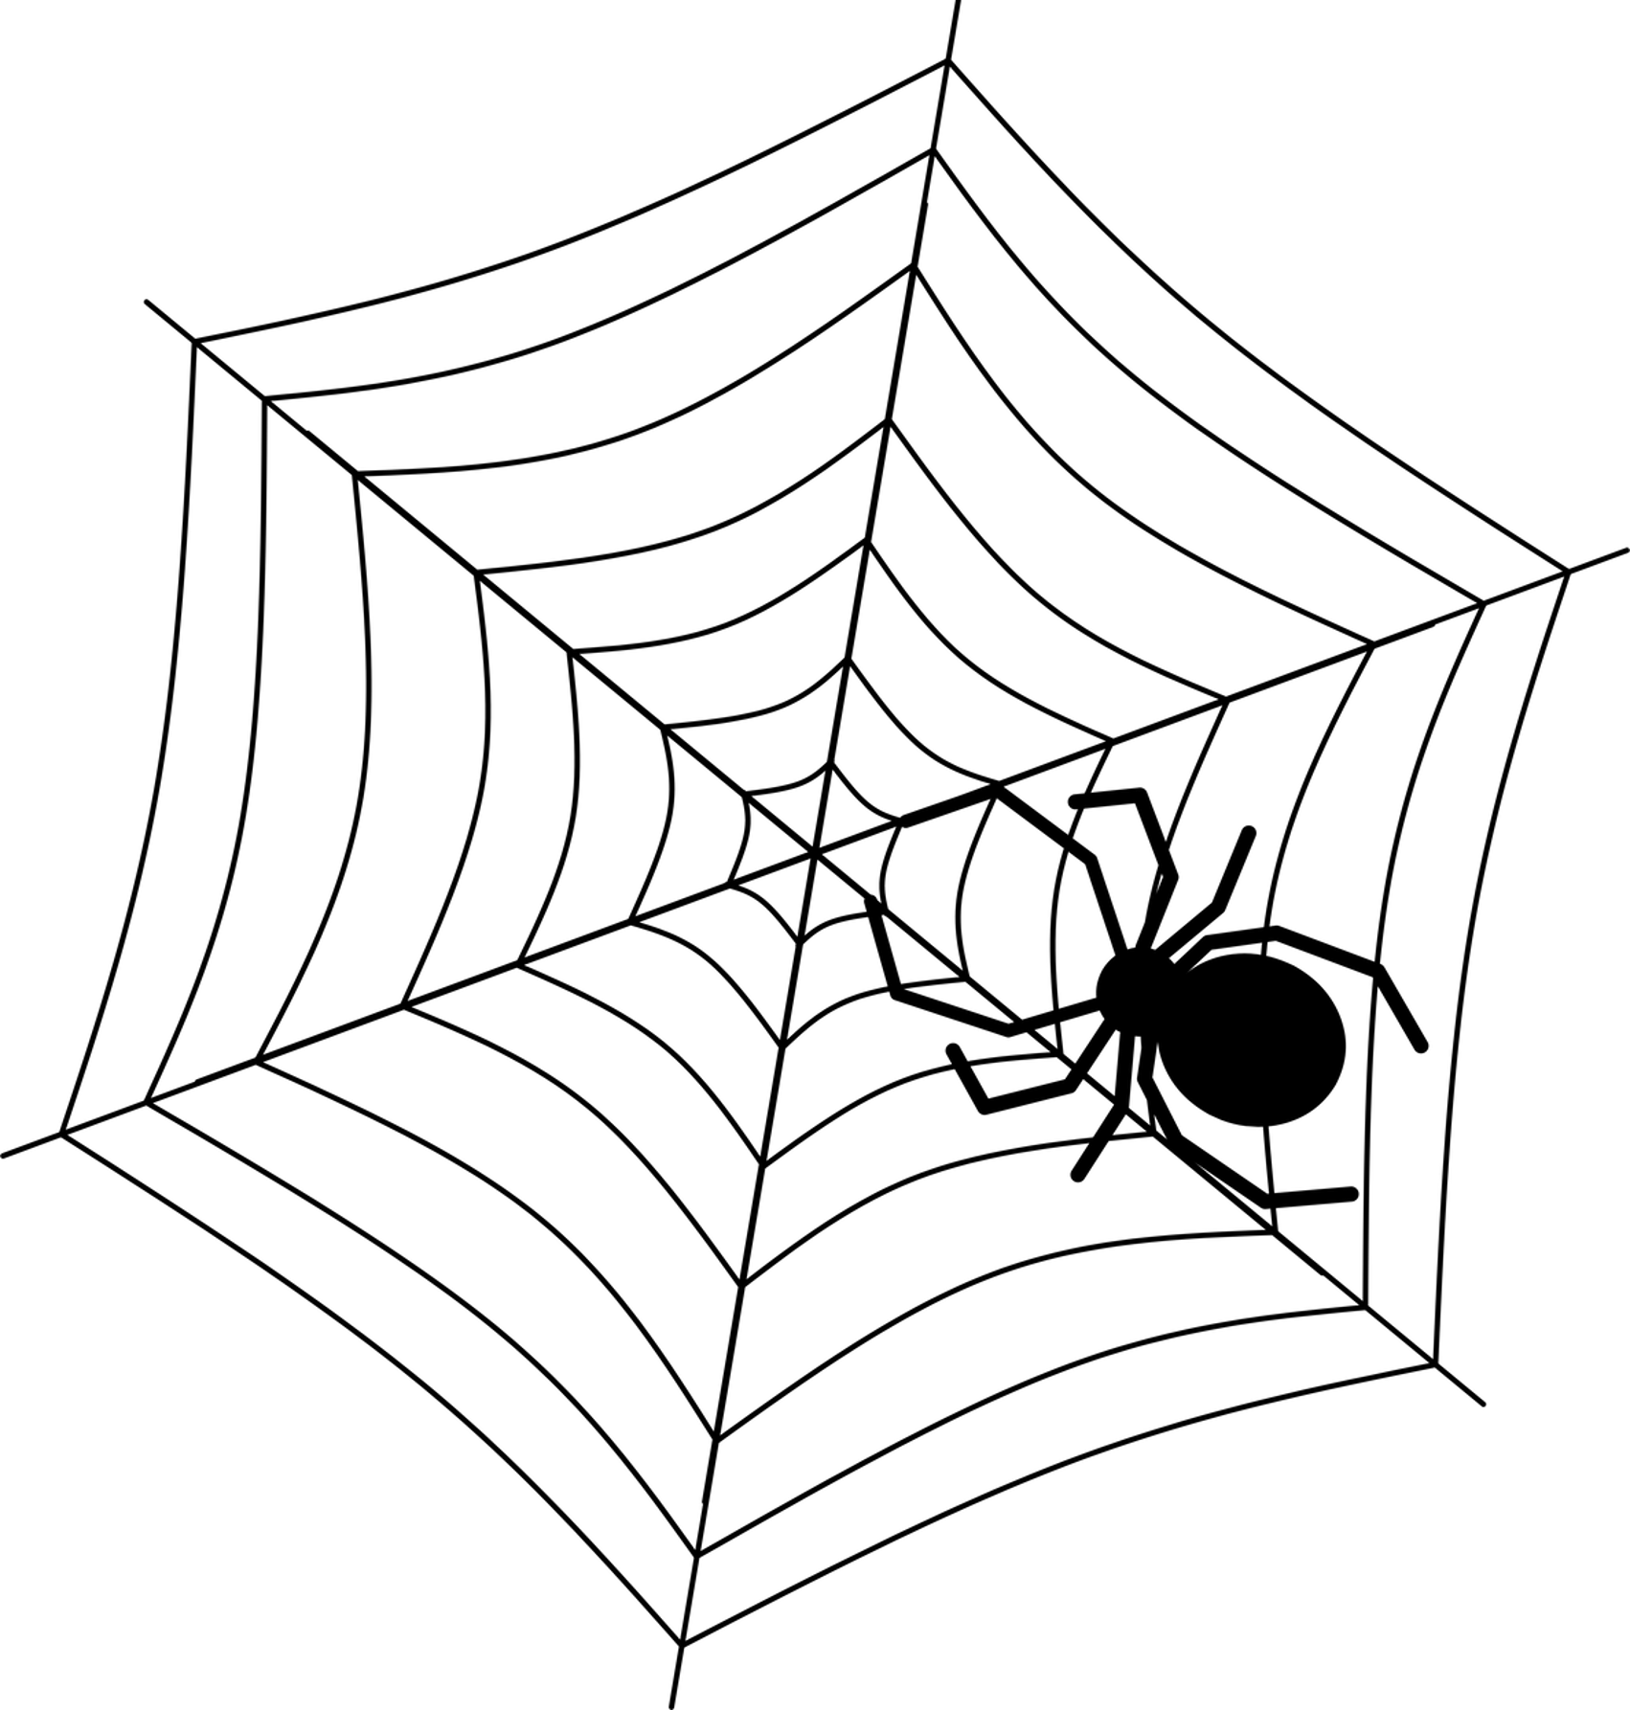
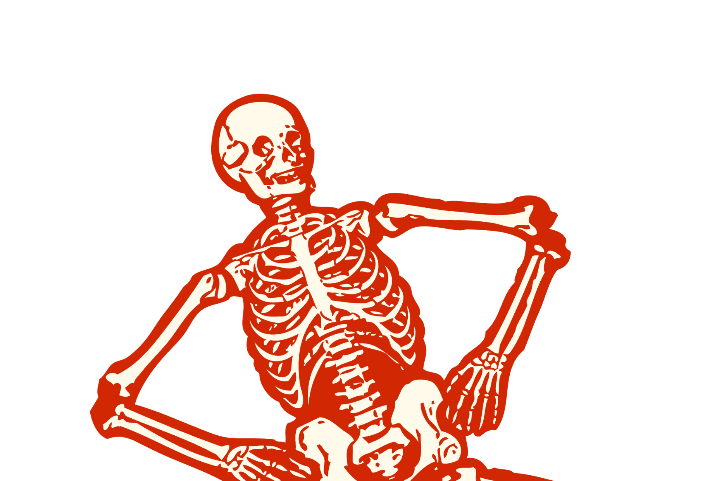
A STRONG
WIZARD
  a whut?
  signed up for Pottermore
  most likely a millenial
  addicted to “What House do you belong in?” quizzes

Slide 6


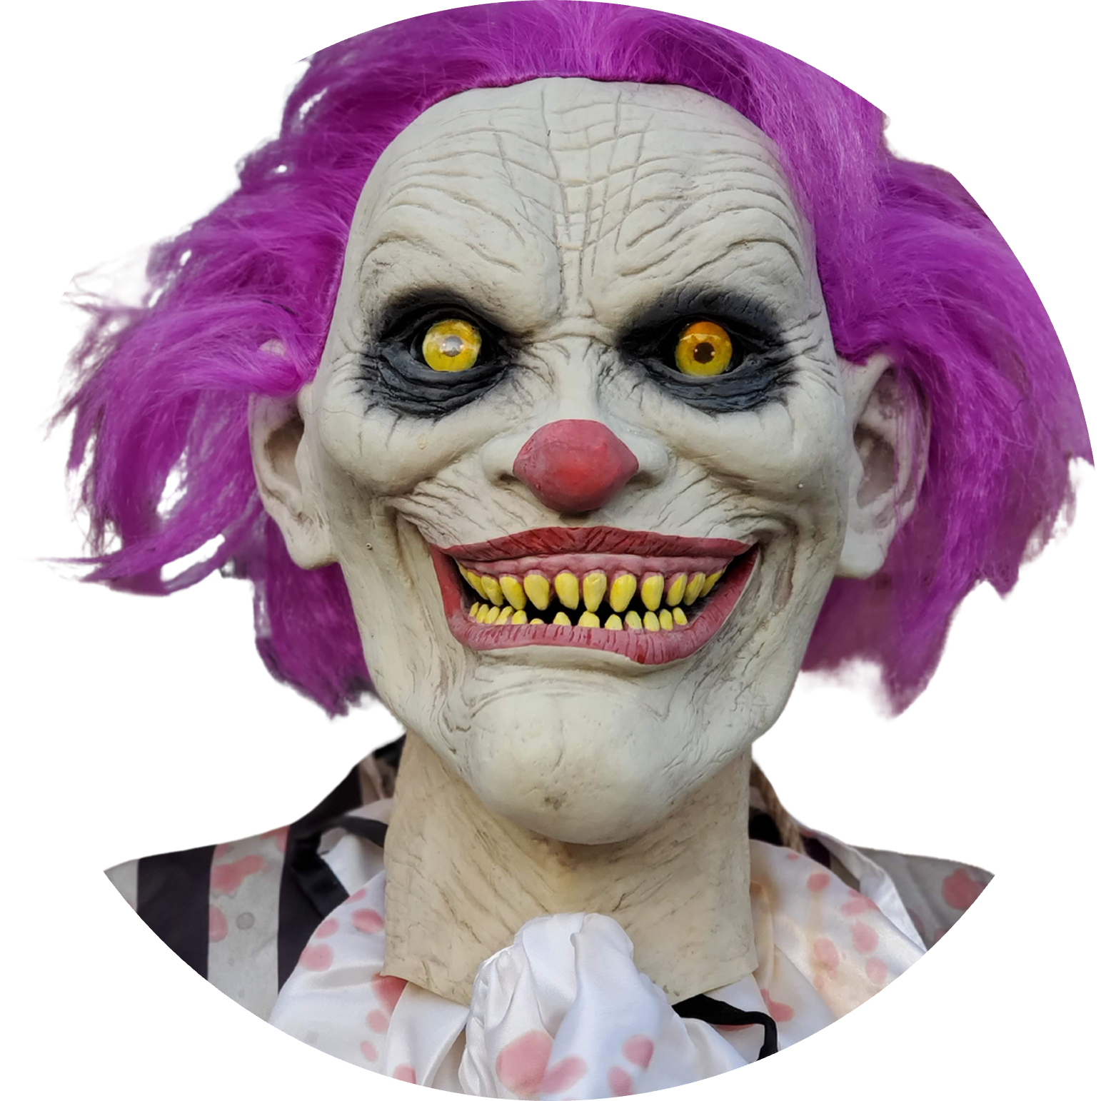



OVERWORKED EMPLOYEE
  hasn’t slept since New Year’s
  underappreciated
  disheveled hair
  allergic to pizza parties but goes for it anyway

Slide 7


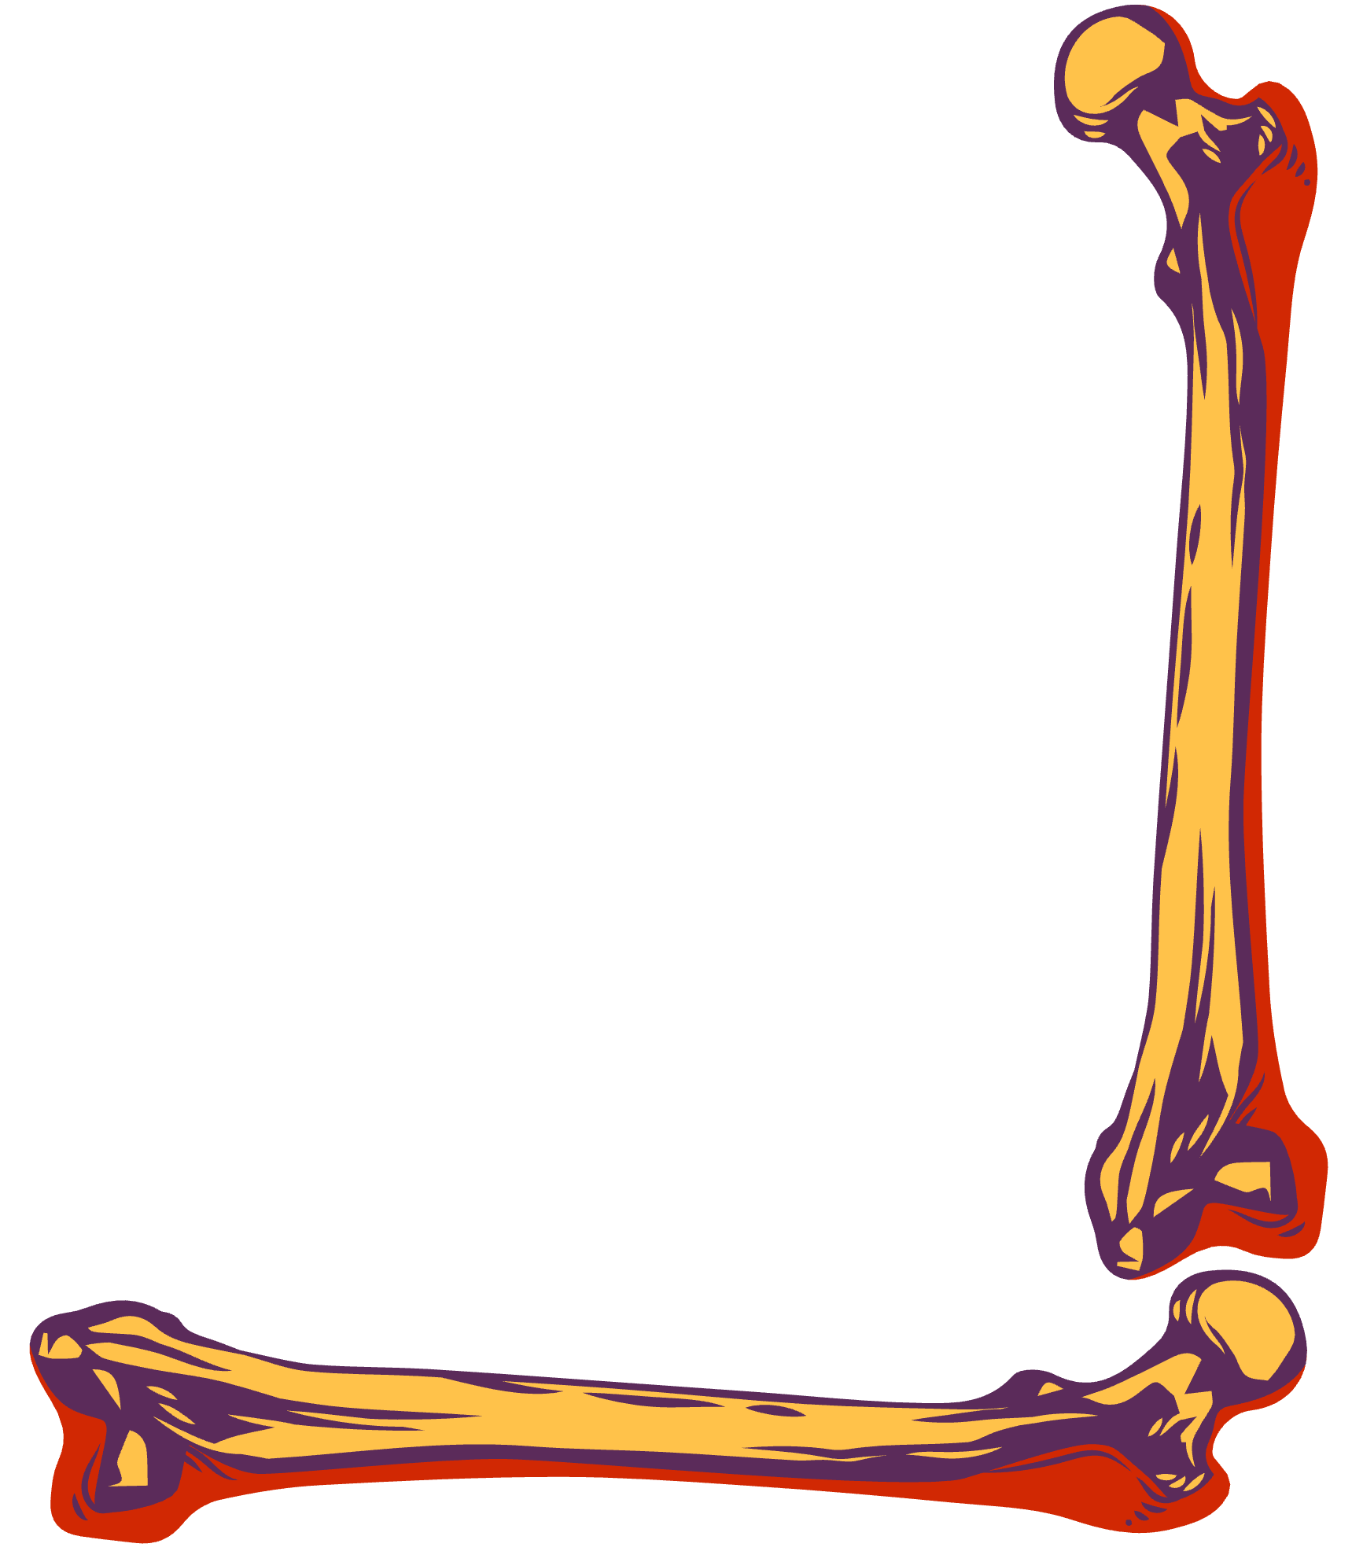



RESOURCE PAGE
  Use these design resources in your Canva Presentation.
Fonts
  Design Elements
  This presentation template
  uses the following free fonts:
  Title:
CALISTOGA
  Body:
OPEN SANS
  You can find these fonts online too.
Colors
  Don't forget to delete this page before presenting.

Slide 8


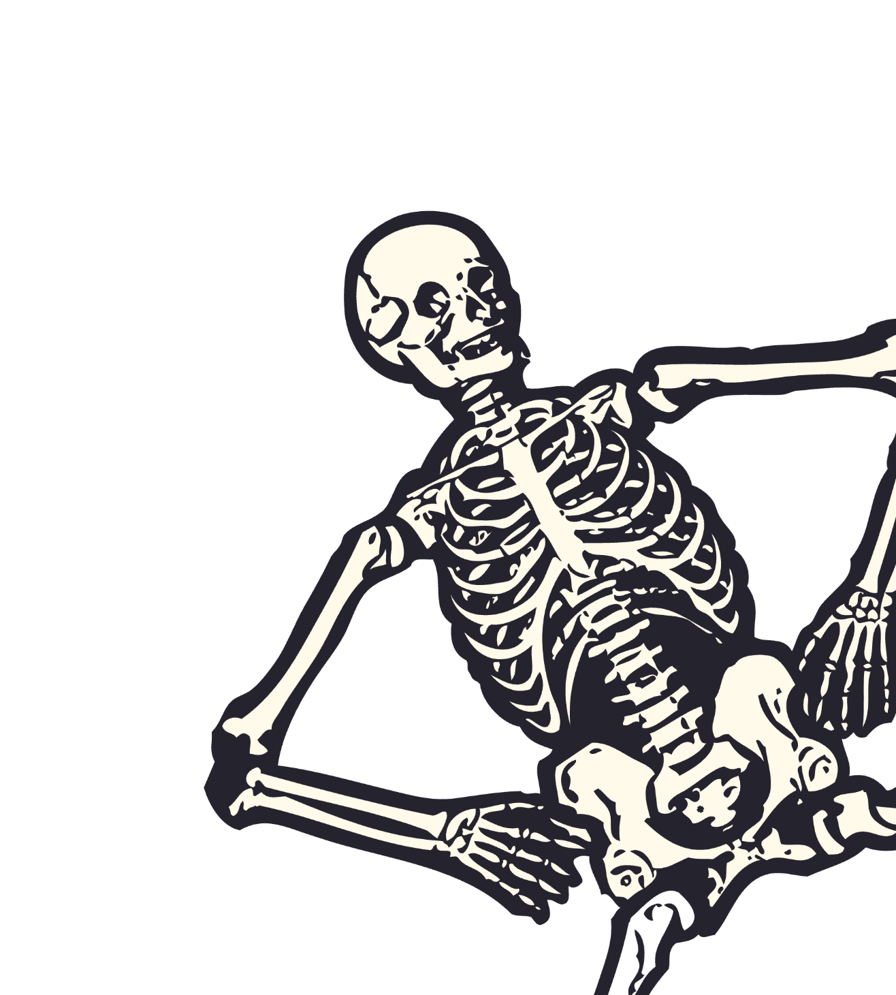
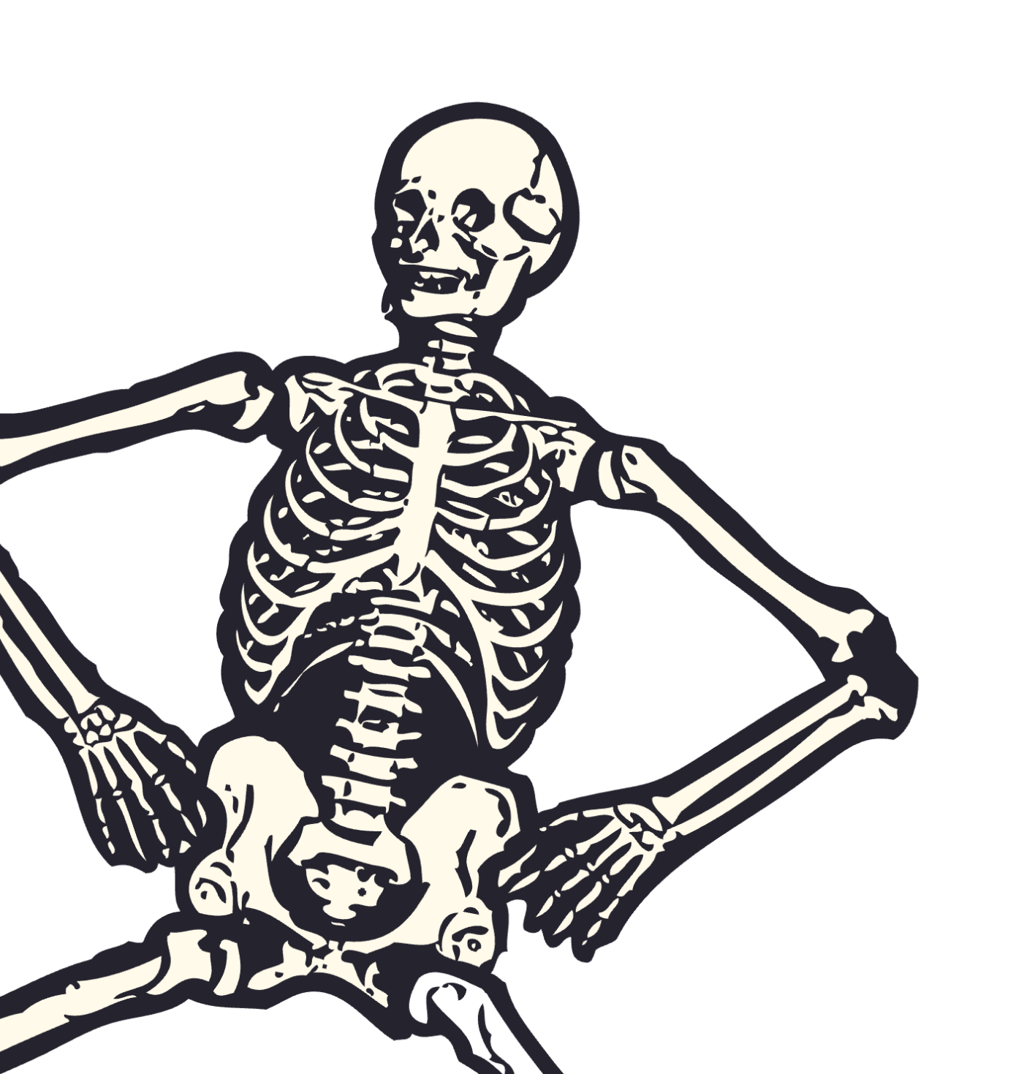
CREDITS
  This presentation template is free for everyone to use thanks to the following:
  for the presentation template
  PEXELS, PIXABAY
  for the photos
  Happy designing!

