Slide 1
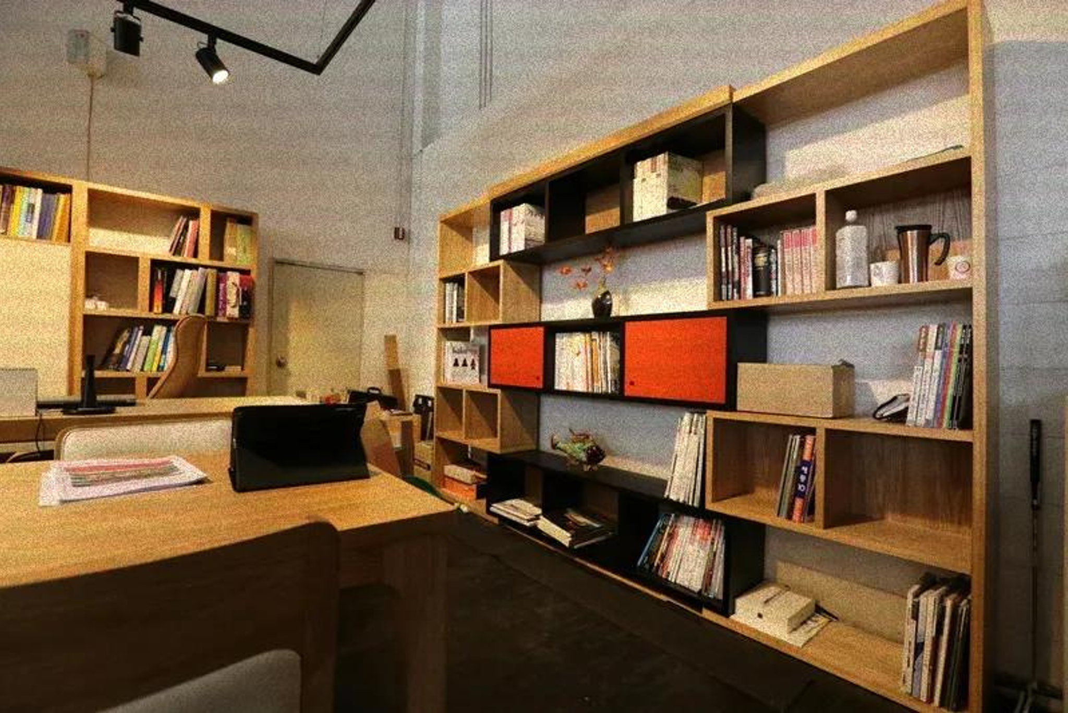

my boss congratulating me on being early to work
me who did overtime and never left the office

Slide 2
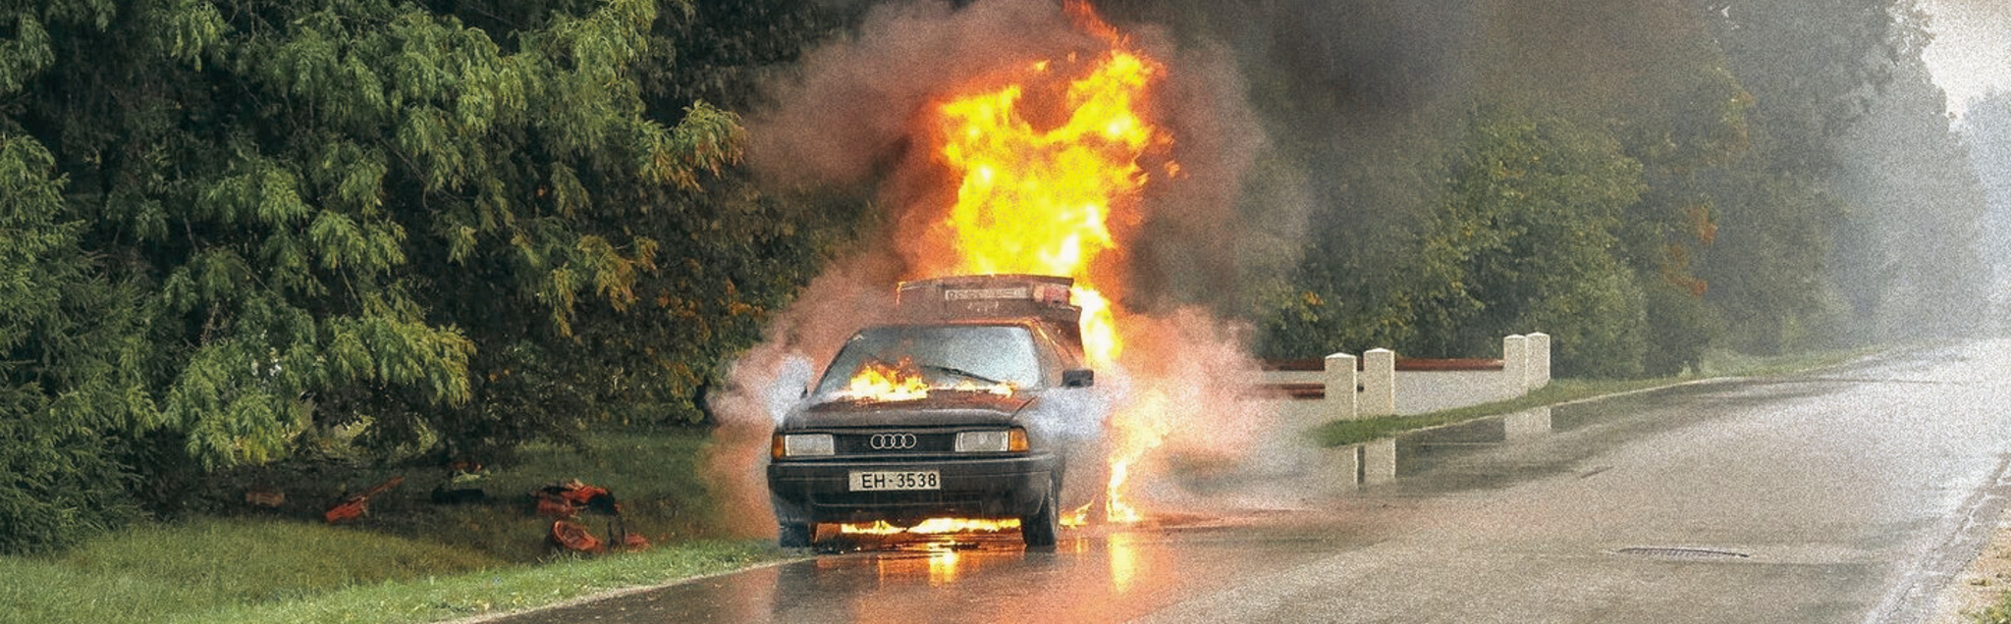
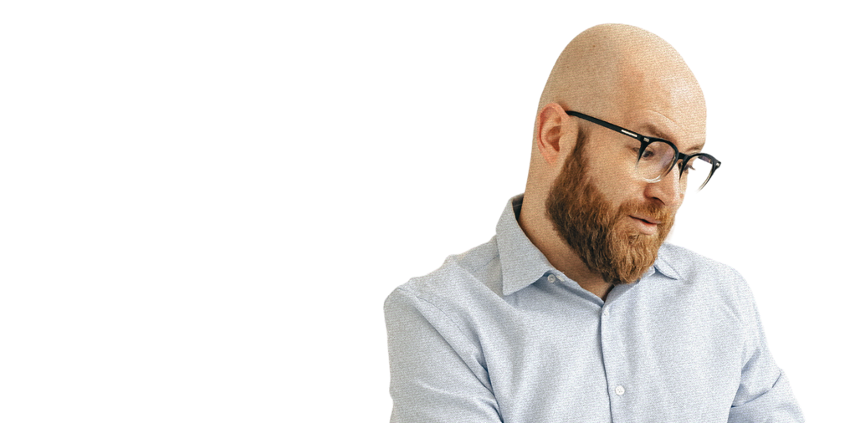
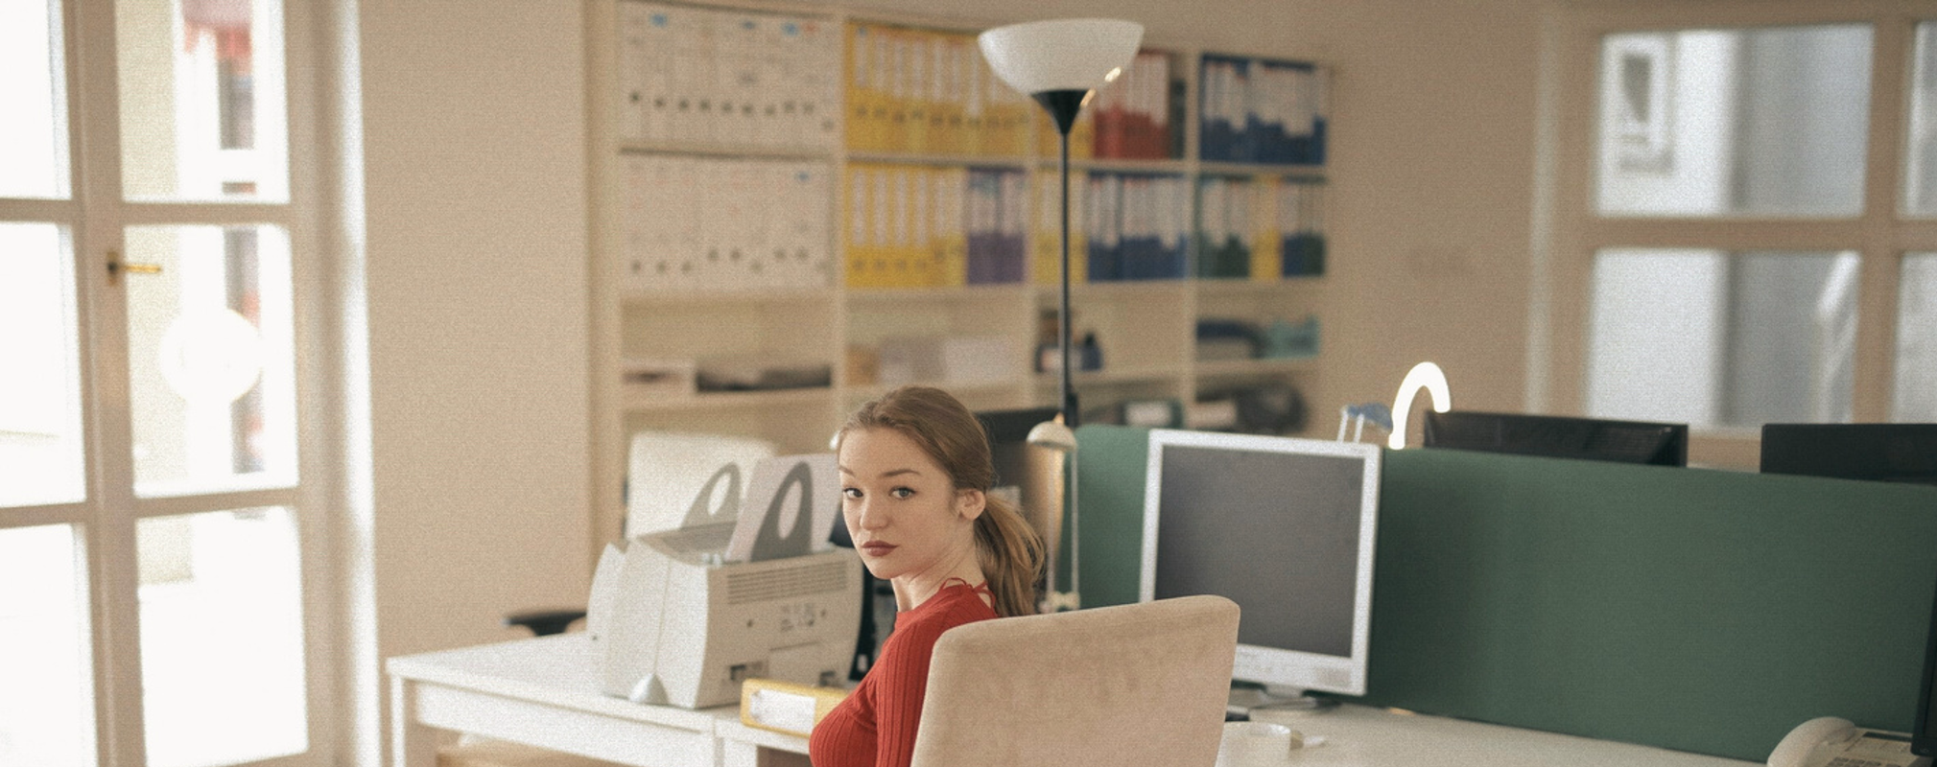
ON THE WAY TO WORK
Occasionally, I’ll hit somebody with my car. So sue me.

Slide 3
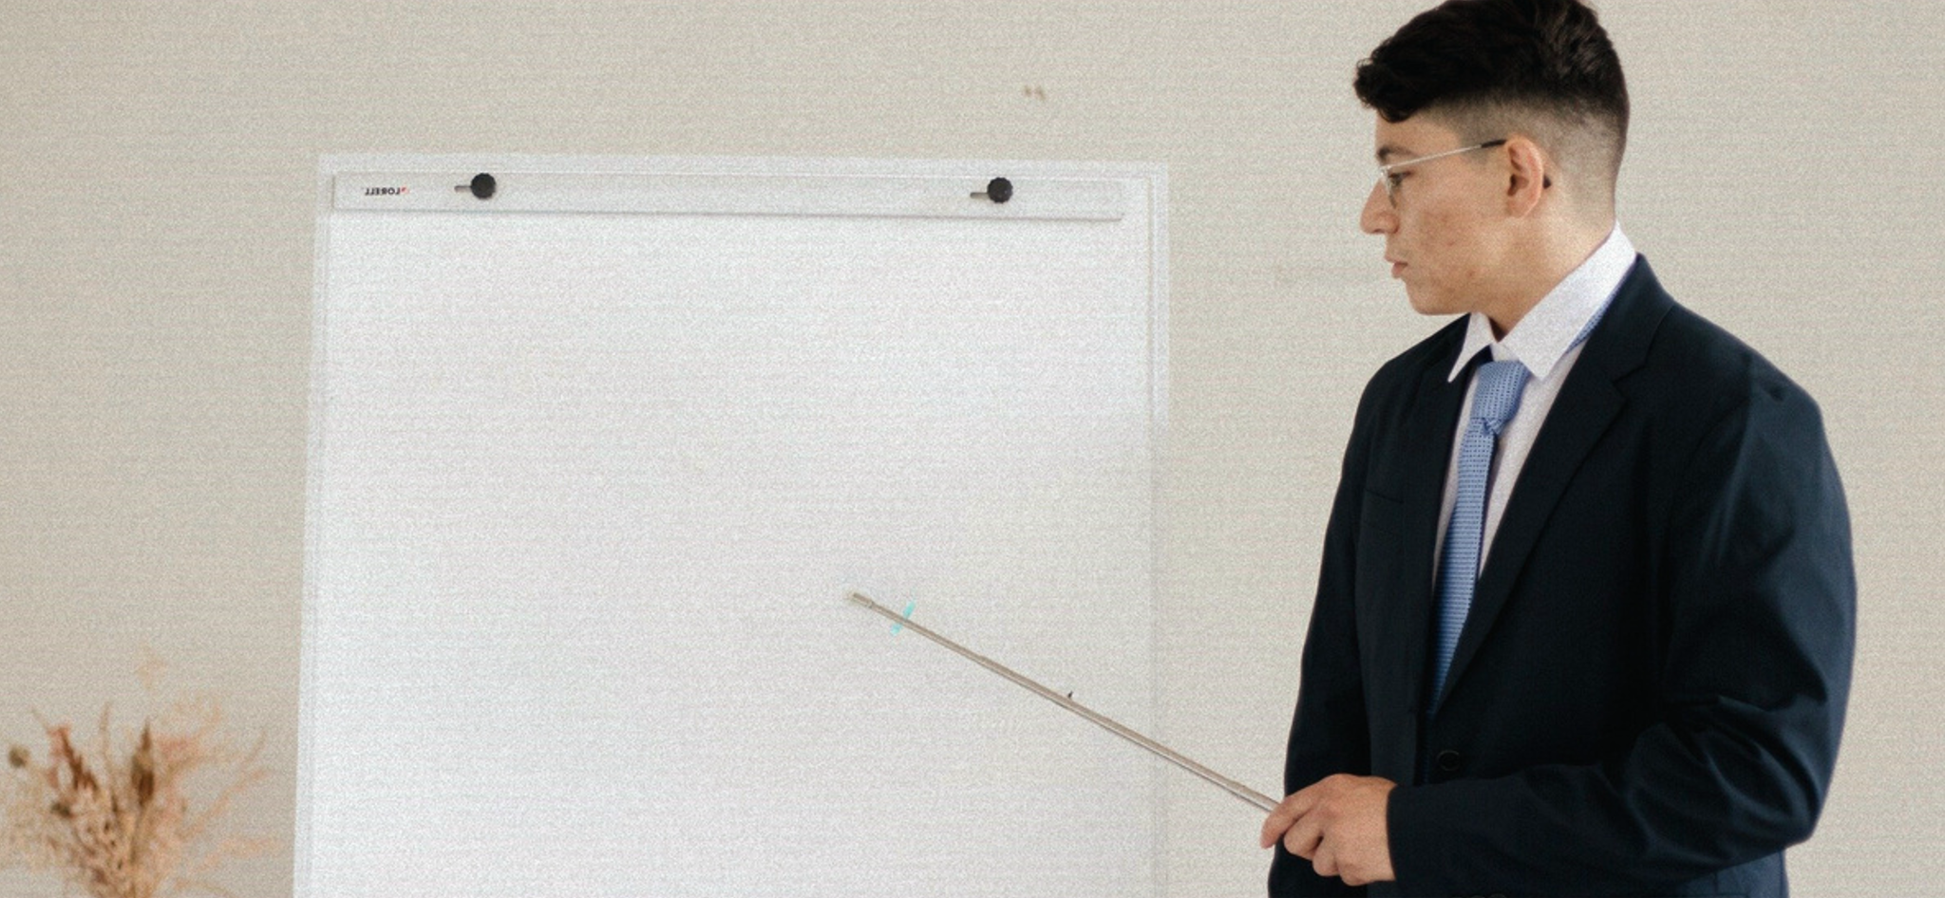
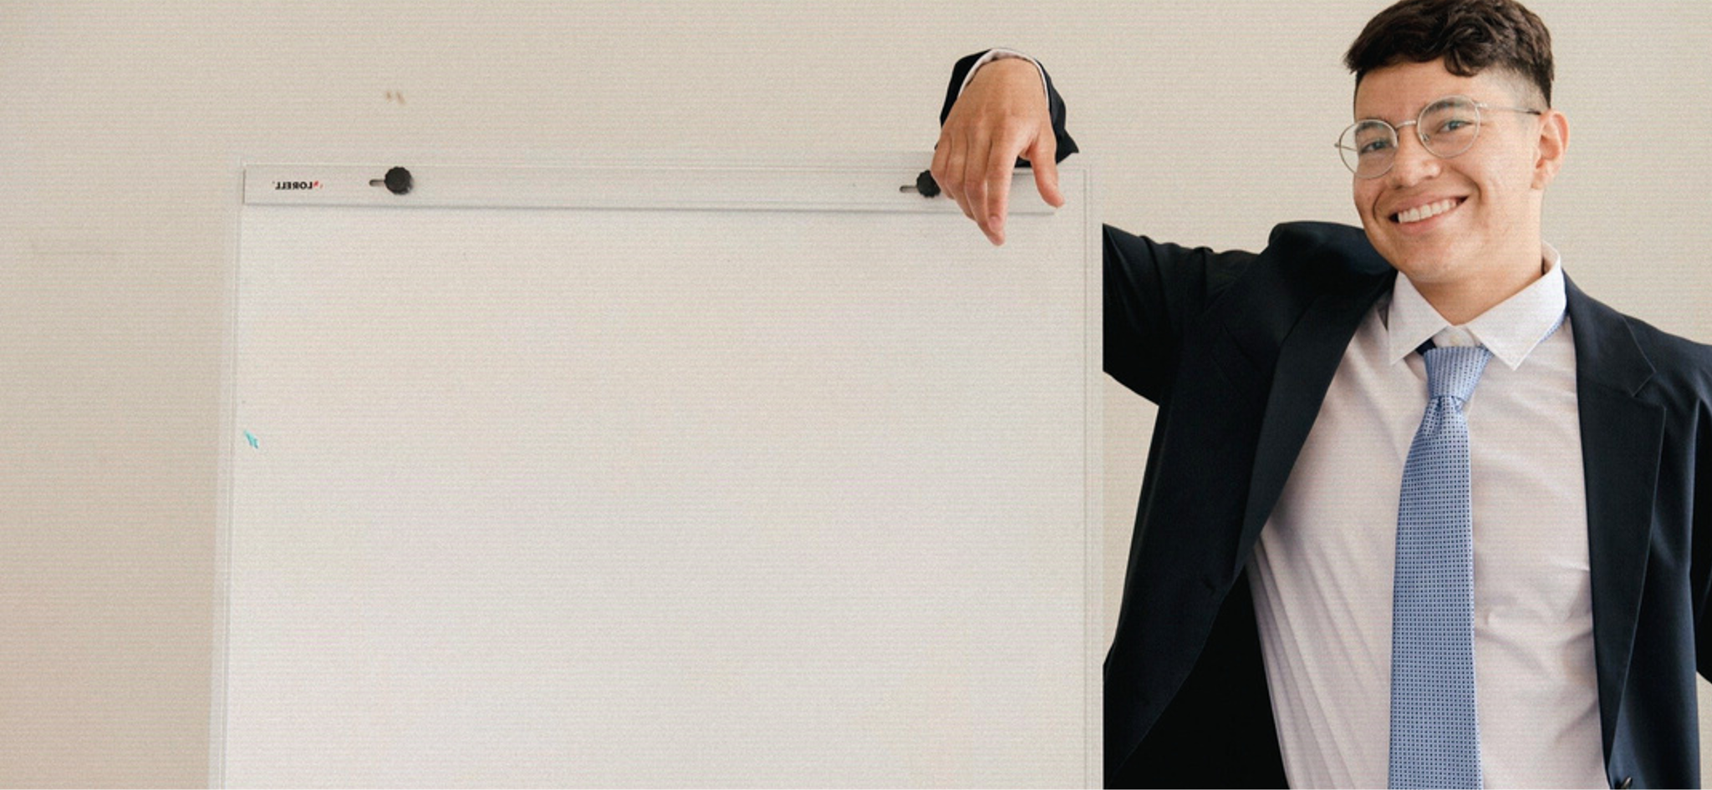
ALWAYS GIVE 100% AT WORK
23% MONDAY
12% TUESDAY
35% WEDNESDAY
30% THURSDAY
0% FRIDAY

Slide 4

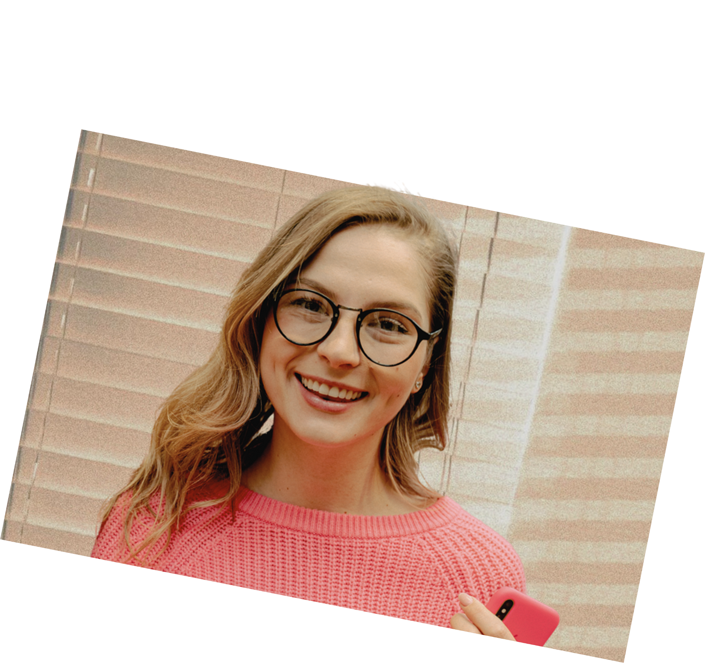
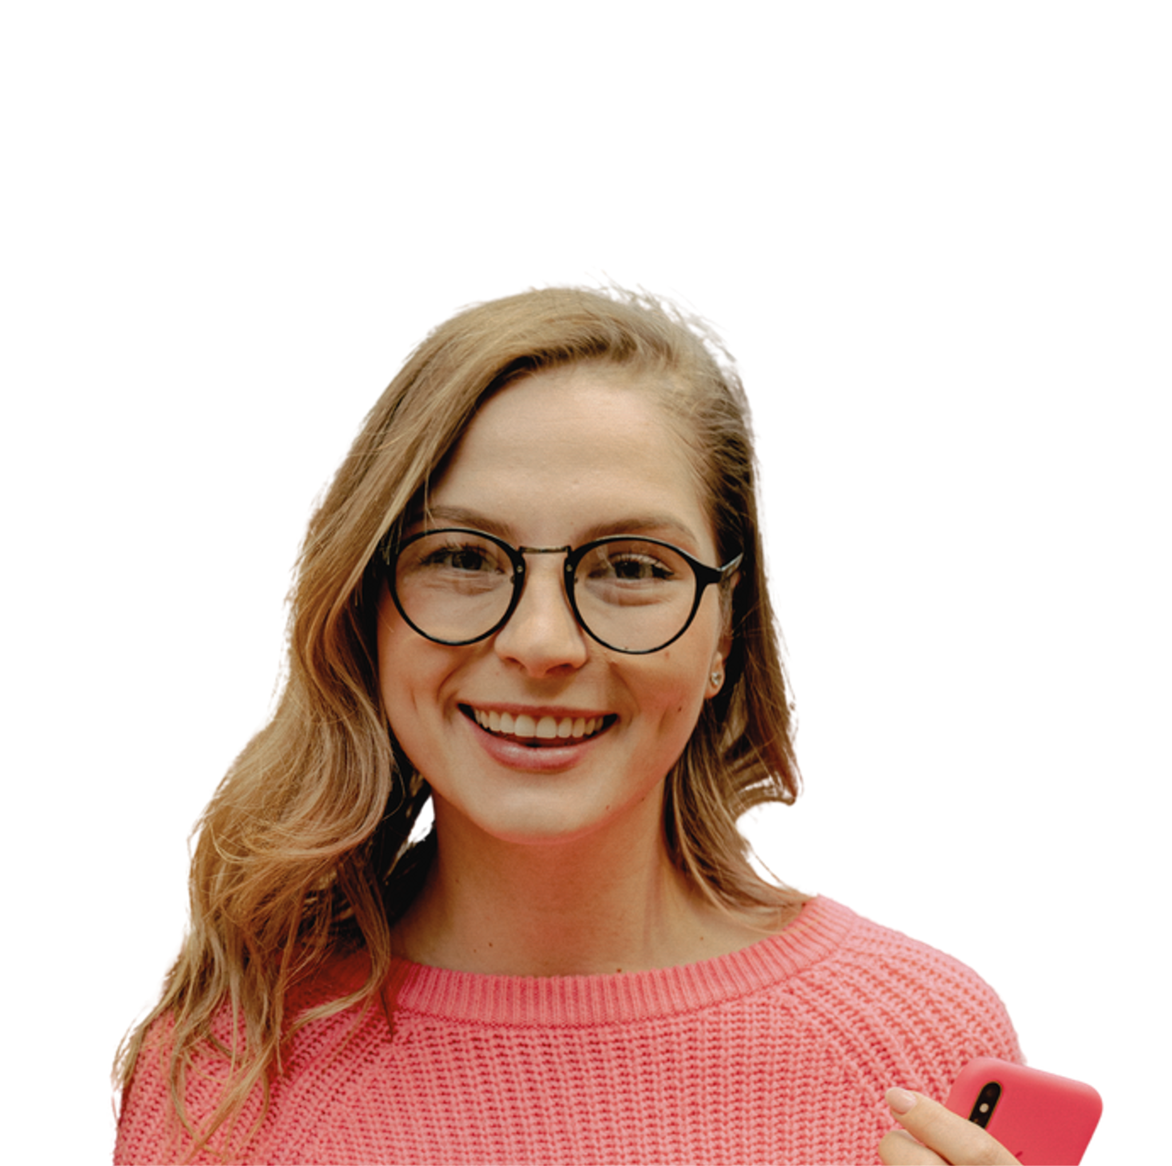

Corporate needs you to find the difference between this picture and this picture.
They’re the same picture.

Slide 5
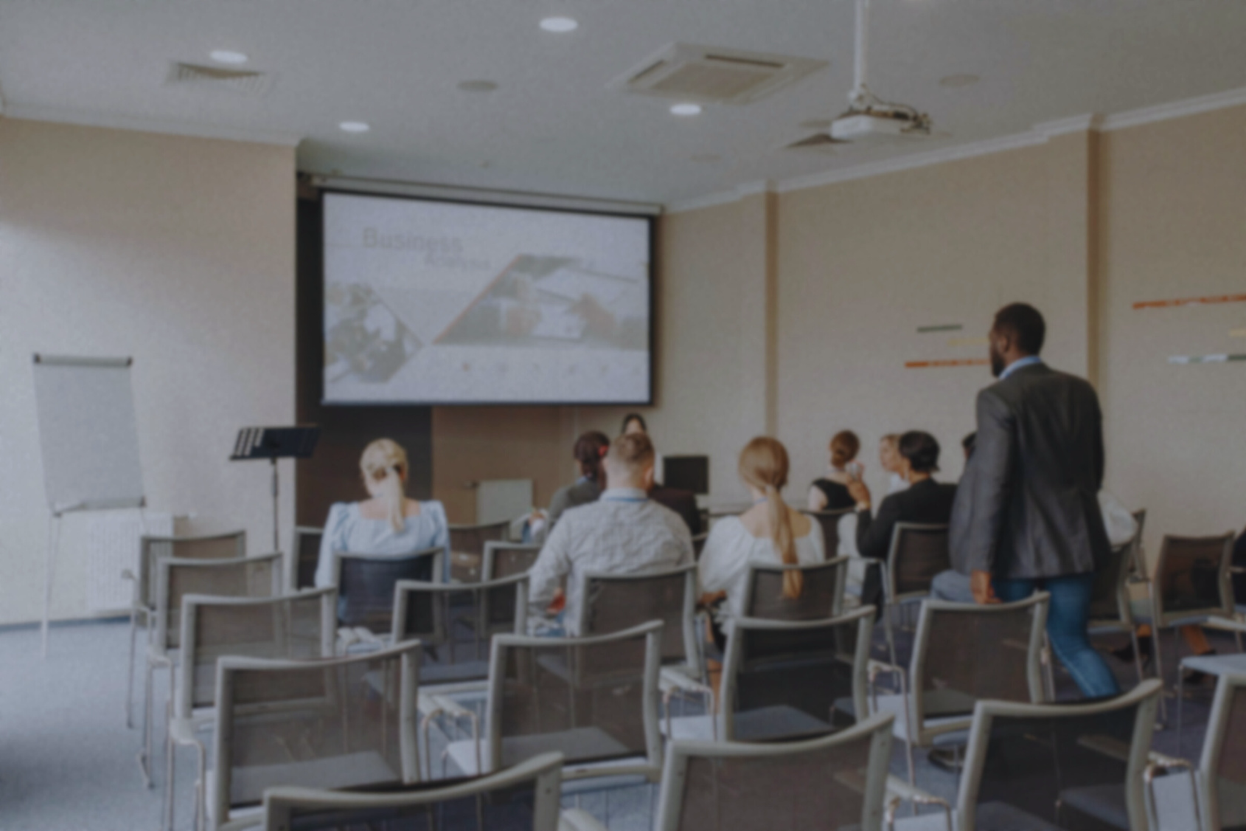
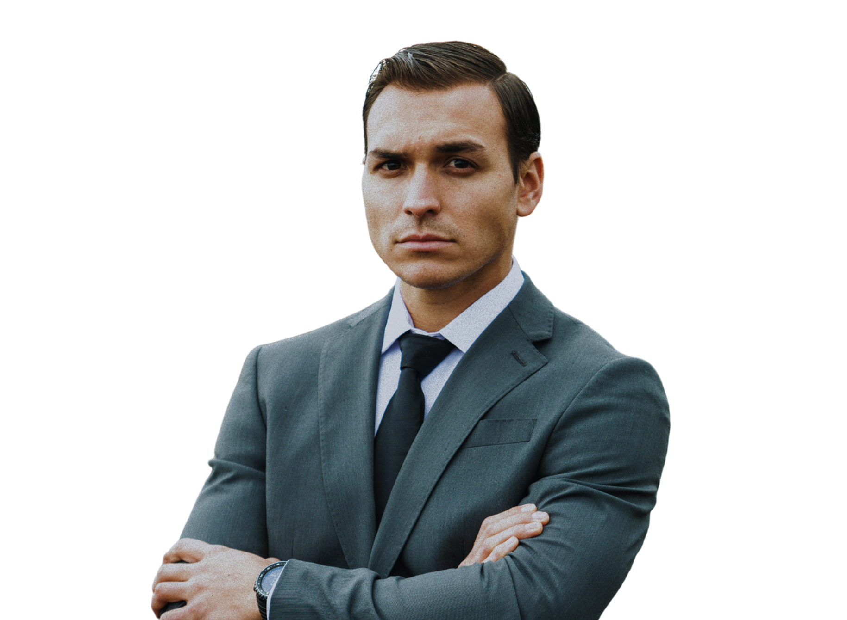
WOULD I RATHER BE FEARED OR LOVED? EASY.
WOULD I RATHER BE FEARED OR LOVED? EASY.
BOTH. I WANT PEOPLE TO BE AFRAID OF HOW MUCH THEY LOVE ME.
BOTH. I WANT PEOPLE TO BE AFRAID OF HOW MUCH THEY LOVE ME.

Slide 6
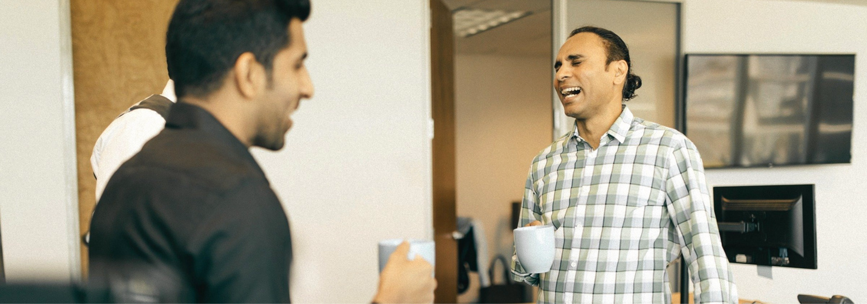
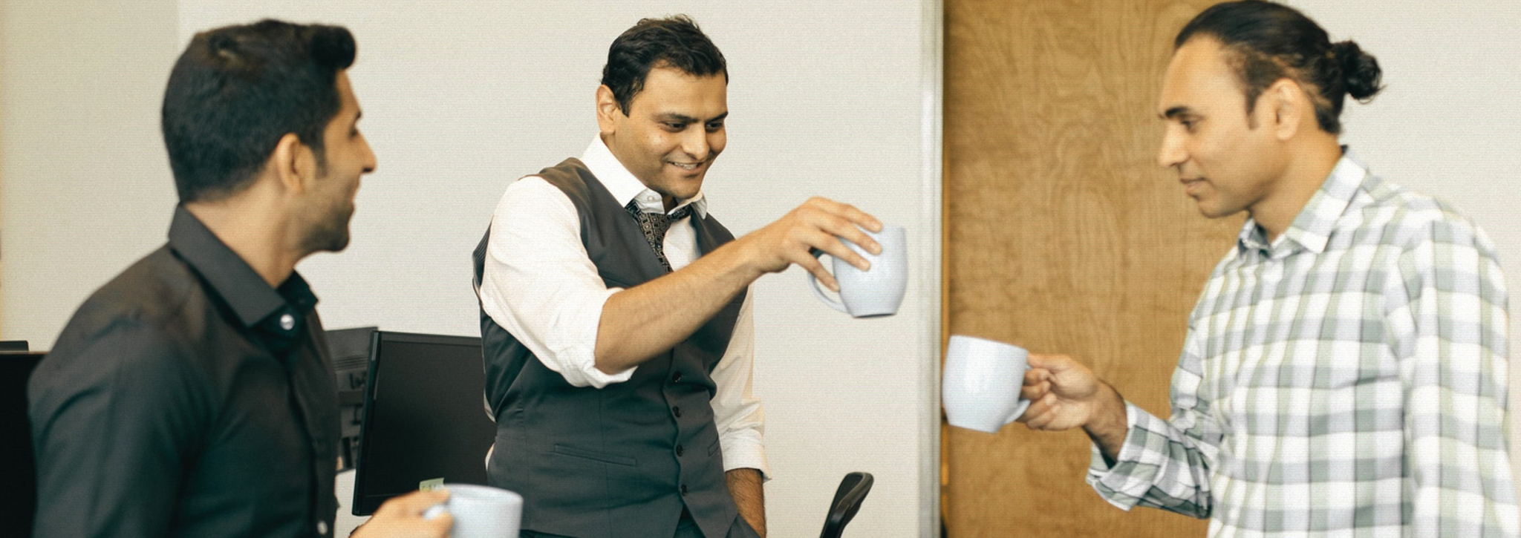
I love inside jokes, love to be a part of one someday.

Slide 7






BEFORE AND AFTER A LONG MEETING
I AM DEAD INSIDE

Slide 8


WORKING FROM HOME BE LIKE
9:00 AM
8:59 AM

Slide 9
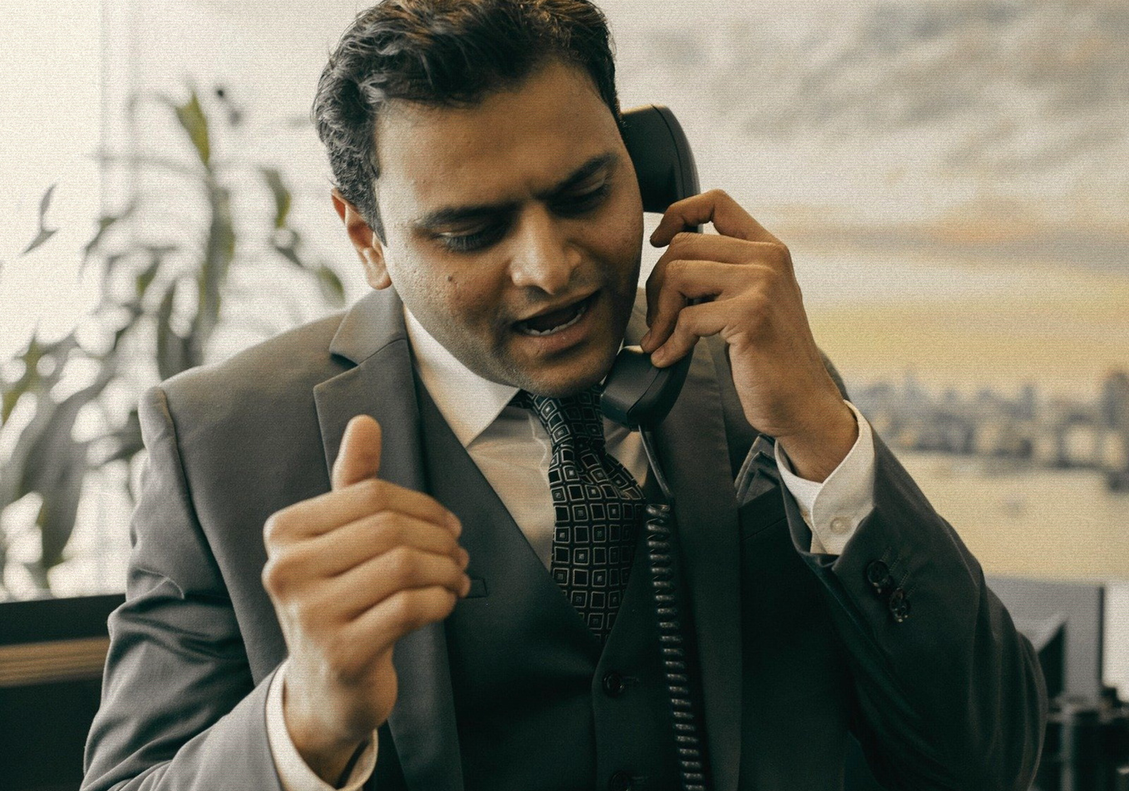
well just tell him to call me ASAP as possible
well just tell him to call me ASAP as possible

Slide 10
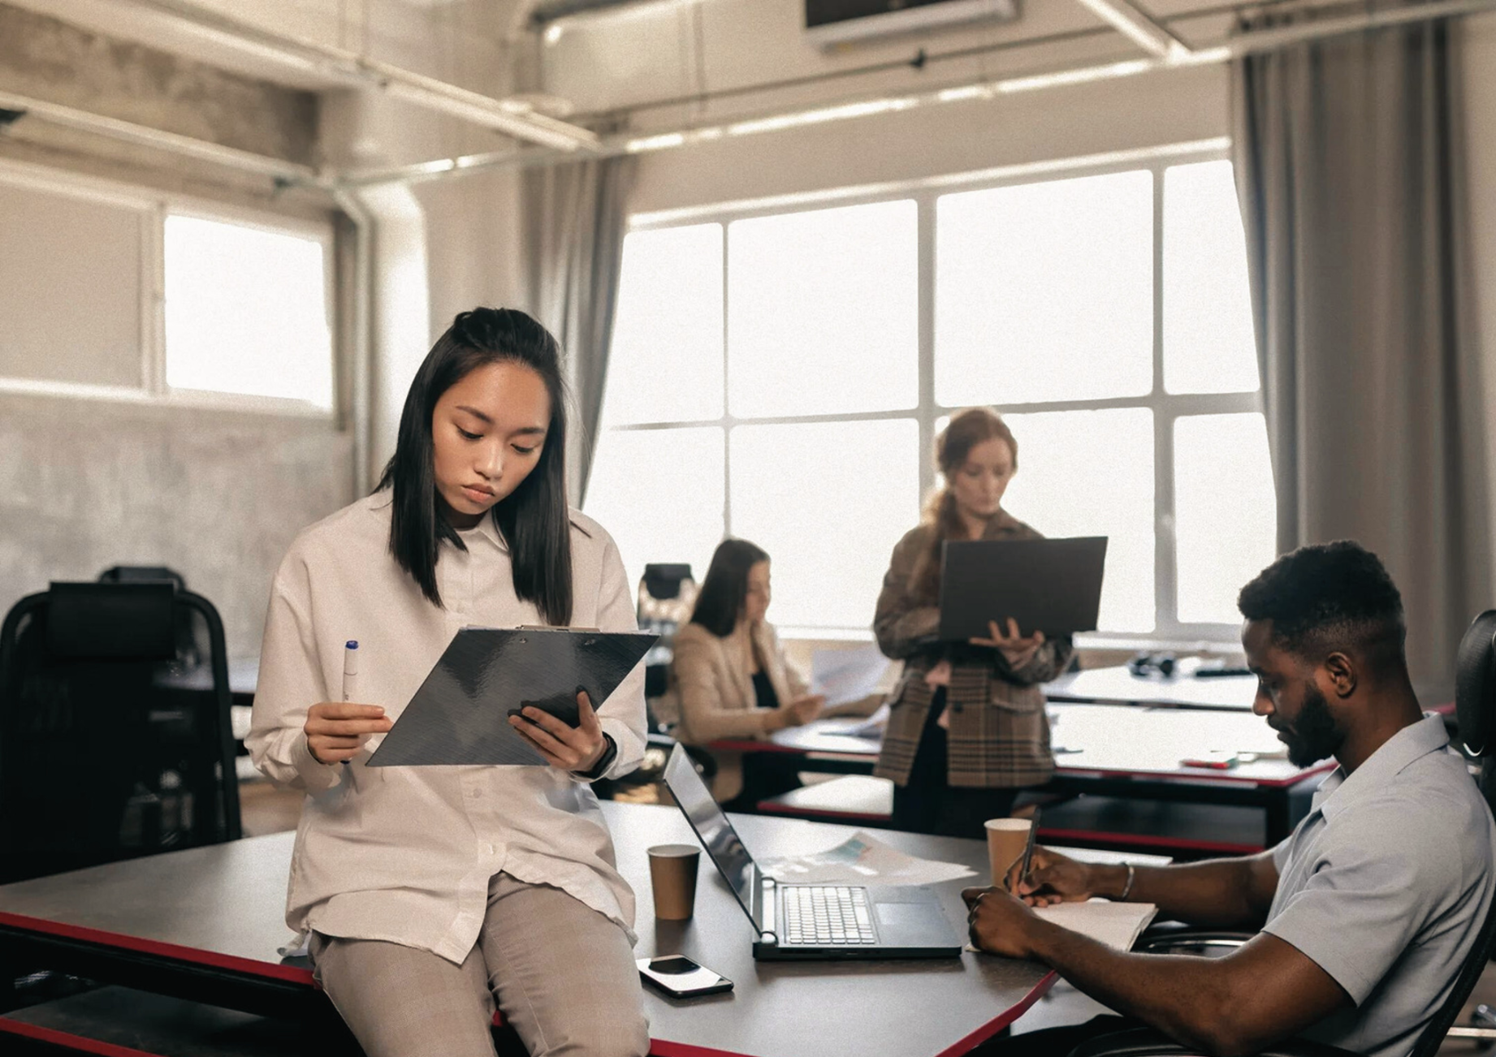

TODAY, SMOKING’S GONNA SAVE LIVES.

Slide 11
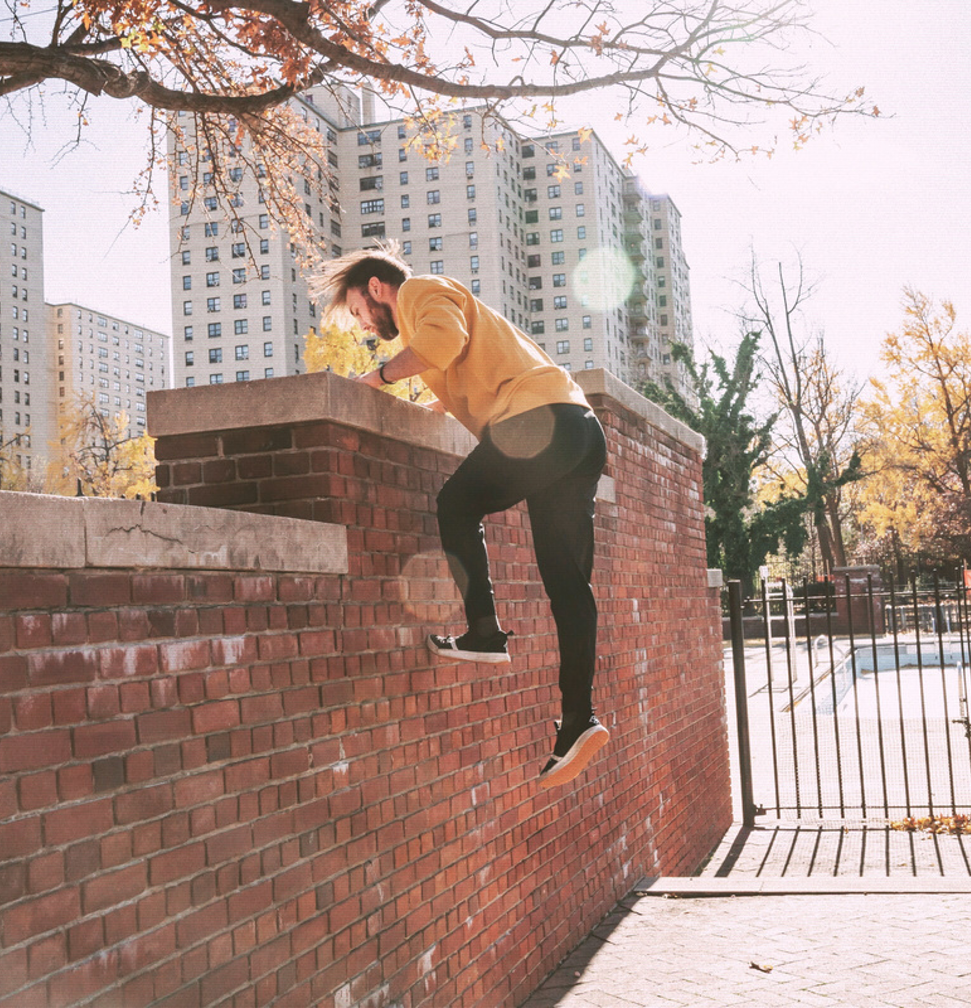
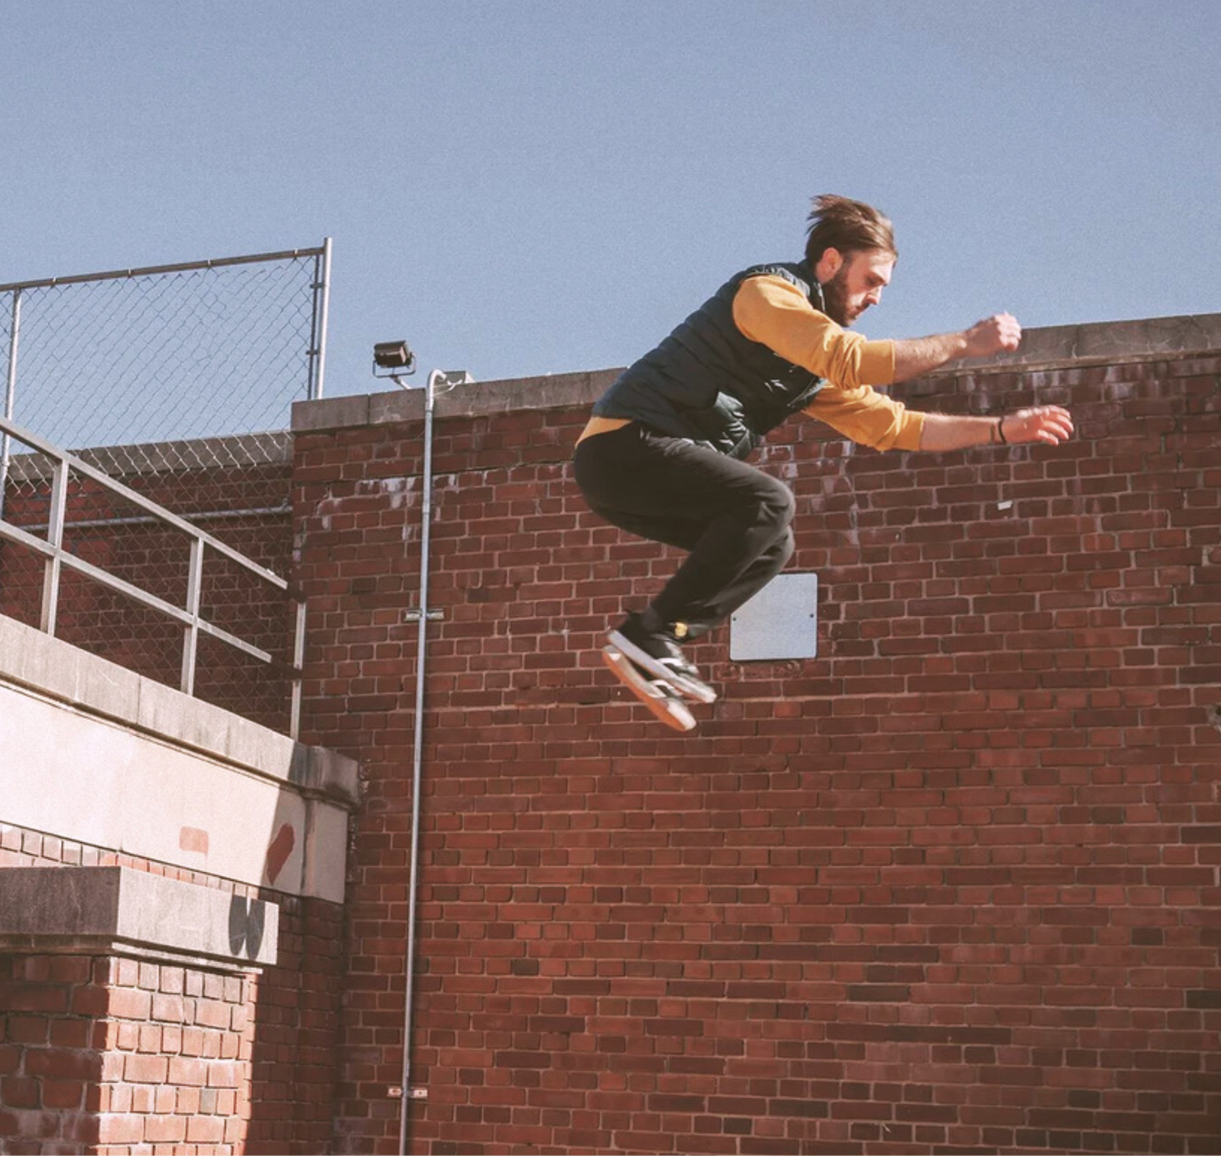
WHEN IT’S PAST 5PM AND THE BOSS GIVES YOU MORE WORK
Parkour!
Nope.

Slide 12
RESOURCE PAGE
  Use these design resources in your Canva Presentation.
Fonts
  Design Elements
  This presentation template
  uses the following free fonts:
  Titles:
ANTON
  Body:
COURIER PRIME
  You can find these fonts online too.
Colors
#FFFFFF
#000000
#EDDA33
  Don't forget to delete this page before presenting.

Slide 13

CREDITS
  This presentation template is free for everyone to use thanks to the following:
  for the presentation template
  PEXELS, PIXABAY
  for the photos
Happy designing!

