Slide 1



Crimewest
Institute
Mental Health Awareness
An introduction to understanding and supporting mental well-being

Slide 2


Contents
What is mental health?
Why mental health matters
Common mental health conditions
The mental health continuum
When and how to seek help
Breaking the stigma
Ways to care for your mental health
Supporting others

Slide 3



What is
mental health?
Define mental health in clear, non-technical language.
Emphasize that it’s a key part of a person’s overall well-being, not just the absence of illness.

Slide 4




Why mental health matters
Fosters supportive relationships
Reason 2
Reason 3
Supporting details here
Supporting details here
Supporting details here

Slide 5
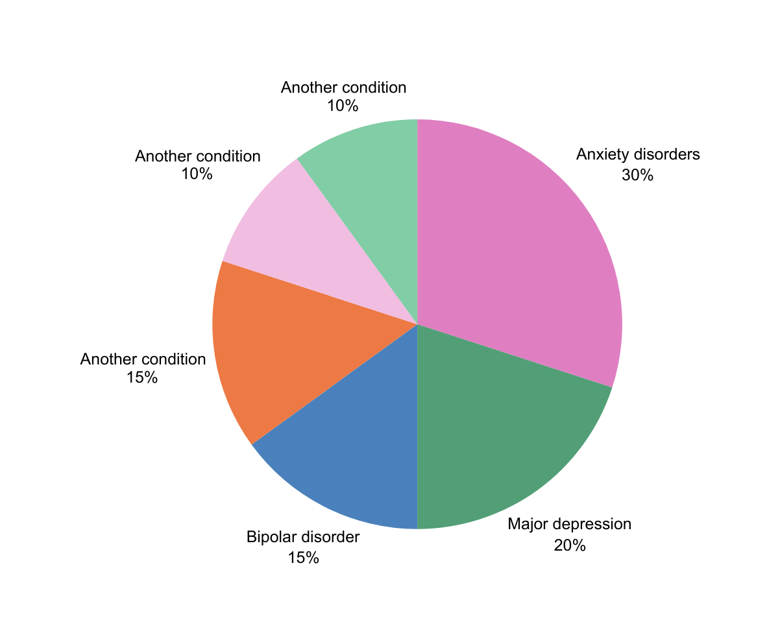

Common mental health conditions
Include a chart that shows the prevalence of common mental health conditions. Explain why the data is important and how it can support mental health awareness.

Slide 6

The mental health continuum
Use the table below to help your audience understand that mental health exists on a continuum or a spectrum.
Healthy | Reacting | Injured | Ill
Supporting details here | Supporting details here | Supporting details here | Supporting details here

Slide 7



When and how to seek help
List signs that may indicate someone needs support.
Include simple steps for staying connected, reaching out for help, and accessing mental health professionals.

Slide 8

Support services
Organization here
Helpline or number here
Organization here
Helpline or number here
Organization here
Helpline or number here

Slide 9

Learning check
Question goes here
Option 1
Option 2
Option 3
Add a multiple-choice question to assess what learners understood from the session.
Option 4

Slide 10

Breaking the stigma
Myth | Fact
Write a common myth about mental health here. | Counteract it with a fact, and include the source.
Write a common myth about mental health here. | Counteract it with a fact, and include the source.
Add more rows as needed. | Add more rows as needed.

Slide 11



Ways to care for your mental health
Tip 1
Tip 2
Tip 3
Briefly describe how this supports well-being.
Briefly describe how this supports well-being.
Briefly describe how this supports well-being.

Slide 12


Supporting others
DOS
DON’TS
List compassionate, practical actions:
  Action here
  Action here
  Action here
List actions that may unintentionally cause harm:
  Action here
  Action here
  Action here

Slide 13
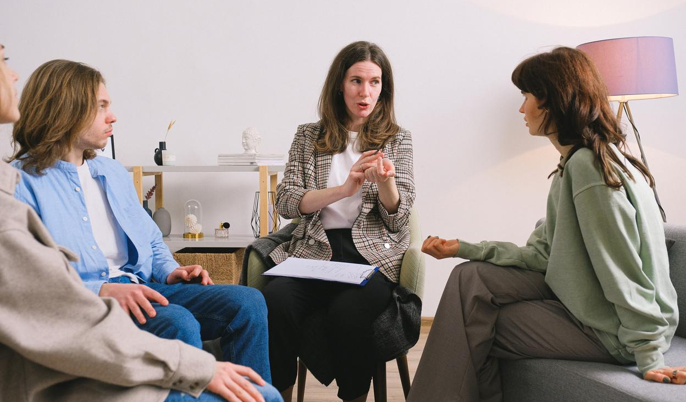


Review
Mental health as part of overall well-being
Highlight the key takeaway from this section.
The mental health continuum
Highlight the key takeaway from this section.
Common conditions and early signs
Highlight the key takeaway from this section.
Where and how to seek support
Highlight the key takeaway from this section.

Slide 14







Resource Page
  Use these in your presentation. Delete or hide this page before presenting.
Fonts
Design Elements / Icons
This presentation template
uses the following free fonts:
TITLES:
Arial Regular
BODY TEXT:
Arial Regular
You can find these fonts online too.
Colors
#DF7FC1
#4981BB
#529F77
#ED7944
#EDEDED

Slide 15

Credits
  This presentation template is free for everyone to use, thanks to the following:
  for this presentation template
Pexels, Pixabay, Sketchify
  for the photos, graphics, and elements
  Happy designing!

