Slide 1

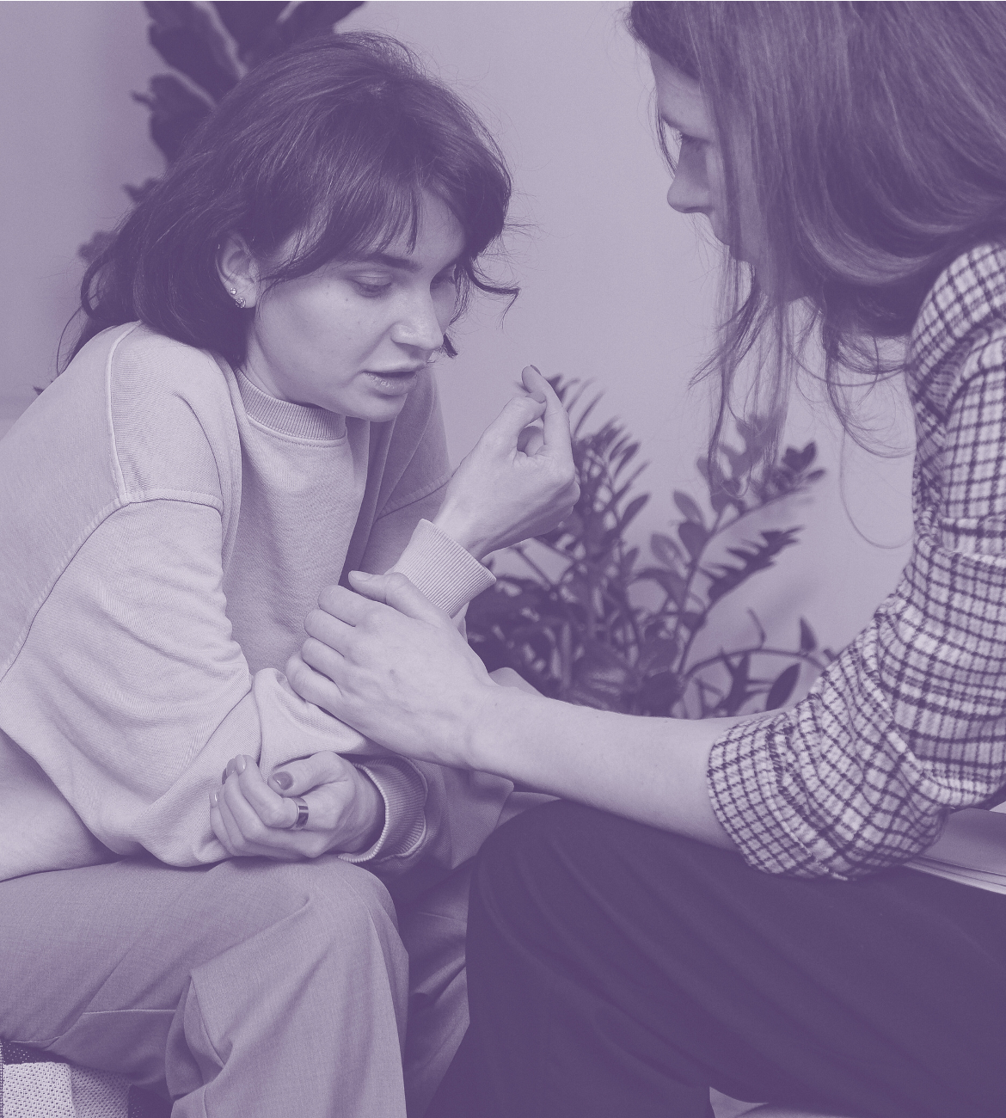
Crimewest
Institute
Suicide Prevention
A guide to understanding, awareness, and action
PRESENTER NAME

Slide 2

Crimewest
Institute
Why suicide prevention matters
Understanding risk and protective factors
Recognizing warning signs and getting help
Contents

Slide 3

Crimewest
Institute
Why suicide prevention matters
Explain that suicide is a serious public health issue, but it's also preventable.
Empower the audience by reminding them that everyone has a role in creating supportive, safe spaces.

Slide 4
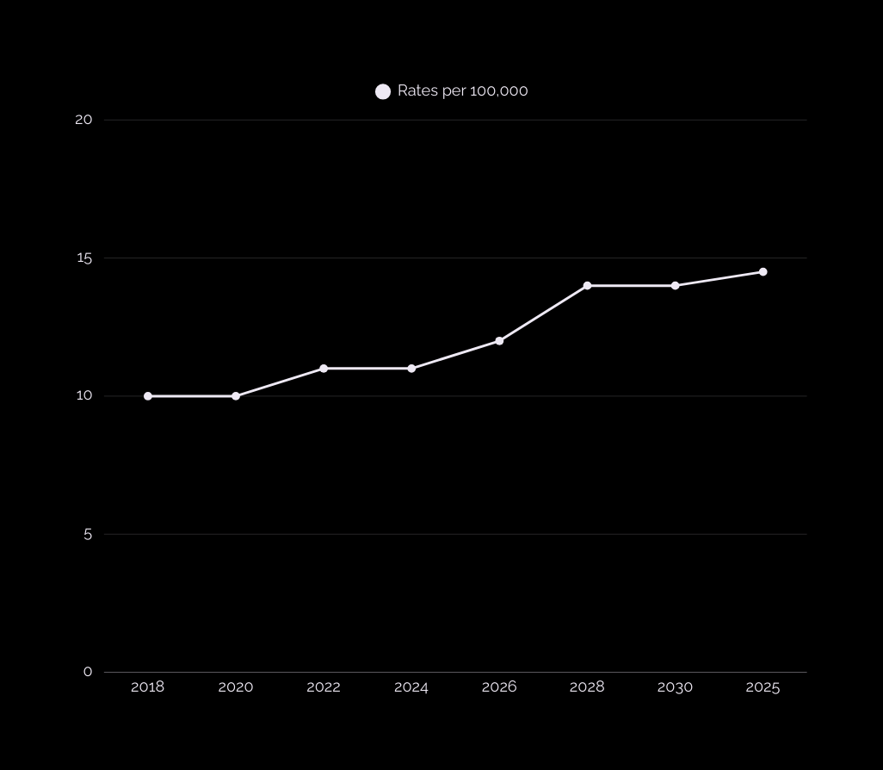
Crimewest
Institute
Data and statistics
Include a chart or graph to show trends, such as rising suicide rates or group disparities.
Explain why this data is important and how understanding it can support prevention efforts.

Slide 5
Crimewest
Institute
Common misconceptions
Empower the audience to respond with compassion and confidence by challenging myths with facts.
Myth | Fact
Add a misconception here. | Add a fact to debunk the misconception here.
Add a misconception here. | Add a fact to debunk the misconception here.
Add a misconception here. | Add a fact to debunk the misconception here.

Slide 6
Crimewest
Institute
Quick poll
Question goes here
Option 1
Option 2
Option 3
Option 4
Use a poll to gauge how participants are feeling or what they believe about the topic. Then, share the results to spark discussion.

Slide 7
Crimewest
Institute
Risk factors
Explain what a risk factor is. Highlight that risk factors do not cause suicide on their own, but they signal when extra care and support are especially important.
Individual
Relationship
Community
  Risk factor here
  Risk factor here
  Risk factor here
  Risk factor here
  Risk factor here
  Risk factor here
  Risk factor here
  Risk factor here
  Risk factor here

Slide 8
Crimewest
Institute
Define protective factors as things that reduce risk and promote resilience. Share examples that feel relevant to your audience.
Protective factors
Individual
Relationship
Community
  Protective factor here
  Protective factor here
  Protective factor here
  Protective factor here
  Protective factor here
  Protective factor here
  Protective factor here
  Protective factor here
  Protective factor here

Slide 9



Crimewest
Institute
Warning signs
List common warning signs of someone who may be in distress.
Sign here
Another sign here
Another sign here
Supporting details here
Supporting details here
Supporting details here

Slide 10

Crimewest
Institute
Where to get help
Option 1
Organization here
Helpline or number here
Option 2
Organization here
Option 4
Helpline or number here
Organization here
Helpline or number here

Slide 11
Crimewest
Institute
Another strategy here
Another strategy here
Strengthen economic support
Strategies to prevent suicide
Another strategy here
Another strategy here
Another strategy here
List key strategies currently used by governments and trusted organizations.

Slide 12
Crimewest
Institute
Review
Why suicide prevention matters
Summarize why this topic is urgent, and emphasize that suicide is preventable.
Risk and protective factors
Recognizing warning signs and getting help
Recognizing warning signs and getting help
Highlight key signs and stress the importance of early action.

Slide 13

Resource
Credits
  Use these in your presentation. Delete or hide this page before presenting.
  This presentation template is free for everyone to use, thanks to the following:
Fonts
This presentation template
uses the following free fonts:
TITLES:
  for this presentation template
Raleway Bold
BODY TEXT:
Raleway Regular
Pexels, Pixabay, Sketchify
You can find these fonts online too.
  for the photos, graphics, and elements
Colors
  Happy designing!
#4A3562
#EEE9F4
#FFF

