Slide 1





Bullying
Prevention
Teacher’s name
Grade Level

Slide 2

What’s inside
1
What is bullying?
2
Types of bullying
3
What bullying feels like
4
How to stand up against it
5
How our class can help

Slide 3



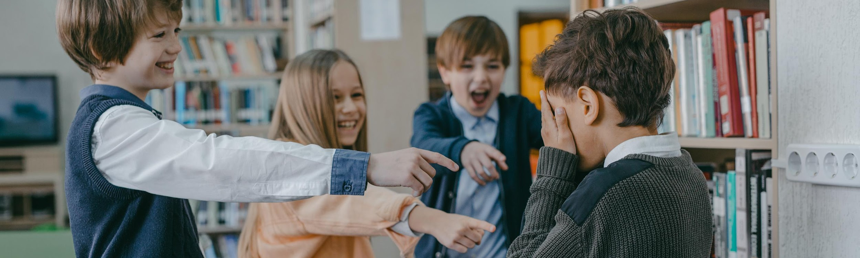
What is bullying?
Explain what bullying means. Add real-life examples or scenarios for clarity. You can also list what bullying is not.

Slide 4




Teasing someone about their appearance
Add example here.
Taking someone’s belongings
When these things happen repeatedly to the same person, it is
Bullying
Add example here.
Add example here.
Add example here.
Add example here.
Add example here.

Slide 5



Activity: Is this bullying?
List sample scenarios and ask students to identify if the scenarios show bullying or not.
Scenario 1:
Dylan often makes fun of Alex by calling him names.
Scenario 2:
Describe a scenario here.
Scenario 3:
Describe a scenario here.

Slide 6

Types of bullying
Physical
Describe what physical bullying looks like. Include an age-appropriate example.
Verbal
Explain how verbal bullying involves words used to hurt, embarrass, or threaten someone.
Relational
Describe how social bullying harms someone’s relationships or reputation.

Slide 7

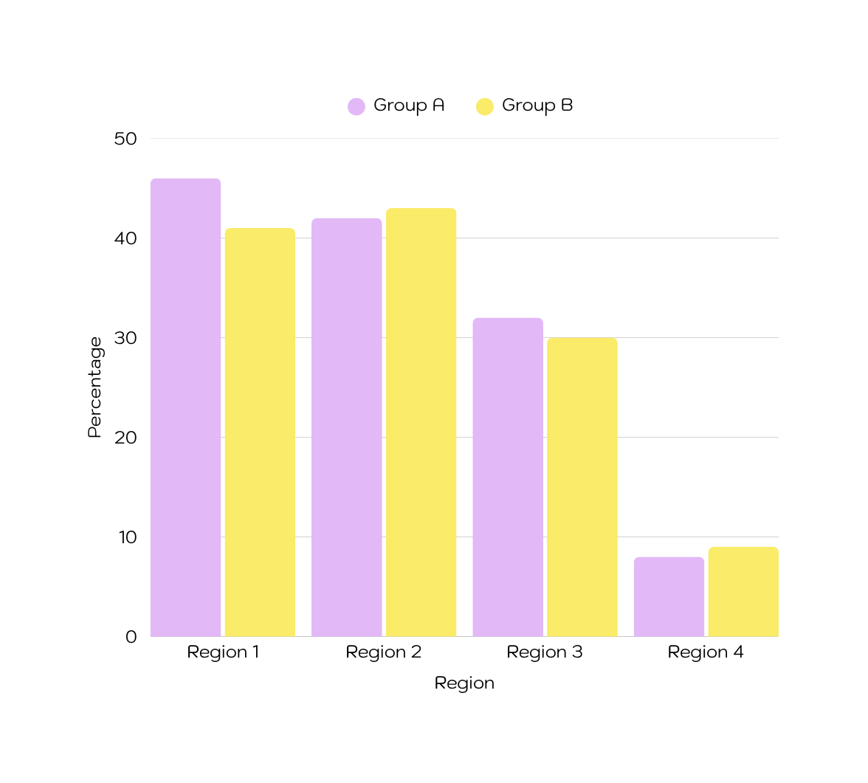



Global prevalence of school bullying
Add a chart or graph related to bullying statistics. Briefly explain what the data shows, why it’s important, and how it relates to the current topic.

Slide 8
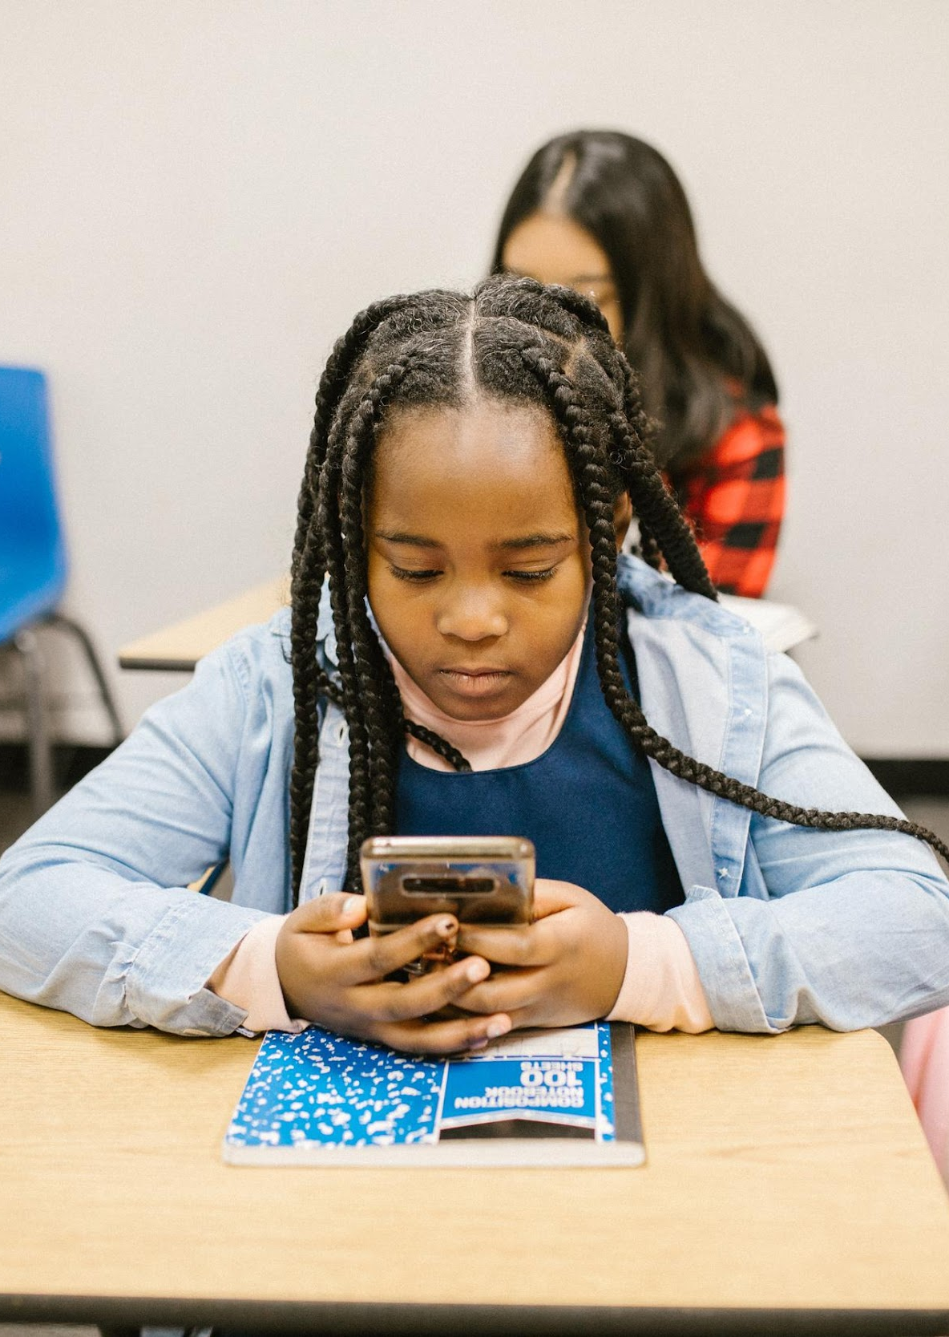
What is cyberbullying?
Introduce the concept of cyberbullying. Mention where it can take place (e.g. social media, messaging apps, and games) and how it can affect someone.

Slide 9

Effects of bullying
Scenario Title
Use any of these discussion prompts:
  How might the person in the scenario feel?
  What effects could the bullying have on them?
  What would you do if you were in their place?
  What can a friend do to help?
Create a fictional scenario that shows one type of bullying. Keep it safe and appropriate for classroom discussion.

Slide 10

From a bystander
Reach out to the person being bullied
Explain why this action matters and how it can be done safely.
Speak up about the bullying
Explain why this action matters and how it can be done safely.
Call in other support
Explain why this action matters and how it can be done safely.
to an upstander

Slide 11

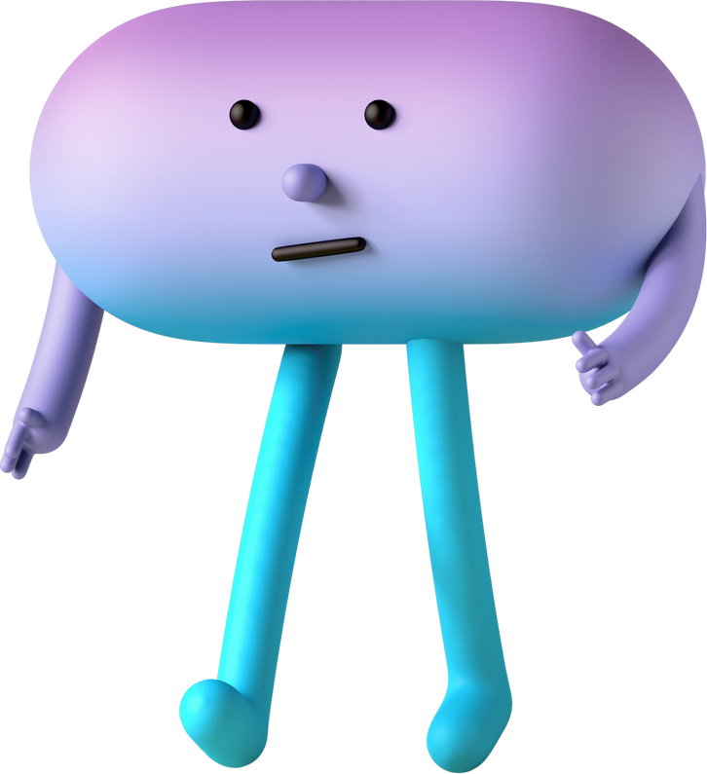
Activity:
Class commitment
Use this slide to guide the class in creating a short anti-bullying pledge together. Let students sign it or decorate it as part of the activity.

Slide 12

Review
What is bullying?
Define bullying and add one example.
What is cyberbullying?
Explain how bullying can happen online and its negative impacts.
Types of bullying
List the main types and explain how bullying can come in different forms.
How to be an upstander
List ways students can help someone being bullied.

Slide 13

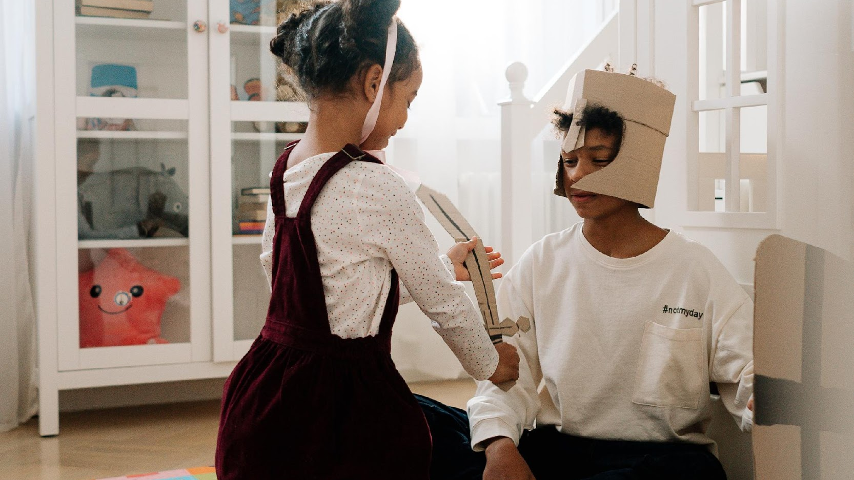
“No act of kindness, no matter how small, is ever wasted.”
— Aesop

Slide 14





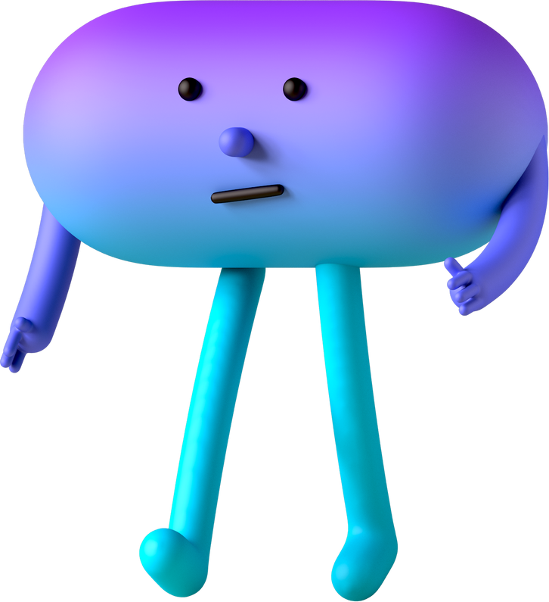








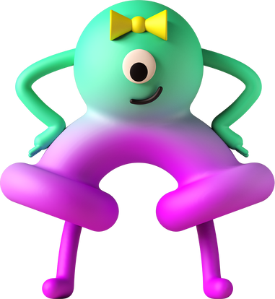
Resource Page
  Use these in your presentation. Delete or hide this page before presenting.
Fonts
Design Elements / Icons
This presentation template
uses the following free fonts:
TITLES:
Paytone One
BODY TEXT:
Kodchasan
You can find these fonts online too.
Colors
#F7B8D4
#FDF080
#B0EFBA
#C0F0F7
#E3B8F7

Slide 15


Credits
  This presentation template is free for everyone to use, thanks to the following:
Pexels, Pixabay, Sketchify
  for this presentation template
  for the photos, graphics, and elements
Happy designing!

