Slide 1


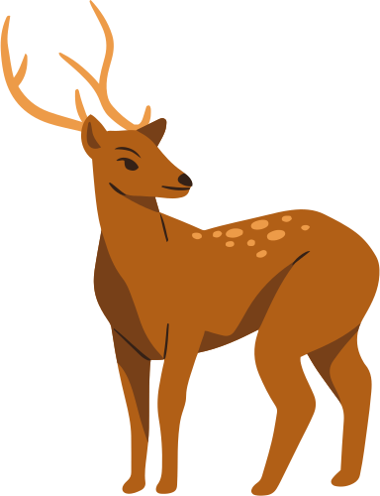

KEYSTONE
LEARNING CENTER
Introduction to Biodiversity
What is it and why does it matter?
GORDON ALIPRANDI - SCIENCE DEPARTMENT

Slide 2

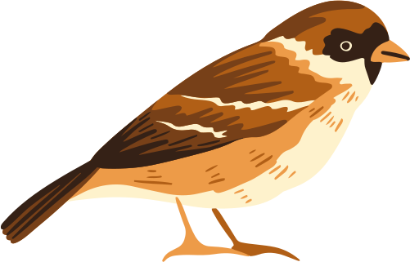
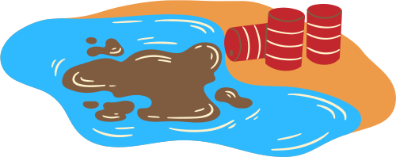
What we’ll cover
What is biodiversity?
Threats to biodiversity
How can we help?
Explore the variety of life around us
Find out what’s putting nature at risk
Learn the small actions that make a big difference

Slide 3
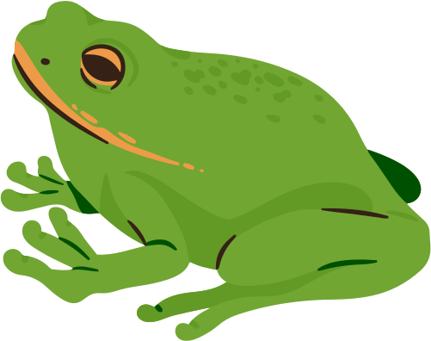
Biodiversity Bingo
Has visited a zoo or aquarium | Has seen a butterfly this week | Can name two types of ecosystems
Has planted a tree before | Recycles at home | Can name an endangered animal
Add another prompt here. | Add another prompt here. | Add another prompt here.
Use this slide to introduce a fun icebreaker that helps students review what they already know.
Create a 3×3 bingo grid with prompts related to nature and biodiversity. Have students walk around the room and find classmates who match each prompt.

Slide 4
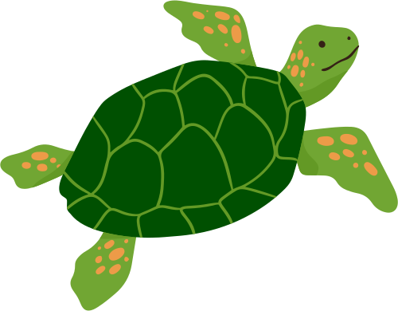
What is Biodiversity?
Define biodiversity. You can also highlight how it helps provide food, clean air and water, and keeps ecosystems in balance.

Slide 5
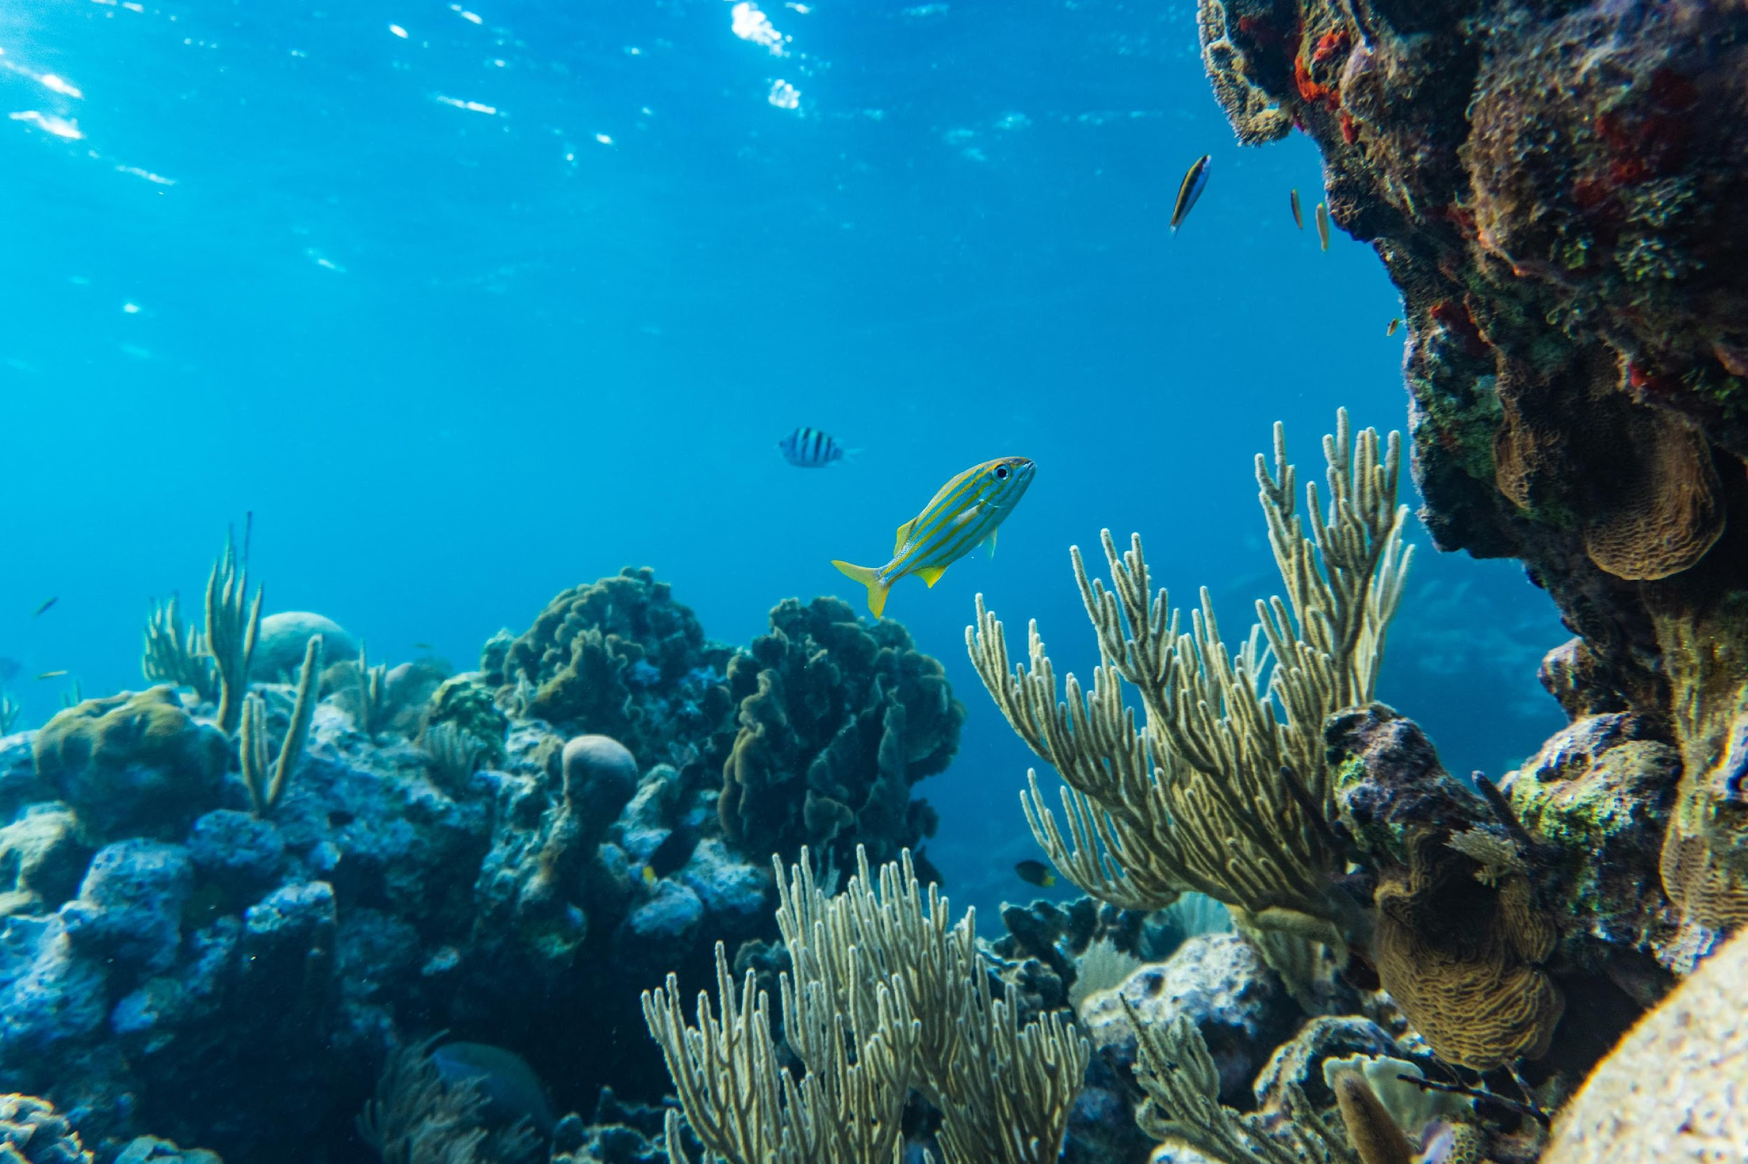
Coral reefs
Mention the organisms that rely on coral reefs. Briefly describe how reefs support thousands of marine species.

Slide 6
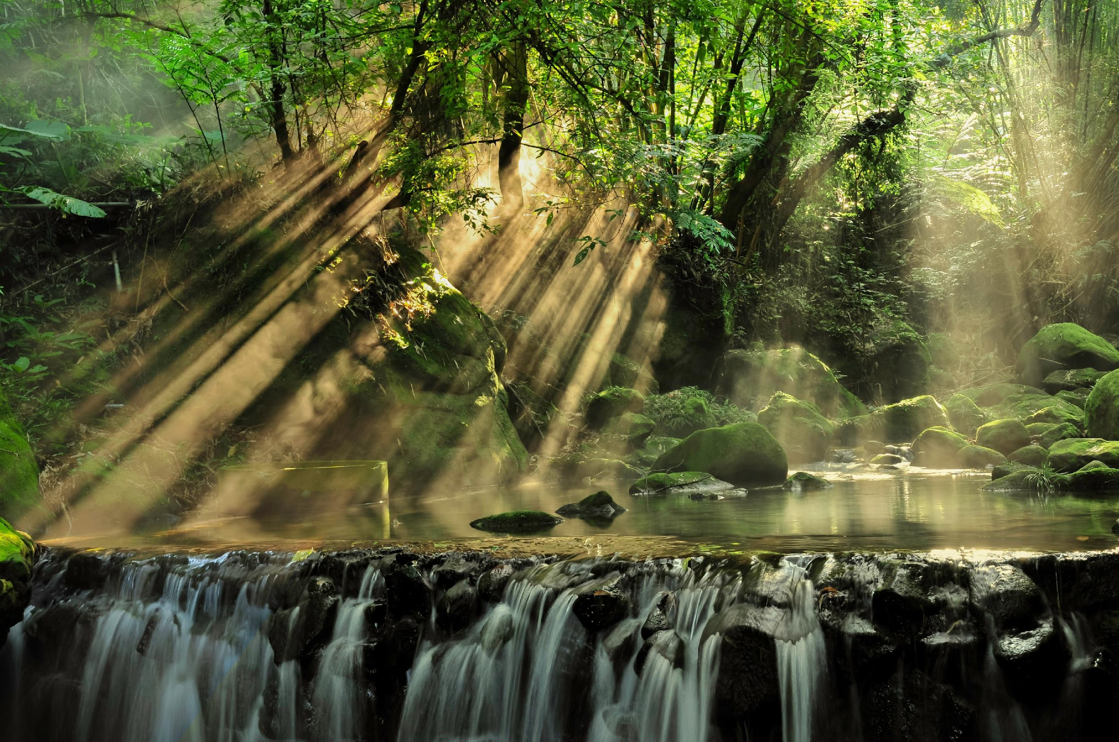
Rainforests
Mention the organisms that rely on coral reefs. Briefly describe how reefs support thousands of marine species.

Slide 7
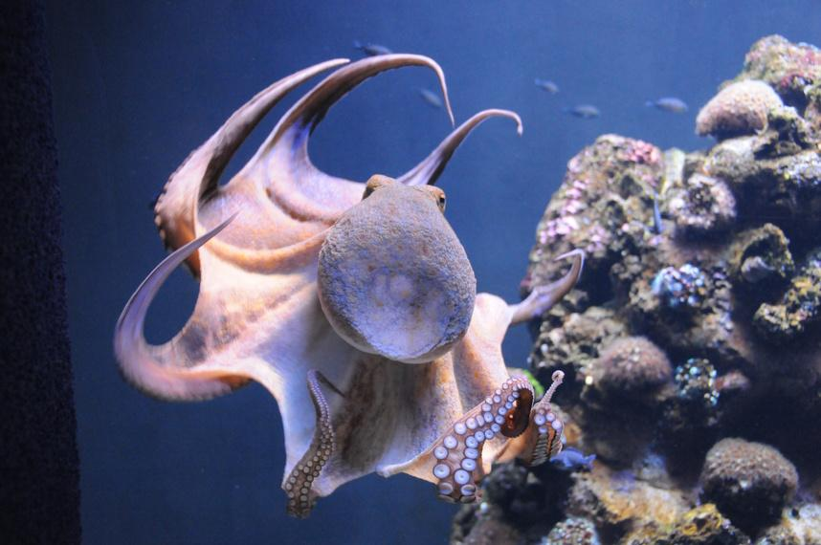
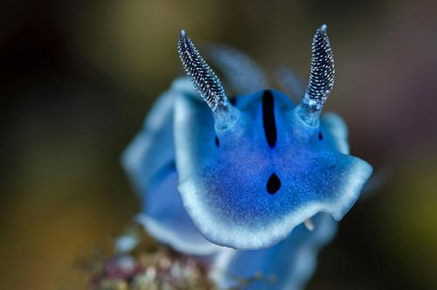
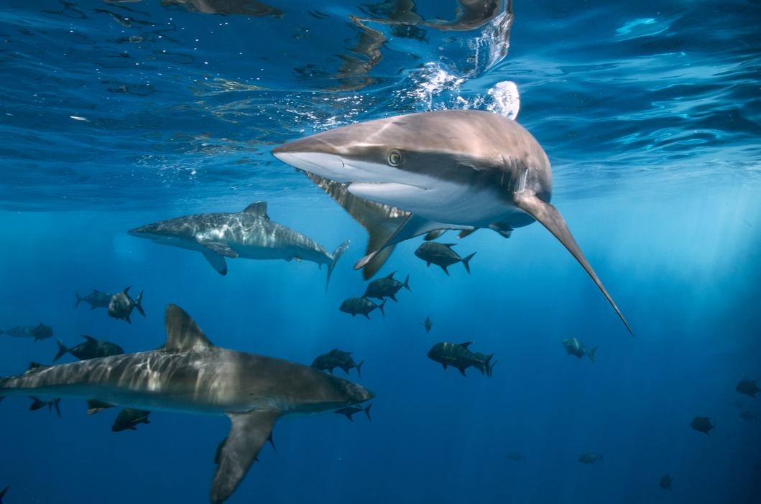
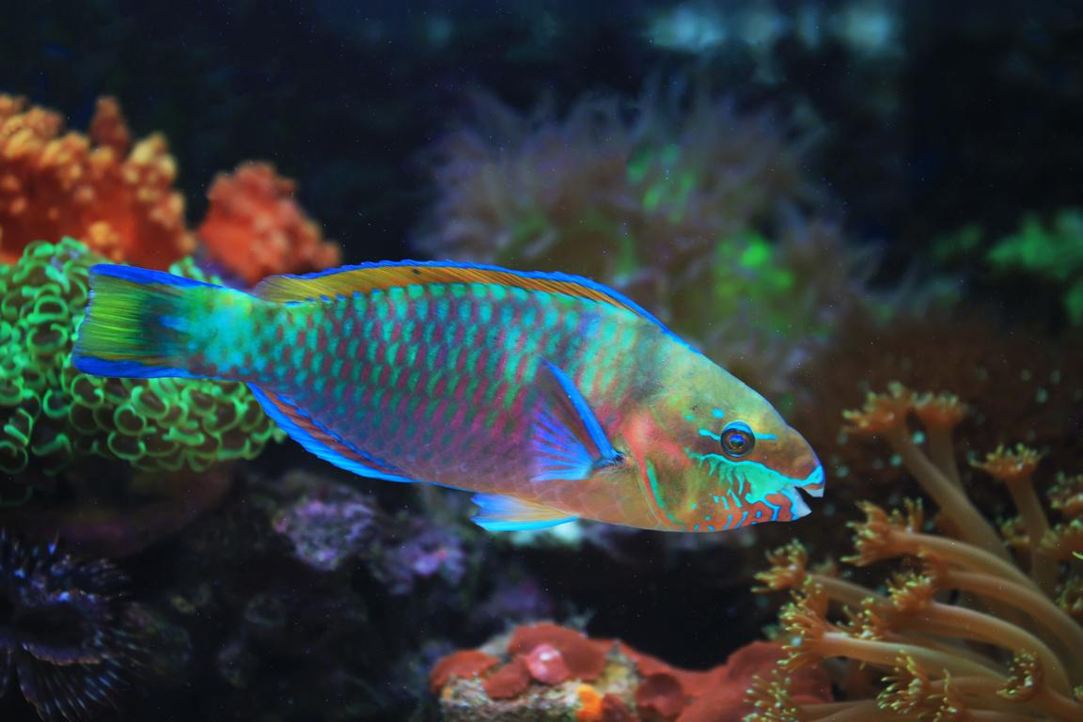
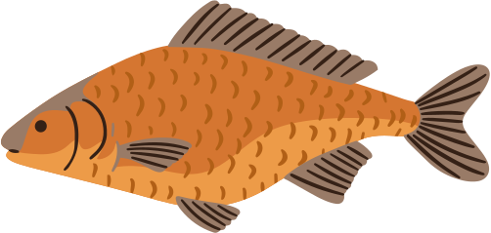
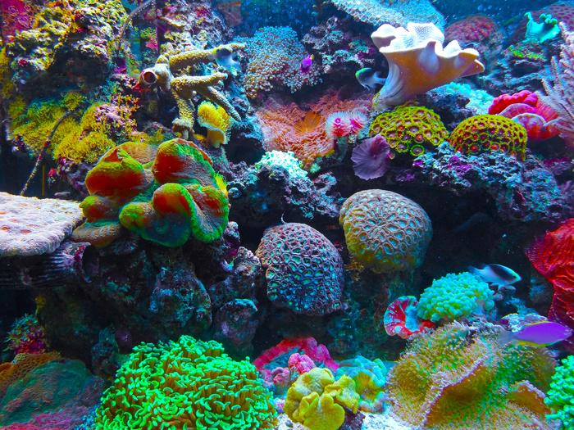
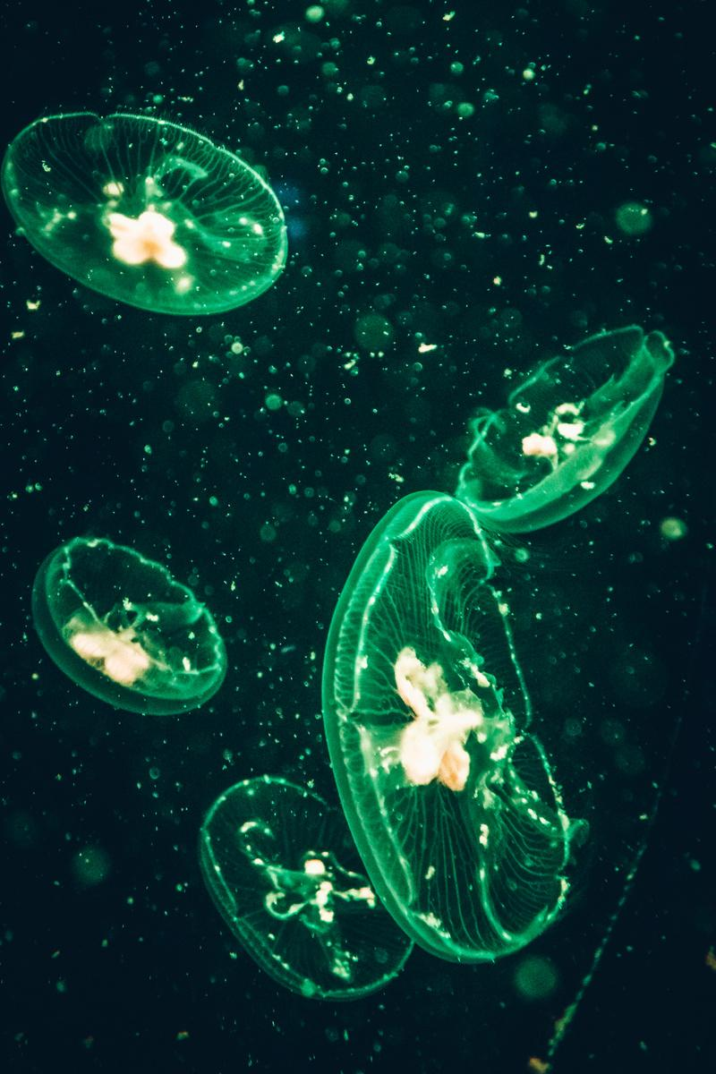
What happens if one goes extinct?
Label here
Use this slide to explore how organisms in a food web are connected. Ask students what might happen if one species (like parrotfish) disappears.
Label here
Label here
Parrotfish
Corals
Plankton

Slide 8
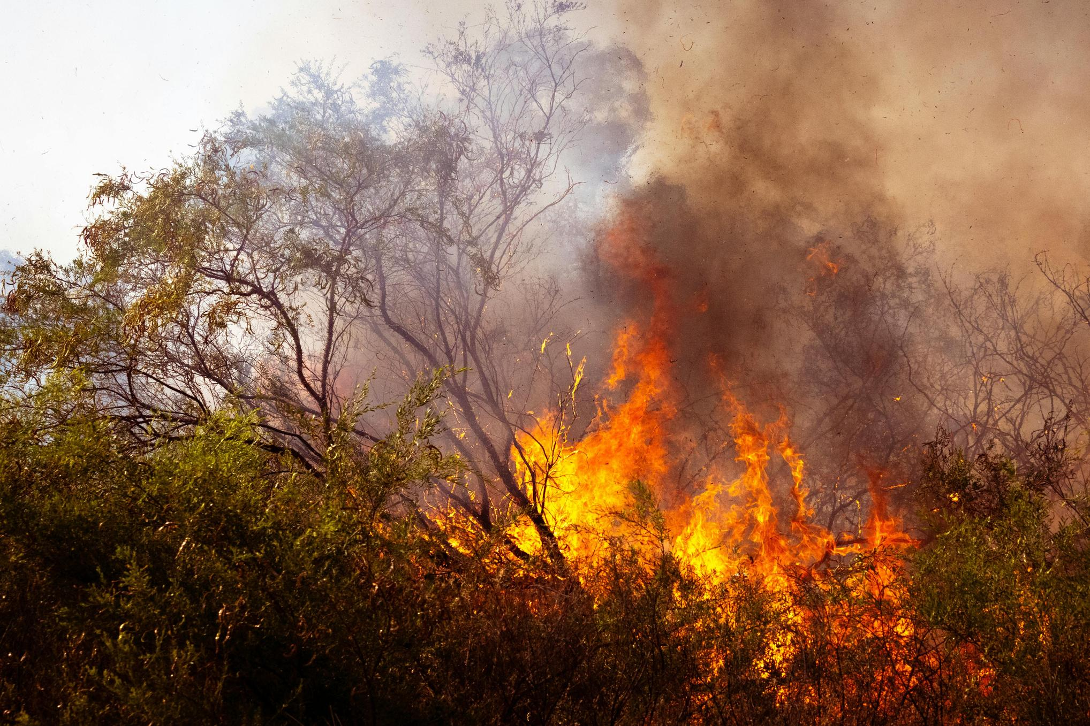
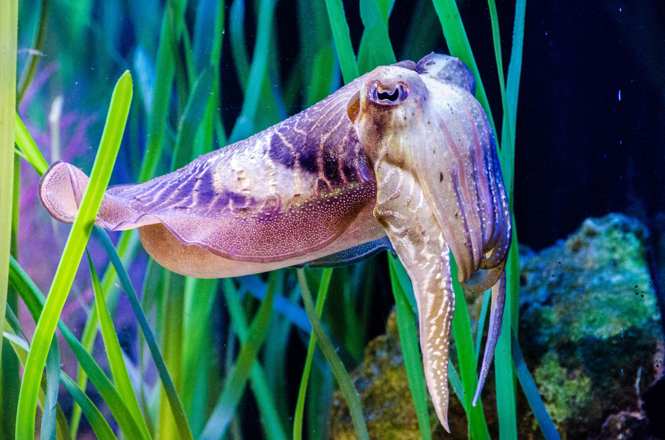
Climate Change
Threats to biodiversity
Explain how warmer oceans affect coral reefs and how animals may lose their habitats
Invasive Species
Explain how invasive species outcompete native species for food and space, leading to population declines

Slide 9
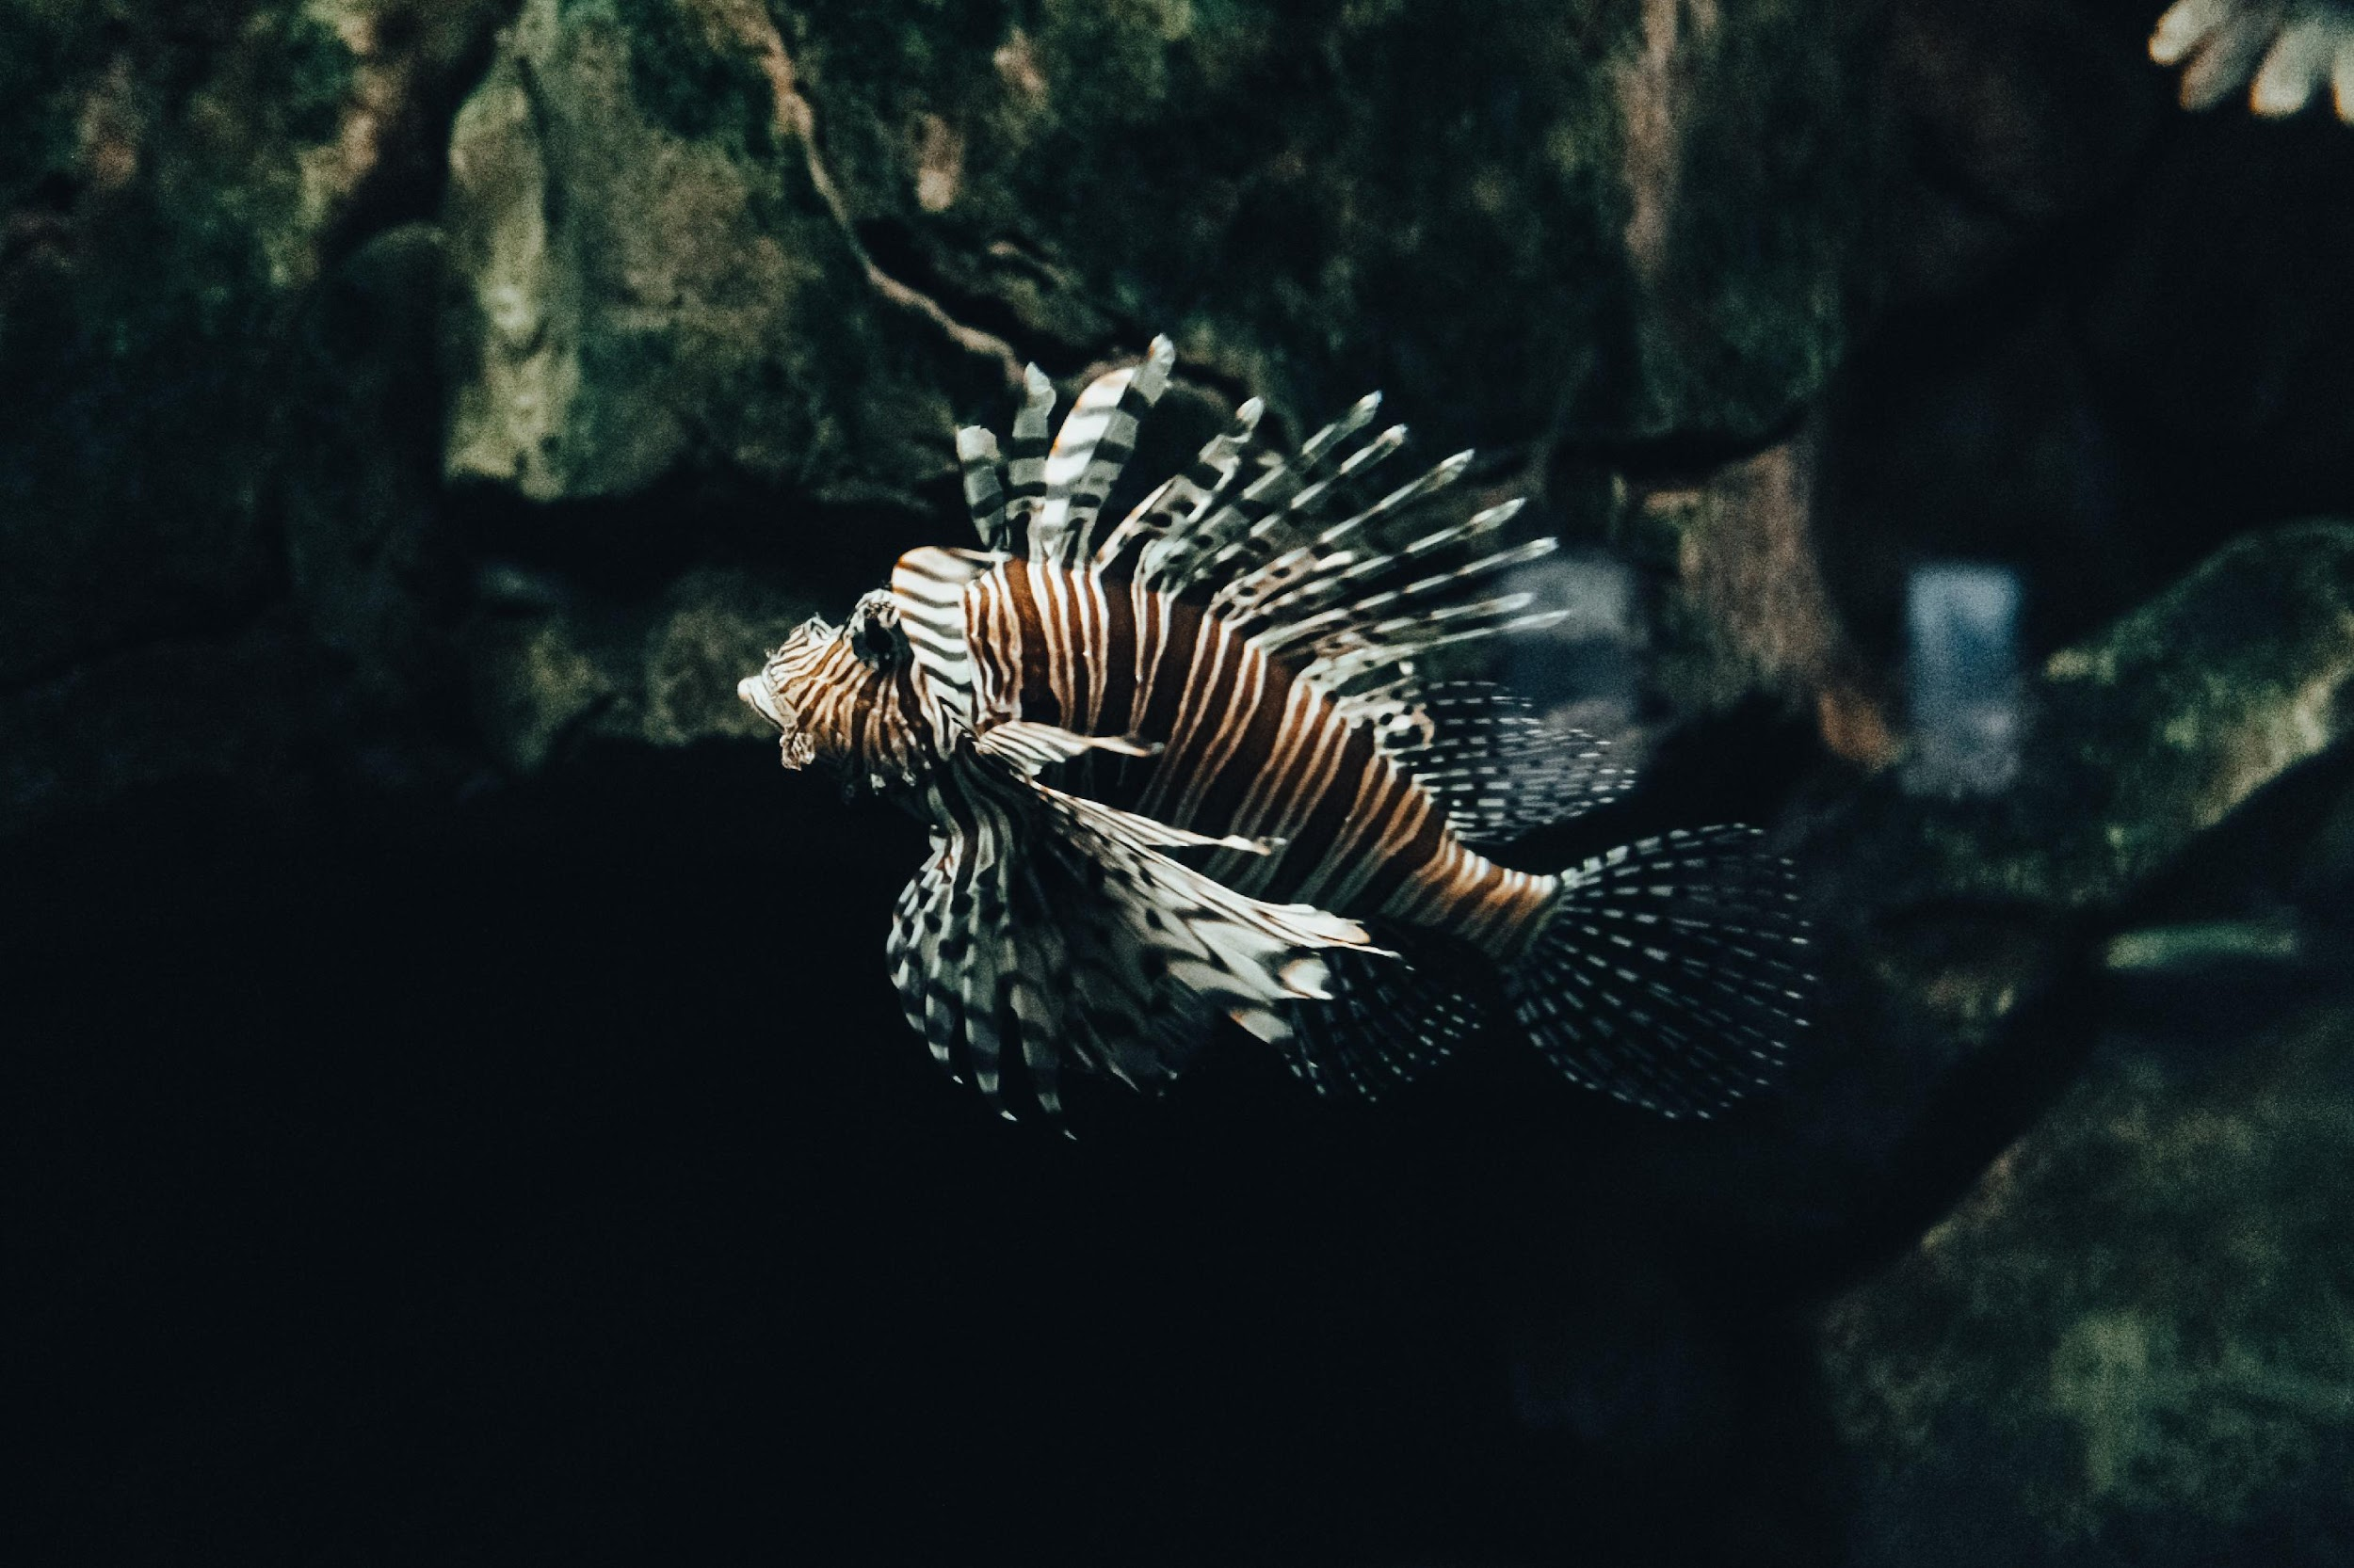
The Lionfish problem
Explain the impact of the lionfish, a striking but harmful invasive species in the Atlantic Ocean and Caribbean Sea.

Slide 10
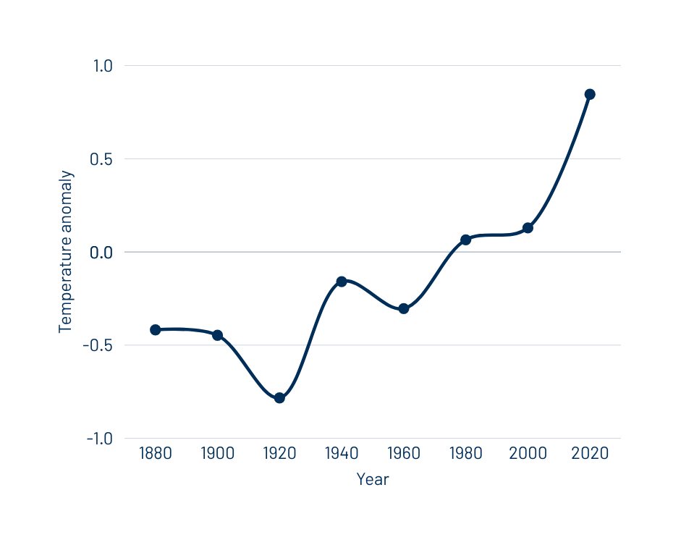
Average global sea surface temperature
Add a brief subtitle here. Include also the source of your data.
Add a chart or graph related to climate change, such as the rising global sea surface temperature. Briefly explain what the graph shows and why it’s important.

Slide 11
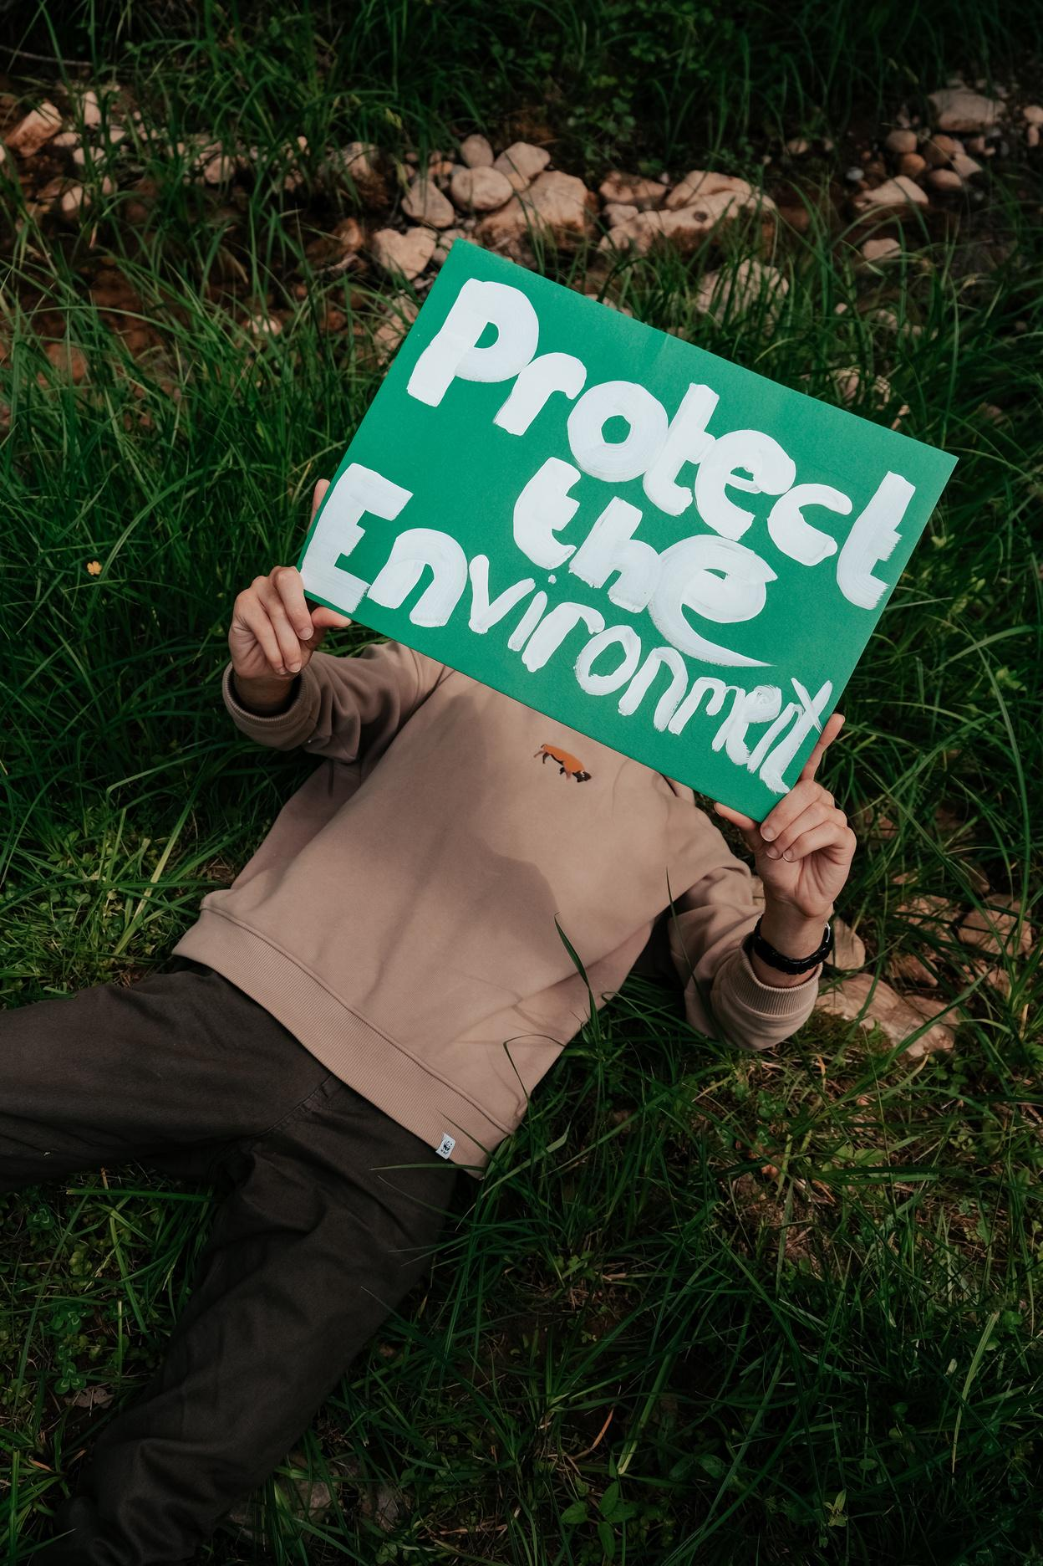
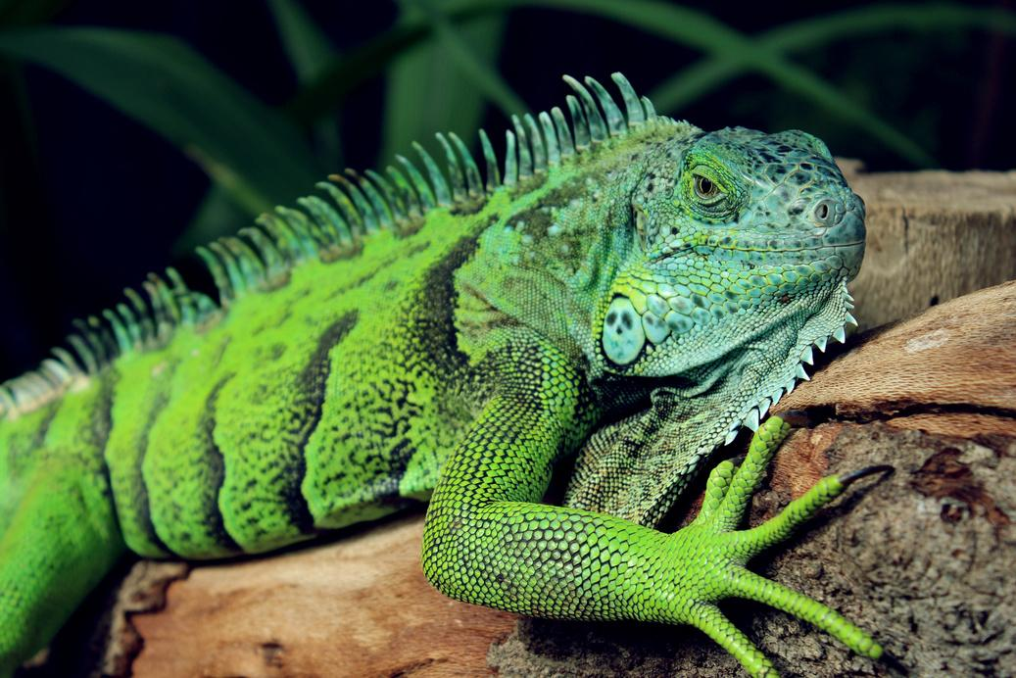
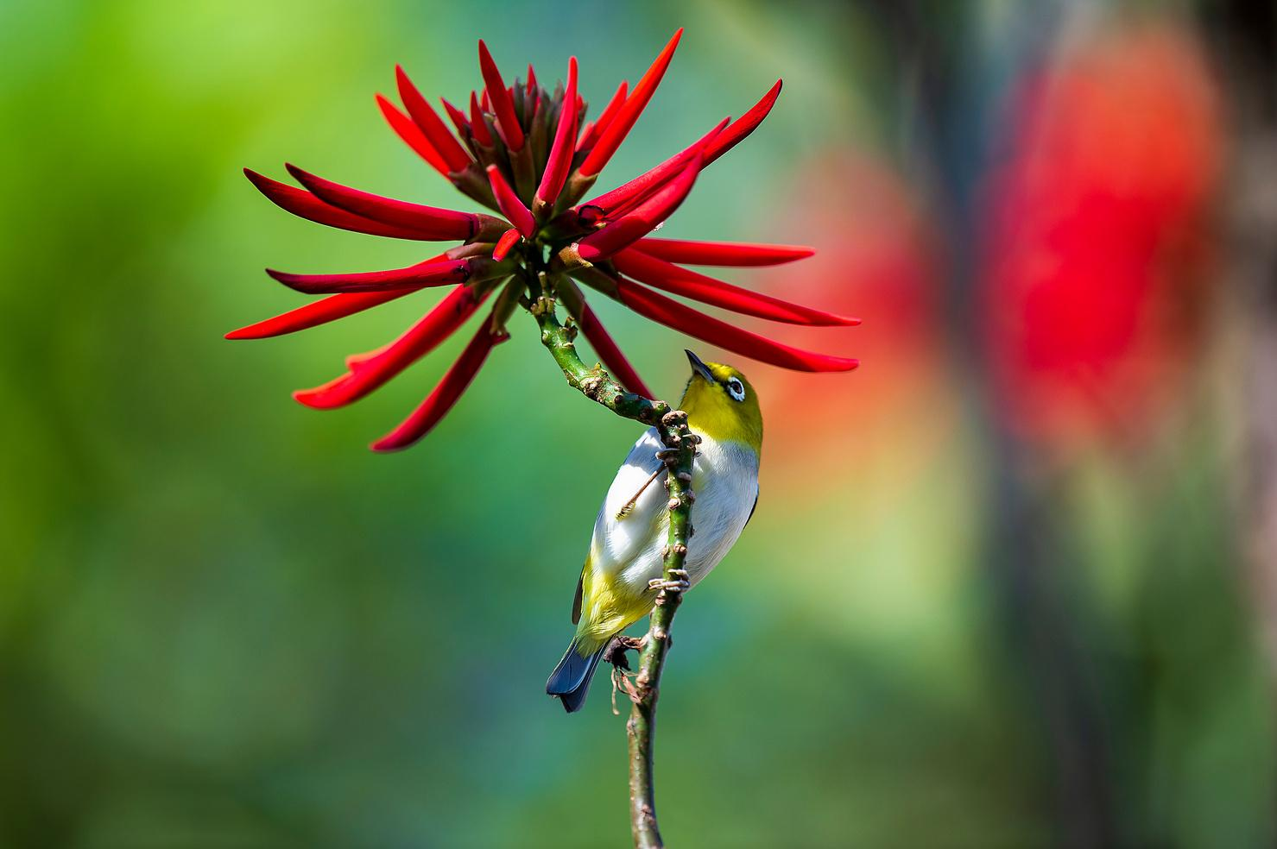
How can we help?
Support institutions that promote the protection and restoration of biodiversity.
Add another practical action students can take to support biodiversity conservation.
Add another practical action students can take to support biodiversity conservation.

Slide 12

Let’s review
What is biodiversity
Define biodiversity and highlight its importance.
Threats to biodiversity
List a few major threats covered in the lesson.
How can we help
Summarize practical actions students can take or support to conserve biodiversity.

Slide 13
Resource Page
  Use these in your presentation. Delete or hide this page before presenting.
Fonts
Design Elements / Icons
This presentation template
uses the following free fonts:
TITLES:
Fredoka
BODY TEXT:
Barlow Regular
You can find these fonts online too.
Colors
#FD6F23
#D9F9B3
#2FB9FF
#012E59
#FF94D8

Slide 14

Credits
  This presentation template is free for everyone to use, thanks to the following:
  for this presentation template
Pexels, Pixabay, Sketchify
  for the photos, graphics, and elements
  Happy designing!

Slide 15
B for blur | C for confetti
D for a drumroll | M for mic drop
O for bubbles | Q for quiet
U for unveil | Any number from 0-9 for a timer
Resource Page
Find the magic in presenting. Select these keys while in Present mode.
Delete or hide this page before presenting.

