Slide 1

Elegant
Birthday
BACKGROUND SLIDES

Slide 2
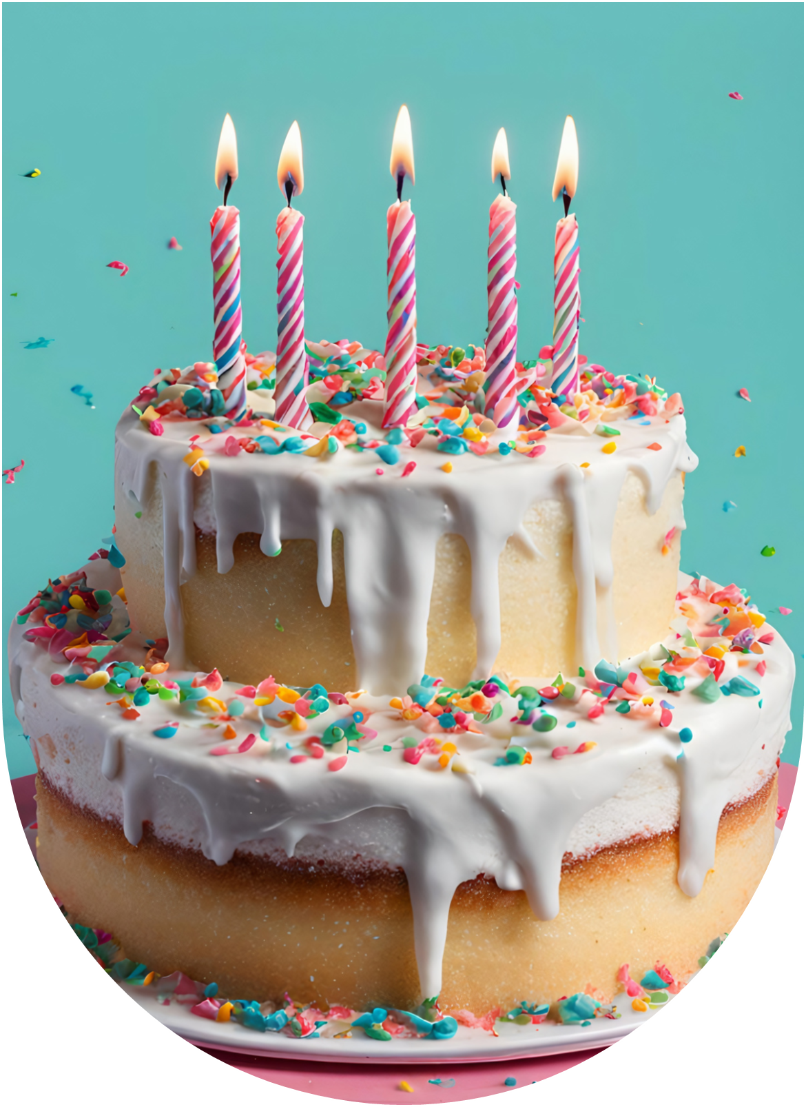

ON YOUR SPECIAL DAY, MAY ELEGANCE AND JOY DANCE TOGETHER TO CREATE UNFORGETTABLE MEMORIES
YOUR FRIEND
Name Surname

Slide 3
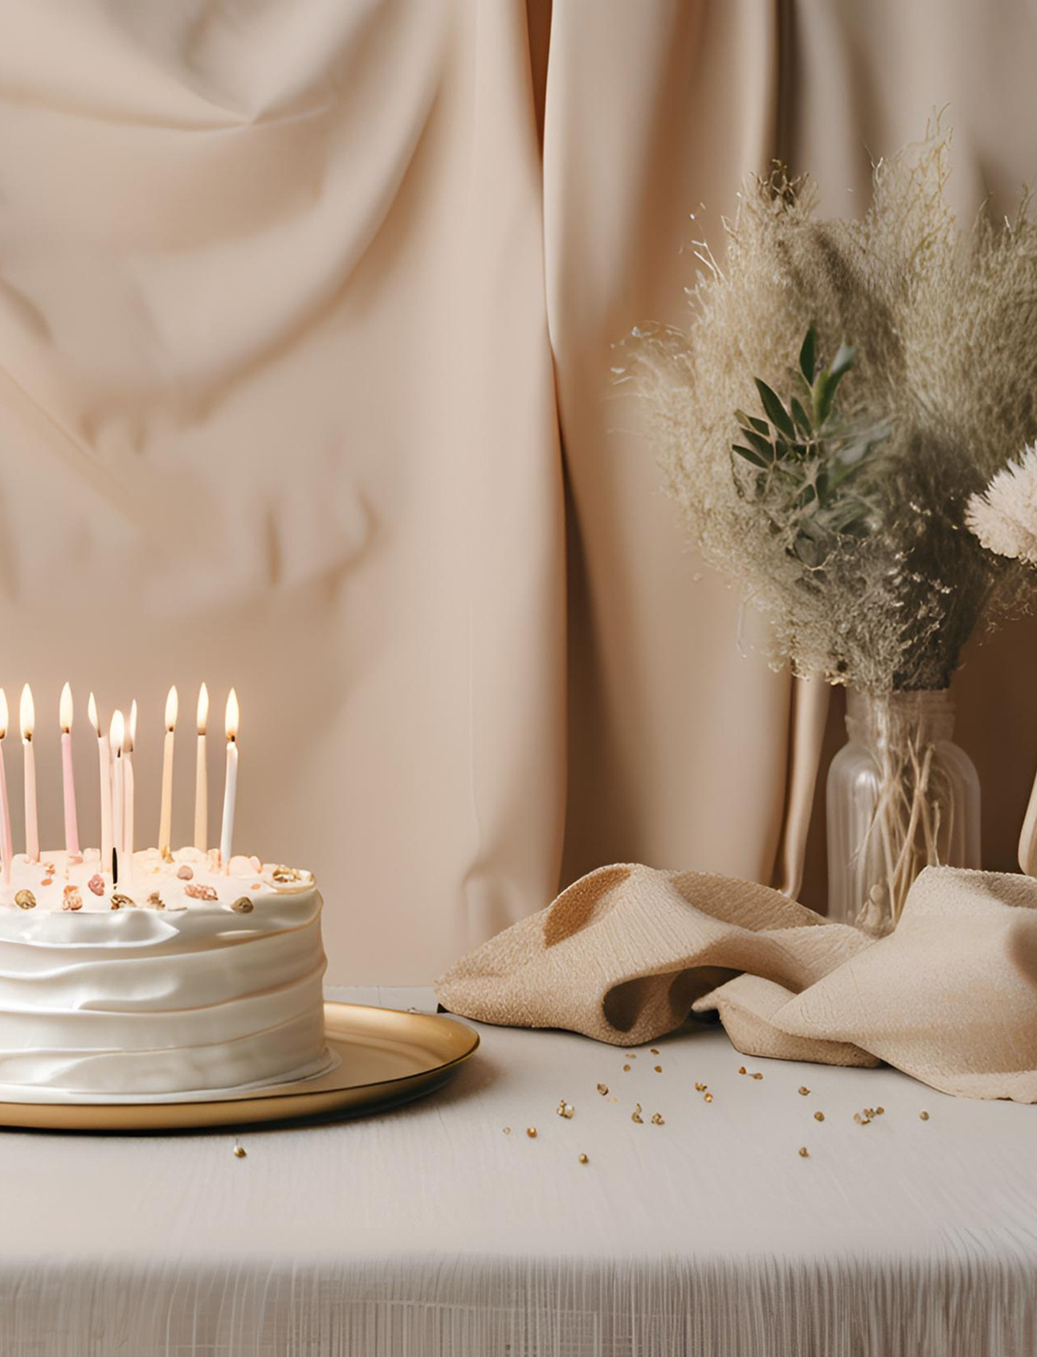

May your birthday
be adorned with
love, grace,
and
cherished
moments.
Happy Birthday!

Slide 4

Happy Birthday!
Wishing yo
a day filled with
beauty, joy, and all
the elegance life
can offer.

Slide 5

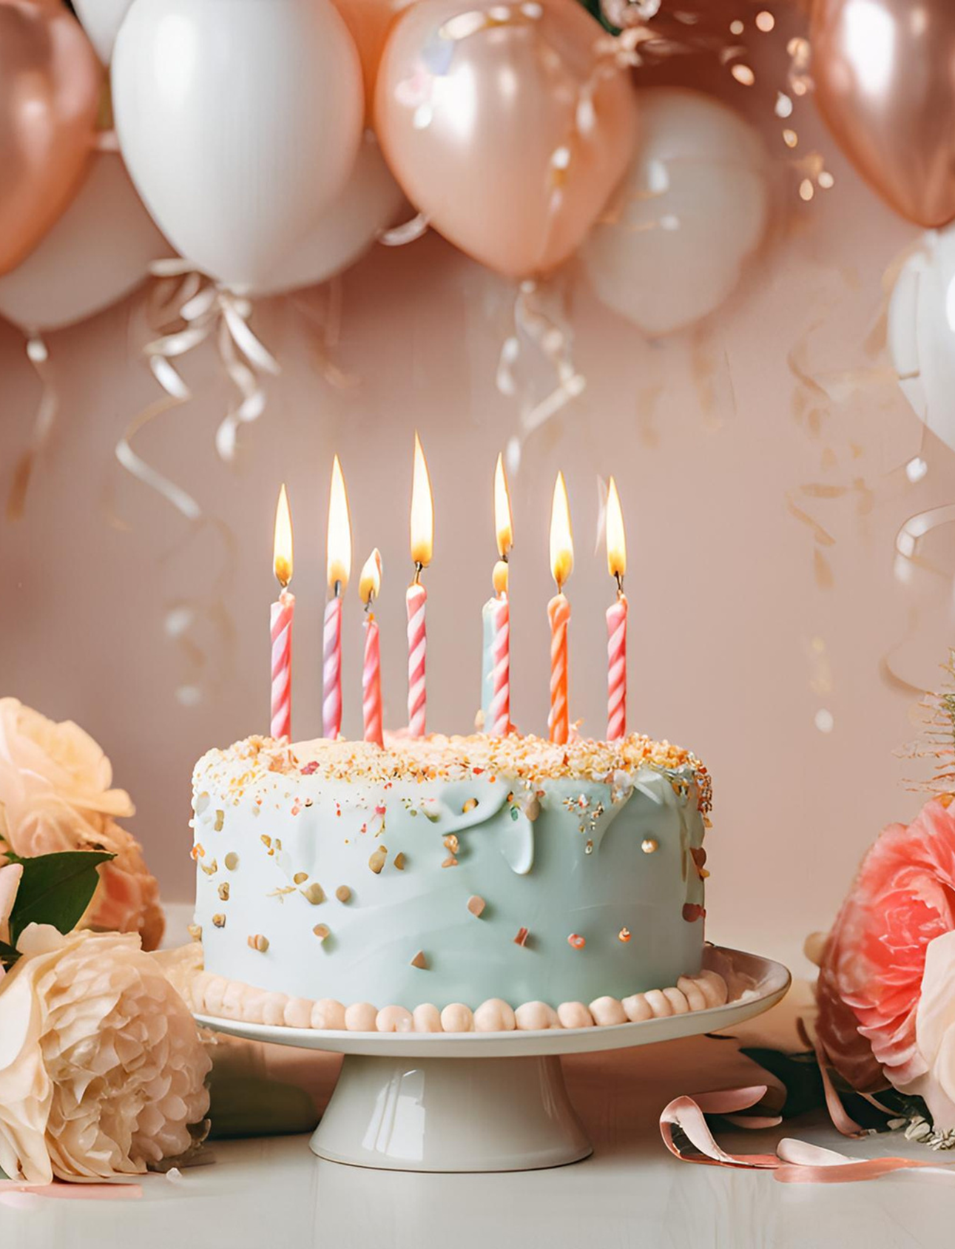
May your birthday
be adorned with
love, grace,
and
cherished
moments.

Slide 6


MAY YOUR JOURNEY AHEAD BE FILLED WITH GRACE, BEAUTY, AND ABUNDANT JOY.
Happy Birthday!

Slide 7
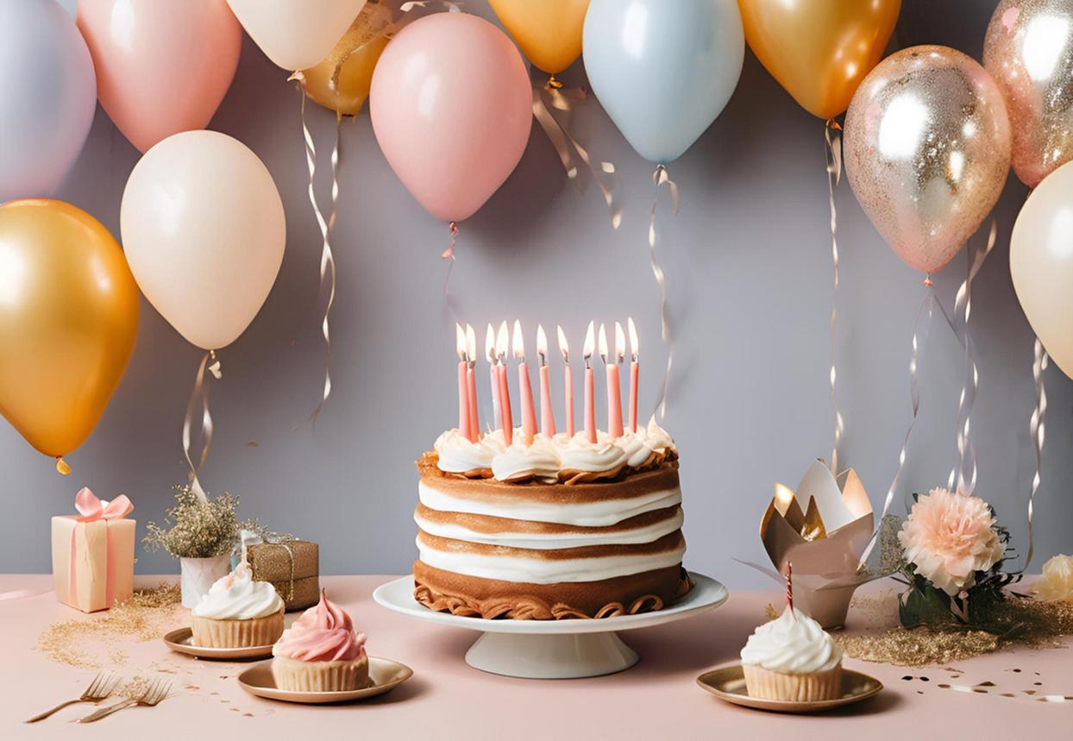
CELEBRATING YOU TODAY WITH WISHES FOR A YEAR AS GRACEFUL AND INSPIRING AS YOU ARE.

Slide 8


May your birthday
be adorned with
love, grace,
and
cherished
moments.

Slide 9
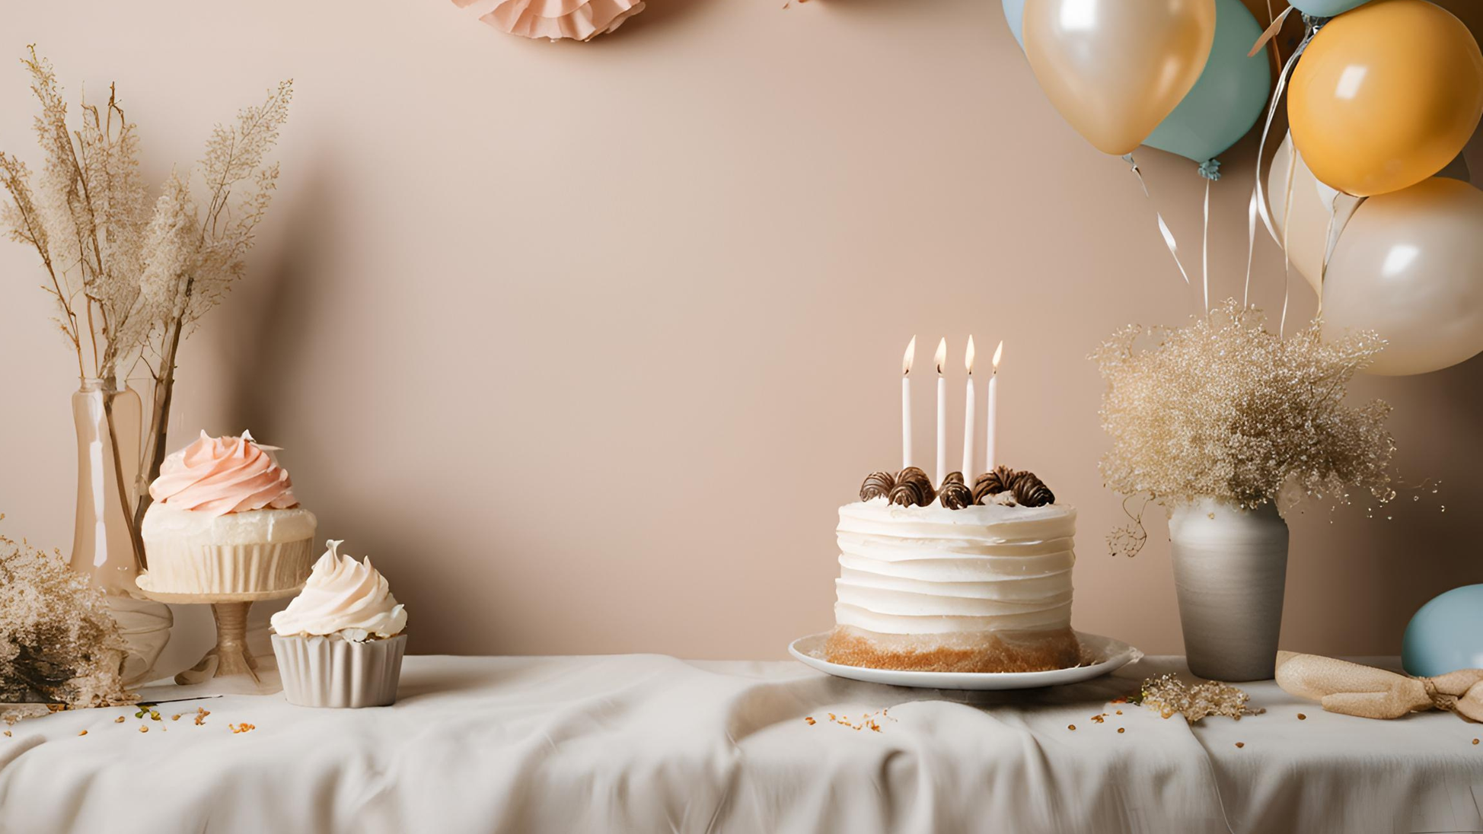

Dear Jane
SENDING YOU REFINED WISHES AND HEARTFELT BLESSINGS ON YOUR SPECIAL DAY.

Slide 10
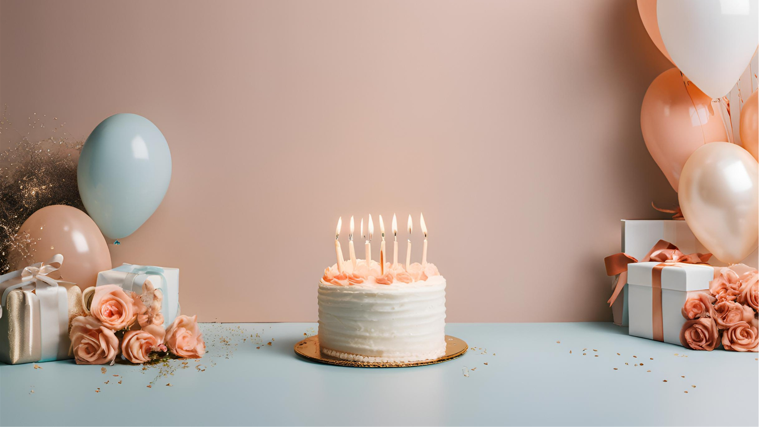
May your birthday sparkle with moments of
love, laughter, and sophistication.
NAME SURNAME

Slide 11
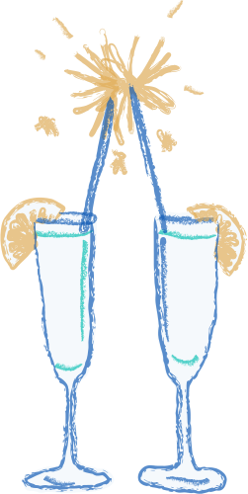
WISHING YOU TIMELESS ELEGANCE AND ENDLESS HAPPINESS ON YOUR SPECIAL DAY.
Name Surname

Slide 12
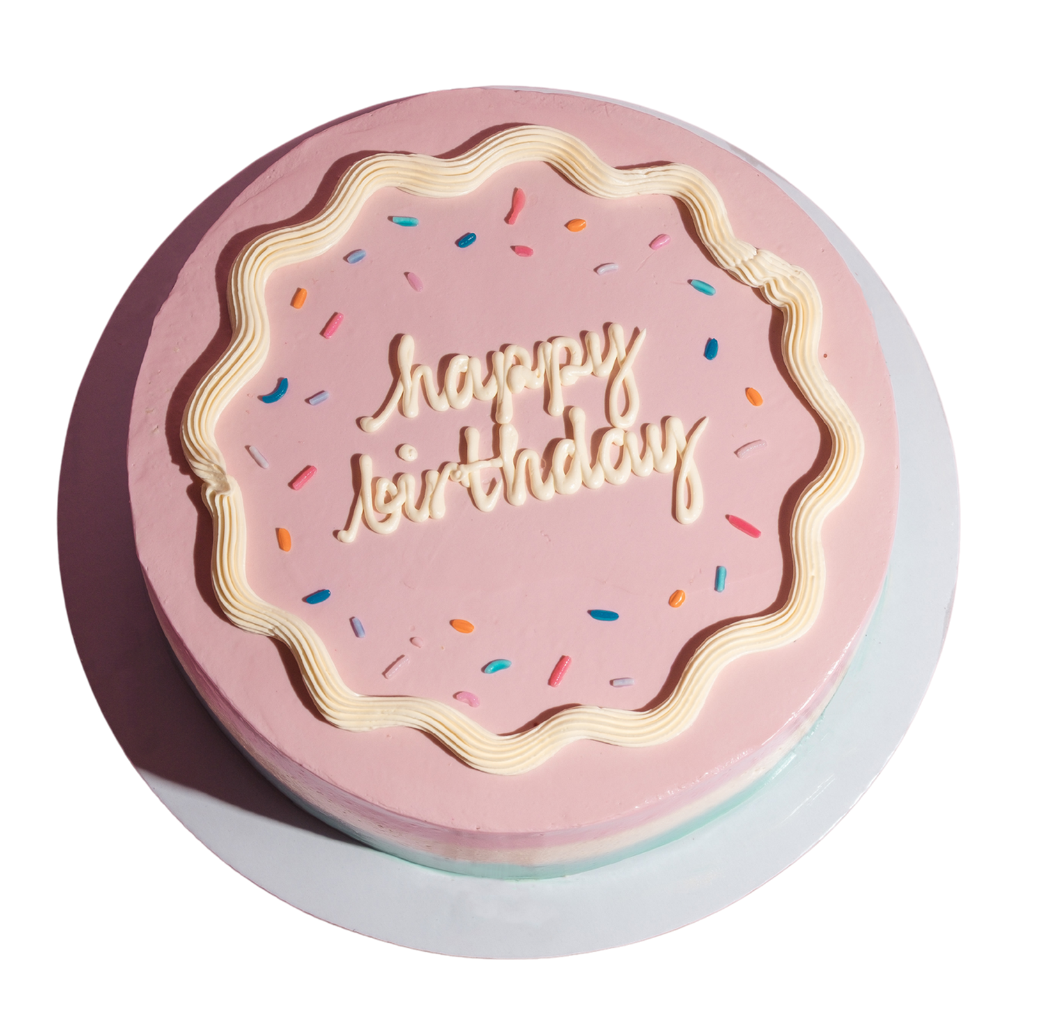
TO A WONDERFUL PERSON
ON THEIR BIRTHDAY:
May your day be as elegant and extraordinary as you.

Slide 13

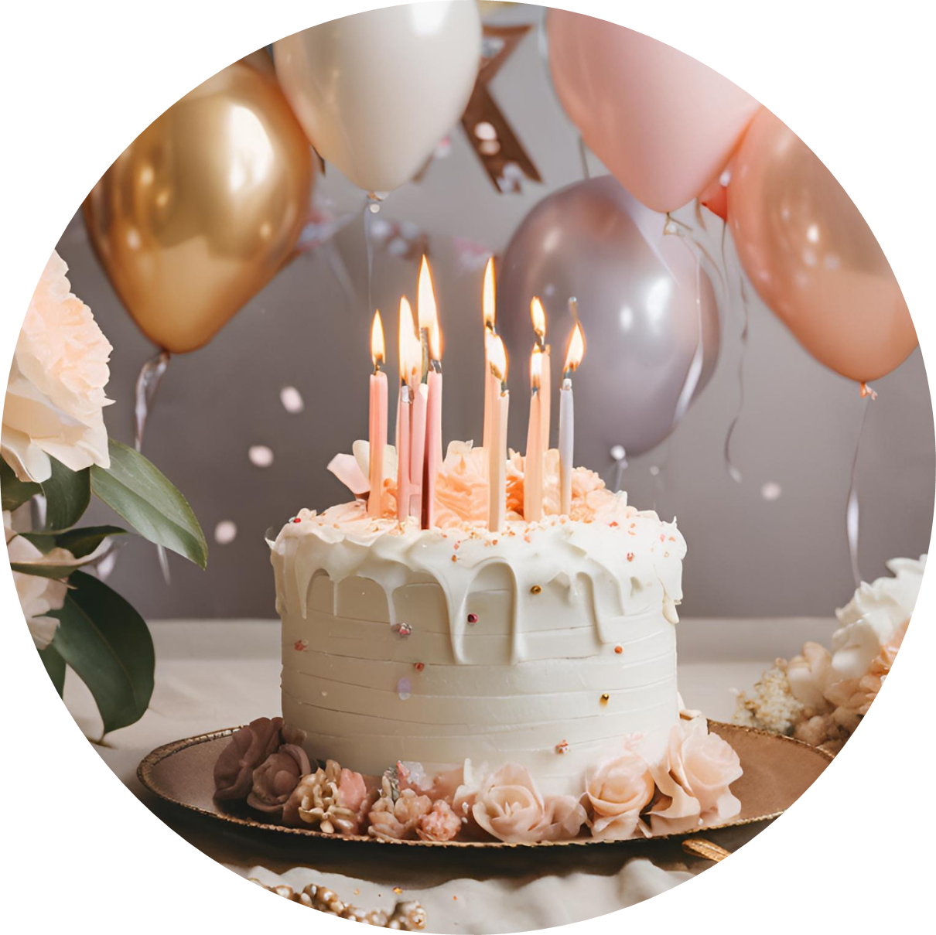
ELEGANCE IS THE ONLY BEAUTY THAT NEVER FADES. WISHING YOU A BEAUTIFULLY ELEGANT BIRTHDAY.
NAME SURNAME

Slide 14

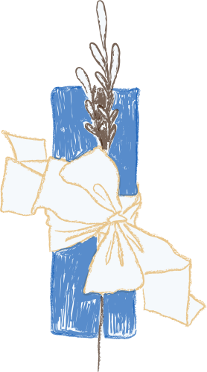
Simon
SENDING YOU REFINED WISHES AND HEARTFELT BLESSINGS ON YOUR SPECIAL DAY.
Happy Birthday!

Slide 15
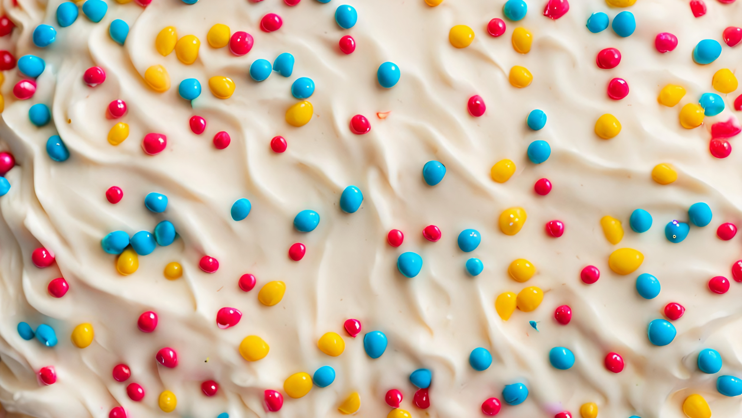
Dear friend
MAY YOUR JOURNEY AHEAD BE FILLED WITH GRACE, BEAUTY, AND ABUNDANT JOY.
Happy Birthday!

Slide 16
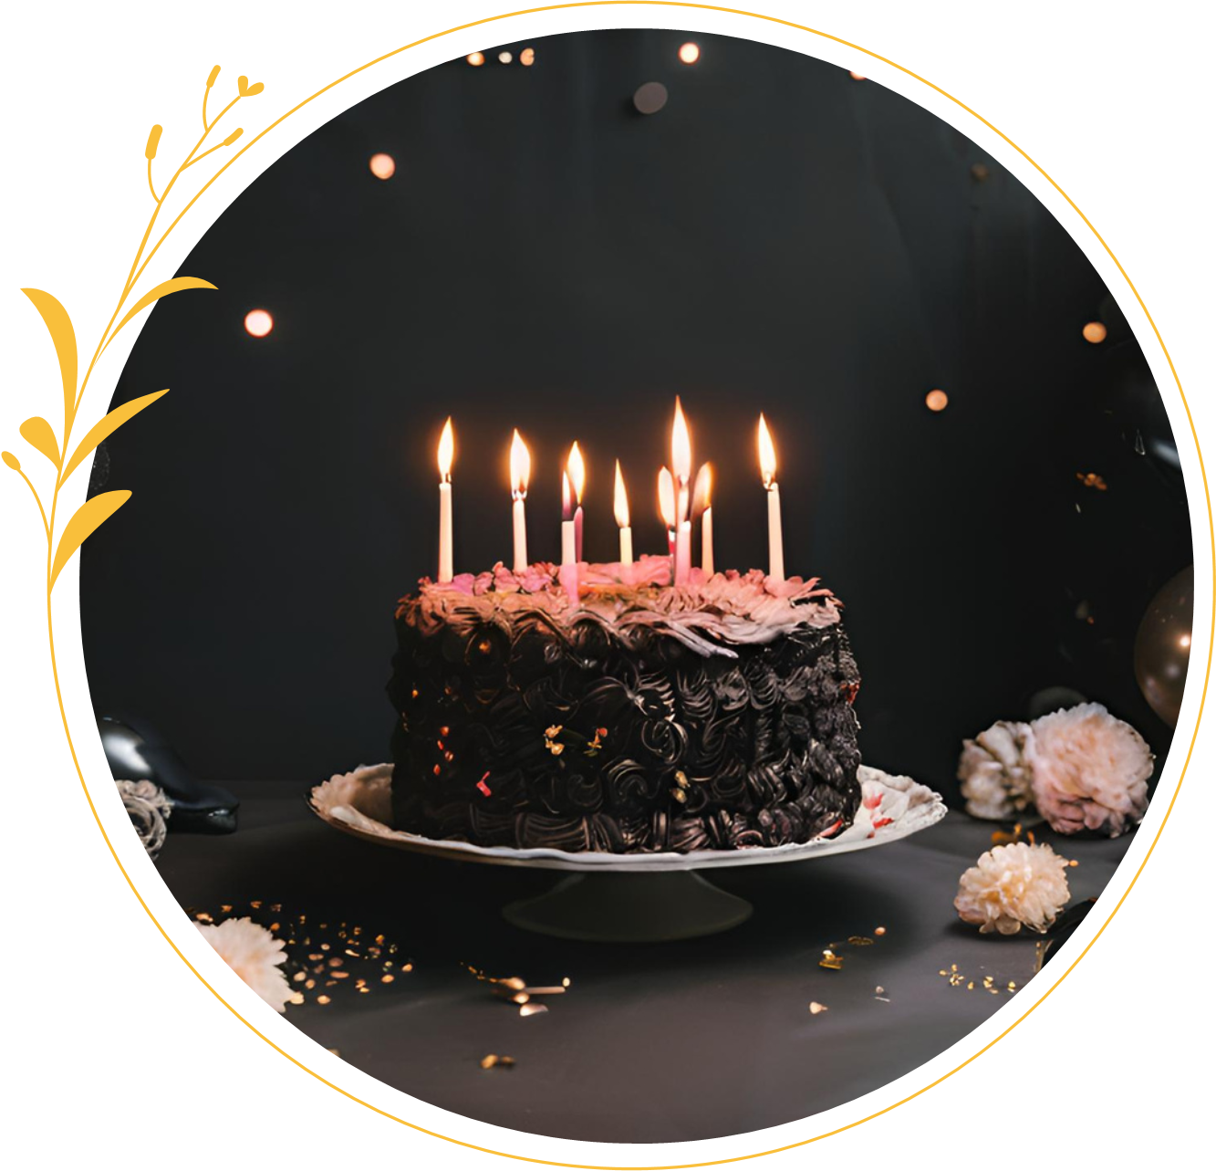
Dear Jane
SENDING YOU REFINED WISHES AND HEARTFELT BLESSINGS ON YOUR SPECIAL DAY.

Slide 17

































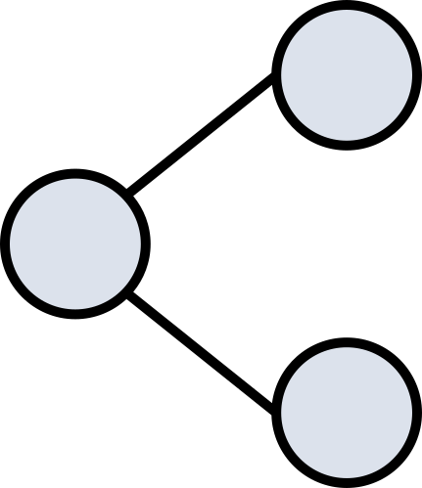





Resource Page
Use these design resources in your Canva Presentation.
Fonts
Design Elements
This presentation template
uses the following free fonts:
TITLES:
ALLURA
HEADERS:
DARKER GROTESQUE
BODY COPY:
DARKER GROTESQUE
You can find these fonts online too.
Colors
#504C44
#DCE2EC
#EACBC1
Don't forget to delete this page before presenting.

Slide 18

Credits
This presentation template is free for everyone to use thanks to the following:
  for the presentation template
Pexels, Pixabay
  for the photos
Happy designing!

