Slide 1


Elegant Border
PRESENTATION SLIDES

Slide 2
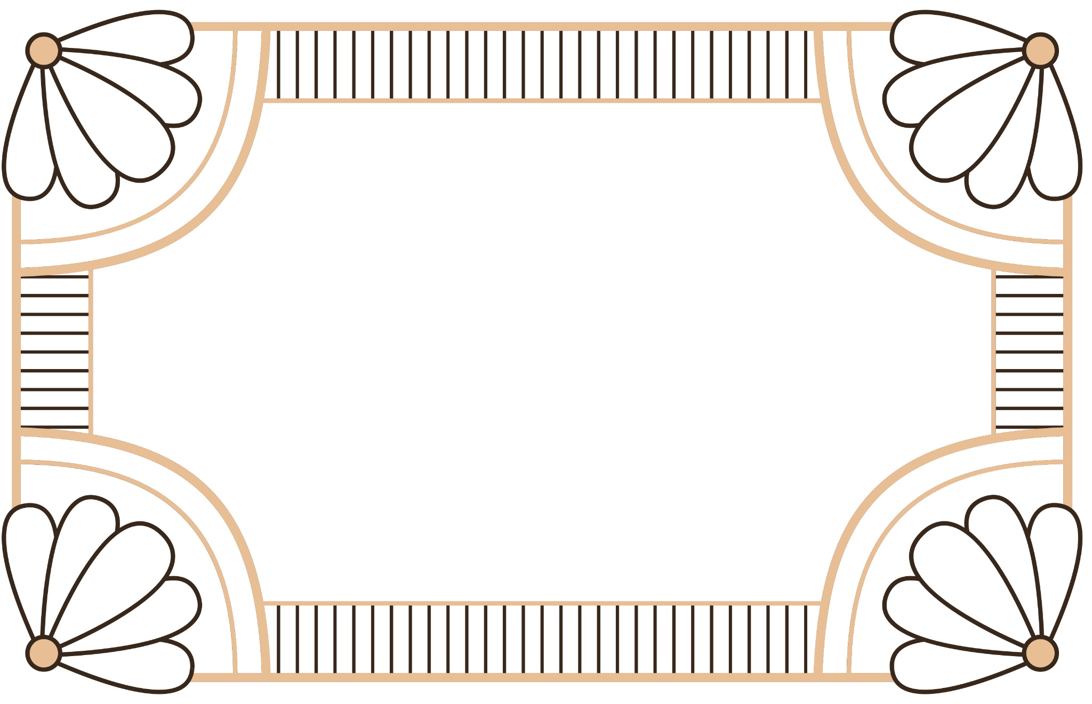
1.
INTRODUCTION
PURPOSE

Slide 3


Introduction
WHY ELEGANT BORDERS?
In the world of design, borders are more than just a finishing touch. They frame your content, guiding the viewer's eye while adding a refined aesthetic. This template offers a variety of border styles that elevate any presentation to a new level of sophistication.

Slide 4

Purpose of This Template
The Elegant Border Slides template is designed to help you create visually stunning presentations that leave a lasting impression. Whether for corporate meetings, academic presentations, or creative pitches, these slides blend functionality with a timeless design.

Slide 5

2.
LAYOUTS
DESIGNS

Slide 6


This section introduces a diverse array of slide layouts designed to suit every type of presentation. Whether you’re starting with a bold title page or diving into detailed, content-rich slides, each layout has been thoughtfully crafted to maintain a sense of elegance and sophistication. The balance of style and function ensures that no matter the type of information you need to convey—whether it's text-heavy data, compelling visuals, or insightful quotes—the borders and design elements will frame your content perfectly, creating a seamless flow throughout your presentation. These layouts offer flexibility while preserving the polished, professional look you want to achieve.
Layout
Overview
VERSATILE LAYOUTS FOR EVERY NEED

Slide 7


Seamless Content Integration
Present your information with clarity and elegance, ensuring each detail stands out.
The carefully crafted borders create a refined framework around your content, guiding the
viewer's eye
without distraction.
Achieve a professional and sophisticated look while keeping your message at the center of attention.

Slide 8
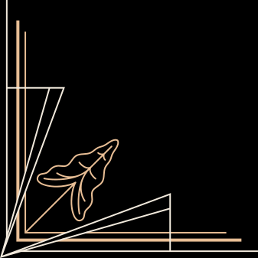

QUOTE SLIDES
Perfection is achieved not when there is nothing more to add, but when there is nothing left to take away.
ANTOINE DE SAINT-EXUPÉRY

Slide 9

3.
IMAGE
DATA

Slide 10
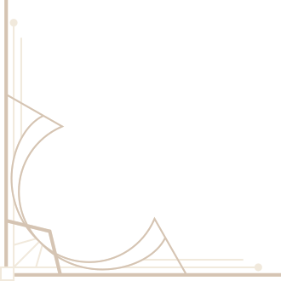



Visual Stories
Combine impactful visuals with concise text to create a powerful narrative. These slides are designed to balance the elegance of borders with the clarity of your message, ensuring your photos capture attention while the text provides meaningful context. Let the borders frame your visual story, making both elements work together seamlessly for maximum impact.

Slide 11





IMAGE GALLERY

Slide 12

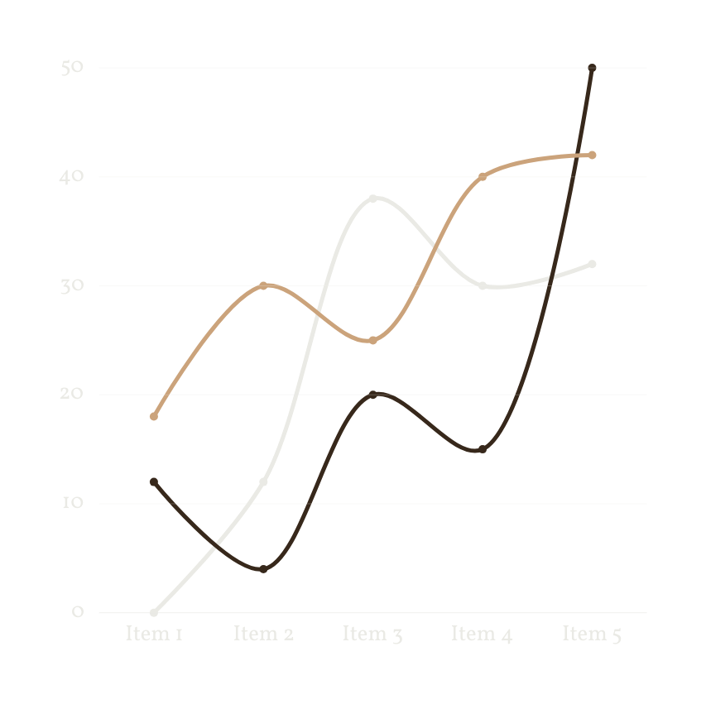
Presenting Data with Grace
Ensure your data stands out with slides that balance elegance and clarity, making complex information easy to follow.

Slide 13




Elegant Data Presentation
67%
20%
92%
CHART 1
CHART 2
CHART 3
Display detailed breakdowns with a pie chart or segmented bar chart, making complex data visually attractive.
Display detailed breakdowns with a pie chart or segmented bar chart, making complex data visually attractive.
Display detailed breakdowns with a pie chart or segmented bar chart, making complex data visually attractive.

Slide 14


Thank You
Thank you for using the Elegant Border Slides template. We hope it adds the sophistication and impact you’re looking for in your next presentation.

Slide 15















Resource Page
Use these design resources in your Canva Presentation.
Fonts
Design Elements
This presentation template
uses the following free fonts:
TITLES:
CORMORANT GARAMOND
HEADERS:
VOLLKORN
BODY COPY:
VOLLKORN
You can find these fonts online too.
Colors
#37281B
#AF8962
#E8BE95
#F0F0F0
DON'T FORGET TO DELETE THIS PAGE BEFORE PRESENTING.

Slide 16

Credits
This presentation template is free for everyone to use thanks to the following:
  for the presentation template
Pexels, Pixabay
  for the photos
HAPPY DESIGNING!

