Slide 1
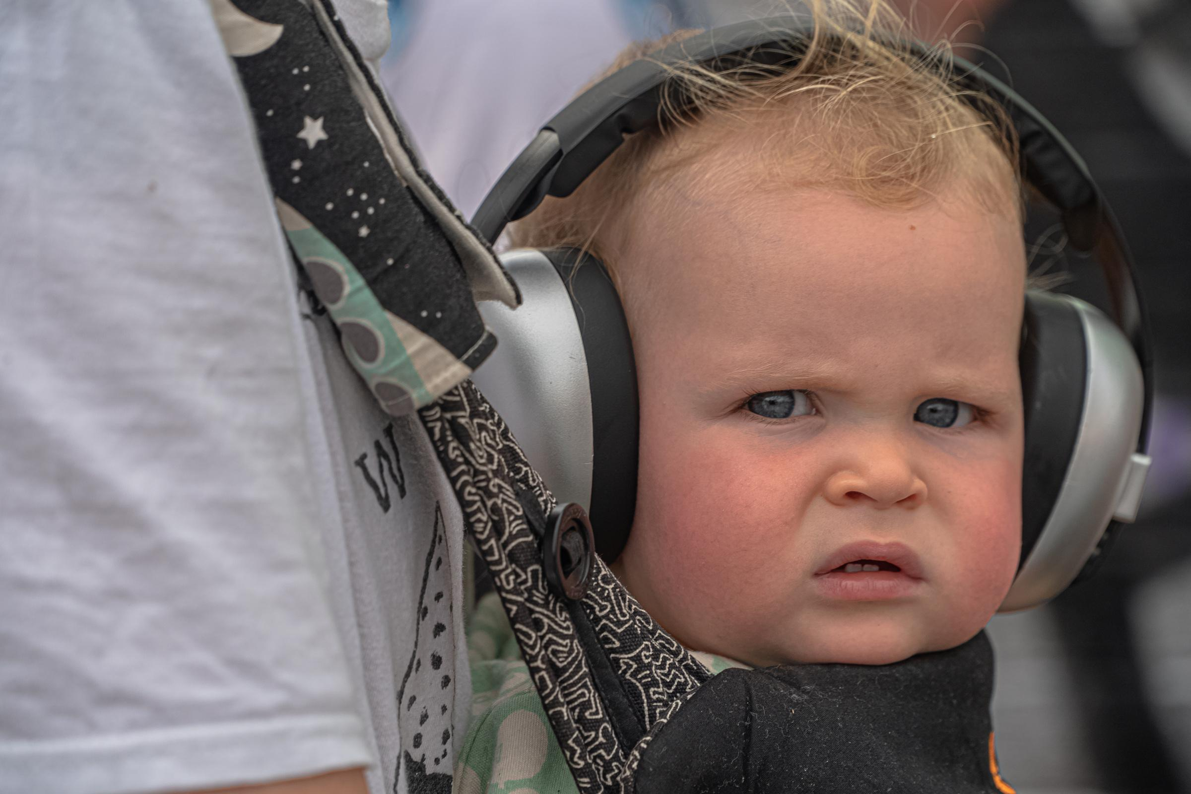
ME LISTENING TO
MY FRIENDS PLAYLIST

Slide 2
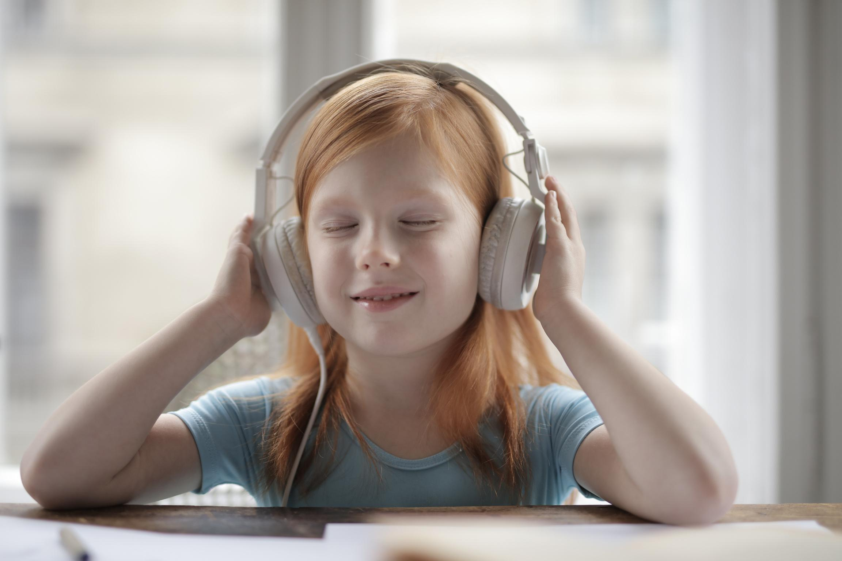
WHEN YOUR FAVORITE SONG COMES ON
AND ALL YOUR STRESS MAGICALLY DISAPPEARS

Slide 3
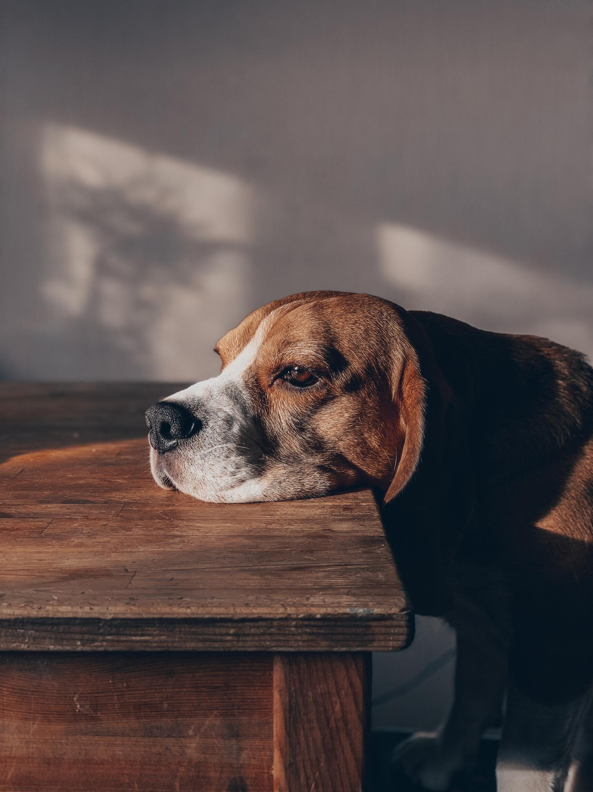
WHEN YOU LISTEN TO SAD MUSIC
AND START QUESTIONING
ALL LIFE DECISIONS

Slide 4

WHEN YOUR LISTENING
TO MUSIC
AND YOU START IMAGINING YOUR OWN MUSIC VIDEO

Slide 5
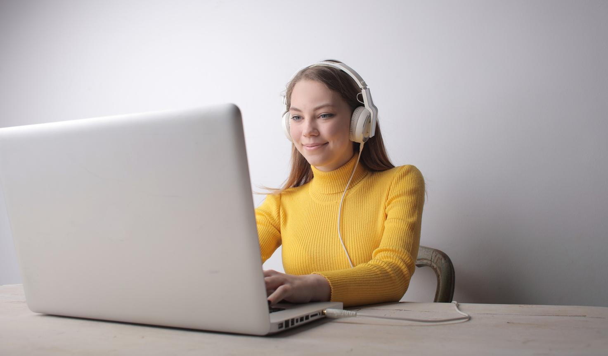
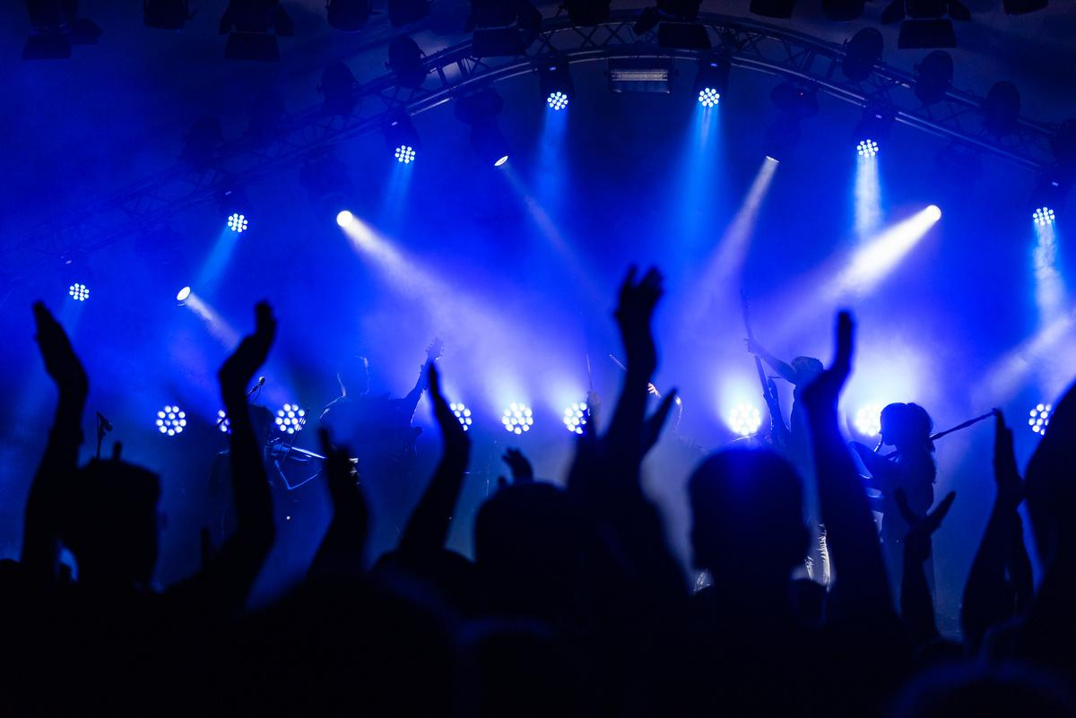
MUSIC WILL HELP ME FOCUS
ME AFTER 30 SECONDS INTO THE SONG

Slide 6
























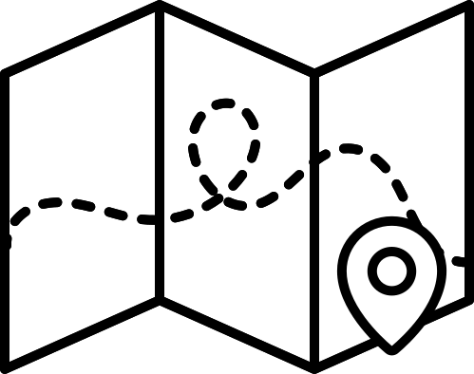














RESOURCE PAGE
  Use these design resources in your Canva Presentation.
Fonts
Colors
This presentation template
uses the following free fonts:
TITLES:
ANTON
BODY COPY:
ANTON
#000000
#FFFFFF
You can find these fonts online too.
Design Elements

Slide 7

CREDITS
This presentation template is free for everyone to use
  thanks to the following:
  for the presentation template
Pexels, Pixabay
  for the photos
  HAPPY DESIGNING!

