Slide 1
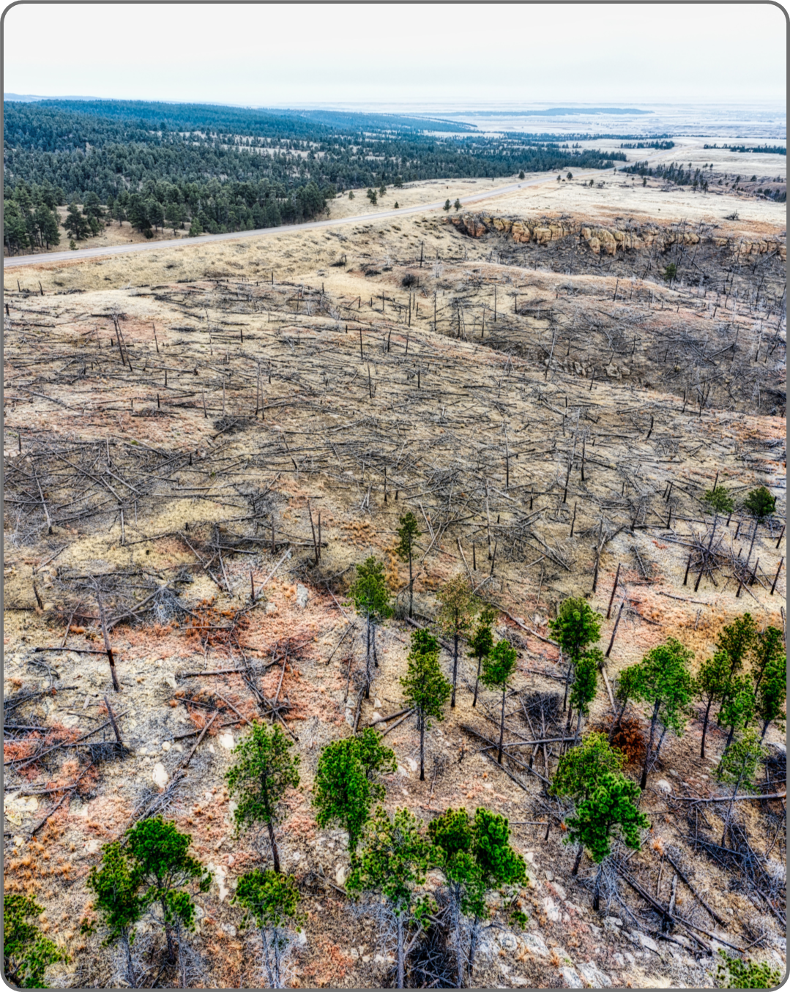

THESIS DEFENSE
Fire, Drought & Deforestation Relationships
Presented by Name Surname

Slide 2
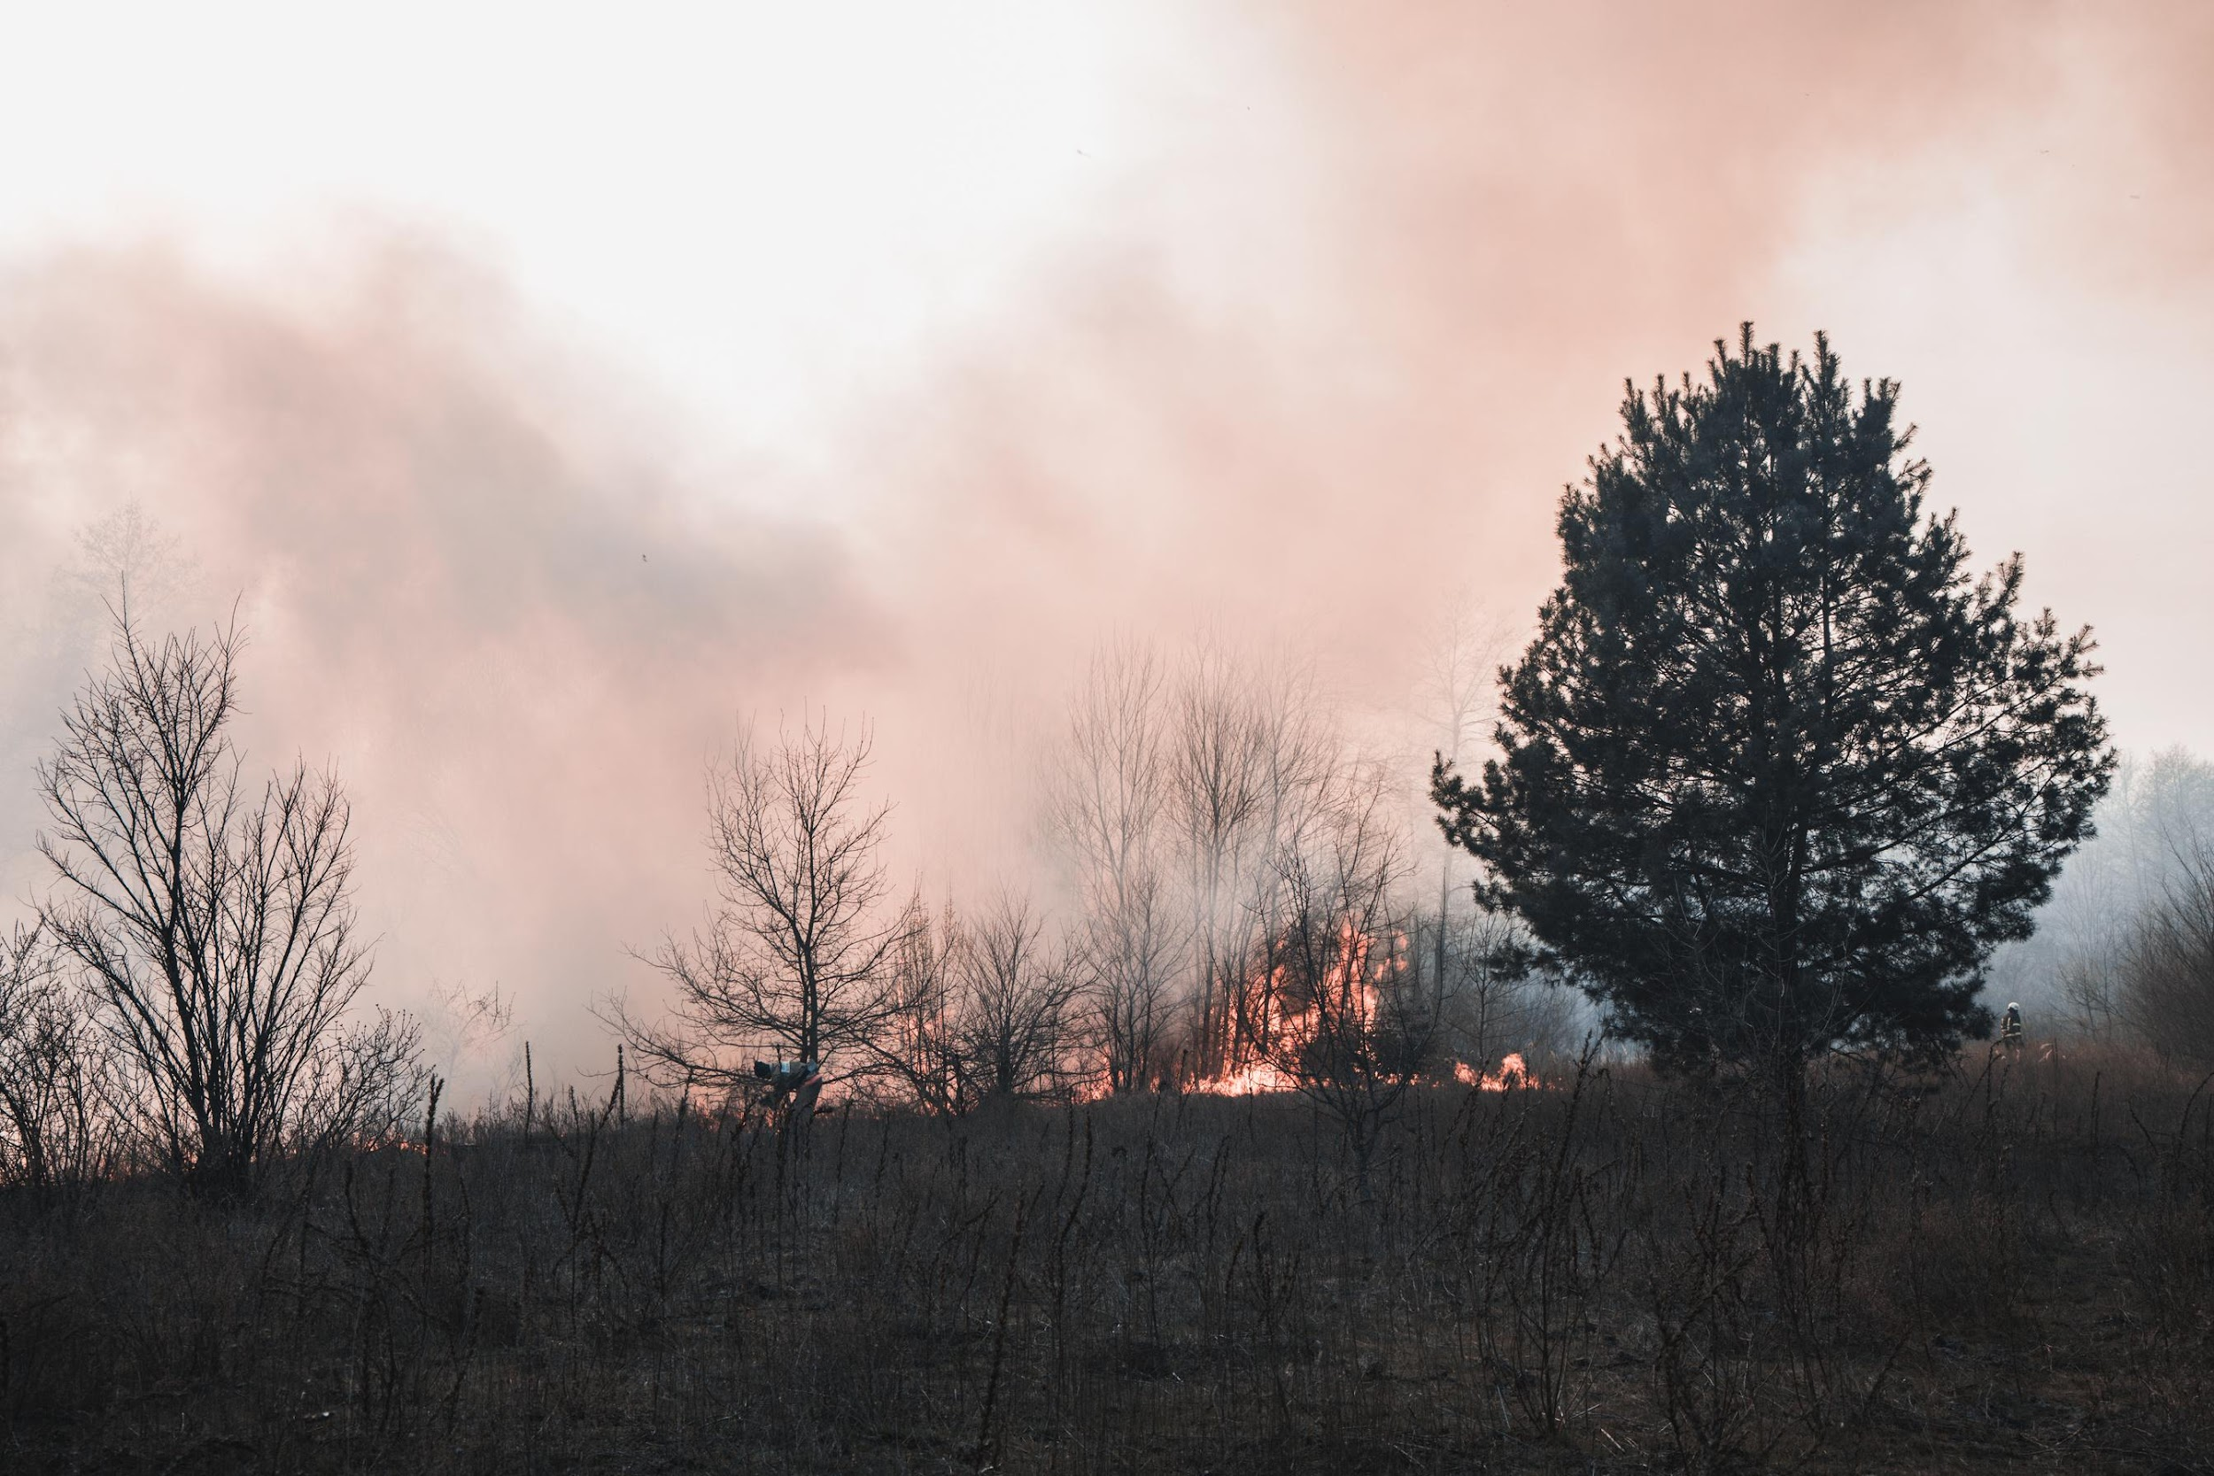
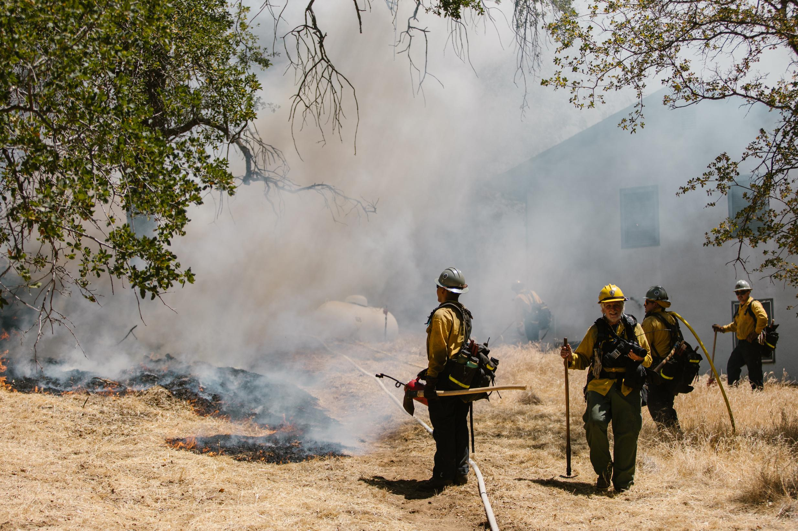
Add an
Agenda Page
Write an agenda here.
1.
Write an agenda here.
2.
Write an agenda here.
3.
Write an agenda here.
4.
Write an agenda here.
5.

Slide 3


Hello there!
I'm Rain, and I'll be sharing with you my beautiful ideas. Follow me at @reallygreatsite to learn more.

Slide 4
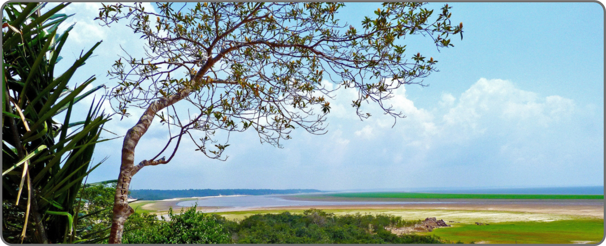
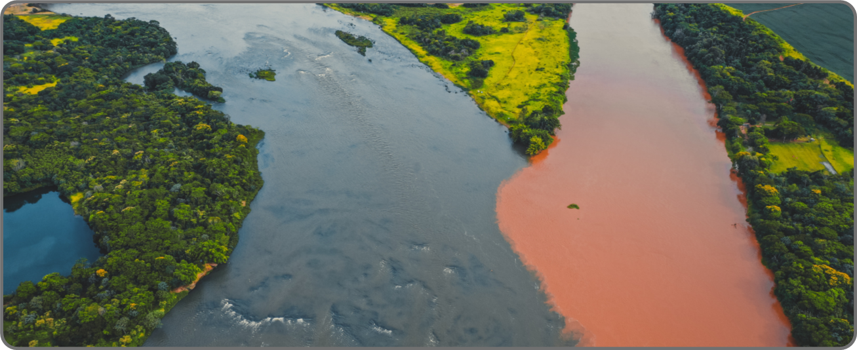
Case Study
Amazon Rainforest
The Amazon Rainforest, often referred to as the "lungs of the Earth," is a critical region for studying the relationships between fire, drought, and deforestation. Over the past few decades, the Amazon has experienced severe deforestation due to logging, agriculture, and cattle ranching. This loss of forest cover has disrupted local climate patterns, leading to prolonged droughts. These droughts, in turn, have increased the frequency and intensity of wildfires, which further degrade the forest.

Slide 5
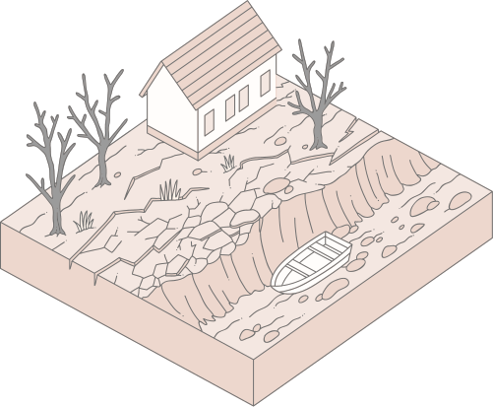
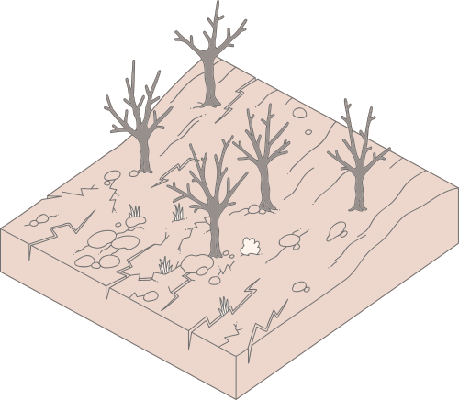
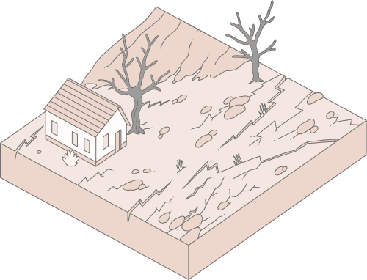
Background and Context
The relationship between fire, drought, and deforestation is complex and multifaceted. Drought conditions can exacerbate the frequency and intensity of wildfires, while deforestation can alter local climate conditions, contributing to increased drought susceptibility. This section provides an overview of the historical context and key drivers behind these phenomena, setting the stage for a deeper exploration of their interconnections.

Slide 6
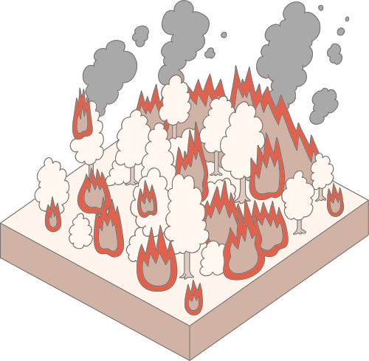
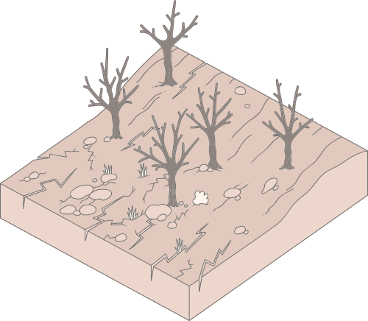

Key Findings
Interconnected Dynamics:
Amplification Effect:
Policy
Gaps:
Fire, drought, & deforestation are tightly interlinked, with changes in one often triggering changes in the others.
Deforestation can amplify drought conditions, which in turn increase the likelihood of wildfires.
Current environmental policies often fail to address the interconnected nature of these phenomena.

Slide 7

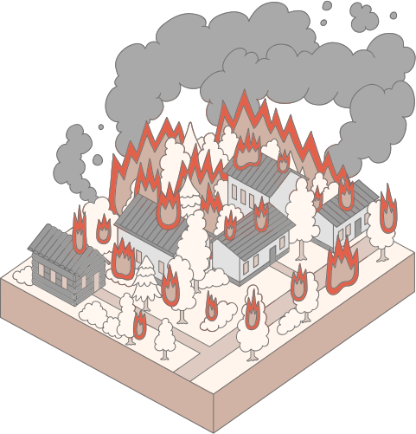
Socioeconomic Consequences
Livelihood Disruption
Population Displacement
Local communities that depend on forests for their livelihoods are often the hardest hit.
Local communities that depend on forests for their livelihoods are often the hardest hit.
Water Scarcity
Health Impacts
Reduced forest cover and increased drought lead to lower water availability.
Increased healthcare costs burden both individuals and healthcare systems.

Slide 8
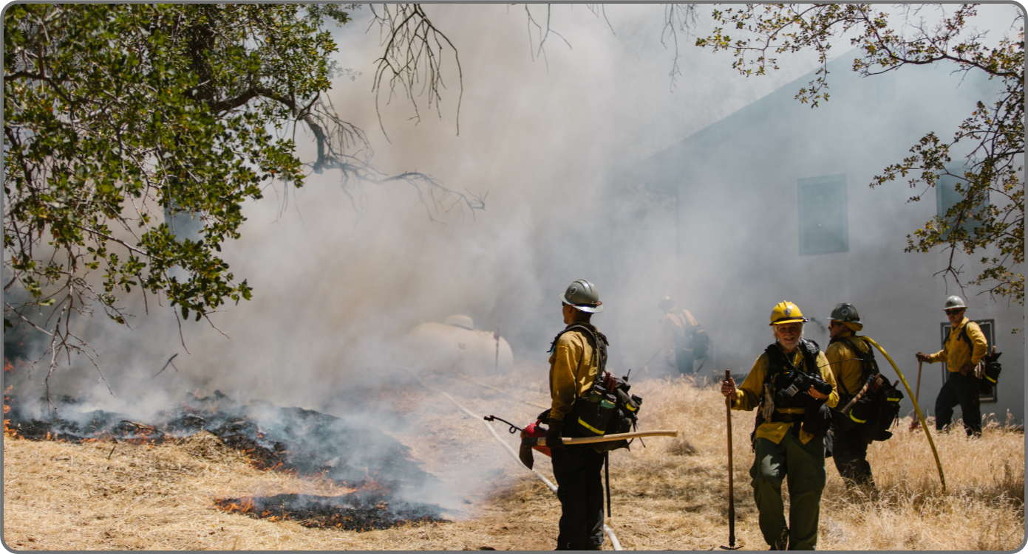
Impact on Biodiversity
The interplay between fire, drought, and deforestation has devastating effects on biodiversity. As forests are cleared and fires become more frequent, many species lose their habitats, leading to a decline in biodiversity. Droughts exacerbate this problem by reducing water availability, which is essential for the survival of many plants and animals.
The loss of biodiversity not only affects ecosystem stability but also reduces the resilience of forests to future environmental changes. Protecting biodiversity requires comprehensive strategies that consider the interconnected nature of these threats.

Slide 9
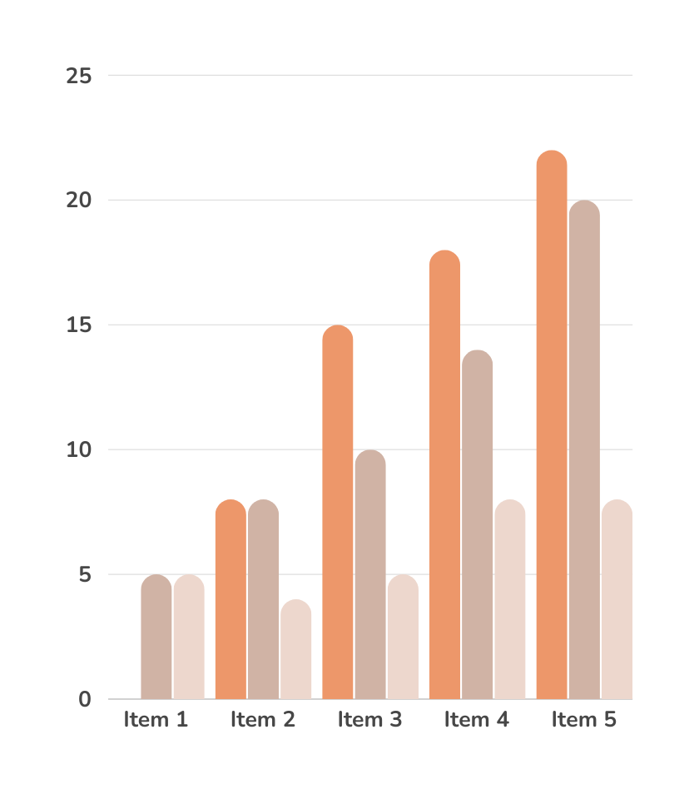
Research
Identify
Presentations are communication tools that can use as lectures, speeches, reports, and more.
Analyze
Presentations are communication tools that can use as lectures, speeches, reports, and more.
Evaluate
Presentations are communication tools that can use as lectures, speeches, reports, and more.

Slide 10
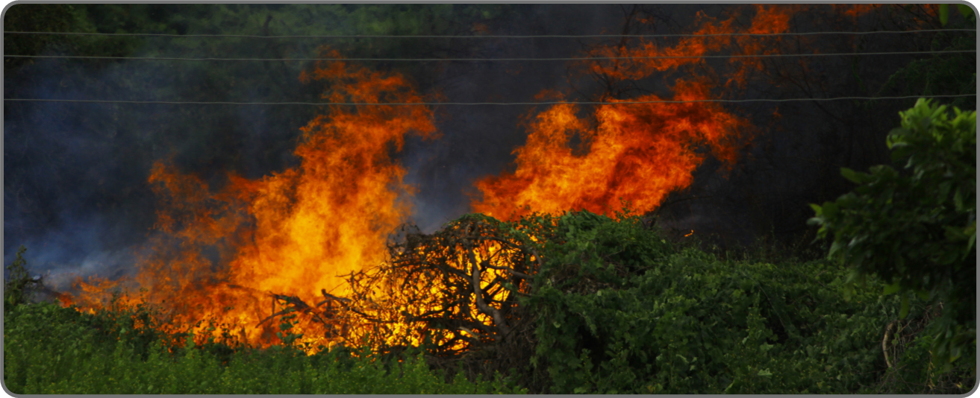
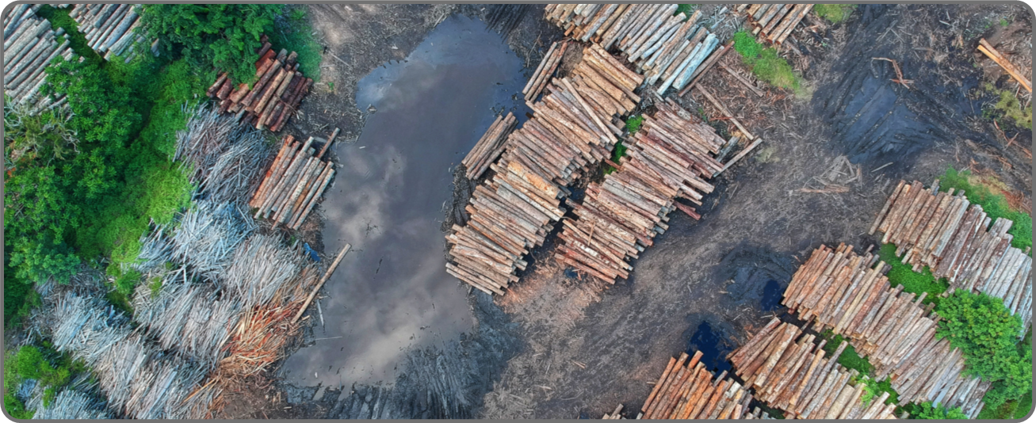
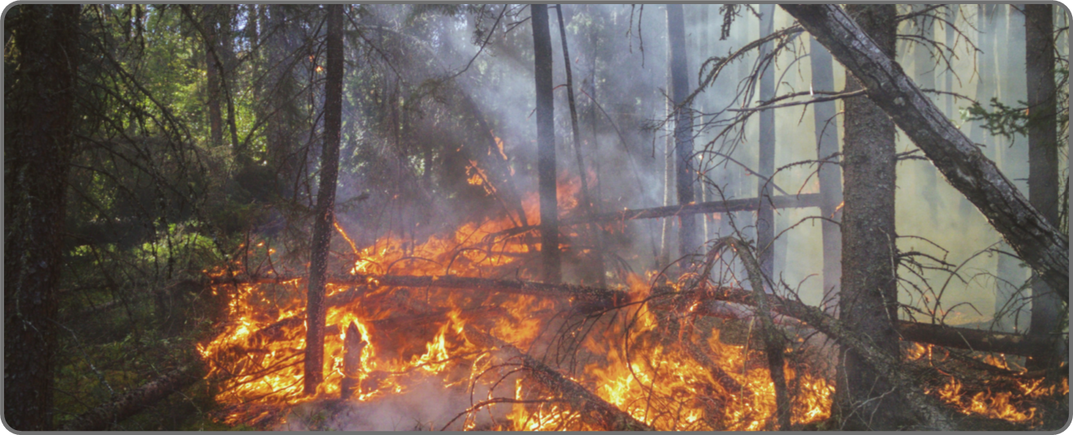
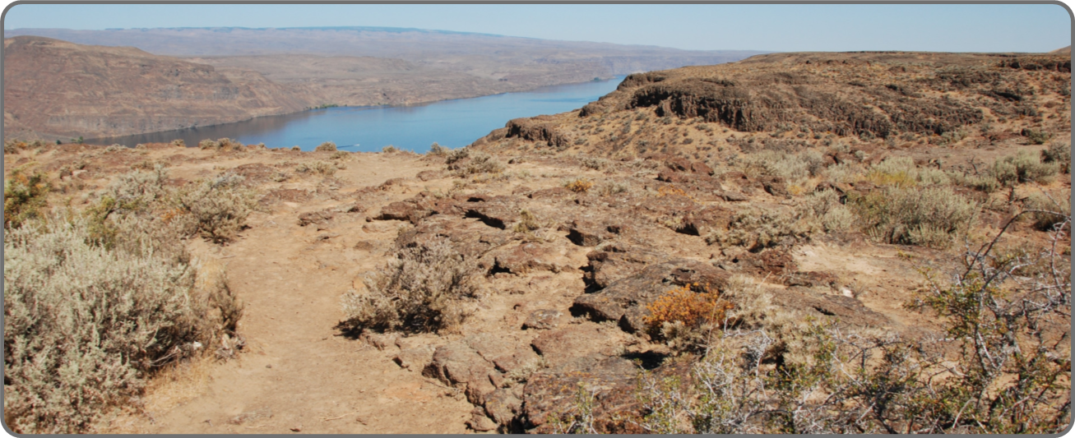
Image Gallery

Slide 11

Policy Recommendations
To effectively address the interconnected issues of fire, drought, and deforestation, integrated policy approaches are essential. Key recommendations include:
Integrated Land Management:
Implementing land management practices that reduce deforestation, enhance forest resilience, and mitigate the impacts of drought.
Early Warning Systems:
Developing and deploying early warning systems for wildfires and droughts to improve preparedness and response.
Community Engagement:
Involving local communities in conservation efforts and providing them with sustainable livelihood options.

Slide 12

Climate Change Feedback Loop
Carbon Emissions and Warming Effects
Mitigation Strategies
The interplay between fire, drought, and deforestation creates a feedback loop that exacerbates climate change. As forests are cleared and fires burn, carbon stored in trees is released into the atmosphere, increasing greenhouse gas concentrations.
Breaking this destructive cycle requires a comprehensive approach that includes reducing deforestation, enhancing forest carbon storage, and implementing fire management strategies. Effective climate change mitigation requires coordinated efforts to reduce deforestation.

Slide 13
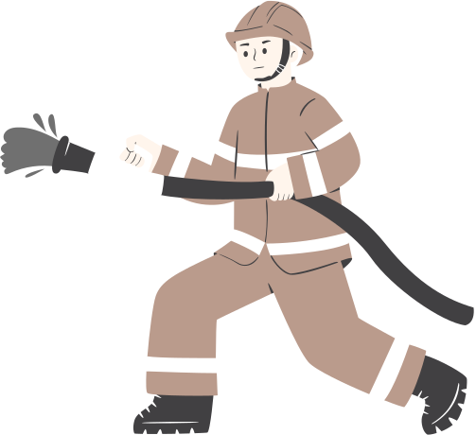
Strategies for Fire Management
Controlled Burns:
Intentionally set, low-intensity fires can reduce fuel loads and prevent larger, more destructive wildfires.
Effective fire management is essential to reduce the risks and impacts of wildfires.
Vegetation Management:
Removing excess vegetation and creating firebreaks can help control the spread of wildfires.
Response Plans:
Developing and rehearsing emergency response plans ensures communities are prepared for wildfire events.

Slide 14

Community-Based Conservation
Engaging local communities in conservation efforts is critical for the success of any environmental management strategy. Community-based conservation empowers residents to take an active role in protecting their environment, leveraging local knowledge and fostering a sense of stewardship. This approach can enhance the effectiveness of policies aimed at reducing fire.
How You Can Help:
Volunteer: Participate in local conservation projects and initiatives.
Educate: Share information about the importance of conservation with your community.
Advocate: Support policies that promote sustainable land use and environmental protection.

Slide 15
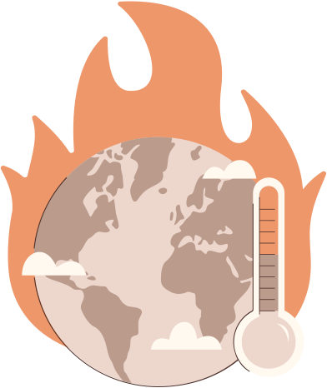
Conclusion
In conclusion, the relationships between fire, drought, and deforestation are complex and deeply intertwined. Our research highlights the need for integrated strategies that address all three issues simultaneously. By understanding these connections, we can develop more effective conservation and management practices that protect both the environment and the communities that depend on it. Future research and policy efforts must continue to explore these relationships and implement solutions that promote sustainability and resilience.

Slide 16




























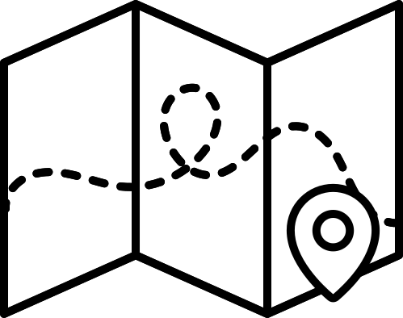










Resource Page
Use these design resources in your Canva Presentation.
Fonts
Design Elements
This presentation template
uses the following free fonts:
TITLES:
MARTEL SERFI
HEADERS:
MARTEL SERFI
BODY COPY:
MARTEL SANS
You can find these fonts online too.
Colors
#FFFFFF
#EDD7CD
#BA9B8C
#ED976A
#414042
  DON'T FORGET TO DELETE THIS PAGE BEFORE PRESENTING.

Slide 17

Credits
This presentation template is free for everyone to use thanks to the following:
  for the presentation template
Pexels, Pixabay
  for the photos
Happy designing!

