Slide 1

NEWS REPORT SLIDES
SLIDESCARNIVAL
NEWS REPORT SLIDES
2024

Slide 2
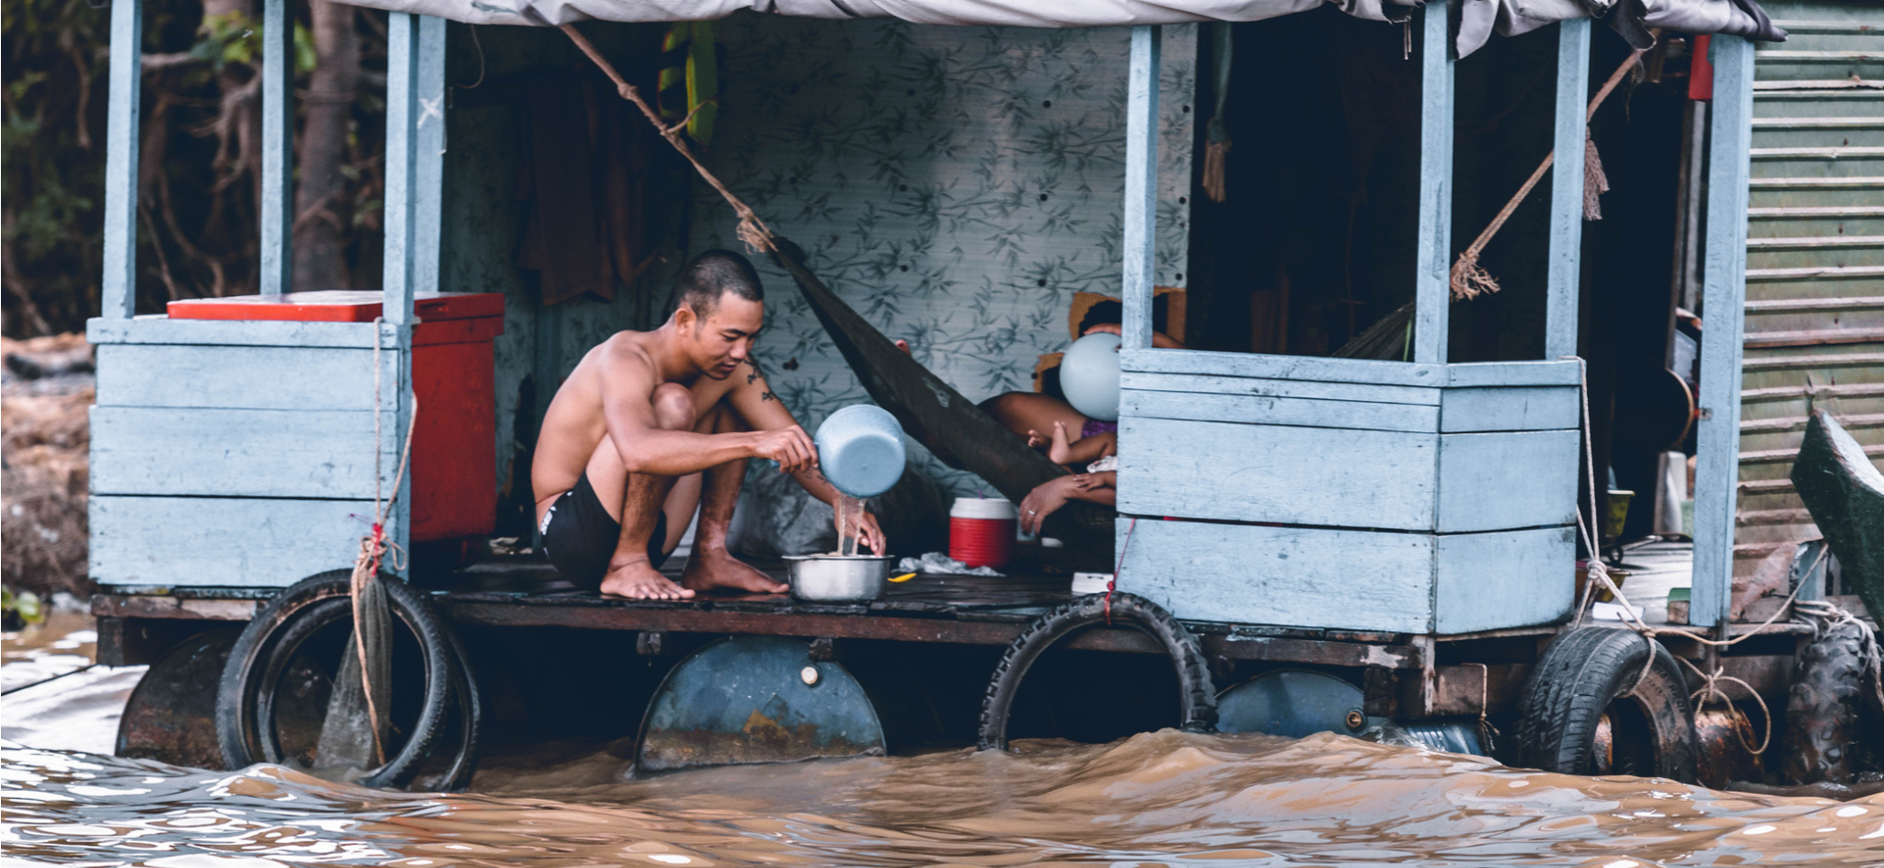
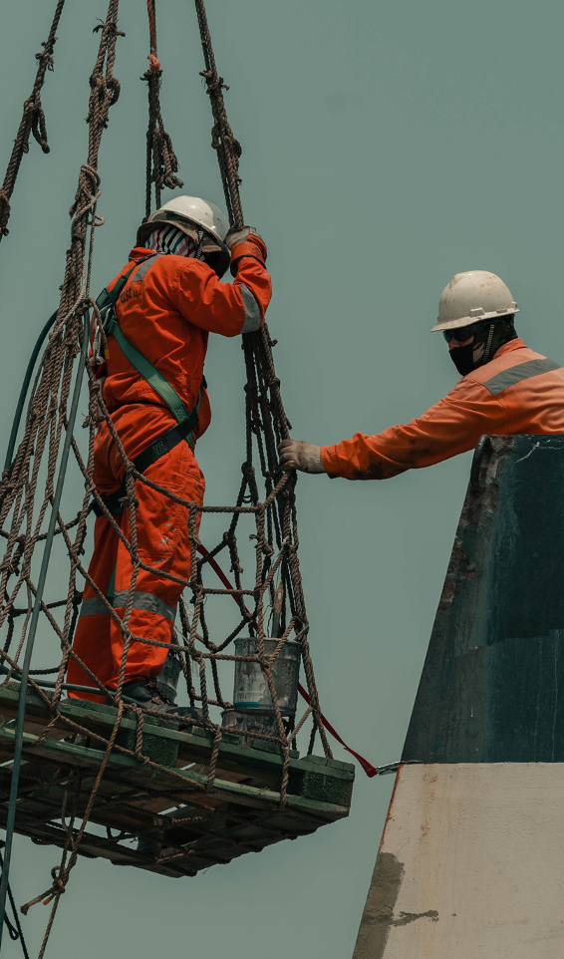
NEWS REPORTS
BY JANE DOE
SEPTEMBER 20,2024
BY JANE DOE
SEPTEMBER 20,2024
After the Storm: The Life and Times of a Community Ravaged by Hurricane Cabal
A Daring Rescue Mission
Elaborate on the news article here.

Slide 3

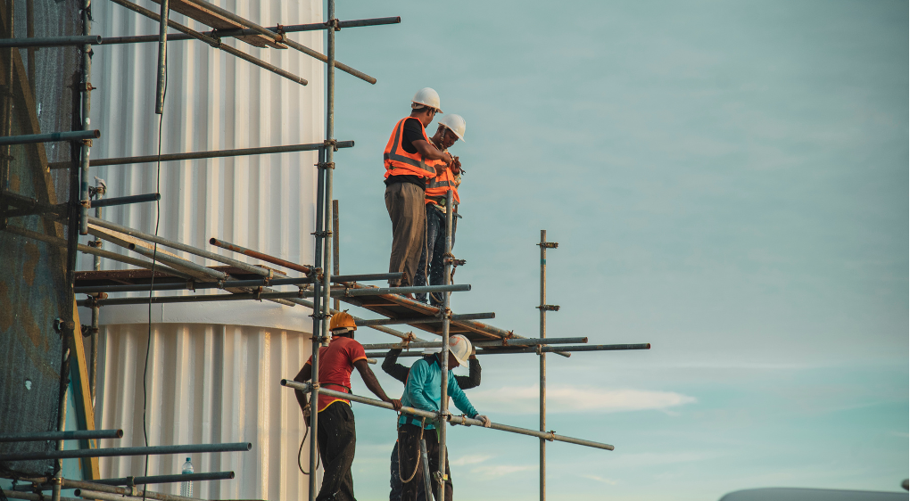

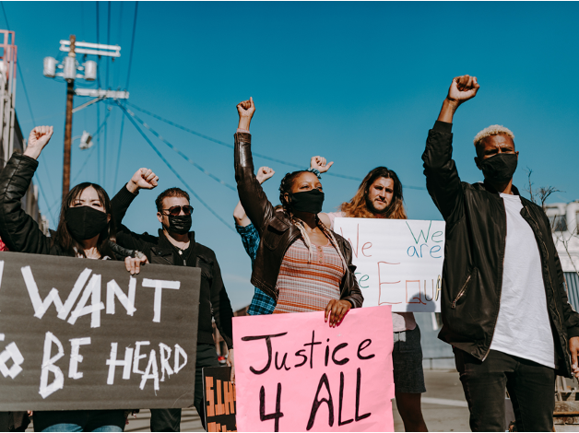
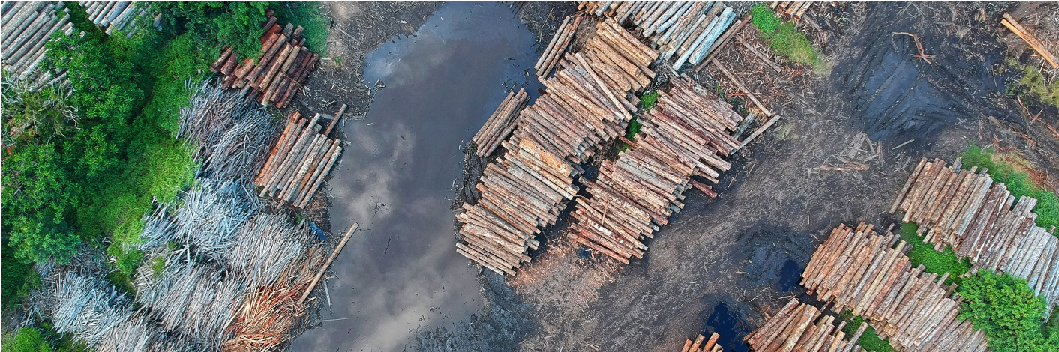
BY JANE DOE
SEPTEMBER 20,2024
BY JANE DOE
SEPTEMBER 20,2024
BY JANE DOE
SEPTEMBER 20,2024
Architectural Advancement
The Loneliness Epidemic
Elaborate on the news article here.
Elaborate on the news article here.
BY JANE DOE
SEPTEMBER 20,2024
BY JANE DOE
SEPTEMBER 20,2024
The White Swan: Poetry in Motion
Riots in the Capital
A Balding Mountain
Elaborate on the news article here.
Elaborate on the news article here.
Elaborate on the news article here.

Slide 4
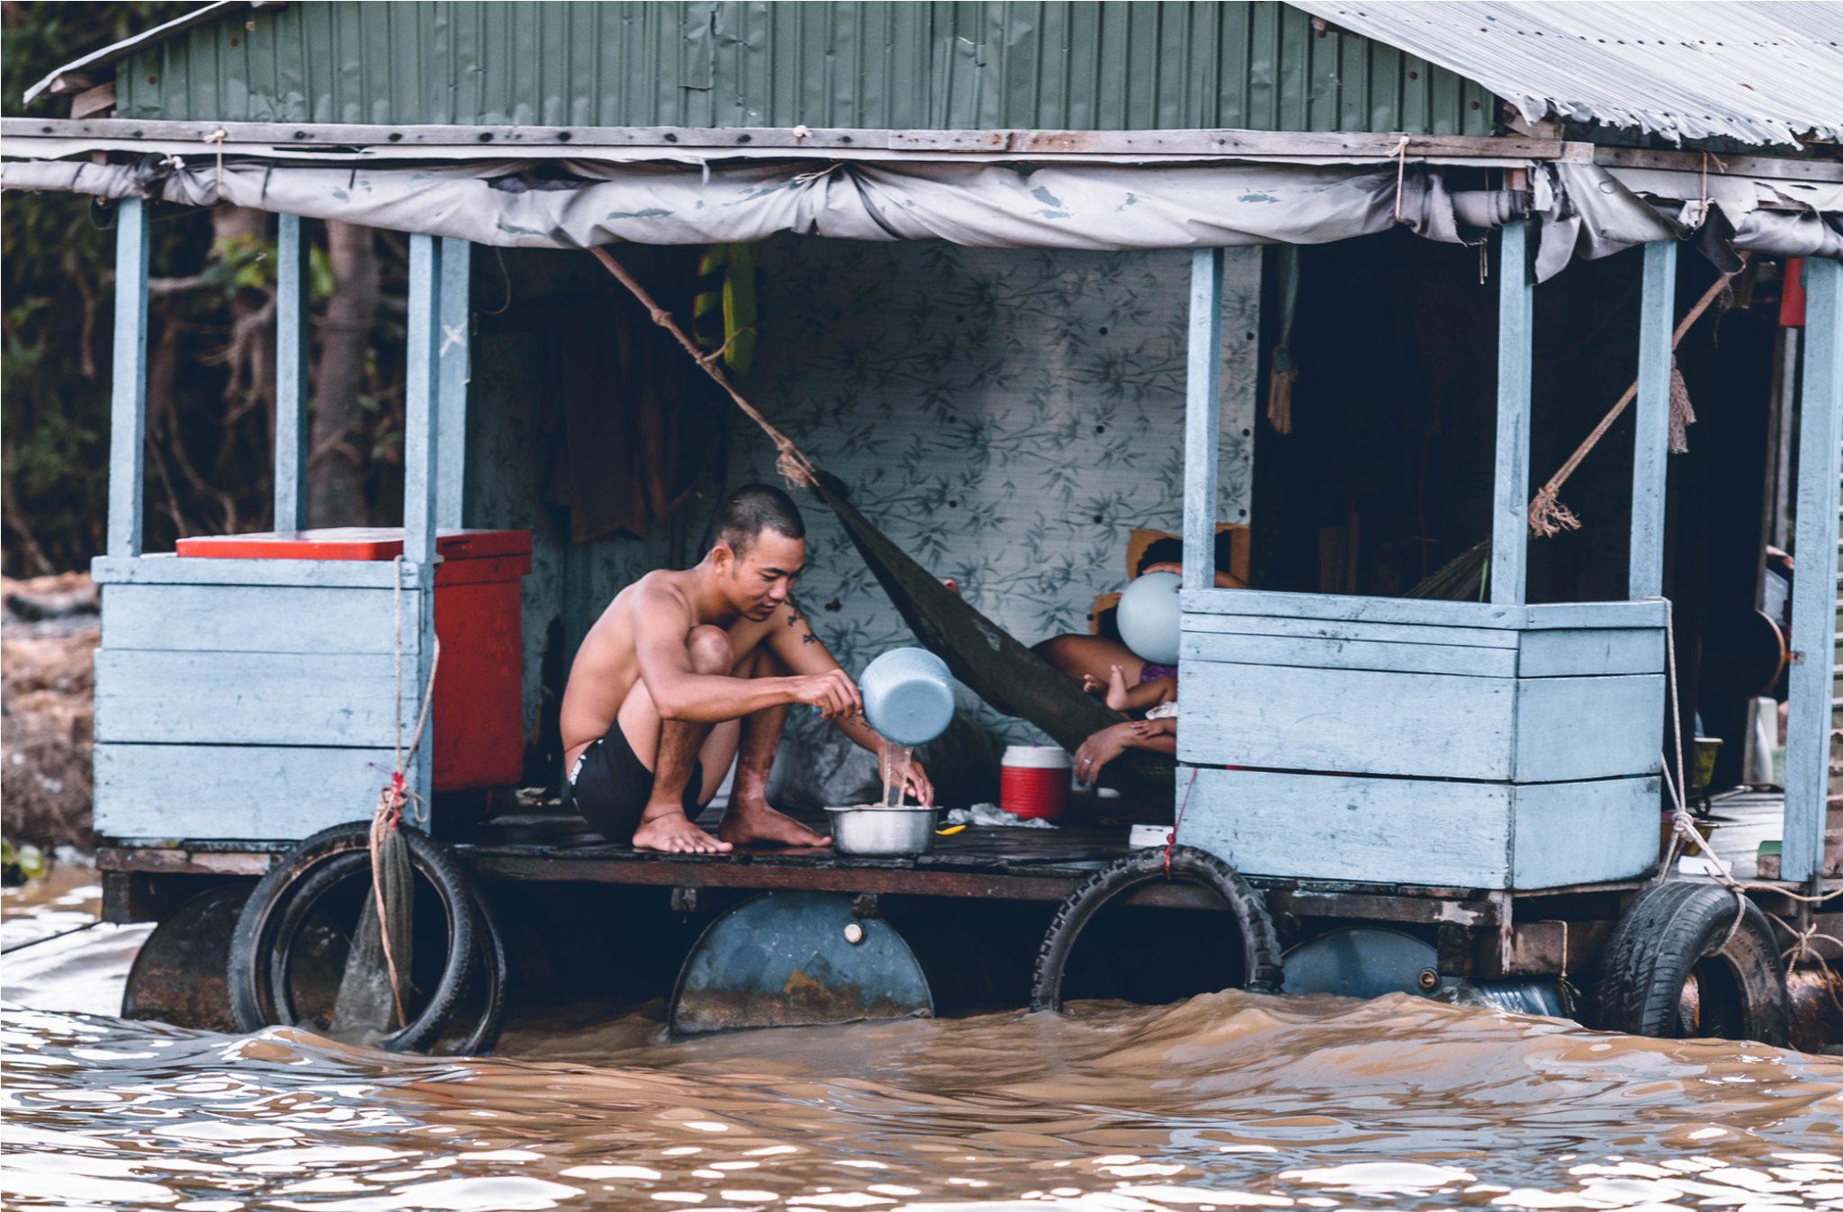
BY JANE DOE
SEPTEMBER 20,2024
After the Storm: The Life and Times of a Community Ravaged by Hurricane Cabal
In the aftermath of a devastating storm that wreaked havoc across the region, thousands of residents are left grappling with the overwhelming task of rebuilding their lives. The powerful storm, which destroyed homes, disrupted power, and claimed lives, has left entire neighborhoods unrecognizable. Amid the destruction, local authorities, relief organizations, and volunteers have stepped in to provide crucial aid, offering food, shelter, and support to those in need.
While the scale of the damage is immense, stories of resilience and community spirit have begun to emerge. Neighbors are coming together to clear debris, assist the elderly, and provide a sense of hope during these trying times. Local schools are working to reopen, giving children a sense of normalcy, while utility crews are working around the clock to restore electricity and clean water.
MAN COOKING ON TOP OF FLOATING HOME (2024)

Slide 5
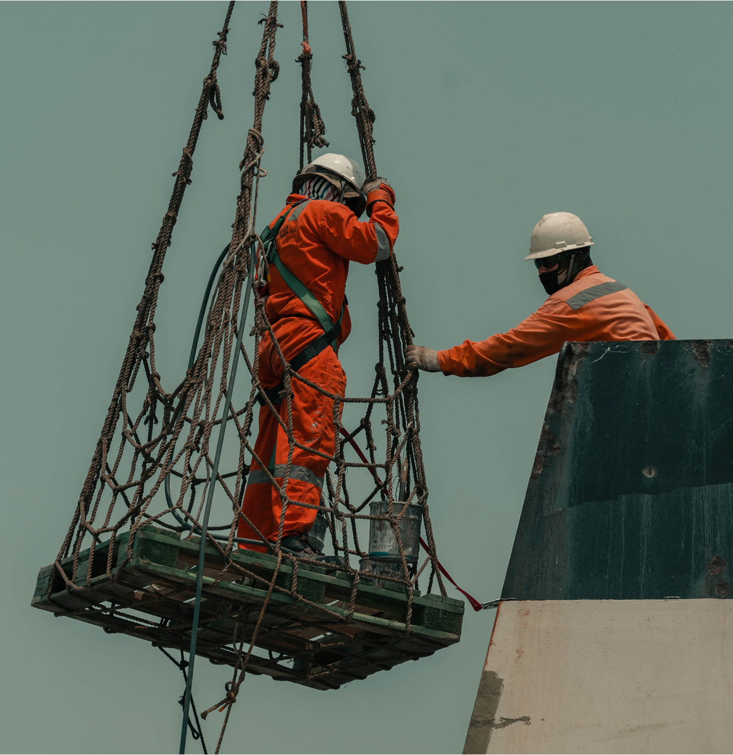
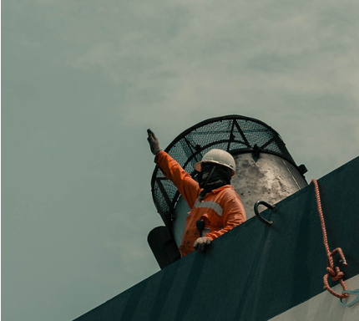
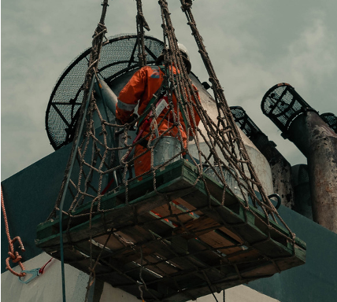
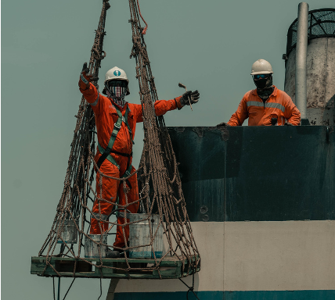
BY JANE DOE
SEPTEMBER 20,2024
A Daring Rescue Mission
In the wake of a catastrophic storm that left widespread destruction, rescue teams are working around the clock in a large-scale effort to locate and assist survivors. Emergency responders, alongside volunteers and military personnel, are braving hazardous conditions to reach those trapped in collapsed buildings and flooded areas. Helicopters, boats, and drones are being deployed to access isolated communities cut off by the storm.
One of the most heroic moments came when rescue crews pulled a family of five from beneath the wreckage of their home, which had been flattened by the storm's powerful winds. In another instance, swift-water rescue teams saved dozens of residents stranded by rapidly rising floodwaters. Despite the challenging conditions, including blocked roads and ongoing power outages, teams remain committed to their mission.
"We're doing everything we can to find and help those who need us," said a rescue team leader. "Every minute counts." While the full scale of the damage is still being assessed, the focus remains on locating the missing and ensuring that survivors are brought to safety. Local shelters and emergency centers are being set up to house and care for those displaced, as the rescue mission continues in earnest.
MAN IS LOWERED INTO THE DANGER ZONE (2024)

Slide 6

BY JANE DOE
SEPTEMBER 20,2024
The White Swan: Poetry in Motion
The city’s cultural scene was brought to life last night as a highly anticipated ballet show graced the stage, captivating the audience with its breathtaking display of artistry and precision. Dancers from the renowned ballet company performed a series of classical and contemporary pieces, showcasing their impeccable technique and emotional depth. The highlight of the evening was a moving rendition of *Swan Lake*, where the lead ballerina’s fluid movements and graceful pirouettes left the audience spellbound.
From the intricate choreography to the stunning costumes and atmospheric lighting, every aspect of the performance was meticulously crafted to immerse the audience in a world of beauty and elegance. The dancers’ ability to convey powerful emotions through their delicate movements brought both awe and tears, as they seamlessly transitioned between moments of joy, sorrow, and triumph.
As the final curtain fell, the performers received a standing ovation, a testament to their dedication and mastery of their craft. "It was magical," said one attendee. "The dancers transported us to another world." The ballet show is set to continue throughout the week, offering more audiences the chance to experience the magic of live performance.
88%
20k
10m
Attendance rate
Ticket Sales
Revenue
Elaborate on the given statistic here.
Elaborate on the given statistic here.
Elaborate on the given statistic here.
THE WHITE SWAN (2023)

Slide 7
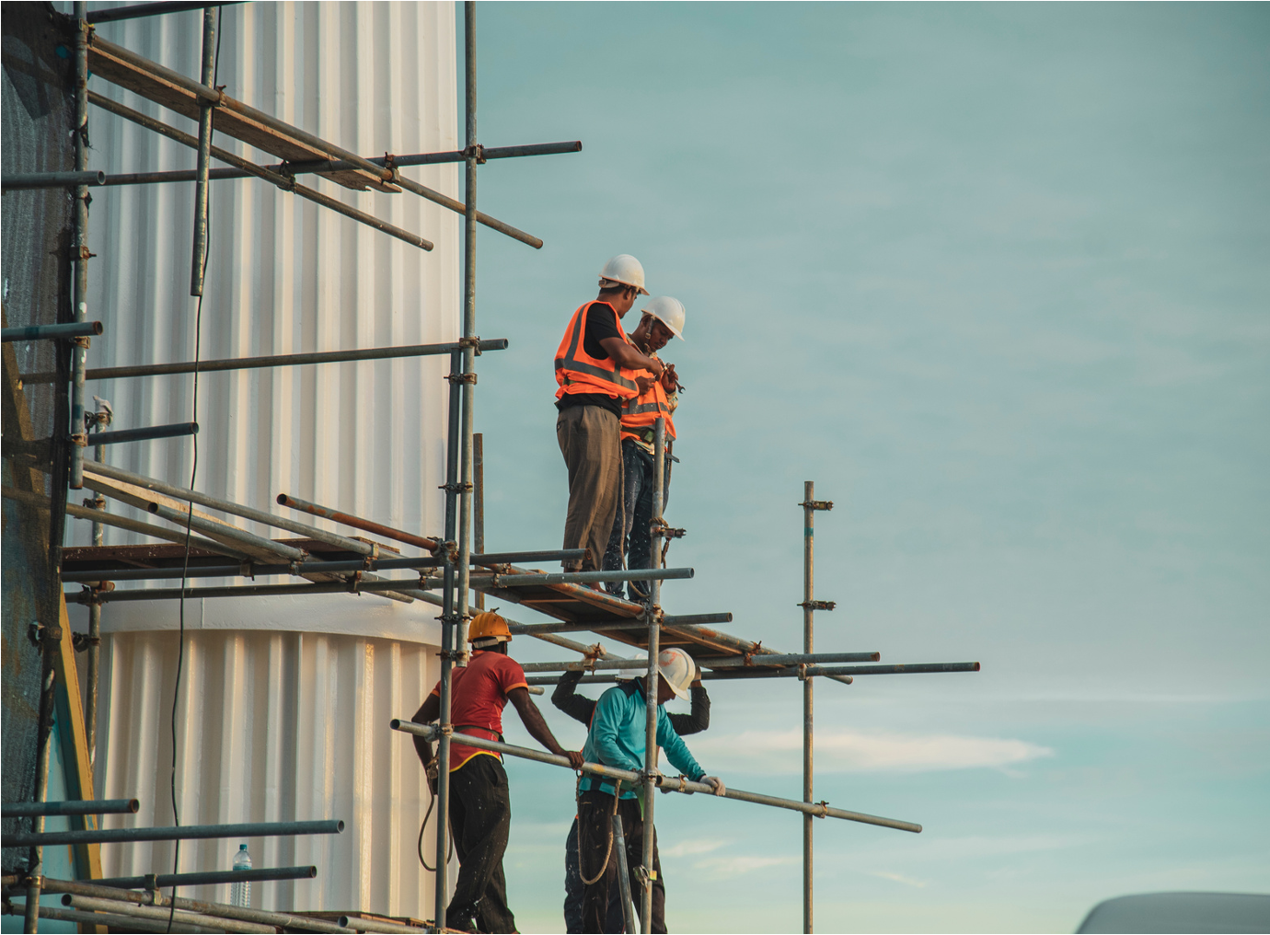
Recent advancements in architecture are transforming the way cities are built and experienced, with cutting-edge technologies and sustainable practices leading the charge. Innovative materials like self-healing concrete, energy-efficient glass, and 3D-printed structures are pushing the boundaries of traditional construction methods, making buildings more resilient and eco-friendly. Smart architecture is also on the rise, with buildings designed to adapt to environmental changes, using integrated systems that monitor energy use, adjust lighting, and even regulate temperature for optimal efficiency.
Urban planners and architects are increasingly prioritizing sustainability, incorporating green spaces, renewable energy sources, and eco-conscious designs into their projects. High-rise buildings now feature vertical gardens, solar panels, and water recycling systems, aiming to reduce the carbon footprint of densely populated areas. Additionally, modular construction techniques are making it faster and more cost-effective to assemble complex structures, allowing for quicker responses to housing demands in growing cities.
Architectural Advancement
BY JANE DOE
SEPTEMBER 20,2024
CONSTRUCTION WORKERS (2022)

Slide 8

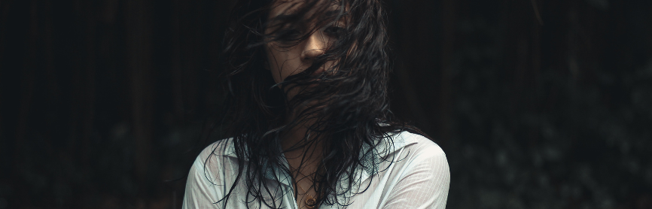


BY JANE DOE
SEPTEMBER 20,2024
SEPTEMBER 20,2024
Related Stories:
Connection on the Internet
Elaborate on the given topic here.
Boys Don’t Cry (Except When They Do)
Elaborate on the given topic here.
MAN DURING A THERAPY SESSION
The Loneliness Epidemic
As modern life becomes increasingly digital and disconnected, loneliness has emerged as a global epidemic, affecting people of all ages and backgrounds. Research shows that prolonged social isolation can lead to serious health issues, including depression, anxiety, and even increased risk of heart disease.
Love Behind a Screen
Elaborate on the given topic here.

Slide 9
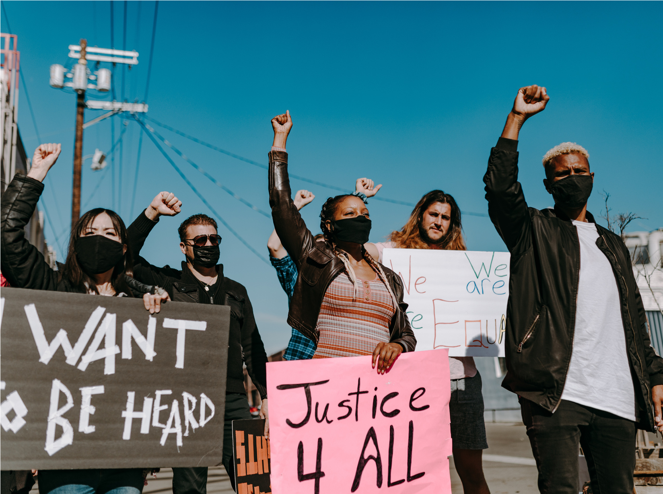
BY JANE DOE
SEPTEMBER 20,2024
Riots in the Capital
Widespread riots broke out last night in the heart of the city, following rising tensions over ongoing social and political issues. What began as a peaceful protest quickly escalated into chaos, as clashes between demonstrators and law enforcement intensified. Crowds flooded the streets, expressing frustration over inequality, police brutality, and economic instability. As the situation spiraled, buildings were set ablaze, storefronts were looted, and vehicles were overturned, leaving parts of the city in disarray.
Authorities responded with tear gas, rubber bullets, and mass arrests, but the unrest persisted well into the night. Several injuries were reported on both sides, with local hospitals treating individuals for wounds ranging from minor to severe. In the aftermath, community leaders are calling for calm and dialogue, urging both demonstrators and officials to find a peaceful resolution to the issues at hand.
In response to the violence, city officials have called for a curfew and deployed additional law enforcement in an effort to prevent further destruction. While some political leaders are condemning the rioters, others are highlighting the deeper systemic issues that sparked the unrest, calling for urgent reforms in policing and economic justice. Civic organizations are stepping in to mediate between protesters and authorities, advocating for constructive solutions and long-term strategies to address the root causes of public anger. The coming days will be critical in determining whether the city moves toward resolution or sees a continued escalation of tensions.
RIOTS (2024)

Slide 10
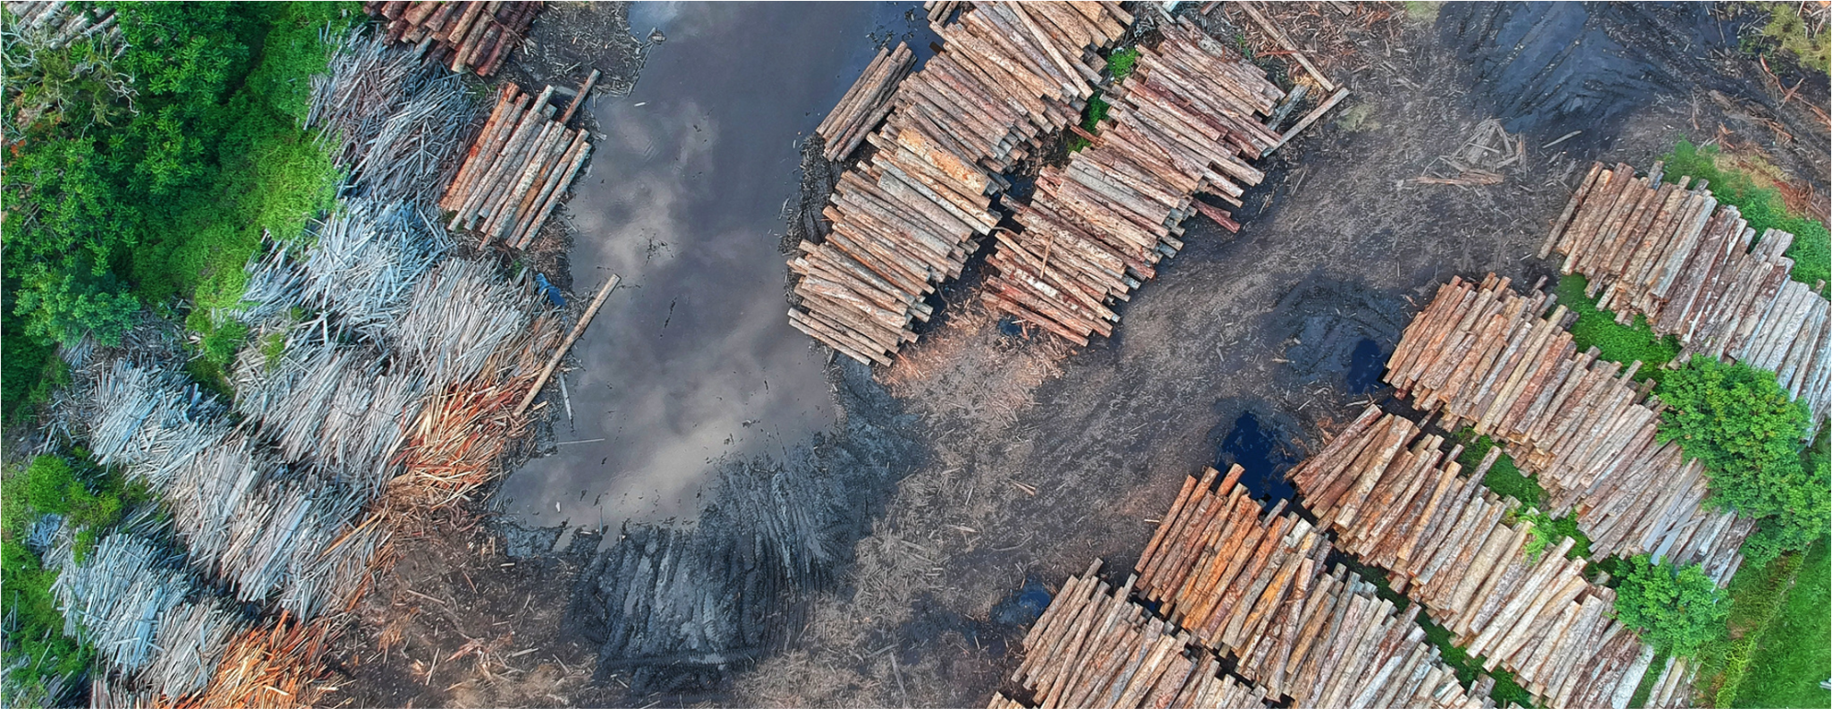
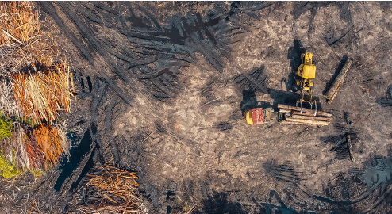
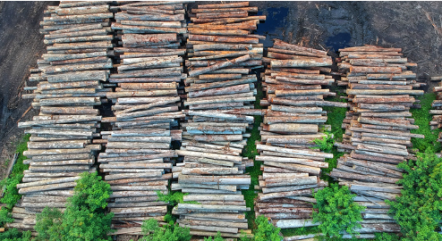
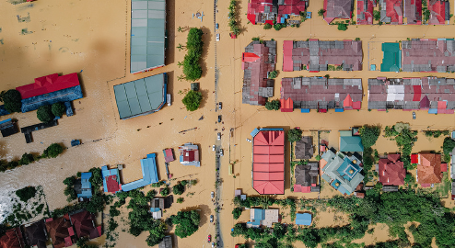
BY JANE DOE
SEPTEMBER 20,2024
DEFORESTATION (2022)
A Balding Mountain
88%
Elaborate on the given statistic here.
Deforestation continues to pose a significant threat to the world's forests, leading to severe environmental and ecological consequences. Large-scale clearing of forests, primarily driven by agriculture, logging, and infrastructure development, is contributing to the loss of biodiversity, disruption of water cycles, and increased carbon emissions. The Amazon rainforest, often referred to as the "lungs of the Earth," is one of the most affected regions, with vast areas being cleared for cattle ranching and soybean production.
120k
Elaborate on the given statistic here.
80m
Elaborate on the given statistic here.

Slide 11




A Timeline of the News Cycle
Timeline Part One
The news cycle is the ongoing process of how news is reported, published, and consumed, starting from breaking news that requires immediate attention to developing stories that evolve over time. It includes follow-up coverage and analysis, enhancing public understanding. In today’s digital age, social media plays a crucial role in rapidly disseminating news and facilitating real-time public engagement, making the news cycle dynamic and influenced by various factors.
Elaborate on this part of the news cycle timeline and what it’s importance is.
Timeline Part Two
Elaborate on this part of the news cycle timeline and what it’s importance is.
Timeline Part Three
Elaborate on this part of the news cycle timeline and what it’s importance is.

Slide 12
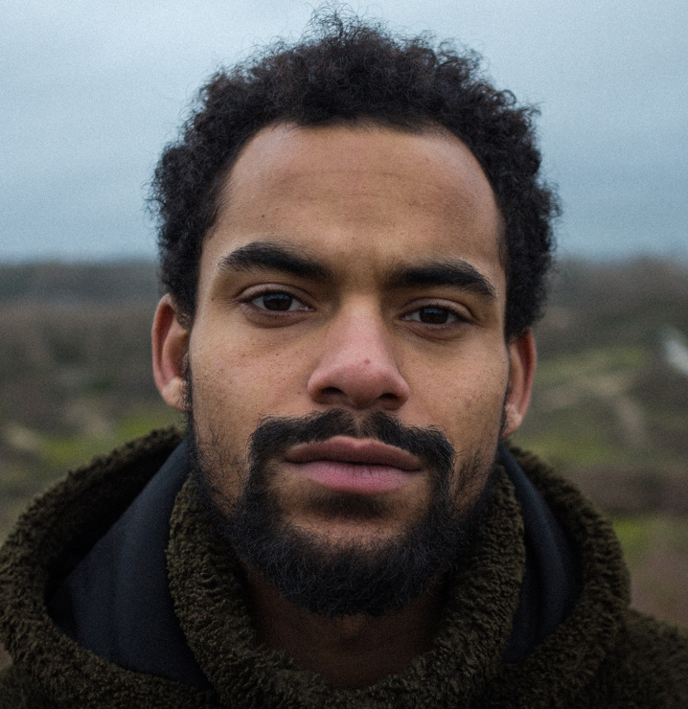


Meet the News Team
The team is a dedicated group of journalists, reporters, and producers committed to delivering accurate and timely news coverage to the world audience. With a diverse range of expertise, the team covers everything from local events and politics to health and environmental issues, ensuring that viewers stay informed on matters that affect their lives. Known for their investigative reporting and engaging storytelling, the The team strives to uphold the highest standards of journalism while fostering trust and transparency in their reporting. Together, they work tirelessly to bring important stories to light, making a meaningful impact on the community they serve.
John Doe
Jane Doe
John Doe
Position
Elaborate on their position, expertise, and experience here.
Position
Elaborate on their position, expertise, and experience here.
Position
Elaborate on their position, expertise, and experience here.

Slide 13
“
WRITE AN ORIGINAL STATEMENT OR QUOTE
— Include a credit, citation, or supporting message

Slide 14
CONTACT US
123 Anywhere St., Any City,ST 12345
123-456-7890
hello@reallygreatsite.com
@reallygreatsite
reallygreatsite.com

Slide 15







































Resource Page
  Use these design resources in your Canva Presentation.
FONTS
DESIGN ELEMENTS
This presentation template
uses the following free fonts:
TITLES:
GILDA DISPLAY
HEADERS:
GILDA DISPLAY
BODY COPY:
INTER
You can find these fonts online too.
COLORS
#FFFFFF
#000000
#386641
  DON'T FORGET TO DELETE THIS PAGE BEFORE PRESENTING.

Slide 16

Credits
  This presentation template is free for everyone to use thanks to the following:
  for the presentation template
Pexels, Pixabay
  for the photos
  Happy designing!

