Slide 1

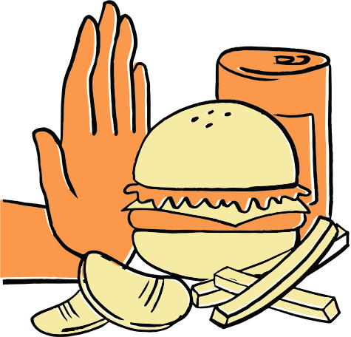
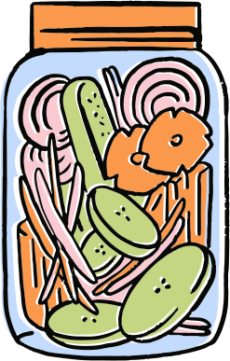
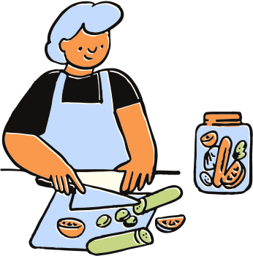
Grade Level
Food and
Nutrition
Understanding what fuels your body
Teacher Name

Slide 2
Introduction to nutrition
Achieving a balanced diet
Today,
we’ll cover
Reading food labels
Tips for
healthy eating

Slide 3

Let’s get started
Ask a question or share a fun fact to engage your students.

Slide 4
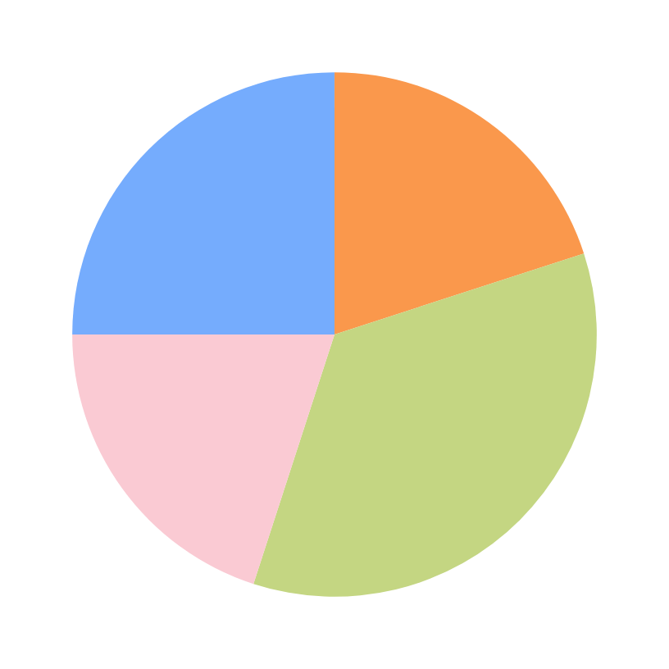

A balanced diet
Grain
Fruit
Water/Dairy
Protein
Vegetables
Describe the ideal mix of food groups on a plate. Use your country’s health department guidelines as a reference.
Body
Movement

Slide 5
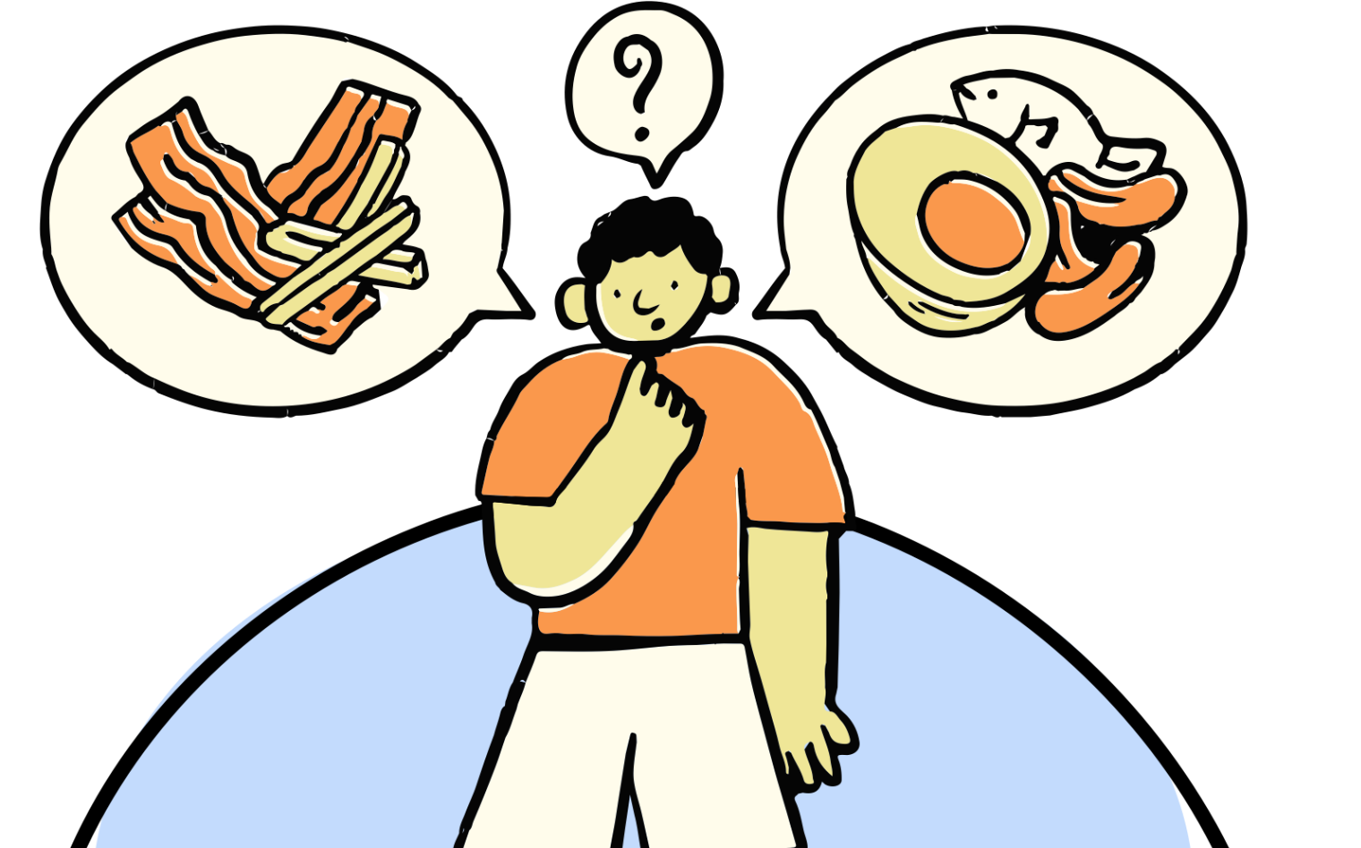
Introduction
to nutrition
Explain what nutrition is in simple terms. Highlight how everyday choices impact one’s health.

Slide 6


Brain bite
Option 1
Add a question with a few response options to check understanding.
Or spark engagement with a short, hands-on task.
Option 2
Option 3

Slide 7
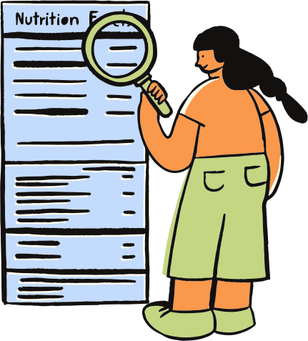
Food labels
Explain what a food label is and why it matters. Refer to your country’s guidelines on food and nutrition labels.

Slide 8
How to read a nutrition label
NUTRITION FACTS SERVINGS PER PACKAGE: Serving Size: | PER SERVE | % DAILY INTAKE
CALORIES
PROTEIN
TOTAL FAT
TOTAL CARBOHYDRATE
SODIUM
POTASSIUM
Key part 1
Key part 2
Key part 3
Break down the key parts of a nutrition label. Focus on how to interpret the numbers and what to look for when comparing products.
Key part 2

Slide 9
Brain bite
Prompt learners to examine two food labels. Ask students to decide which product is the healthier choice and why.
NUTRITION FACTS SERVINGS PER PACKAGE: 6 Serving Size: 27g (About 15 chips) | PER SERVE | % DAILY INTAKE
CALORIES | 160
PROTEIN | 2g
TOTAL FAT | 10g | 13%
TOTAL CARBOHYDRATE | 15g | 6%
SODIUM | 150mg | 7%
NUTRITION FACTS SERVINGS PER PACKAGE: 6 Serving Size: 27g (About 15 chips) | PER SERVE | % DAILY INTAKE
CALORIES | 120
PROTEIN | 2g
TOTAL FAT | 3.5g | 4%
TOTAL CARBOHYDRATE | 22g | 4%
SODIUM | 140mg | 6%
Product A
Product B

Slide 10
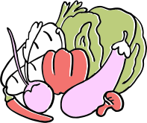
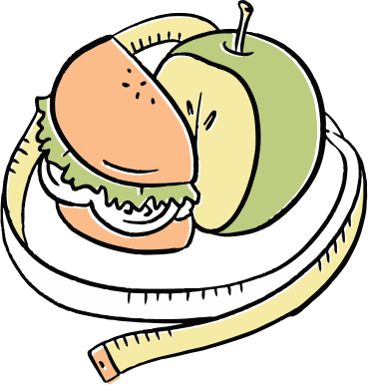

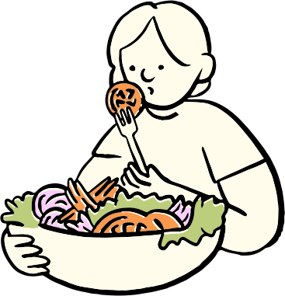
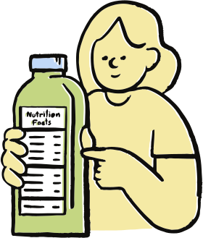
Tips for
healthy eating

Slide 11
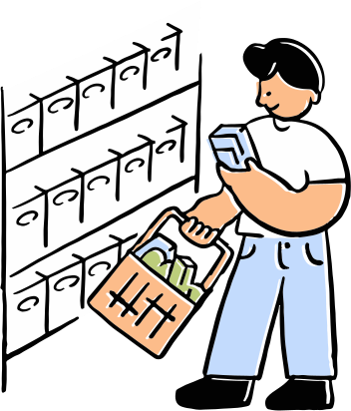
Tip 1
Introduce an easy, realistic habit learners can apply right away.

Slide 12


Tip 1
Focus on what learners can add to their daily meals, instead of what to avoid.
Add more slides if needed.

Slide 13
Let's Review
What’s a
balanced plate?
Tips for
healthy eating
What is
nutrition?
How to read
food labels
The key components and how to portion food groups
Two or three practical ideas learners can use right away
A quick definition and why it matters
What to look for and why it’s helpful

Slide 14

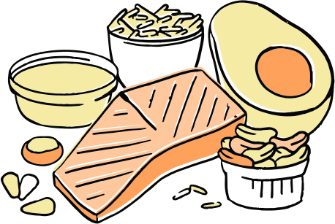

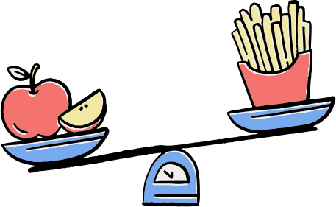
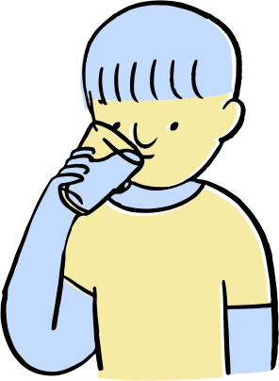

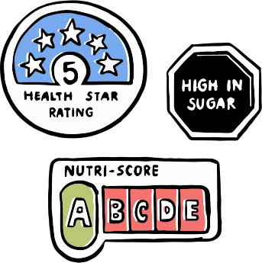

Resource Page
Use these in your presentation. Delete or hide this page before presenting.
Fonts
Design Elements / Icons
This presentation template
uses the following free fonts:
TITLES:
Sawarabi Mincho
BODY TEXT:
Questrial
You can find these fonts online too.
Colors
#C3DBFD
#FACAD3
#FA984C
#C4D682
#F6EBA5

Slide 15

Credits
This presentation template is free for everyone to use, thanks to the following:
Pexels, Pixabay, Sketchify
for this presentation template
for the photos, graphics, and elements
Happy designing!

