Slide 1


WINCREST ACADEMY
NUTRITION &
LIFE STAGES
Learn what to eat and why at every age
GRADE 9
TEACHER SARINA GWAN

Slide 2
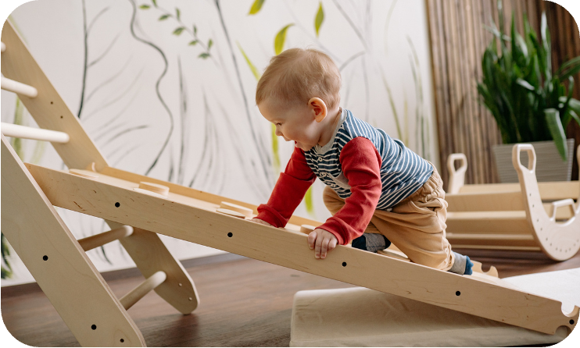


WHAT YOU’LL LEARN TODAY
How nutrition needs change at each life stage:
THE EARLY YEARS
THE GROWING YEARS
THE TEENAGE YEARS

Slide 3
THIS OR THAT?
MILK
ENERGY BAR
FRUIT
OR
OR
OR
JUICE
SANDWICH
CHOCOLATE
Does your choice meet your current life stage needs?

Slide 4
THIS OR THAT?
MILK
ENERGY BAR
FRUIT
OR
OR
OR
JUICE
SANDWICH
CHOCOLATE
Does your choice meet your current life stage needs?

Slide 5


THE EARLY YEARS
0-2 YRS
  Babies start with milk, then slowly try solid foods from around 6 months.
  Once ready, they can eat mashed or blended food.
  They can also try soft finger foods, like cooked carrot or brocolli, they can “chew” with their gums.

Slide 6
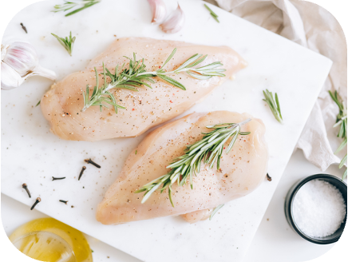
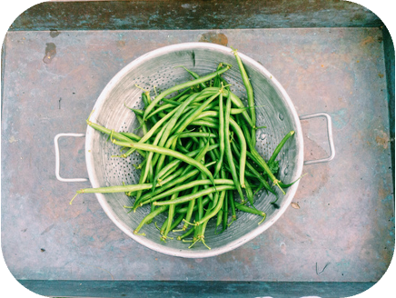
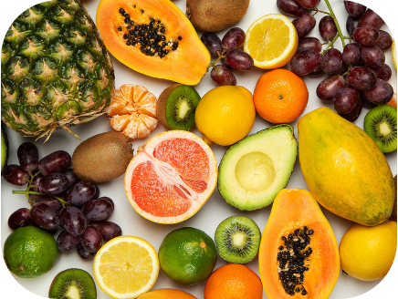

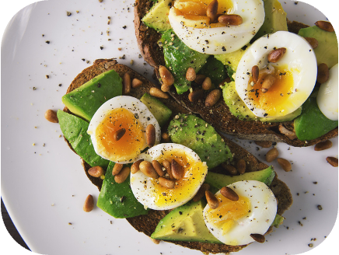
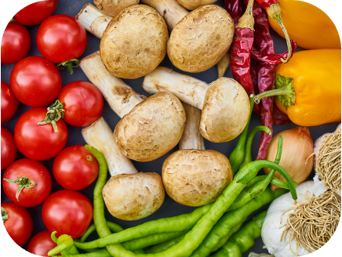
THE EARLY YEARS
As they become more active, babies need:
Protein to help build bones and tissues
Foods with
vitamins A and C
MEAT
BEANS
FRUITS
FISH
EGGS
VEGETABLES

Slide 7


THE GROWING YEARS
3-12 YEARS
  Kids now have full teeth and eat a range of foods.
  They need carbohydrates for energy, nutrient-rich meals, and plenty of water.

Slide 8

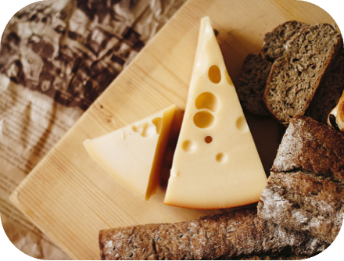
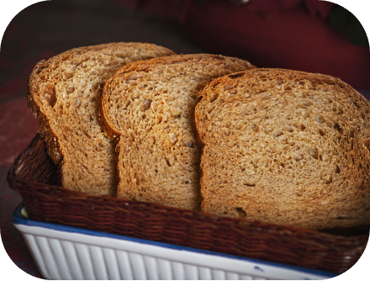
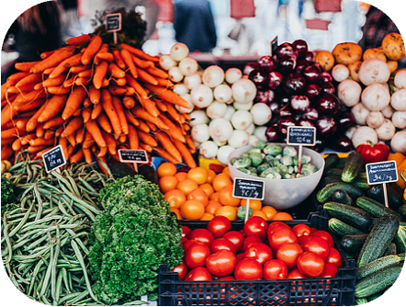

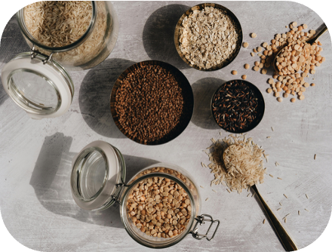
THE GROWING YEARS
As they become more active, kids need:
MILK
CHEESE
BROWN BREAD
VEGETABLES
Calcium to build strong, healthy bones
Fiber to support digestion
YOGURT
CEREAL

Slide 9


THE TEENAGE YEARS
13-19 YEARS
  Teenagers need a balanced diet to fuel their changing bodies.
  Their meals should include all five food groups and enough water.
  Healthy habits now can last a lifetime.

Slide 10
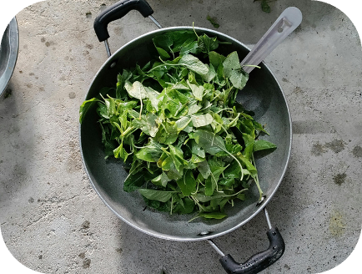
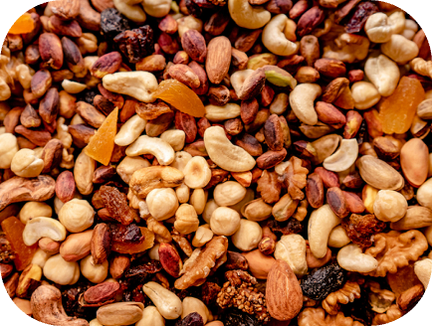

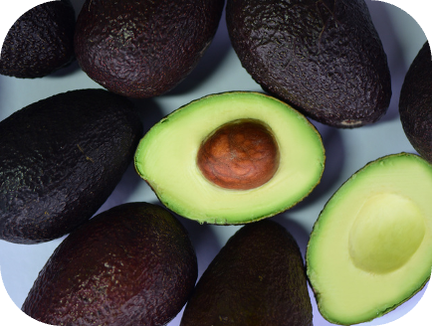
THE TEENAGE YEARS
As their bodies grow and change quickly, teens need:
SPINACH
Potassium for heart health and blood pressure
NUTS
Magnesium to support bones, muscles, and nerves
SWEET POTATOES
AVOCADOS

Slide 11


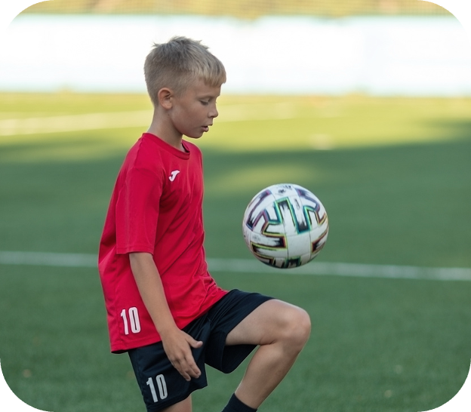

THE TEENAGE YEARS
Choose one guest. Based on their life stage, build a healthy plate that meets their nutrition needs.
KAI (AGE 1)
SKY (AGE 10)
JODY (AGE 16)
Kai is learning to walk and loves soft, squishy foods.
Sky is in grade school and plays soccer after school.
Jody is a swimmer who trains most mornings before class.

Slide 12
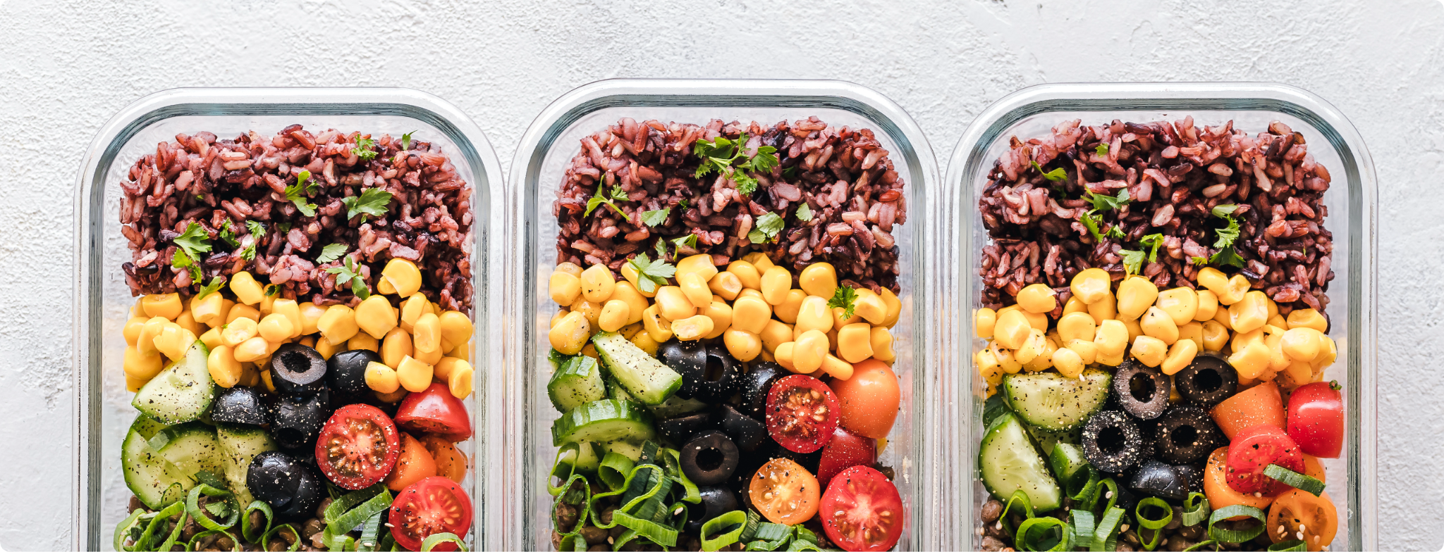
WHAT’S ON YOUR PLATE?
Think about your stage of life. Create a plate
that fuels your body and fits your needs.

Slide 13
KEY TAKEAWAY
“At all stages of our growth, we need food that’s rich in nutrients and energy.”

Slide 14







































Resource Page
  Use these in your presentation. Delete or hide this page before presenting.
Fonts
Design Elements / Icons
This presentation template
uses the following free fonts:
TITLES:
Barlow Condensed
BODY TEXT:
Work Sans
You can find these fonts online too.
Colors
#FFFFFF
#9CE7D1
#57CBAD
#01A880
#00664E

Slide 15

Credits
  This presentation template is free for everyone to use, thanks to the following:
Pexels, Pixabay, & Sketchify
  for this presentation template
  for the photos, graphics, and elements
  Happy designing!

