Slide 1
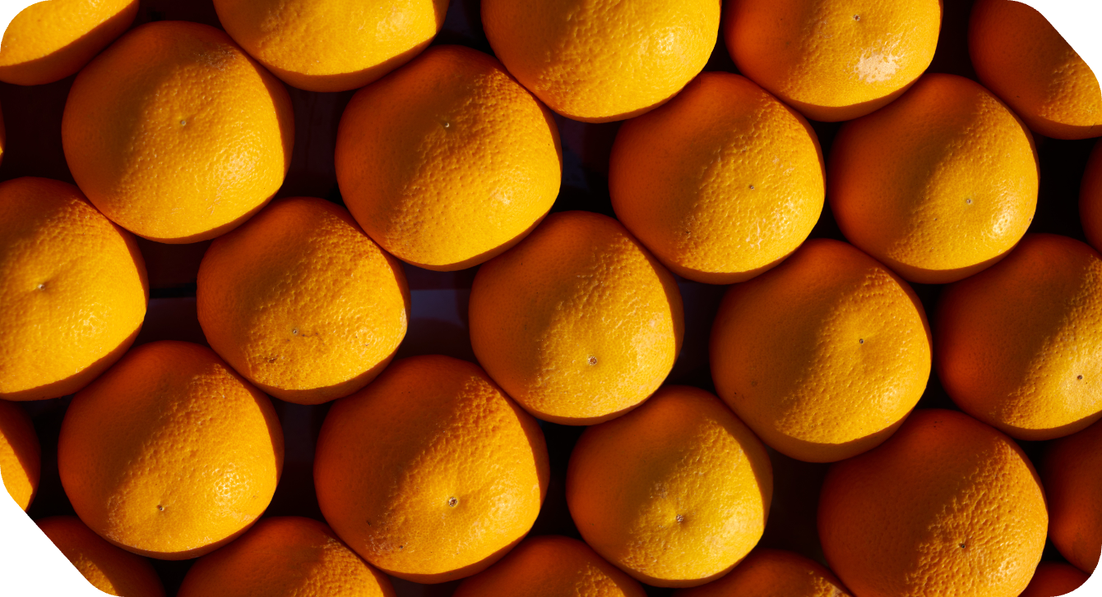
NUTRITION
The
Game Slides
LET’S PLAY

Slide 2
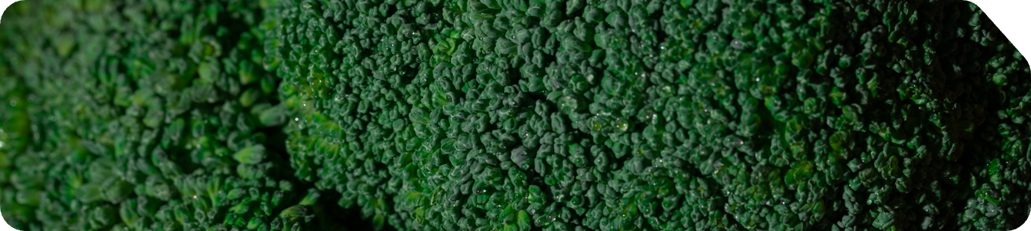
HOW TO
PLAY
CHOOSE A CATEGORY
ANSWER IN
A QUESTION
SCORE
POINTS
KEEP IT MOVING
Pick a category and number to reveal your clue.
The host will read the clue. Your job is to answer in the form of a question.
Answer correctly to earn points. If not, another team gets
a chance.
Whoever answers correctly picks the next box. Take turns and keep it fun!

Slide 3

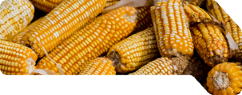
GAME
BOARD
FUN FACTS
CATEGORY
CATEGORY
CATEGORY
CATEGORY
100
100
100
100
100
200
200
200
200
200
300
300
300
300
300
400
400
400
400
400
500
500
500
500
500

Slide 4
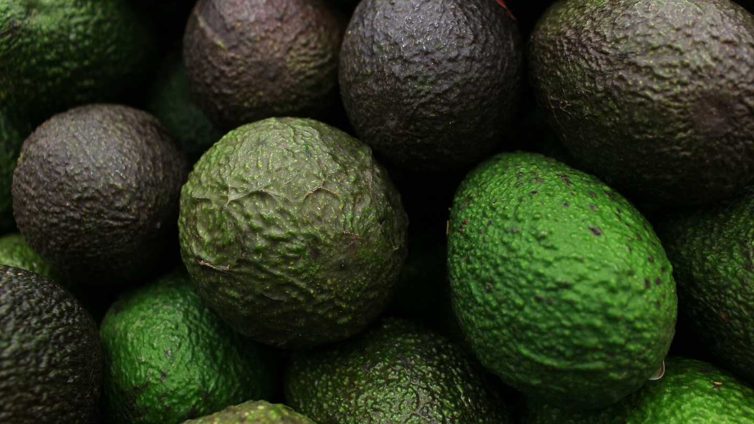
FACT
100
FUN
BACK TO
GAME BOARD
This red and juicy food is often called a vegetable, but it’s actually a fruit.
REVEAL ANSWER

Slide 5
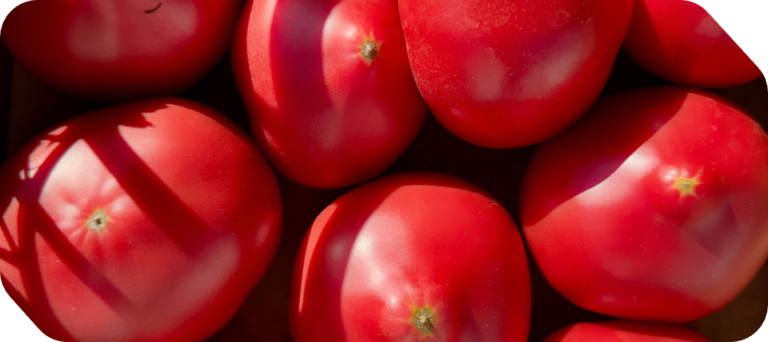
100
ANSWER
BACK TO
GAME BOARD
WHAT IS A TOMATO?

Slide 6
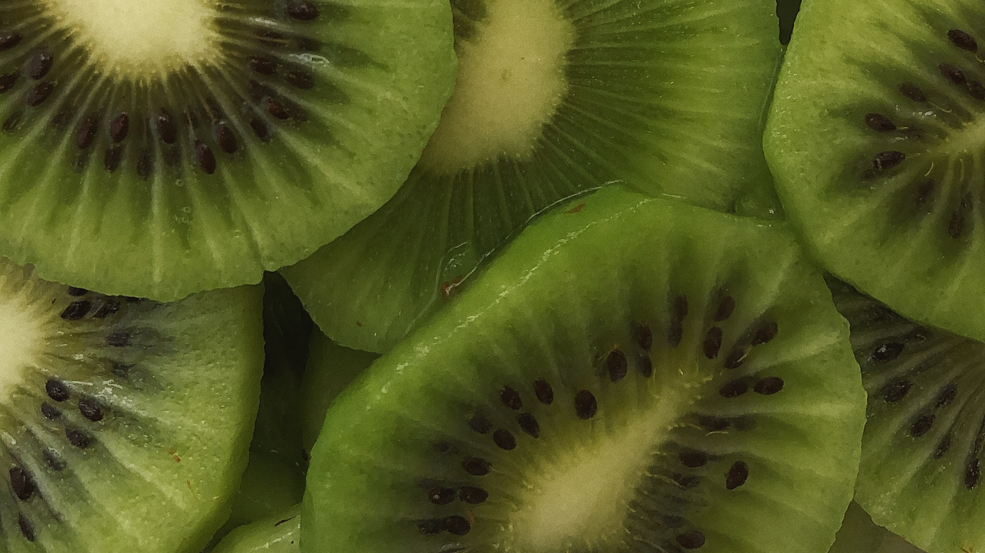
FACT
200
FUN
BACK TO
GAME BOARD
This orange vegetable used to be purple before becoming the color we know today.
REVEAL ANSWER

Slide 7
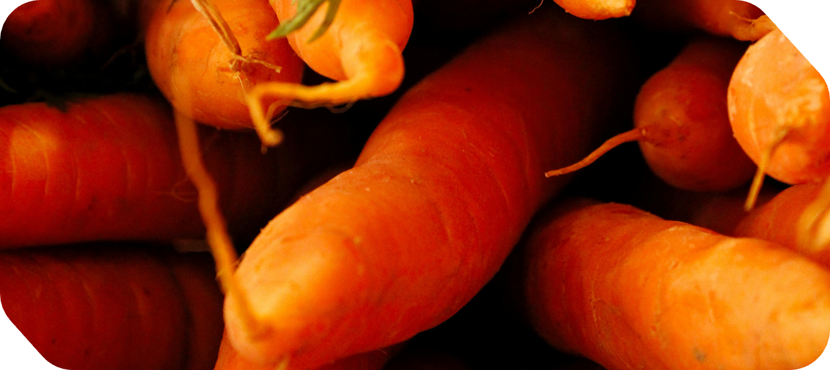
200
ANSWER
BACK TO
GAME BOARD
WHAT IS A CARROT?

Slide 8
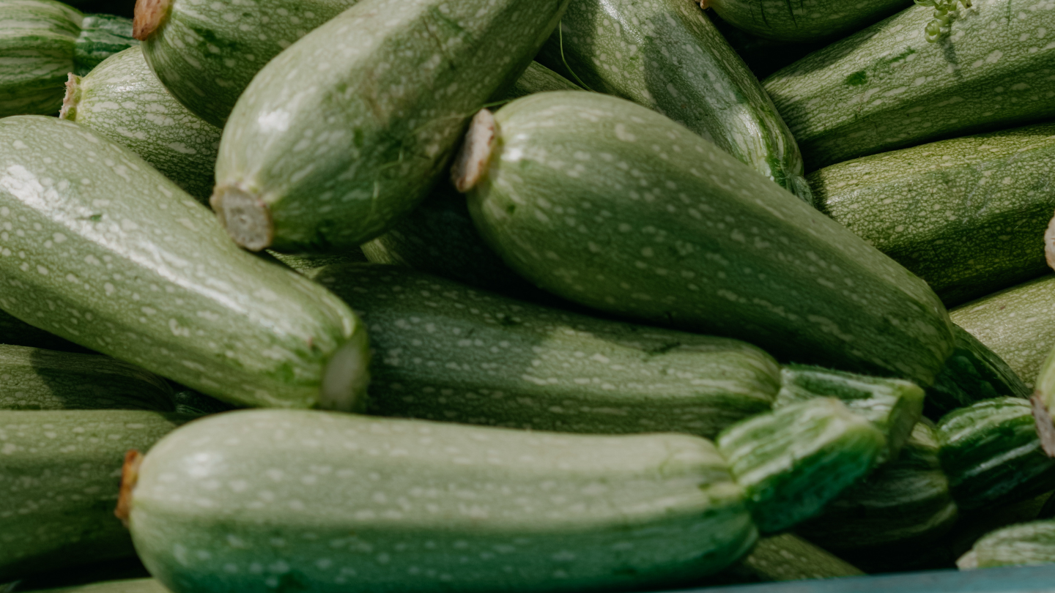
FACT
300
FUN
BACK TO
GAME BOARD
This yellow fruit floats in water,
and it’s technically a berry.
REVEAL ANSWER

Slide 9
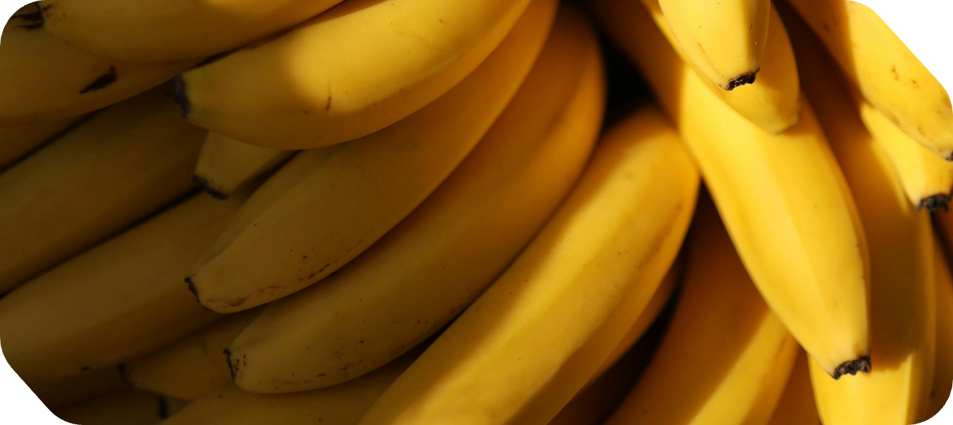
300
ANSWER
BACK TO
GAME BOARD
WHAT IS A BANANA?

Slide 10
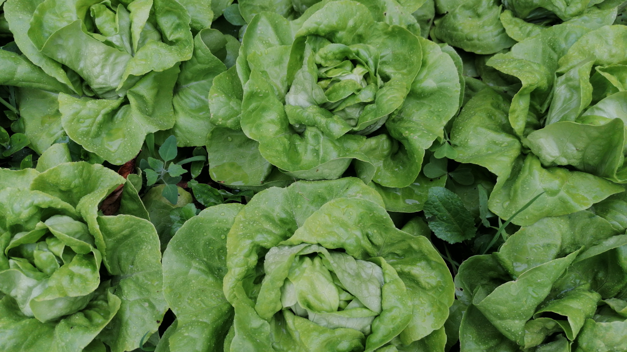
FACT
400
FUN
BACK TO
GAME BOARD
This crunchy vegetable has more water
in it than a glass of milk.
REVEAL ANSWER

Slide 11
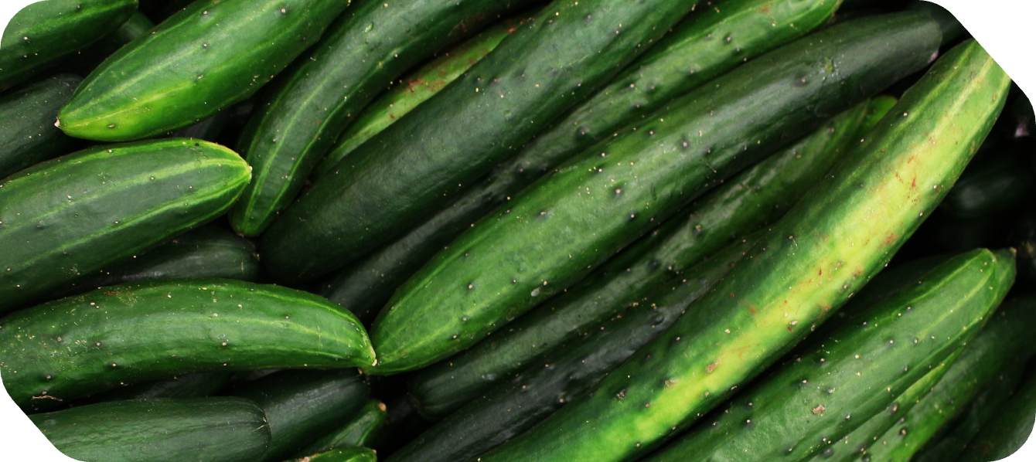
400
ANSWER
BACK TO
GAME BOARD
WHAT IS A CUCUMBER?

Slide 12
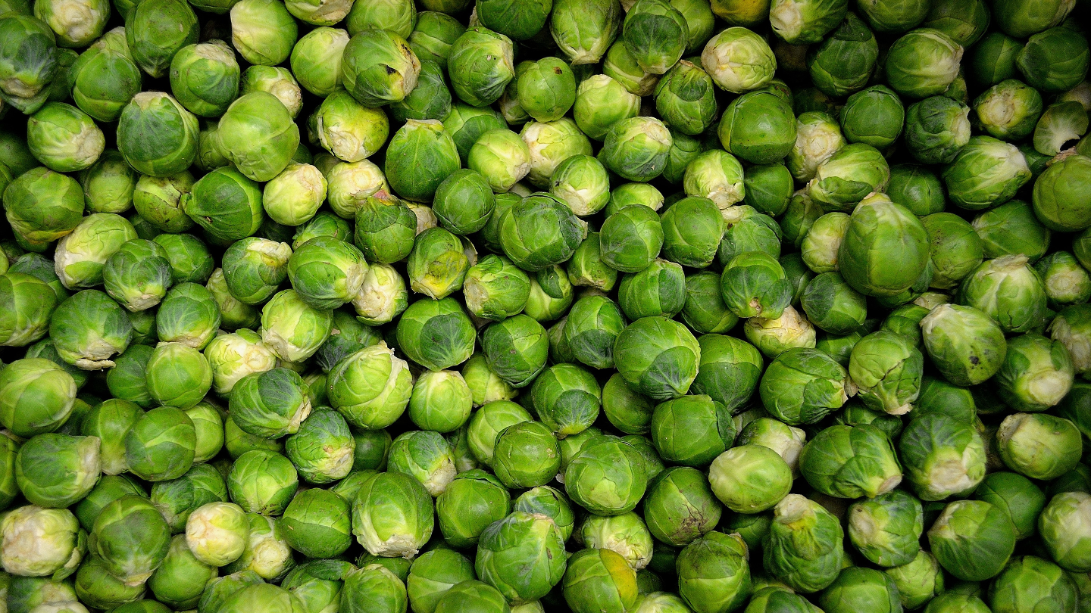
FACT
500
FUN
BACK TO
GAME BOARD
This fruit has tiny seeds on the outside instead of the inside.
REVEAL ANSWER

Slide 13
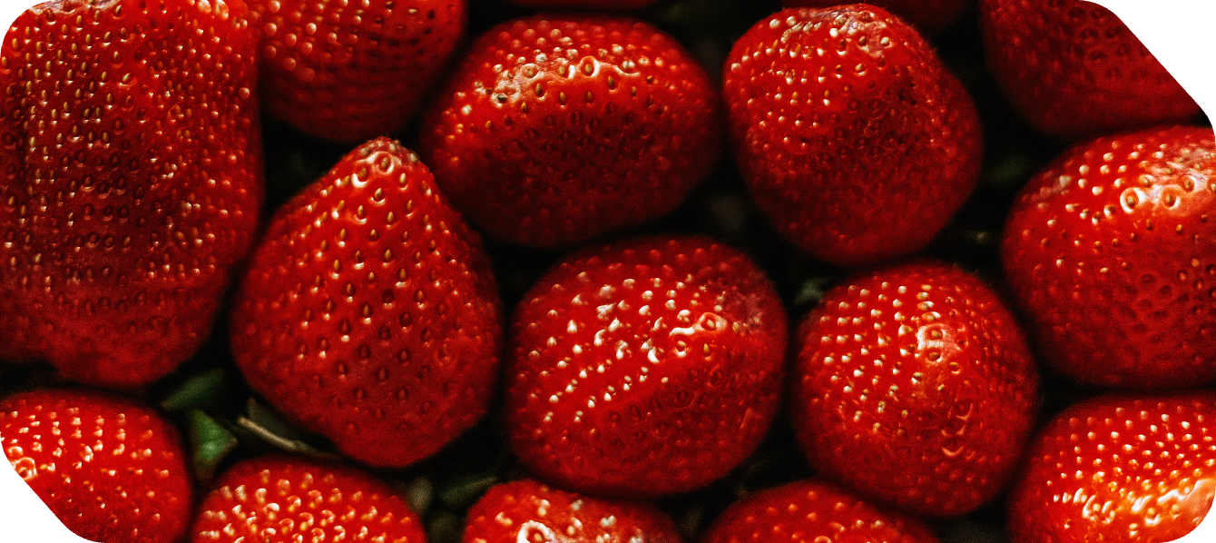
500
ANSWER
BACK TO
GAME BOARD
WHAT IS A STRAWBERRY?

Slide 14
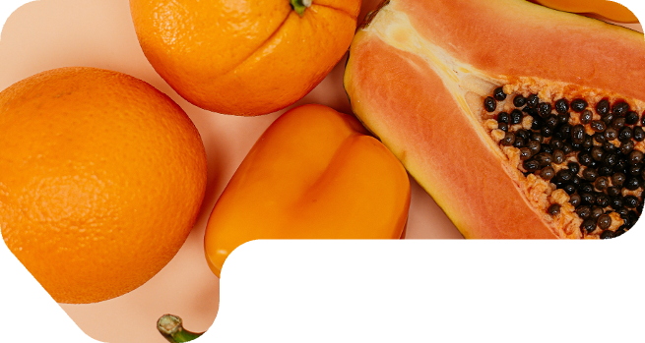
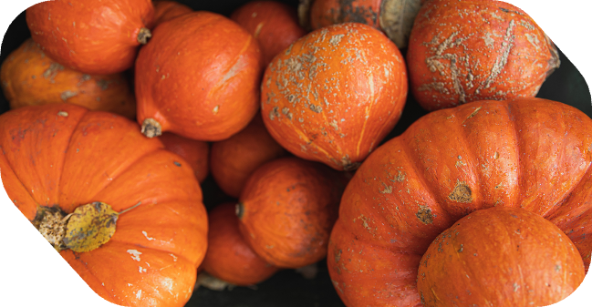
SNACK-TACULAR
WORK!
HOPE YOU HAD FUN WHILE LEARNING ALONG THE WAY!

Slide 15
Resource Page
  Use these in your presentation. Delete or hide this page before presenting.
FONTS
DESIGN ELEMENTS / ICONS
This presentation template
uses the following free fonts:
TITLES:
LUCKIEST GUY
BODY TEXT:
Nunito Sans Condensed
You can find these fonts online too.
COLORS
#CE4F11
#2A5F28
#EFC123
#CC2D5A
#FFEFD3

Slide 16

Credits
  This presentation template is free for everyone to use, thanks to the following:
  for this presentation template
Pexels, Pixabay, Sketchify
  for the photos, graphics, and elements
HAPPY
DESIGNING!

