Slide 1


JEOPARDY PRESENTATION
PHILIPPINE HISTORY TRIVIA GAME

Slide 2

HOW TO USE THIS PRESENTATION
GOOGLE SLIDES
POWERPOINT
CANVA
Click on the "Google Slides" button below this presentation preview. Make sure to sign in to your Google account. Click on "Make a copy." Start editing your presentation.
Alternative: Click on the "Share" button on the top right corner in Canva and click on "More" at the bottom of the menu. Enter "Google Drive" in the search bar and click on the GDrive icon to add this design as a Google slide in your GDrive.
Click on the "PowerPoint" button below this presentation preview. Start editing your presentation.
Alternative: From Canva template file, Click on the "Share" button on the top right corner in Canva and click on "More" at the bottom of the menu. Enter "PowerPoint" in the search bar and click on the PowerPoint icon to download.
Click on the "Canva" button under this presentation preview. Start editing your presentation. You need to sign in to your Canva account.

Slide 3

RULE #1
Elaborate on what you want to discuss.
RULE #2
Elaborate on what you want to discuss.
GAME RULES
RULE #3
Elaborate on what you want to discuss.

Slide 4


KEN
MARIE
SAM
100
1,000
500
SCOREBOARD

Slide 5
CATEGORY #1
CATEGORY #2
CATEGORY #3
CATEGORY #4
10 Pts.
10 Pts.
10 Pts.
10 Pts.
20 Pts.
20 Pts.
20 Pts.
20 Pts.
30 Pts.
30 Pts.
30 Pts.
30 Pts.
40 Pts.
40 Pts.
40 Pts.
40 Pts.
50 Pts.
50 Pts.
50 Pts.
50 Pts.

Slide 6

#1
CATEGORY HERE
Elaborate on what you want to discuss.

Slide 7


CATEGORY #1
Sino ang ating pambansang bayani?
10 Pts.
Back to Panel
Scoreboard

Slide 8
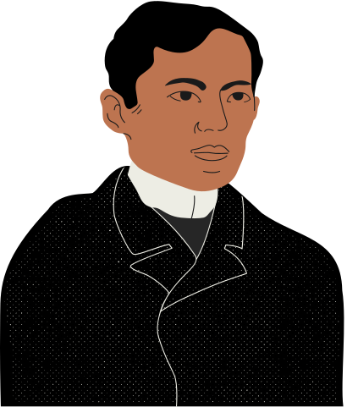
ANSWER
Dr. Jose Protacio Rizal Mercado y Alonso Realonda
Nanalo ka ng 10 Pts!

Slide 9

#2
CATEGORY HERE
Elaborate on what you want to discuss.

Slide 10
CATEGORY #2
Kailan nadiskubre ang Pilipinas?
10 Pts.
Back to Panel
Scoreboard

Slide 11

ANSWER
Marso 16, 1521
Nanalo ka ng 10 Pts!

Slide 12


PAHINGA MUNA!

Slide 13

#3
CATEGORY HERE
Elaborate on what you want to discuss.

Slide 14
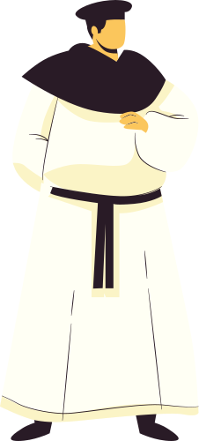
CATEGORY #2
Who were the three priests falsely accused of mutiny and was executed?
10 Pts.
Back to Panel
Scoreboard

Slide 15

ANSWER
GOMBURZA:
Mariano Gomez
José Burgos
Jacinto Zamora
Nanalo ka ng 10 Pts!

Slide 16

#4
CATEGORY HERE
Elaborate on what you want to discuss.

Slide 17
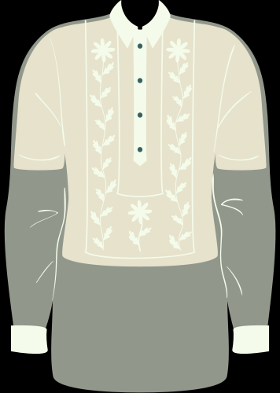

CATEGORY #2
Anu-ano ang branches ng Philippine government?
10 Pts.
Back to Panel
Scoreboard

Slide 18

ANSWER
Executive
Legislative
Judicial
Nanalo ka ng 10 Pts!

Slide 19



1ST PLACE
FINAL SCORE
2ND PLACE
3RD PLACE
Marie
1,000 Pts
Sam
500 Pts
Ken
100 Pts

Slide 20
SALAMAT PO!
Add call-to-action statement here.

Slide 21









RESOURCE PAGE
Use these design resources in your Canva Presentation.
This presentation template uses the following free fonts:
Titles: Capriola
Headers: Lato Bold
Body Copy: Lato Regular
You can find these fonts online too. Happy designing!
Don't forget to delete this page before presenting.

Slide 22

THIS PRESENTATION TEMPLATE IS FREE FOR EVERYONE TO USE THANKS TO THE FOLLOWING:
SlidesCarnival for the presentation template
Pexels and Pixabay for the photos
Happy Designing!

