Slide 1
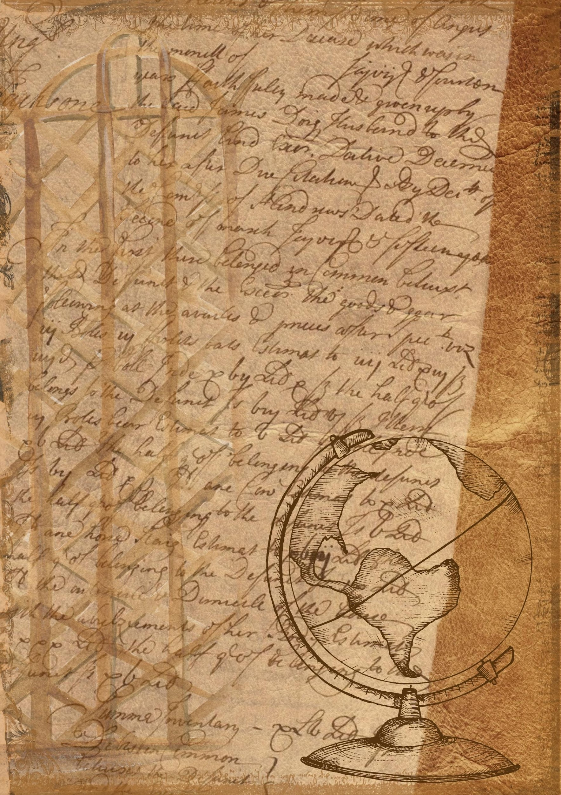
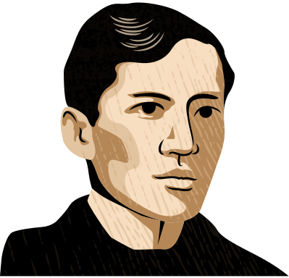
NOLI ME TANGERE
Lesson Background

Slide 2


Contents
01
Introduction to José Rizal
Plot Summary
05
02
Historical Context
Climax of the Novel
06
03
Overview of the Novel
Noli vs El Fili
07
04
Main Characters
Modern Relevance
08

Slide 3
Introduction to José Rizal
José Rizal, born on June 19, 1861, in Calamba, Laguna, was a Filipino nationalist and writer who advocated for peaceful reforms during the Spanish colonial period. Educated in the Philippines and Europe, Rizal was influenced by democratic ideas, which shaped his vision for change. His novels, Noli Me Tangere and El Filibusterismo, boldly criticized Spanish abuses and promoted Filipino rights. Rizal’s works ignited Filipino nationalism, making him a key figure in the fight for independence. Despite his peaceful approach, Rizal was executed on December 30, 1896, solidifying his legacy as a national hero.

Slide 4
Historical Context
The Philippines endured over 300 years of harsh Spanish colonial rule with exploitation and discrimination.
Filipinos suffered social inequality, abuse by powerful friars, economic hardship, and widespread discontent.
European Enlightenment ideas influenced Filipino intellectuals like Rizal, leading to a reform movement.
Rizal and other reformists advocated for peaceful changes and greater representation, exemplified by the publication of Noli Me Tangere in 1887 to expose colonial abuses.

Slide 5
Overview of the Novel
Noli Me Tangere, published in 1887, is a novel by José Rizal that critiques the social, political, and religious structures of the Philippines during Spanish colonial rule. The title, which means "Touch Me Not," symbolizes the untouchable issues of oppression and injustice in Filipino society. The novel follows Crisostomo Ibarra, a young man who returns to the Philippines after studying in Europe, only to face corruption and abuse by the Spanish friars and colonial government. Through Ibarra’s journey, Rizal exposes the struggles of Filipinos under colonial rule, addressing themes of social inequality, religious hypocrisy, and the importance of education and reform. The novel is a mix of political commentary, social critique, and romance, and it played a significant role in inspiring the movement for Philippine independence.

Slide 6




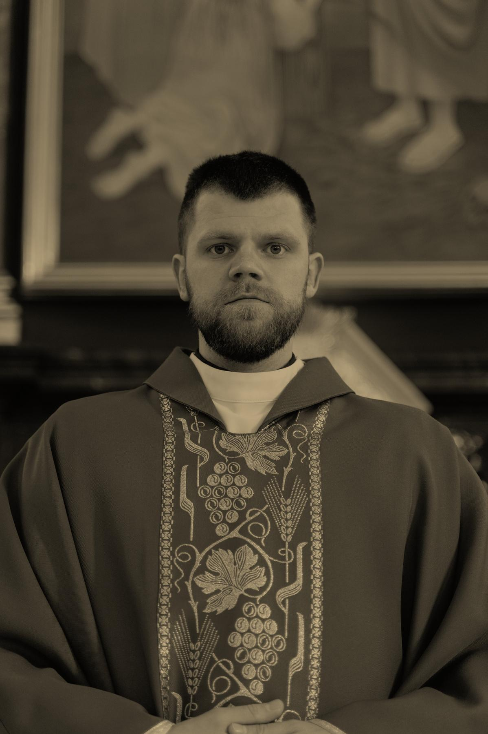
Main Characters
Crisostomo Ibarra
Maria Clara
Padre Damaso

Slide 7
María Clara de los Santos y Alba
María Clara de los Santos is a fictional character in José Rizal's novel Noli Me Tángere (1887). The beautiful María Clara is the childhood sweetheart and fiancée of the protagonist, Crisóstomo Ibarra, who returns to his Filipino hometown of San Diego to marry her. After Ibarra is implicated in a fake revolution and is thought to be dead, María Clara opts to become a nun rather than marry another man. She remains unhappy for the rest of her life and her death is later mentioned in the sequel, El filibusterismo (1891).

Slide 8

Plot Summary
Crisostomo Ibarra, a young Filipino educated in Europe, returns home to improve his country by building a school, believing education drives progress. He faces opposition from corrupt figures like Padre Damaso, who caused his father's wrongful death. As Ibarra deals with social and political challenges, his love for Maria Clara is tested by the Church's influence. After being falsely accused of rebellion, Ibarra escapes with the help of revolutionary Elias, while Maria Clara, thinking she is illegitimate, enters a convent. The novel concludes with Ibarra disillusioned and heartbroken, highlighting the abuses of Spanish colonial rule and igniting Filipino nationalism.

Slide 9



“There are no tyrants if there are no slaves.”
Noli Me
Tangere

Slide 10

Climax of the Story
The climax of Noli Me Tangere occurs when Crisostomo Ibarra is falsely accused of leading a rebellion against the Spanish authorities. His enemies, particularly the corrupt friars, conspire to frame him in an attempt to destroy his reputation and thwart his plans for reform. During a town fiesta, government forces uncover weapons planted to implicate Ibarra in a supposed uprising. Ibarra is arrested, and the situation escalates, leaving him betrayed and abandoned. This pivotal moment leads to his eventual escape with the help of Elias, marking the turning point in the novel where Ibarra’s hopes for peaceful reform are crushed.

Slide 11
Noli Me Tangere vs El Filibusterismo
 | Noli Me Tangere | El Filibusterismo
THEMES | Focuses on social issues such as injustice, corruption, and the abuse of power by the Spanish authorities and friars. It emphasizes peaceful reform through education and awareness. | A darker, more revolutionary novel that highlights the need for radical change, even through violence if necessary. It portrays a growing sense of disillusionment and desperation in the fight against oppression.
TONES | Generally hopeful and idealistic, with a focus on love, reform, and the possibility of change. Ibarra believes education can lead to progress. | Bitter and cynical, reflecting Rizal’s disappointment with the lack of change. The protagonist, now Simoun (Ibarra in disguise), seeks revenge and advocates for revolution rather than reform.
APPROACH | Crisostomo Ibarra, the protagonist, initially seeks peaceful solutions, like building a school, to uplift the Filipino people. | Ibarra returns as Simoun, a wealthy jeweler plotting a violent revolution, having lost faith in peaceful reform.
LOVE STORY | Central to the novel is the love between Ibarra and Maria Clara, which represents hope and innocence. | The love story fades into the background as Simoun’s desire for revenge overshadows his former love for Maria Clara.
CONCLUSION | Ends with Ibarra’s escape, disillusioned but still holding on to his ideals. | Ends tragically with Simoun’s death and failure, symbolizing the futility of revenge and the complexities of fighting for freedom.

Slide 12

Conclusion
The conclusion of Noli Me Tangere highlights the tragic consequences of oppression and injustice under Spanish colonial rule. Crisostomo Ibarra, wrongfully accused of rebellion, is forced to flee, losing everything—his status, love, and dreams of reform. Maria Clara enters a convent, symbolizing her submission to the oppressive system. The novel ends on a somber note, with Ibarra presumed dead, but it subtly calls for action, inspiring Filipinos to seek independence and justice.

Slide 13

Thank You!

Slide 14







































RESOURCE PAGE
  Use these design resources in your Canva Presentation.
Fonts
Design Elements
This presentation template
uses the following free fonts:
TITLES:
PIRATA ONE
BODY COPY:
VESPER LIBRE
You can find these fonts online too.
Colors
#B58756
#513217
  DON'T FORGET TO DELETE THIS PAGE BEFORE PRESENTING.

Slide 15

CREDITS
  This presentation template is free for everyone to use thanks to the following:
  for the presentation template
Pexels, Pixabay
  for the photos
  Happy designing!

