Slide 1
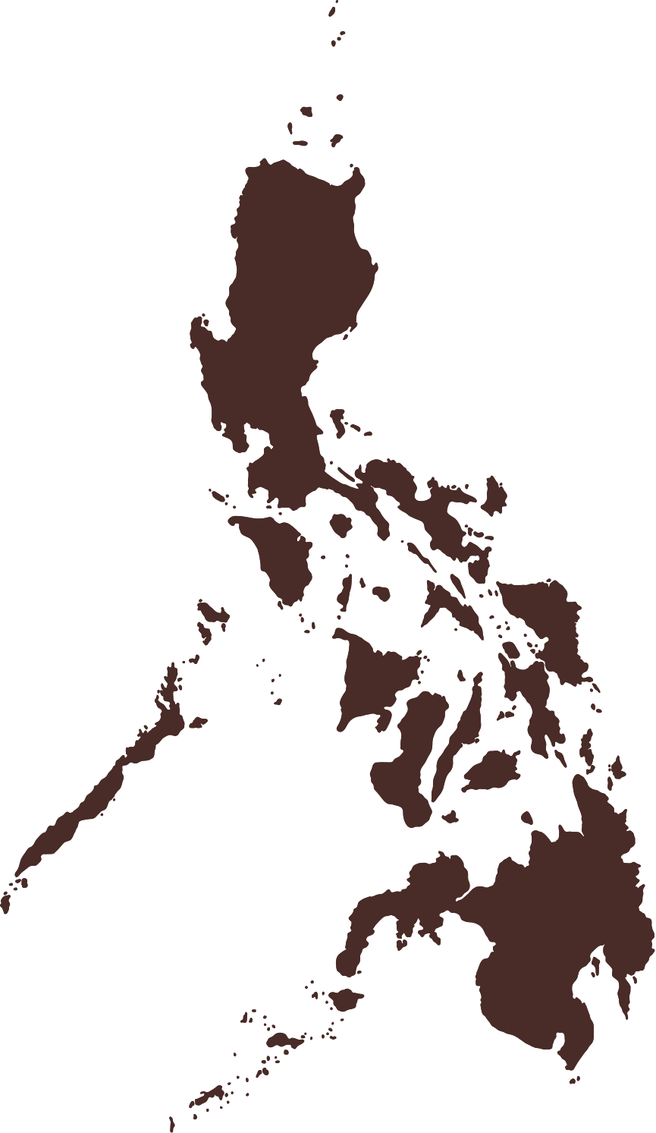

THE PHILIPPINE MAP
Cordillera Administrative Region
Ilocos Region
Region I
Cagayan Valley
Region II
Central Luzon
Calabarzon
Region III
Region IV-A
Bicol Region
Region V
Southwestern
Tagalog Region
Eastern Visayas
Mimaropa
Region VIII
Western
Visayas
Region VI
Central Visayas
Region VII
Caraga
Northern Mindanao
Region XIII
Region X
Zamboanga Peninsula
Davao
Region
Region IX
Bangsamoro
Region XI
BARMM
Soccsksargen
Region XII

Slide 2
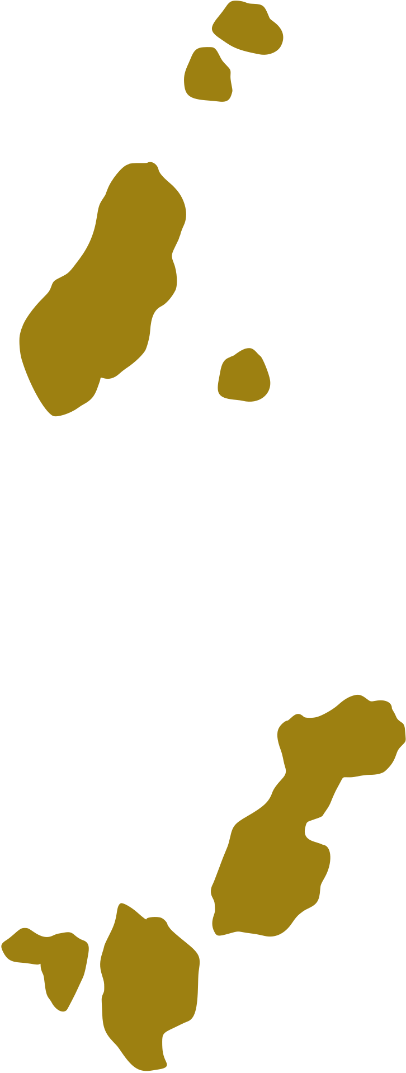

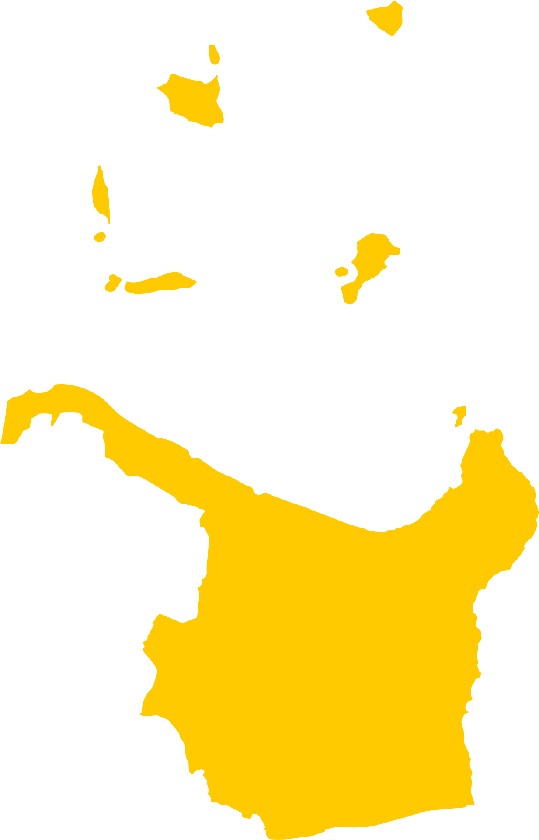



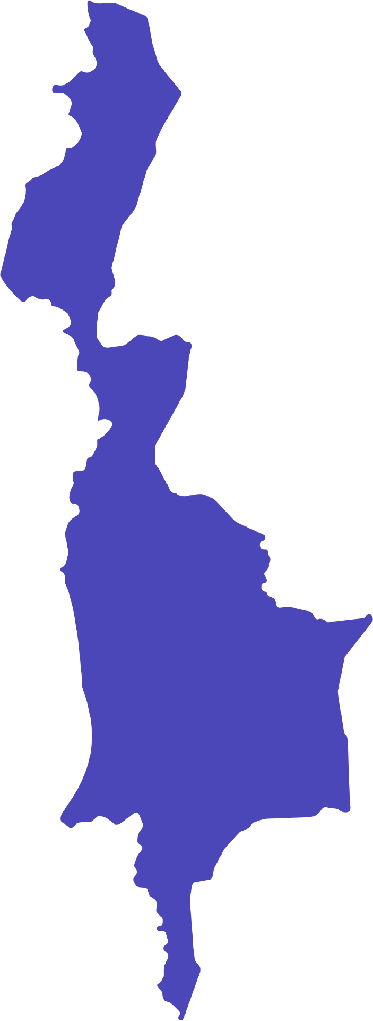
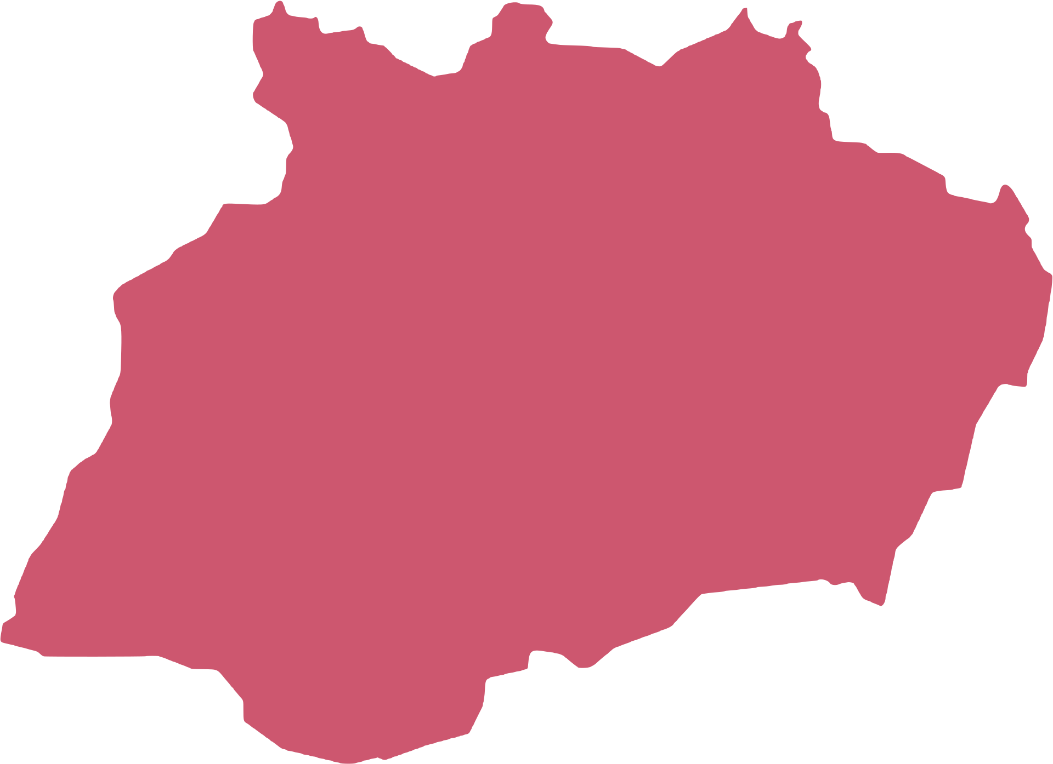

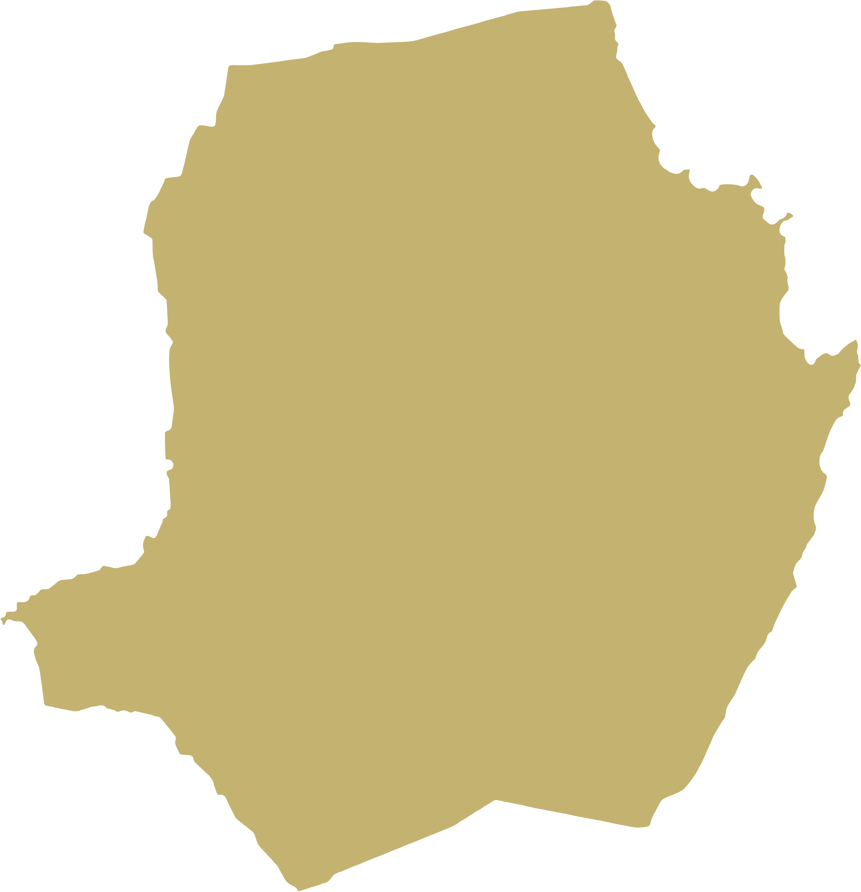



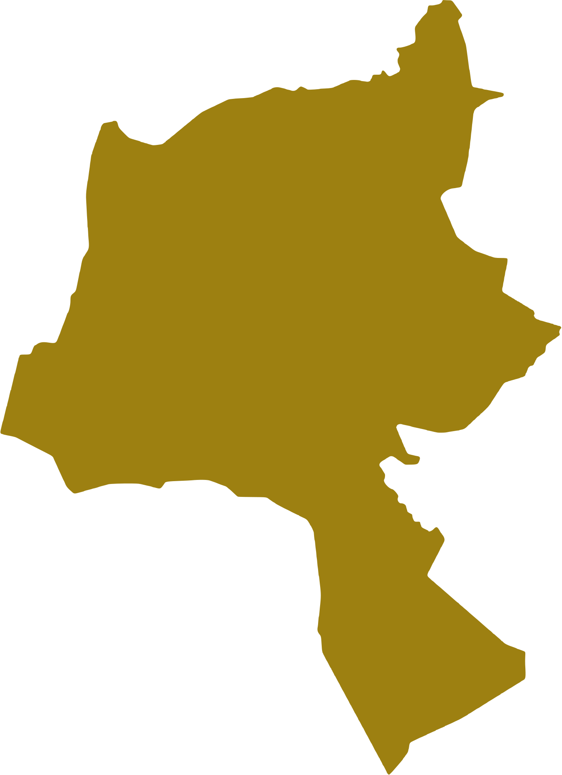

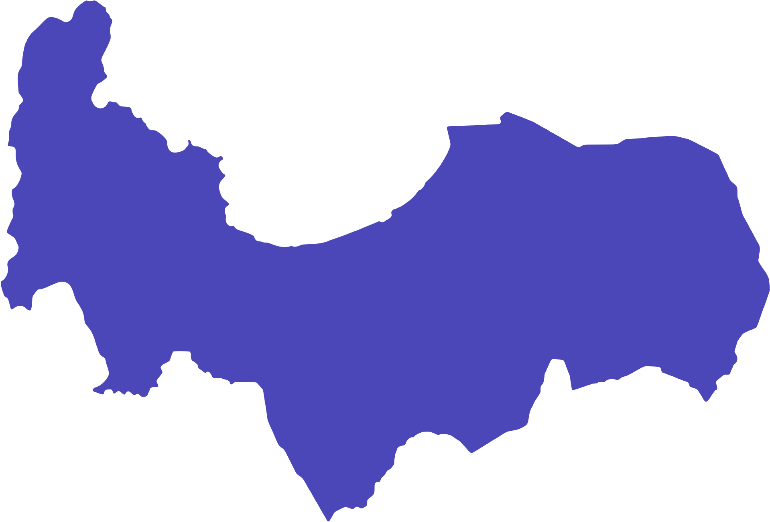

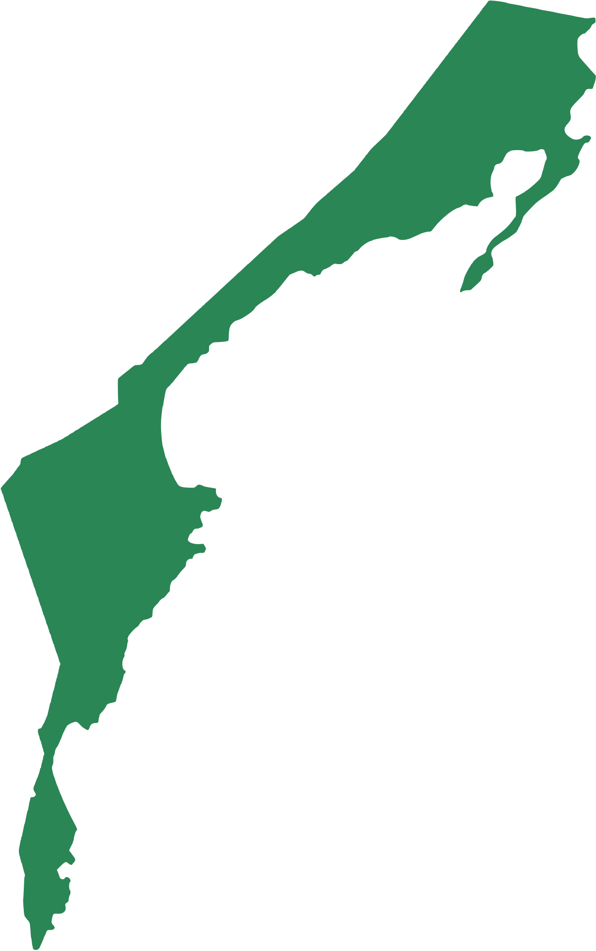

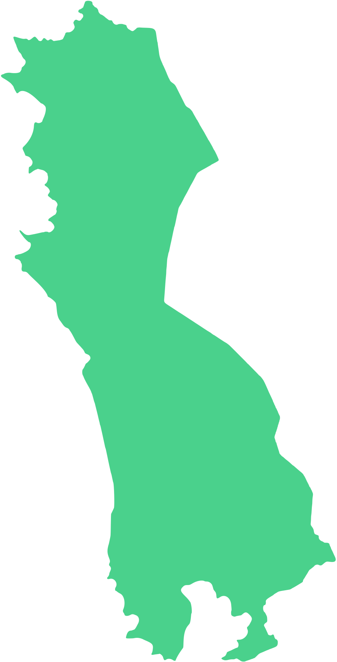
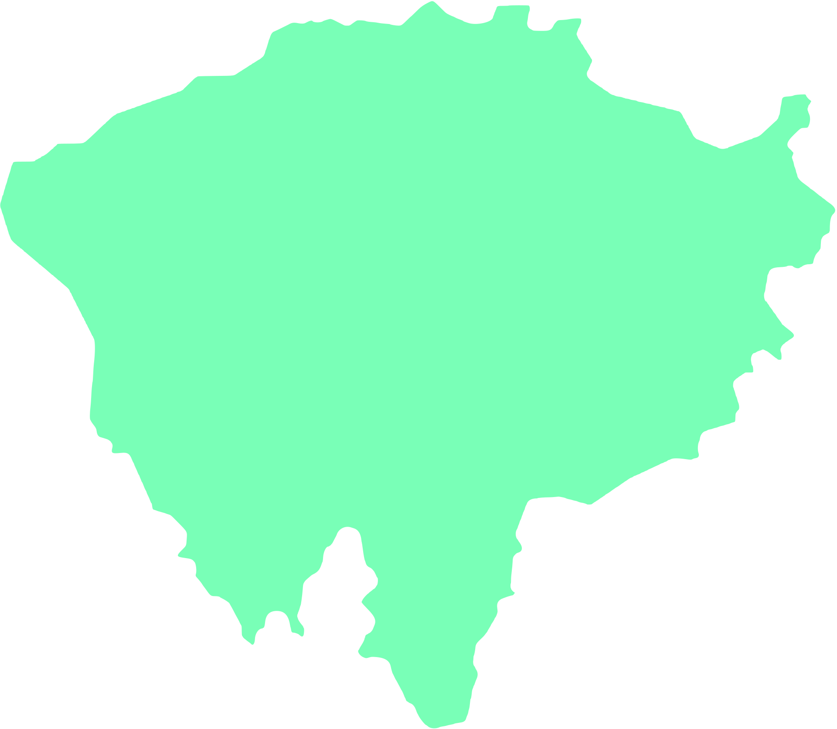






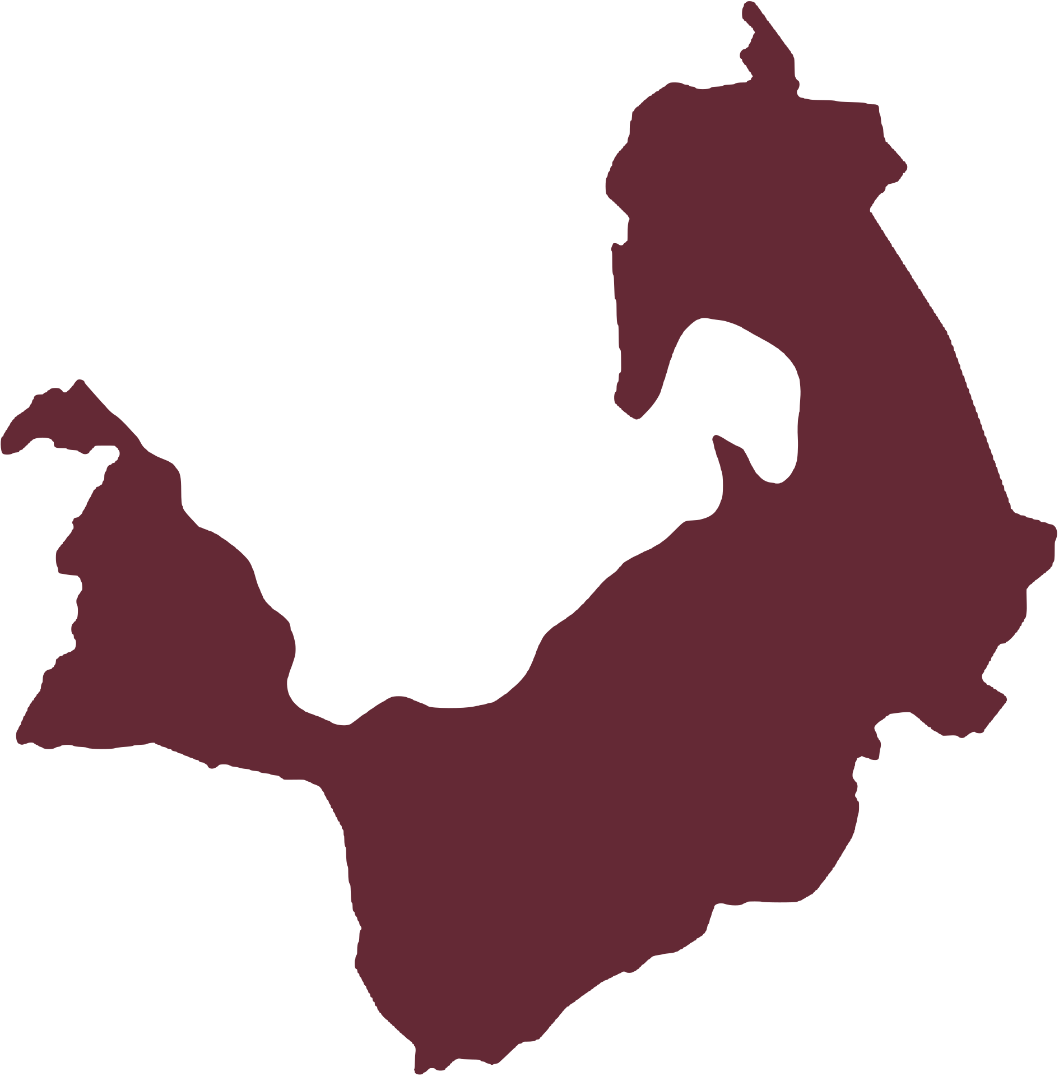

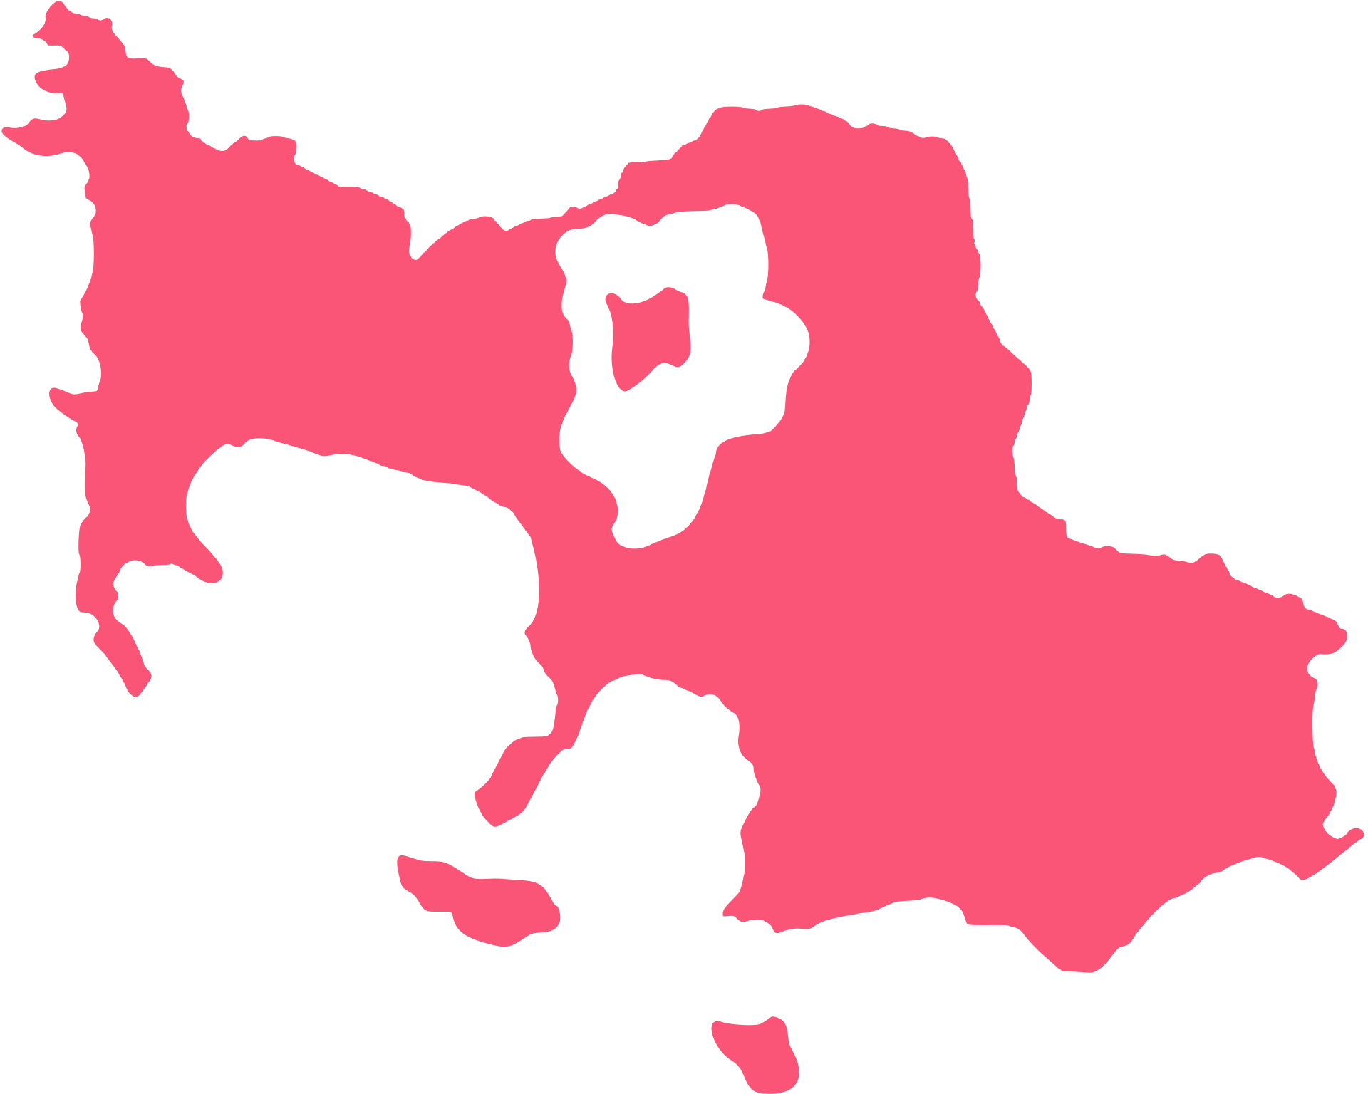
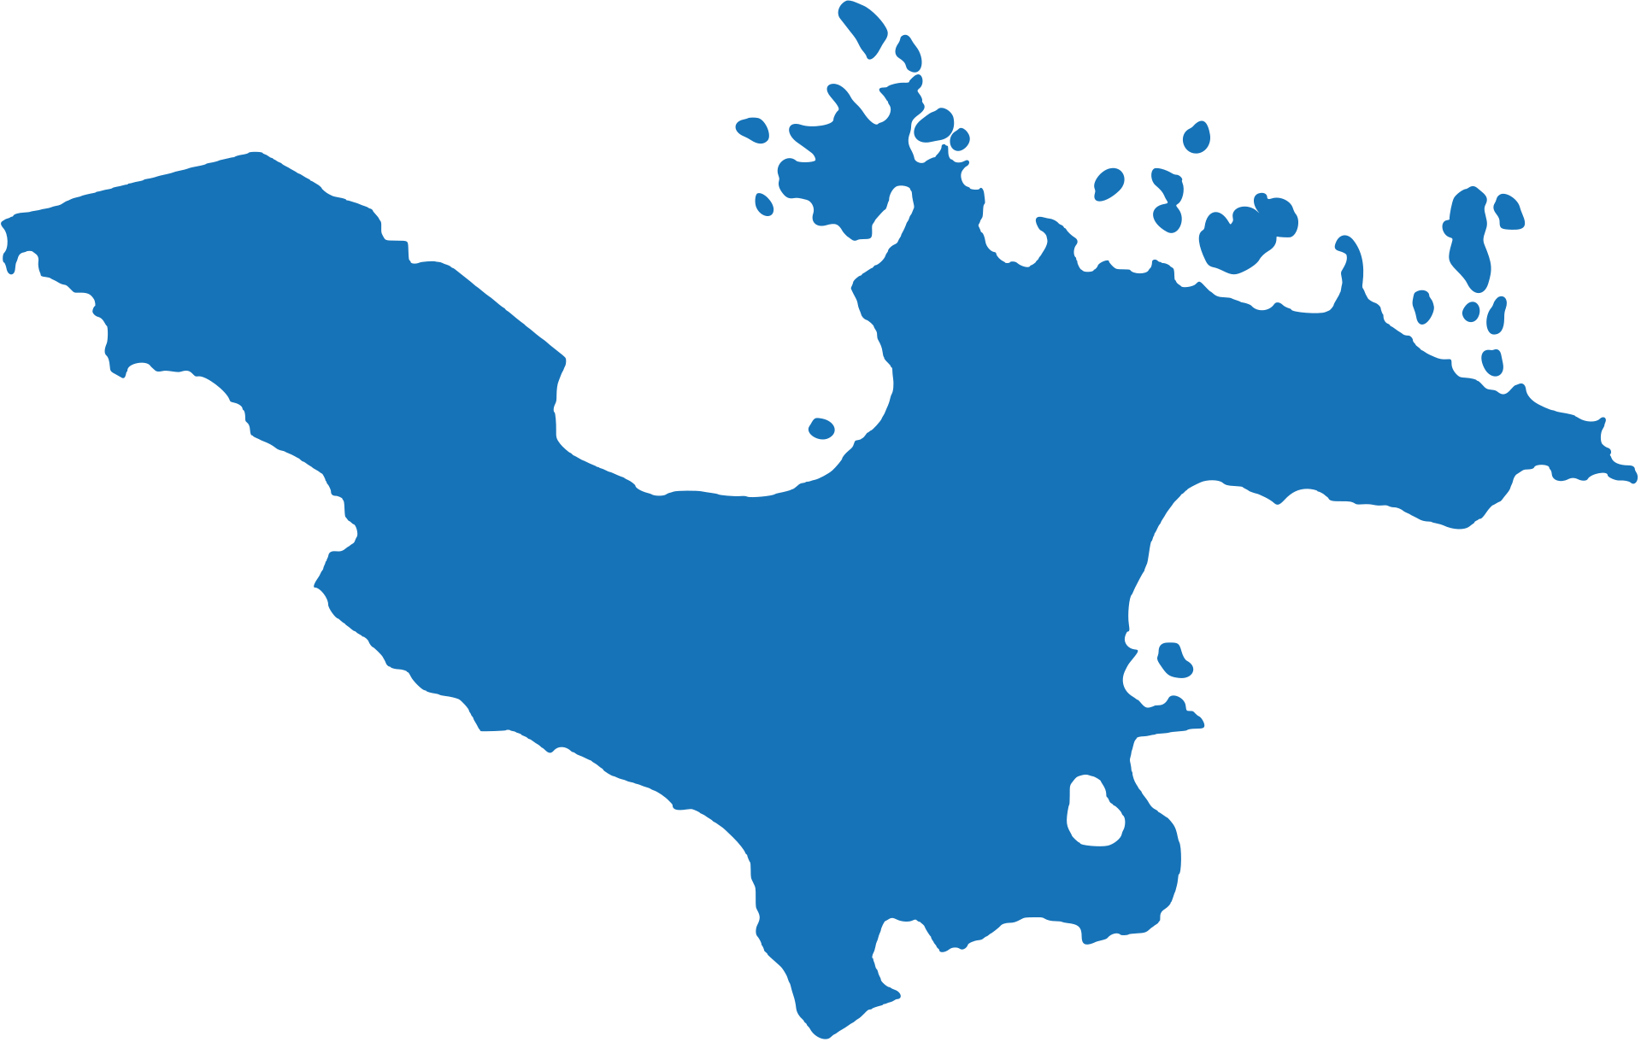
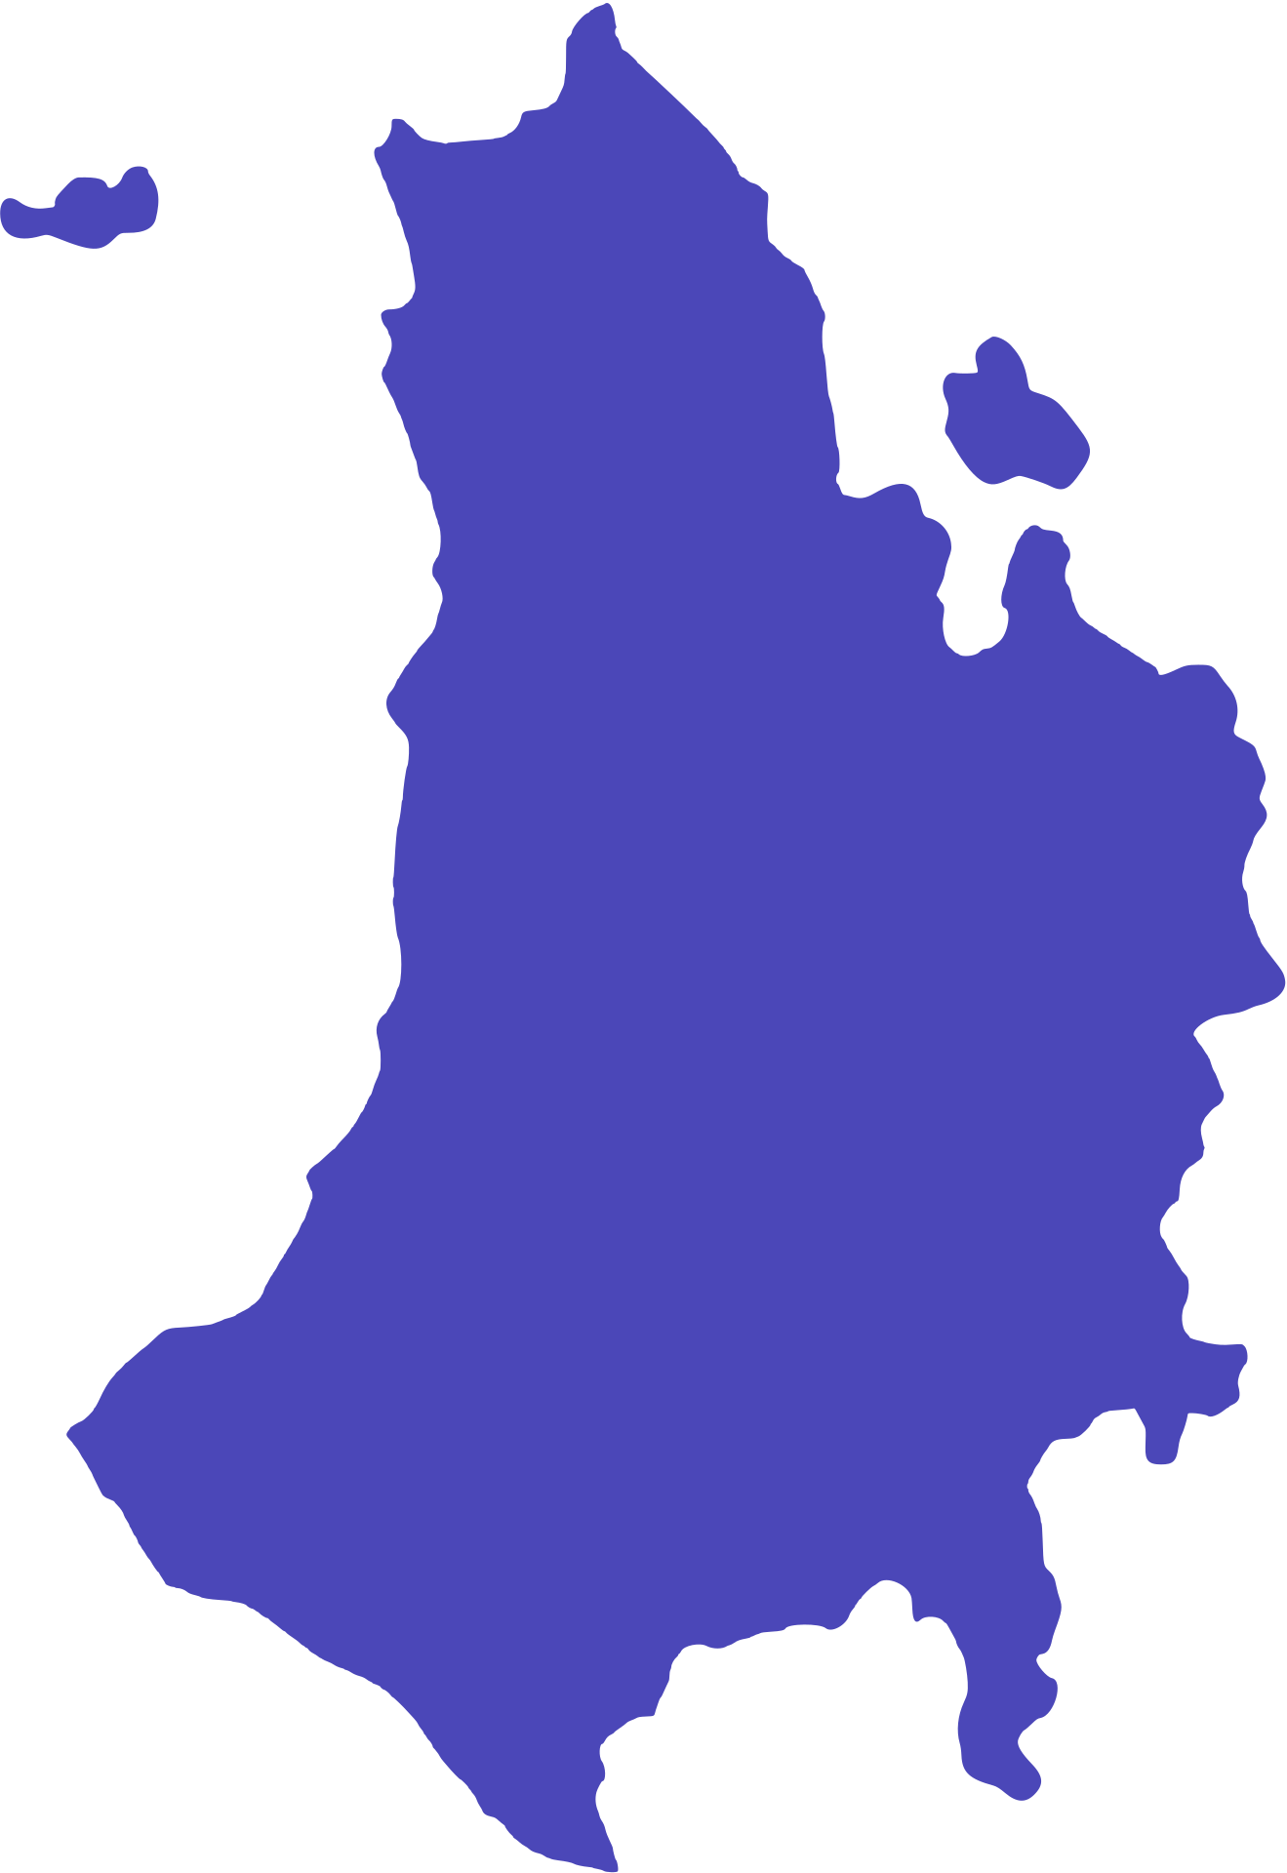
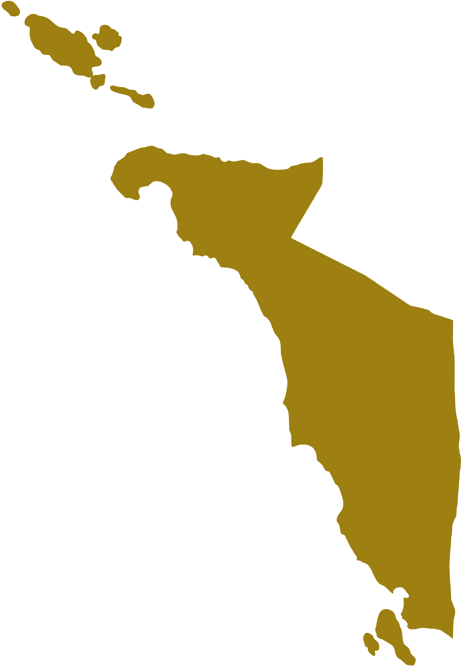
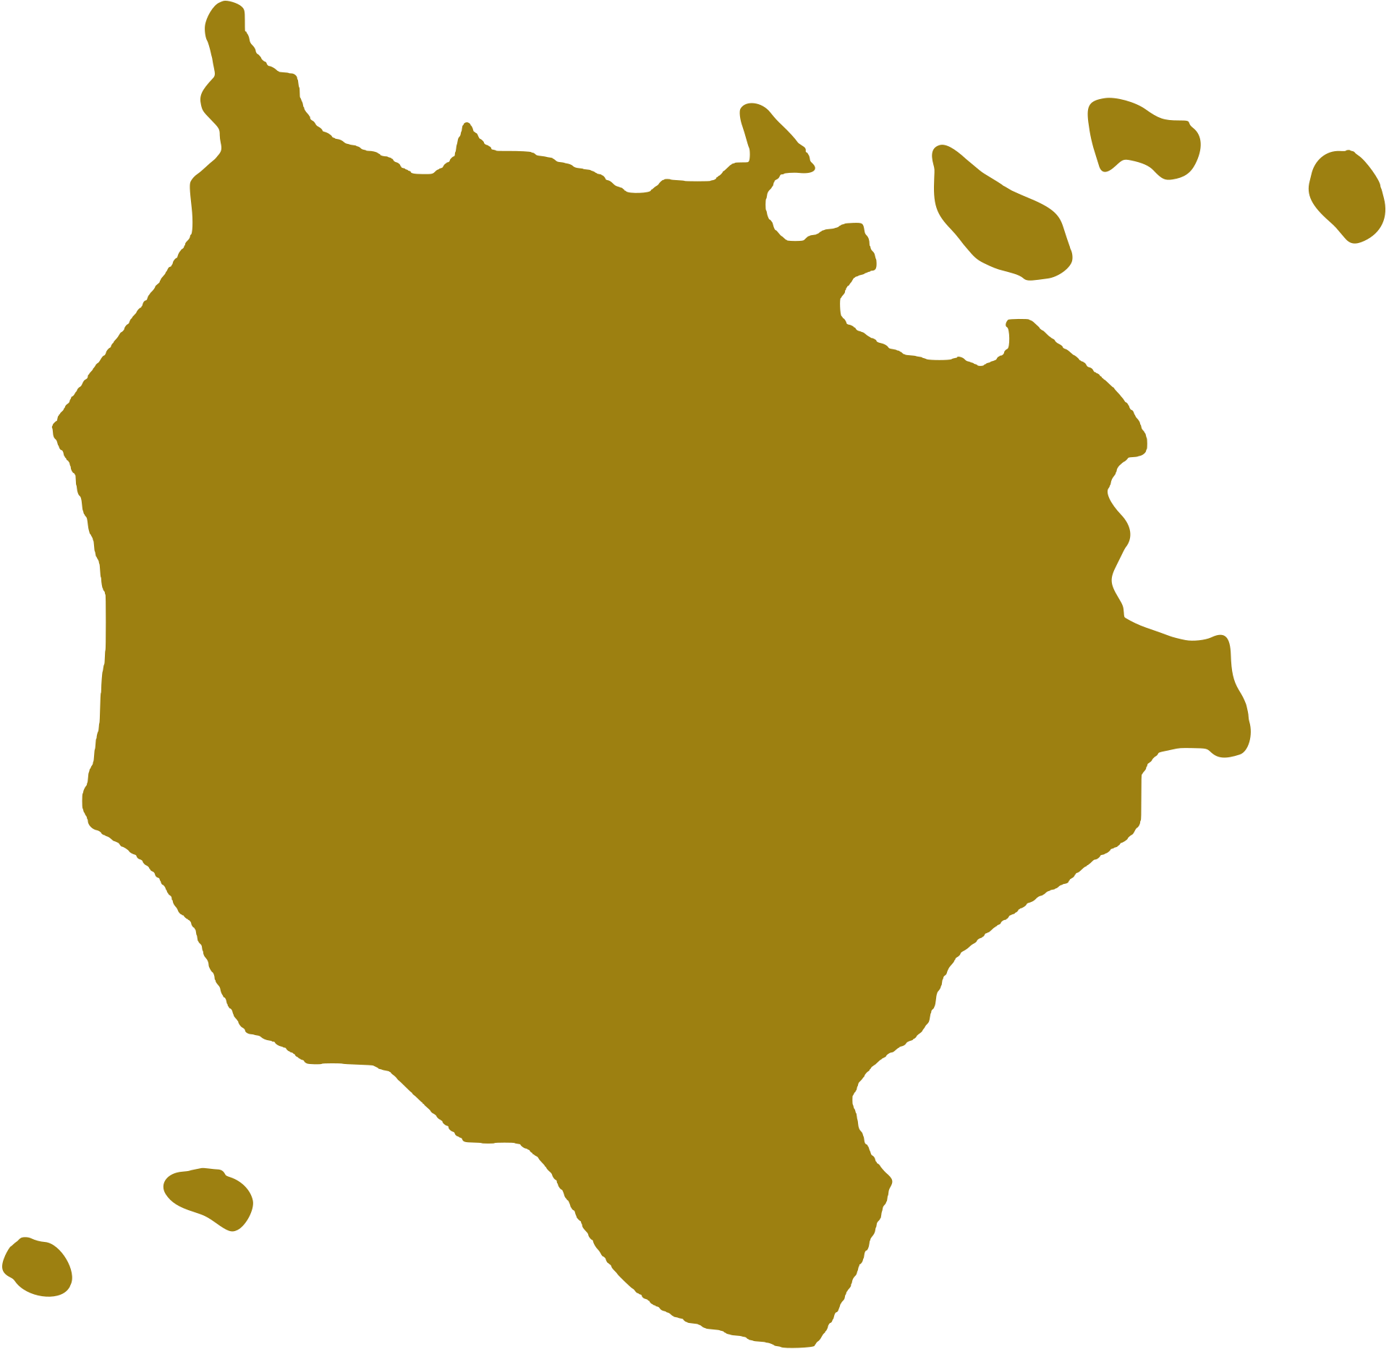
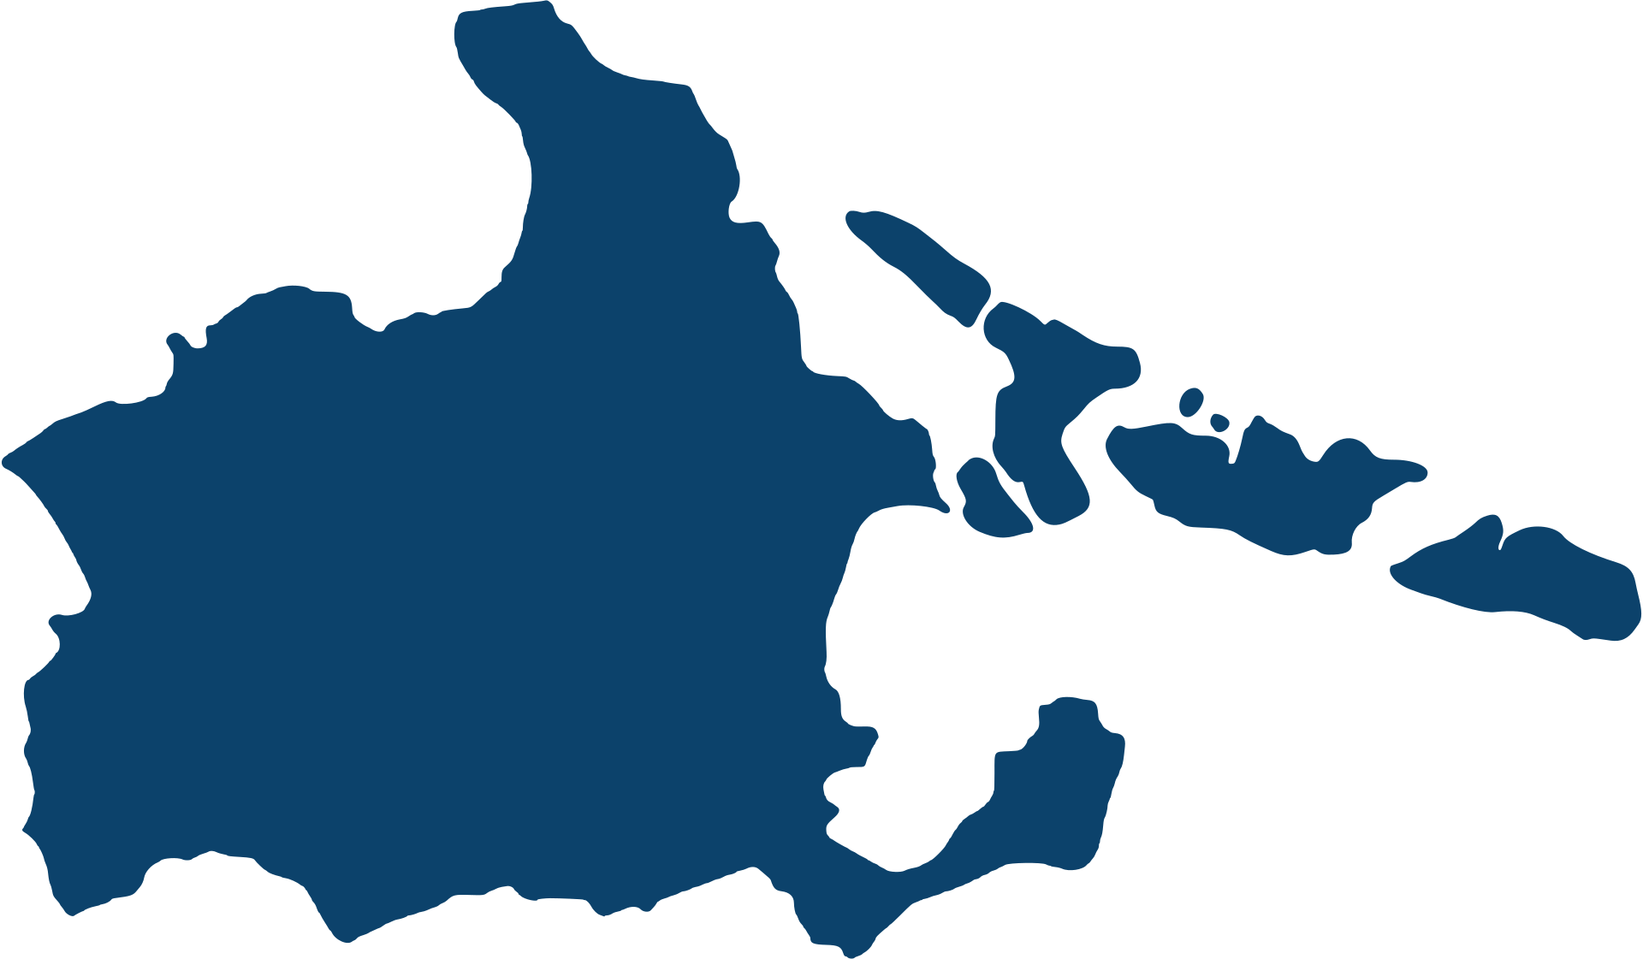
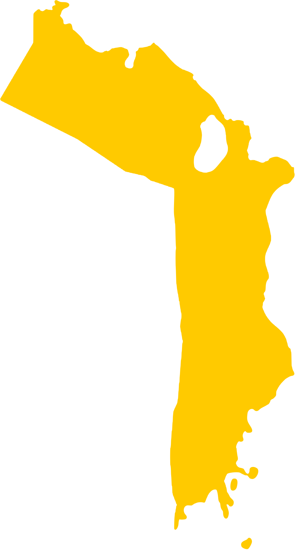
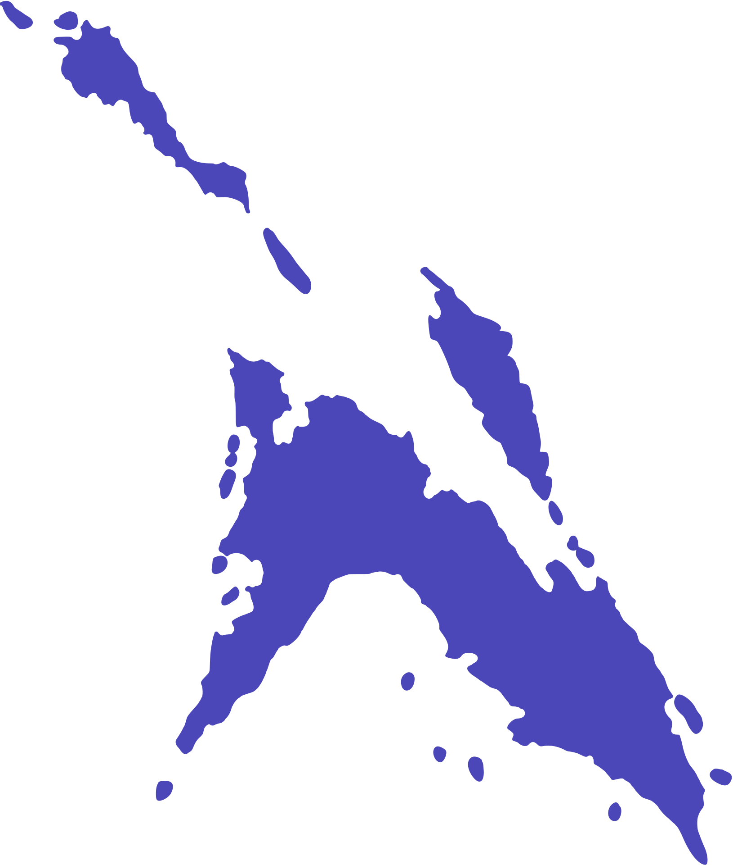
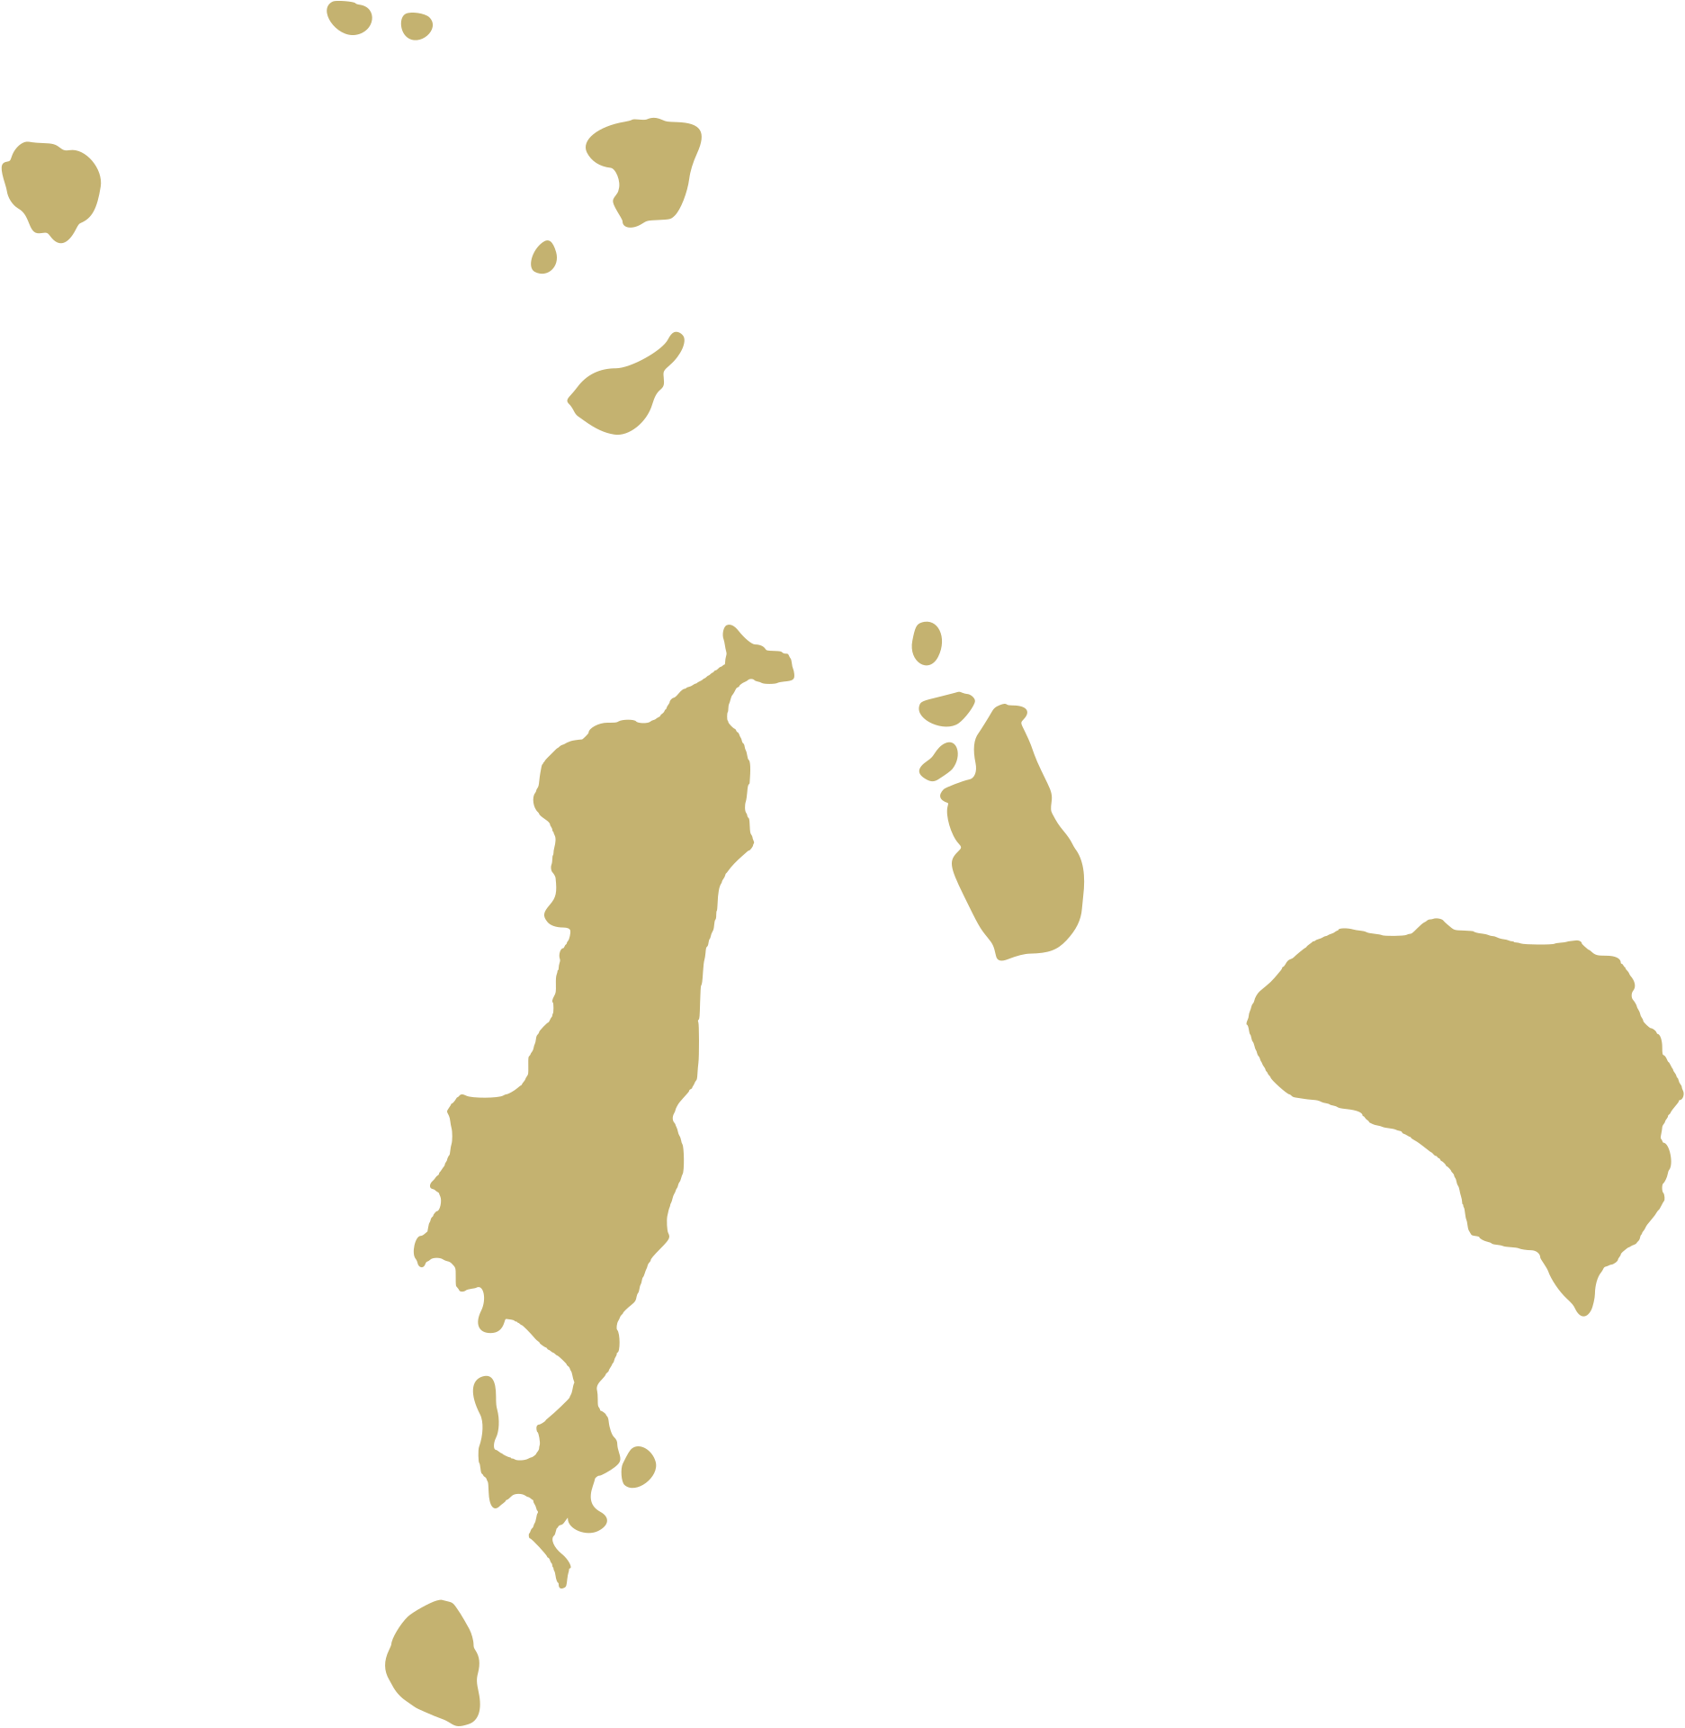
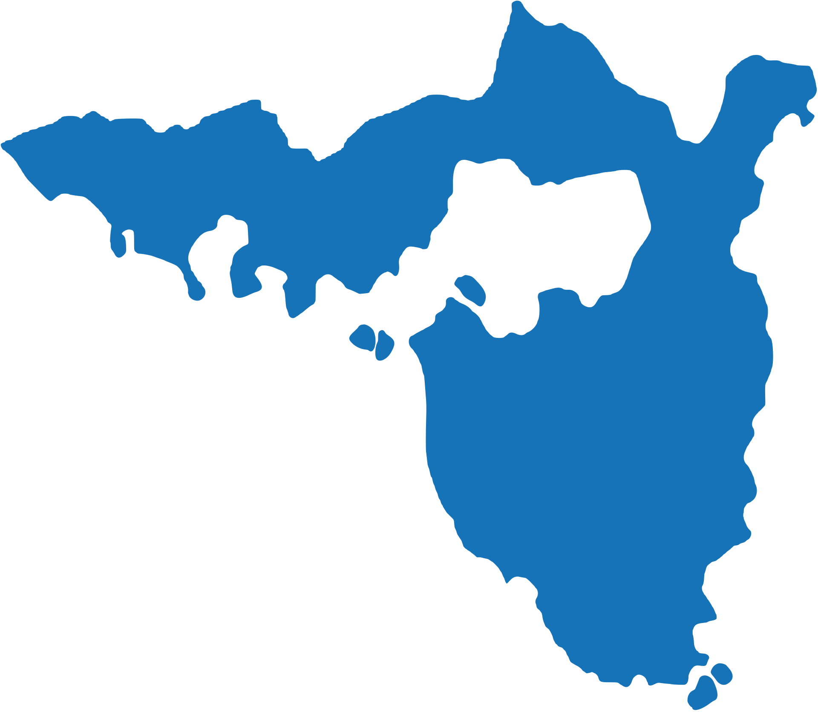
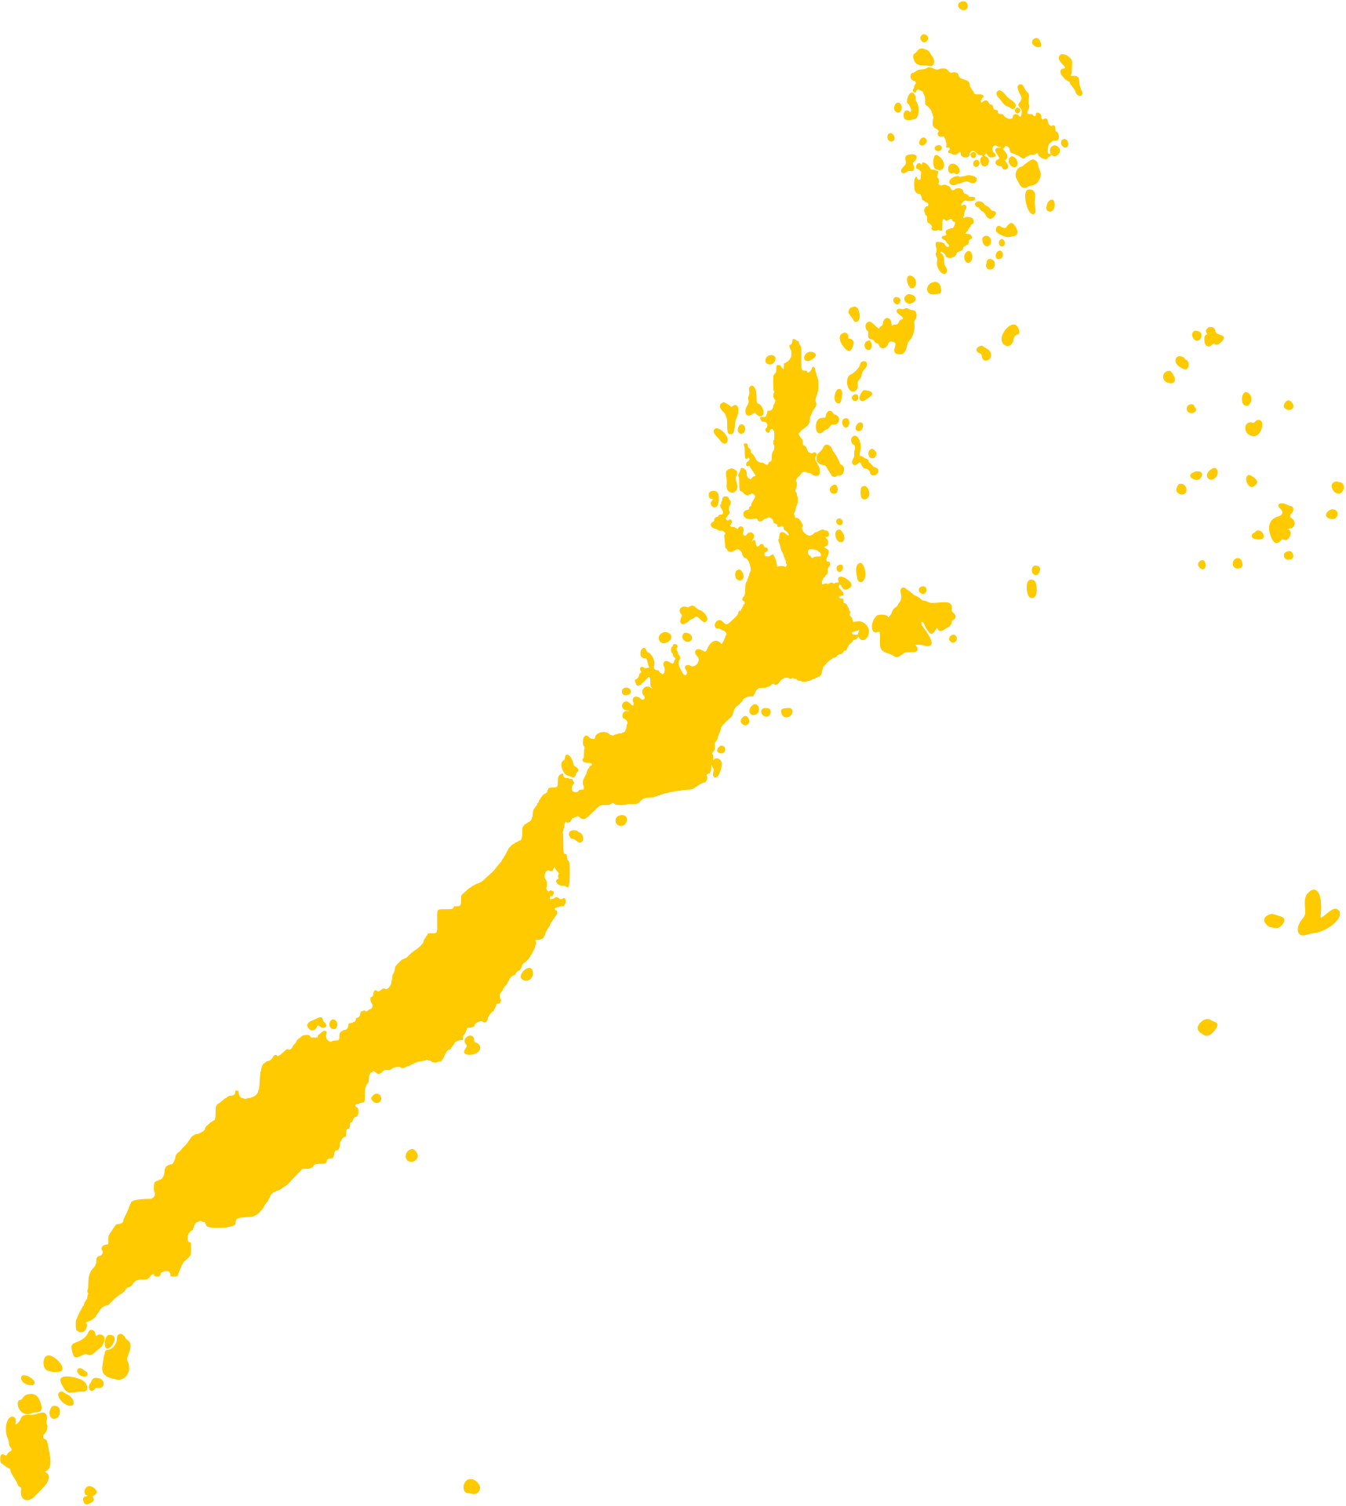
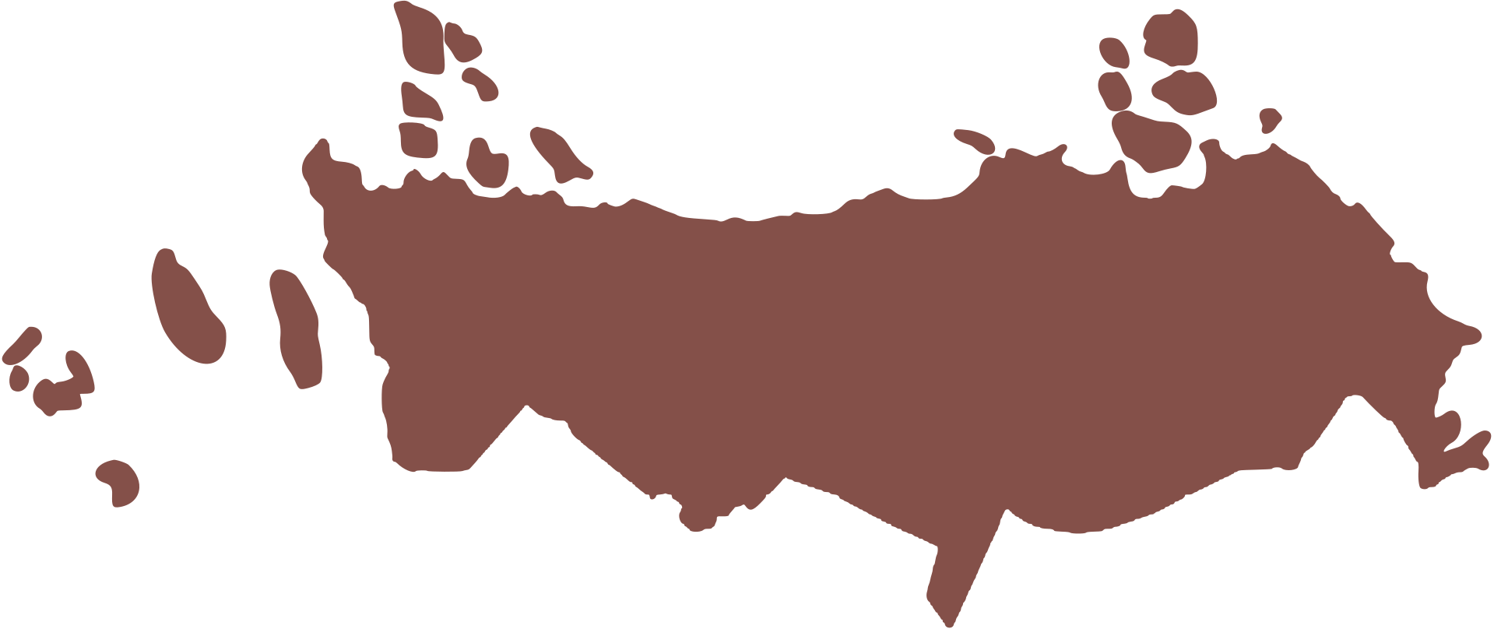
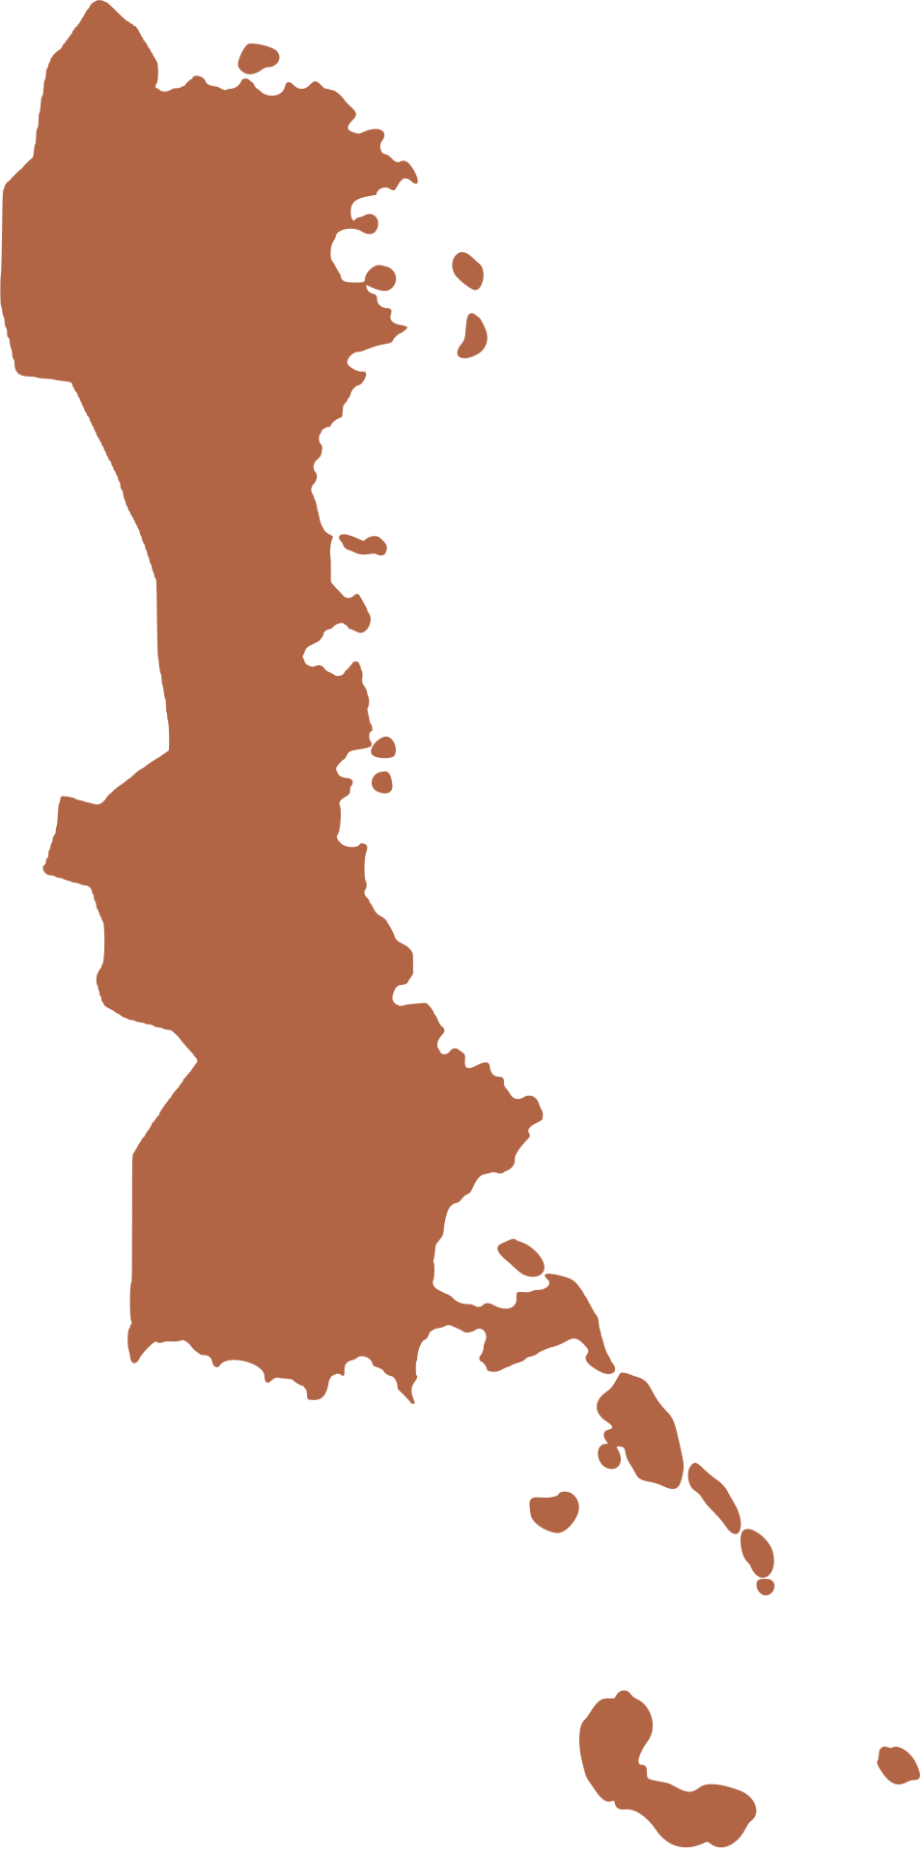
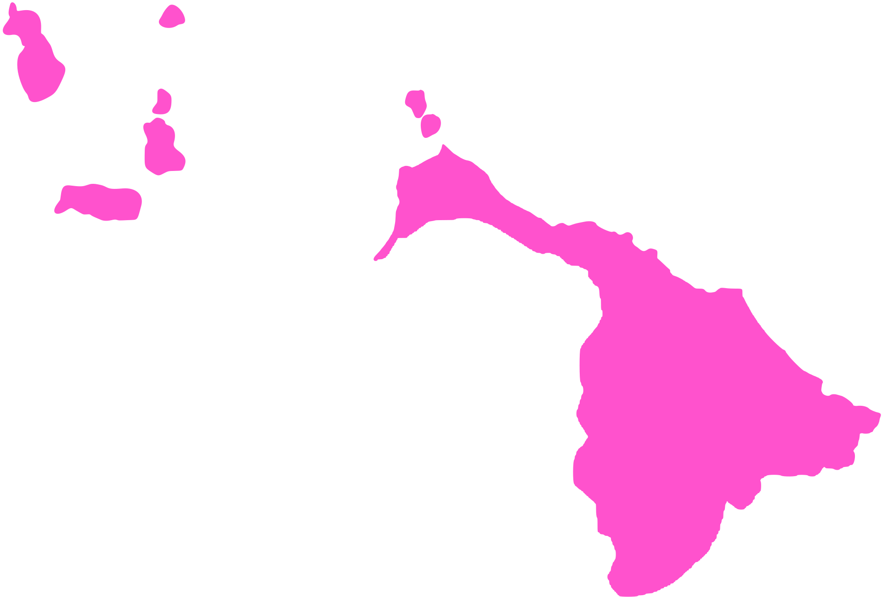
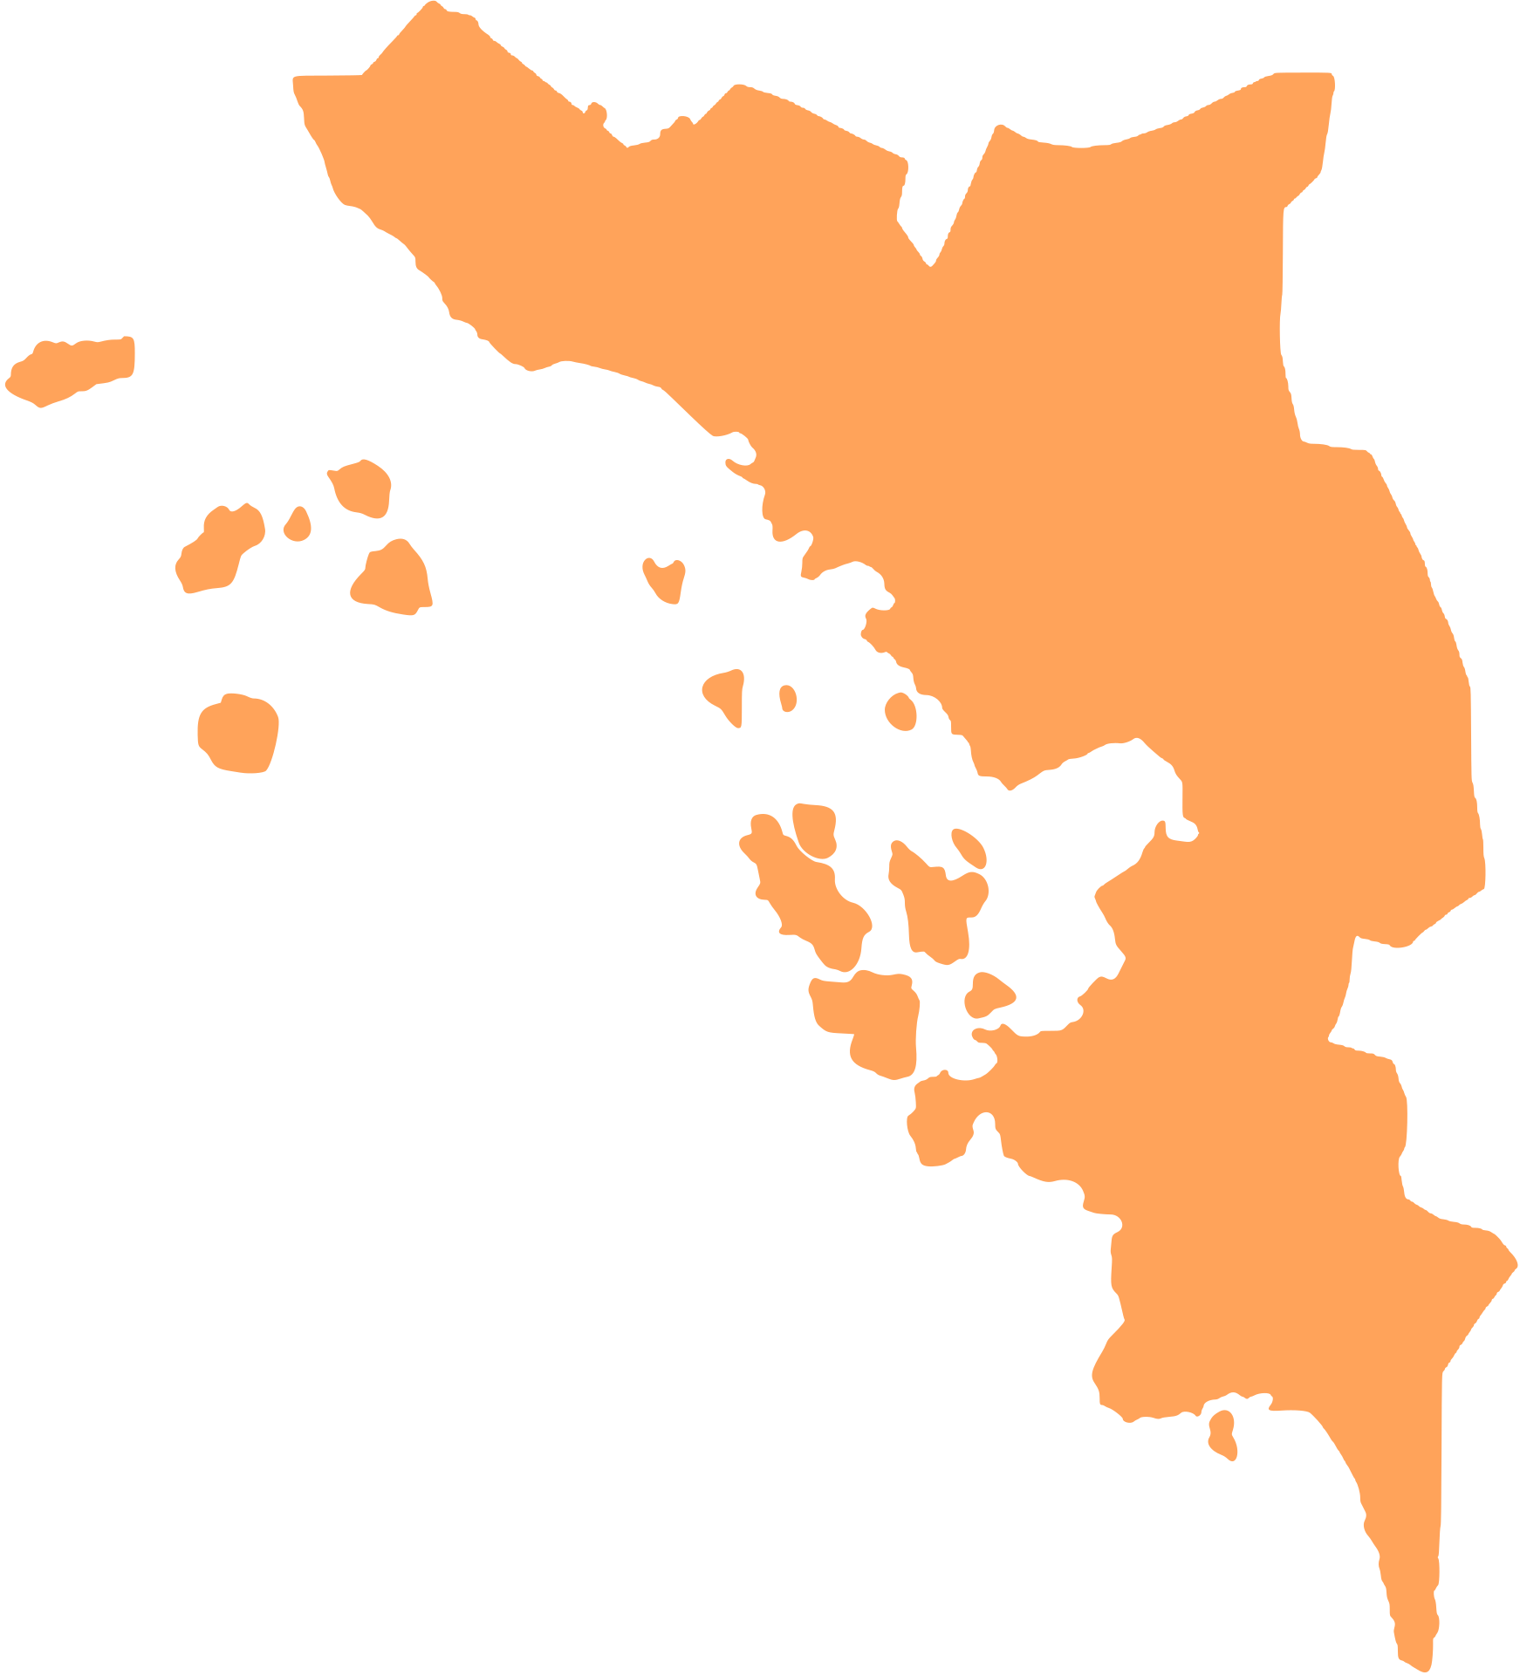

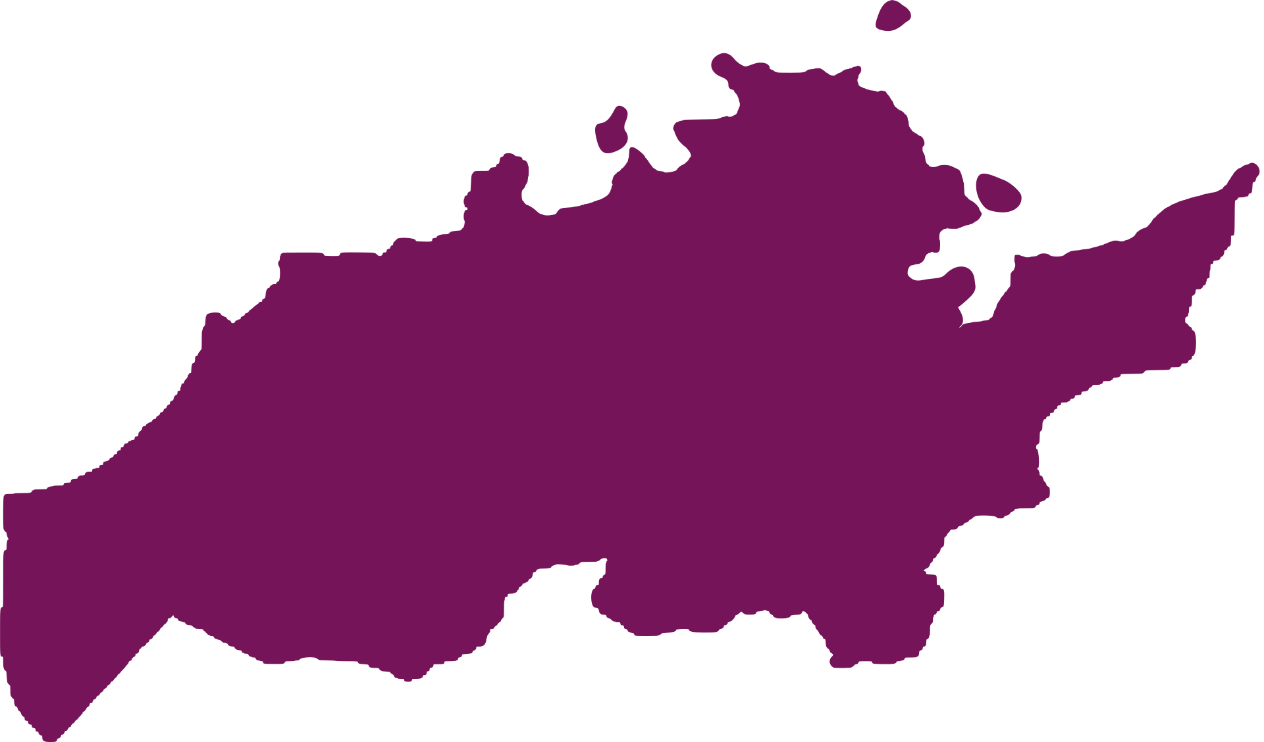


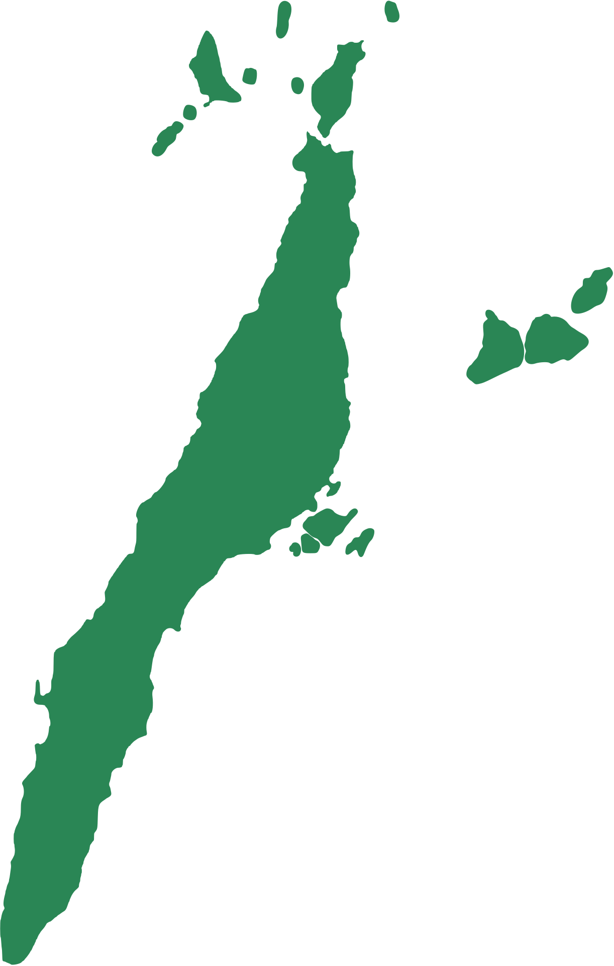
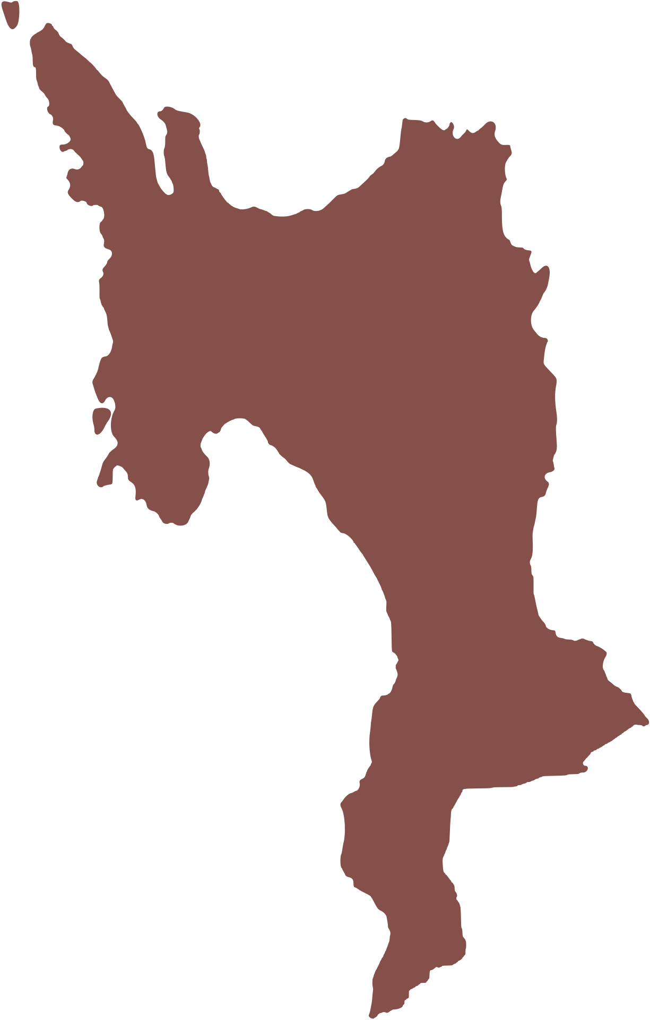
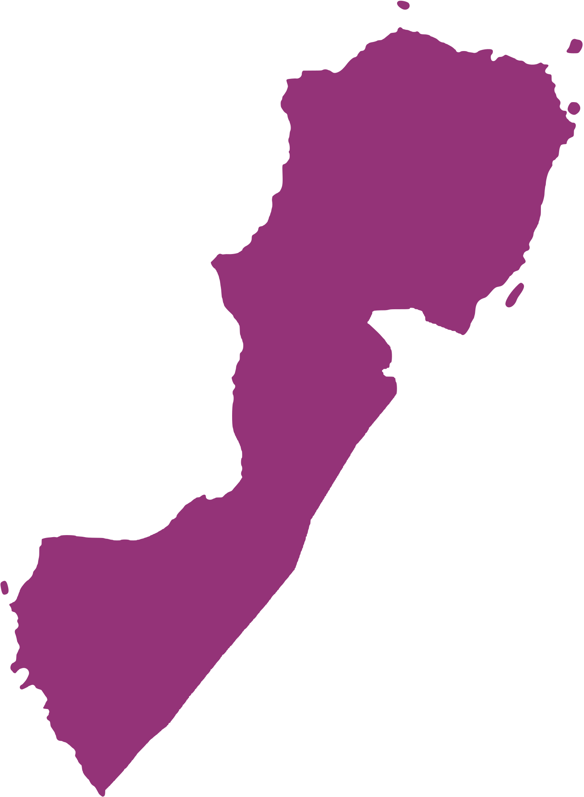

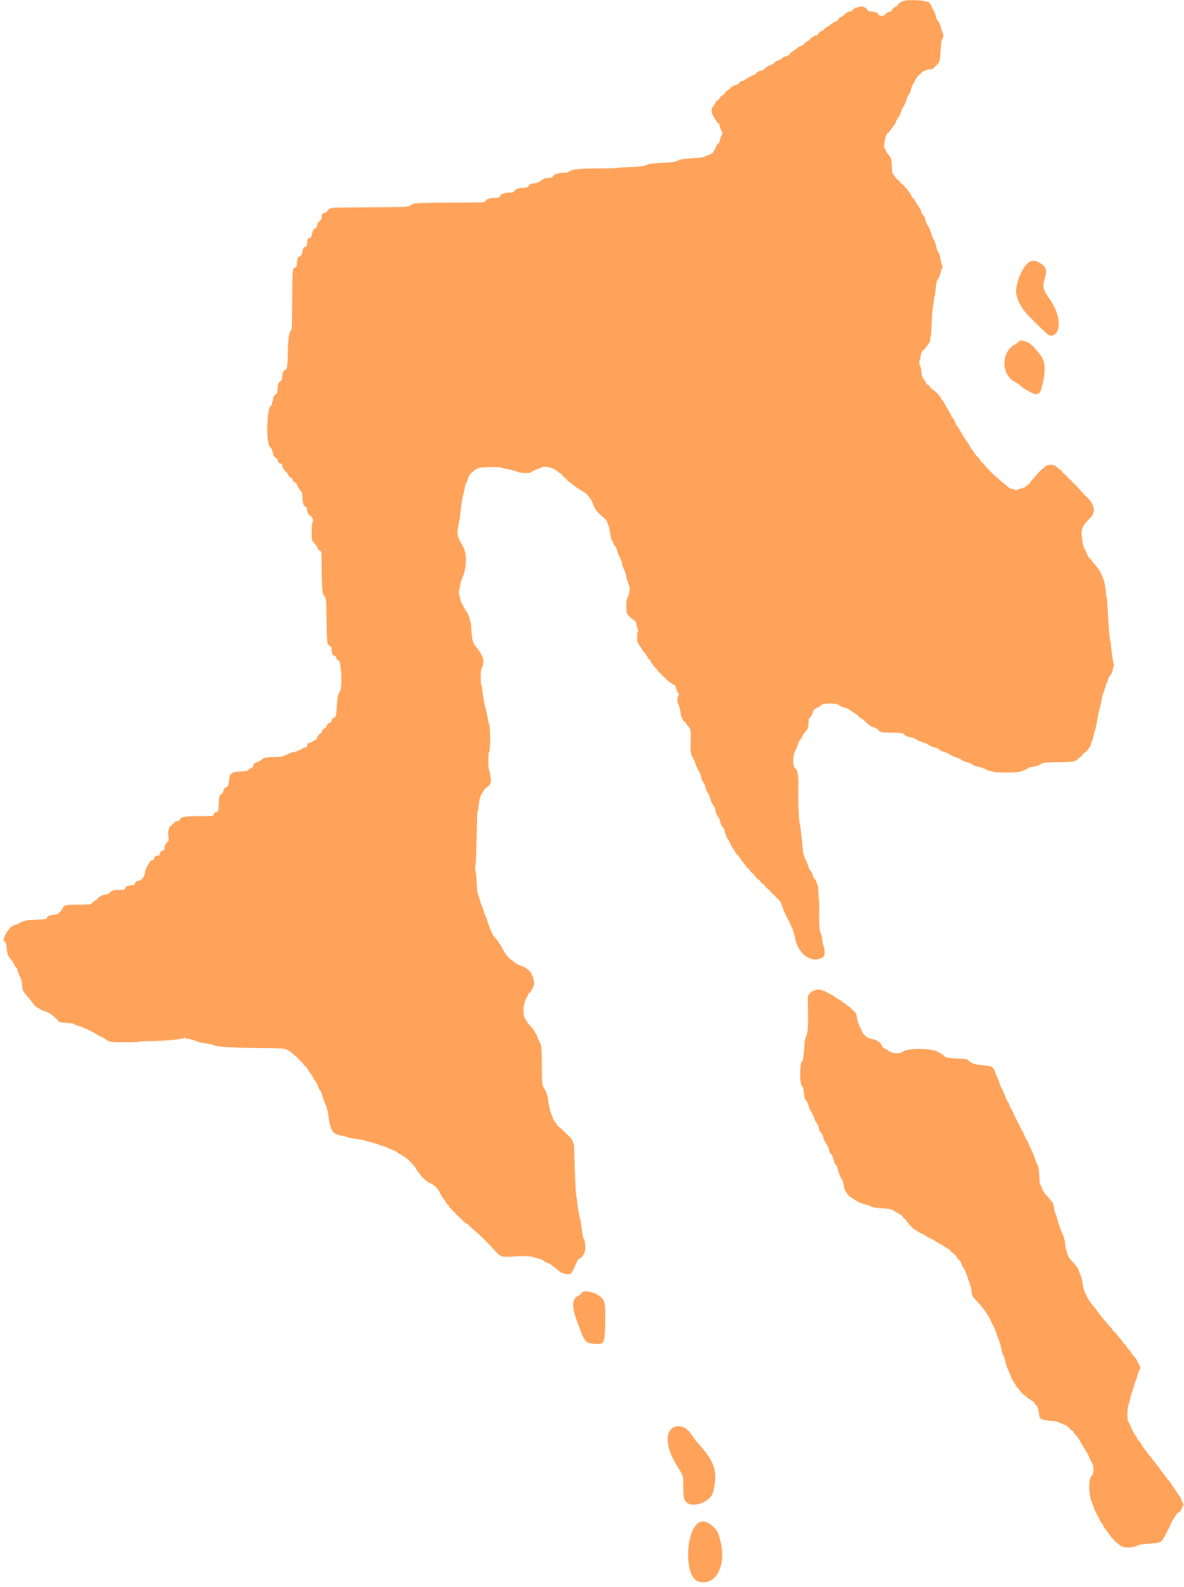
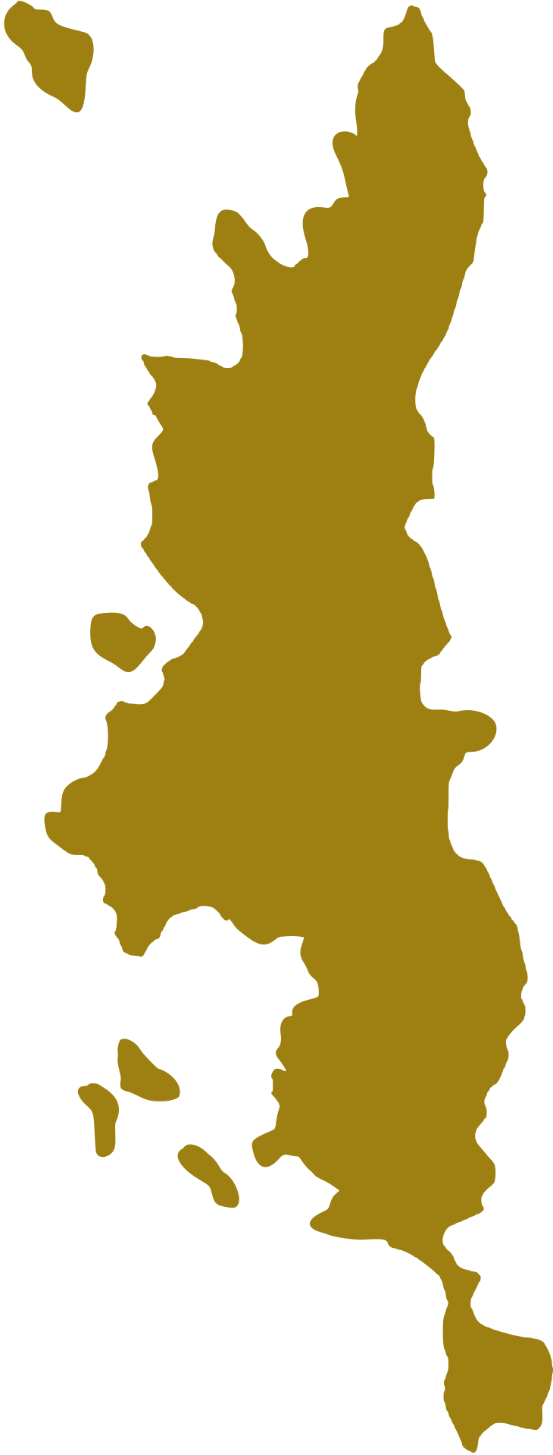
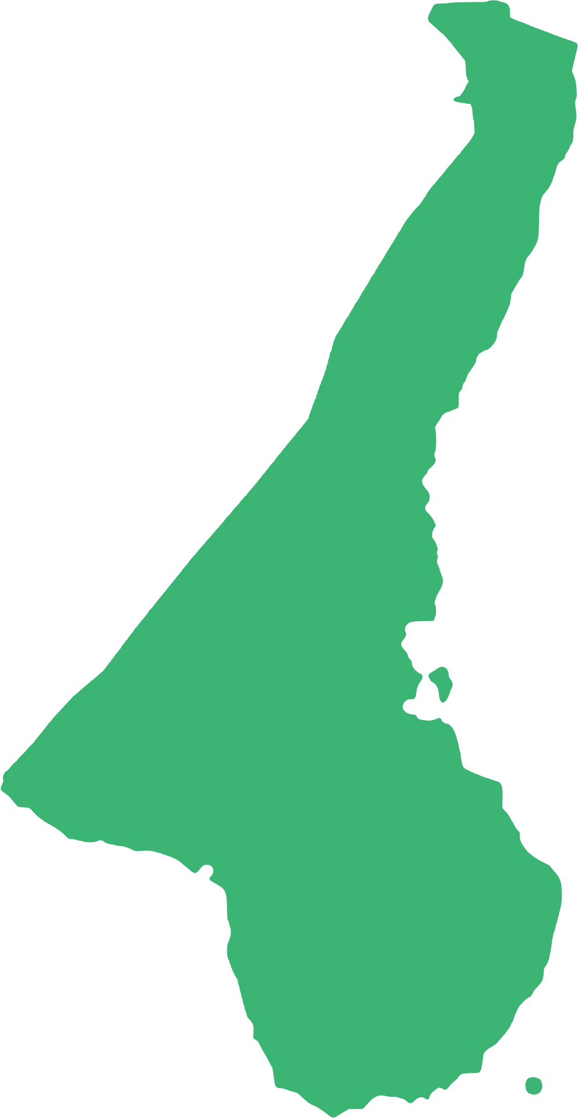
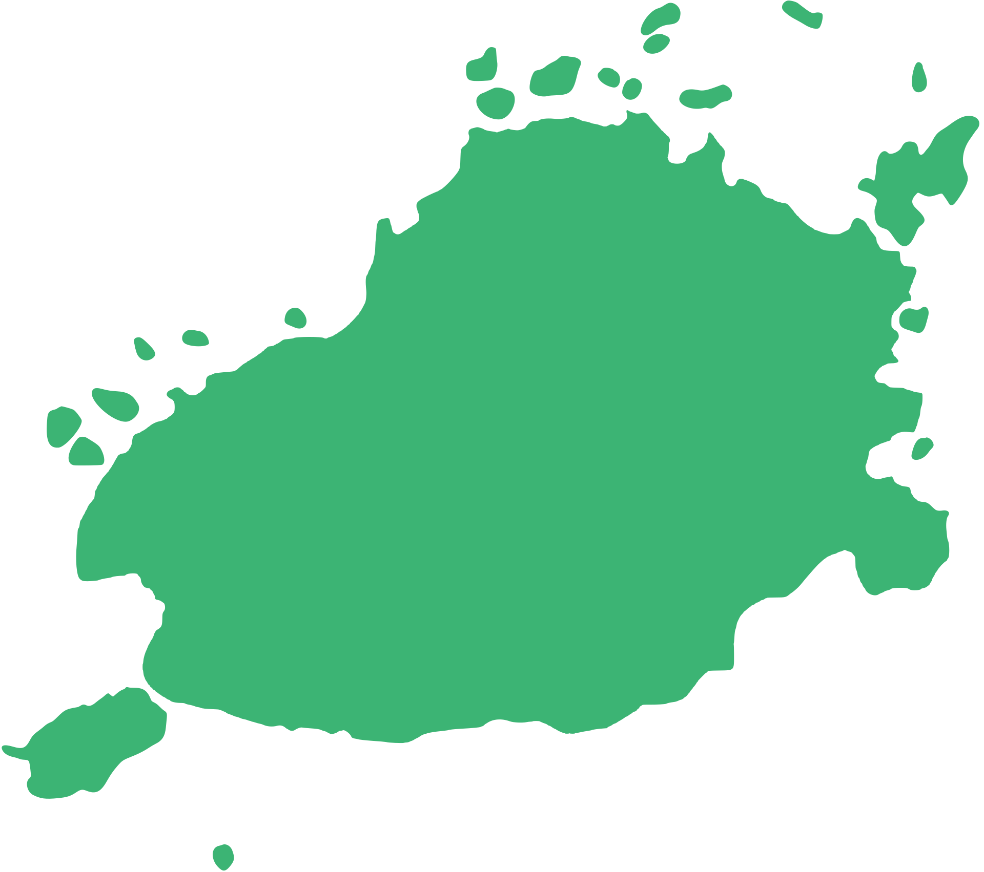
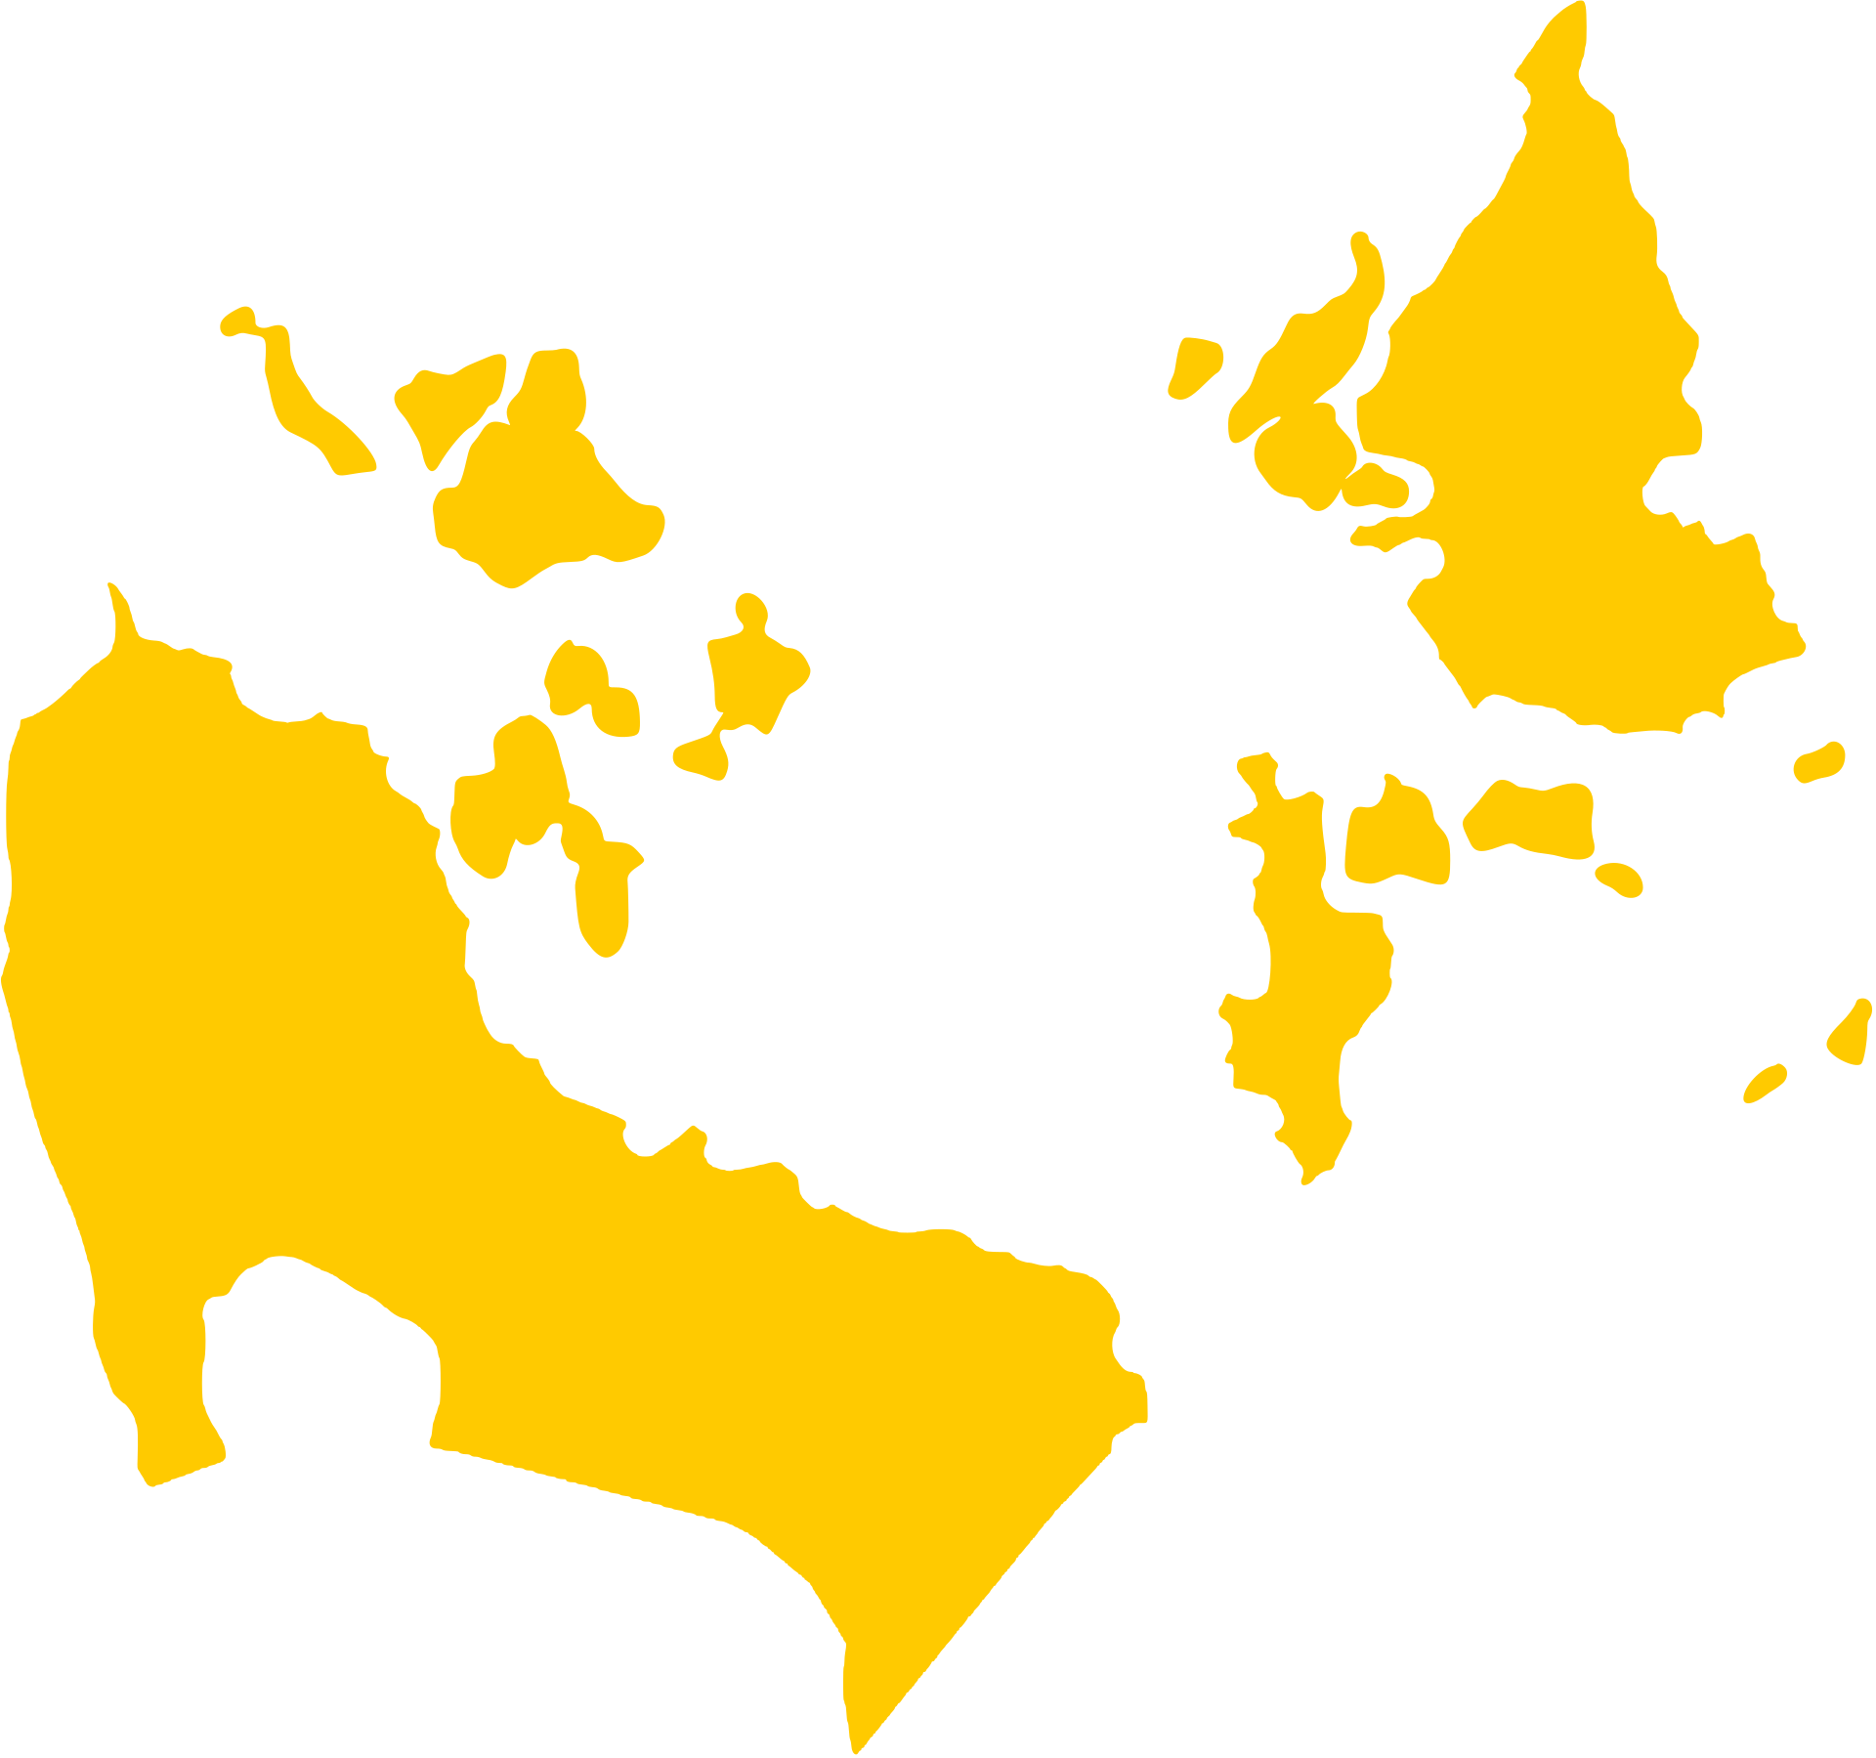


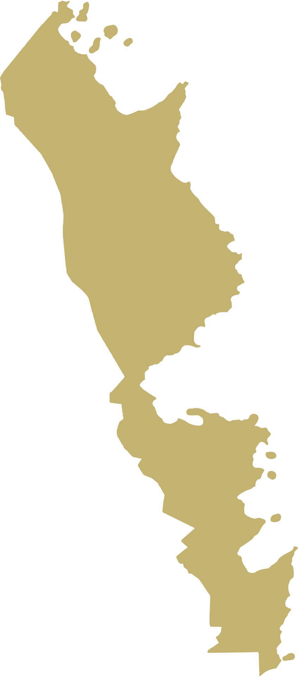

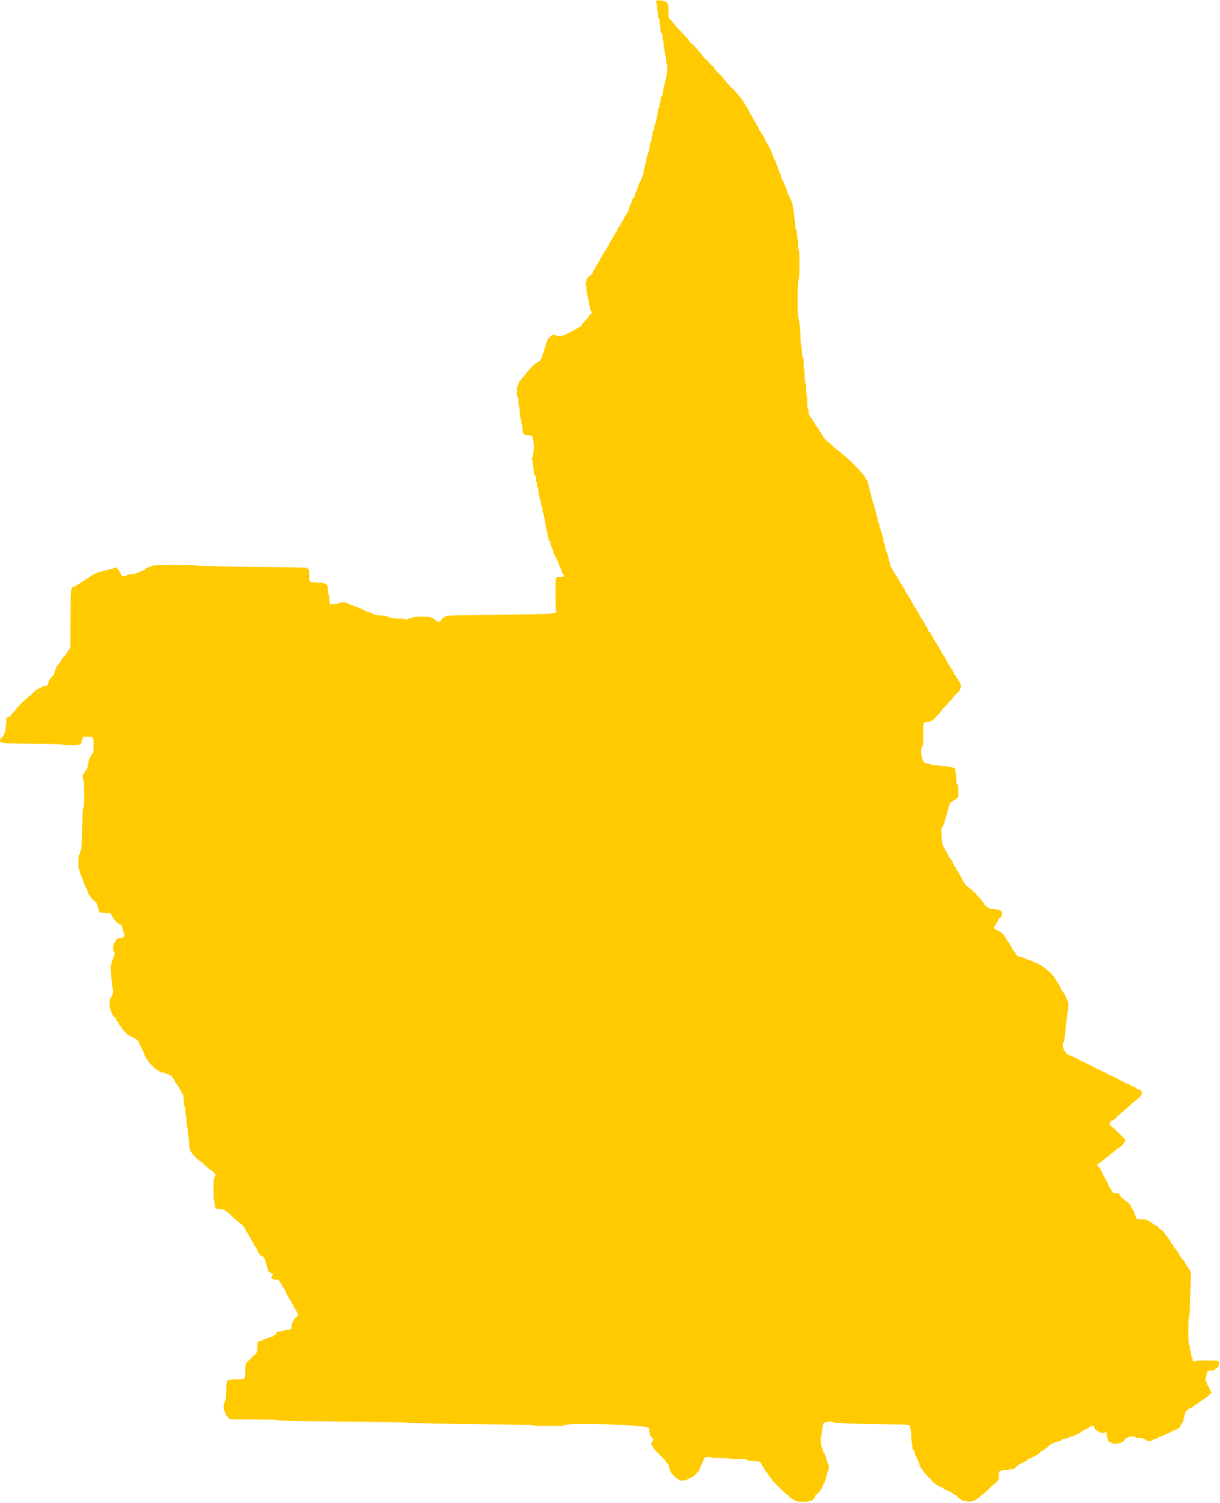
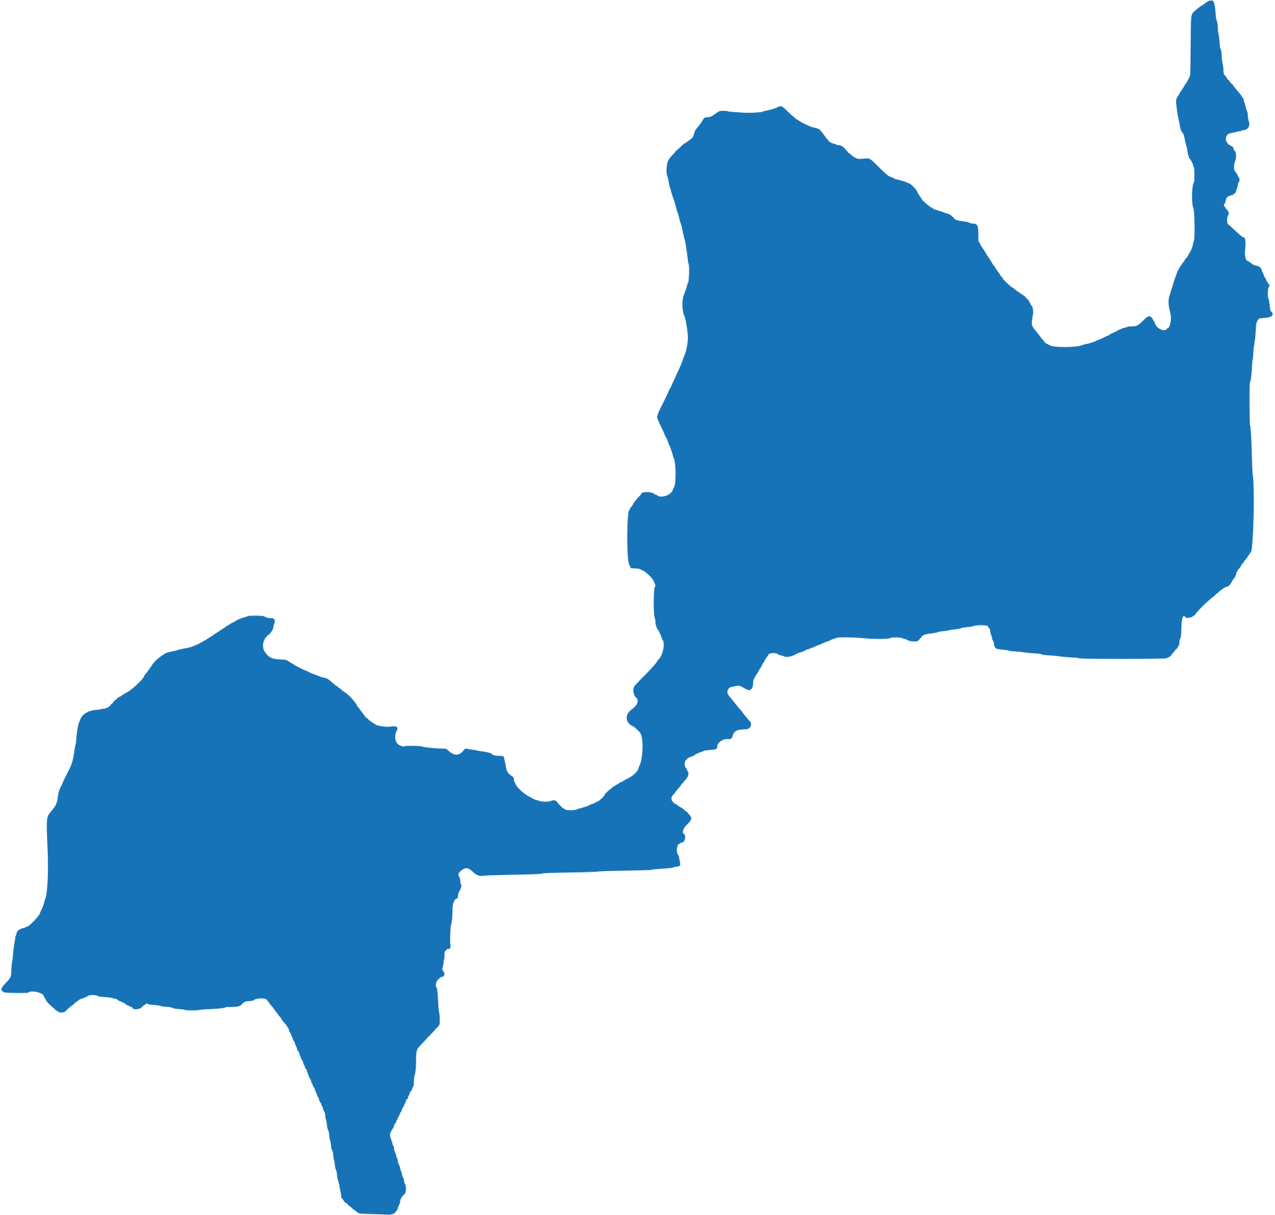
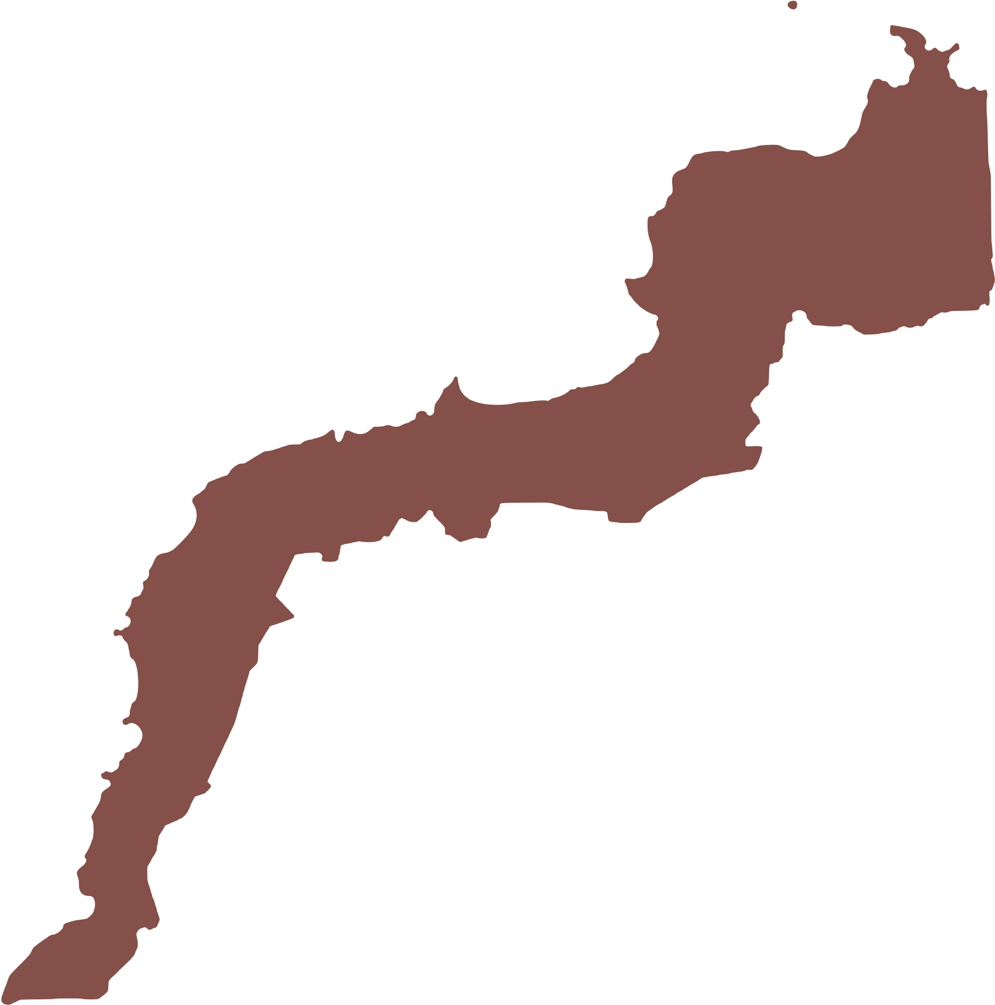


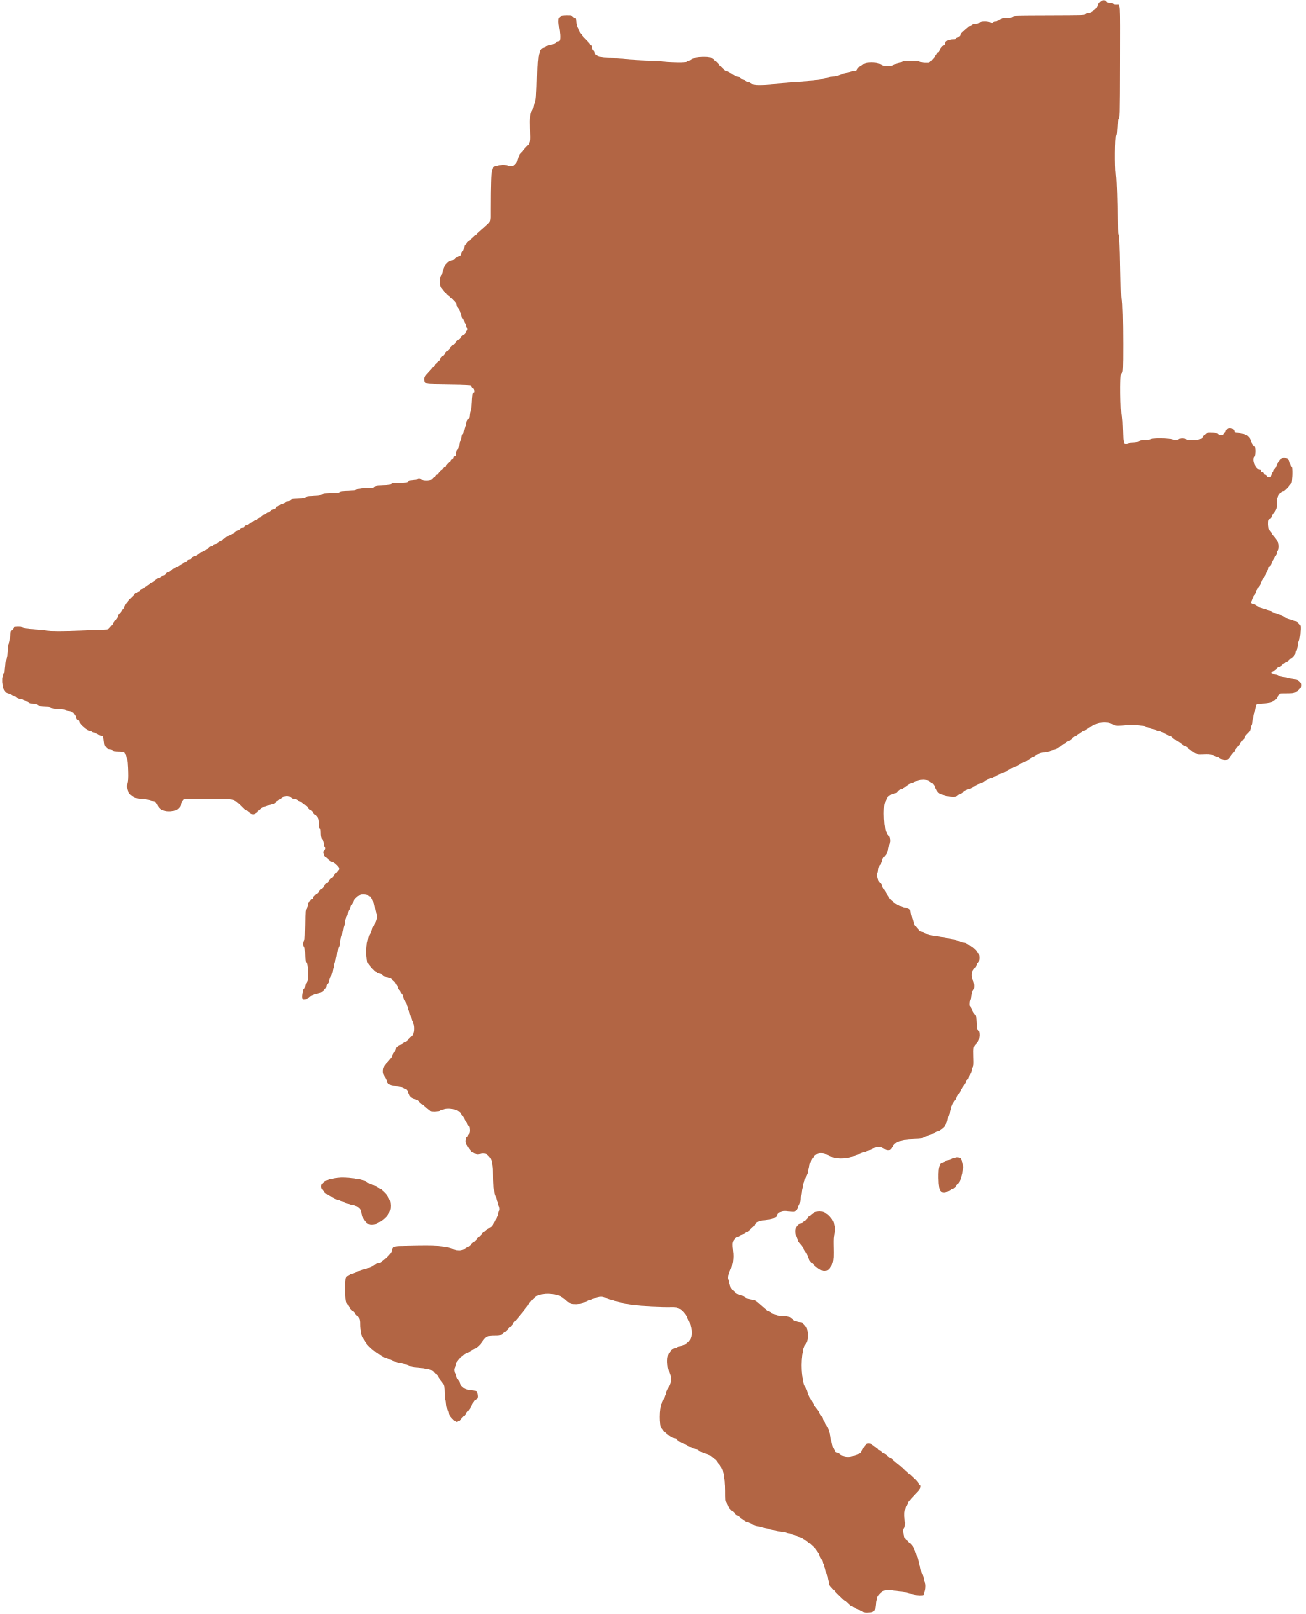
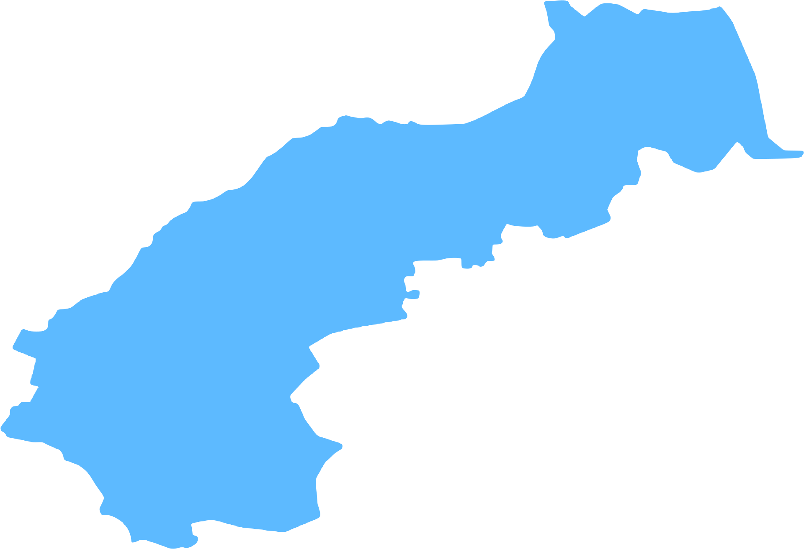
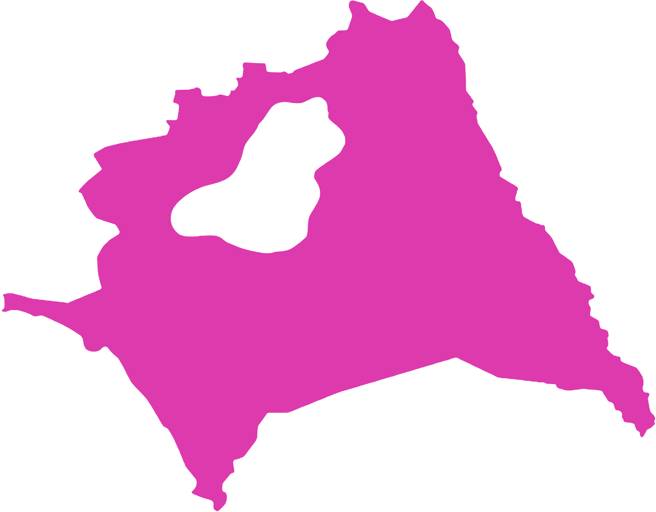


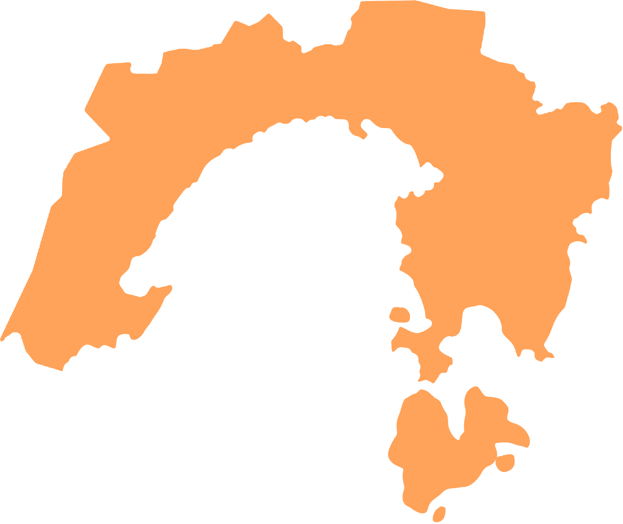

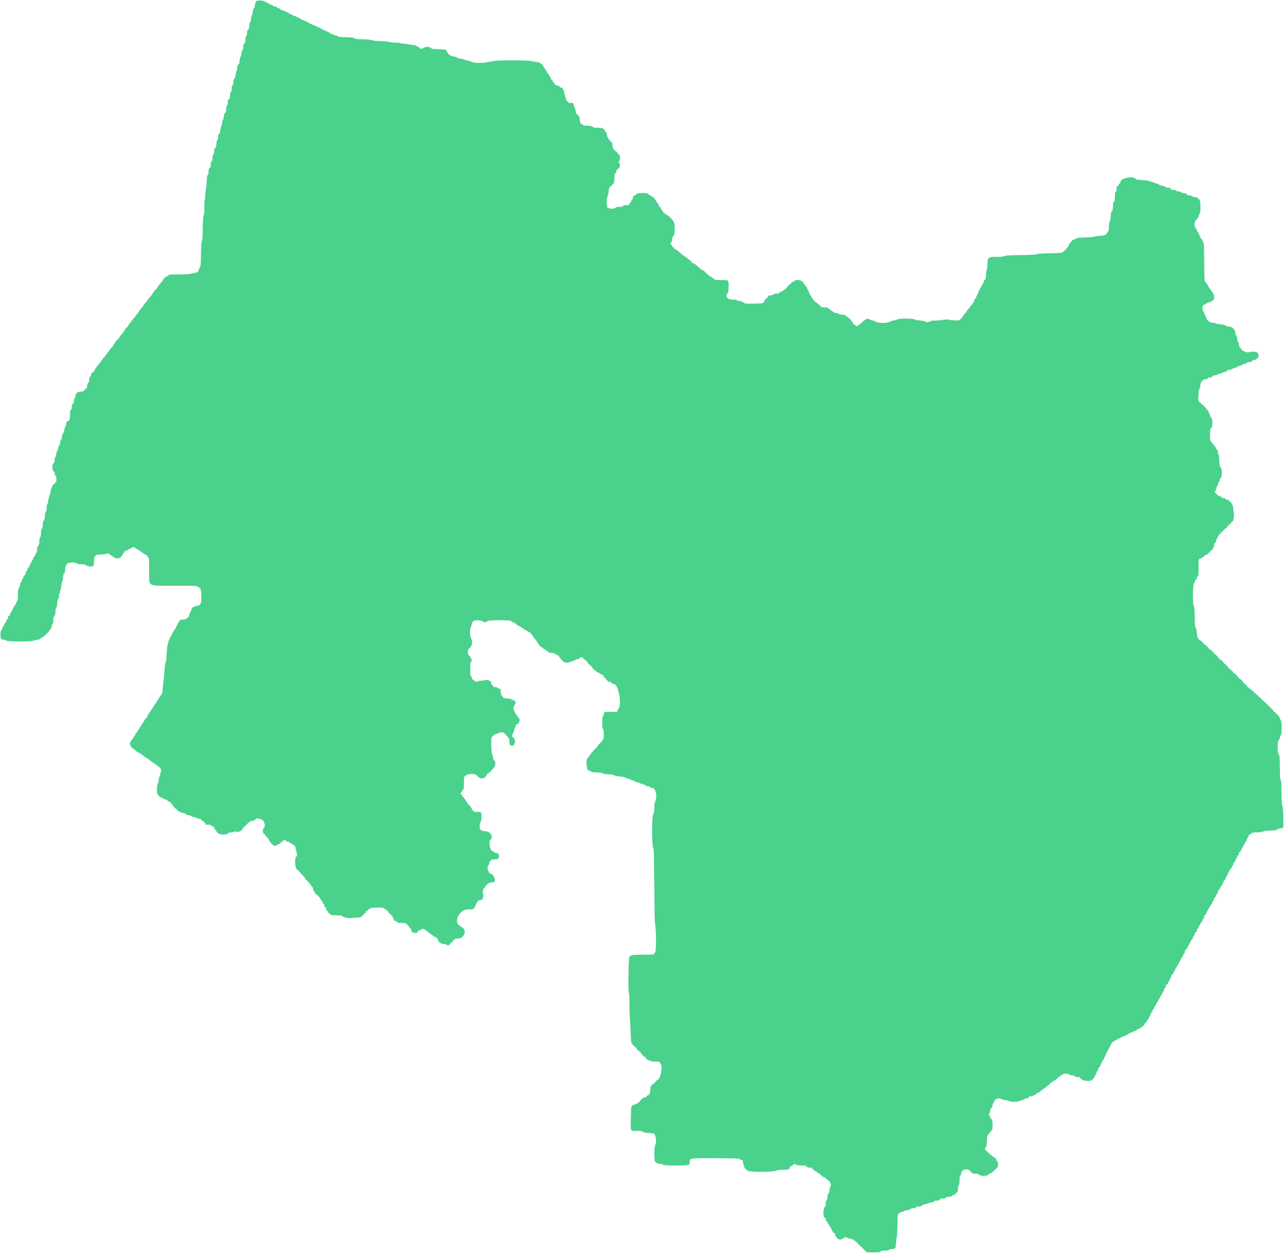
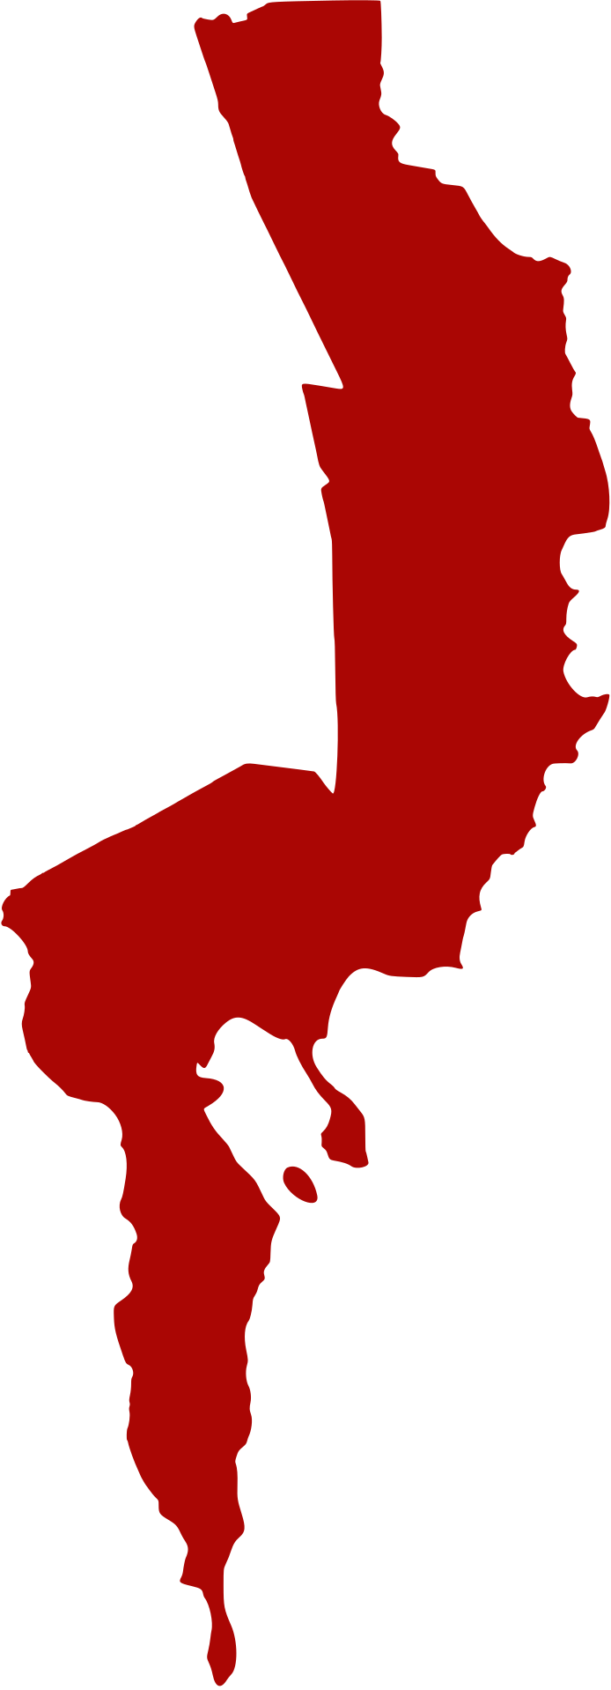
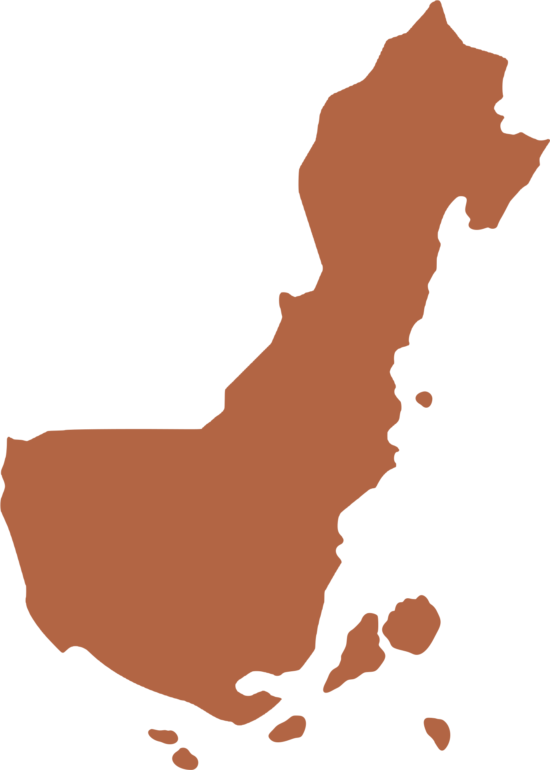
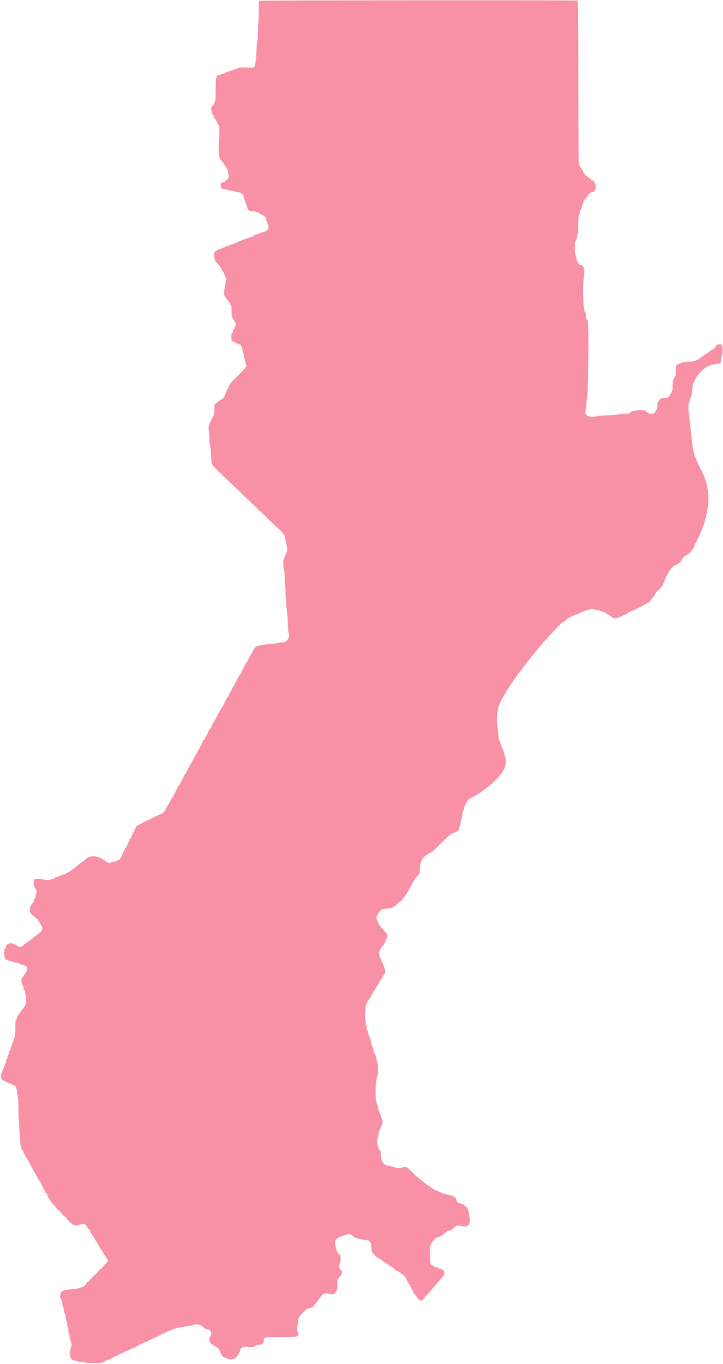

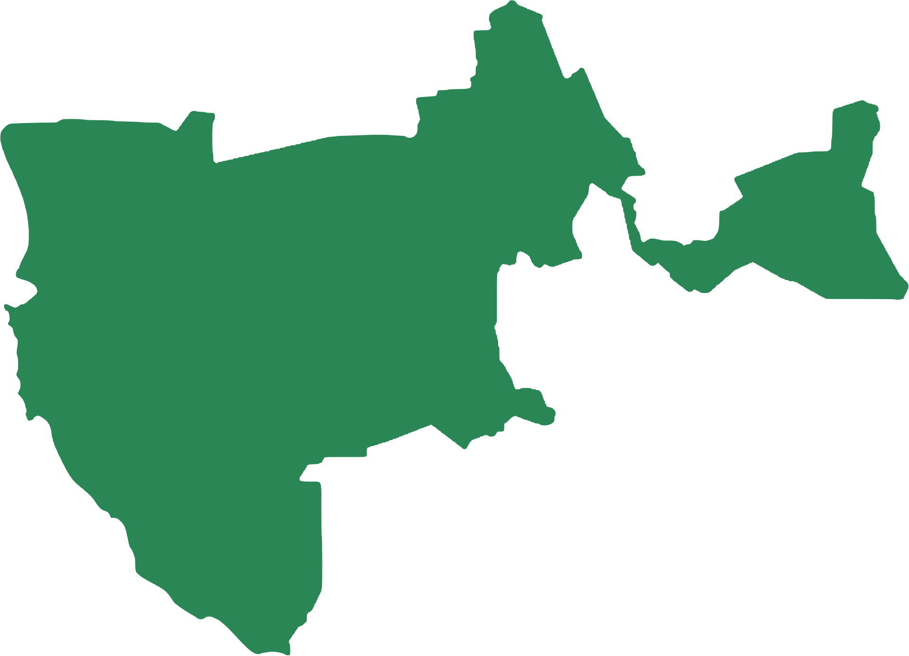
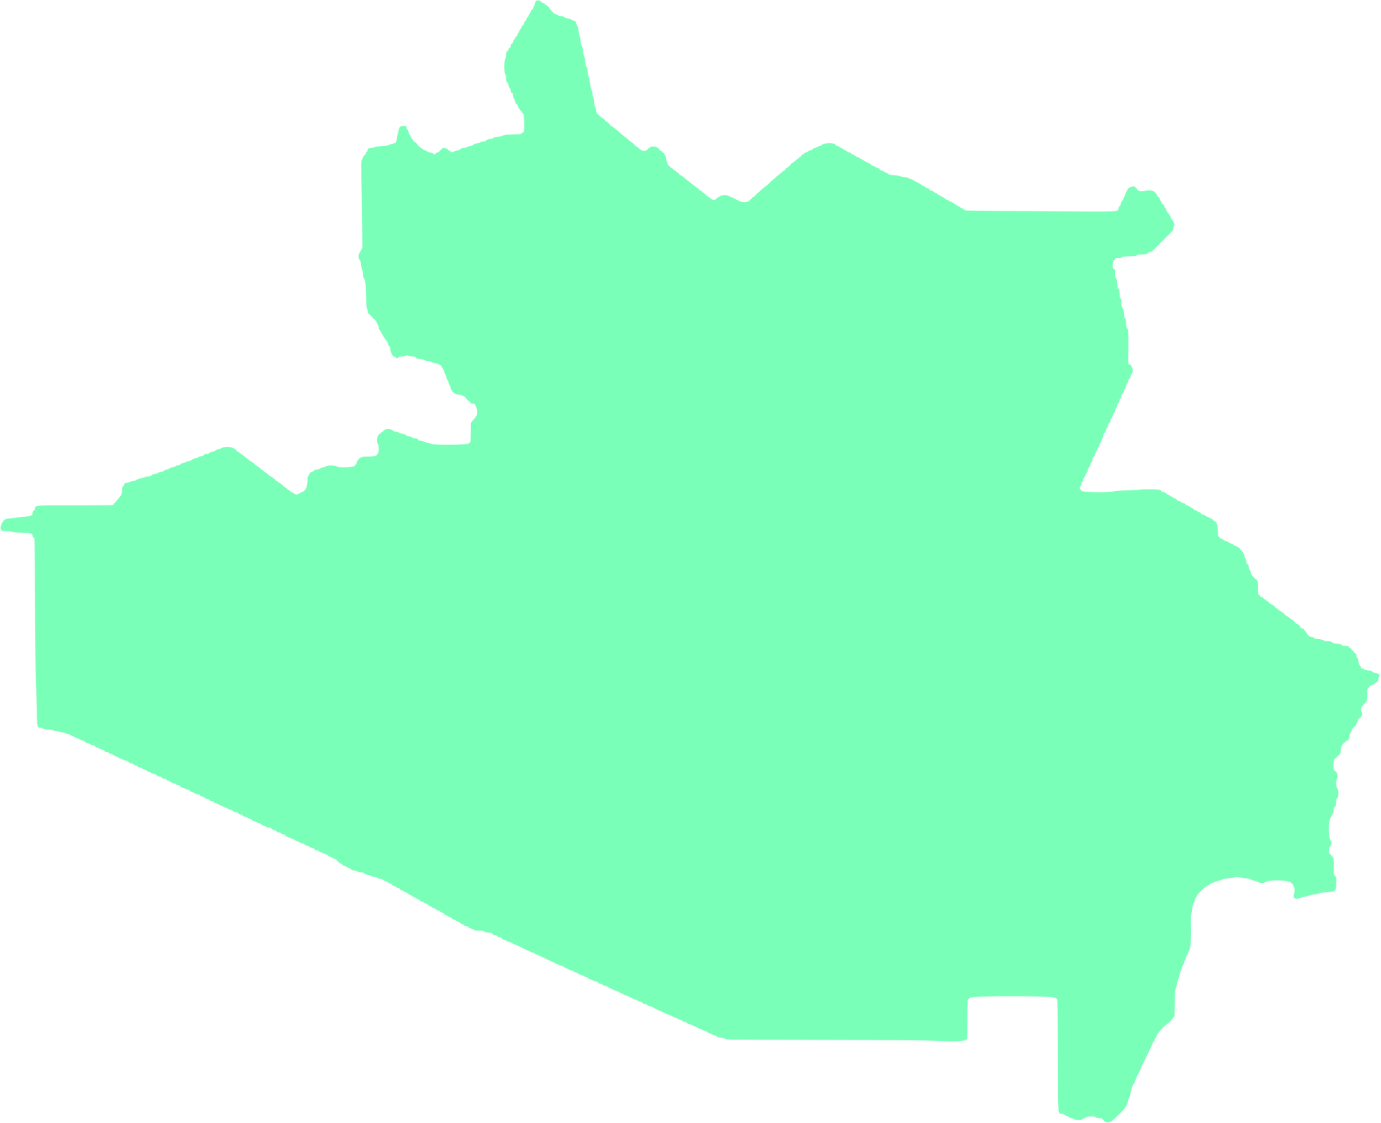




THE PHILIPPINE MAP
Cordillera Administrative Region
Ilocos Region
Region I
Cagayan Valley
Region II
Central Luzon
Calabarzon
Region III
Region IV-A
Bicol Region
Region V
Southwestern
Tagalog Region
Eastern Visayas
Mimaropa
Region VIII
Western
Visayas
Region VI
Central Visayas
Region VII
Caraga
Northern Mindanao
Region XIII
Region X
Zamboanga Peninsula
Davao
Region
Region IX
Bangsamoro
Region XI
BARMM
Soccsksargen
Region XII

Slide 3

THE PHILIPPINE MAP
Cordillera Administrative Region
Ilocos Region
Region I
Cagayan Valley
Region II
Central Luzon
Calabarzon
Region III
Region IV-A
Bicol Region
Region V
Southwestern
Tagalog Region
Eastern Visayas
Mimaropa
Region VIII
Western
Visayas
Region VI
Central Visayas
Region VII
Caraga
Northern Mindanao
Region XIII
Region X
Zamboanga Peninsula
Davao
Region
Region IX
Bangsamoro
Region XI
BARMM
Soccsksargen
Region XII

Slide 4







































RESOURCE PAGE
  Use these design resources in your Canva Presentation.
Fonts
This presentation template
uses the following free fonts:
TITLES:
ANTON
BODY COPY:
CAVEAT
You can find these fonts online too.
Design Elements

Slide 5

CREDITS
This presentation template is free for everyone to use
  thanks to the following:
  for the presentation template
Pexels, Pixabay
  for the photos
  HAPPY DESIGNING!

