Slide 1



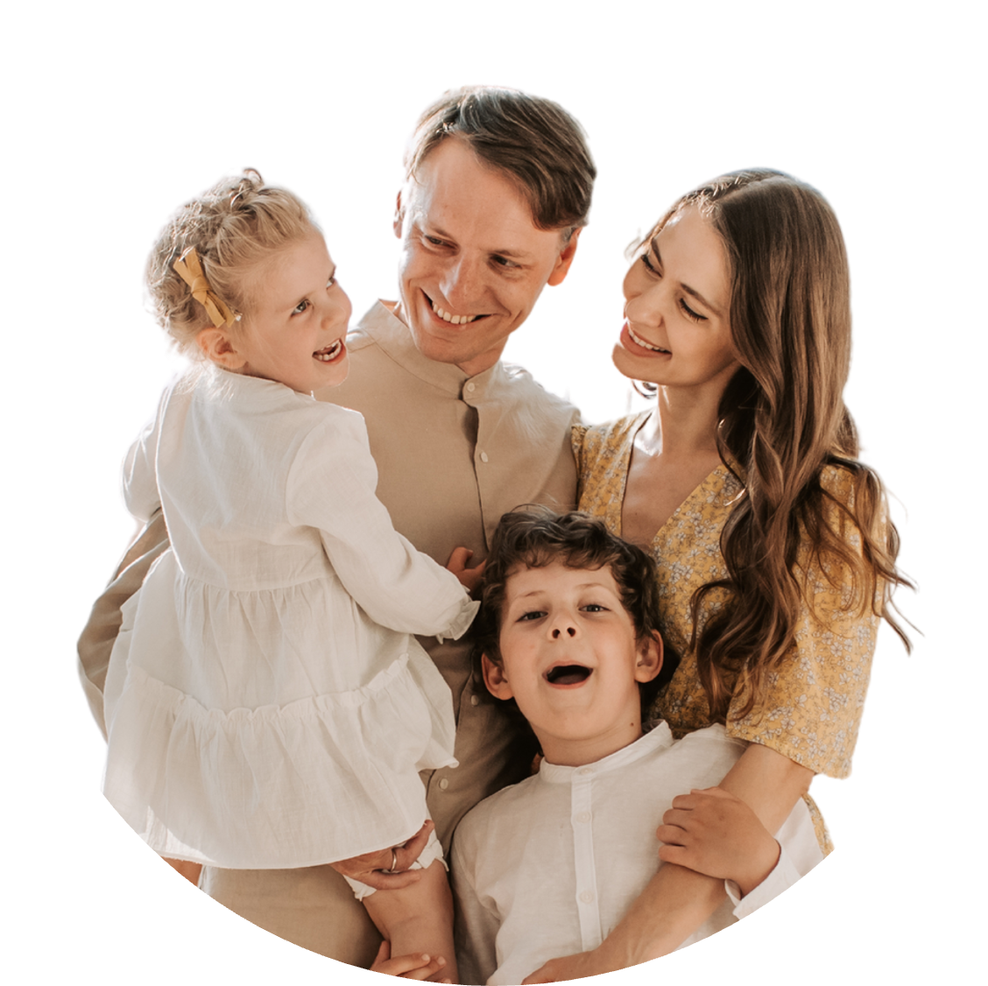


Family
Photo Album
  Write a subtitle for this presentation

Slide 2

How to Use This Presentation
Google Slides
PowerPoint
Canva
Click on the "Google Slides" button below this presentation preview. Make sure to sign in to your Google account. Click on "Make a copy." Start editing your presentation.
Alternative: Click on the "Share" button on the top right corner in Canva and click on "More" at the bottom of the menu. Enter "Google Drive" in the search bar and click on the GDrive icon to add this design as a Google slide in your GDrive.
Click on the "PowerPoint" button below this presentation preview. Start editing your presentation.
Alternative: From Canva template file, Click on the "Share" button on the top right corner in Canva and click on "More" at the bottom of the menu. Enter "PowerPoint" in the search bar and click on the PowerPoint icon to download.
Click on the "Canva" button under this presentation preview. Start editing your presentation. You need to sign in to your Canva account.

Slide 3


Introduction
  Each photo is a brushstroke, painting a portrait of the love, resilience, and shared moments that define us. Join us in this visual narrative that celebrates the beauty found in our everyday lives.

Slide 4


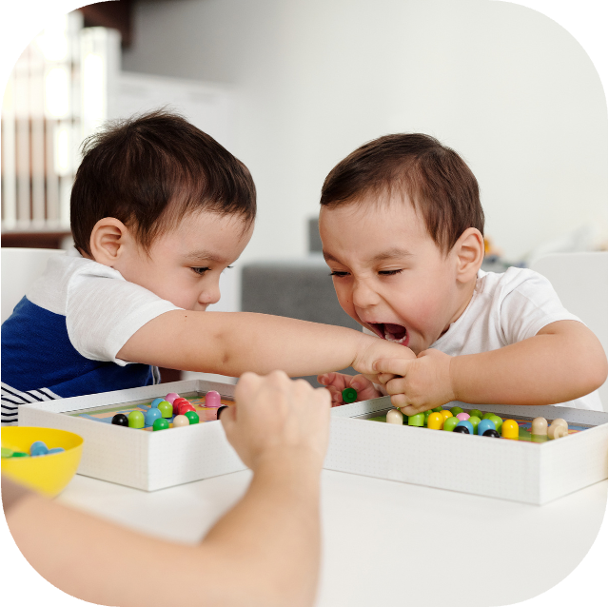


Family Ties
  Welcome to our cherished family moments! 'Family Ties' is a visual journey through the laughter, love, and lasting bonds that define us.

Slide 5


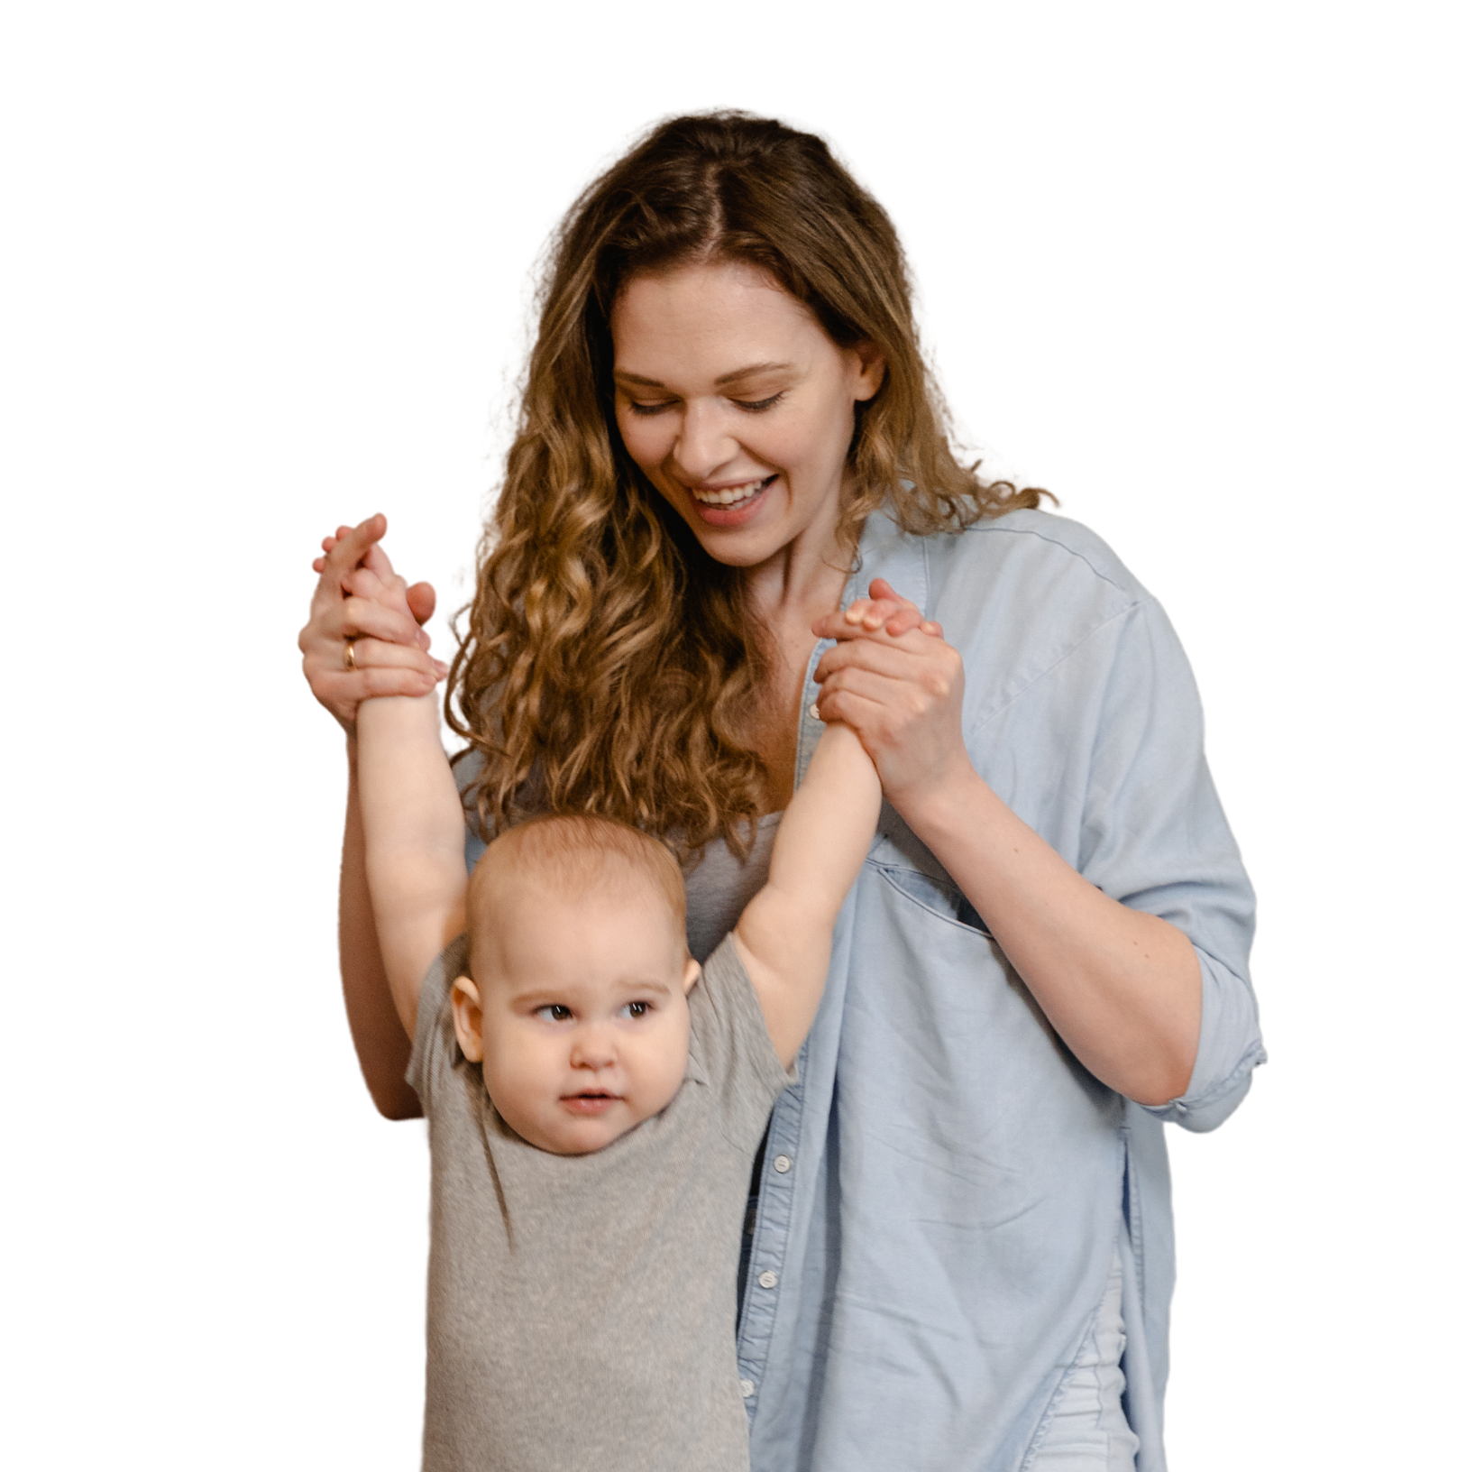


Our Story Begins...
  In this opening chapter, 'Our Story Begins,' we revisit the early days and foundation of our family. Each photo tells a tale of beginnings and shared adventures.

Slide 6

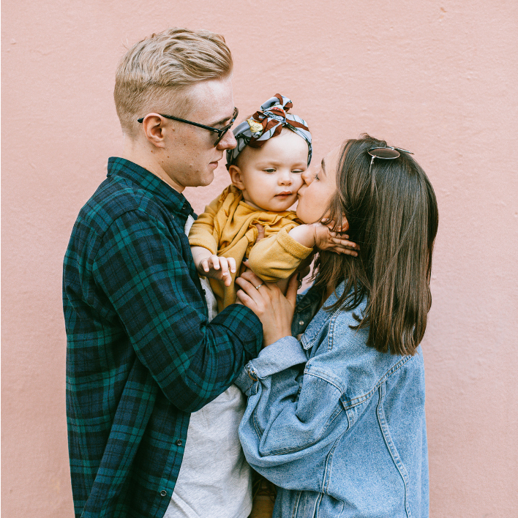

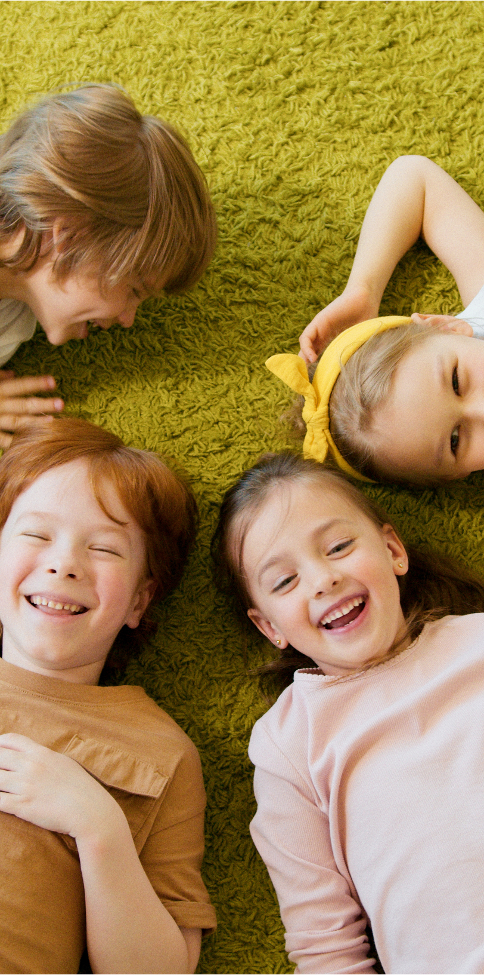


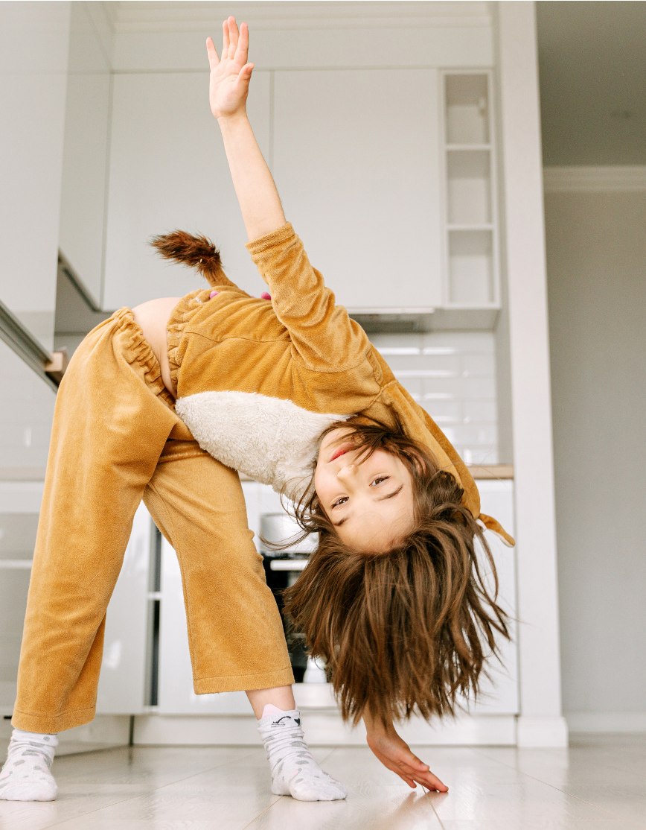
Memories in Motion
  We highlight the joyous milestones that have marked our journey — birthdays, anniversaries, and achievements. Each photo is a snapshot of happiness.

Slide 7



Daily Delights
  Discover the beauty in the ordinary with 'Daily Delights.' These photos capture the simple yet profound moments that make up the fabric of our everyday lives.

Slide 8


Through the Seasons
  Witness the changing seasons of our lives in 'Through the Seasons.' From cozy winter holidays to vibrant summer picnics, our family gathers in every season.

Slide 9

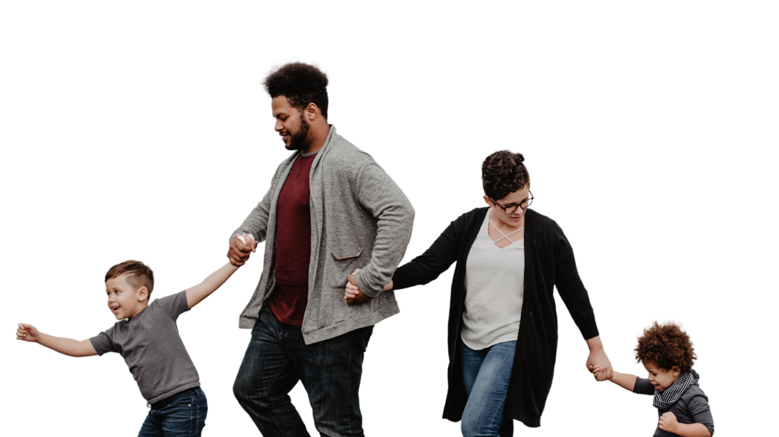

Family is the anchor that holds us through life's storms.

Slide 10







Furry Friends
These photos capture the unconditional
  love and joy that our pets bring to our lives.

Slide 11





Journeys Together
  These photos tell stories of shared adventures, new discoveries, and the joy of exploring as one.

Slide 12






Keeping Traditions Alive
  This slide showcases the special customs and rituals that have been passed down through generations, creating a tapestry of continuity and connection.

Slide 13

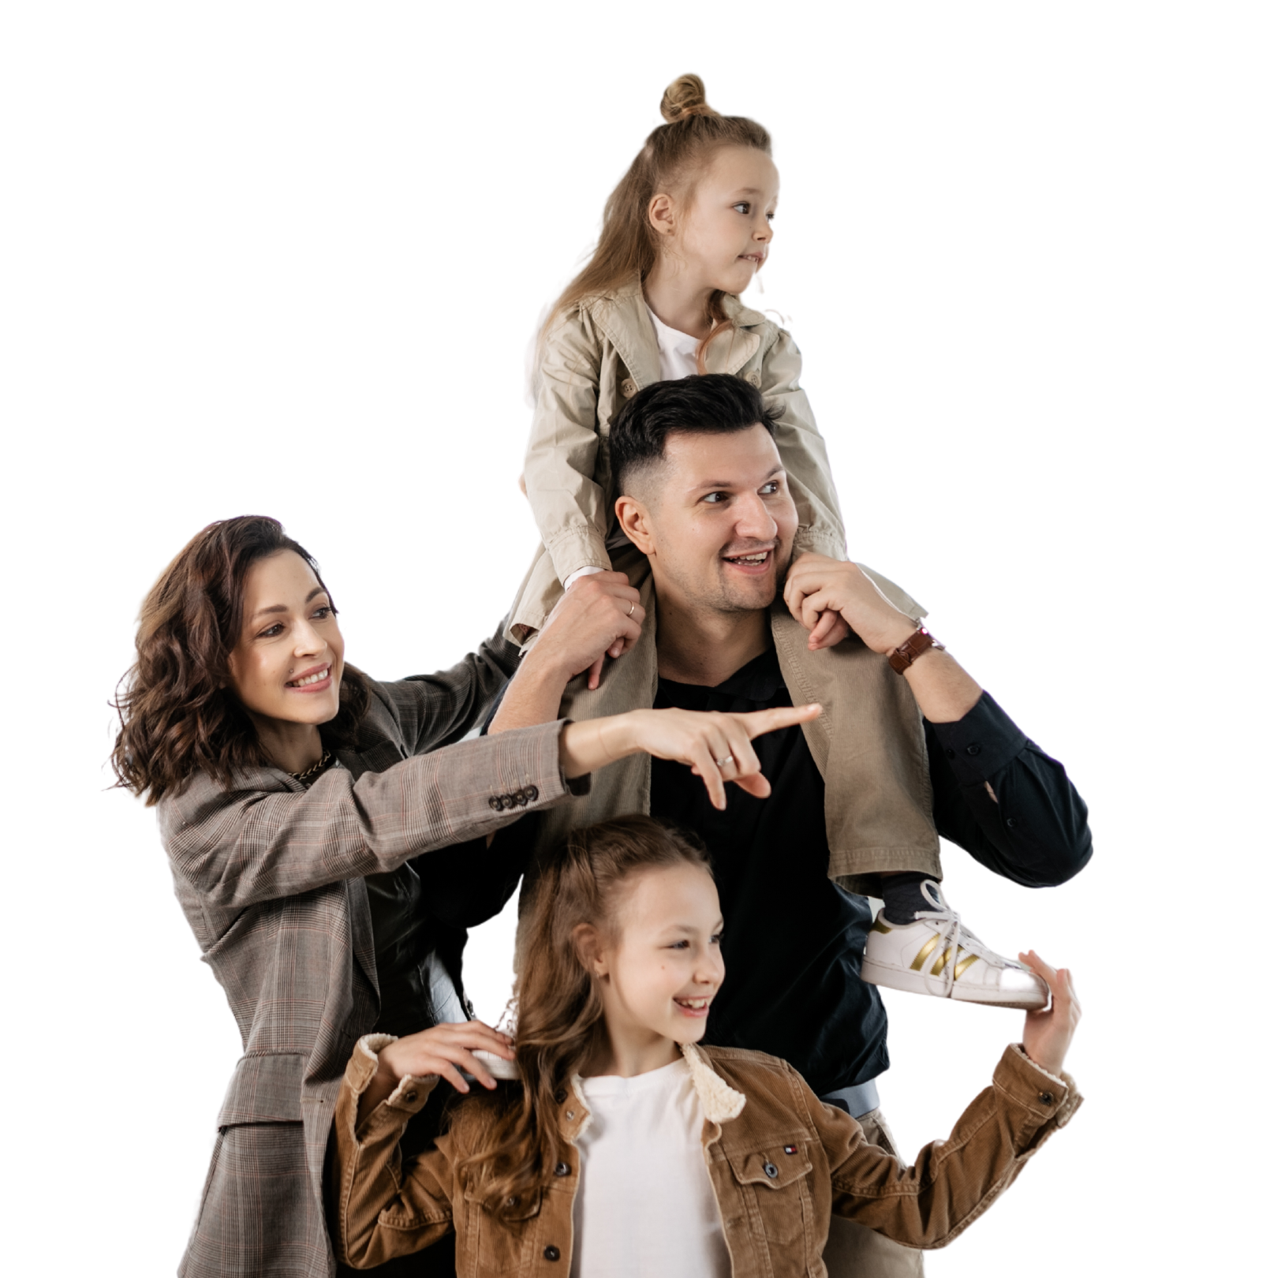



"Family means putting your arms around each other and being there."

Slide 14



Brothers & Sisters Forever
  we celebrate the unique bonds between siblings — the laughter, the squabbles, and the unbreakable ties that define family.

Slide 15






Heartfelt Moments
  These images encapsulate the deep expressions of love within our family. These images reflect the warmth, understanding, and compassion that define our relationships.

Slide 16



Resource
Page
Use these design resources
  in your Canva Presentation.
This presentation template
uses the following free fonts:
Titles: Pangolin
Headers: Ubuntu
Body Copy: Ubuntu
You can find these fonts
online too. Happy designing!
Don't forget to delete this
page before presenting.

Slide 17



Credits
  This presentation template is free for everyone to use thanks to the following:
SlidesCarnival
  for the presentation template
Pexels
  for the photos

