Slide 1
YOUR
CONSULTING
PRESENTATION
Let's go

Slide 2



How to Use This Presentation
Canva
PowerPoint
Google Slides
Click on the "Canva" button under this presentation preview. Start editing your presentation. You need to sign in to your Canva account.
Export this design from Canva as a PowerPoint template. Open the design in Canva. This will provide you with all the fonts used and elements used in this presentation as listed on page 21. Learn more on slide 3.
Export this design from Canva as a GoogleSlide template. This will provide you with all the fonts used and elements used in this presentation as listed on page 21. Learn more on slide 4.

Slide 3
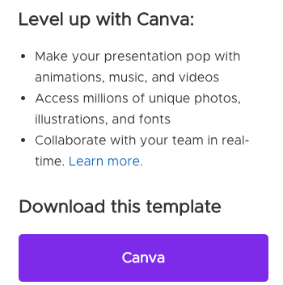
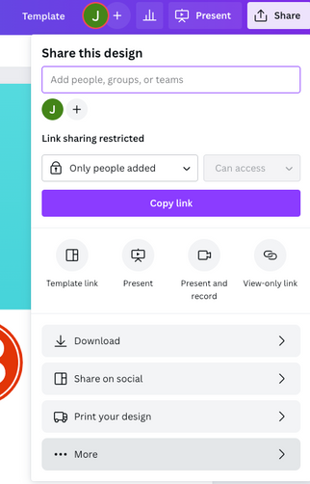
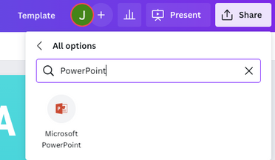
Download this presentation as a Powerpoint template in 3 steps
1
2
3
Click on the "Canva" button next to this presentation. Start editing your presentation. You may need to sign in to your Canva account.
Click on the "Share" button on the top right corner in Canva and click on "More" at the bottom of the menu.
Enter "PowerPoint" in the search bar and click on the PowerPoint icon to download.

Slide 4
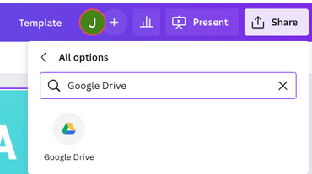
Use this presentation as a Google Slide template in 3 steps
1
2
3
Click on the "Canva" button next to this presentation. Start editing your presentation. You may need to sign in to your Canva account.
Click on the "Share" button on the top right corner in Canva and click on "More" at the bottom of the menu.
Enter "Google Drive" in the search bar and click on the Google Drive icon to add this design as a Google slide in your G Drive. It will ask you to link your Google account to Canva the first time.

Slide 5

Target
1
2
Expand Service Offerings
Leverage Technology
To consider expanding its service offerings to meet the changing needs of its clients and stay competitive in the market.
To invest in technology solutions that can enhance the efficiency and effectiveness of its consulting services, such as data analytics tools, project management software, and virtual collaboration platforms.
3
4
5
Build a Strong Team
Establish Thought Leadership
Foster Client Relationships
To focus on recruiting, developing, and retaining top talent to build a strong team of experts with diverse skills and experiences.
To establish itself as a thought leader in the industry by publishing research studies, white papers, and articles on relevant topics, and by speaking at conferences and other events.
To prioritize building and maintaining strong relationships with its clients, through regular communication, feedback, and collaboration, to ensure that its services are meeting their needs and expectations.

Slide 6
Table Of Contents
1
2
3
Introduction
Our Process
About Us
Elaborate on what you want to discuss.
Elaborate on what you want to discuss.
Elaborate on what you want to discuss.

Slide 7

Welcome
to Presentation
I'm Rain, and I'll be sharing with you my beautiful ideas.
Follow me at to learn more.
@reallygreatsite

Slide 8
1
Introduction
Elaborate on what you want to discuss.

Slide 9

Our Company
Who we are?
As a consulting company, we specialize in providing strategic, financial, technology, human resources, and other specialized consulting services to a wide range of clients across industries.
What we do?
Our services include strategy consulting, financial consulting, technology consulting, human resources consulting, and other specialized consulting services. Our team of experts uses agile methodologies and best practices to deliver measurable results that help our clients improve their operations, drive growth, and enhance customer experience.ou want to discuss.

Slide 10
Timeline
10.21
Launch of Consulting Services
First Client Engagement
03.22
The company officially launched its consulting services, establishing its brand and promoting its unique value proposition to potential clients.
The company secured its first consulting engagement with a major client, demonstrating its expertise and building its reputation in the industry.
Expansion of Service Offerings
Acquisition or Merger:
07.24
03.25
The company will expand its consulting services to include new areas of expertise or specialized offerings, further differentiating itself from competitors.
The company will acquire another consulting firm or merge with a complementary business, increasing its scale and capabilities in the market.

Slide 11
MANDATORY PAGE
2
Our Process
Elaborate on what you want to discuss.

Slide 12
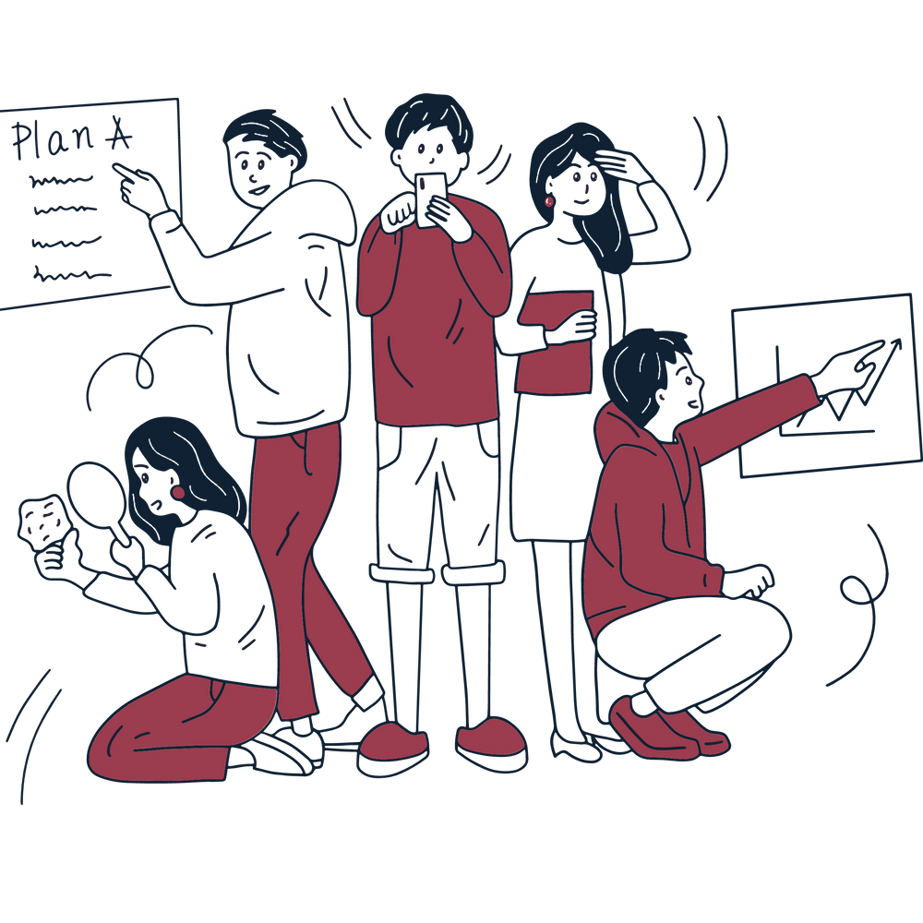
Our Services
Strategy Consulting
Financial Consulting
We help businesses develop and implement effective strategies to achieve their goals and gain a competitive advantage in the market.
We provide financial advice and analysis to help businesses improve their financial performance, manage risks, and make informed decisions.
Human Resources Consulting
Technology Consulting
We assist companies with their human resources needs, from talent acquisition and management to employee engagement and retention.
We offer technology expertise to help businesses leverage technology to streamline operations, improve productivity, and enhance customer experience.

Slide 13
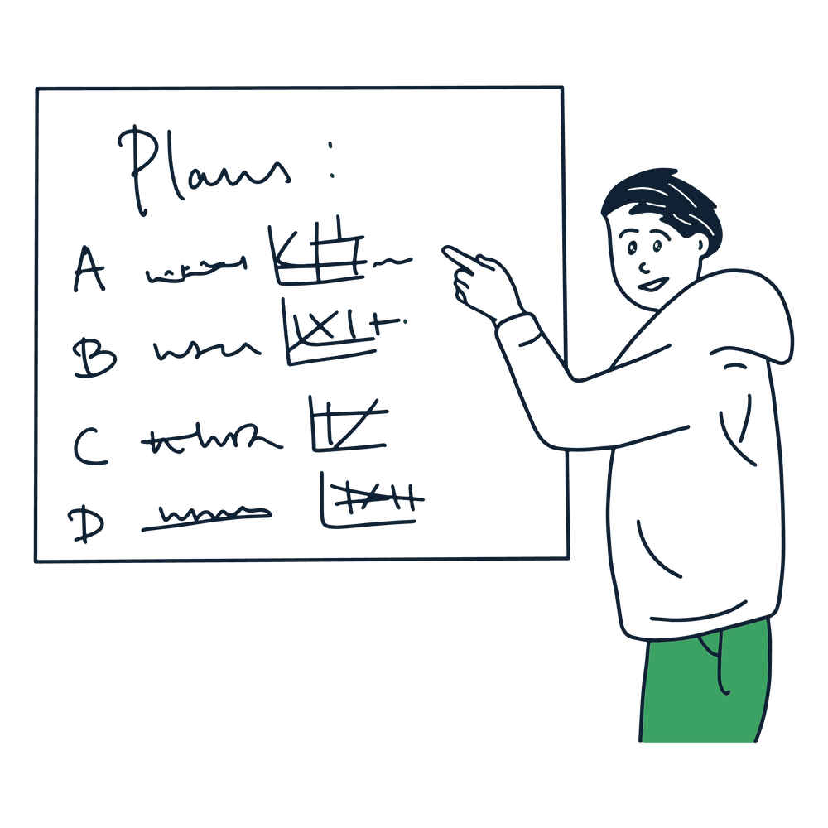
Your Project
Our Digital Transformation Accelerator project helps businesses embrace digital transformation by developing a roadmap and implementing solutions that enhance operations, drive growth, and improve customer experience. Our team uses agile methodologies and best practices to ensure on-time delivery, within budget, and measurable results. The project is designed to help businesses stay ahead of the competition and drive long-term success.
2024
Write your role

Slide 14





Gallery
What can you say about your projects? Share it here!
2024

Slide 15

Strategy Consulting
3.1%
Analysis
Financial Consulting
12.3%
Other Consulting Services
33.8%
The pie chart shows the percentage of revenue generated by five consulting services offered by the company.
Technology consulting and other consulting services make up the largest portion of the company's business (27.7% and 33.8% respectively), followed by human resources consulting (23.1%). Financial consulting and strategy consulting account for the smallest portions of the company's business (12.3% and 3.1% respectively).
The chart indicates that the company has a diverse portfolio of services with a strong focus on technology and other specialized consulting areas.
Human Resources Consulting
23.1%
Technology Consulting
27.7%

Slide 16
Strengths
Weaknesses
Opportunities
Threats
  We help businesses develop and implement effective strategies to achieve their goals and gain a competitive advantage in the market.
  Experienced and knowledgeable team.
  Strong client relationships.
  Heavy reliance on a few key clients.
  Limited brand recognition compared to larger firms.
  Limited geographic reach compared to competitors.
  Growing demand for specialized consulting services.
  Increasing use of technology in consulting services.
  Opportunities to expand into new industries or regions.
  Intense competition from other consulting firms.
  Economic downturns affect client spending.
  Difficulty in retaining top talent due to high competition and attractive compensation packages from competitors.

Slide 17
Table
Table 1 | Table 2 | Table 3 | Table 4
42 | 49 | 74 | 12
89 | 166 | 196 | 432
275 | 395 | 397 | 653
402 | 427 | 487 | 764
654 | 876 | 895 | 1368
Table title

Slide 18

2 out
of 5
12
millions
95%
Elaborate on the featured statistic.
Elaborate on the featured statistic.
Elaborate on the featured statistic.

Slide 19
Pricing
$300
$20
$70
  Four-hour consultation session per quarter.
  Customized action plan for the year.
  Email, phone, and video conference support during business hours.
  Access to a dedicated team of consultants, priority scheduling, and exclusive invitations to industry events and workshops.
  One-hour consultation session per week.
  Customized action plan for the week.
  Email support during business hours.
  Access to industry-specific resources and research.
  Two-hour consultation session per month.
  Customized action plan for the month.
  Email and phone support during business hours.
  Access to a dedicated consultant and priority scheduling.
Weekly
Monthly
Yearly

Slide 20

A picture is worth a thousand words

Slide 21
3
About Us
Elaborate on what you want to discuss.

Slide 22

Our
History
This consulting company was founded by a group of passionate and determined individuals who wanted to make a difference in the world. They started small but grew quickly, partnering with some of the biggest names in various industries and attracting top talent from around the world.
Despite their success, the founders never lost sight of their original vision and values. They continue to push themselves and their team to be the best they can be, always striving for excellence. Today, this consulting company stands as a testament to the power of passion, perseverance, and purpose.

Slide 23
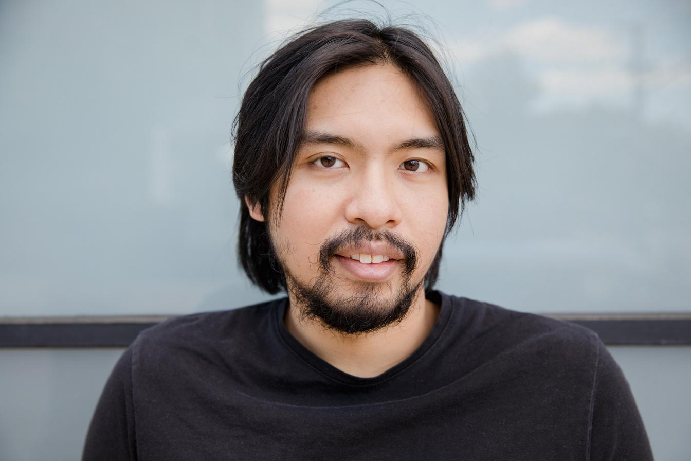



Our team
They work tirelessly to provide practical and innovative solutions, driven by a sense of purpose and a desire to create a positive impact. For them, the journey is just as important as the destination, and they approach each day with a spirit of collaboration, creativity, and resilience.
This consulting company is powered by a team of brilliant and dedicated individuals who share a common passion for making a difference in the world.
David Kim
Sarah Nguyen
James Johnson
Anna Lee
Chief Technology Officer
Head of Product Management
Director of Risk and Compliance
Chief Financial Officer

Slide 24

Our Founder
Jamie Park, the founder of this consulting company, is an inspiring and determined individual. Her passion for making a positive impact in the world has driven her to overcome numerous obstacles and work tirelessly to build a successful company. Jamie's commitment to excellence and belief in the power of collaboration, creativity, and innovation continues to inspire her team and clients alike.
Despite the many obstacles she faced, Jamie never lost sight of her goal. She persevered through adversity and overcame every challenge that came her way. Her unwavering commitment to excellence and her unwavering belief in the power of collaboration, creativity, and innovation have made her a true role model and inspiration to all those around her.
Jamie Park

Slide 25
Our Partners
Company 1
Company 2
Company 3
Elaborate on what you want to discuss.
Elaborate on what you want to discuss.
Elaborate on what you want to discuss.

Slide 26

Awards
Award 1
Award 2
Elaborate on what you want to discuss.
Elaborate on what you want to discuss.
Award 1
Award 2
Elaborate on what you want to discuss.
Elaborate on what you want to discuss.

Slide 27

Write an original statement or inspiring quote
— Include a credit, citation, or supporting message

Slide 28

Contact Us
123 Anywhere St., Any City,ST 12345
123-456-7890
hello@reallygreatsite.com
@reallygreatsite
reallygreatsite.com

Slide 29

Credits
This presentation template is free for everyone to use thanks to the following:
  SlidesCarnival for the presentation template
  Pexels for the photos
Happy designing!

Slide 30

Fonts In this Presentation
This presentation template uses the following free fonts:
  Titles: CY Grotesk Wide Demi
  Headers: CY Grotesk Wide Demi
  Body Copy: DM Sans
Happy designing!
You can find these fonts online too.

Slide 31
Resource
Page
Use these design resources in your Canva Presentation.
Don't forget to delete this page before presenting.
Happy designing!

Slide 32

Free templates for all your presentation needs
For PowerPoint, Google Slides, and Canva
100% free for personal or commercial use
Ready to use, professional, and customizable
Blow your audience away with attractive visuals

