Slide 1
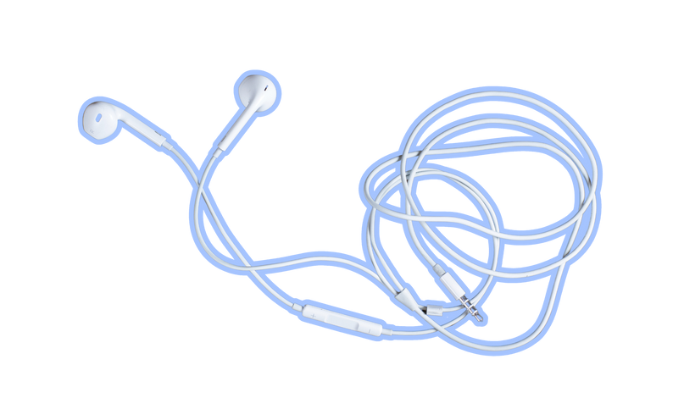
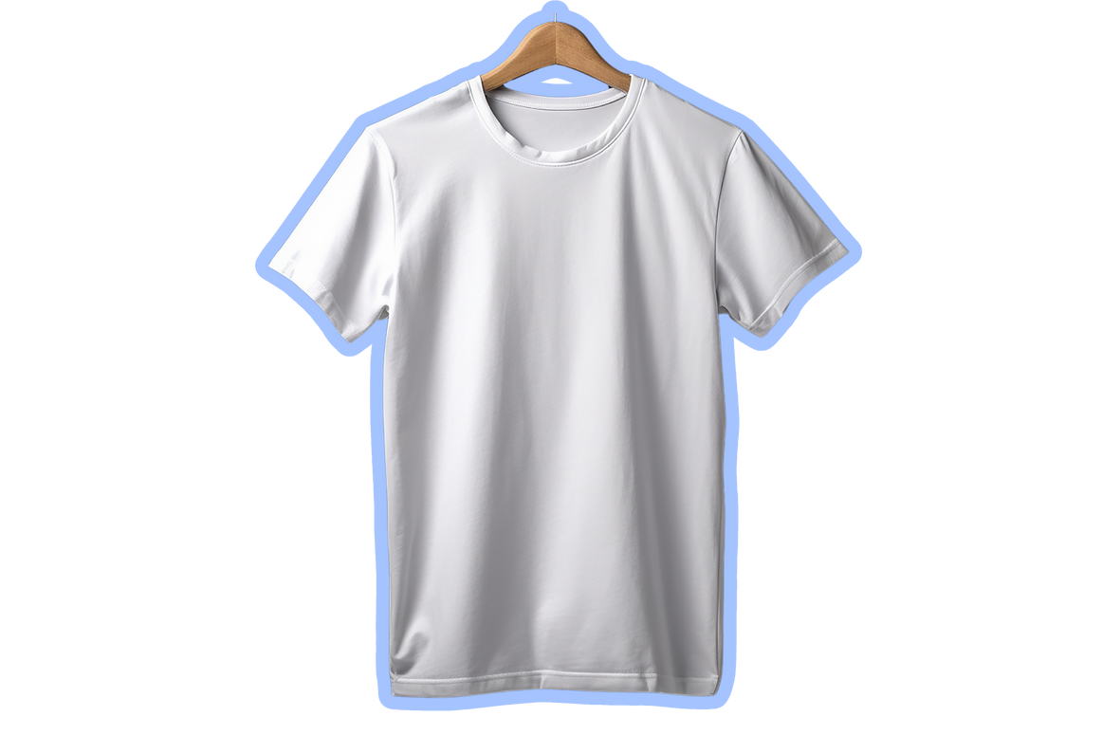
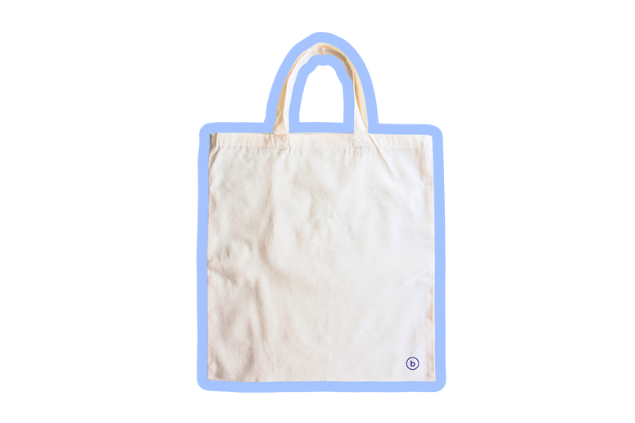
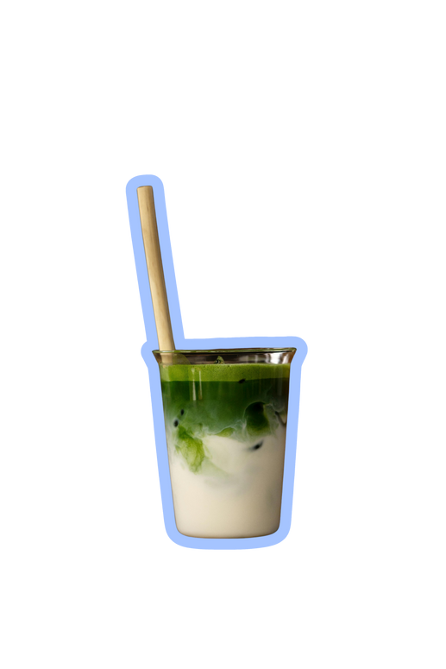
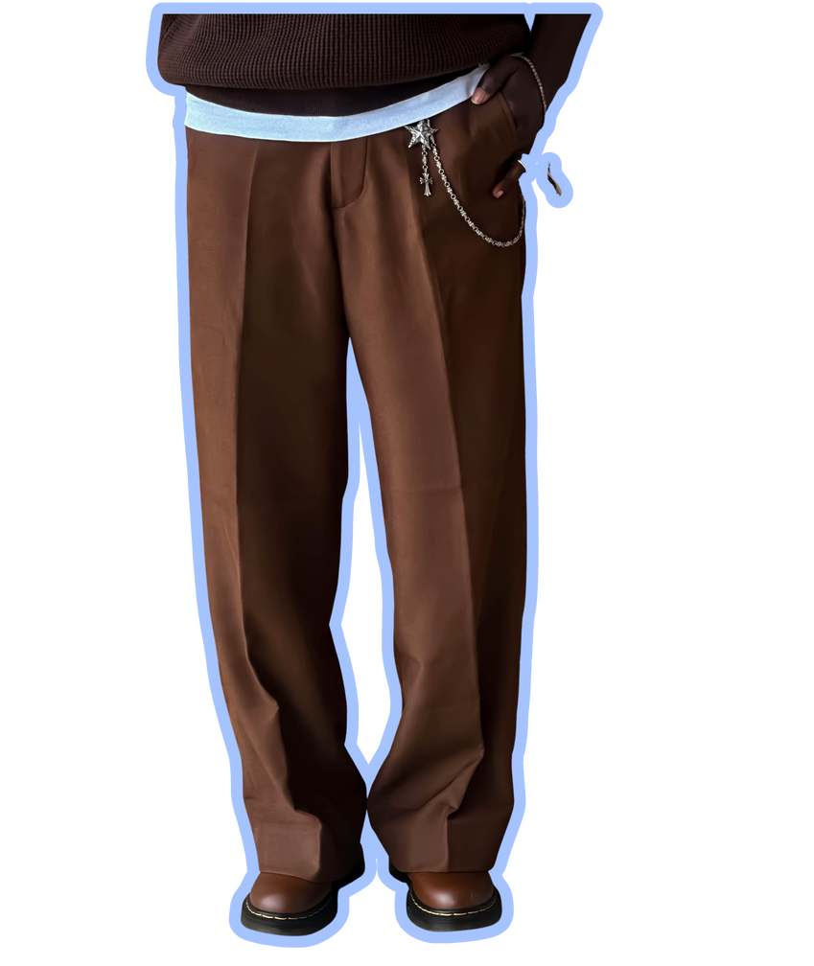


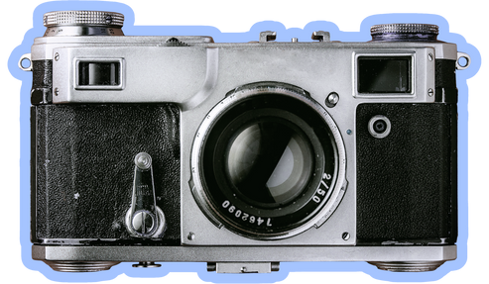
  Starter Packs 101
The Performative Male
  How to nail the look
Oversized t-shirt
Wired earphones
Tote bag
Ceremonial-grade matcha with oat milk
Indie vinyl
Baggy trousers
“Vintage” footwear
Feminist literature
Film camera

Slide 2
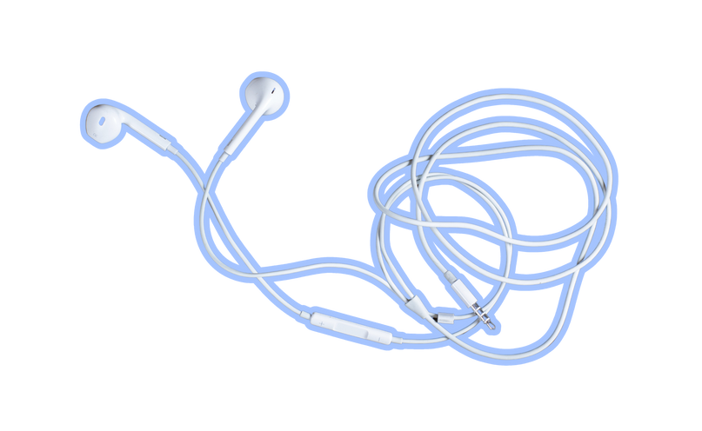
  Resource Page
  Use these in your template, then delete or hide this page afterward.
  Fonts
  Colors
This presentation template
uses the following free fonts:
TITLES:
Times New Roman
BODY TEXT:
#F4F3EF
#1A1E4D
#A4C2FB
  Almarai
You can find these fonts online too.
  Design Elements / Icons

Slide 3

Credits
  This template is free for everyone to use, thanks to the following:
  for this template
Pexels, Pixabay, Sketchify
  for the photos, graphics, and elements
  Happy designing!

