Slide 1


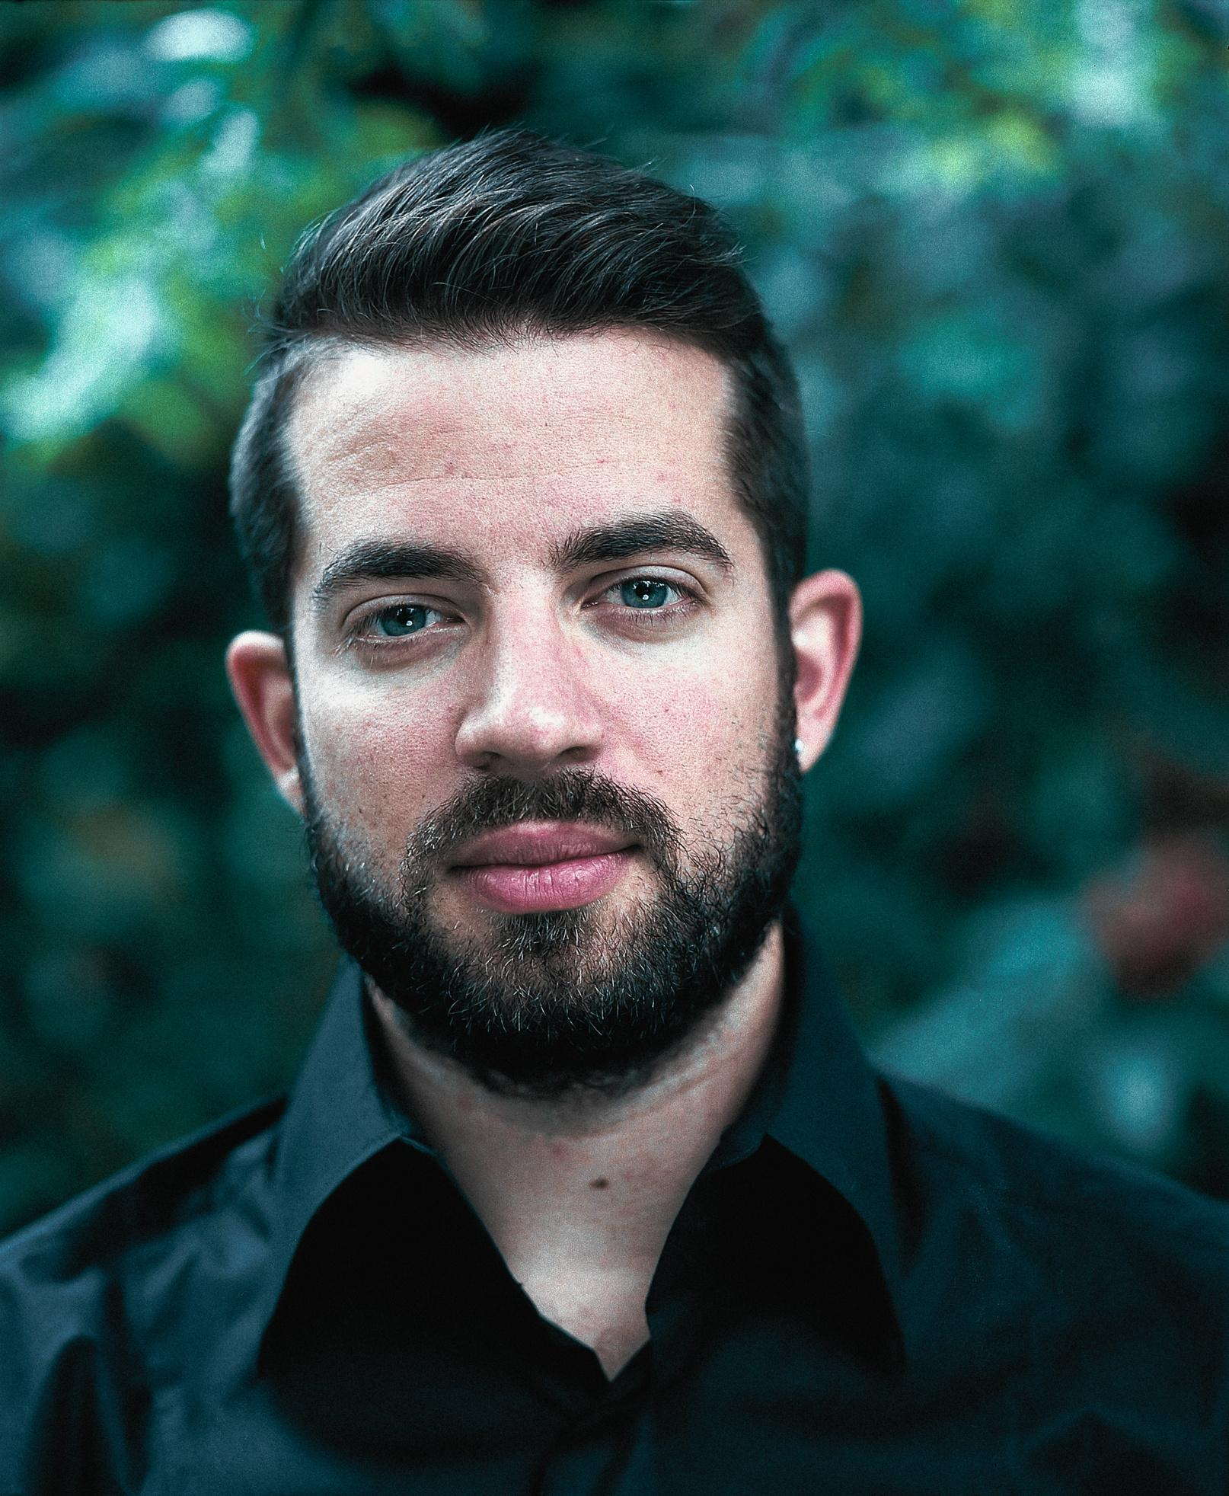


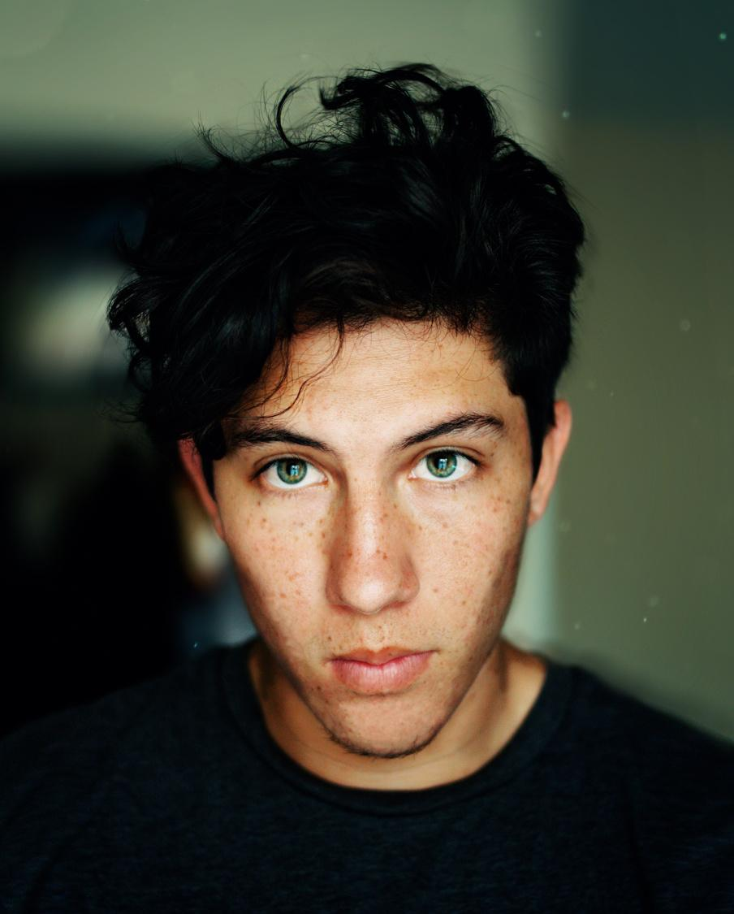
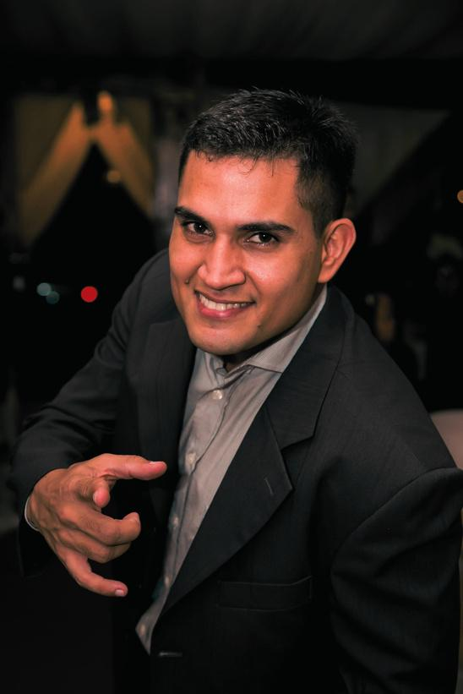
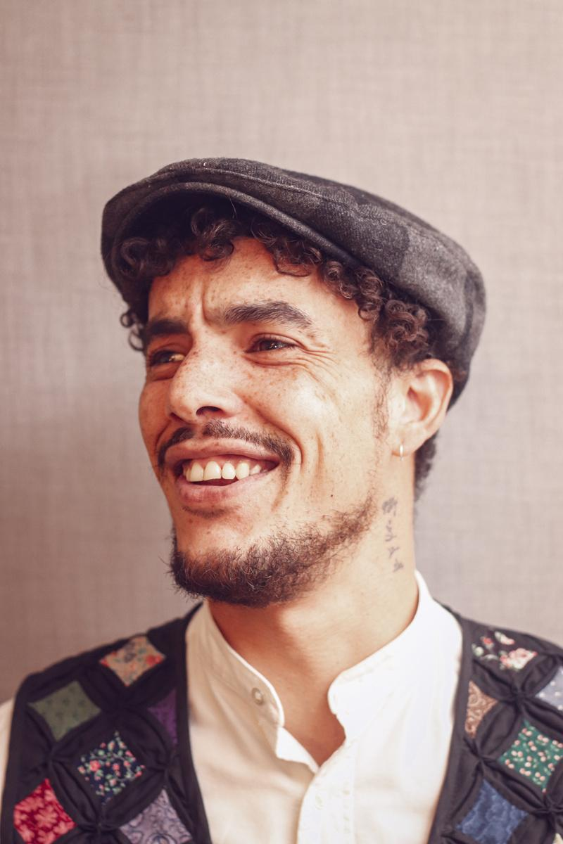
MOST WANTED
Federal Bureau of Investigation
Johnny
Billy
Oliver
Matthew
William
Ronnie
Samuel
Keith
THE NOTORIOUS GANG
For First Degree Murder (5 Counts)
DESCRIPTION
The Notorious Gang, a ruthless and feared gang, emerged in the late 1990s from the rough streets of Los Angeles. Originally formed for mutual protection against larger gangs, they quickly evolved into a highly organized criminal enterprise. Their reputation for violence and intimidation has earned them a notorious status both on the streets and with law enforcement agencies.
The Crimson Serpents are involved in a variety of illegal activities, including drug trafficking, extortion, armed robbery, and human trafficking. However, their most heinous crimes are the five first-degree murders they have been linked to. These murders were meticulously planned and executed, often to eliminate rivals, enforce discipline within their ranks, or silence potential informants.
IF YOU HAVE ANY INFORMATION ABOUT THIS GROUP PLEASE CONTACT #123456789

Slide 2
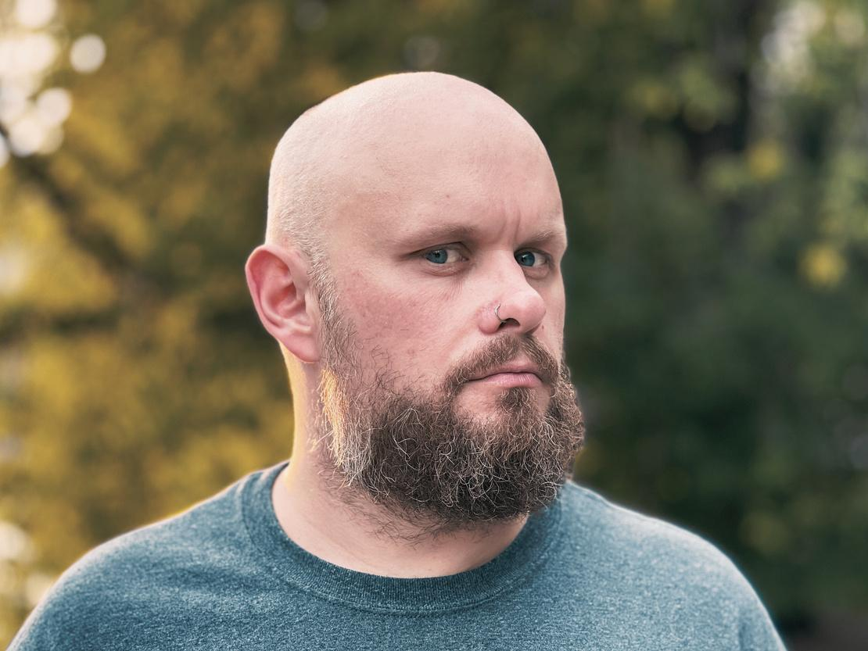
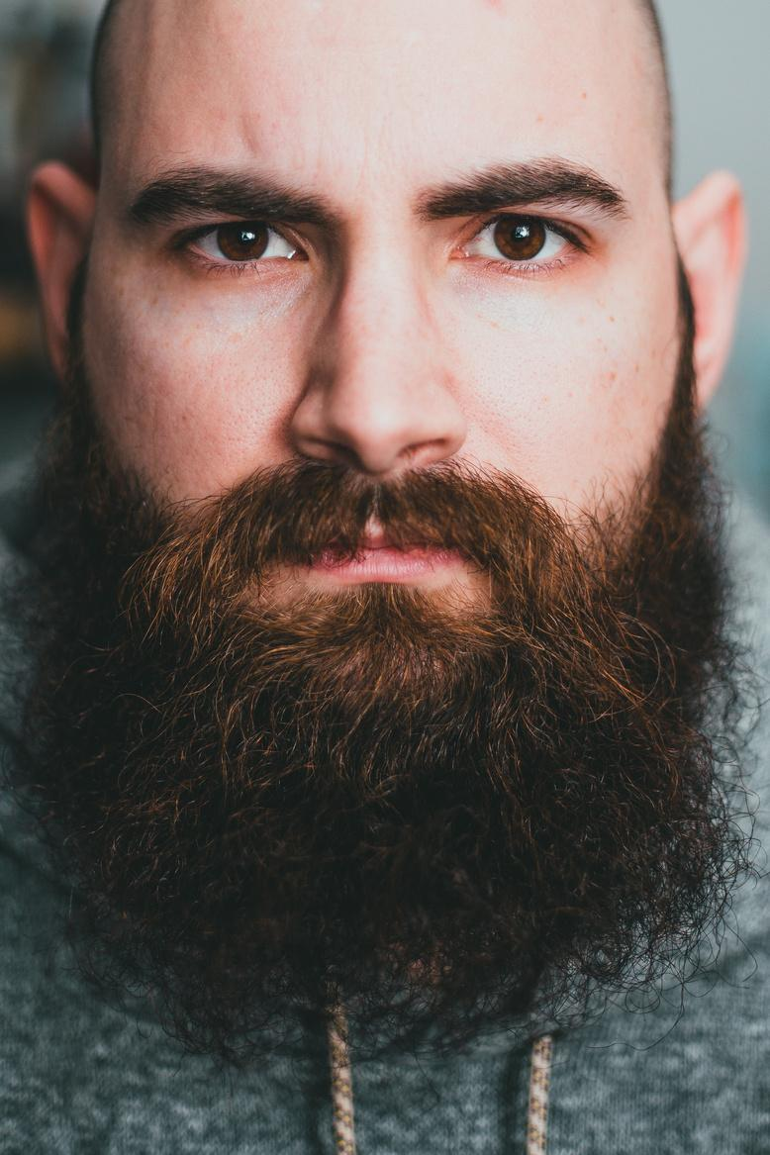
MOST WANTED
Federal Bureau of Investigation
JAMES ROBERT WILLIAM
For First Degree Murder (5 Counts)
DESCRIPTION
Age: 45 | Height: 6'2" (188 cm) | Weight: 210 lbs (95 kg) | Eye Color: Brown | Hair Color: Black
James Robert William, often referred to as "Nightwalker," is a notorious criminal with a violent past. He was born and raised in the rough neighborhoods of Chicago, Illinois, where he quickly fell into a life of crime. From a young age, he was known for his aggressive behavior and lack of empathy, traits that only worsened as he grew older. Walker is a high school dropout who spent his teenage years involved in gang activities, which eventually escalated to more severe criminal offenses.
IF YOU HAVE ANY INFORMATION ABOUT THIS PERSON PLEASE CONTACT #123456789

Slide 3







































RESOURCE PAGE
  Use these design resources in your Canva Presentation.
Fonts
Colors
This presentation template
uses the following free fonts:
TITLES:
BANTAYOG
GERMANIA ONE
BODY COPY:
GIRASSOL
VOLLKORN
#22336B
#F0F0F0
You can find these fonts online too.
Design Elements

Slide 4

CREDITS
This presentation template is free for everyone to use
  thanks to the following:
  for the presentation template
Pexels, Pixabay
  for the photos
  HAPPY DESIGNING!

