Slide 1
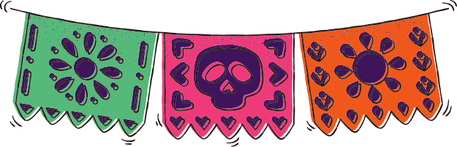

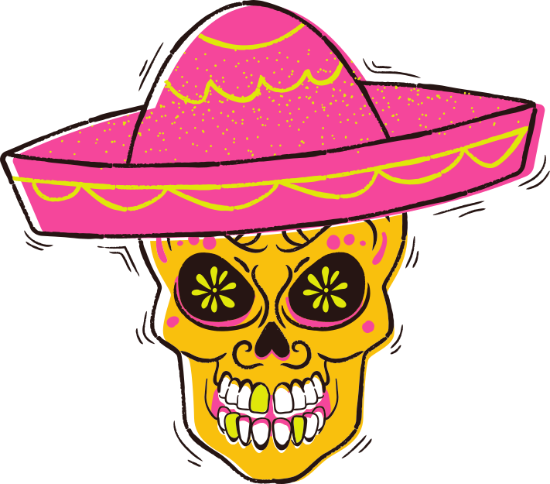
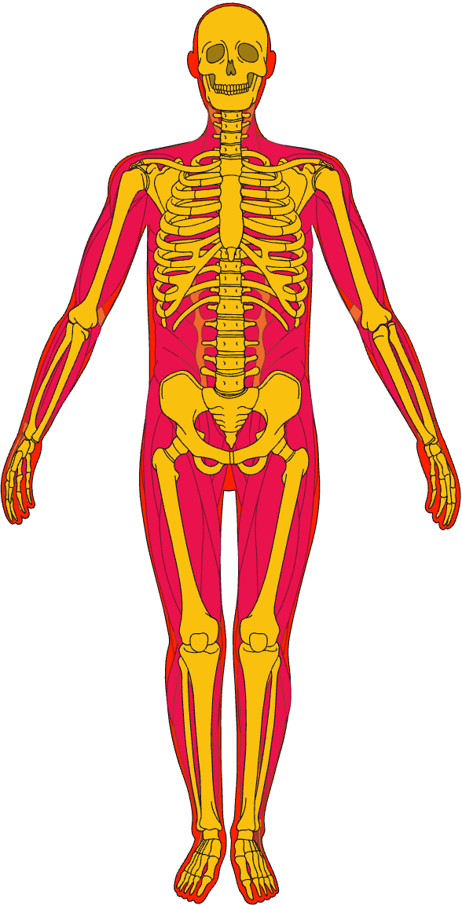

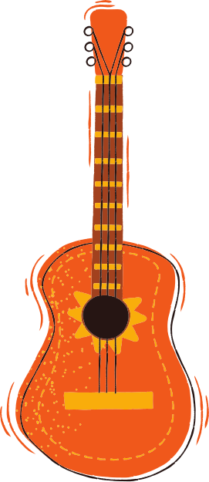
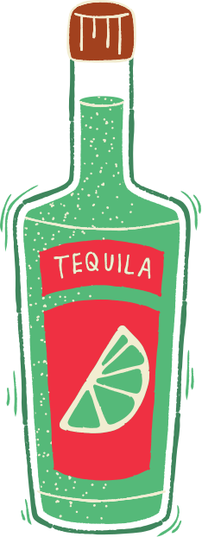
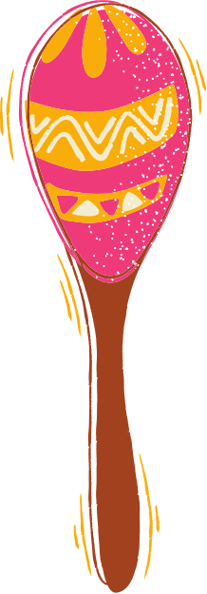
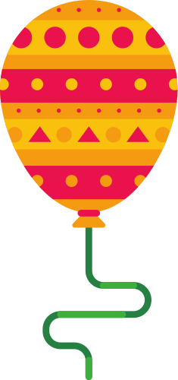
FUNCTIONS OF THE
Skeletal System
Support
Cranium (skull)
Keeps the body upright and prevents it from collapsing
Mandible (jaw)
Clavicle (collarbone)
Scapula (shoulder blade)
Protection
Sternum (breastbone)
Shields soft organs such as the brain, heart, and lungs
Rib (rib cage)
Humerus (upper arm)
Spinal column (backbone)
Movement
Ulna (forearm)
Radius (forearm)
Allows movement by
working together
with the muscles
Carpals (wrist bones)
Metacarpals (hand bones)
Phlanages (fingers)
Pelvic Girdle (pelvis)
Factory
Sacrum
Forms red blood cells, specifically
in the bone's red marrow
Cocyx (tailbone)
Femur (thigh bone)
Patella (kneecap)
Tibia (shin bone)
Storage
Fibula (calf bone)
Stores and releases calcium to the body
Tarsals (ankle bones)
Metatarsals (foot bones)
Phalanges (toe bones)

Slide 2
Resource Page
This presentation template uses the following free fonts:
Titles: Barriecito | Body Copy: Jua
Don't forget to delete this page before presenting.

Slide 3

Credits
This presentation template is free
for everyone to use thanks to the following:
SlidesCarnival for the presentation
template Pixabay,
Pexels for the photos

