Slide 1
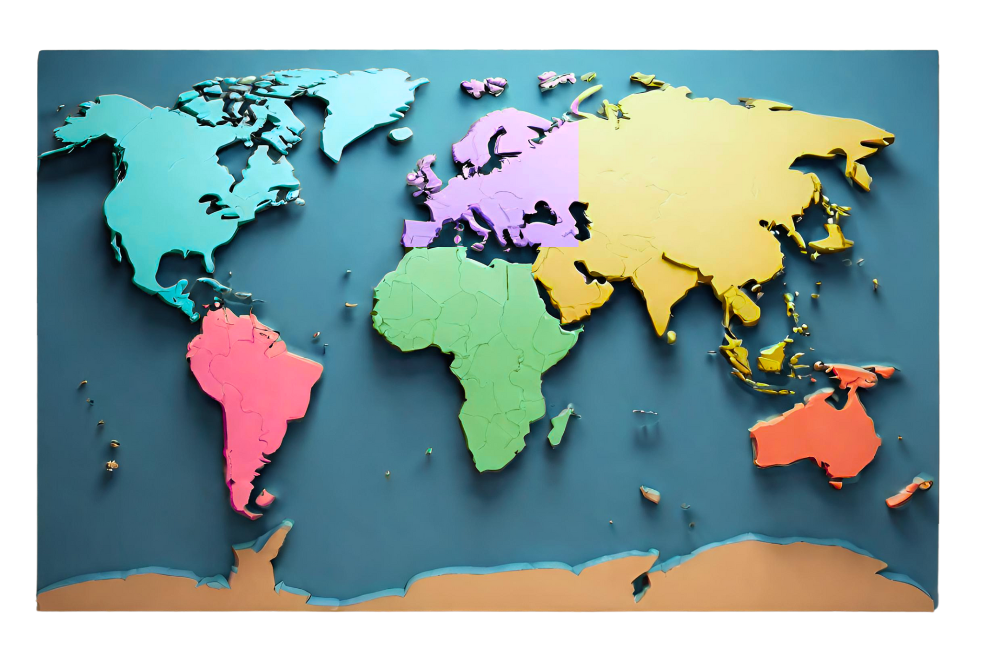
CONTINENTS
A continent is a large landmass that is typically distinguished by its physical and geological characteristics, such as its size, elevation, climate, and vegetation. There are seven continents: Africa, Antarctica, Asia, Europe, North America, Australia, and South America.
NORTH AMERICA
SOUTH AMERICA
North America, bordered by three oceans, boasts diverse geography and significant global influence.
South America, hemmed by the Atlantic and Pacific, features diverse landscapes like the Amazon and Andes.
EUROPE
AFRICA
Situated in the northern hemisphere, is renowned for its rich history, diverse cultures, and iconic landmarks.
The second-largest continent, is famed for its lush rainforests, diverse wildlife, and rich cultural heritage.
ASIA
AUSTRALIA
The largest continent, known for diverse cultures, ancient civilizations, bustling cities, and stunning natural landscapes.
A continent and a country famed for its unique wildlife, stunning beaches, vast Outback, and iconic landmarks.
ANTARCTICA
the southernmost continent, is characterized by its extreme cold, vast ice sheets, and unique wildlife, making it a pristine and largely uninhabited wilderness.

Slide 2
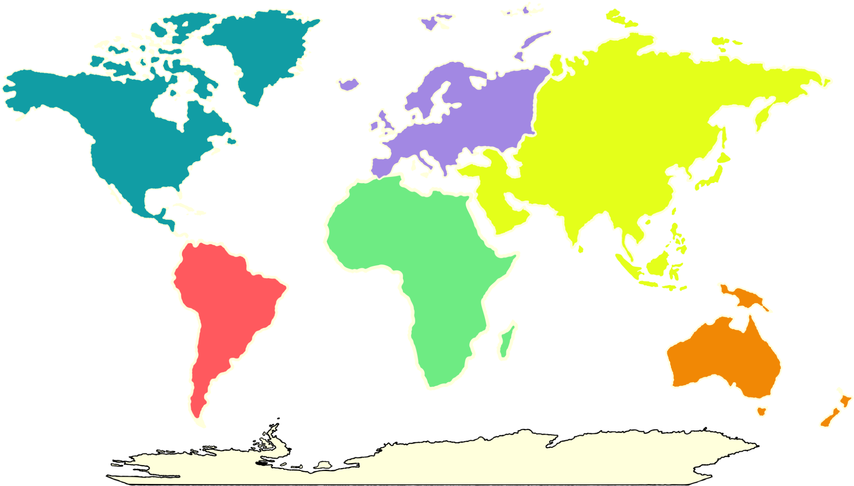
CONTINENTS
NORTH AMERICA
North America, bordered by three oceans, boasts diverse geography and significant global influence.
SOUTH AMERICA
South America, hemmed by the Atlantic and Pacific, features diverse landscapes like the Amazon and Andes.
EUROPE
Situated in the northern hemisphere, is renowned for its rich history, diverse cultures, and iconic landmarks.
AFRICA
The second-largest continent, is famed for its lush rainforests, diverse wildlife, and rich cultural heritage.
ASIA
The largest continent, known for diverse cultures, ancient civilizations, bustling cities, and stunning natural landscapes.
AUSTRALIA
A continent and a country famed for its unique wildlife, stunning beaches, vast Outback, and iconic landmarks.
ANTARCTICA
the southernmost continent, is characterized by its extreme cold, vast ice sheets, and unique wildlife.

Slide 3
RESOURCE PAGE
Use these design resources in your Canva Poster Design
This poster template uses the following free fonts:
Title: Alata
Header: Alata
Body: Alata
You can find these fonts online too.
  Don't forget to delete this page before presenting.

Slide 4

CREDITS
This poster design template is free for everyone to use thanks to the following:
for the poster template
for the photos
Happy designing!
SLIDESCARNIVAL
PEXELS

