Slide 1












CLASSROOM
Rules
  Raise your hand if you need anything
  Together we can keep our classroom clean
  Put things back to its places
  Let’s do our best in studying!

Slide 2



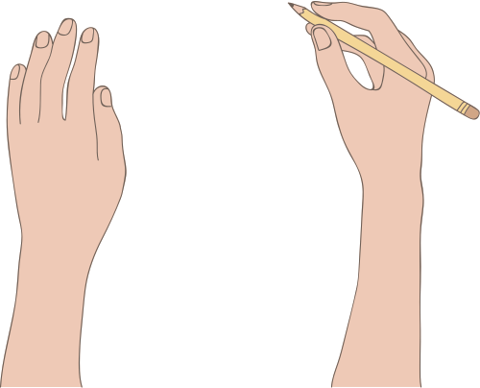











CLASSROOM
RULES
  Raise your hand if you need anything
  Let’s do our best in studying!
  Put things back to its places
  Together we can keep our classroom clean

Slide 3

RESOURCE PAGE
  Use these design resources in your Canva Template.
Fonts
This template uses the following free fonts:
TITLES:
LONDRINA & PASSION ONE
HEADERS:
LONDRINA & PASSION ONE
BODY COPY:
COUSTARD & OVERPASS
You can find these fonts online too.
Colors
#231F20
#106585
#DAE588
#BBFFED
#CE9DDD
#FECD1A
#E94A51
#F4D696
Design Elements

Slide 4

CREDITS
  This template is free for everyone to use thanks to the following:
  for the template
Pexels, Pixabay
  for the photos
HAPPY DESIGNING!

