Slide 1
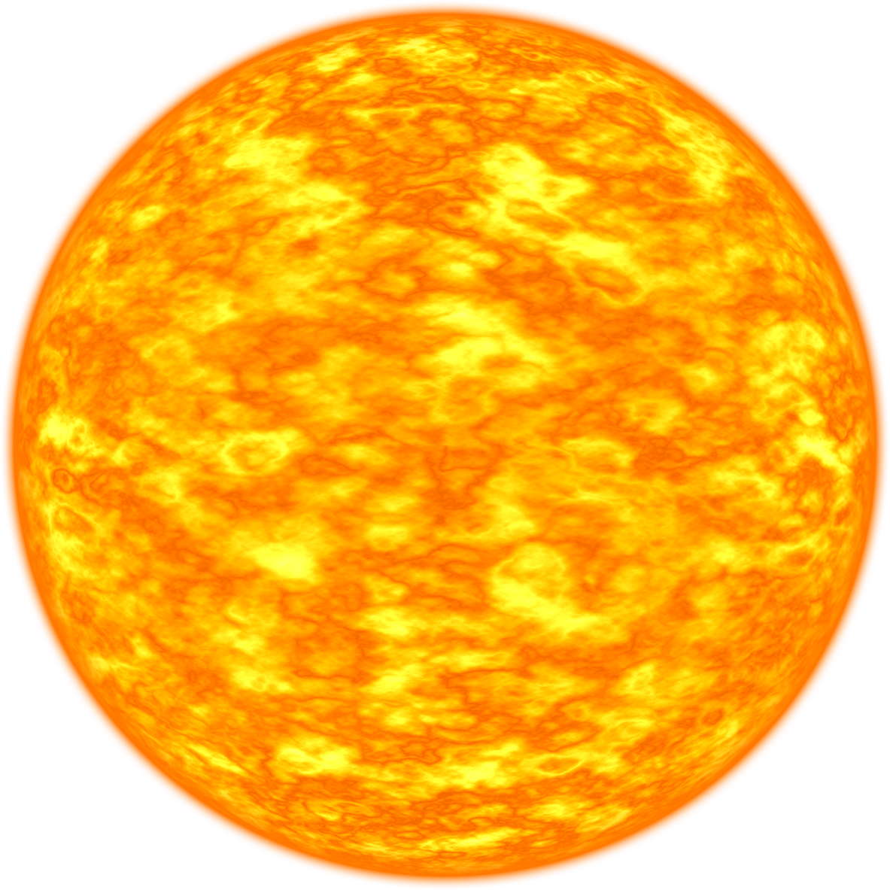
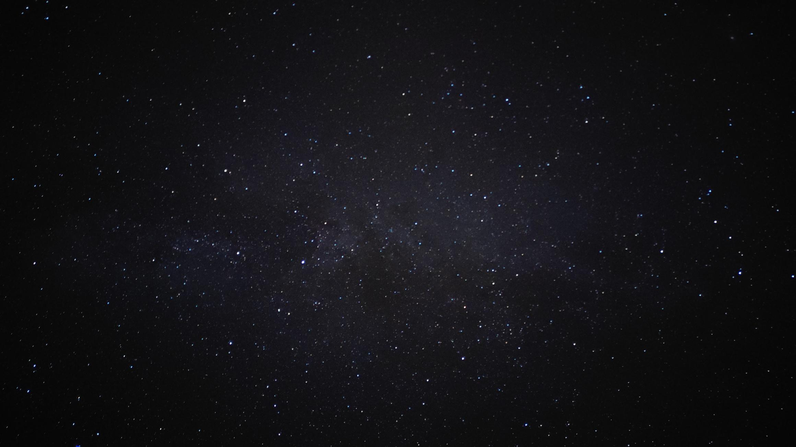
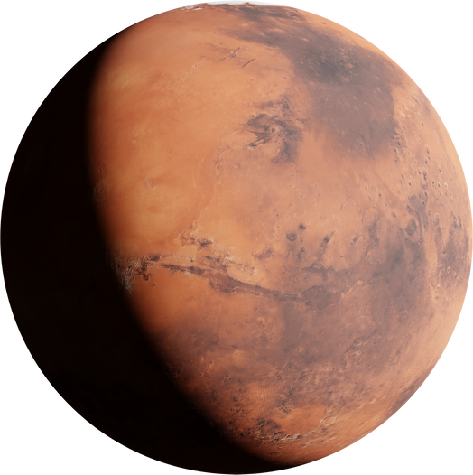
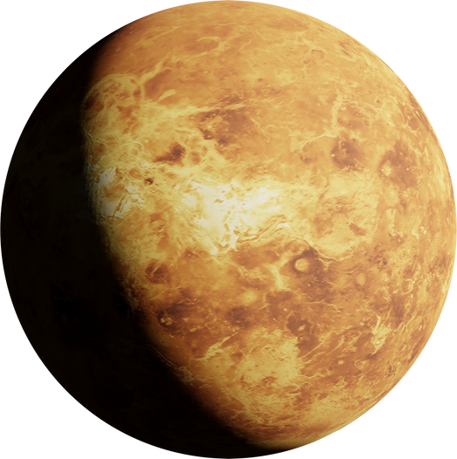
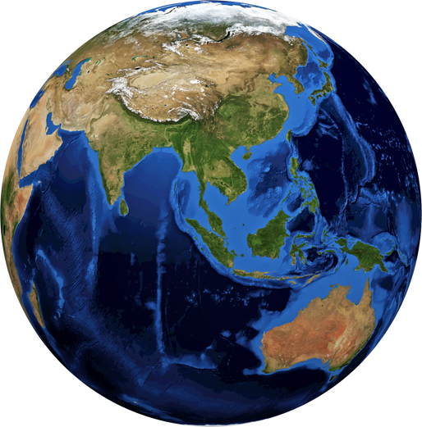
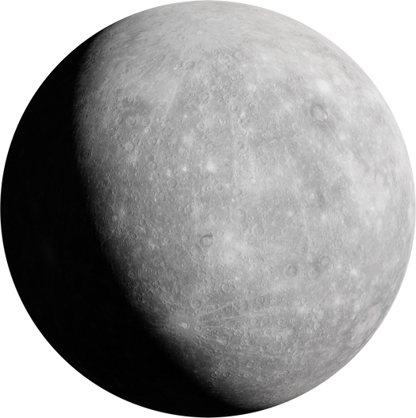
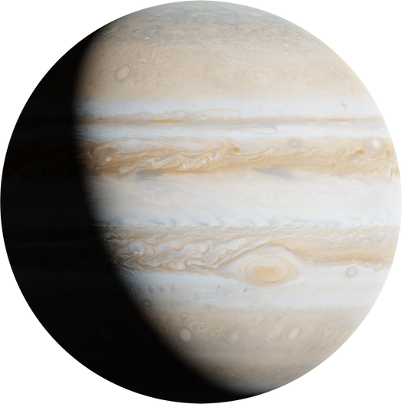
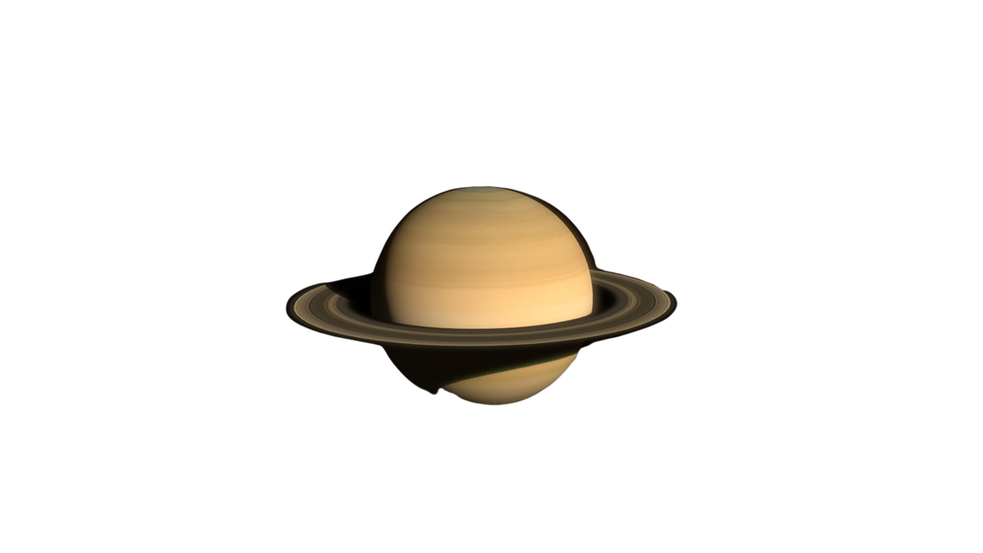
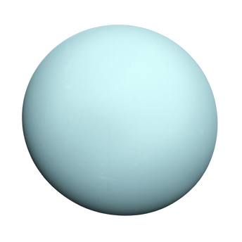
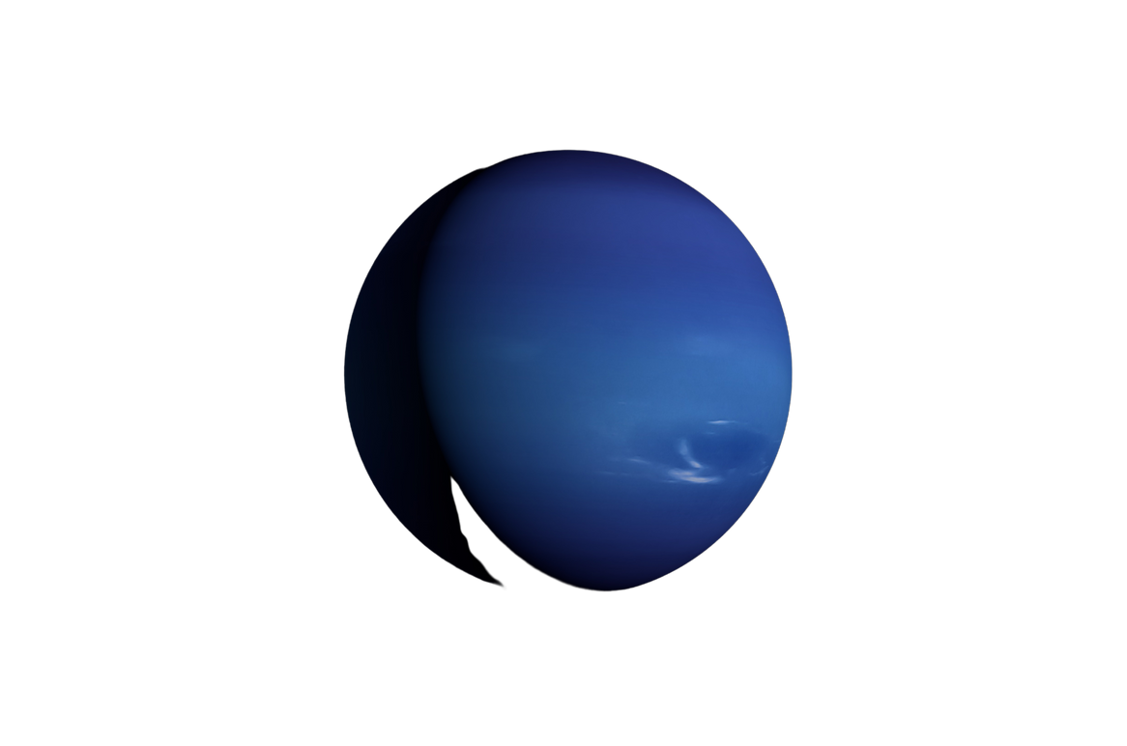
SOLAR SYSTEM
The solar system has one star, eight planets, five dwarf planets, at least 290 moons, more than 1.3 million asteroids, and about 3,900 comets.
MERCURY
VENUS
EARTH
MARS
JUPITER
SATURN
URANUS
NEPTUNE
It’s the nearest planet to the sun and is also the smallest planet in the solar system and takes around 88 days to complete one revolution which is the smallest time duration.
When observed from the Earth, it’s the second brightest and takes 224.7 Earth days to complete one revolution and 243 Earth days for rotation on its axis,
It’s the third planet from the Sun and is the only known planet to harbour life. The Earth's age is around 4.5 billion years old.
It’s the fourth planet from the sun and also the second-smallest in the solar system. Its red colour also makes it known as the red planet.
It’s the fifth planet from the Sun and the largest planet among all. It’s also one of the brightest things that can be seen in the sky with naked eye.
It’s the sixth planet from the Sun and the second largest planet in the solar system. It’s a giant gas planet with an average radius that is 9 times radius of the earth.
It’s the seventh planet from the Sun and has the fourth largest planet by mass and third largest by radius. It's also referred to as ice giant.
It’s the eighth planet from the Sun. It’s the fourth largest planet by diameter. The third most massive planet and is the densest giant planet.

Slide 2
RESOURCE
PAGE
This presentation template uses
the following free fonts:
Titles: Michroma
Body Copy: Arimo
Don't forget to delete this page
before presenting.
Happy Designing!

Slide 3

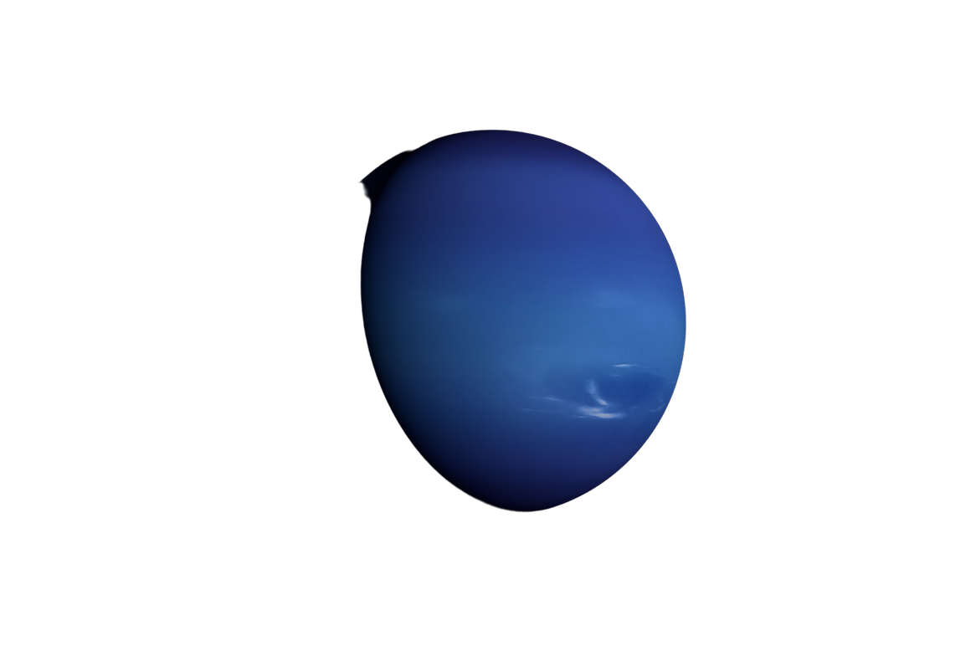
CREDITS
This presentation template is free for everyone
to use thanks to the following:
SlidesCarnival for the presentation template
Pixabay, Pexels for the photos
Happy Designing!

