Slide 1




Motivational Cards

Slide 2

How to Use This Presentation
Google Slides
PowerPoint
Canva
Click on the "Google Slides" button below this presentation preview. Make sure to sign in to your Google account. Click on "Make a copy." Start editing your presentation.
Alternative: Click on the "Share" button on the top right corner in Canva and click on "More" at the bottom of the menu. Enter "Google Drive" in the search bar and click on the GDrive icon to add this design as a Google slide in your GDrive.
Click on the "PowerPoint" button below
this presentation preview. Start editing
  your presentation.
Alternative: From Canva template file, Click on the "Share" button on the top right corner in Canva and click on "More" at the bottom of the menu. Enter "PowerPoint" in the search bar and click on the PowerPoint icon
  to download.
  Click on the "Canva" button under this presentation preview. Start editing your presentation. You need to sign in to your Canva account.

Slide 3



It takes courage to
GROW UP
and become who you are!

Slide 4



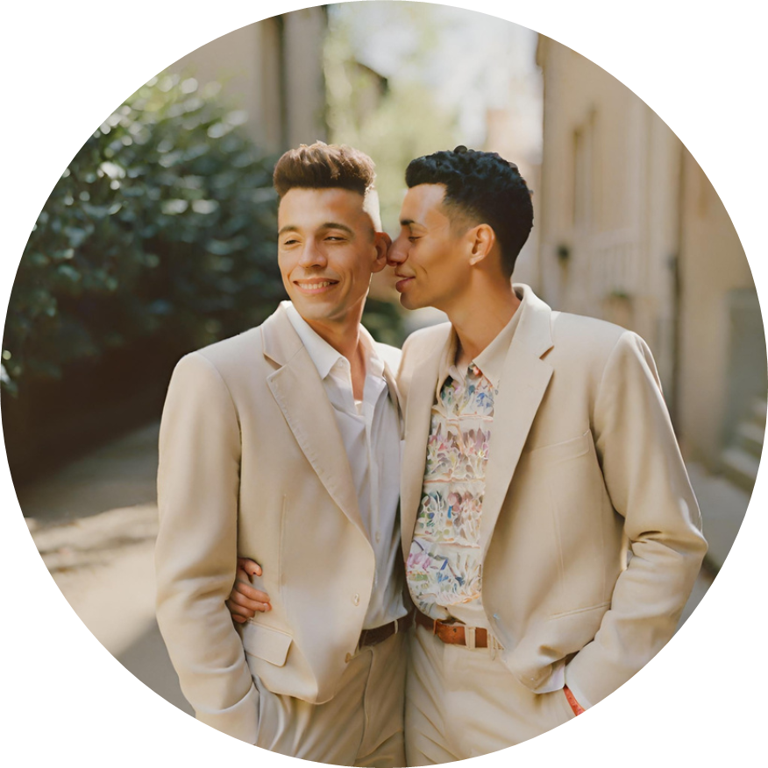


Love is love.
  Your heart knows no bounds, and that's a beautiful thing. Celebrate the love you give and receive with pride.

Slide 5



Your identity is a work of art.
Every color, every shade, makes you uniquely beautiful.

Slide 6



The only choice I made was to
BE MYSELF

Slide 7


Gay
by Birth
Proud
by Choice

Slide 8

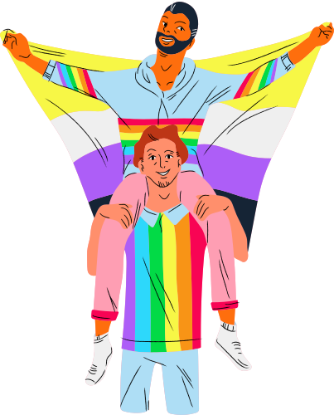
Always remember
Love
Wins
Now and forever

Slide 9
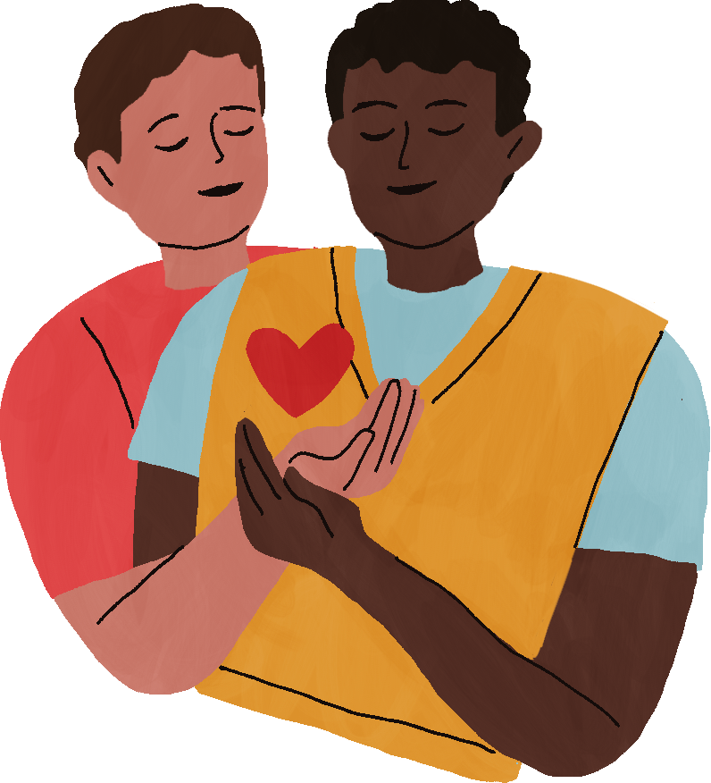

Love is love.
Your heart knows no bounds, and that's a beautiful thing. Celebrate the love you give and receive with pride.

Slide 10


You are
embraced to a
Community
YOU FIND OTHERS
LIKE YOU WHEN
YOU ARE HONEST

Slide 11




Slide 12

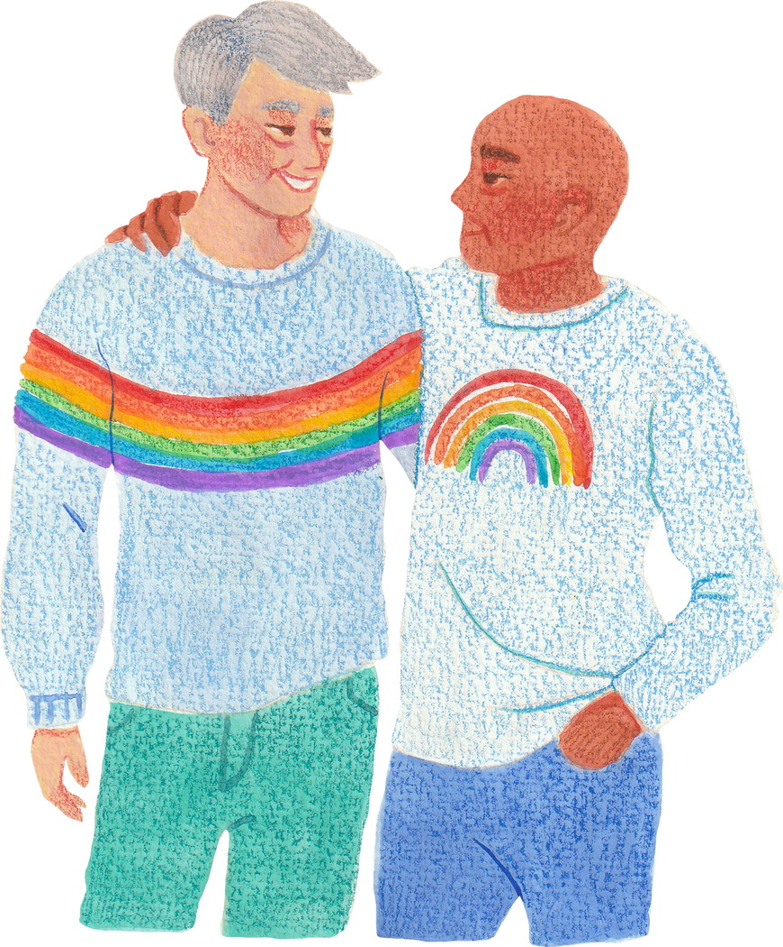

You are not alone. Your journey is shared by a community that loves and supports you.
Together, we are stronger and unstoppable.

Slide 13
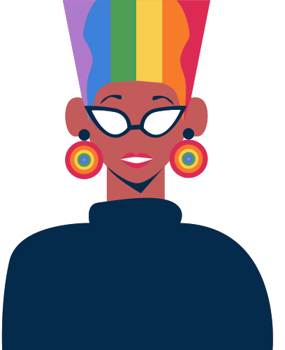

You and only you know
who you are
Don't let anyone call
you want you're not

Slide 14



Your heart knows no bounds, and that's a beautiful thing.
Celebrate the love you give and receive with pride.

Slide 15

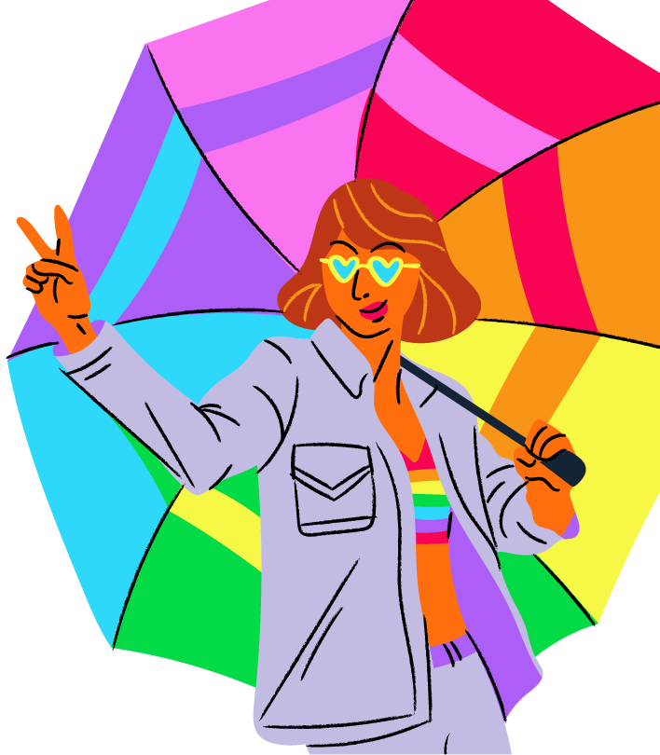
STAND
tall
AND
Proud

Slide 16


YOUR IDENTITY IS
YOUR POWER.
Stand tall, be proud, and let the world see the incredible strength that comes from embracing your true self.

Slide 17
Resource Page
Use these design resources in your Canva Presentation.
  This presentation template uses the following free fonts:
Calistoga
Economica
Grand Hotel
Bungee
Glass Antiqua
Josefin Sans
Crafty Girls
Architects Daughter
Walterturncoat
Oswald
  You can find these fonts online too. Happy designing!
  Don't forget to delete this page
  before presenting.

Slide 18


This presentation template is free for everyone to use thanks to the following:
  SlidesCarnival for the presentation template
  Pexels for the photos
Happy designing!

