Slide 1


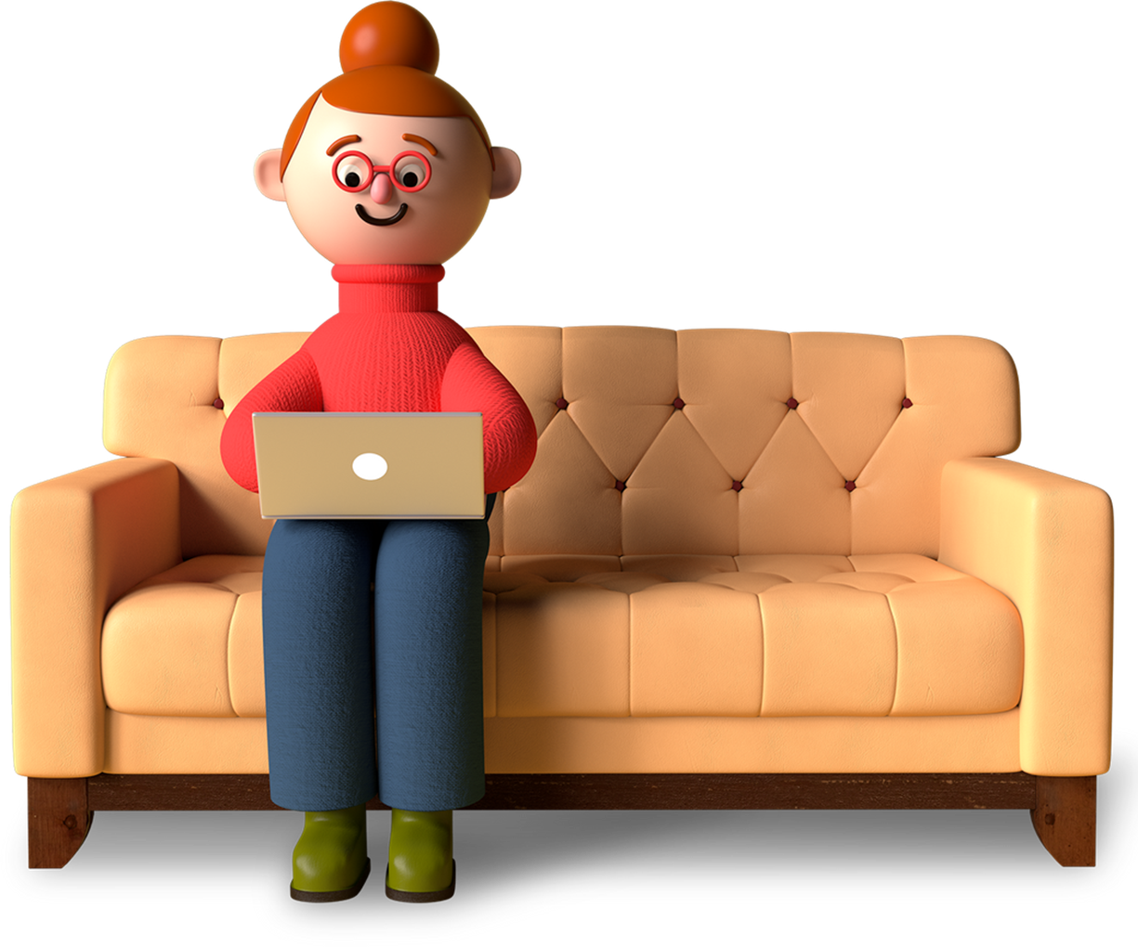
International Programmers Day
Let`s Celebrate

Slide 2

Introduction
History of Programming
Contact Us
Table Of Contents
01
Introduction
02
Role of Programmers
Elaborate on what you want to discuss.
Elaborate on what you want to discuss.
03
History of Programming
Elaborate on what you want to discuss.

Slide 3

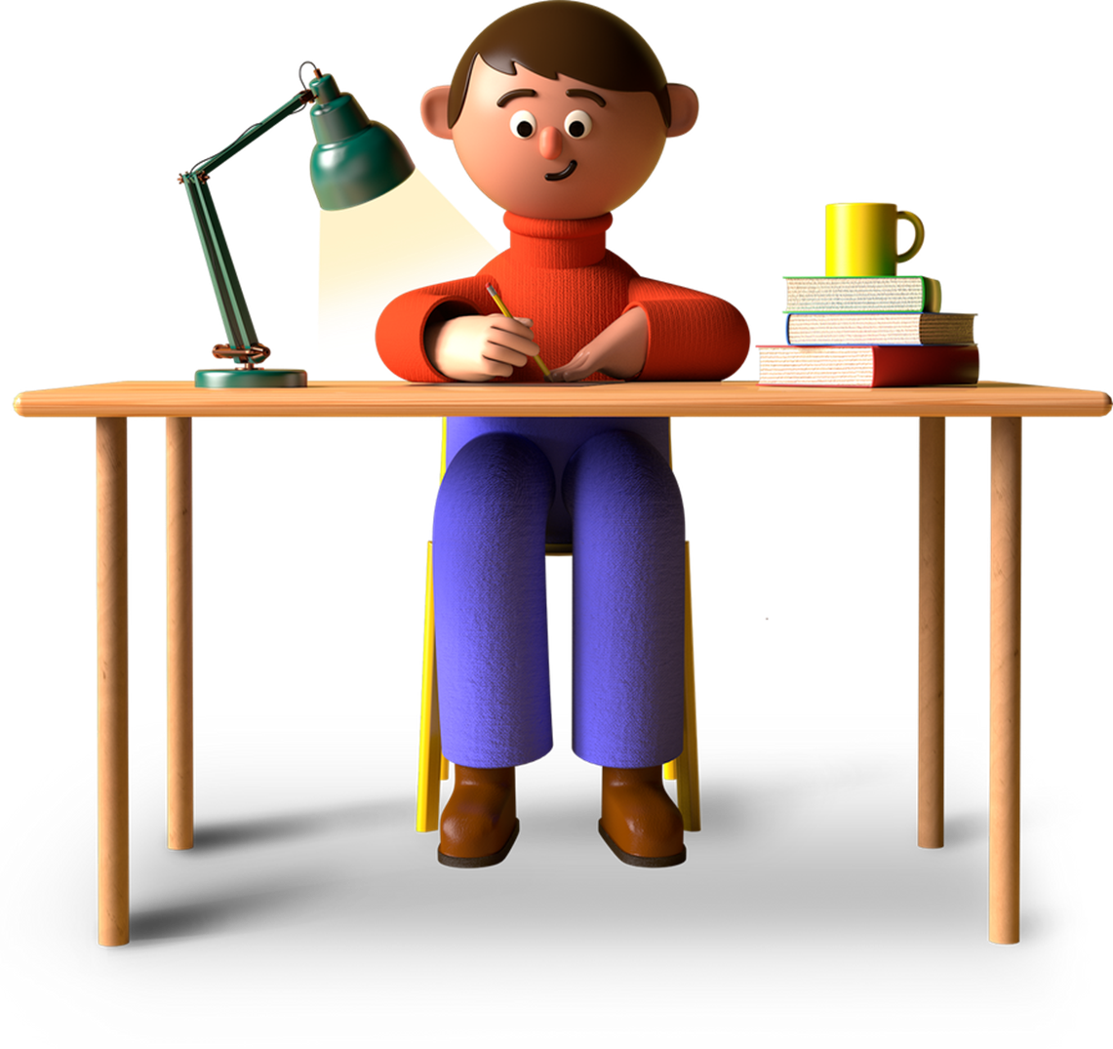
Introduction
History of Programming
Contact Us
Introduction
Welcome to a journey of discovery and exploration as we delve into the depths of knowledge and unlock the wonders of the world around us. In this passage, we will embark on a captivating exploration of various topics that will broaden our horizons and stimulate our minds.
Let us set forth with curiosity and open hearts, ready to embrace the beauty and diversity that lies ahead. Join me as we unravel the mysteries of the universe and expand our understanding of the extraordinary tapestry of life. Let the adventure begin!

Slide 4

Introduction
History of Programming
Contact Us
Welcome To Presentation
Ladies and gentlemen, welcome to today's presentation. We are excited to have you all here with us as we delve into the fascinating world of [Topic]. Throughout this presentation, we will explore key insights, engage in thought-provoking discussions.
So, sit back, relax, and prepare to be inspired by the knowledge and creativity that will unfold before your eyes. Thank you for joining us on this journey of learning and discovery. Let's begin!

Slide 5



Introduction
History of Programming
Contact Us
Importance of celebrating
Acknowledgment of Innovation
Programmers are the driving force behind technological innovation. Celebrating their contributions acknowledges their role in creating new solutions and pushing the boundaries of what is possible in various fields.
Recognition of Hard Work
Programming is a demanding profession that requires dedication, problem-solving skills, and continuous learning. Celebrating programmers recognizes the hard work they put into developing and maintaining software systems.

Slide 6
Introduction
History of Programming
Contact Us
Promotion of Diversity
Innovation
Representation
Market Relevance
Celebrating programmers from underrepresented groups sends a powerful message that everyone belongs in the tech industry. It provides role models for aspiring programmers who may
Celebrating programmers from underrepresented groups sends a powerful message that everyone belongs in the tech industry. It provides role models for aspiring programmers who may
Celebrating programmers from underrepresented groups sends a powerful message that everyone belongs in the tech industry. It provides role models for aspiring programmers who may

Slide 7
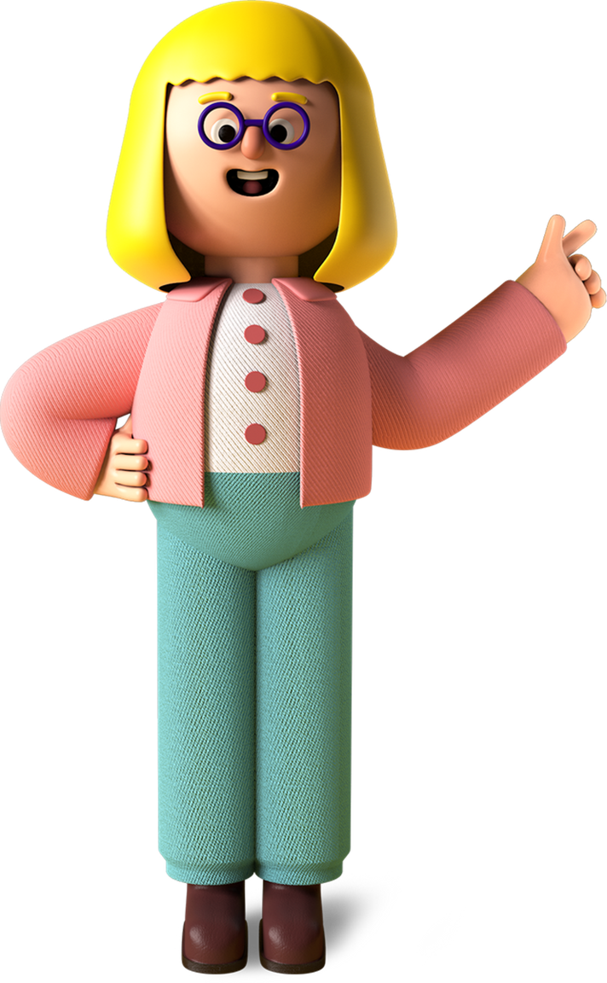
Introduction
History of Programming
Contact Us
History of Programming
Throughout the history of programming, there have been countless innovations and developments that have shaped the way we interact with technology today. From the early days of punch cards and assembly language to the modern era of high-level languages and artificial intelligence, the field of programming has evolved in remarkable ways.
Pioneers like Ada Lovelace, Grace Hopper, and Alan Turing have made significant contributions to the field, paving the way for future generations of programmers to build upon their work.

Slide 8




Introduction
History of Programming
Contact Us
Key milestones and developments in the field
Key 1
Key 2
Key 3

Slide 9
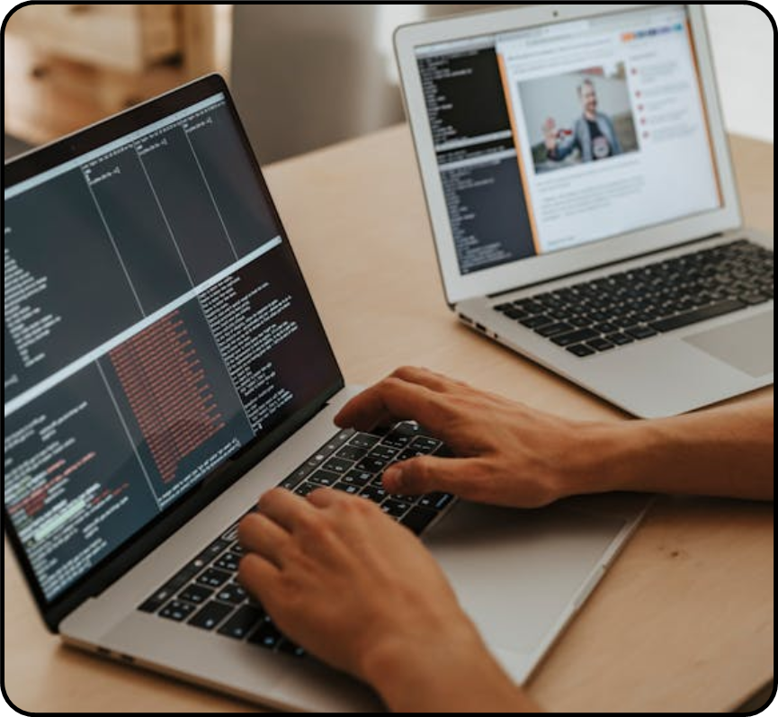
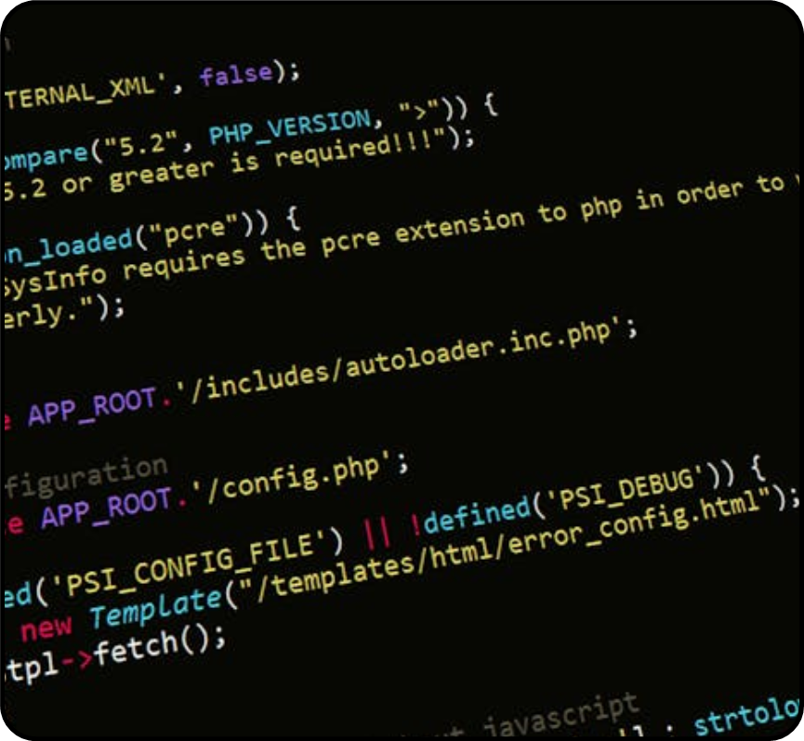

Introduction
History of Programming
Contact Us
Gallery Image
What can you say about your projects? Share it here!

Slide 10
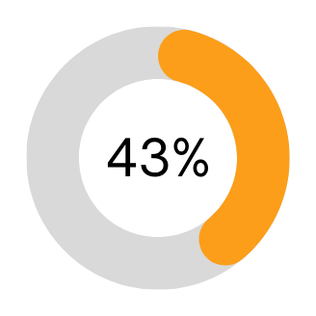
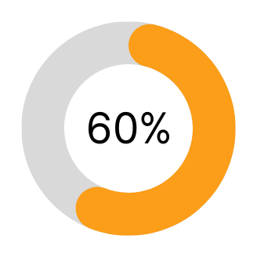
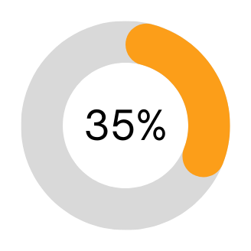
Introduction
History of Programming
Contact Us
Market Research
Elaborate on the featured statistic
Elaborate on what you want to discuss.
Elaborate on what you want to discuss.
Elaborate on what you want to discuss.

Slide 11
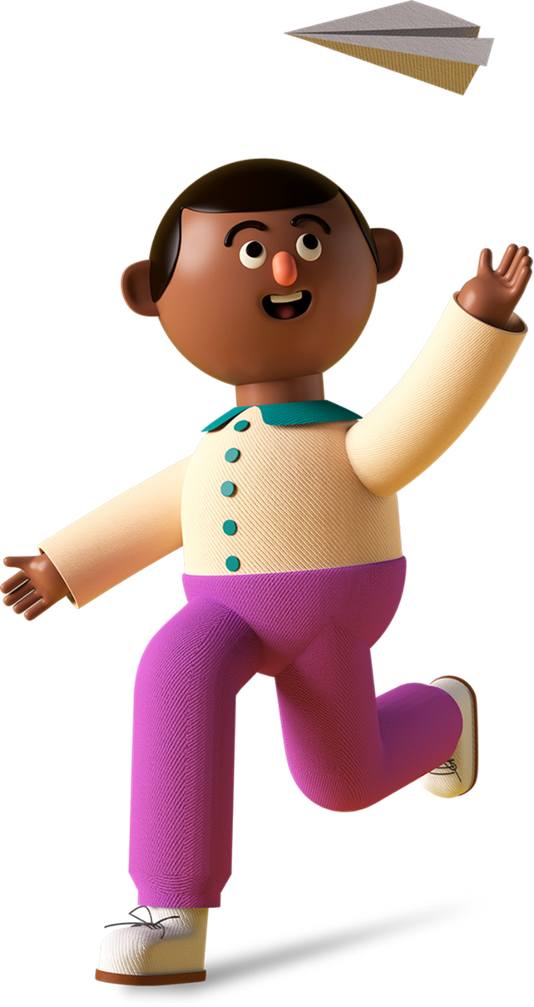
Introduction
History of Programming
Contact Us
Role of Programmers
Programmers play a crucial role in the world of technology and software development. Their expertise and skills are essential for creating computer programs, applications, and systems that power our daily lives. They are responsible for writing, testing, debugging, and maintaining the code that allows software to function properly.
Programmers are problem solvers, constantly seeking innovative solutions to improve efficiency and user experience. Their work requires attention to detail, creativity, and a deep understanding of programming languages. In essence, programmers are the architects behind the digital world, shaping the way we interact with technology and each other.

Slide 12

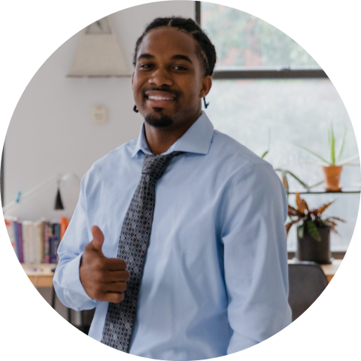



Introduction
History of Programming
Contact Us
Our programer
Your name
Your name
Your name
Elaborate on what you want to discuss.
Elaborate on what you want to discuss.
Elaborate on what you want to discuss.

Slide 13

Introduction
History of Programming
Contact Us
A picture is worth a thousand words

Slide 14
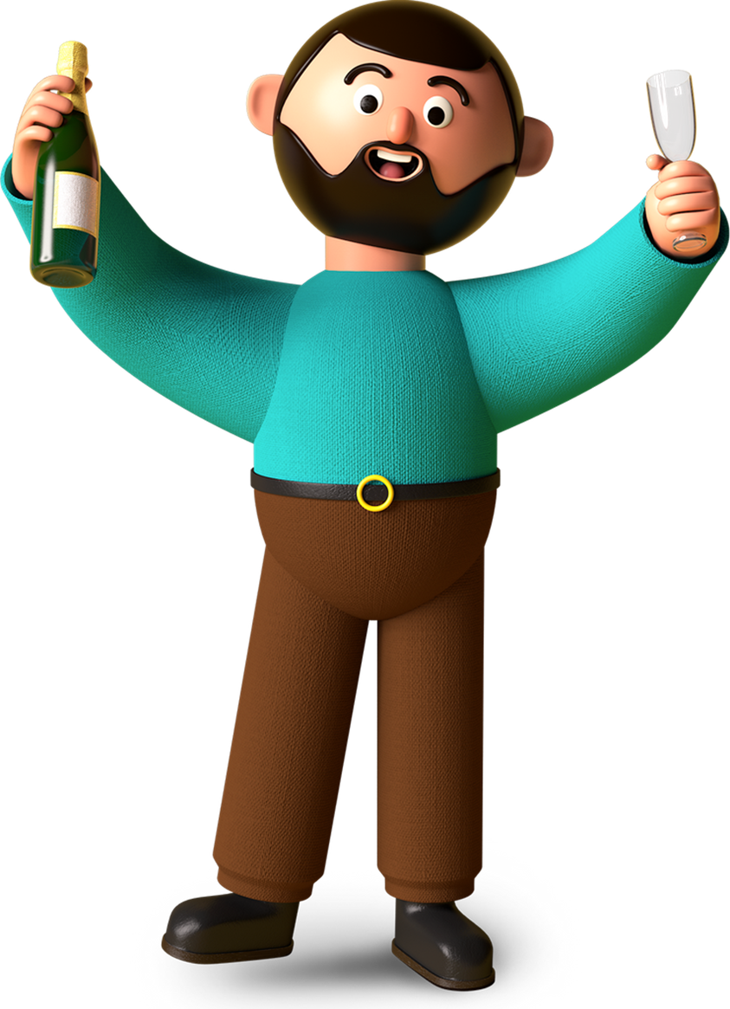

Introduction
History of Programming
Contact Us
Plan celebrating
Step 1: Define the Purpose and Goals
Step 2: Choose the Format
Step 3: Set the Date and Time
Step 4: Plan the Agenda and Time

Slide 15

Introduction
History of Programming
Contact Us
Define the Purpose and Goals
Recognition
Inspiration
To acknowledge the valuable contributions of programmers to society, technology, and innovation.
To inspire current and future programmers by showcasing their achievements, creativity, and problem-solving skills.

Slide 16

Introduction
History of Programming
Contact Us
Our History
Add a point
Add a point
Add a point
Add a point
Elaborate on what you want to discuss.
Elaborate on what you want to discuss.
Elaborate on what you want to discuss.
Elaborate on what you want to discuss.

Slide 17
Introduction
History of Programming
Contact Us
Write an original statement or inspiring quote
— Include a credit, citation, or supporting message

Slide 18

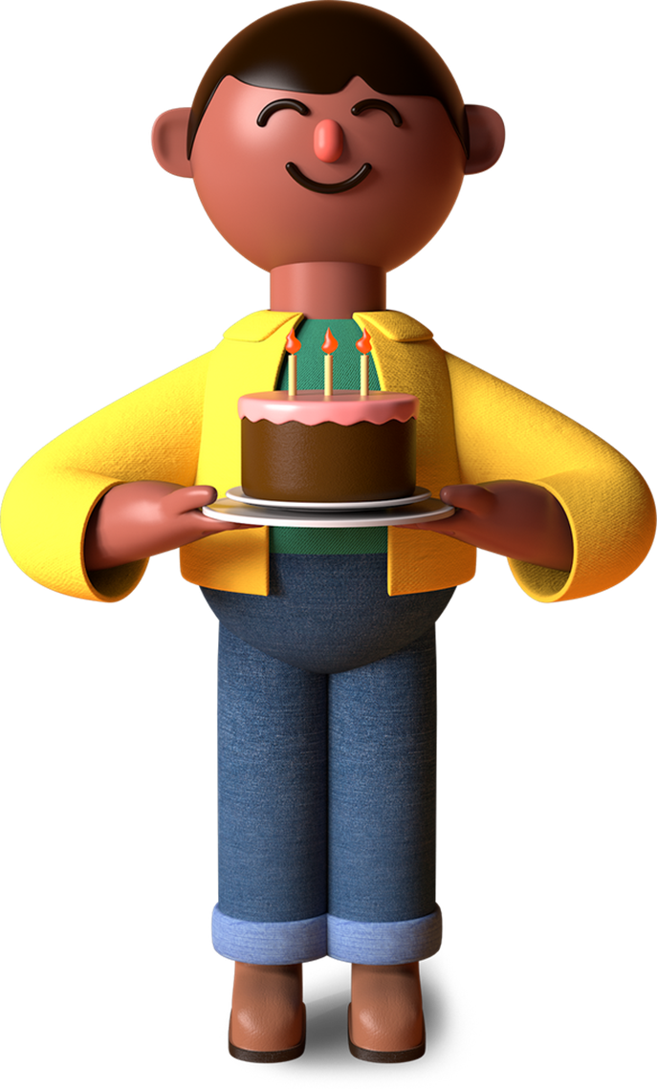
Introduction
History of Programming
Contact Us
Thank you!
Let's continue to celebrate programmers and their invaluable contributions to innovation, progress, and society!
[Your Organization's Logo]
[Date]

Slide 19


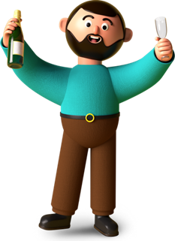



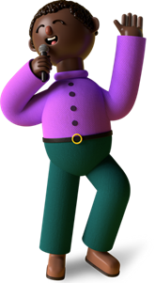











Introduction
History of Programming
Contact Us
Resource Page
Use these design resources in your Canva Presentation.
You can find these fonts online too. Happy designing!
Don't forget to delete this page before presenting.
This presentation template uses the following free fonts:
  Titles: Oswald
  Headers: Oswald
  Body Copy: Open Sauce

Slide 20

Introduction
History of Programming
Contact Us
Credits
This presentation template is free for everyone to use thanks to the following:
SlidesCarnival for the presentation template
Pexels for the photos
Happy designing!

