Slide 1
INTRODUCTION TO
{JAVA PROGRAMMING}
FOR HIGH SCHOOL

Slide 2
TABLE OF CONTENTS
01
02
03
INTRODUCTION
OUR PROJECTS
ABOUT US
Elaborate on what you want to discuss.
Elaborate on what you want to discuss.
Elaborate on what you want to discuss.

Slide 3
01
INTRODUCTION
Welcome to an exciting journey of exploration and discovery! In this passage, we will delve into the depths of knowledge and immerse ourselves in the wonders of the world. Prepare to be captivated by the beauty of language and the power of words as we embark on a literary adventure together. Let your imagination soar as we navigate through the realms of creativity and inspiration. Get ready to unlock the doors to new perspectives and broaden your horizons. So sit back, relax, and let the magic of storytelling transport you to extraordinary places beyond your wildest dreams.

Slide 4

WELCOME TO PRESENTATION
I'm Rain, and I'll be sharing with you my beautiful ideas. Follow me at @reallygreatsite to learn more.

Slide 5
WHAT IS JAVA?
Java is a versatile and widely-used programming language that is renowned for its portability, flexibility, and robustness. Developed by Sun Microsystems in 1995, Java has since become a cornerstone of modern software development. One of Java's key strengths is its "write once, run anywhere" mantra, which allows developers to write code that can be executed on any platform that supports Java without the need for recompilation. This feature, along with its rich ecosystem of libraries and tools, has made Java a popular choice for building a wide range of applications, from mobile apps to enterprise systems. Whether you are a beginner learning the basics of programming or a seasoned developer working on complex projects.

Slide 6
ANATOMY JAVA PROGRAM
PACKAGE DECLARATION (OPTIONAL):
  Packages are used to organize related classes and interfaces into namespaces.
  Syntax: package package_name;
  Example: package com.example.myproject;
IMPORT STATEMENTS (OPTIONAL):
  Import statements are used to specify classes or entire packages that are used in the program.
  Syntax: import package_name.class_name;
  Example: import java.util.Scanner;

Slide 7


VARIABLES AND DATA TYPES
VARIABLES
DATA TYPES
Elaborate on what you want to discuss.
Elaborate on what you want to discuss.

Slide 8

PRIMITIVE DATA TYPES
Primitive data types are the building blocks of any programming language. These data types are the most basic types of data that can be manipulated by a program. In most programming languages, primitive data types include integers, floating-point numbers, characters, booleans, and more.
Integers are whole numbers without any decimal points, while floating-point numbers include decimal points. Characters represent individual letters, numbers, or symbols, and booleans are used to represent true or false values.

Slide 9

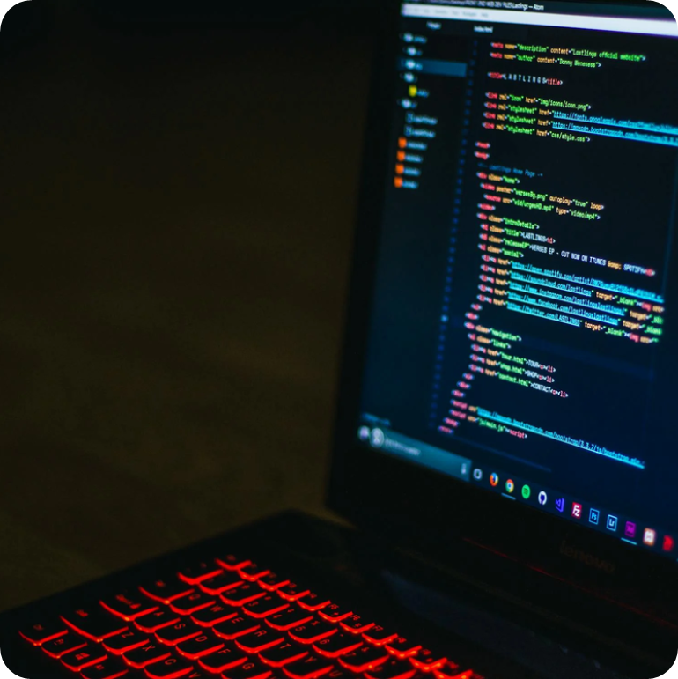
  GALLERY IMAGE
What can you say about your projects? Share it here!

Slide 10
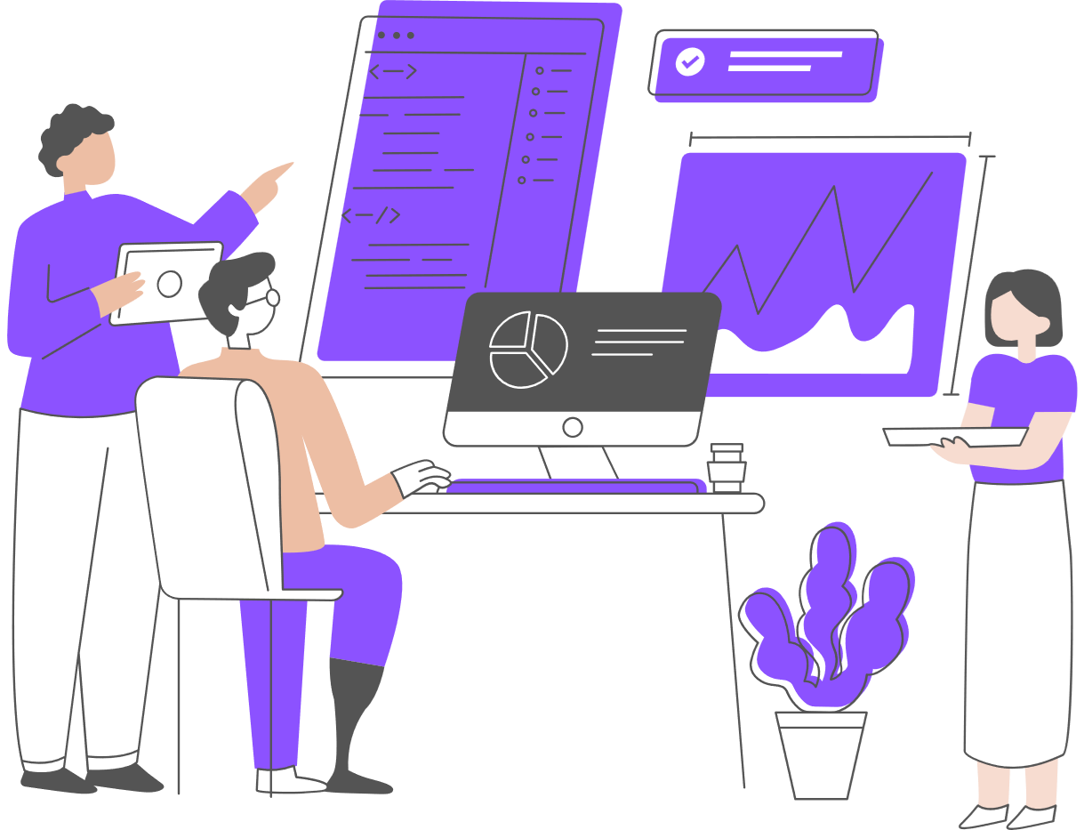
  OPERATORS AND EXPRESSIONS
  Relational operators are used to compare two values and return a boolean result.
  Java supports the following relational operators:
    Equal to ==
    Not equal to !=
    Greater than >
    Less than <
    Greater than or equal to >=
    Less than or equal to <=

Slide 11



  LOGICAL OPERATORS
Elaborate on what you want to discuss.
Elaborate on what you want to discuss.
Elaborate on what you want to discuss.

Slide 12


  OUR TEACHER
TEACHER NAME
TEACHER NAME
Elaborate on what you want to discuss.
Elaborate on what you want to discuss.

Slide 13
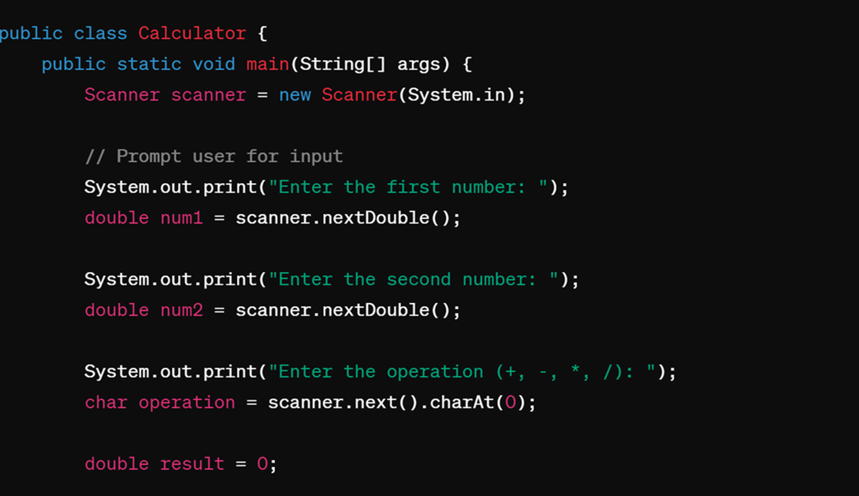
  PRACTICAL EXERCISE
Let's create a simple calculator program in Java that can perform basic arithmetic operations such as addition, subtraction, multiplication, and division. This exercise will help reinforce your understanding of operators and expressions in Java.

Slide 14

  INTRODUCTION TO GUI PROGRAMMING WITH JAVAFX
JavaFX is a powerful framework that allows developers to create dynamic and interactive Graphical User Interfaces (GUIs) for their Java applications. With JavaFX, developers can design visually appealing interfaces with ease, thanks to its rich set of features and components.
One of the key advantages of using JavaFX for GUI programming is its ease of use.

Slide 15
OVERVIEW OF JAVAFX
JavaFX ist eine moderne Softwareplattform für die Entwicklung von benutzerfreundlichen und interaktiven Anwendungen. Mit JavaFX können Entwickler ansprechende Benutzeroberflächen erstellen, die sowohl auf Desktop- als auch auf mobilen Geräten gut funktionieren. Diese Plattform bietet eine Vielzahl von Tools und Bibliotheken, um die Gestaltung und Implementierung von grafischen Benutzeroberflächen zu erleichtern. JavaFX unterstützt auch die Integration von Multimedia-Inhalten wie Audio- und Video-Dateien, was es zu einer vielseitigen Wahl für Entwickler macht, die reichhaltige Anwendungen erstellen möchten. Insgesamt bietet JavaFX eine leistungsstarke und flexible Umgebung für die Entwicklung von modernen Anwendungen.

Slide 16
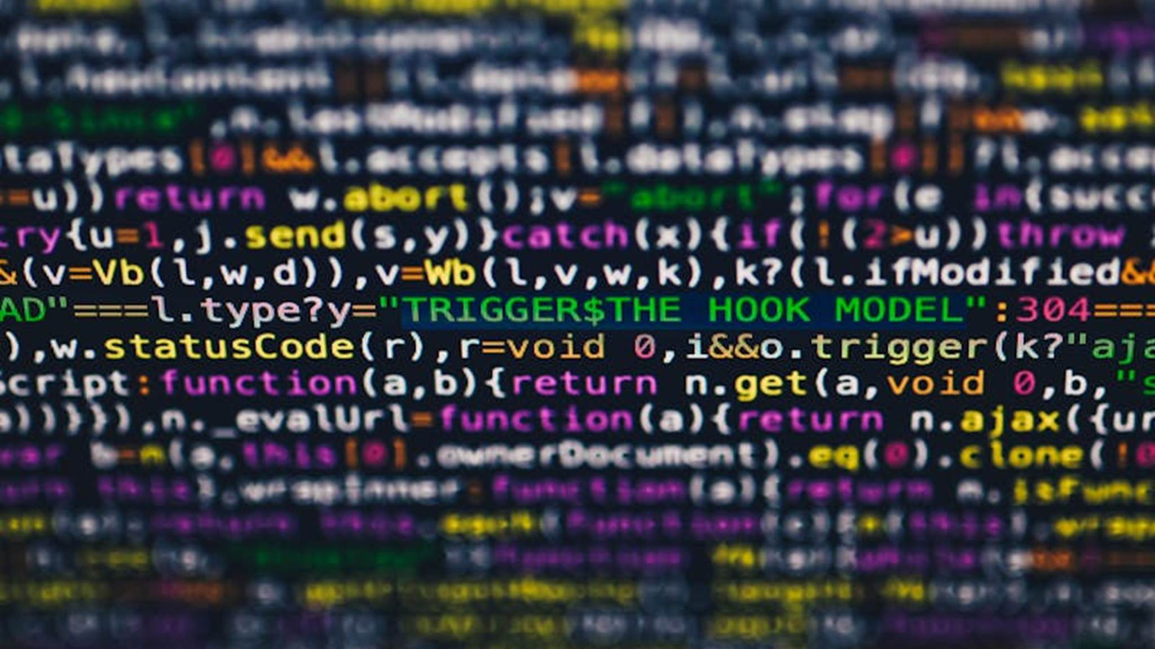
A PICTURE IS WORTH A THOUSAND WORDS

Slide 17
WRITE AN ORIGINAL STATEMENT OR INSPIRING QUOTE
— Include a credit, citation, or supporting message

Slide 18
THANK YOU!
Thank you for participating in our programming language workshop for beginners. We hope you found the content informative, engaging, and valuable for your learning journey.
We appreciate your active participation, insightful questions, and dedication to expanding your programming skills. Remember that learning to code is a continuous journey, and we encourage you to continue exploring, practicing, and honing your programming abilities.
If you have any further questions, feedback, or suggestions, please don't hesitate to reach out to us. We're here to support you in your learning endeavors.
Keep coding, stay curious, and never stop learning!
Best regards,

Slide 19











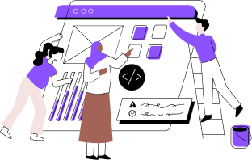
RESOURCE PAGE
Use these design resources in your Canva Presentation.
You can find these fonts online too. Happy designing!
Don't forget to delete this page before presenting.
This presentation template uses the following free fonts:
Titles: Courier PS
Headers: Roboto Mono
Body Copy: Roboto Mono

Slide 20

CREDITS
This presentation template is free for everyone to use thanks to the following:
SlidesCarnival for the presentation template
Pexels for the photos
HAPPY DESIGNING!

