Slide 1

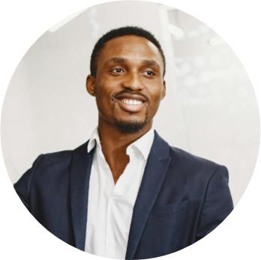


John Doe
Public Relations Specialist
123-456-7890
hello@reallygreatsite.com
Profile
Skills
Dynamic public relations specialist with 6+ years of industry experience and a fresh perspective on effective PR communications. Committed to working with clients to create unique and specialized PR strategies that support their goals.
Media Relations Strategies
Campaign Management
Client Relationship Management
Education
Brand Management
PR Performance Metrics
Bachelor of Arts in Communications, Hartwick College, Oneonta, NY
January 2012 - April 2017
Data Analysis
Employment History
Languages
Public Relations Specialist at Bett and Rothschild Communications, New York
February 2020 - current
English
German
  Development and implementation of public relations strategies for clients from various industries.
  Organization of press conferences, events and interviews to ensure media coverage.
  Collaboration with journalists, bloggers and influencers to increase brand awareness.
  Development of content for social networks and conducting online campaigns.
Franch
Arabic

Slide 2

Jane Doe
Public Relations Specialist
123-456-7890
hello@reallygreatsite.com
123 Anywhere St., Any City
Public Relations
Dynamic public relations specialist with 6+ years of industry experience and a fresh perspective on effective PR communications. Committed to working with clients to create unique and specialized PR strategies that support their goals.
Work Experience
Public Relations
MediaBoost Communications
August 2022 - Present
  Developed and executed a comprehensive public relations strategies strategy that resulted in a 35% increase in media coverage and a 13% increase in brand awareness within the first year.
  Established and maintained relationships with key media outlets and influencers, resulting in a 40% increase in positive media coverage and a 17% increase in social media engagement.
ABC Public Relations Agency, Los Angeles, CA
Creative producer
January 2020 - March 2022
  Development and implementation of public relations strategies for clients from various industries.
  Organization of press conferences, events and interviews to ensure media coverage.
  Collaboration with journalists, bloggers and influencers to increase brand awareness.
  Development of content for social networks and conducting online campaigns.
PXYZ Corporation, Los Angeles, CA
Assistant specialist in public relations
July 2016 - May 2020
  Supporting the team in public relations tasks.
  Media monitoring and analysis of publications about the company.
  Preparation of press releases and media materials.

Slide 3
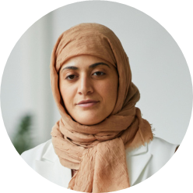






Jane Doe
Public Relations Communication
123-456-7890
hello@reallygreatsite.com
reallygreatsite.com
123 Anywhere St., Any City
Education
Summary
Bachelor of Arts in Communications, Hartwick College, Oneonta, NY
January 2000 - April 2004
Public relations professional with 15 years of experience in developing and
executing strategic communication campaigns. Proficient in media relations,
crisis communication, and social media management.
Goethe Zertifikat B2
Goethe Institut Jakarta
March 2012 - April 2017
Skills
Experience
Public Relations
Marketing Coordinator
Sun Education
February 2020 - current
Event Management
German Teaching
  Managing marketing communication and activity campaign Building to promote Sun Education.
  Creating branding and marketing activities together with brand communication department and product teams for print media and digital media.
  Voice over talent for sun education advertisement videos.
Teaching
Website Management
Blog Writing
Languages
Public Relations Executive (Full time
Freelancer) Wil & Co Creative Agency
February 2019 - January 2020
English
Franch
German
Arabic
  Managing marketing communication and activity campaign Building to promote Sun Education.

Slide 4
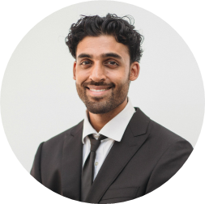




Work Experience
Public Relations Assistant
Haworth House PR, LLC
February 2022 - ongoing
  Pitched coverage opportunities directly to large women's wellness publications (Well + Good, The Everygicl Country & Town House) and coordinated sample requests.
  Managed brand accounts as well as external communications and image.
  Trend forecasting and developing pitches for clients based on reports.
John Doe
Public Relations Specialist
Wunderkind PR, Inc, Los Angeles, CA, Public Relations Assistant
April 2019 - January 2022
Education
  Compiled extensive media report on allies including publication analytics.
  Assisted in coordination for book tour via researching and pitching into tour markets for authors.
  Performed social media research for authors, generated guide for creating a linkiree, formatted manuscripts, wrote press materials, designed media highlight sheet etc.
Bachelor of Arts Public Relations
University of Southern California
2014-2018
Los Angeles, CA
Minora in Public Relations
Hofstra University
2012-2014
Los Angeles, CA
ABC Public Relations Agency, Los Angeles, CA
July 2017 - March 2019
Skills
  Designed and formatted press materials for authors to be appealing and themed.
  Performed TedX research for authors.
  Generated relevant media lists of editors, journalists and tastemakers for pitching purposes.
Social Media Management
Media Writing
Media Outreach & Pitching
Market Research & Analytics
Contact
Website Management
Microsoft Office
123-456-7890
Adobe Acrobat
hello@reallygreatsite.com
reallygreatsite.com

Slide 5
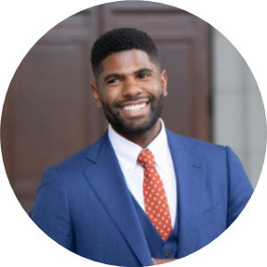


John Doe
Public Relations Manager
Summary
Skills
Public Relations Manager with 8+ years of experience in developing and executing successful PR campaigns for major companies. Skilled in media relations, crisis management, and event planning.
Communication
Media Relations
Writing
Networking
Research
Strategic Planning
Education
Bachelor of Arts in Communications
University of California, Los Angeles
2013-2017
Work Experience
Public Relations Manager, Murphy Group
November 2020 - present
  Successfully implemented public relations strategies to successfully position client brands in the market and drive positive awareness.
  Developed and maintained strong relationships with high-profile media outlets, resulting in increased media coverage.
  Developed messaging and branding strategies to promote client products, services and events.
Public Relations Manager, Altenworth, Hodkiewicz and Denesik July 2015 - December 2020
  Spearheaded the development of press releases, media advisories, and pitches to build relationships with editors and reporters.
  Crafted and executed a comprehensive social media strategy to increase engagement with target audiences.
  Managed the public relations budget and tracked ROI for all campaigns
123-456-7890
hello@reallygreatsite.com

Slide 6




Jane Doe
123-456-7890
hello@reallygreatsite.com
123 Anywhere St., Any City
Public Relations Specialist
reallygreatsite.com
Objective
Professional background includes extensive customer service via telecommunications and retail services, office administration, training and development. Experience in working directly with a wide spectrum of clients; including business owners, doctors, management teams and the general public. Rapidly took on additional tasks by seeking ways to improve company operations. A career signature in helping solve customer needs.
Skills
Computer Skills
Software Development
Microsoft Office
Information Technology
Networking
Work Experience
Public Relations
ABC Corporation, October 2018 - Present
  Coordinated all functions of public relations communications for Memorial Healthcare System for 5 district hospitals.
  Wrote press releases for newsworthy events for all 5 hospitals.
  Assisted director with publicity of events and worked in conjunction with John Doe Children's Hospital Foundation in coordinating fundraising efforts.
  Provided current and accurate publickey information to hospital staff through direct mailings, email, phone calls and fax.
  Wrote highly effective press releases resulting in increased public awareness of hospital programs.
Education
Bachelor of Science in Communications, Lynn University - Boca Raton, FL
September 2011 - June 2016

Slide 7
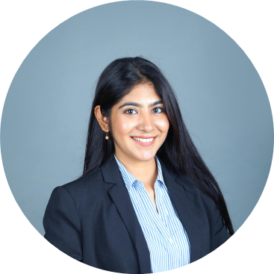
Jane Doe
Public Relations and Communications
Skills
Profile
Proficient in media relations, crisis communication, and social media management. Proven track record of securing positive media coverage and maintaining strong relationships with key stakeholders. Gifted communicator with exceptional writing and presentation skills. Committed to delivering impactful and measurable results.
PR Performance Metrics
Media Relations Strategies
Data Analysis
Microsoft Office
Communication
Strategic Planning
Work Experience
Networking
PR Account Executive
Weber Shandwick,
November 2019 - December 2022
Languages
English
  To maintain and develop positive relationships with media partners and other stakeholders.
  To assist in managing and organizing specific marketing and communications campaigns.
  Promotional events for clients from inception to completion.
  Drafting pitch releases.
  Research/ organizing speaking opportunities.
  Staffing media interviews and roundtable discussions.
German
Franch
Spanish
Chinese
Contact
123-456-7890
Education
hello@reallygreatsite.com
National Diploma Public
Relations
San Jose State University
September 2013 - June 2018
reallygreatsite.com

Slide 8
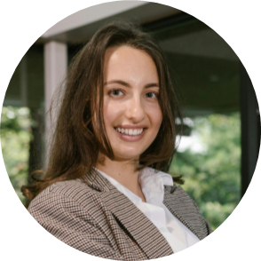
Jane Doe
Public Relations Manager
My Life Philosophy:
“Every day is an opportunity to open new horizons, make the world a little better and leave a mark in the hearts of others”
Summary:
Public relations and communications manager with 10+ years of experience; created
innovative strategies that helped 300 brands and organizations reach audiences, relate to
their communities, and communicate their messages.
Work Experience:
Resume Worded, New York, NY
Public Relations Manager
July 2021 - ongoing
  Orchestrated and paid for social media campaigns for 15 invite-only marketing and promotion events.
  Arranged and led an RW campaign that helped to secure 450+ media placements, and boosted referral sessions from 2K to 10K in 5 months.
  Identified opportunities that increased open and click-through rates, which achieved a 45% open rate and 37% click rate averages.
Associate Public Relations Manager
Growthsi, San Francisco, CA
August 2018 - May 2021
  Crafted 350 executive speeches, news releases, statements, and media advisories.
  Created content and copy for social media channels (Twitter, Facebook, and Instagram), and organically grew following by 120%.
  Wrote 15 articles on consumer psychology and entrepreneurship, which generated 33000 page views, 3500 re-tweets, and 4300 newsletter subscribers.
Languages:
English
Spanish
German
Franch
123-456-7890
hello@reallygreatsite.com

Slide 9




Resource Page
Use these design resources in your Canva Presentation.
You can find these fonts online too. Happy designing!
Don't forget to delete this page before presenting.
This presentation template uses the following free fonts:
  Titles: Raleway
  Body Copy: Inter

Slide 10

Credits
This presentation template is free for everyone to use thanks to the following:
SlidesCarnival for the presentation template
Pexels for the photos
Happy designing!

